Slide 1
Colatron
End-to-end text-to-speech, rebuilt properly
Mann Mehta (PES2UG24CS266)
Marapareddy Deekshitha (PES2UG24CS268)
UE24CS352A Machine Learning · Team 25 · Problem 20 · October 2026
Notes:
Introduce the team. Our problem statement (number 20) is Colatron, based on a 2018 Stanford CS229 project that tried end-to-end text to speech. We rebuild that pipeline properly and show, with numbers, that it works far better.

Slide 2
The 2018 Stanford attempt
Text in, speech out, trained on LJ Speech
Only about 200 sentences used for training
Words randomly mapped to phonemes or letters
Three models: SVR, a 4-layer neural net, seq2seq LSTM with attention
Inverse STFT to turn spectrograms into audio
MOS = mean opinion score: listeners rate each clip from 1 (bad) to 5 (excellent).
*Tacotron score as reported by Google, for reference
Notes:
The 2018 team trained three models on about 200 sentences. Their best, a seq2seq LSTM with attention, scored 2.5 out of 5 from 10 listeners, well below Tacotron's 3.82. Its output repeated words.

Slide 3
Why it failed, and our fix
1
Tiny data
2
Shallow models
200 sentences, versus 13,100 clips for a real TTS model
SVR and a 4-layer net cannot map text to a large spectrogram
Our fix: Use a Tacotron 2 trained on all of LJ Speech
Our fix: Deep encoder, attention decoder and post-net
3
Random text mapping
4
Attention never aligned
The same word got different inputs each run, and nothing could be cached
The decoder lost its place, so words repeated
Our fix: Text cleaning plus a fixed character vocabulary
Our fix: Location-sensitive attention; we measure the alignment
Notes:
The paper itself lists these reasons. Each one maps to a specific change in our system.

Slide 4
Our pipeline
Text
Cleaning
Acoustic model
Mel spectrogram
Vocoder
.wav
typed sentence
numbers, abbreviations, fixed character ids
Tacotron 2 (pretrained) or our baseline
80 bands, 256-sample hop
Griffin-Lim (ours) or HiFi-GAN (pretrained)
22,050 Hz audio
Written by us
Swappable: ours or pretrained
Every part shares one mel format (src/audio_config.py), so any acoustic model can feed any vocoder. That makes fair comparisons possible.
Notes:
Two swappable stages. The acoustic model turns text into a mel spectrogram, a picture of the sound. The vocoder turns that picture into audio. Because both share one mel format, we can swap Tacotron 2 for our baseline, or Griffin-Lim for HiFi-GAN, and compare fairly.

Slide 5
What we built vs reused
Built and trained by us
Pretrained (not trained by us)
Data download, text cleaning, fixed vocabulary
Mel extraction and train / val / test split
Baseline text-to-mel model, trained from scratch
Griffin-Lim vocoder and shared audio settings
Inference CLI and Gradio demo
Alignment analysis and mel-distance evaluation
Tacotron 2
torchaudio, trained on LJ Speech
HiFi-GAN vocoder
SpeechBrain, trained on LJ Speech
Why: training Tacotron 2 takes days on GPUs. We had one week and laptop CPUs.
Notes:
Be upfront about this. The two heavy neural networks are pretrained. Everything else, including the only model we trained ourselves (the baseline), the vocoder comparison and all the evaluation, is our own work.

Slide 6
Data and preprocessing
13,100
Raw text
Dr. Smith paid $42.50 in 1984.
Cleaned
doctor smith paid forty two dollars and fifty cents in nineteen eighty four.
Fixed ids (37 symbols)
d→5 o→16 c→4 t→21 … same mapping on every run
clips in LJ Speech 1.1
~24 h
one female speaker
404
clips in our subset
Audio → 80-band log-mel spectrogram (FFT 1024, hop 256, 0 to 8 kHz)
Cached to disk once, instead of recomputed every run
Sanity check: plot a real mel and turn it back into audio
324 / 40 / 40
train / val / test clips
Deekshitha
Notes:
The subset is picked by hashing file names, so everyone gets the same clips. The fixed vocabulary fixes the paper's random mapping. The mel settings match the pretrained models, so all systems speak the same format.

Slide 7
Baseline: trained from scratch
Characters (fixed ids)
Training
L1 loss on normalised mel frames
Adam, learning rate 1e-3, gradient clipping 1.0
60 epochs, batch 16, best validation checkpoint
Mels normalised per band (mean / std)
Embedding, 128-d
3 × Conv1D, 256 channels, kernel 5
Stretch to target length (no attention)
Deliberately weak. Like the paper's simple models, it has no learned alignment: each character just gets an equal share of time. It shows what happens without attention and data.
MLP → 80-band mel frames
Griffin-Lim → audio
Deekshitha
Notes:
This is the only model we train ourselves. The highlighted step is the key weakness: instead of learning which character to read when, it stretches the character features evenly over time.

Slide 8
Main system: Tacotron 2
1
Encoder
What we did with it
Loaded torchaudio's LJ Speech checkpoint
Chose the standard mel format so Griffin-Lim and HiFi-GAN read the same mel
Exposed mel + alignment for analysis
Fixed seeds so samples are reproducible (its prenet keeps dropout on)
character embedding, 3 convolutions, bidirectional LSTM
2
Attention
location-sensitive: uses where it looked last step, so it moves forward
3
Decoder
LSTMs predict one mel frame at a time, plus a stop signal
4
Post-net
5 convolutions refine the whole spectrogram
Mann
Notes:
Tacotron 2 is the architecture the paper wanted but could not train: seq2seq with attention, done properly. We did not train it either; we use a pretrained checkpoint. Our work is wiring it into a shared mel format so vocoders are interchangeable and the attention can be inspected.

Slide 9
Vocoders: speed and quality
WaveRNN
Griffin-Lim
HiFi-GAN
one sample at a time
signal processing, no learning
GAN, all frames in parallel
48.7 s
0.08 s
0.65 s
to make 3.3 s of speech
to make 3.3 s of speech
to make 3.3 s of speech
Tried and removed: too slow for a live demo
Fast, intelligible, slightly metallic
Natural sounding, about 5× faster than real time
Same sentence, laptop CPU. Griffin-Lim and HiFi-GAN get the identical mel, so only the vocoder differs (WaveRNN time includes Tacotron 2, about 1 s). Audio: samples/main_griffinlim/, samples/main_hifigan/.
Mann
Notes:
Play samples/main_griffinlim/05.wav then samples/main_hifigan/05.wav here. Same mel, different vocoder: Griffin-Lim guesses the missing phase and sounds metallic, HiFi-GAN learned to generate realistic waveforms.

Slide 10
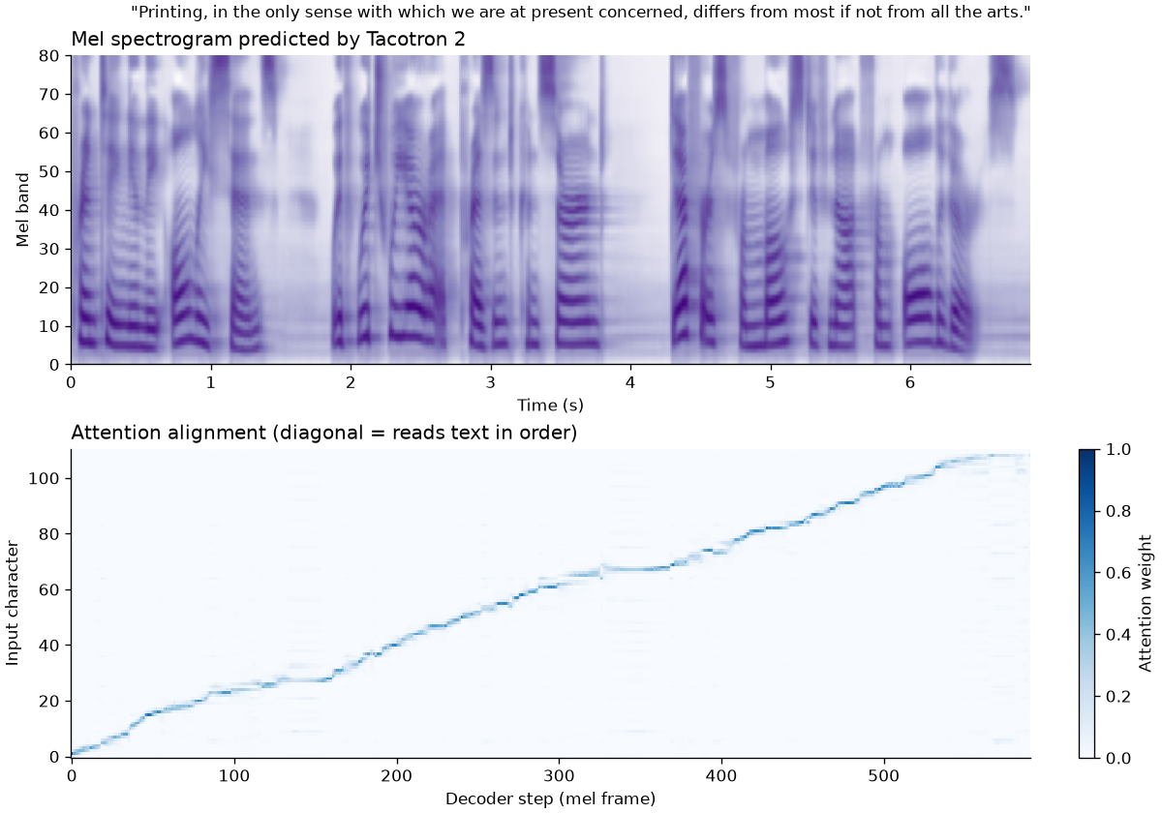
Attention reads text in order
95–97%
of decoder steps never move backwards in the text
84–88%
of characters become the main focus (spaces and punctuation are passed quickly)
A clean diagonal means no repeated or skipped words, which is exactly what the 2018 model got wrong.
Mann
Notes:
Bottom panel: each column is a moment of speech, the dark line shows which character the model is reading. It climbs steadily from first to last character. The flat steps are pauses at commas. Measured on three test sentences.

Slide 11
Objective score: mel distance
27% lower
mel L1 distance than our baseline
20 held-out test clips
Generated audio → mel with the same settings
DTW lines up the two mels in time before comparing
Caveats: our baseline used Griffin-Lim while the main system used HiFi-GAN, and Tacotron 2 may have seen these clips in pretraining. Both favour the main system.
Deekshitha
Notes:
Mel distance compares each system's output with the real recording of the same sentence. DTW handles different speaking speeds. Mention the caveat yourselves before the panel does.

Slide 12
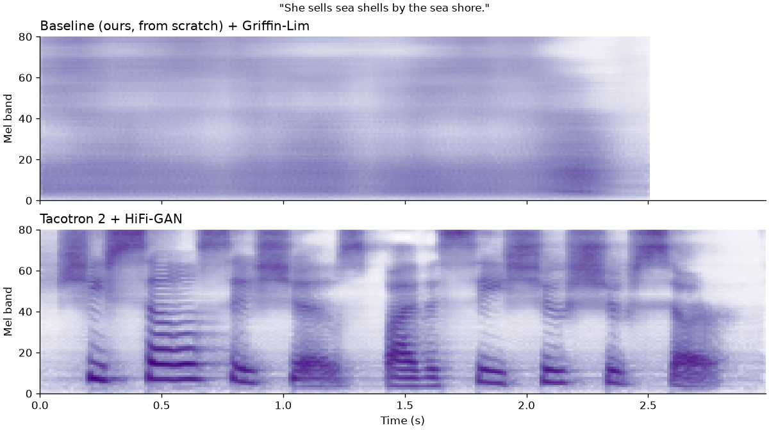
Why the baseline sounds like noise
Tacotron 2
Separate syllables, pauses between words, pitch stripes, and the hiss of each "s" and "sh".
Our baseline
One smooth blur. It cannot learn when each sound happens, so it predicts the average spectrum.
Without learned timing (attention), the model collapses to the mean: the 2018 paper's failure, reproduced.
Mann + Deekshitha
Notes:
Play samples/baseline/05.wav, then samples/main_hifigan/05.wav. The picture explains the sound: the baseline has no syllable structure at all. With equal time per character, its predictions never line up with real audio, so L1 training pushes it to the average spectrum. That is exactly why attention, or some learned timing, is needed.

Slide 13
Conclusions
1
Data and depth matter most
Limitations
Main models are pretrained, not trained by us
Pretrained model may have seen test clips
One speaker, English only
No formal listening test (MOS)
Next: fine-tune Tacotron 2 on a GPU
Our from-scratch baseline (324 training clips) has a 37% higher mel distance to real speech than Tacotron 2.
2
Alignment is the key
Tacotron 2's attention forms a clean diagonal (95–97% monotonic), so no repeated words.
3
Vocoder sets the sound quality
On identical mels, HiFi-GAN avoids Griffin-Lim's metallic phase artefacts.
4
It runs live on a laptop
Tacotron 2 + HiFi-GAN is faster than real time on CPU.
Notes:
Tie back to the paper: their conclusion was that they needed more data and deeper models. Our results confirm it from both sides.

Slide 14
Who did what
Mann Mehta
Marapareddy Deekshitha
Repo, environment, shared audio settings
Tacotron 2 integration
Griffin-Lim and HiFi-GAN vocoders
Attention plots and alignment stats
Fixed comparison samples
Inference CLI, Gradio demo, README
LJ Speech download and subset
Text cleaning and fixed vocabulary
Mel extraction, splits, sanity check
Baseline model and its training
Mel-distance evaluation
Results table
src/models/tacotron.py, src/vocoder/, src/infer.py, app/
src/preprocess/, src/models/baseline.py, eval/
Notes:
Each of us explains our own files in the Q&A. The GitHub commit history matches this split.

Slide 15
Live demo
python app/app.py → http://127.0.0.1:7860
1
Type a sentence
2
Choose a vocoder
3
Hear it, see the alignment
Backup: pre-generated audio in samples/
Notes:
Start the app before the review so models are already loaded. Try one sentence from the panel. If anything fails, play the files in samples/.

