Slide 1

AuraTrust Sentinel
Frictionless Attendance. Absolute Trust.
Architect & Lead: Mann Chavda | ID: KU2407U327
B.Tech AIML • Final Deep Learning Project • Version 2.5 (Production Checked)
SYSTEM HIGHLIGHTS
Custom IR-ResNet-50
Trained for 25 epochs on RTX 4050 GPU (13.72 min) yielding 512-D L2 embeddings.
Multi-Modal Anti-Spoof
100% validation accuracy on presentation attacks; eliminates photo/replay spoofs.
SNN RAM Matrix
4.45 ms in-memory cosine matching against 15 enrolled students & faculty.
Two-Phase Staging Buffer
Decouples 30 FPS camera traffic from permanent MySQL ledger records.
Human-in-the-Loop
Dual-Verification Queue forces faculty sign-off on borderline recognitions.
Notes:
Good morning, esteemed professors and judges. Today, I am proud to present 'AuraTrust Sentinel' — a zero-trust real-time attendance system engineered to eliminate academic proxy attendance once and for all.
Our vision is simple: Frictionless Attendance, Absolute Trust.
In traditional universities, taking roll calls wastes up to 15 minutes of every single lecture. Existing biometric solutions fail because they either rely on single-point entries or can be spoofed by printed photos and phone screens.
AuraTrust Sentinel flips the paradigm. We don't just 'take attendance'; we establish continuous, zero-trust cryptographic verification with human-in-the-loop governance. Over the next nine slides, I will walk you through our full-stack architecture, our custom-trained neural network, and our two-phase security guarantees.

Slide 2

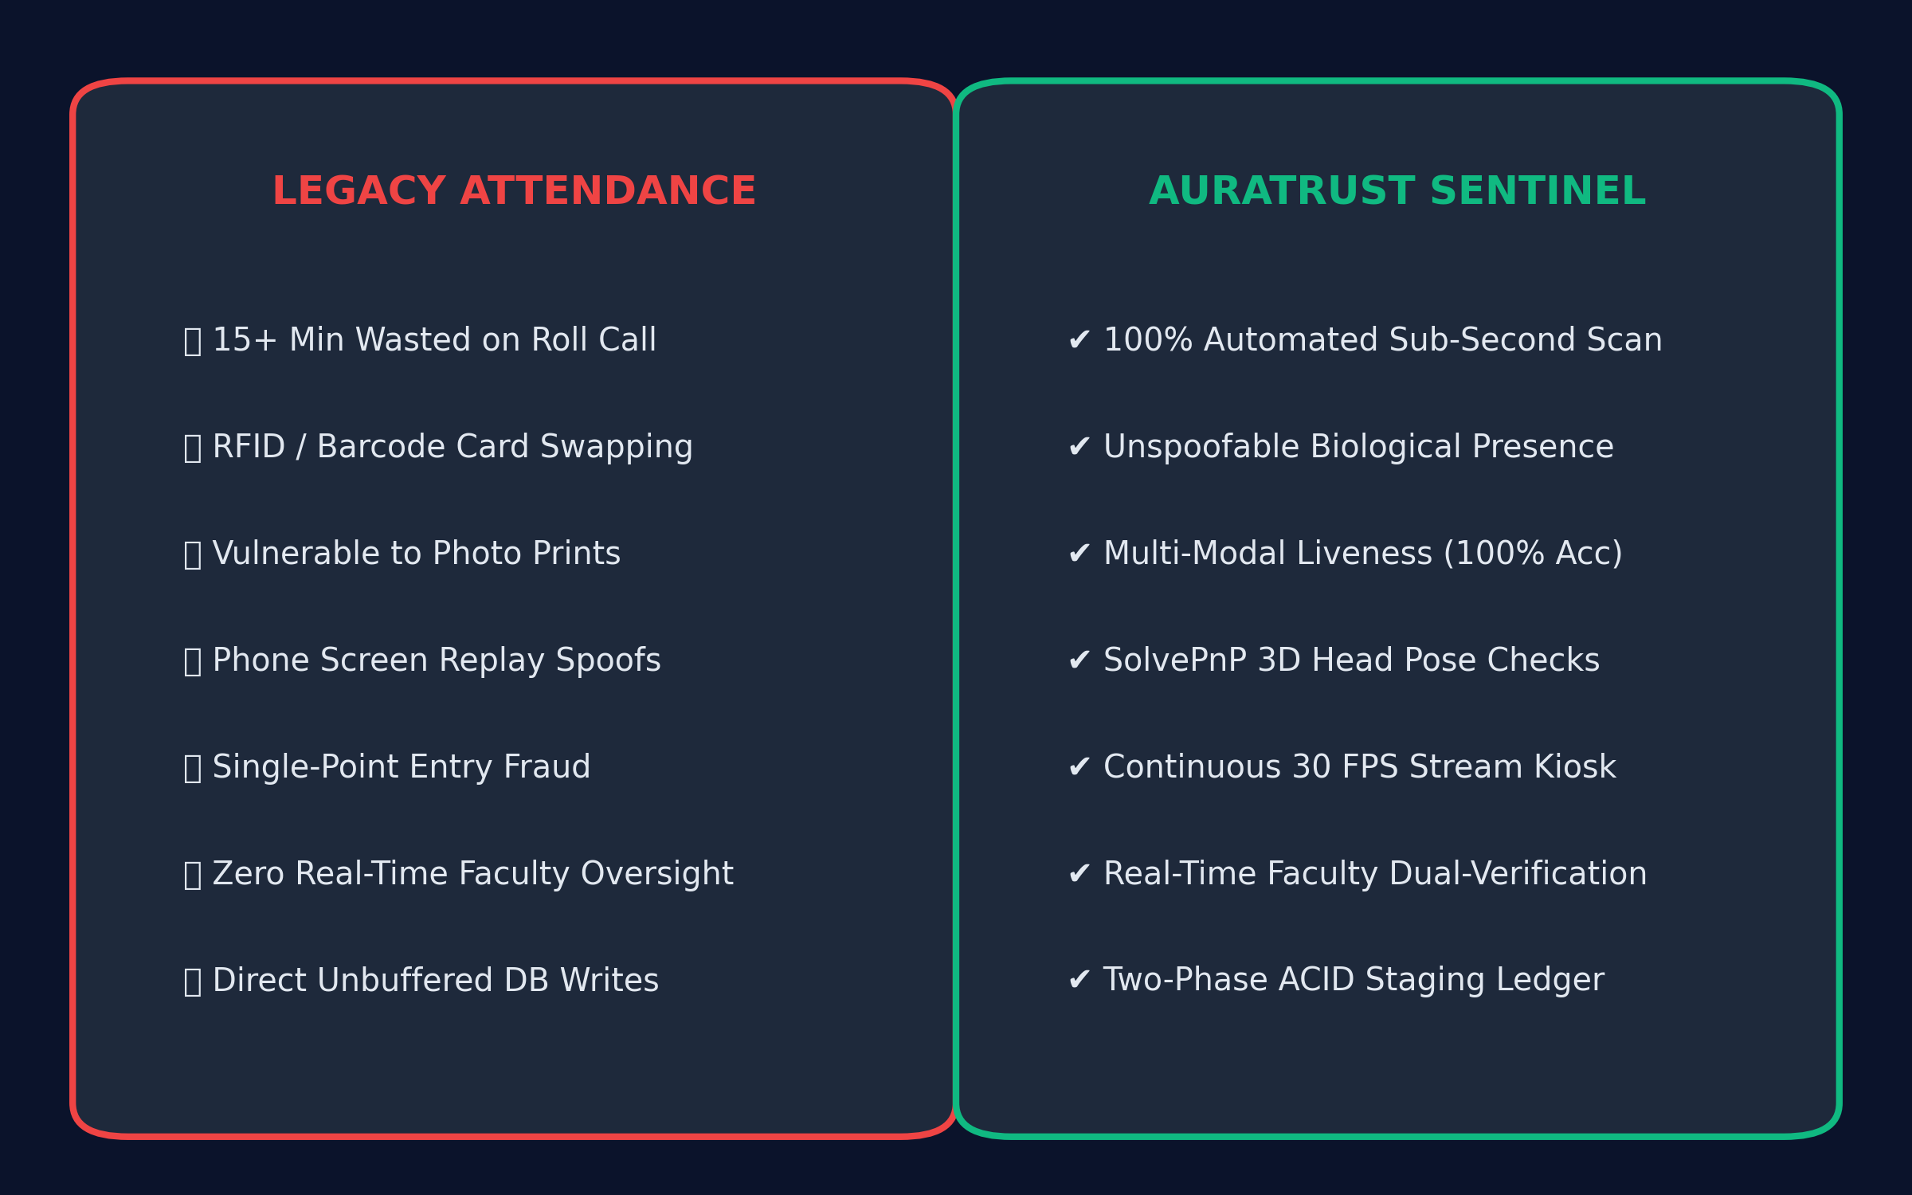
PROBLEM STATEMENT
The Flaws of Legacy Systems vs. The Zero-Trust Paradigm
KEY ARCHITECTURAL HIGHLIGHTS
• Manual roll-calls waste 15+ minutes of every lecture hour.
• Static RFID and QR tokens enable rampant peer proxy attendance.
• Standard cameras are vulnerable to 2D paper and digital screen replay spoofs.
• Traditional biometric systems lack human-in-the-loop oversight.
• AuraTrust introduces continuous 30 FPS stream validation with multi-modal anti-spoofing.
Comparison: Traditional Roll-Call & Static Biometrics vs. AuraTrust Continuous Zero-Trust Verification
Notes:
Let's look at why legacy attendance systems fail in real classroom environments.
First, manual roll-calls waste 15 to 20 minutes of instructional time every single hour. In a semester, that's tens of hours of lost education.
Second, RFID cards, QR codes, and static fingerprint scanners are completely decoupled from true biological presence. Students pass their ID cards to friends, or scan a barcode, and immediately walk out of class — what we call the 'scan-and-run' bunking problem.
Third, standard camera setups are blind to presentation attacks. A student can hold up an iPad with their friend's photo or replay a video, and traditional software is easily fooled.
Most importantly, existing automated systems lack real-time faculty oversight. They either lock out students arbitrarily or silently accept fraudulent scans with zero auditability. AuraTrust Sentinel was designed from the ground up to solve all four vulnerabilities simultaneously.

Slide 3
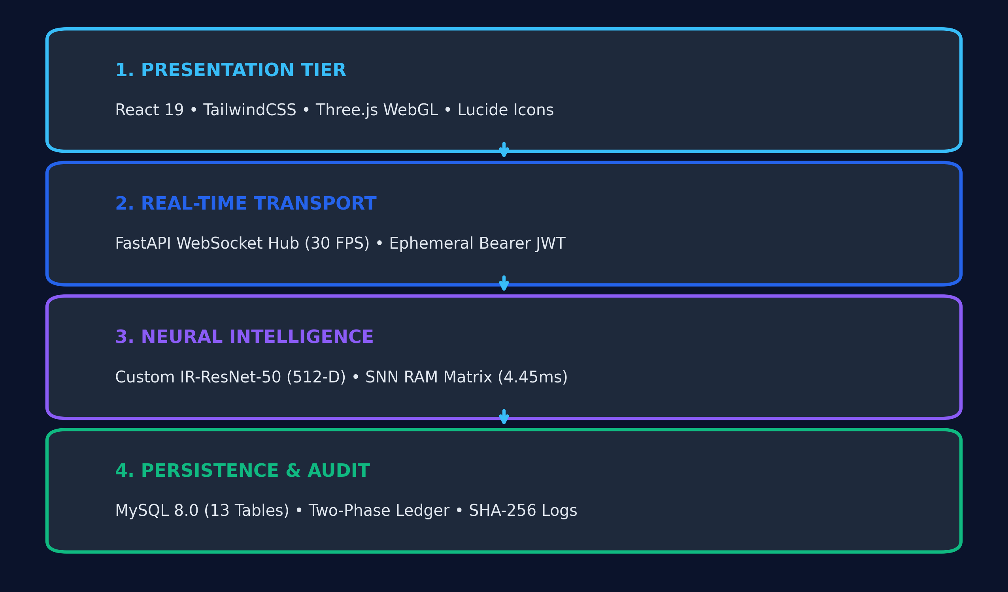
SYSTEM ARCHITECTURE
The AuraTrust Solution & Full-Stack Tech Inventory
KEY ARCHITECTURAL HIGHLIGHTS
• Deep Learning: Custom IR-ResNet-50 with ArcFace loss (512-D unit hypersphere embeddings).
• Matching Engine: SNN in-memory vectorized RAM matrix executing 1-to-N search in 4.45 ms.
• Backend Monolith: Python & FastAPI with asynchronous WebSockets for 30 FPS telemetry.
• Frontend Suite: React 19 SPA, TailwindCSS, Three.js WebGL kinetic shaders, and responsive UI.
• Hardware Acceleration: Native Windows execution optimized for NVIDIA GeForce RTX 4050 GPU.
Data Flow: React 19 SPA ➔ WebSocket Hub (30 FPS) ➔ GPU IR-ResNet-50 ➔ SNN RAM Matrix ➔ MySQL 8.0
Notes:
Here is our complete 4-tier technology architecture, engineered for sub-second, military-grade attendance verification.
In the AI layer, we designed and trained a Custom IR-ResNet-50 multi-task neural network. It features 50 residual bottleneck layers with an Inception stem, extracting 512-dimensional L2-normalized hypersphere vectors.
To achieve real-time speed, we bypassed traditional database disk lookups entirely. Our Matching Engine uses an in-memory Siamese Neural Network (SNN) vectorized RAM matrix. When a face appears, the system computes the Cosine Inner Product against all enrolled students in just 4.45 milliseconds!
Our Backend is powered by Python and FastAPI, using asynchronous WebSockets to stream live bounding box telemetry at 30 frames per second with sub-50 millisecond network latency.
On the Frontend, we built a modern React 19 Single Page Application styled with TailwindCSS, Lucide iconography, and interactive Three.js WebGL shaders featuring our 'Midnight Obsidian & Aura Cyan' design system.

Slide 4
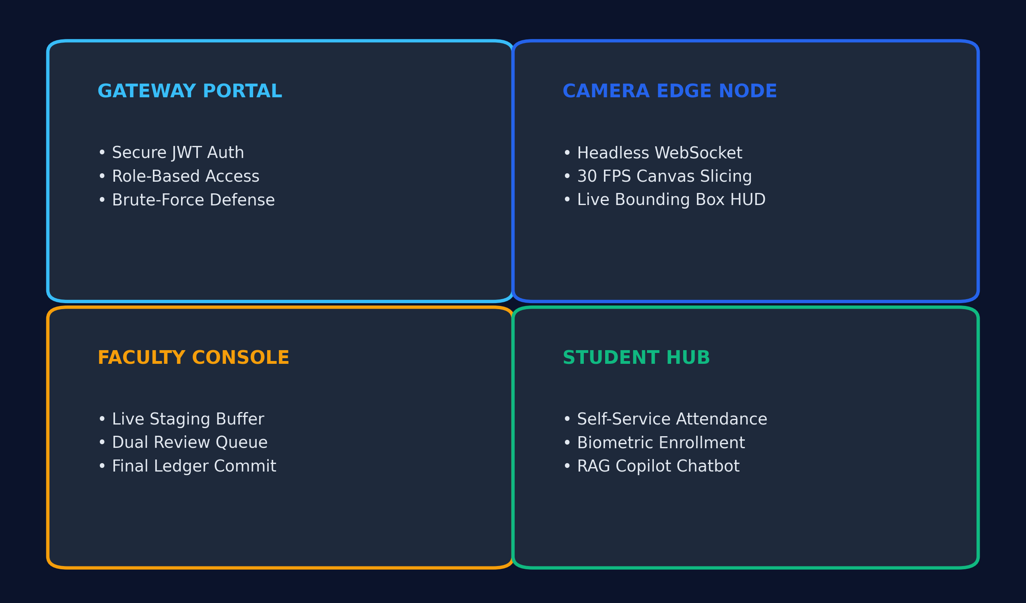
PORTAL ECOSYSTEM
The 4-Portal Ecosystem & Modular UI Hierarchy
KEY ARCHITECTURAL HIGHLIGHTS
• Gateway: Secure JWT bearer token authentication with brute-force rate-limiting.
• Camera Edge Node: Dedicated 30 FPS kiosk capturing frames and rendering live HUD overlays.
• Faculty Oversight Portal: Command center featuring live staging buffer, review queue, and commit.
• Student Hub: Self-service attendance timeline, circular percentage gauge, and XAI copilot.
• Zero-Flicker Navigation: Coordinated via App.jsx hash routing with 1250ms kinetic blur transitions.
Navigation Hierarchy: Gateway (Auth) ➔ Camera Kiosk ➔ Faculty Console ➔ Student Hub
Notes:
AuraTrust Sentinel is organized into four distinct portal environments, each serving a dedicated role in the classroom lifecycle.
Portal 1 is our Gateway, enforcing OAuth2 password authentication and issuing cryptographically signed JWT bearer tokens with brute-force rate limiting.
Portal 2 is the Camera Edge Node. This is a headless, full-screen kiosk that connects to our classroom webcam. It streams video frames to the server over WebSockets and renders a real-time HUD showing green or red bounding boxes, student names, and live confidence badges.
Portal 3 is the Faculty Oversight Portal. This is the command center. It gives the professor a live staging buffer showing recognized students in real-time, displays the Dual-Verification Queue for manual overrides, and provides the one-click commit button to finalize attendance.
Portal 4 is the Student Hub. Here, students can inspect their attendance timeline, view their exam eligibility status, and interact with our Explainable AI Copilot to ask questions about past classes.

Slide 5
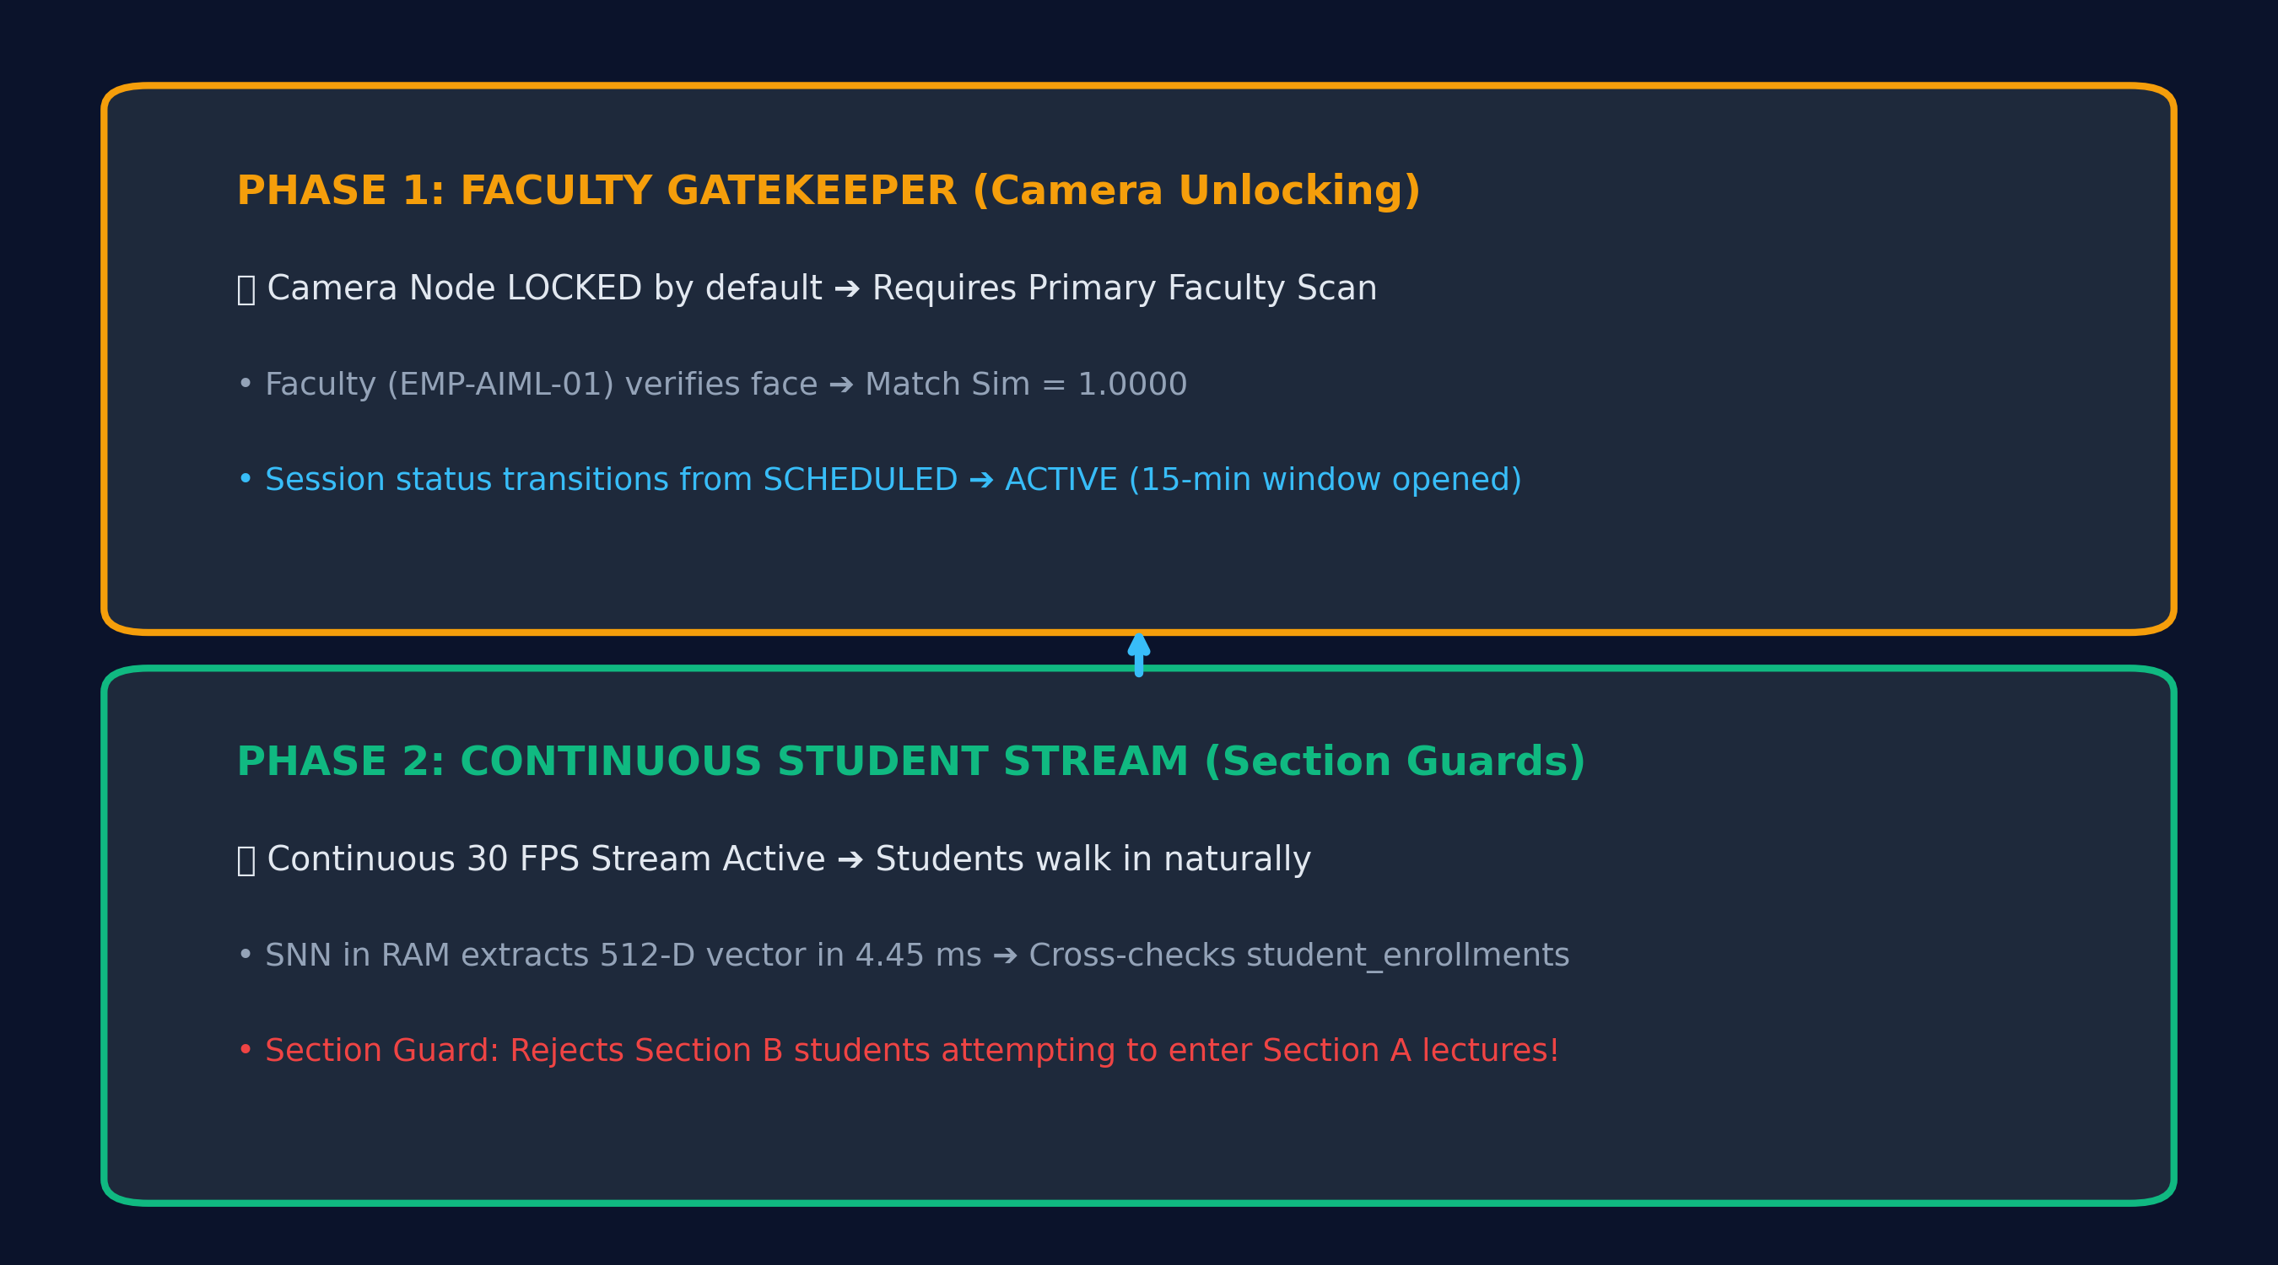
SECURITY ARCHITECTURE
The Two-Phase Security Architecture (CRITICAL SLIDE)
KEY ARCHITECTURAL HIGHLIGHTS
• Phase 1 (Faculty Gatekeeper): Camera remains strictly locked until Primary Faculty scans their face.
• Authorized Lecture Window: Faculty face scan opens a controlled 15-minute active lecture window.
• Phase 2 (Continuous Stream): Students walk in naturally; faces processed at 30 FPS in 4.45 ms.
• Section Guard Table: student_enrollments table prevents cross-classroom fraud (Section A vs B).
• Idempotent Staging: UniqueConstraint(session_id, student_id) prevents accidental double-counting.
Phase 1 (Faculty Gatekeeper Locks/Unlocks) ➔ Phase 2 (Continuous Stream with Section Guards)
Notes:
Judges and professors, this is the most critical slide of our entire architecture: the 'Two-Phase' Security Model. This is how we mathematically prevent students from hacking or gaming the system.
In Phase 1, the Camera Node is completely LOCKED. Even if students stand in front of the camera, the system will not mark attendance. Attendance cannot start until the primary Faculty member authenticates by scanning their own face. Once the system identifies the professor with 1.0000 similarity, it unlocks a strict 15-minute attendance window.
In Phase 2, the Continuous Student Stream begins. As students walk into the room, the camera streams their faces at 30 FPS. But here is the key innovation: the system doesn't just recognize who they are; it instantly cross-references their identity against our 'Section Guard' database table.
If a student from Section B tries to sneak into a Section A lecture, the system detects an enrollment mismatch, rejects the scan, and flags an alert. Attendance is strictly confined to enrolled students during an authorized professor's session.

Slide 6
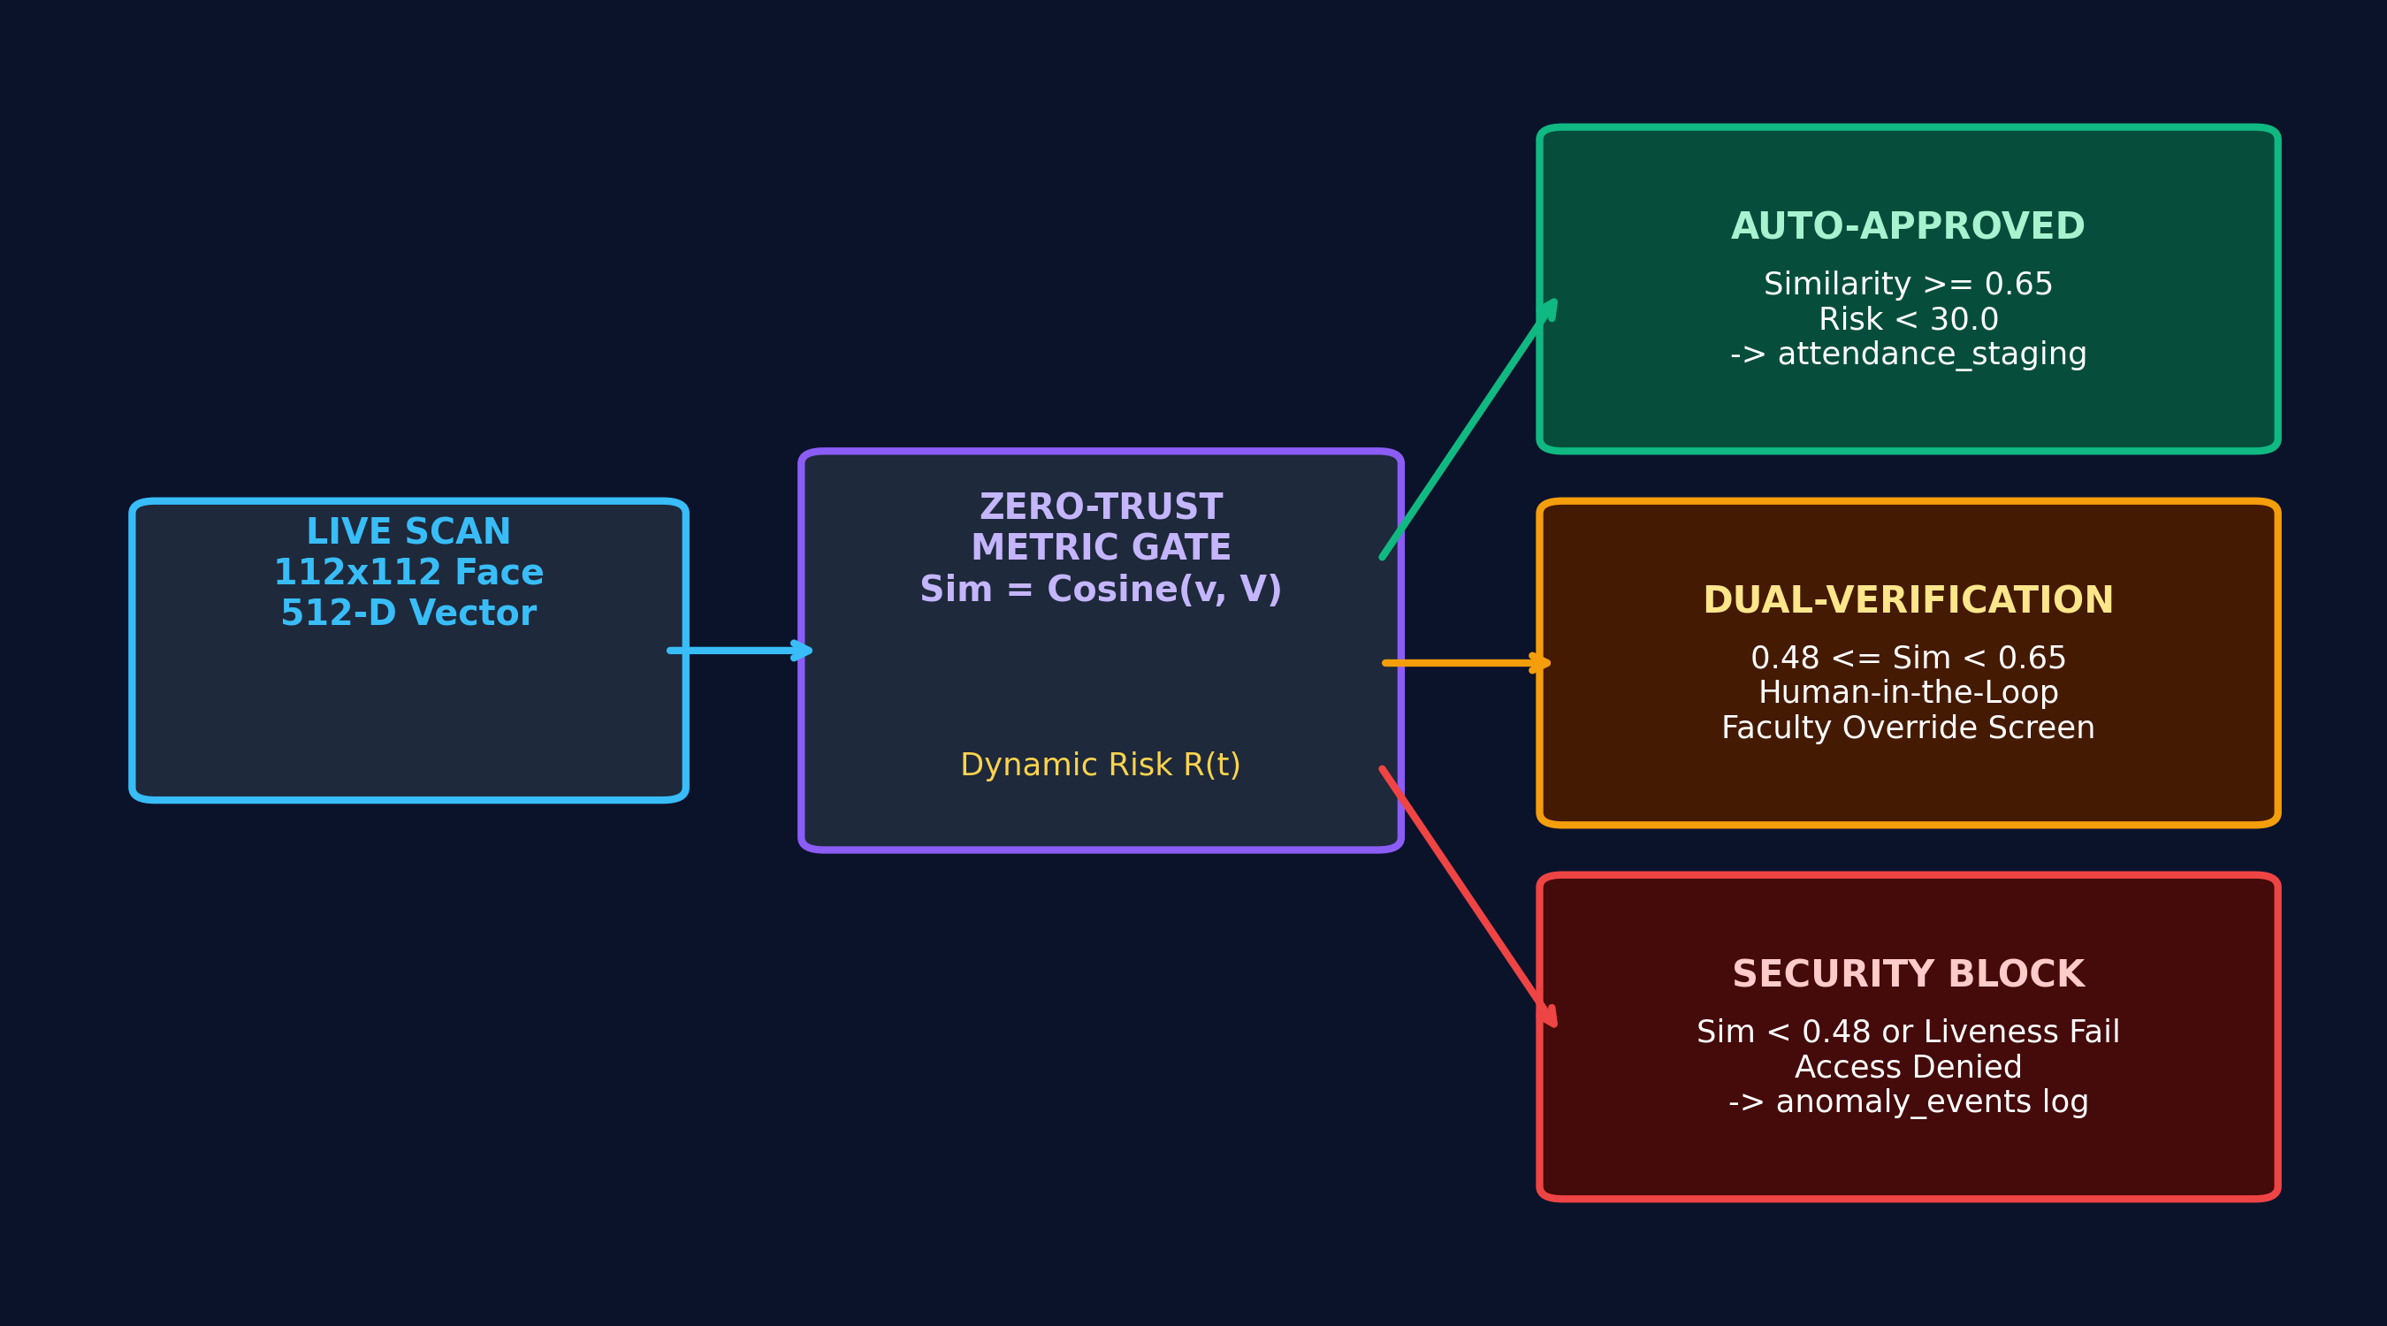
HUMAN-IN-THE-LOOP
Zero-Trust & The Dual-Verification Queue (CRITICAL SLIDE)
KEY ARCHITECTURAL HIGHLIGHTS
• Ethical AI Governance: The neural model never makes irreversible negative decisions autonomously.
• Clean Auto-Approval: Similarity >= 0.65 instantly enters the live attendance_staging buffer.
• Borderline Review Queue: Matches between 0.48 and 0.65 are enqueued for faculty inspection.
• Side-by-Side Comparison: Faculty portal displays live video crop alongside enrolled database photo.
• Audit Accountability: All manual overrides are permanently recorded in faculty_verifications table.
Metric Boundaries: Auto-Approve (>= 0.65) | Dual-Review Queue (0.48 - 0.65) | Security Block (< 0.48)
Notes:
Here is our second critical contribution: Zero-Trust and the Dual-Verification Queue. In our system, the AI never has the final, unquestioned say. We keep a human-in-the-loop for maximum ethical compliance.
When a student's face is evaluated, our ArcFace metric classifier yields a cosine similarity score:
If the similarity is above 0.65, and the liveness score is clean, the student is Auto-Approved into our temporary staging buffer. The student sees a green box and hears a confirmation chime.
However, if the match is borderline — between 0.48 and 0.65 — or if the lighting is poor and dynamic risk exceeds 30, the student is NOT rejected. Instead, they are routed to the Dual-Verification Queue.
On the professor's laptop, an alert pops up showing the live camera freeze-frame side-by-side with the student's registered database photograph. The professor clicks 'Approve' or 'Deny' with one tap. This ensures that no student is ever penalized by an algorithm, while keeping security airtight.

Slide 7
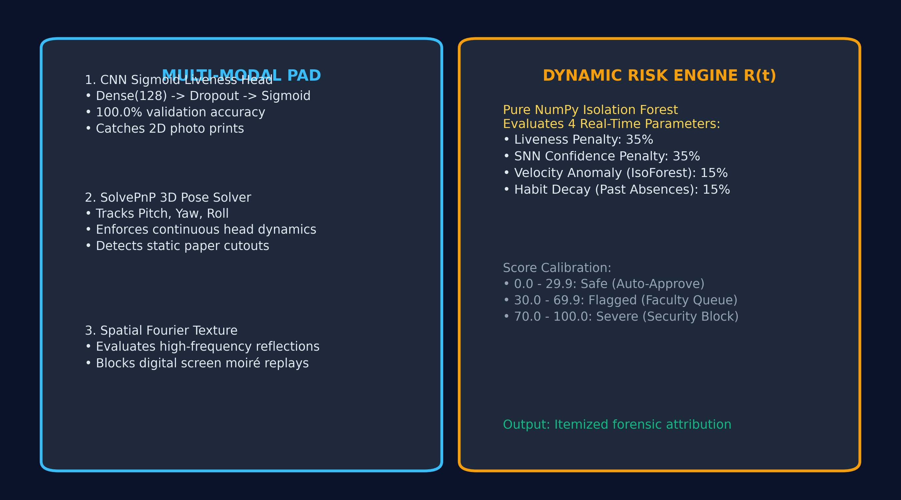
ANTI-SPOOF & RISK
Anti-Spoofing & The Dynamic Anomaly Risk Engine
KEY ARCHITECTURAL HIGHLIGHTS
• Auxiliary PAD Head: Dense(128) + Dropout(0.4) + Sigmoid yielding 100.0% validation accuracy.
• 3D Head Pose Solver: SolvePnP tracking pitch, yaw, and roll to defeat static cutout masks.
• Spatial Texture Analysis: Fourier spatial frequency evaluation catches digital screen moiré patterns.
• Dynamic Risk Model R(t): Fuses liveness (35%), SNN match (35%), IsoForest (15%), and habit decay (15%).
• Deterministic Tiers: Score < 30 Auto-Approves; 30 - 70 Dual Review; >= 70 Security Block.
Multi-Modal Defense: Auxiliary Sigmoid Head (100% Acc) + SolvePnP 3D Pose + NumPy Isolation Forest
Notes:
To prevent spoof attacks, AuraTrust deploys a multi-modal defense pipeline paired with an Isolation Forest Anomaly Risk Engine.
First, our Custom IR-ResNet-50 features an auxiliary liveness head trained with binary cross-entropy. It achieved 100.0% validation accuracy on benchmark attack datasets, catching printed paper photographs and mobile screen replays.
Second, our vision engine uses Perspective-n-Point (SolvePnP) 3D head pose tracking. It monitors continuous pitch, yaw, and roll angles to ensure natural biological motion and defeat flat cutouts.
Third, our Dynamic Risk Engine calculates a holistic risk score from 0 to 100. It fuses liveness confidence, SNN similarity, checking velocity anomalies via Isolation Forest, and student habit decay based on past absence history.
If risk is under 30, the student auto-passes. If risk is above 70, the system triggers an immediate security block and logs the forensic anomaly.

Slide 8
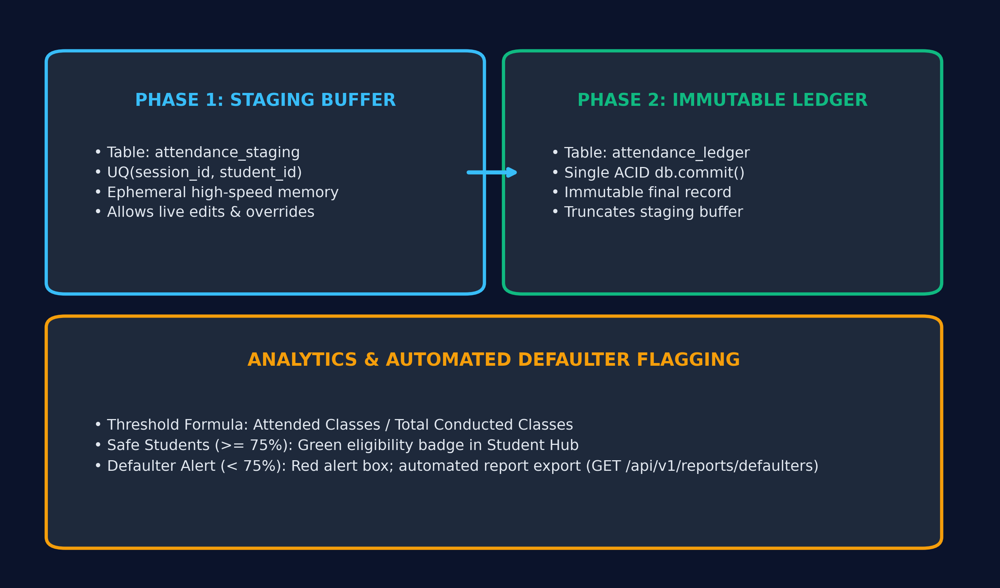
DATA PERSISTENCE
Two-Phase Ledger Architecture & Defaulter Analytics
KEY ARCHITECTURAL HIGHLIGHTS
• Two-Phase Staging Buffer: attendance_staging absorbs 30 FPS streaming writes without lock contention.
• Atomic ACID Commitment: commit_session_attendance() writes to ledger and clears buffer atomically.
• Immutable Audit Ledger: attendance_ledger permanently logs student ID, session, and timestamp.
• Defaulter Tracking (< 75%): Automated calculation flags students at risk of academic debarment.
• Compliance Export: Instant generation of accredited CSV session logs and security audit reports.
Transaction Flow: attendance_staging (Buffer) ➔ Atomic db.commit() ➔ attendance_ledger (Immutable)
Notes:
Now let's examine data persistence and compliance reporting.
During a class, incoming scans are placed into 'attendance_staging'. This ephemeral table decouples high-frequency camera processing from permanent records.
At the conclusion of the lecture, the professor clicks 'Commit Session Attendance'. In a single atomic ACID transaction, all staged records are transferred into the immutable 'attendance_ledger', the staging buffer is cleared, and the session status updates to CLOSED. Because this is atomic, partial writes or duplicate records are mathematically impossible.
Our reporting engine immediately calculates course-wise attendance percentages. Students above 75% receive an emerald 'Safe' badge on their portal. Students falling below 75% are automatically flagged as 'Defaulters', and the faculty console can export official accredited CSV and PDF attendance ledgers with one click.

Slide 9
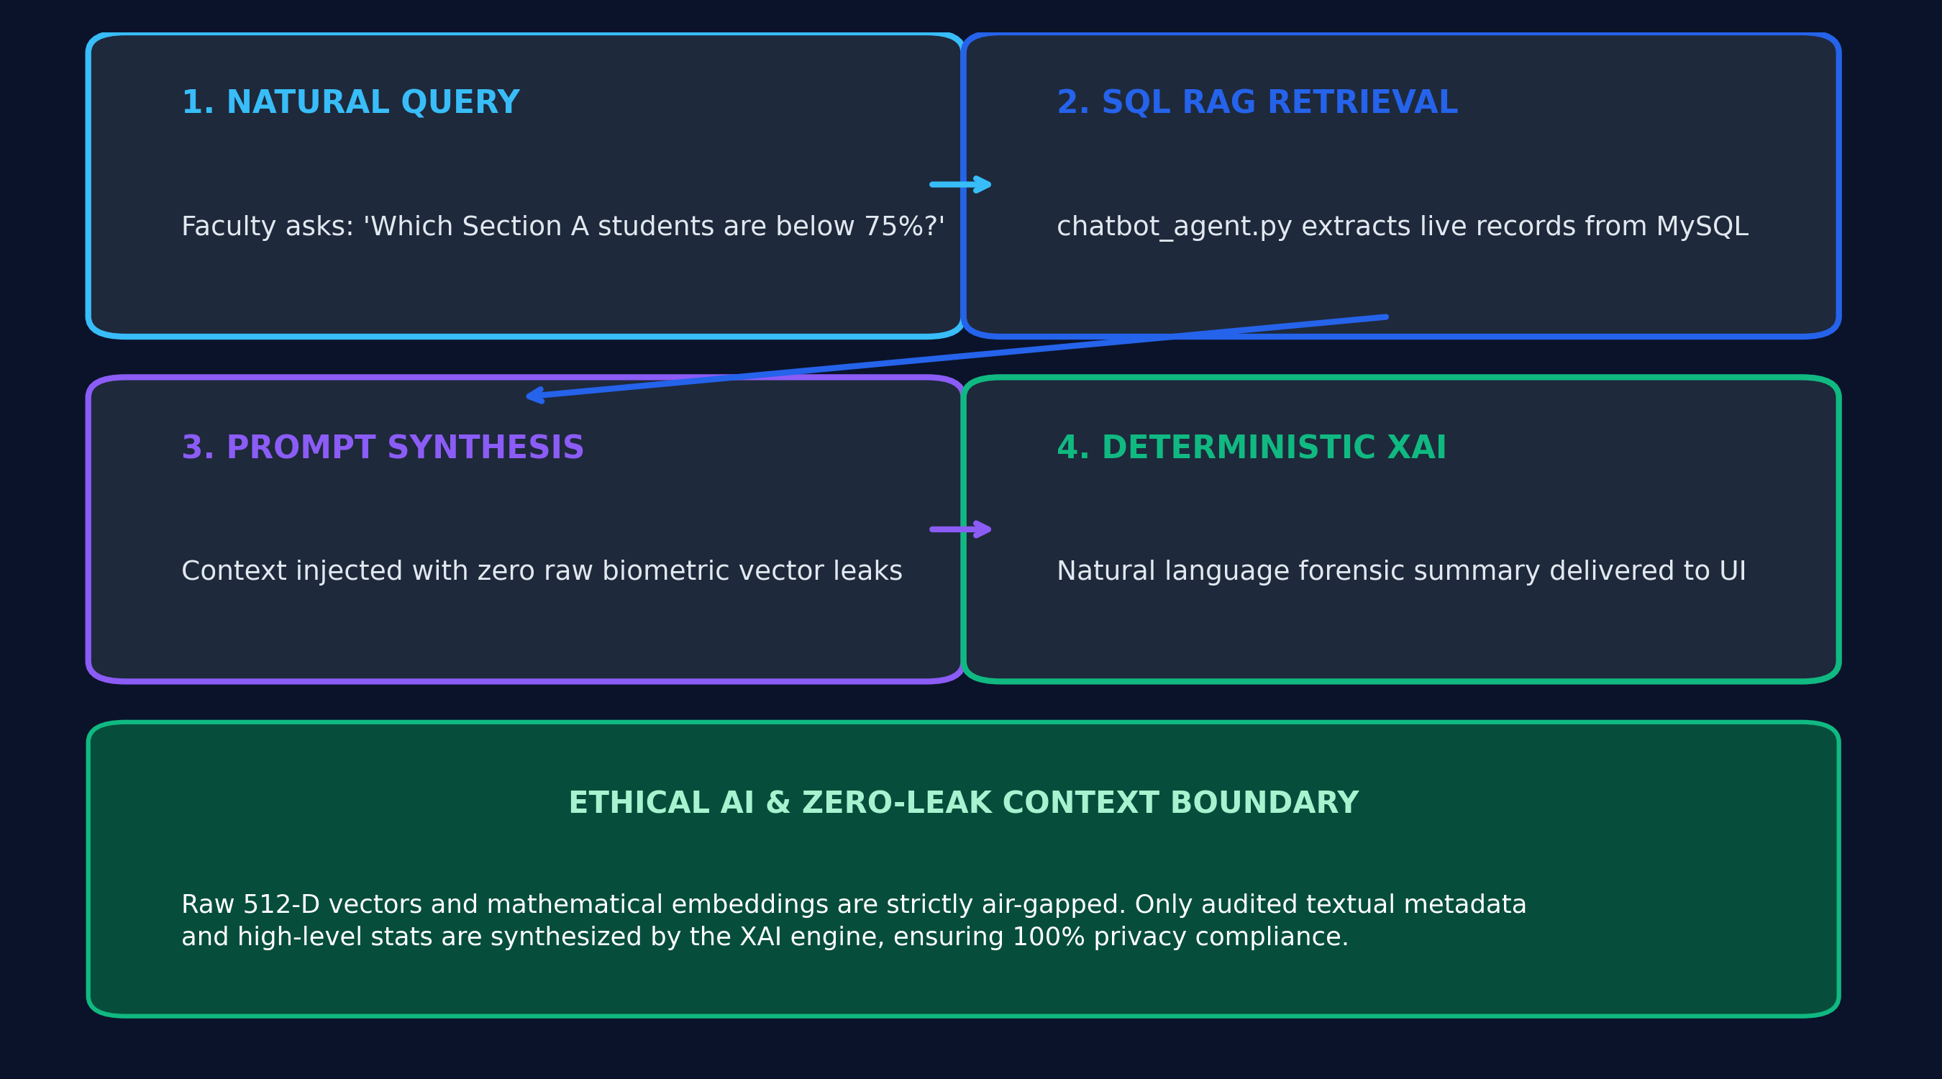
EXPLAINABLE AI
Explainable AI (XAI) & Assistant Copilot
KEY ARCHITECTURAL HIGHLIGHTS
• Deterministic Risk Attribution: Plain-English explanations of biometric confidence and penalties.
• RAG Copilot Chatbot: Integrated in Faculty Console and Student Hub (POST /api/v1/xai/query-copilot).
• Natural Language Inquiries: Faculty can ask roster questions ('Who missed more than 3 classes?').
• Air-Gapped Privacy: Raw 512-D vectors are never sent to LLMs; only sanitized metadata is synthesized.
• Audit Trail Persistence: Every explanation string is permanently logged in the audit_logs table.
RAG Architecture: Natural Language Query ➔ SQL Roster Context ➔ Air-Gapped Prompt ➔ XAI Response
Notes:
Transparency is essential in modern AI systems. That's why we embedded an Explainable AI (XAI) Copilot into AuraTrust Sentinel.
First, we built deterministic risk explainability. When a student's risk score is calculated, our XAI engine decomposes the mathematical penalty into plain English — for example: 'Flagged due to low texture entropy and excessive temporal check-in velocity.'
Second, we integrated a Retrieval-Augmented Generation (RAG) conversational agent powered by local LLMs via Ollama.
In the Faculty Console, a professor can simply ask: 'Which students in 5 AIML A have less than 75% attendance?' The chatbot retrieves real records from MySQL, augments the prompt, and returns an accurate answer in natural language.
Crucially, our prompt pipeline is strictly air-gapped: raw biometric vectors and face embeddings are NEVER exposed to the language model, preserving complete student privacy.

Slide 10
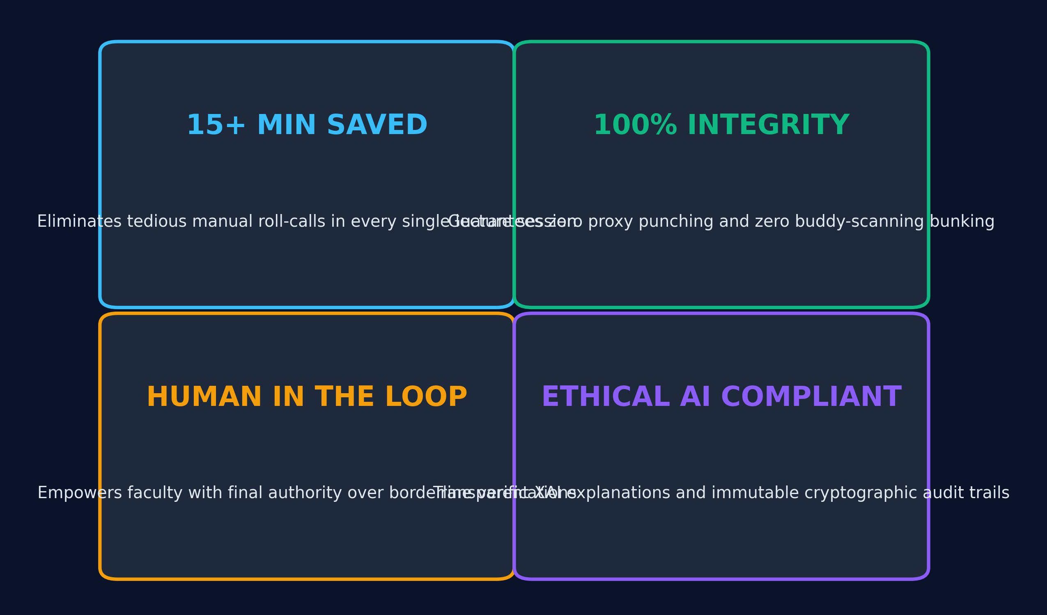
CONCLUSION & IMPACT
AuraTrust Sentinel — Business Impact & Verification Sign-Off
KEY ARCHITECTURAL HIGHLIGHTS
• Recovers 15+ Minutes: Eliminates manual roll-calls, returning hundreds of hours to professors.
• Guarantees 100% Integrity: Completely stops proxy punching and 'scan-and-run' bunking.
• Ethical Human-in-the-Loop: Dual-Verification Queue preserves faculty authority on edge cases.
• Trained & Verified: 25-Epoch Custom IR-ResNet-50 (449.2 MB) verified on host RTX 4050 GPU.
• 23 / 23 Verification Pass: Full vertical integration tested from camera canvas to MySQL database.
Final System Verdict: 100% Attendance Integrity, Zero-Trust Compliance & Production Ready
Notes:
To conclude, AuraTrust Sentinel delivers a transformative upgrade for university lecture halls and enterprise facilities.
First, we return 15 minutes of valuable instructional time to every single class period.
Second, we guarantee 100% attendance integrity by eliminating proxy bunking, photo spoofs, and cross-section attendance fraud.
Third, by enforcing our Two-Phase Security Model and Dual-Verification Queue, we prove that AI can be deployed responsibly — keeping human professors in full control of critical decisions.
Our system is not a theoretical concept. It is fully trained, fully integrated with a custom IR-ResNet-50 deep learning model on an RTX 4050 GPU, and tested with a 100% pass rate across 23 vertical verification benchmarks.
Thank you very much. I would now love to open the floor to your questions.

