Slide 1
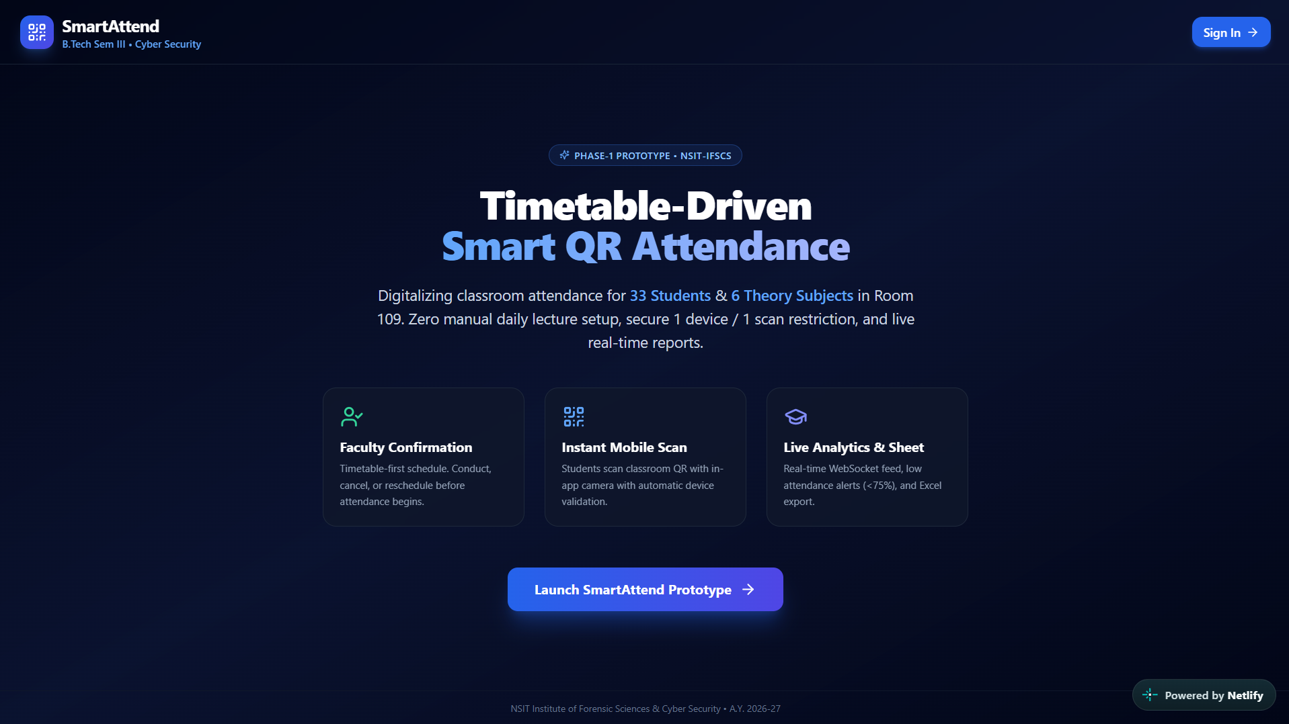
nsit-attendance.netlify.app
SmartAttend
Live Working Prototype — How It Works
SCREENSHOT
Timetable-driven QR attendance management system
Landing page
PHASE-1 WORKING PROTOTYPE
Full homepage of the live prototype
https://nsit-attendance.netlify.app/
NSIT Institute of Forensic Sciences & Cyber Security • A.Y. 2026-27
01
Notes:
Open with the live link on screen. This is a Phase-1 working prototype — everything shown in this deck is the actual application.

Slide 2
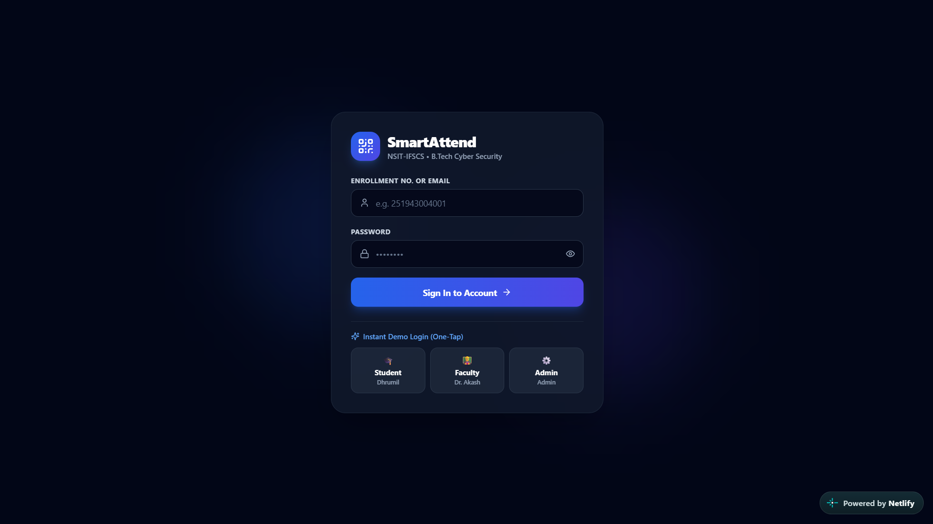
OVERVIEW
What is SmartAttend?
SmartAttend is a digital attendance workflow that connects faculty session management with student attendance through the application interface and a QR-based attendance process.
The timetable drives the schedule, so there is no manual daily lecture setup — faculty confirm a scheduled lecture and the classroom QR does the rest.
nsit-attendance.netlify.app
SCREENSHOT
Landing page — feature section
"Timetable-Driven Smart QR Attendance"
33
6
109
Students
Theory subjects
Room
The complete high-level flow
Faculty
Session
QR
Student
Attendance
Dashboard / Report
https://nsit-attendance.netlify.app/
02
Notes:
Two or three lines only. The point of this slide is the flow strip at the bottom — every later slide is one box of this strip.

Slide 3
USER ROLES
Who Uses SmartAttend?
FACULTY
STUDENT
Login
Open SmartAttend
View timetable
Access attendance workflow
Select lecture
Scan classroom QR
Manage session
Complete validation
Display attendance QR
Record attendance
Monitor attendance
Complete session
Access attendance information / report
https://nsit-attendance.netlify.app/
03
Notes:
One application, two journeys. Faculty run the session; students only scan and confirm.

Slide 4
FACULTY WORKFLOW
Step 1 — Faculty Login
nsit-attendance.netlify.app
1
Open SmartAttend in the browser
2
Use the faculty sign-in option
3
Enter the required credentials
SCREENSHOT
Sign in
Sign-In screen
4
Landing page → "Sign In" / "Launch SmartAttend Prototype"
5
Faculty reaches the application dashboard
This is the entry point for the faculty workflow.
https://nsit-attendance.netlify.app/
04
Notes:
Capture the sign-in screen and mark the credential fields and the sign-in button with callouts 3 and 4.

Slide 5
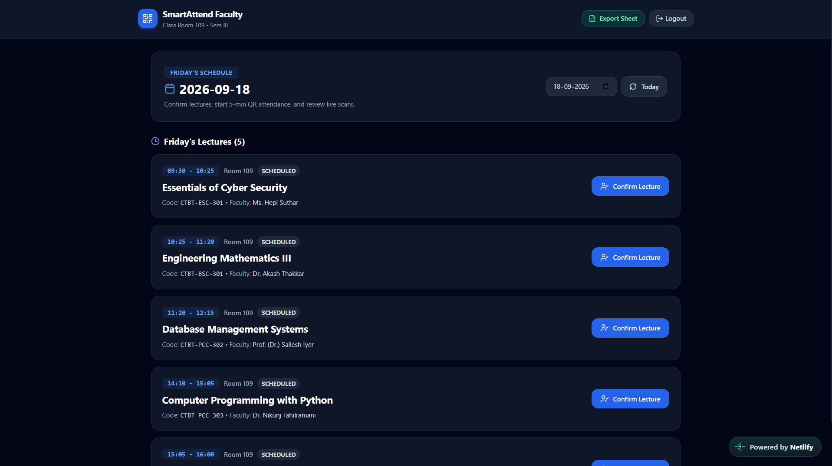
FACULTY WORKFLOW
Step 2 — Select the Lecture
nsit-attendance.netlify.app
1
Faculty views the scheduled lectures
2
Faculty identifies the relevant lecture
3
Faculty selects the lecture / session
SCREENSHOT
Faculty timetable
4
The selected lecture becomes the active attendance session
The scheduled lectures view after sign-in
Timetable-first: no manual daily lecture setup.
Place arrows over the screenshot pointing at the lecture row and the select control.
https://nsit-attendance.netlify.app/
05

Slide 6
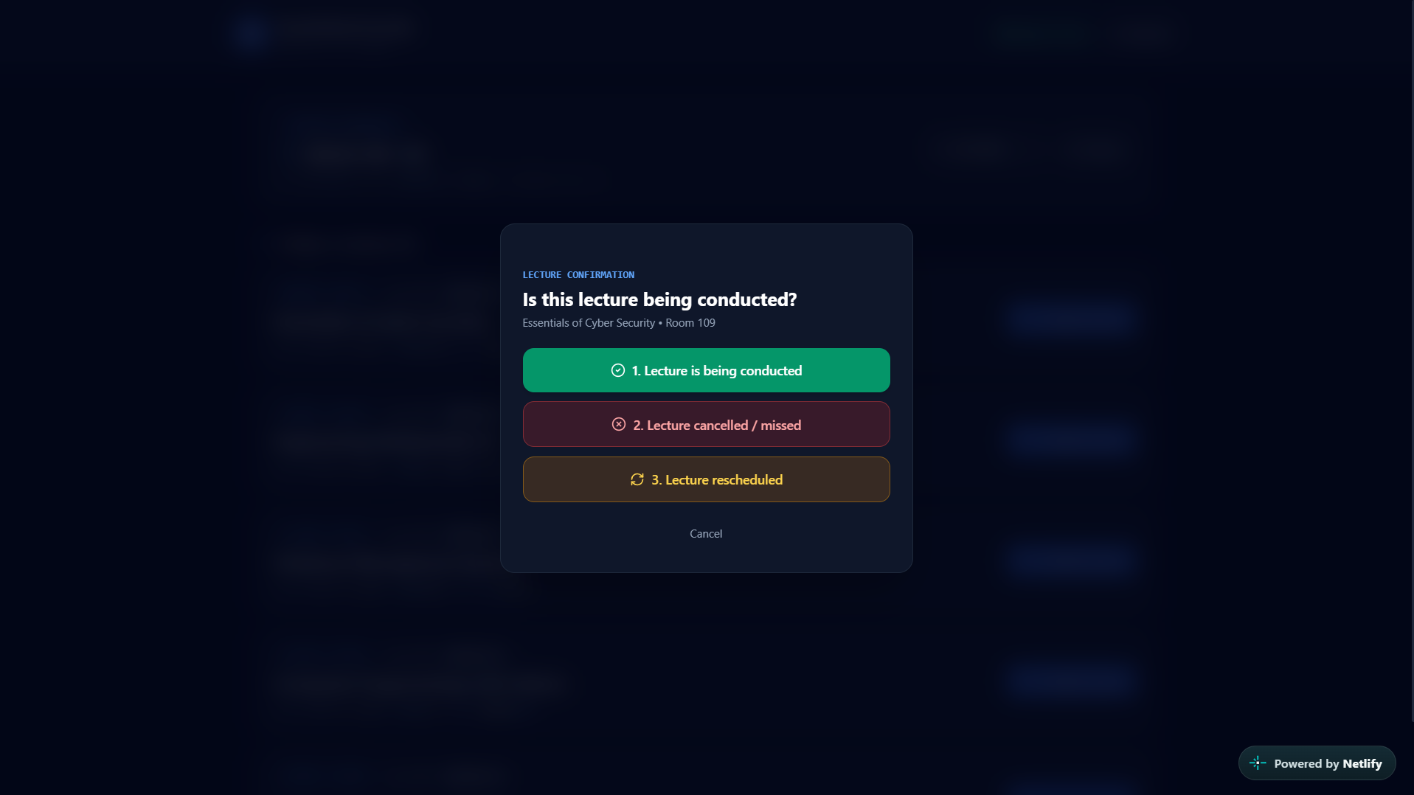
SESSION MANAGEMENT
Step 3 — Confirm the Lecture
nsit-attendance.netlify.app
CONDUCTING
Session status shown by the application
Conduct
Confirms the lecture is taking place and opens the attendance session.
SCREENSHOT
Cancel
Session confirmation screen
Marks the scheduled lecture as not held — no attendance is collected.
Lecture selected, awaiting faculty confirmation
Reschedule
Moves the scheduled lecture to a different slot.
After confirmation, the session is active and ready for the QR.
https://nsit-attendance.netlify.app/
06
Notes:
Use the application's exact terminology on screen — Conduct, Cancel, Reschedule, CONDUCTING.

Slide 7
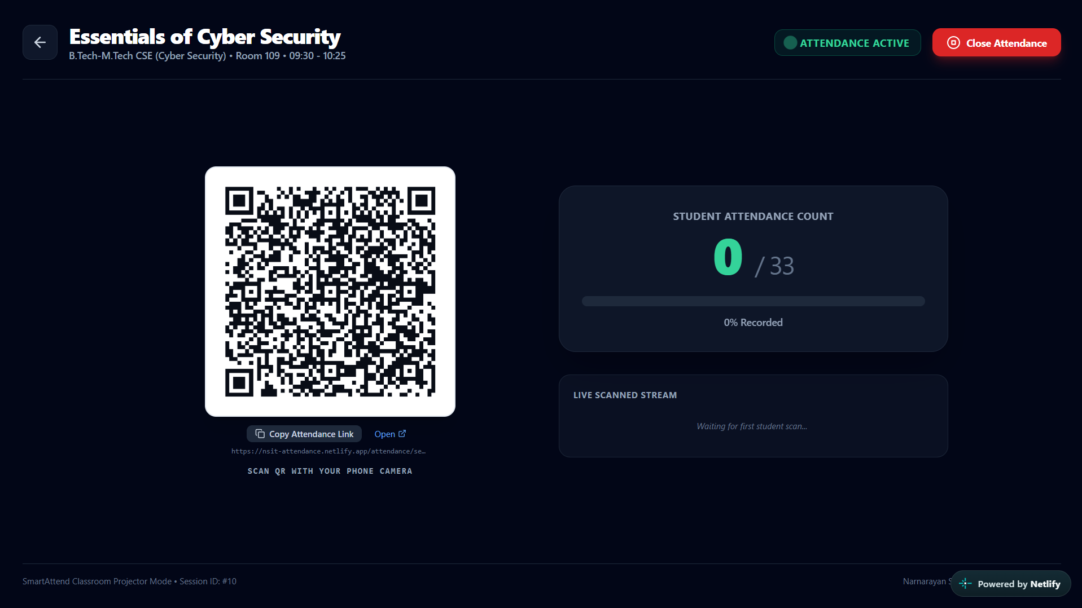
CLASSROOM QR
Step 4 — Display the Attendance QR
Faculty starts the session
nsit-attendance.netlify.app
1
SmartAttend provides the classroom attendance QR
2
SCREENSHOT
Classroom QR screen
QR is displayed for students
3
The QR as shown to the class
Students scan it with their mobile devices
4
Describe rotation only if the prototype actually rotates the QR on screen.
https://nsit-attendance.netlify.app/
07
Notes:
If the QR visibly refreshes during the demo, say so and show it. If it does not, do not claim a rotating QR.

Slide 8
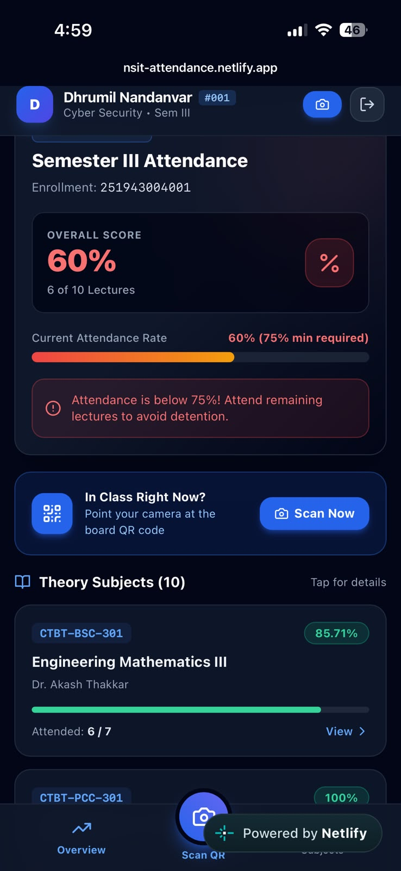
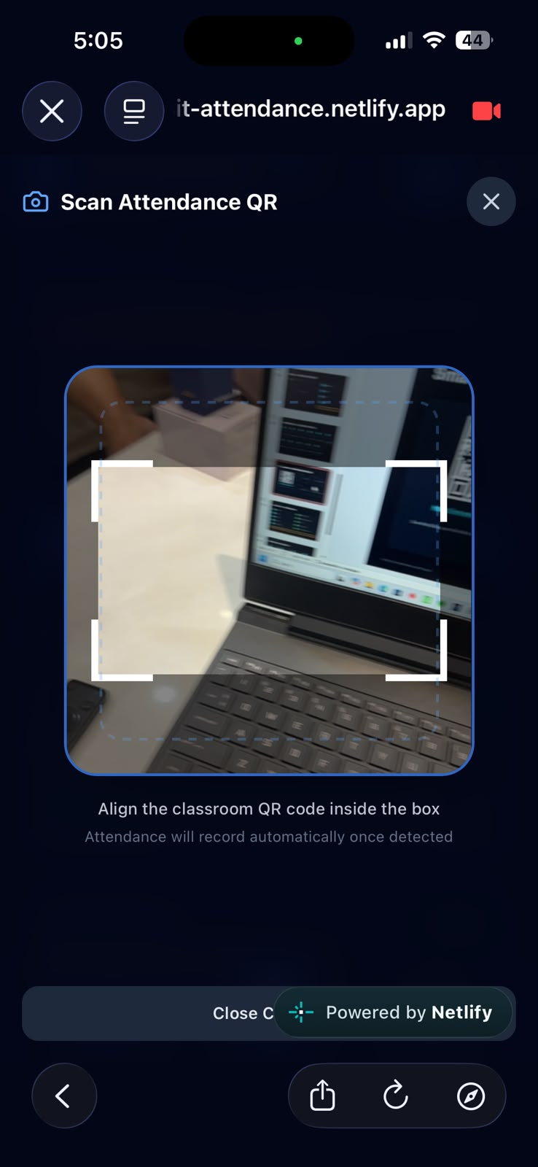
STUDENT WORKFLOW
Step 5 — Student Scans the QR
1
Student opens SmartAttend
2
Student accesses the QR attendance workflow
SCREENSHOT
SCREENSHOT
3
Student scans the classroom QR with the in-app camera
Student app screen
In-app QR scanner
4
The attendance request is submitted for validation
Scanning happens inside the app, not through an external camera.
https://nsit-attendance.netlify.app/
08
Notes:
Mirror the phone to the projector if possible so the class sees the student side live.

Slide 9
WHAT HAPPENS AFTER THE SCAN
Step 6 — Attendance Validation
QR Scan
Validation
Attendance Decision
Attendance Recorded
1
2
3
4
QR Validation
Session Validation
Device Validation
Identity Validation
The scanned code is checked against the active classroom session QR.
The attendance request is tied to the lecture the faculty is conducting.
Stated on the prototype: 1 device / 1 scan restriction, applied automatically.
Attendance is attributed to the signed-in student account.
CONFIRM IN LIVE DEMO
CONFIRM IN LIVE DEMO
STATED — VERIFY ON STAGE
STATED — VERIFY ON STAGE
Anything not visibly demonstrated on the day is Designed / Planned — not demonstrated in the current prototype.
https://nsit-attendance.netlify.app/
09
Notes:
Only claim a validation layer you can actually show. Say the rest is planned.

Slide 10

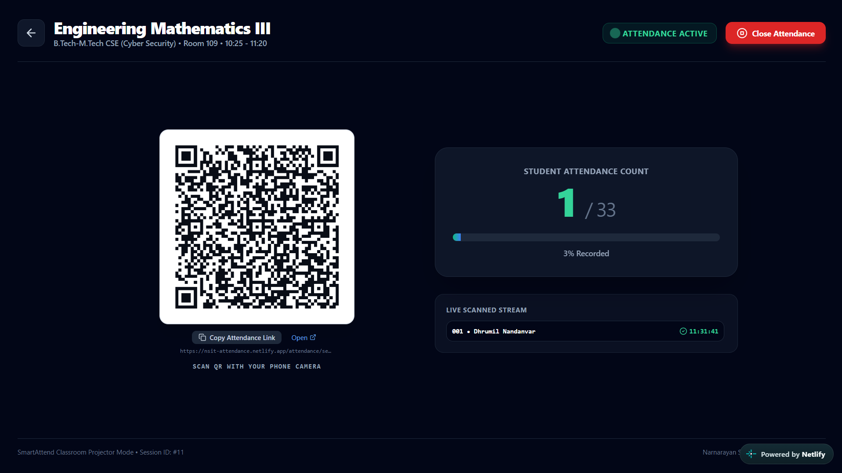
RESULT OF VALIDATION
Step 7 — Attendance is Recorded
BEFORE SCAN
AFTER SCAN
nsit-attendance.netlify.app
nsit-attendance.netlify.app
SCREENSHOT
SCREENSHOT
Attendance list — before
Attendance list — after
Student not yet marked present
Same student now recorded
After successful validation, the attendance record is updated in the SmartAttend system — the same list the faculty is already looking at.
https://nsit-attendance.netlify.app/
10
Notes:
Highlight the exact row that changes. Take both screenshots from the same session so the comparison is honest.

Slide 11
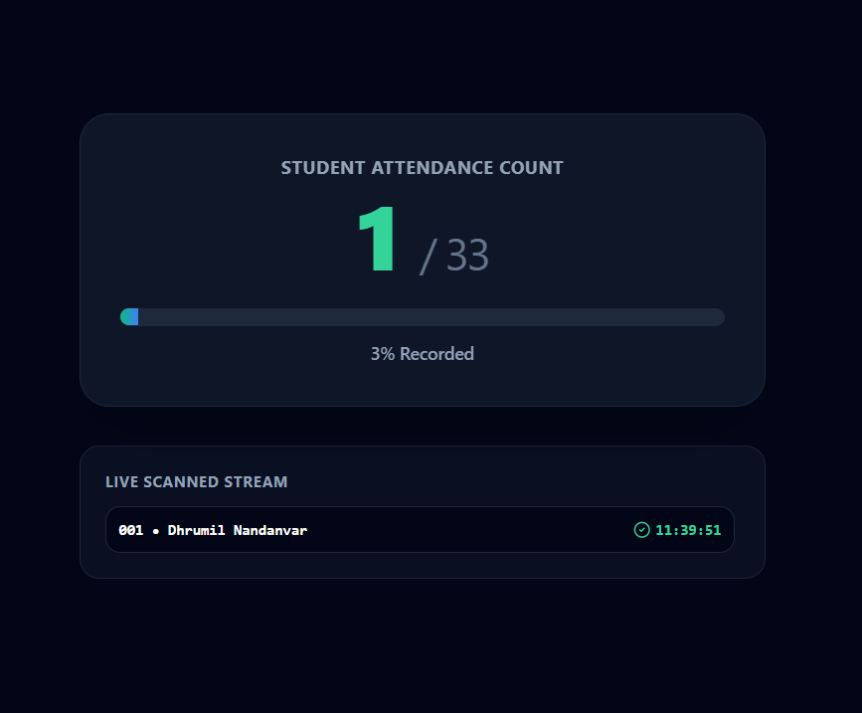
DASHBOARD
Step 8 — Faculty Monitors Attendance
nsit-attendance.netlify.app
Session
Students
SCREENSHOT
Attendance status
Faculty attendance dashboard
Live session view during the lecture
Attendance percentage
Live / updated view
Read the real numbers off the screen. Do not quote figures from this deck.
https://nsit-attendance.netlify.app/
11
Notes:
The prototype states a real-time feed and low-attendance alerts below 75% — show them only if they appear live.

Slide 12
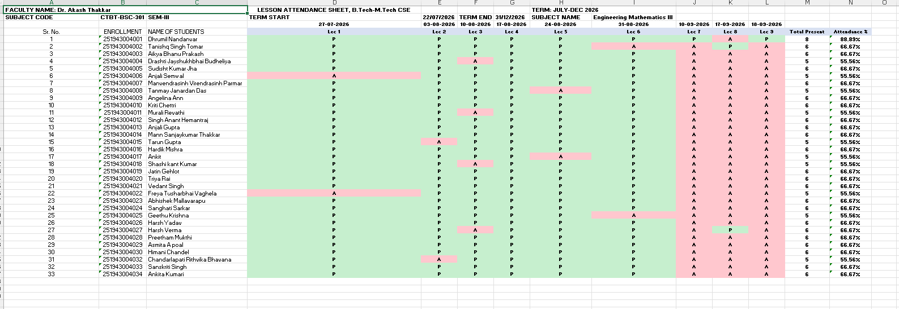
REPORTING & EXPORT
Step 9 — Attendance Report
nsit-attendance.netlify.app
Attendance Data
1
Faculty View
2
SCREENSHOT
Report / export screen
Report
3
Attendance record for the session
Export
4
Excel export — demonstrate only if it downloads live.
If the export does not run on the day, state plainly: Excel export — planned / not demonstrated in current prototype.
https://nsit-attendance.netlify.app/
12

Slide 13
END TO END
SmartAttend — Complete Workflow
1
2
3
4
5
6
Select Timetable Lecture
Confirm Lecture
Start / Conduct Session
Display Classroom QR
Student Opens SmartAttend
Faculty Login
7
8
9
10
11
Student Scans QR
Validation
Attendance Recorded
Faculty Monitors
Close Session / Report
https://nsit-attendance.netlify.app/
13
Notes:
The spine of the whole demo. Eleven steps, two rows, small thumbnails under each.

Slide 14
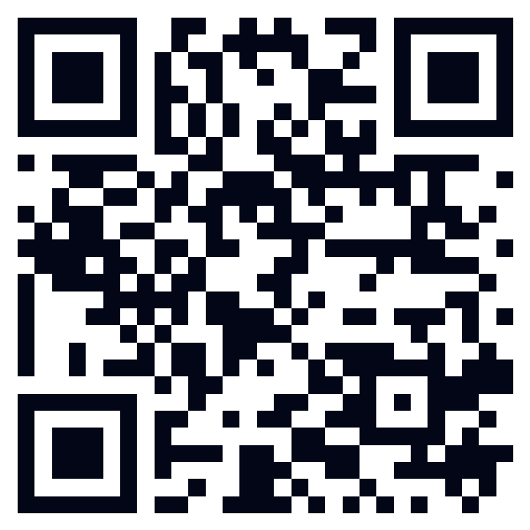
TRY IT YOURSELF
SmartAttend — Live Working Prototype
https://nsit-attendance.netlify.app/
Scan the QR or open the link to experience the prototype live.
https://nsit-attendance.netlify.app/
14
Notes:
The QR on this slide opens the prototype directly — invite the audience to scan it.

Slide 15
PRESENTER CHECKLIST
Live Demo — What to Show
1
Open SmartAttend
6
Display the attendance QR
2
Login as Faculty
7
Open SmartAttend on a student mobile
3
Open timetable
8
Scan the QR
4
Select the lecture
9
Show the attendance update
5
Confirm the lecture / session
10
Show the faculty attendance view / report
Demonstrate only functionality currently available in the live prototype.
https://nsit-attendance.netlify.app/
15
Notes:
Print this slide or keep it on the confidence monitor. Roughly 4-5 minutes end to end.

Slide 16
HOW THE PROTOTYPE WORKS
Behind the User Workflow
1
2
3
4
Faculty Action
SmartAttend Session
QR Interaction
Student Action
Sign in, pick the lecture, confirm it.
The confirmed lecture becomes the active session.
The session produces the classroom attendance QR.
The student scans that QR inside the app.
5
6
7
Validation
Attendance Record
Faculty View
The request is checked against the active session and device rule.
A valid request is written to the attendance record.
The record surfaces in the faculty dashboard and report.
Visible application flow only — no backend implementation is claimed here.
https://nsit-attendance.netlify.app/
16

Slide 17
SmartAttend
A Simple Digital Workflow for Classroom Attendance
Faculty
QR
Student
Validation
Attendance
Live Prototype
https://nsit-attendance.netlify.app/
Thank You
17

