Slide 1
Hpcl8001 slurm to queue train/library jobs

Slide 2
Usage:
Login hpcl8001 with putty or other ssh tools
hpcl8001
user: your mpib username
code: your mpib password
Pool folders in hpcl8001:
Pool-mann-projects: /fs/pool/pool-mann-projects
Pool-mann-pub: /fs/pool/pool-mann-pub

Slide 3
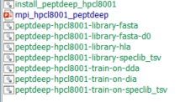
Usage:
Go to “pool-mann-projects/Feng/pcmann353_server/mpi_slurm” folder:
Run `sh install_peptdeep_hpcl8001.sh` at hpcl8001 for your account (install only once)
Copy train and library shell (.sh) files into you project folder
Edit the .sh files for your projects, please change my email address to yours
Run `sbatch peptdeep-hpcl8001-xxx.sh` to submit your job
`squeue` to check the jobs in the slurm queue
`scancel id` to cancel your job

Slide 4
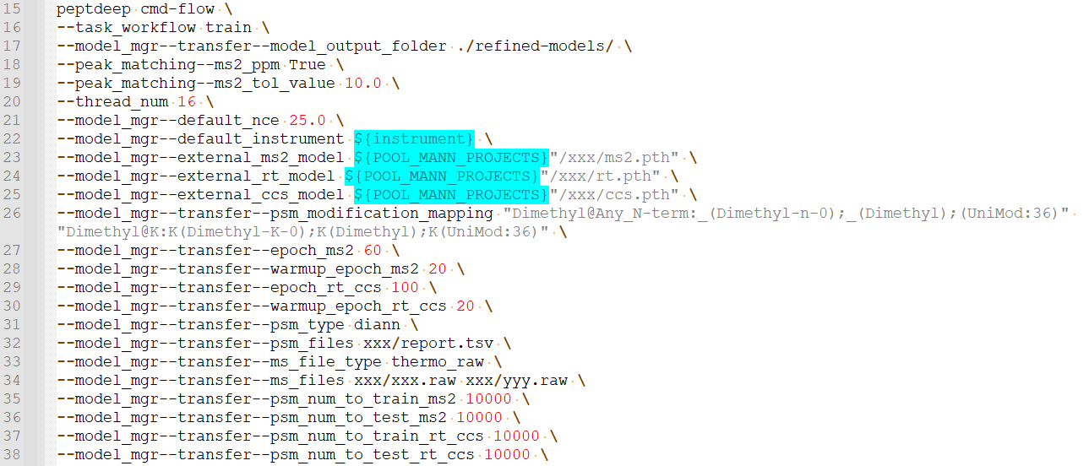
An example of .sh file for training
peptdeep-pcmann353-train-on-dia.sh

Slide 5
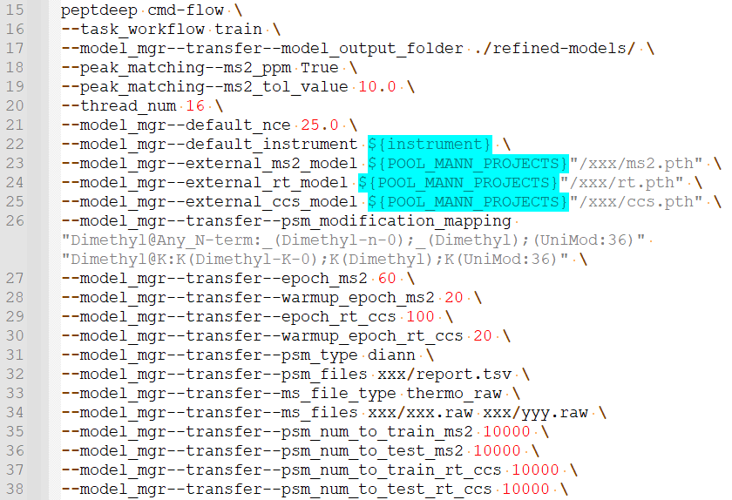
An example of .sh file for training
peptdeep-pcmann353-train-on-dia.sh
L16: task, “train”
L17: refined model output folder
L18-19: ppm when extracting fragments
L21-22: nce and instrument
L23-25: external models as pretrained models
L26: modification mapping of other search engines
L27-30: epoch for training, no need to change
L31-32: psm files for transfer learning, supported psm_type:
diann (report.tsv), spectronaut_report (xxx.csv), speclib_tsv (spectral library files), maxquant (msms.txt), alphapept (msdata.hdf), and pfind (pFind-Filtered.spectra)
L33-34: MS files for fragment extraction, only thermo data are supported in ms_file_type:
thermo_raw (xxx.raw), mzml (xxx.mzML), raw.hdf (xxx.raw.hdf)
Run `alpharaw parse --raw xx1.raw --raw xx2.raw` to convert raw to raw.hdf in pcmann353
L35-38: psm number for training and testing, please check your identified precursor numbers to determine these values

Slide 6
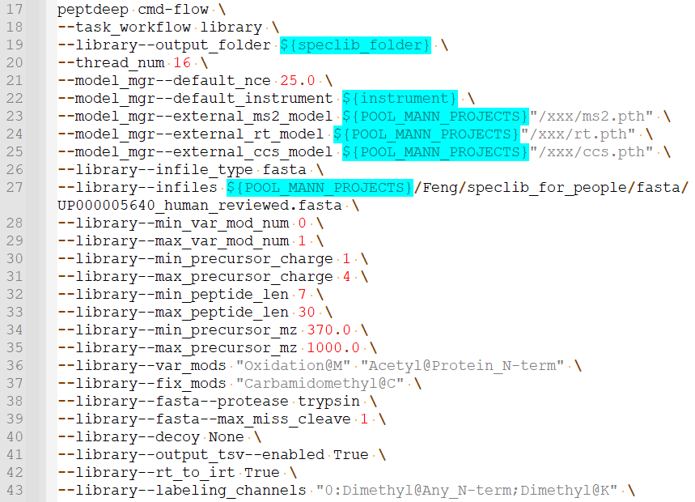
An example of .sh file for library prediction
peptdeep-pcmann353-library-fasta-d0.sh
L18: task, “library”
L19: library output folder
L21-22: nce and instrument
L23-25: external models for prediction
L26-27: input file type and files for prediction, supported:
fasta (xxx.fasta), speclib_tsv (library.tsv), diann (report.tsv), sequence_table (sequence.tsv) …
L28-35: general fasta settings for library
L36-37: fixed and var modifications, set as empty “—library—fix_mods \” if no modifications
L38-39: cleavage
L43: comment or remove this line for unlabeled data.

