Slide 1

BALANCING SKYRIM
The Mystery of the Hybrid Dominance
Why 20,001 players chose expressive complexity over cold strategic efficiency.
Revealing the Behavioral Heart of the RPG
Mann Pawar,
MSBA, William and Mary 2026
Behavioral Optimization Model | Strategic Design Portfolio

Slide 2
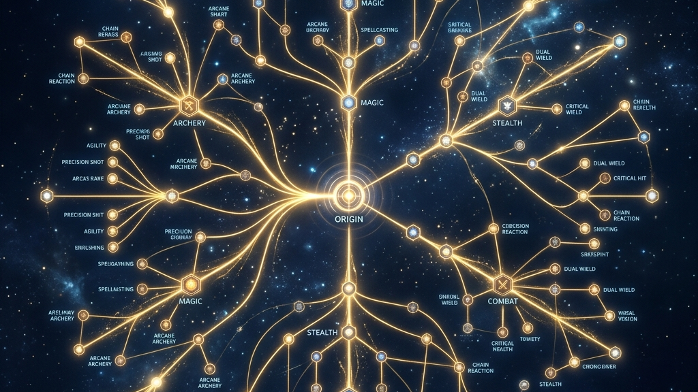
THE CONUNDRUM
02 / 08
Efficiency vs. Expression: The Core Paradox
In a game of numbers, why do players pick the 'sub-optimal' path?
STRATEGIC VALUE
HUMAN CHOICE
THE HYBRID ANCHOR
We define the 'Perfect Play'
efficiency of each class against
the NPC environment.
Observed behavior deviates sharply
from the theoretical combat
optimum.
We test if data-derived complexity
explains this deviation better than
raw damage stats.
Behavioral Optimization Model | Strategic Design Portfolio

Slide 3
STRATEGIC ENGINE
03 / 08
Nash Equilibrium Baseline
Solving for the dominant strategy against a zero-sum NPC gauntlet.
Archetype | Hybrid | Mage | Stealth | Warrior
Hybrid | 0.500 | 0.227 | 0.001 | 0.312
Mage | 0.773 | 0.500 | 0.004 | 0.607
Stealth | 0.999 | 0.996 | 0.500 | 0.997
Warrior | 0.688 | 0.393 | 0.003 | 0.500
MECHANICAL PROOF
The Payoff Matrix (A) represents
the 'Win Ratio' of one archetype
against another.
Stealth's 3.0x
damage multiplier and range produce
the 0.998 dominance seen in the
zero-sum baseline.
Behavioral Optimization Model | Strategic Design Portfolio

Slide 4

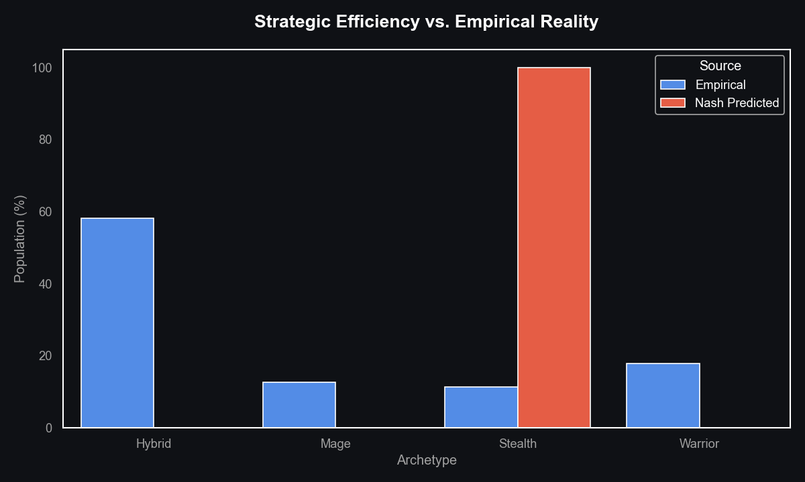
COGNITIVE FRICTION
04 / 08
The Efficiency-Reality Gap
Nash baseline predicts 100% Stealth concentration. Real players reject this.
Notice the massive deviation:
Nash predicts total Stealth concentration, but players overwhelmingly favor the Hybrid variety.
Behavioral Optimization Model | Strategic Design Portfolio

Slide 5
THE BREAKTHROUGH
05 / 08
Rarefied Expressive Complexity
Deriving the value of 'variety' directly from 20,001 build hashes.
We calculate rarefied complexity by subsampling a fixed group of 2,000 players from each archetype and measuring the ratio of unique build combinations within that specific sample.
58.6%
27.3%
2x
Hybrid Uniqueness
Warrior Uniqueness
Complexity Multiplier
Discovery Space
Players aren't failing to optimize for combat; they are successfully optimizing for variety.
Redundant Path
Most are following the same Redundant Path (e.g., One-Handed + Shield + Heavy Armor).
Hybrid vs Others
Data proves that a Hybrid player is twice as likely to be exploring a unique systemic niche compared to any other archetype.
Behavioral Optimization Model | Strategic Design Portfolio

Slide 6
REVERSE OPTIMIZATION
06 / 08
Calibrating the Behavioral Heart
Reverse-calculating the weight of complexity through Alpha-Sweep optimization.
OBJECTIVE FUNCTION
ALPHA RECOVERY
THE WEIGHT OF FUN
Blend combat efficiency and build
uniqueness into a unified value
term.
Sweep alpha from 0 to 1 to find the
point where model error is
minimized.
Result: Players value complexity at
a 0.37 weight. This is a critical design
signal.
Behavioral Optimization Model | Strategic Design Portfolio

Slide 7
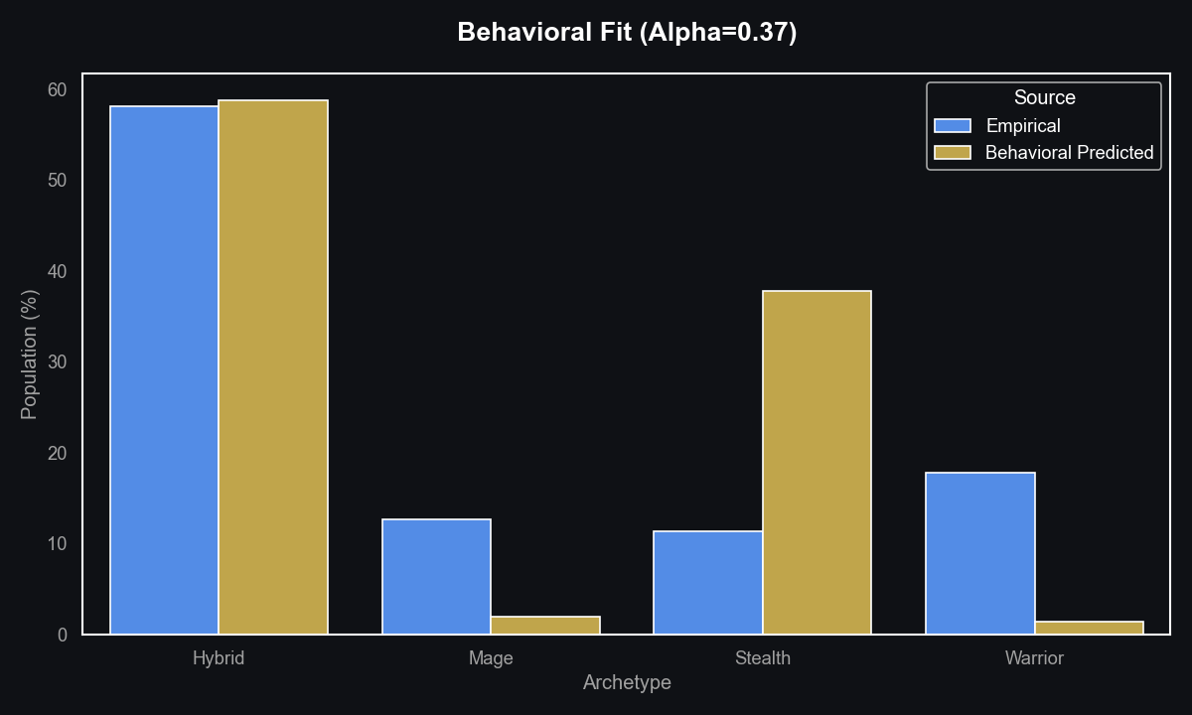
VALIDATION
07 / 08
Closing the Strategic Gap
The behavioral model finally captures the true mechanics of player motivation.
By incorporating 'Rarefied Complexity' as an objective, the model (Blue) successfully recovers the Hybrid-majority structure.
Behavioral Optimization Model | Strategic Design Portfolio

Slide 8

THE SOUL OF PLAY
08 / 08
Mastery and Memory in the Tundra
Final recommendations for the next generation of RPG design.
DESIGN LOOP
AI EVOLUTION
FUTURE OPS
Balance for situational friction,
not just raw damage nerfs. It balances the game by increasing the need for variety rather than just decreasing a number.
Model NPCs as mechanical mirrors to
player expressive utility. You make the Hybrid's variety a tactical necessity, which aligns the game's difficulty with the player's natural desire for expressive play.
Track the 'Optimization Drift' to
signal when a meta becomes too
efficient. This allows designers to use our model as an early warning system to see when a game is becoming stale or solved.
Behavioral Optimization Model | Strategic Design Portfolio

