Slide 1
Technical Writing and Presentation CSE 3100
Group:
Emamul Haque Manna(160204)
Fatimatuj Jhora (160213)

Slide 2
Background Topics
Offline signature recognition system using histogram of oriented gradients.
Authors:
Ms. Pallavi Patil
Mr. Bryan Almeida
Ms. Niketa Chettiar
Mr. Joyal Babu

Slide 3
Problem Definition
The most common way of authenticating a document or financial transactions is handwritten signatures.
In most of the cases, verification of these signatures is done by visual inspection. A person compares the two signatures and accepts the matched signature. But the process of visually verifying the signatures become cumbersome and time consuming . Automating the signature verification will improve the situation and eliminate the possibility of forging.
Signature verification systems are designed to discriminate between two classes genuine and forgery.
There are three types of forgeries;
1.random
2. simple
3. skilled
as shown in Fig. 1

Slide 4
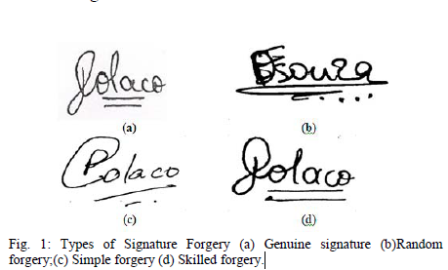
In random forgery, a forger uses his/her signature for access.
In simple forgery a forger is aware of the name of
person but has no idea about the exact shape. In skilled
forgery, forger is aware of exact shape and has taken enough
efforts to practice so as to imitate it exactly.

Slide 5
Existing Techniques
There are various techniques for offline signature recognition. Such as neural
networks , hidden Markov models , template matching, fuzzy nets , support vector
machines .

Slide 6
Proposed Technique
The proposed technique is an offline signature recognition system which uses
histogram of oriented gradients. The important characteristic of histogram of
gradient is its ability to discriminate between images based on edge direction
without knowledge of their actual position. Feedforward backpropagation neural
network is used for classification. The system gives recognition rate of 96.87% with 4
training sample per individual.

Slide 7
Experiment Setup
The proposed system comprises of three main modules;
1. preprocessing module
2. Feature extraction module
3. Neural network based classifier module.

Slide 8
Experiment Steps
The experiment is done by three steps. They are ,
A. Preprocessing module :
The first step in any signature verification system is preprocessing in different
operations such as color normalization, size normalization, angle normalization,
noise removal, thinning are performed to bring all signatures in standard format.
In preprocessing module, all signatures are brought into standard format before
giving it to feature extraction module.
Fig. 2 shows input and preprocessed images.

Slide 9
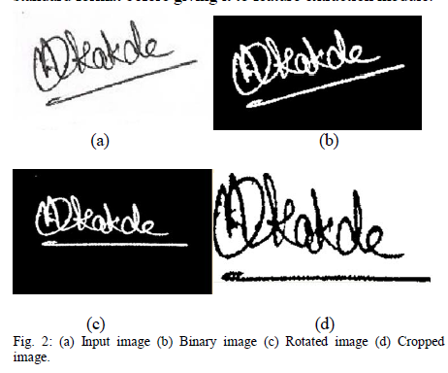

Slide 10
B. Feature extraction using Histogram of Gradient :
The main idea behind HOG is that any shape or local object in an image can be very well discriminated by knowledge of only edge direction and without knowing their actual position. The advantage of HOG is, it is insensitive to transformation such as rotation, noise and minute deformation.
HOG feature extraction requires defining two kinds of computational units: cell and block. Size of the block is double the size of cell . There are three main steps involved in HOG feature extraction,
Step 1: Gradient Computation
Step 2: Gradient Vote
Step 3: Normalization Computation

Slide 11
C. Neural network based classifier module :
Three layer feedforward back-propagation network is consists of input layer, hidden layer and output layer.
Input layer is used for holding the inputs whereas hidden layer serves as a common point for taking input from input layer and passing it to output layer. The output layer holds the output data.

Slide 12
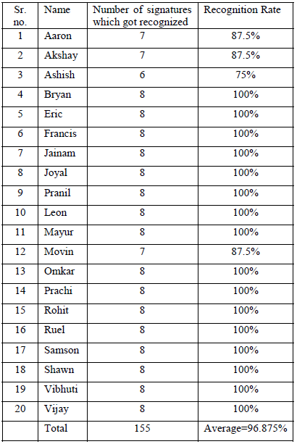
Experiment Results
Signatures of 20 individuals was collected. And the test result is shown in table 1.

Slide 13
Table I shows number of recognized signatures for each individual and its
corresponding recognition rate. For each individual, 12 signatures were collected
from which 4 signatures were used for training the classifier and the remaining
8 were used for testing.
The system achieves average recognition rate of 96.875%.

Slide 14
Conclusion
Histogram of oriented gradient is used in offline signature recognition. The system
uses concept of histogram of oriented gradient. To extract features from signature
along with feedforward backpropagation neural network classifier to differentiate
between genuine signature and forgery. The system achieved average recognition
rate of 96.875% for 20 individuals with 4 signature per person used for training.
With more intra- class variation and comparatively less training samples system
achieves fairly good recognition rate.

Slide 15
Thank You.

