Slide 1
P-532
Recommendation System

Slide 2
GROUP MEMBERS:
Bhuvaneshsaikumar Mannaru
Shaik Nabi
Shaik Mahammad Bahaddin
Trainer Name: Varun
Co-Trainer: Stephy John

Slide 3
OBJECTIVE
To develop an online course recommendation system that suggests personalized course options to learners by analyzing their interests, previous enrollments, engagement patterns, and course characteristics using collaborative filtering, content-based, or hybrid recommendation techniques.

Slide 4
DATA SET DESCRIPTION
This dataset is designed to support the development of a course recommendation system. It contains detailed information about learners and online courses, enabling personalized suggestions based on user behavior and course attributes.
•Number of Instances (Rows): 100000
•Number of Variables (Columns): 14

Slide 5
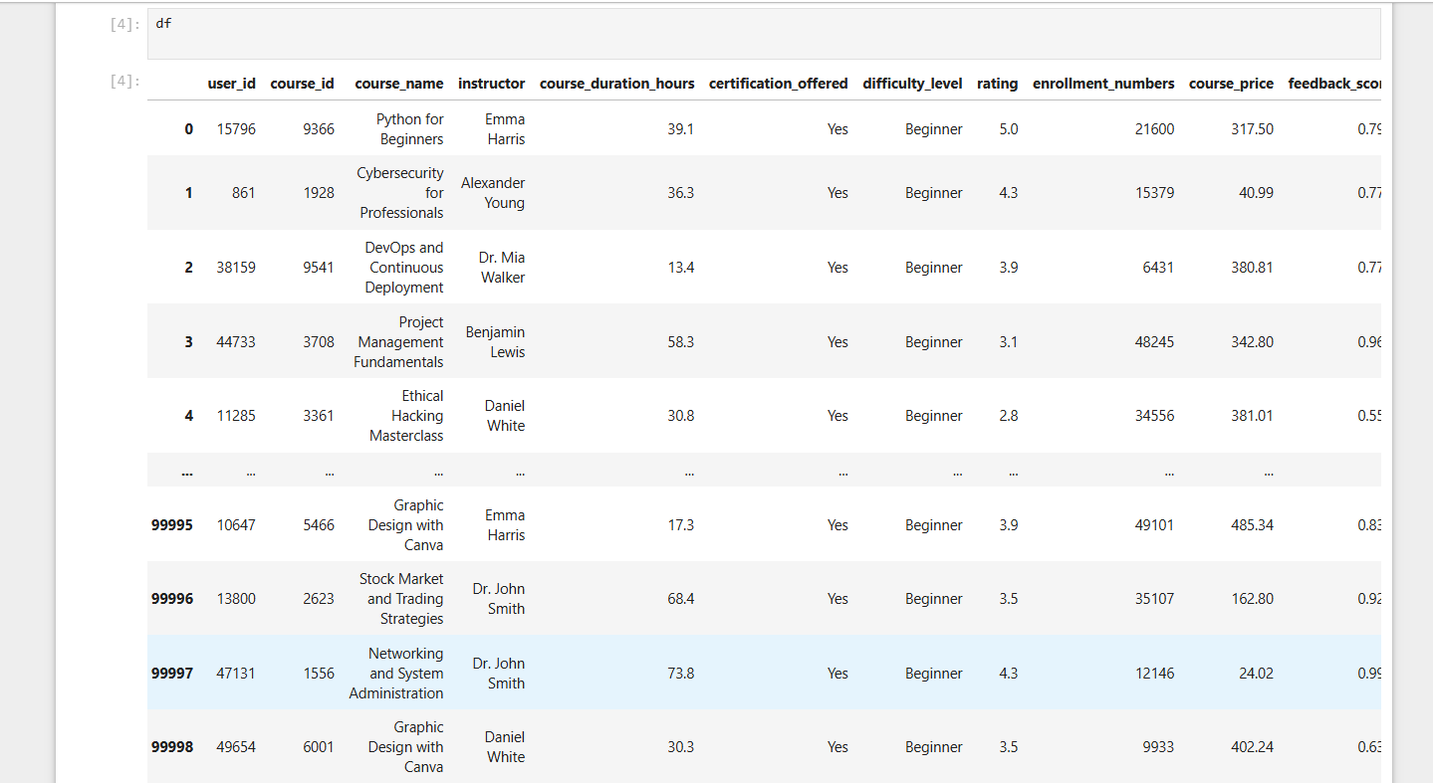
DATA SET INFO

Slide 6
Key Features:
User & Course Info: Unique IDs for learners and courses, course names, and instructor details.
Course Attributes: Duration, price, difficulty level, certification availability, and study materials.
Engagement Metrics: Ratings, enrollment numbers, feedback scores, time spent on course.
User Behavior: Number of previously taken courses to gauge learning history.
The dataset is ideal for building collaborative filtering, content-based, or hybrid

Slide 7


Exploratory Data Analysis

Slide 8
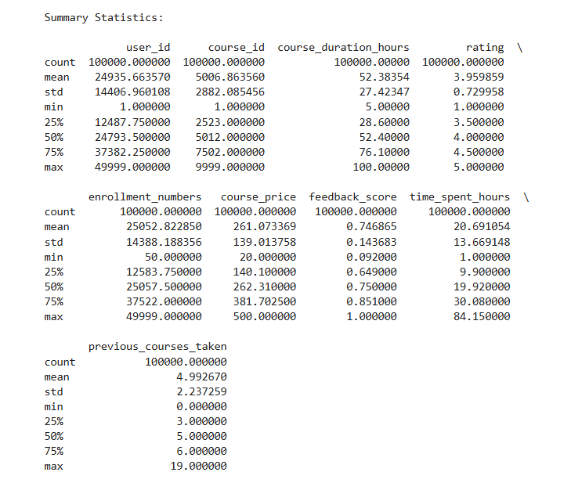
SUMMARY STATISTICS

Slide 9
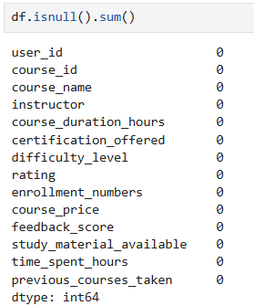
Missing Values:
No missing values and duplicates found

Slide 10
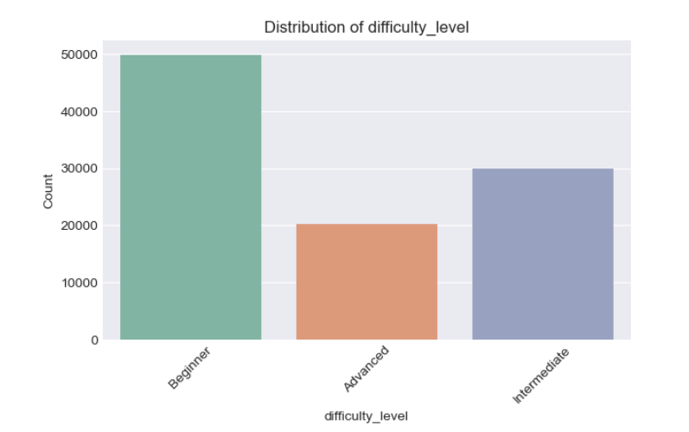
Visualizations
Distribution of Difficulty_Level

Slide 11
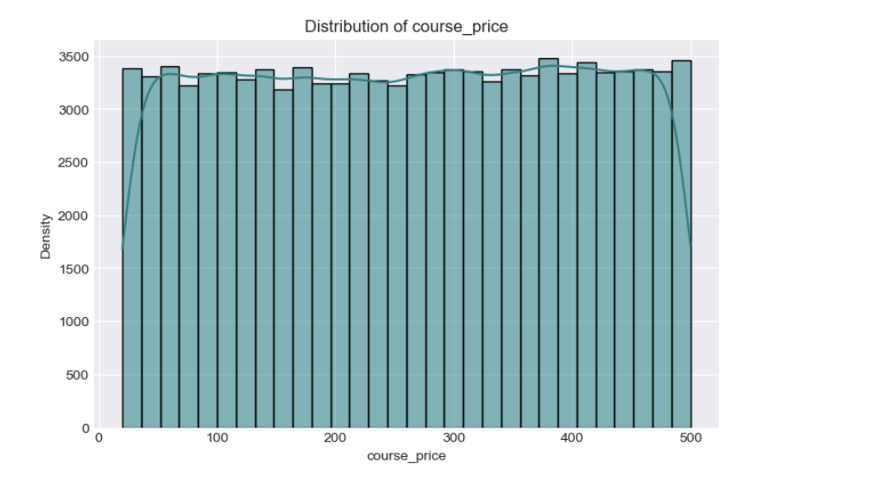
Distribution of Course Price

Slide 12
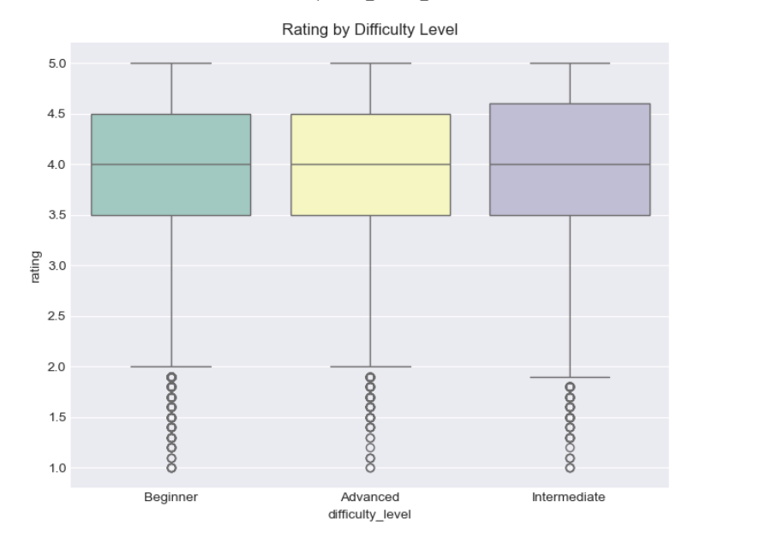
Rating By Difficulty Level

Slide 13
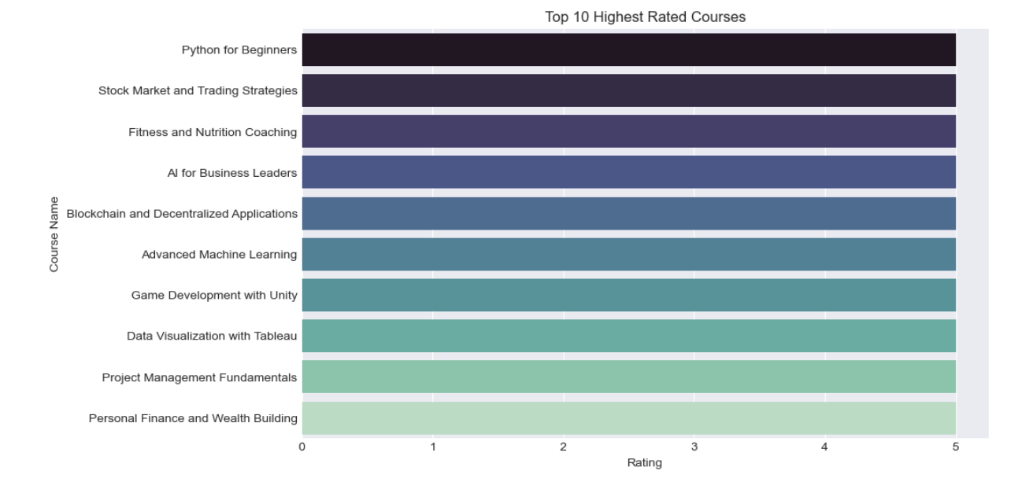
Top 10 Highest Rated Courses

Slide 14
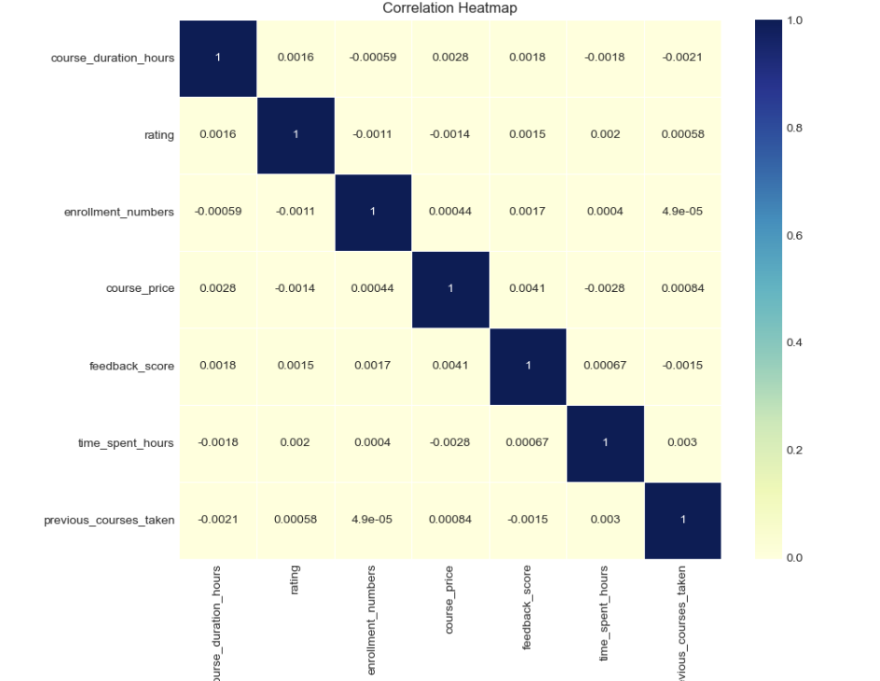
Correlation Heatmap

Slide 15
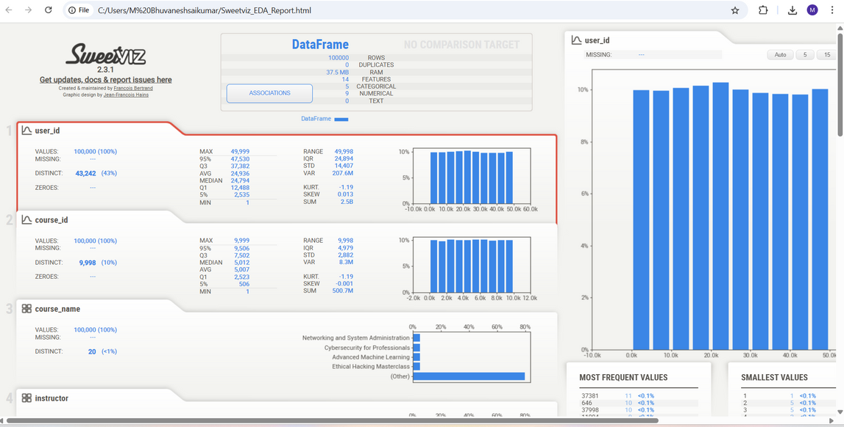
Automated EDA Report Sweetviz
Sweetviz is a Python library used to generate highly visual, interactive Exploratory Data Analysis (EDA) reports. It quickly analyzes datasets and compares them, providing a complete overview of:
Feature distributions and summary statistics
Missing values and data types
Correlations between variables
Target feature analysis for classification problems
Sweetviz helps speed up data understanding and supports better data-driven decision-making early in the project.

Slide 16
Model Building

Slide 17
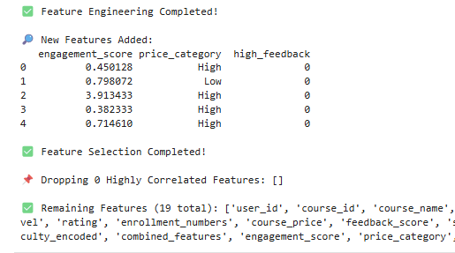
Feature Engineering & Selection
🛠️ Feature Engineering & Selection
Feature Engineering:
New meaningful features were created to improve model performance:
Engagement Score – Measures how much time a user spent compared to course duration.
Price Category – Bins course prices into 'Low', 'Medium', and 'High'.
High Feedback Label – Flags courses with high student satisfaction.
Feature Selection:
To reduce redundancy and improve model efficiency:
A correlation-based filter was applied.
Highly correlated features (threshold > 0.85) were removed to avoid multicollinearity.
These steps enhance both model accuracy and interpretability.

Slide 18
A User-Item Matrix was created using ratings given by users to different courses.
Missing ratings were filled with zeros to standardize the matrix.
Cosine Similarity was used to calculate how similar users are to each other based on their rating behavior.
This matrix helps recommend courses by identifying users with similar preferences and suggesting courses liked by similar users.
Collaborative Filtering – User-Based Approach

Slide 19
Content-Based Filtering – KNN with TF-IDFVector Machine (SVM)
To recommend similar courses based on content:
TF-IDF Vectorization was applied on combined course features (e.g., name, instructor, difficulty).
K-Nearest Neighbors (KNN) with cosine distance was used to find similar courses efficiently.
This model is optimized for large datasets by avoiding full similarity matrix computation.
It enables personalized recommendations based on course content rather than user behavior.

Slide 20
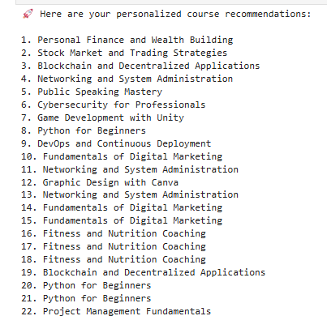
Hybrid Recommendation System
This model combines Collaborative Filtering and Content-Based Filtering to provide more accurate and personalized course recommendations.
Content-Based Part: Recommends similar courses based on text features using TF-IDF and KNN.
Collaborative Part: Suggests courses using user similarity and past ratings.
Blending Factor (α): Allows tuning the influence of each approach (e.g., α=0.5 balances both).
The hybrid model ensures better coverage and relevance by leveraging both user behavior and course content.

Slide 21
Deployment Using Streamlit App

Slide 22
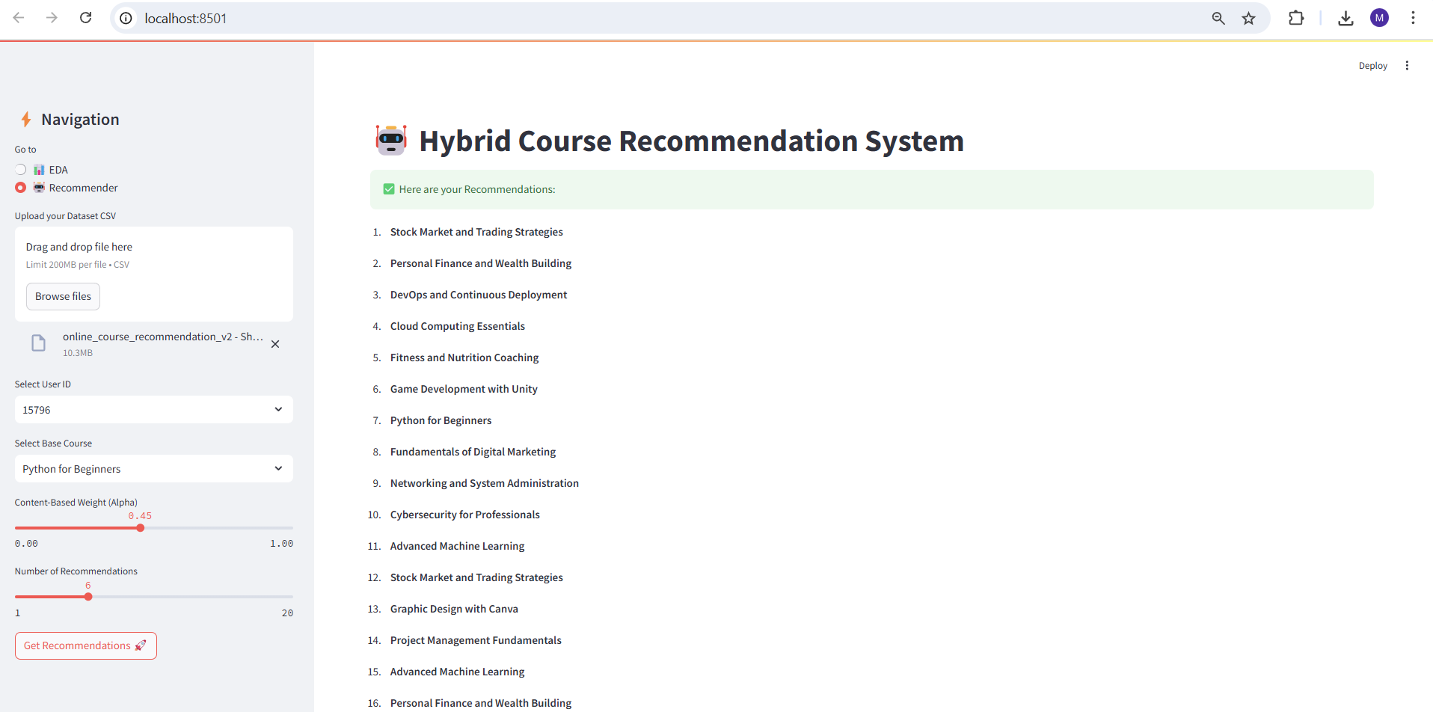
After Deployment in Streamlit App

Slide 23
Web App – Online Course Recommender (Streamlit)
An interactive web application was built using Streamlit to showcase both EDA and a hybrid recommendation engine:
🧪 EDA Module
Uses Sweetviz to generate an automated, interactive EDA report.
Provides insights into distributions, correlations, and feature summaries.
🤖 Recommender Module
Combines Content-Based Filtering (TF-IDF + KNN) and Collaborative Filtering (User similarity).
Users can adjust the alpha blending factor to control the influence of each method.
Allows real-time selection of user ID, base course, and number of recommendations.
This app makes the system user-friendly and supports data exploration and personalized recommendations in a single interface.

Slide 24
Challenges Faced During The Project
Team Coordination:
Ensuring smooth collaboration among team members with varying roles and technical skills.
Feature Selection:
Selecting the most meaningful features from 19 variables while avoiding multicollinearity and redundant information.
Model Interpretability:
Making hybrid recommendation outputs easy to understand and actionable for non-technical stakeholders.
Deployment Integration:
Embedding the hybrid model within a Streamlit app for real-time, interactive recommendations.
Scalability Concerns:
Efficiently processing a large dataset with potentially thousands of users and courses without slowing performance.
Overfitting Risk:
Balancing model complexity to ensure good generalization on new, unseen data.

Slide 25
Conclusion
The Online Course Recommendation System successfully combines advanced techniques like hybrid recommendation models (collaborative filtering and content-based filtering) to provide personalized course suggestions for users. Through thorough feature engineering and careful model selection, we were able to enhance the system’s performance and accuracy.
The deployment of the recommendation engine in a user-friendly Streamlit web app ensures seamless interaction, making the system accessible and engaging for learners.
While challenges like team coordination, feature selection, and scalability were faced, the project provided valuable insights into real-time recommendation systems and their application in the education domain.
This project sets the foundation for further enhancements, such as handling larger datasets, adding more features, and improving model interpretability, making it a robust solution for personalized learning.

Slide 26
Thank You

