Slide 1
Blinkit
Using Microsoft Power BI

Slide 2
Introduction
This dashboard is created to show the comprehensive analysis of blinkit sales performance, customer satisfaction and inventory distribution to identify key insights and opportunities for optimization using various KPIs and visualizations in Power BI.

Slide 3
Methodology
In Power BI – upload the data – Get data.
Perform ETL.
Create the dashboard.

Slide 4
Transform Data
Replace the values as lf, low fat and reg to Low Fat and Regular in column item fat content.
Check column quality for each column.
Close and apply the transformations in power query editor.

Slide 5

DAX Operations
Create a measure as:
Total sales:
Average sales:
No. of items:
Average rating:

Slide 6
Parameter
Create a new parameter in fields as metrics.
Add the fields:
Total sales
Avg sales
No of items
Avg rating

Slide 7
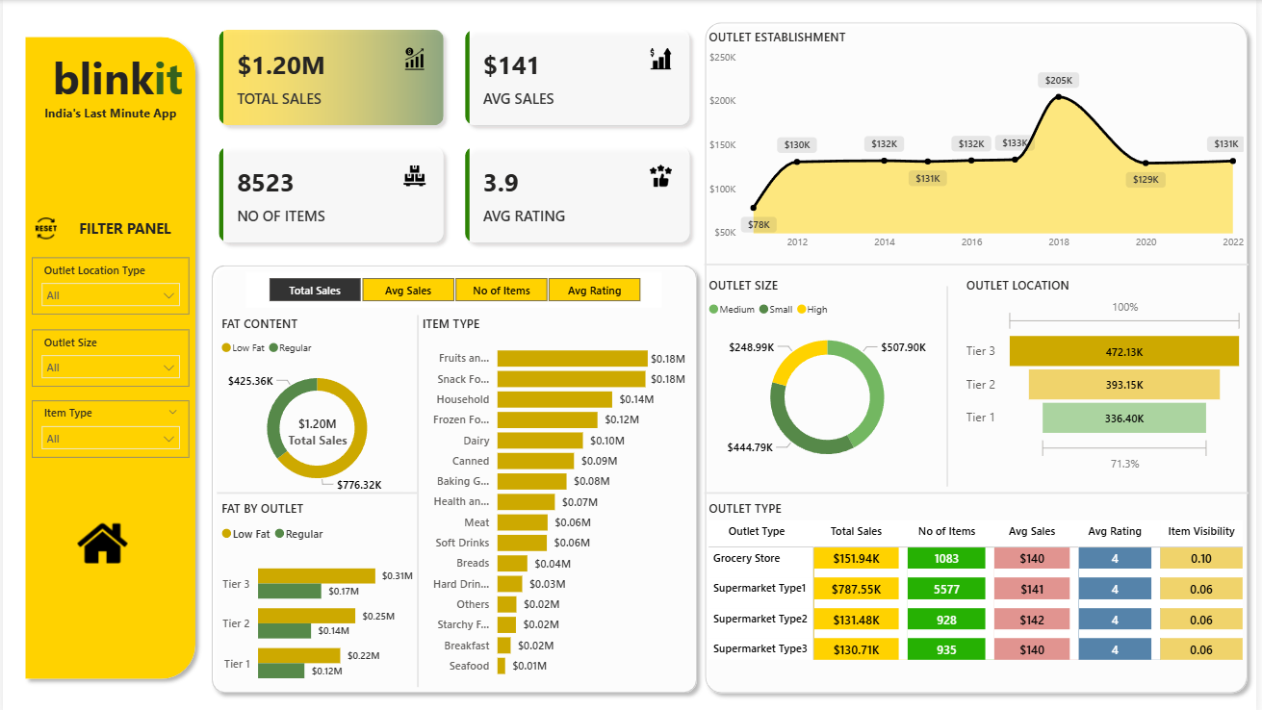
Dashboard

