Slide 1
Healthcare
Using Microsoft power bi

Slide 2
Introduction
This dashboard is for healthcare data for the patient waiting list.
Project goal:
Track current status for patient waiting list.
Analyze historical monthly trend for waiting list.
Detailed specialty level and age profile analysis.

Slide 3
Methodology
In Power BI – load the data – get data.
Use folder connection to import the data.
Perform ETL.

Slide 4
Transform Data
Check the data type of the columns.
Append the inpatient and outpatient data.
For appending check for all the column headers as they should be same for both the tables.
Rename the column with difference in column name.
Create the column case_type in outpatient table which is not available by using add custom column.
Now append the tables as append query as new.
Remove the duplicate and blank values in age profile and time bands.
Close and apply the transformations in power query editor.

Slide 5
Modelling tab
Hide the inpatient and outpatient data for modeling view.
Load the mapping table into Power BI for specialties.
Perform the ETL.
Create relation between mapping table and all data using specialty name as primary key.

Slide 6
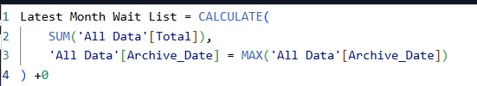
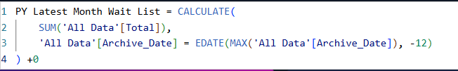
DAX Operations
Create a new measure:
Latest month wait list:
PY latest month wait list:

Slide 7
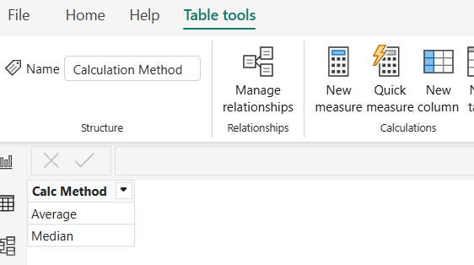
Create new table
Create table as Calculation method. This will help to toggle between average and median waiting list.

Slide 8

DAX Operation
Create measures as:
Average waiting list:
Median waiting list:
Avg/Med wait list:

Slide 9
DAX Operation
Create a new measure:
No data left:
No data right:

Slide 10
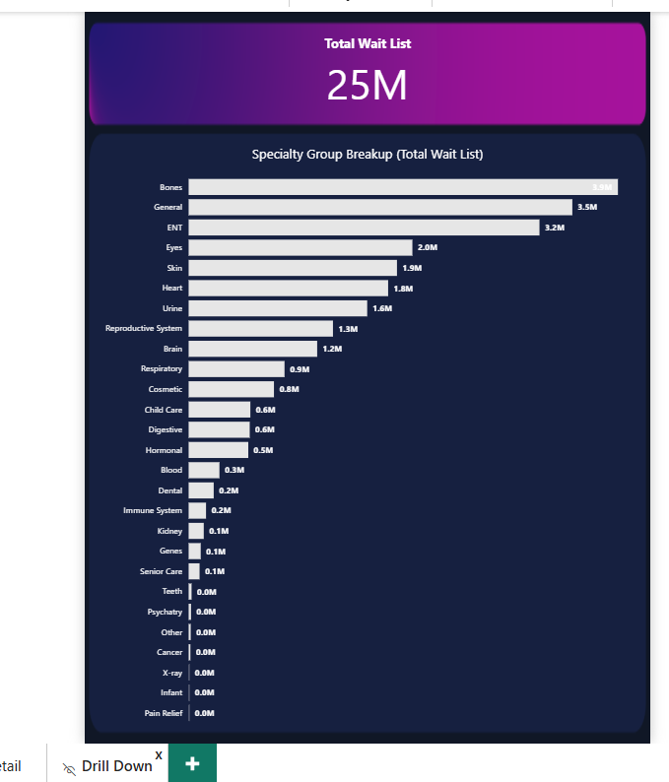
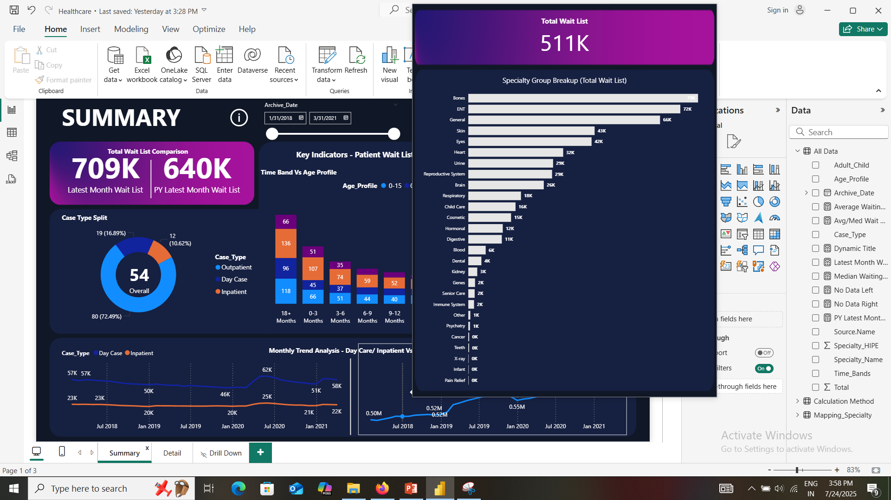
Custom Tooltip chart
Add a new page as drilldown.
Create the charts in tooltip type view.
Go to summary page, select the chart and go to format visual and enable the tooltip as drilldown.

Slide 11
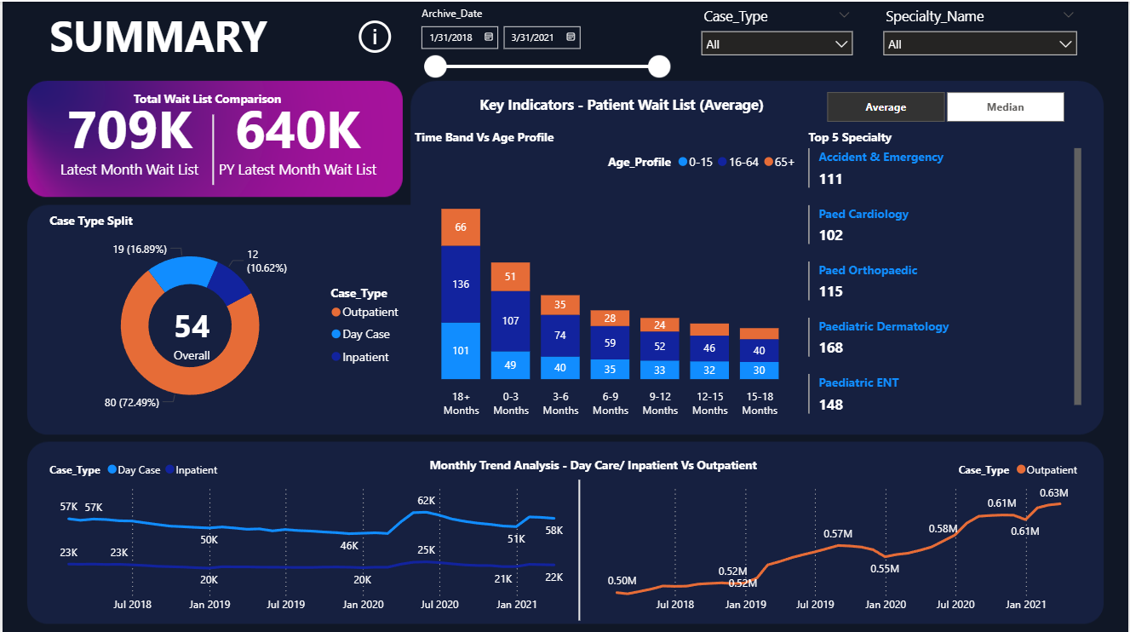
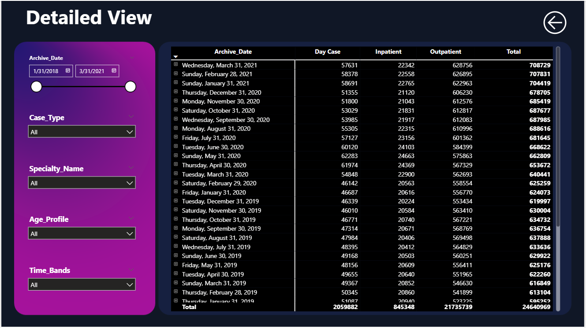
Dashboard

