Slide 1

Project Title - Seasonal Agriculture Performance Analysis
By Mannat Sharma
Sanatan Dharma College
AICTE STU ID : STU6a2da00d593fb1781374989

Slide 2

PROBLEM STATEMENT
Agricultural activities are influenced by seasonal variations in environmental conditions,
farming practices, resource availability and market conditions. As a result, agricultural
performance may differ from one season to another.
However, raw agricultural data does not clearly explain how agricultural performance changes
across seasons or what patterns can be observed in different seasonal conditions.
The problem is to analyze the given agricultural dataset and investigate seasonal differences
in agricultural performance by identifying meaningful patterns, trends, relationships and
variations within the available data.

Slide 3
Project Description
The project analyzes a dataset containing 4,000 farm-level records and 28 variables.
The dataset covers 8 states, 10 districts, 8 crops and 3 seasons — Kharif, Rabi and Zaid.
The analysis includes data exploration, cleaning, preparation, statistical analysis and visualization.
Key performance measures include yield, production, revenue, cost, profit, water usage, water efficiency and disease/pest risk.
The objective is to convert raw agricultural data into meaningful insights for better seasonal planning

Slide 4

WHO ARE THE END USERS?
Farmers and Farm Managers — To compare productivity, costs, profits and resource utilization across seasons.
Agricultural Planners and Departments — To understand seasonal patterns and identify areas requiring attention.
Agribusiness Stakeholders — To understand crop production and economic variations.
Data Analysts and Researchers — To study relationships between environmental conditions, farming practices and agricultural outcomes.
Students and Academic Evaluators — To demonstrate a complete real-world data analytics workflow.

Slide 5

Technology Used
Python
Used for data analysis and preprocessing.
Pandas
Used for data loading, cleaning, grouping and aggregation.
NumPy
Used for numerical operations and data processing.
Matplotlib / Seaborn
Used to create visualizations and identify patterns.
Jupyter Notebook
Used to document and present the complete analysis workflow.

Slide 6
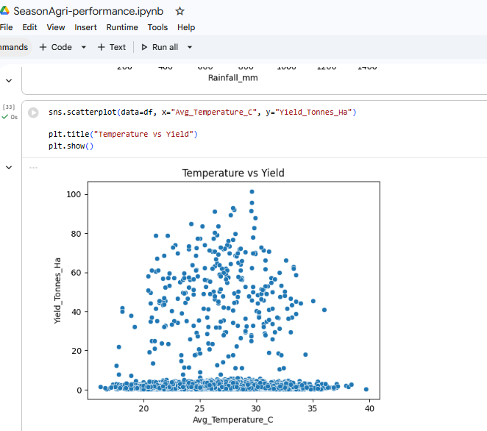
RESULTS

Slide 7
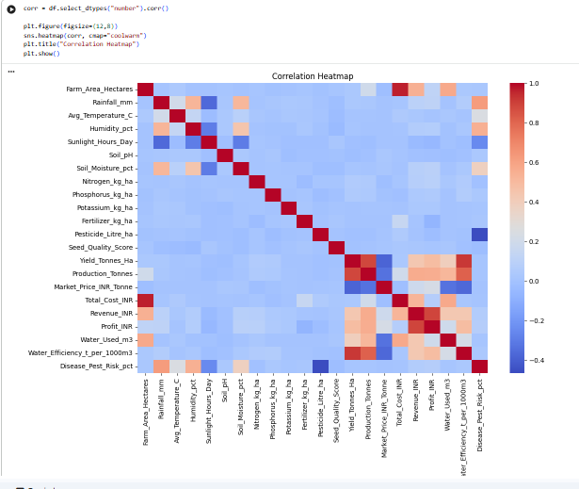
RESULTS

Slide 8
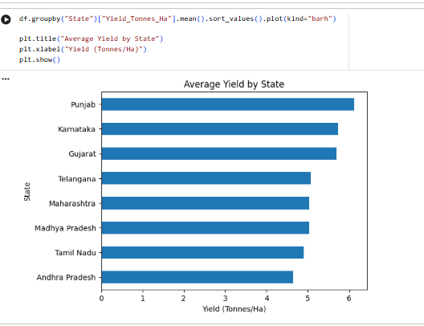
RESULTS

Slide 9
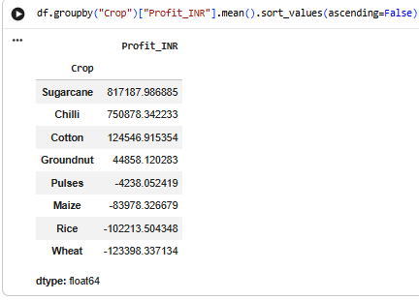
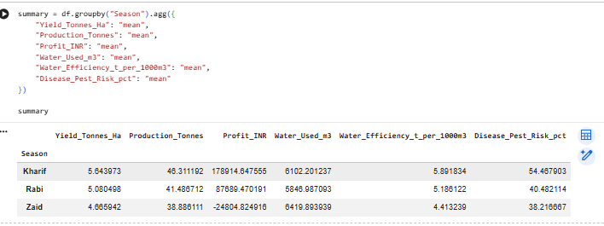
RESULTS

Slide 10
Future scope
Develop an interactive dashboard for season, crop, state and irrigation-level analysis.
Apply predictive analytics and machine learning to estimate yield, profit and disease/pest risk.
Integrate external weather, market-price and soil datasets.
Perform deeper analysis of relationships between environmental conditions, resource usage and agricultural outcomes.
Add multi-year data to identify long-term seasonal trends.

Slide 11
GitHub Link
My github link :
[ ]

Slide 12

VOIS Course completion certificate -
Course name- Data Visualization

Slide 13
Thank you
Seasonal Agriculture Performance Analysis
VOIS AICTE Batch 1 | Data Analytics Major Project
MANNAT SHARMA FUTURE DATA ANALYST
.
.

