Slide 1



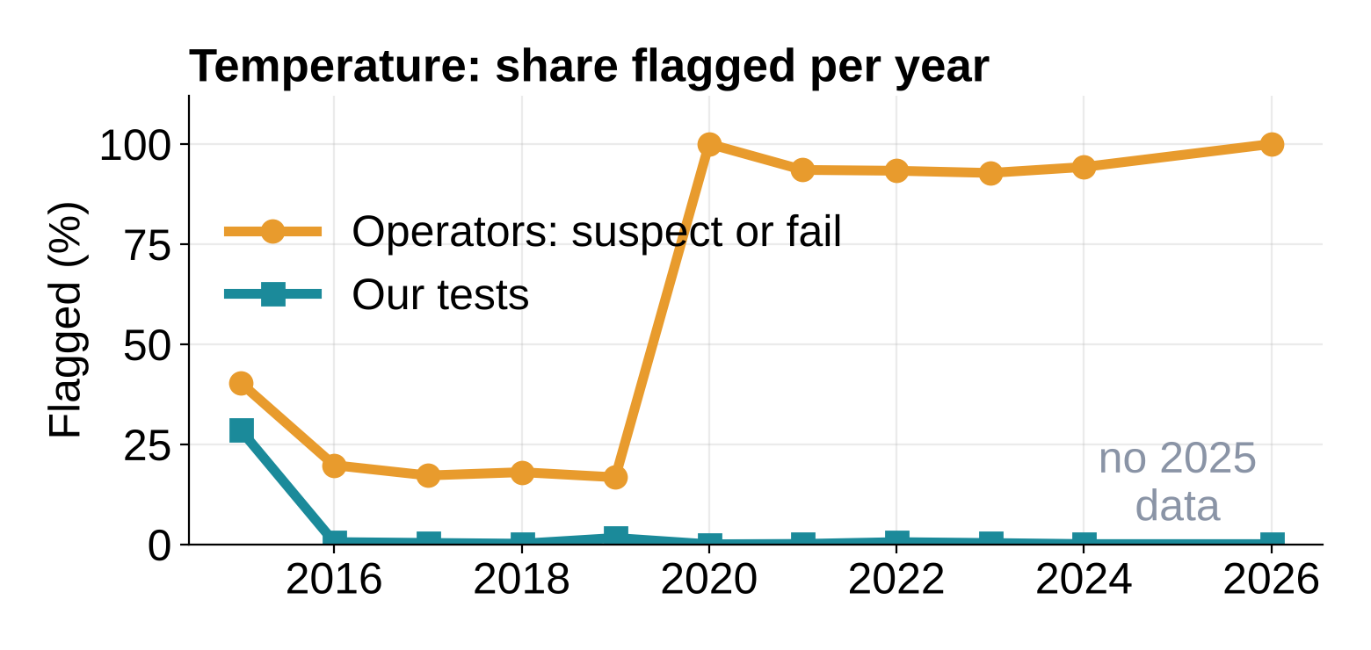
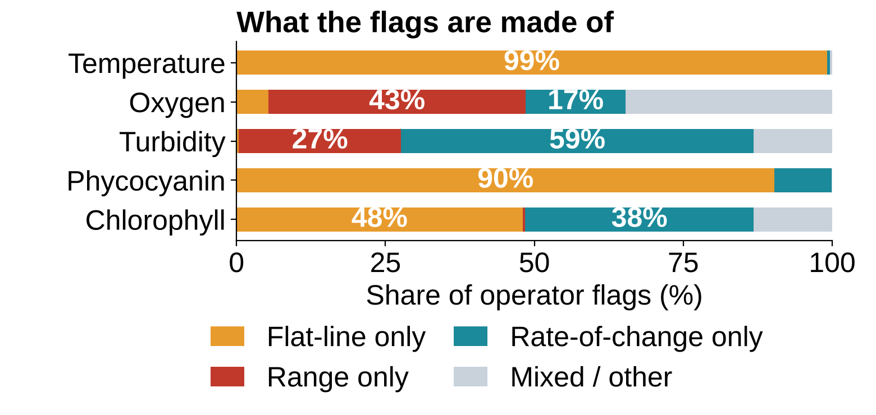
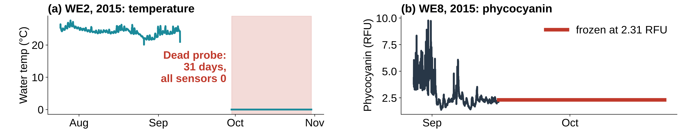
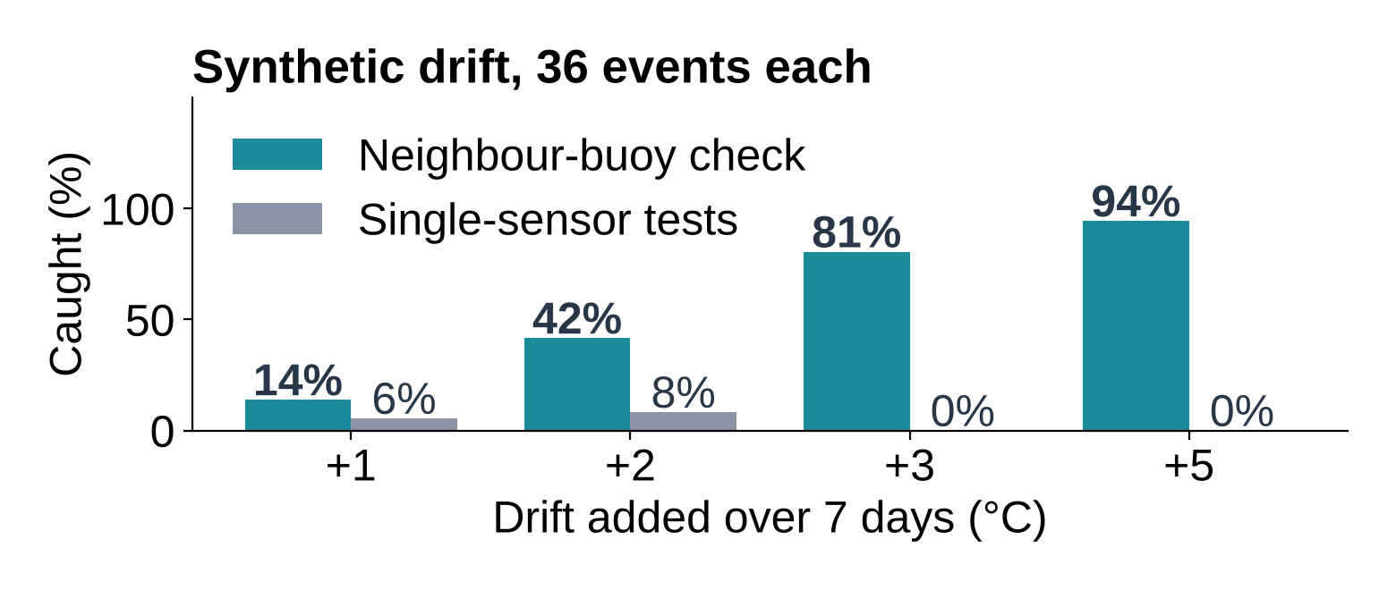
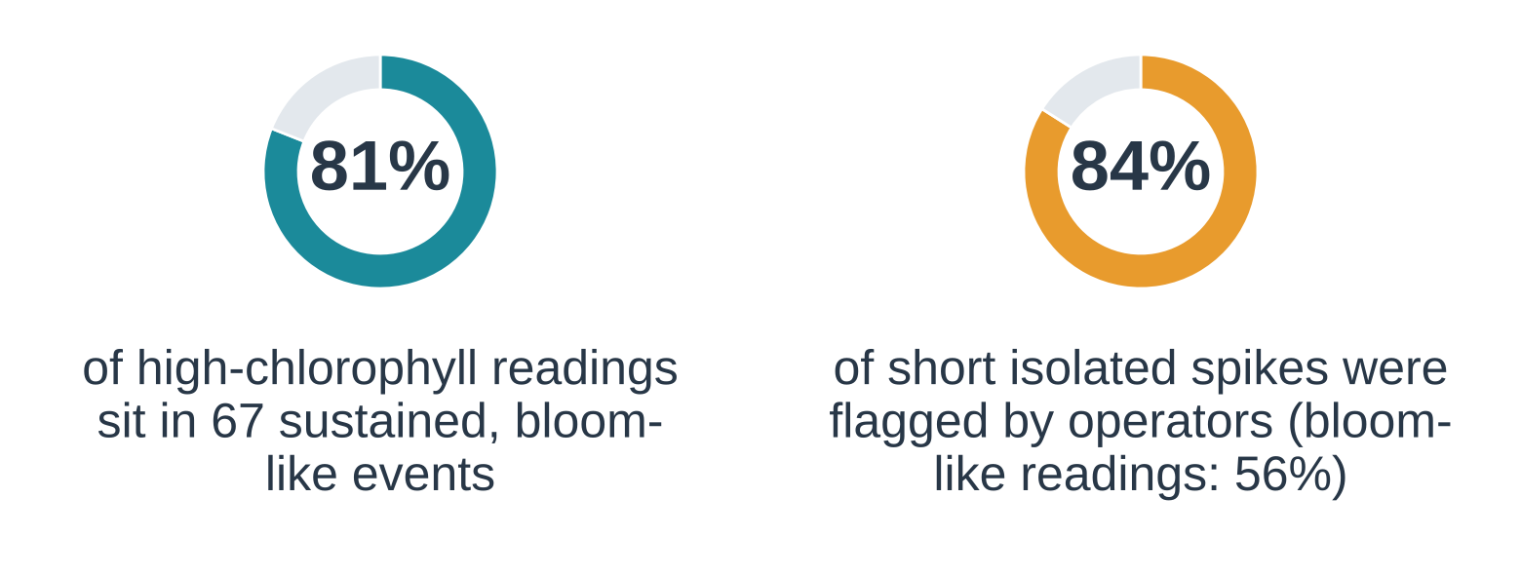
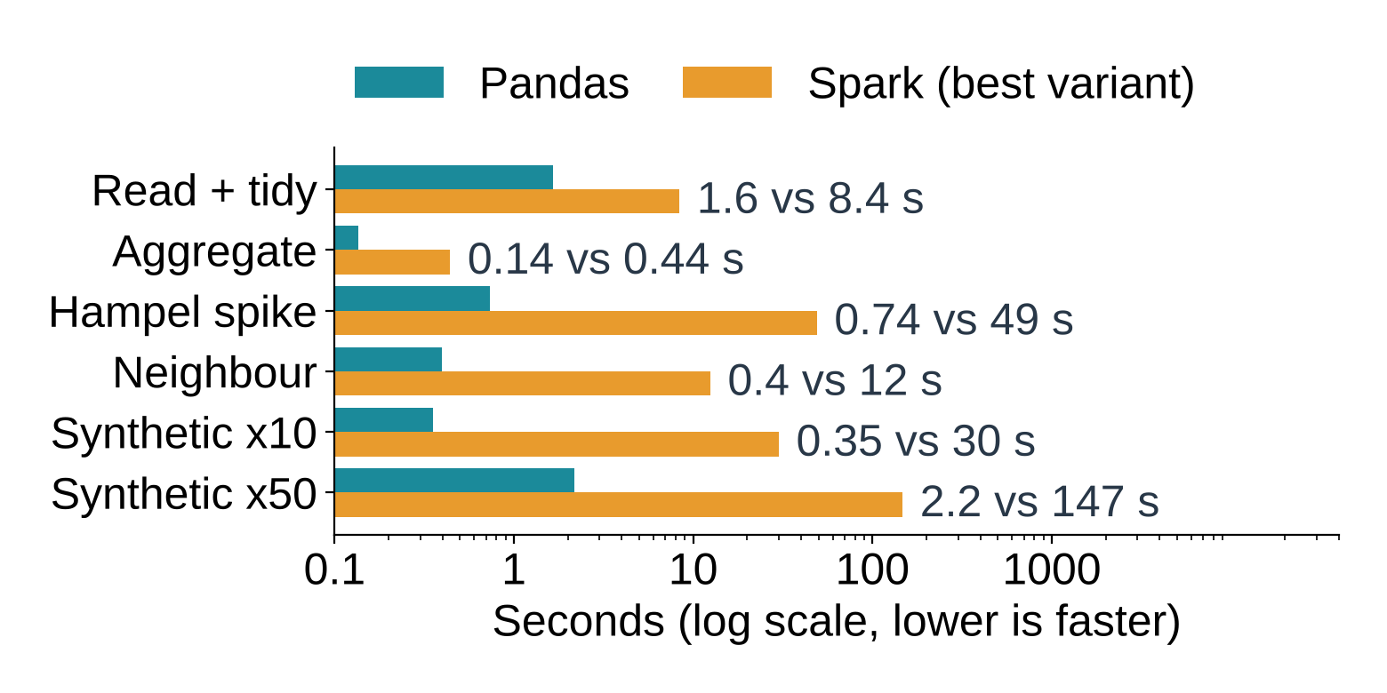
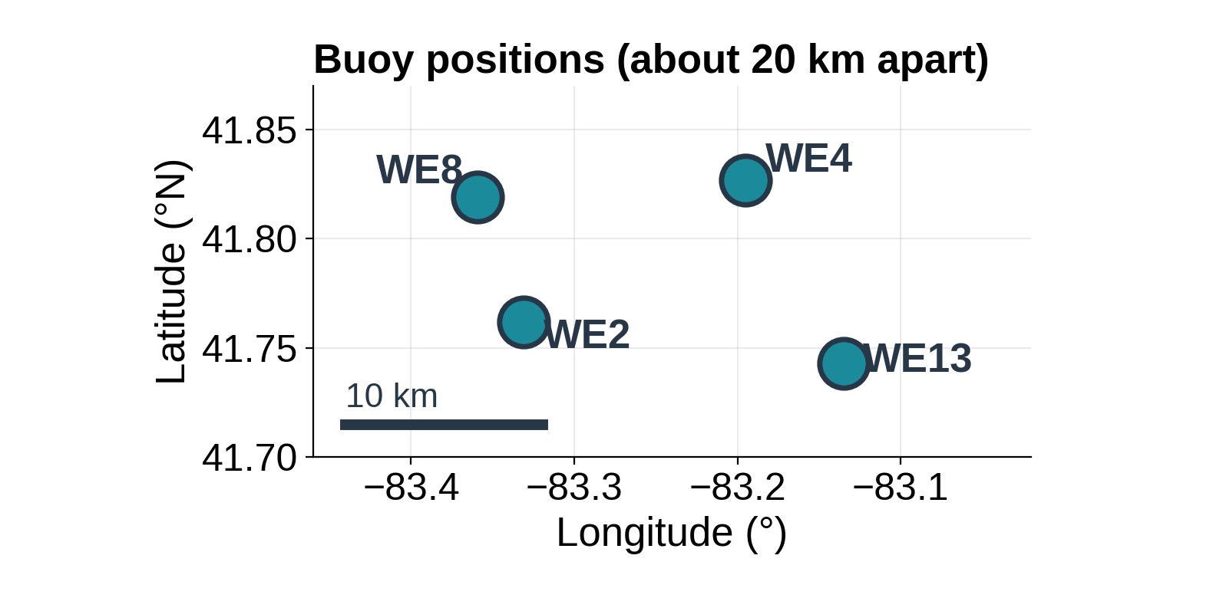
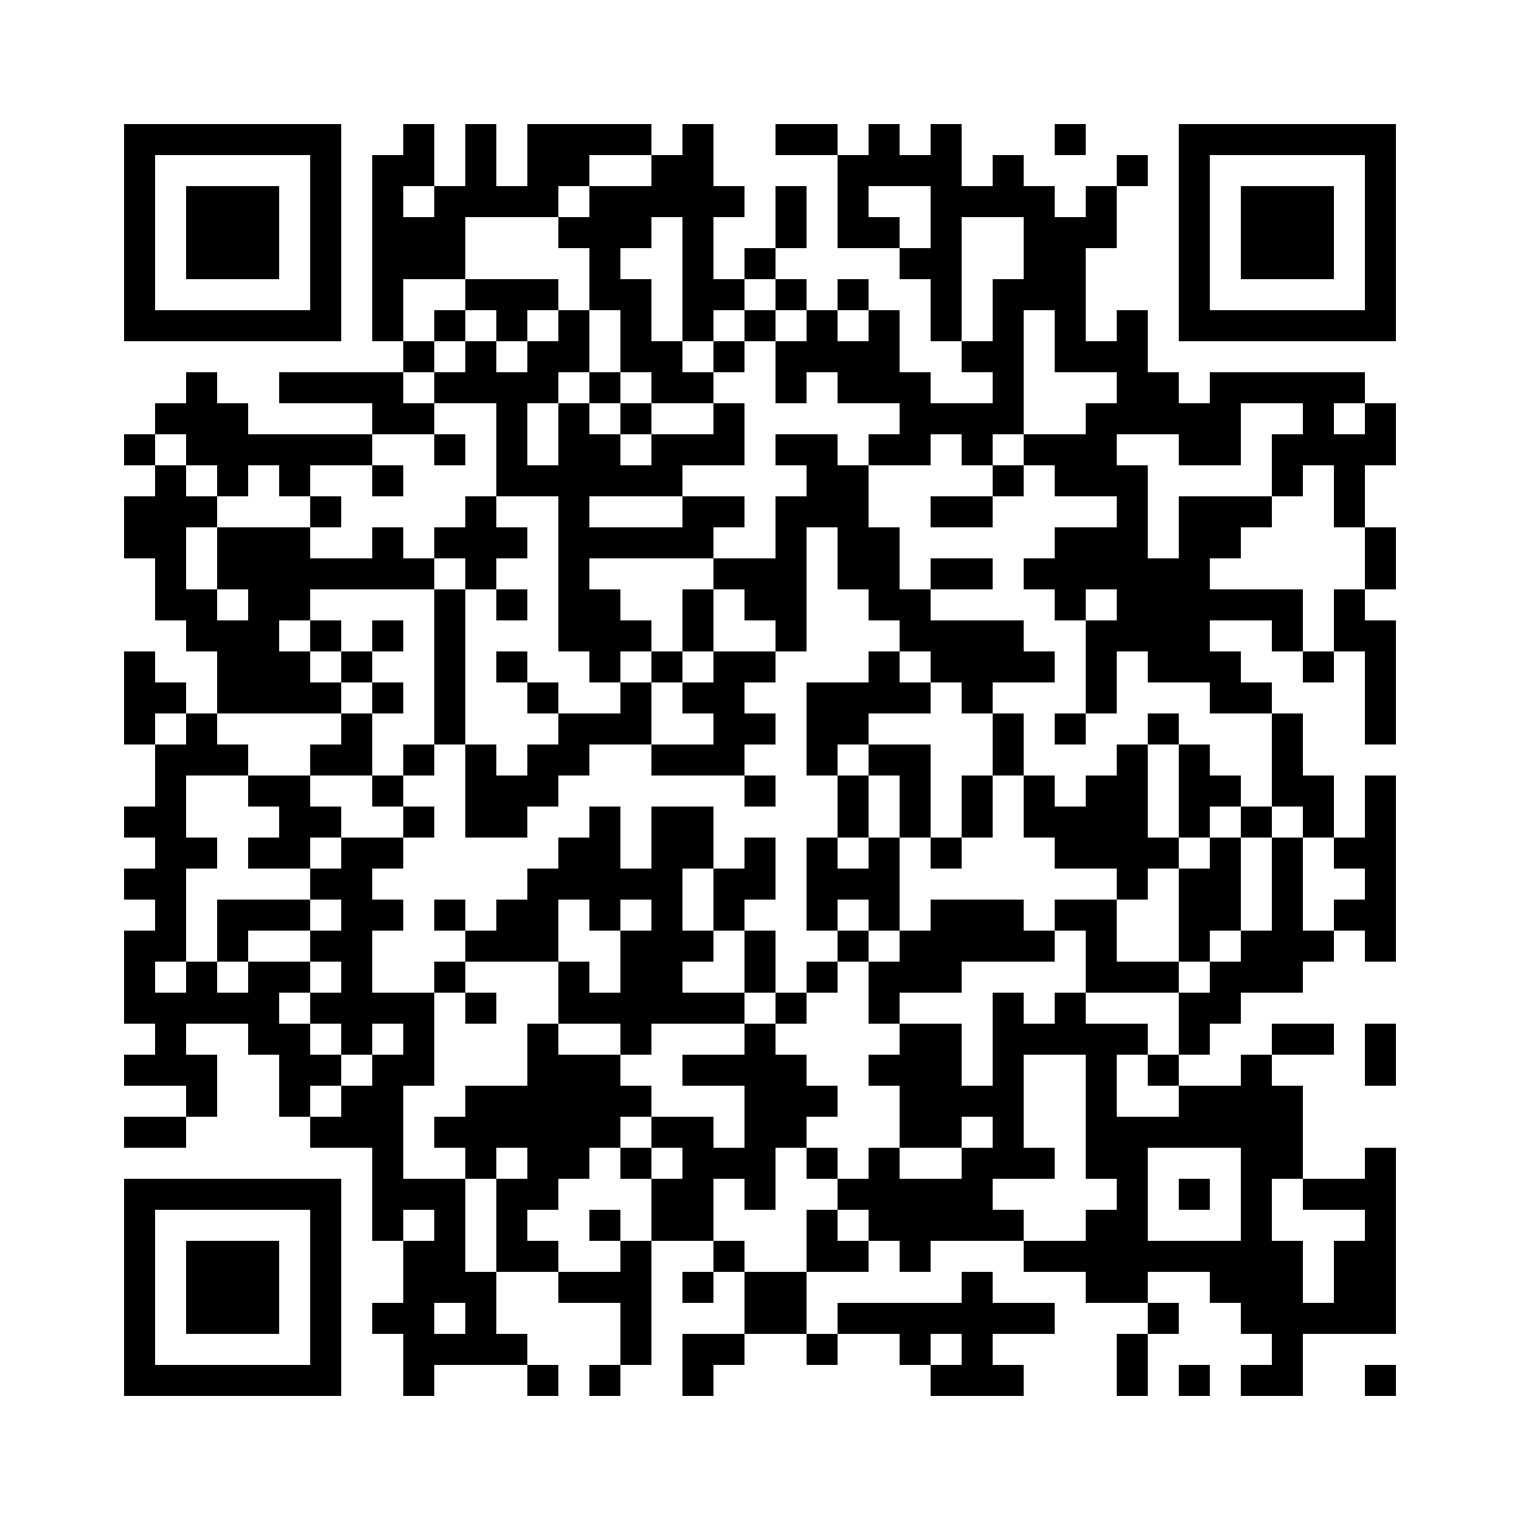
LAKE 2026: 15TH BIENNIAL LAKE CONFERENCE
A Secure Cloud-Based Framework for Smart Lake Water-Quality
Monitoring and Anomaly Detection
Mannat Tomar
BCA (Hons.) Data Science, Minor in Cybersecurity, Chanakya University, Devanahalli, Bengaluru
mannatt.bca23@chanakyauniversity.edu.in | Bengaluru, Karnataka | 18–20 November 2026 | www.lake2026conference.in
Theme: IoT Buoys, Real-time Sensor Networks & Hydrological Monitoring
Abstract
Results
Smart lake monitoring depends on sensor buoys, but their readings can be missing, frozen, wrong or tampered with. We screened 330,384 readings (1.9 million sensor values) from four NOAA-GLERL buoys in western Lake Erie, 2015–2026, with simple, explainable tests, and compared them with the operators’ own quality flags. A local replay prototype, a PySpark port and a proposed secure cloud design complete the framework. All results use archived US data.
1 Operator flags are not a fault list
Operators flag 43–47% of algae, oxygen and turbidity readings and 78% of temperature readings. One rule causes 99% of temperature flags. In 2016–2019, 17–20% of evaluated readings were flagged; in 2021–2026, 93–100%.
Key findings
99%
of flagged temperature readings come from one flat-line rule
31 + 36 days
dead probe at WE2 and frozen sensor at WE8, found by simple rules
81%
of +3 °C slow drifts caught by neighbour buoys; single-sensor tests caught 0%
Same flags
Spark = Pandas (4 of 42,069 differ) but slower: 49 s vs 0.7 s
2 Real faults our tests find
Autumn 2015: all WE2 sensors read 0 for 31 days (2,983 readings; operators flagged about 99%). WE8’s phycocyanin sensor stayed at 2.31 RFU for 36 days (3,458 readings).
Introduction
Background
Western Lake Erie has toxic algae blooms. In 2014 one forced the city of Toledo to issue a tap-water ban [1].
NOAA GLERL buoys report water quality every 15 minutes in the open-water season [2].
Sensors fail, freeze or can be tampered with, so decisions need data that can be trusted.
3 Slow drift: neighbours help
4 Bloom or fault?
Synthetic faults on a copy: spikes caught 94–95%, 6-hour stuck values 65–73%. A +3 °C drift is caught late: median 5 days.
Of 13,521 high-chlorophyll readings, most sit in slow, shared rises (bloom-like). 239 short isolated spikes (290 readings) are the candidates for sensor faults, not confirmed.
Problem and questions
Can simple tests find faulty buoy readings, and can neighbouring buoys tell a natural bloom from a fault?
RQ1 What do the records cover, and how much is missing?
RQ2 What are the operators’ quality flags made of?
RQ3 Which faults do simple tests catch (real and synthetic)?
RQ4 Do neighbouring buoys help with slow drift?
RQ5 (Design only) How could a secure cloud pipeline protect the data?
5 Spark vs Pandas: same flags, slower here
Data and Methods
Same rules, same data, one CPU core (median of 3 runs; ×50 test: 1 run). Spark matched Pandas but was slower on every job. Synthetic = WE2 temperature copied 10× or 50×.
Detector | Pandas | Spark | Overlap
Dead probe | 3,071 | 3,071 | 100%
Spike | 27,988 | 27,984 | 99.99%
Stuck | 10,137 | 10,137 | 100%
Neighbour | 873 | 873 | 100%
Data
Four Western Erie buoys via GLOS Seagull; archived CSVs downloaded Oct 2026. Six sensors: chlorophyll, phycocyanin, oxygen, temperature, turbidity, conductivity.
Buoy | Dataset | Readings | Period | 15-min
WE2 | obs_80 | 111,403 | 2015–26 | 96%
WE4 | obs_81 | 82,094 | 2015–26 | 78%
WE8 | obs_82 | 104,048 | 2015–26 | 99%
WE13 | obs_215 | 32,839 | 2016–19 | 94%
The 4 differing spike rows come from CSV number parsing at the exact threshold. Shuffle partitions, Parquet and lag/lead windows did not speed Spark up.
Cybersecurity and Pipeline
Local prototype and proposed cloud design
No 2025 data; 11–15 gaps over 7 days per buoy (winter). −999 is the documented missing-value code.
Buoy sensors
Ingest + validate
Store + hash
Detect
Alert + review
Methods
Designed, not built: device certificates and mutual TLS · object store with Object Lock · IAM · KMS encryption · audit logs
1 Tidy
2 Read flags
3 Our tests
4 Synthetic
5 Spark check
Teal = ran locally on archived data (replay, not live). WE2 2018 replay: 11,425 readings in 124 daily batches, median 22 ms each; 1,083 spike alerts, identical to the batch run.
Tidy: SHA-256 of raw files; −999 → missing; K → °C; merge the two identical phycocyanin columns.
Operator flags: 1 pass, 2 not evaluated, 3 suspect, 4 fail [3]; we test how they are made.
Our tests: dead probe (4 of 5 sensors read 0); spike (9-reading median, 6× robust scale [4]); stuck (24 identical readings, gaps up to 20 min); neighbour check (temperature vs median of other buoys, 6 h rolling median).
Synthetic tests: spikes, 6-hour stuck values and slow drifts added to a copy (99 or 36 events each).
Spark and Pandas: same rules in both, compared flag by flag; timed on one CPU core of a cloud sandbox (Xeon 2.1 GHz, 4 GB RAM, PySpark 4.3.0, Pandas 3.0.6). An earlier run on my laptop (Spark 3.5.6, older settings) was also slow: 563 s for the three detectors, start-up included.
Threat to the data | Design control | Evidence from this project
Dead, frozen or glitchy sensor | Range, stuck and spike checks | Tested: real cases found; spikes 94–95% caught (synthetic)
Slow drift or manipulation | Cross-buoy checks; human review | Tested (synthetic): +3 °C drift 81% caught, +1 °C only 14%
Silent edits to stored data | Immutable raw zone, signed manifests | Tested: SHA-256 caught a 1-character edit; chained log caught an edited entry
Spoofing, eavesdropping, unauthorised access | Mutual TLS [5]; IAM and KMS [6] | Not built or tested
Conclusion
Limitations
Operator flags are not a fault list: one rule drives most of them.
Simple, explainable tests find real faults; neighbour buoys catch drift of 3 °C or more.
Next: ask NOAA and GLOS why flags stop; test Spark on much larger data.
US lake data, not Indian; archived replay, not a live feed.
Flags are automatic tests, not confirmed faults; our thresholds are analyst choices.
Drift of 1–2 °C is mostly missed; the stuck test skips gaps over 20 min.
Spark was timed on one core and a small data set; the cloud parts are a design, not built.
Acknowledgements
Data: NOAA GLERL buoys, served by GLOS Seagull (glos.org/seagull); we thank NOAA GLERL and GLOS. Analysis, figures and design are the author’s. Code and results: github.com/Mannat29/lake-buoy-anomaly-detection
[1] Fondriest Environmental (2014) Toledo water crisis hastens Lake Erie buoy near water intake. [2] NOAA GLERL & CIGLR, Lake Erie HAB water-quality data, NOAA NCEI. [3] NOAA GLERL Tech. Memo. GLERL-181 (2026), buoy quality-control tests. [4] Hampel (1974) J. Am. Stat. Assoc. 69, 383–393. [5] NIST SP 800-52 Rev. 2. [6] AWS, Security best practices in IAM.
Scan here

