Slide 1
Selection of Time Headway for String-Stable CACC
under Noisy V2V Communication
The base paper reproduced to its printed digits, then extended — validated across three independent simulation backends
Control Systems — Project Presentation
Base paper: G. Ma, P. R. Pagilla, S. Darbha, “Selection of Time Headway in Connected and Autonomous Vehicle Platoons Under Noisy V2V Communication,”
IEEE Transactions on Intelligent Transportation Systems, vol. 26, no. 1, pp. 1029–1038, January 2025. doi: 10.1109/TITS.2024.3498701
Backends: Python scientific core · ROS 2 distributed (one process per vehicle) · MATLAB / Simulink block model
Status: reproduced to the paper's printed digits · 87 unit tests green · Monte-Carlo certification run CERTIFIED

Slide 2
TEAM
Project Team
Control Systems — Selection of Time Headway for String-Stable CACC under Noisy V2V Communication
Mannav Daasaradhi
Manikanta Koushik
cb.ai.u4aid24030
cb.ai.u4aid24037
Prajith
Sakthi Charukesh
cb.ai.u4aid24039
cb.ai.u4aid24049
Base paper reproduced to its printed digits, then extended — validated across the Python, ROS 2 and MATLAB / Simulink backends.

Slide 3
Problem statement — the physical problem
WHY PLATOONING
WHY V2V CHANGES THE PROBLEM
▪ Highway capacity is spacing-limited, not speed-limited
– capacity ≈ v / (L + r + h·v) vehicles per lane per second
– at v = 25 m/s: every 0.1 s of headway costs 2.5 m per vehicle
– humans need h ≈ 1.5–2 s; standard ACC still needs h ≥ 1 s
▪ Two failure modes — only one is obvious
– individual: does vehicle i track its predecessor? Solved by any stable feedback loop.
– STRING stability: does a disturbance GROW as it travels backwards down the platoon?
▪ String instability is what phantom traffic jams are
– growth is geometric, gᴺ: a per-hop gain g = 1.0035 is invisible over 11 vehicles (1.039×) and a factor 2 over 200
– nothing in a 200 s time trace reveals it — the verdict must be frequency-domain
▪ Radar alone cannot close the gap
– predecessor-following at CONSTANT SPACING is provably string-unstable: the double integrator forces sup|Γ| > 1
– constant time headway d = r + h·v fixes it — but the price is exactly the road space we wanted back
▪ V2V feedforward is the lever
– broadcasting the predecessor's ACCELERATION lets the follower act BEFORE the gap changes
– in this model it halves the headway floor: 2τ₀ → τ₀
▪ …but the lever is a radio
– the one signal CACC adds over ACC is the one that travels over an imperfect channel
– design for a clean channel, deploy on a dirty one → SILENT string instability
A 12-vehicle platoon at h = 0.95 s occupies 345 m; at h = 0.88 s it occupies 324 m — 1.75 m per vehicle, ≈6 % more flow.
Problem statement
CACC under noisy V2V | 1

Slide 4
Problem statement — the research problem
From “does the paper work?” to “would it survive deployment?”
THE QUESTION THE BASE PAPER ASKS
▪ Given a signal-to-noise ratio ρ on the V2V link carrying the predecessor's acceleration, what is the SMALLEST time headway h_{w} at which the platoon is still GUARANTEED string stable — for every admissible channel realisation and every vehicle lag τ ∈ (0, τ₀] ?
▪ Its answer is a closed form: the bound h_{w,lb}(k_{a}, ρ), the feedforward gain k_{a}* that minimises it, and the resulting minimum h*_{w,lb}.
WHAT ITS ANSWER ASSUMES — each assumption is a deployment gap
– channel statistics are TIME-INVARIANT and known at design time
– the guarantee holds in the MEAN sense and is BINARY (pass / fail)
– there is NO communication delay and NO packet loss
– every link is HONEST; only the radio is noisy, the radar is clean
– the gains are chosen ONCE, offline, for one value of ρ
THE THREE QUESTIONS WE ADD
▪ 1. Real channels vary. What happens when ρ changes DURING operation, and can the platoon ESTIMATE it and adapt online?
▪ 2. Can a binary worst-case verdict be made QUANTITATIVE — a calibrated probability of exceedance instead of a bound paying for 10⁻⁶ events?
▪ 3. What if a link LIES? A predecessor-following chain has no redundancy, so consensus-style filtering cannot be applied.
Success criteria: reproduce the paper exactly · quantify its deployment gaps · build and validate the fix · certify on a Monte-Carlo harness · agree across three independent backends.
Problem statement
CACC under noisy V2V | 2

Slide 5
The decoder ring — every symbol in the deck, in plain words
Read this page once and every equation later in the deck is already introduced
Symbol
Name
What it actually means
Value here
h_{w}
time headway
SECONDS of gap you keep behind the car ahead. Multiply by speed to get metres. THE quantity this whole project is about.
0.95 s
d = r + h_{w}·v
spacing policy
the gap you aim for: a fixed bumper distance plus h_{w} seconds of travel — so the faster you go, the more room you leave
r → d = 5 m
δ_{i}
spacing error
how far car i actually is from that target gap. Drive δ to zero and the gap is right at every speed.
metres
τ
actuator lag
how sluggish the engine/brake loop is — you ask for an acceleration, you get it about τ seconds later
≤ τ₀ = 0.5 s
ρ
channel SNR
radio quality. BIG ρ = clean radio, small ρ = noisy. Everything in the paper is a function of it.
5 (13.98 dB)
w
channel factor
the number the TRUE acceleration gets multiplied by in transit. w = 1 would be a perfect radio.
1 ± 1/ρ
k_{a}
feedforward gain
how hard you act on what the RADIO tells you the car ahead is doing
0.5
k_{v}
damping gain
how hard you act on the speed difference you SEE on radar
0.63
k_{p}
spacing gain
how hard you act on the gap error you SEE on radar
0.009
γ = k_{v} + h_{w} k_{p}
combined authority
total feedback strength. THE ONE PLACE headway enters the maths — remember this and slide 10 makes sense.
—
H̃(s)
error propagation
the filter that turns the car-ahead's gap error into THIS car's gap error. One filter, every hop.
—
‖H̃‖∞
peak gain
the WORST amplification that filter does, over every frequency. The single number the verdict is taken on.
must be ≤ 1
Rule of thumb for the whole deck: k_{a} is the RADIO gain, k_{v} and k_{p} are the RADAR gains, h_{w} is the price in road space, and ρ is how much you can trust the radio today.
Decoder ring
CACC under noisy V2V | 3

Slide 6
Base paper — the car, and the gap it aims for
Eqs. (1) and (2) — the plant and the spacing policy
GOAL
Two ideas before any control appears: a car cannot change speed instantly, and the gap it aims for grows with speed.
1
THE CAR — you ask for an acceleration, you get it late
IN WORDS: u is the acceleration you COMMAND, a is what the car actually delivers, and τ is the delay between them. τ is never known exactly — only that it is no worse than τ₀ = 0.5 s, which is why every guarantee must hold for a whole RANGE of τ.
2
THE GAP IT AIMS FOR — spacing error, eq. (2)
IN WORDS: δ is how far this car is from where the time-headway policy says it should be. Push δ to zero and the gap is correct at any speed.
τ is the DOMINANT lag of the inner acceleration loop, not one component's time constant. A mixed fleet is absorbed by τ₀ = maxᵢ τᵢ, so a design certified on (0, τ₀] covers every vehicle below τ₀.
Base paper
CACC under noisy V2V | 4

Slide 7
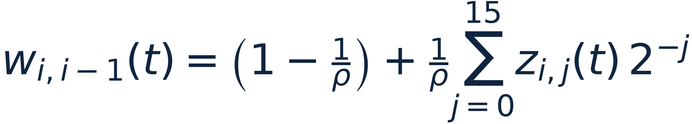
Base paper — the control law, and the radio that corrupts it
Eqs. (6) and (5) — N = 12 followers · τ₀ = 0.5 s · d = 5 m · ρ = 5 (13.98 dB) · v_{ss} = 25 m/s
3
THE CONTROL LAW — three terms, three information sources, eq. (6)
IN WORDS: Left to right: act on what the car ahead is DOING, on the speed difference, and on the gap error. ONLY the first term travels over the radio — so only the first is corrupted. That asymmetry is the entire premise of the paper.
4
THE RADIO — the 16-bit multiplicative channel, eq. (5)
IN WORDS: The acceleration you RECEIVE is the true one multiplied by w. w is built from 16 random bits, so it can never stray further than 1/ρ away from 1 — it is BOUNDED, and that is the only reason a hard guarantee is possible at all. Note E[w] ≠ 1: the channel is optimistically biased by 4.8 %.
WHAT THIS BUYS US
A Gaussian noise model would have infinite tails, so NO finite headway could ever guarantee string stability. Bounded support is the only reason the deterministic theorem exists at all.
Base paper
CACC under noisy V2V | 5

Slide 8
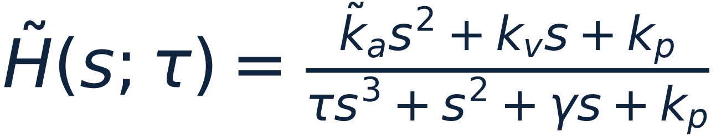
Base paper — how errors travel, and the test they must pass
Eqs. (14) and Definition 2 — why a 200-car question is really a one-car question
1
ONE FILTER GOVERNS EVERY HOP — eq. (14)
IN WORDS: Errors do not ADD down the platoon, they get MULTIPLIED by this one filter at every hop. Headway enters only through γ, and γ only in the bottom line — so headway can add damping, never gain. A 200-car question just became a one-car question.
2
THE TEST — robust string stability, Definition 2
IN WORDS: No frequency may be amplified — for any actuator lag up to τ₀ and any channel the radio might hand you. Note it can never be BETTER than 1: at zero frequency the filter equals exactly 1, so the margin is zero by construction.
Gains MULTIPLY down a chain, so the per-hop gain is raised to the Nth power. A per-hop 1.0035 is 1.039× over 11 vehicles and a factor 2 over 200 — which is why the verdict is taken in the frequency domain and never off a time trace.
Base paper
CACC under noisy V2V | 6

Slide 9
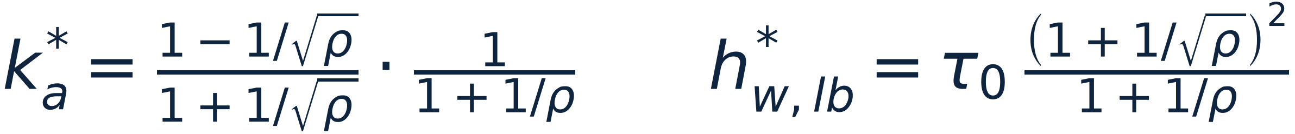
Base paper — the answer, and the best it can do
Eqs. (14), (16)–(19) — the whole result set, each line said in words underneath
3
THE ANSWER — the smallest headway that can be certified, eq. (17)
IN WORDS: Given how clean the radio is (ρ) and how hard you lean on it (k_{a}), this is the shortest headway that can still be certified. Go below it and NO choice of the two radar gains can rescue you.
4
THE BEST YOU CAN DO — the optimum, eqs. (18) and (19)
IN WORDS: Trusting the radio more shortens the headway — until the noise it carries hurts more than the information helps. k_{a}* is that balance point. At ρ = 5 it is 0.3183, which buys 0.8727 s.
At ρ = 5, τ₀ = 0.5 s the paper prints k_{a} bound 0.8333, h_{w,lb}(0.5) = 0.9375 s, k_{a}* = 0.3183 and h*_{w,lb} = 0.8727 s — all four reproduced to 0.00 %. The five numerical cases of §IV: 1 stable (h = 0.95) · 2 unstable (h = 0.65) · 3 at the optimum (h = 0.88) · 4 platoon length 345 m vs 324 m · 5 heterogeneous τᵢ.
Base paper
CACC under noisy V2V | 7

Slide 10
Novelty, phase-wise — the seven phases
★ = core research contribution ★★ = the flagship extensions
Phase
What it adds
Assumption removed
Key result
ADR
0 Reproduce
Full re-implementation from the paper: CTHP law, 16-bit channel, RK4 platoon, frequency-domain analysis
— (fidelity baseline)
printed digits exact:
0.9375 / 0.3183 / 0.8727 / 0.8333
D-001…07
1 Gap audit
V2V latency θ on the feedforward path + Bernoulli packet loss with ZOH, at FIXED case-A gains
“no delay”, “no packet loss”
DELAY binds, not noise: only ≈0.2 s of budget at the paper's own design
D-008
2 Distribute
One OS process per vehicle on ROS 2; wall-clock substepped integration; radar extrapolation by message age
“a monolithic simulator is enough”
< 2 % per-hop agreement with the offline core under real OS jitter
D-011…15
3 Adapt ★
Online SNR estimation ρ̂ from radar-vs-beacon residuals → rate-limited headway adaptation + timestamp predictor
“γ_{i,j} are time-invariant”
ρ̂ median {10.4, 3.1, 10.7} vs true {10, 3, 10}; delay penalty flatlined
D-016
4 Re-tune
Online gain scheduling: hold γ at 90 % of the (28a) ceiling for the estimated ρ
“gains are fixed once chosen”
breaks the fixed-gain wall at ρ* ≈ 1.8:
‖H̃‖∞ 1.019 → 0.99999
D-017
5 Flagship ★★
A: spatial ρ(x) map with look-ahead · B: physics-consistency V2V trust gate · C: exact channel law → chance-constrained headway
“reactive is enough”, “links are honest”, “binary worst case”
A: 0 % unstable in-zone (vs 6.9 %) · B: collision → 8.4 m gap · C: −10.5 % headway at 1e−2 risk
D-021…23
6 Certify
Monte-Carlo scenario×seed harness → PASS/FAIL report; plus Simulink as an independent third backend
“one implementation is evidence”
CERTIFIED across 4 scenario families; Simulink ↔ Python agree to 1e−4
D-018, 24
Novelty & comparison
CACC under noisy V2V | 8

Slide 11
Systems — what we built, and the three backends it runs on
THE MODEL AND THE CHANNEL
ANALYSIS, ADAPTATION, AND EXECUTION
S1 VEHICLE + CONTROLLERS vehicle.py, controllers.py
– state x = [p, v, a]; ȧ = (u − a)/τ, u saturated to [−8, +3] m/s² BEFORE integration
– τ = 0.5 s, L = 4 m, r = 1 m ⟹ d = 5 m, matching the paper
– three laws behind ONE interface — ACC (radar only), CACC (+ unity feedforward), CTHP (the base-paper law)
– CTHP is STATELESS, so the gain scheduler can swap the instance mid-run with no state transfer
S2 V2V CHANNEL network.py, qos_map.py
– four independently switchable impairments — NOISE (w per eq. 5, held 10 ms) · DELAY θ · LOSS + zero-order hold · ATTACK injection on one link
– the ρ-INDEPENDENT bit cache: it stores U′ = Σ z_{j} 2⁻ʲ, not w, so a ρ-schedule RESCALES the same realisation instead of redrawing it
– ⟹ two zone studies are seed-comparable: the difference between runs is the schedule, not the dice
– QoSMap gives channel quality by POSITION, ρ(x), and exposes it at (x + v·preview) — the look-ahead that makes adaptation predictive rather than reactive
S3 ANALYSIS + CERTIFICATION analysis.py, certificate.py
– delays evaluated EXACTLY as e^{−jωθ}, never Padé — margins here are 10⁻³ and Padé phase error would corrupt exactly the verdicts we need
– min_stable_headway BISECTS on h, because (28a)/(28b) are sufficient-not-necessary; hinf_worst grids k̃_{a} across I so the binding endpoint is CHECKED, not assumed
– ChannelLaw.build(ρ) — the EXACT law of w, 2¹⁶ = 65 536 atoms
S4 ADAPTATION estimation.py, trust.py
– ρ̂ from radar-vs-beacon residuals over an AGE-based window — a count-based window was tried first and FAILED (ρ̂ stuck at 3.1 after zone exit)
– h-table built ONCE by bisection, then rate-limited to 0.05 s/s; scheduler holds γ at 90 % of the (28a) ceiling
S5 THREE BACKENDS, ONE SET OF EQUATIONS
– Python core — hand-written RK4 over the stacked state
– ROS 2 — one OS process per vehicle; the nodes IMPORT cacc.*, so there is no second implementation to drift
– Simulink — a width-N model built programmatically from a reviewable .m, so the .slx is a diffable artefact
Declarative YAML scenarios ⟹ a study is a name plus a seed; each run writes results/<study>/<stamp>/ with figures AND metrics.json, so every number on a later slide traces to a file.
Systems
CACC under noisy V2V | 9

Slide 12
Where the headway formula comes from — turning the test into algebra
Eq. (25) — the string-stability inequality, derived rather than quoted
GOAL
The reviewer's most likely question is “where does 0.9375 come from?”. It comes from four steps, and these are the first two.
1
SQUARE BOTH SIDES — the test becomes a polynomial
IN WORDS: “No frequency is amplified” is awkward to work with, but squaring it turns it into two polynomials to compare. Write each one out by separating the real and imaginary parts.
2
SUBTRACT — and watch two things vanish, eq. (25)
IN WORDS: k_{p}² cancels between the two, and a whole ω² factors out. What is left is a QUADRATIC in ω² that must never go negative — and our code checks this identity numerically to 1.8×10⁻¹², so there is no algebra slip hiding here.
Do this on the whiteboard if asked: it is four lines. docs/derivations/02-ma2025-base-paper.md §2.6.1 has every cancellation written out.
Where the formula comes from
CACC under noisy V2V | 10

Slide 13
Where the headway formula comes from — squeezing the gains out
Eqs. (28a), (28b) → (17) — the step the deck used to skip
3
DEMAND EACH COEFFICIENT BE POSITIVE, then robustify — eqs. (28a), (28b)
IN WORDS: A quadratic is certainly non-negative if every coefficient is. Then make it hold for EVERY channel the radio might produce: (28a) is worst when the channel over-reports, (28b) when it under-reports. Note (28a) contains NO h_{w} — remember that.
4
CHAIN THE TWO — the gains cancel and only headway survives, eq. (17)
IN WORDS: This is the whole trick. (28b) puts a FLOOR under γ and (28a) puts a CEILING on it; sandwich them and k_{v} and k_{p} drop out, leaving an inequality in headway alone. Put ρ = 5, τ₀ = 0.5, k_{a} = 0.5 in and you get 0.60 / 0.64 = 0.9375 s.
WHAT THIS BUYS US
READ THE ASYMMETRY: (28a) has no h_{w} in it, so no amount of headway can rescue an over-aggressive γ. That single fact is why headway-only adaptation hits a wall at ρ* ≈ 1.8, and why Phase 4 (re-tuning the gains) had to exist.
The split in step 3 is SUFFICIENT, NOT NECESSARY: a quadratic can have a negative middle coefficient and still stay non-negative. Our counterexample (k_{a}=0.5, k_{v}=0.70, k_{p}=0.009, h_{w}=1.50) fails (28a) yet has ‖H̃‖∞ = 1.000000 — so h_{lb} is CONSERVATIVE for a platoon whose gains are already fixed.
Where the formula comes from
CACC under noisy V2V | 11

Slide 14
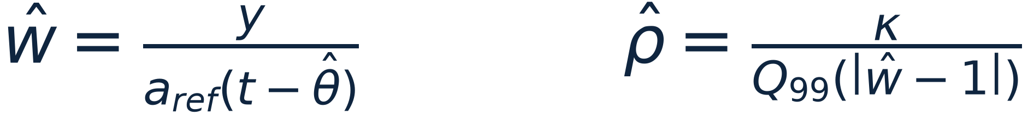
What we added (1–3) — undo the delay, measure the channel, move the headway
Phases 1 and 3 (D-008, D-016) — each removes one assumption the base paper needs
1
PREDICTOR — undo the V2V delay before it destabilises the string
IN WORDS: Take it away and the platoon goes string-unstable at a delay of ≈40 ms — too small to think to look for. With it, it survives to ≈220 ms. Delays are evaluated EXACTLY as e^(−jωθ), never Padé, because our margins are 10⁻³ and Padé phase error would corrupt the very verdicts we need.
2
ESTIMATOR — work out how noisy the radio is, online
IN WORDS: Compare what the radio SAID against what the radar SAW, and the spread of the disagreement tells you ρ. Because |w−1| ≤ 1/ρ STRICTLY, any high quantile errs in a known direction — so ρ̂ is conservative BY CONSTRUCTION, not by tuning.
3
ADAPTER — move the headway, but at a speed a passenger can accept
IN WORDS: Without it you would need one certified design for every possible ρ. The rate limit is what keeps a headway change a COMMANDED manoeuvre rather than a lurch.
Nothing here replaces the paper — it all sits on a reproduction that matches its printed digits to four decimals.
What we added
CACC under noisy V2V | 12

Slide 15
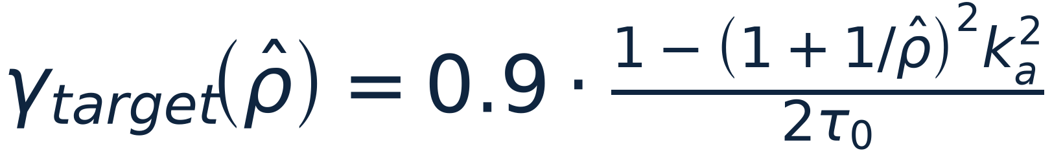
What we added (4–6) — re-tune the gains, survive a liar, price the risk
Phases 4 and 5 (D-017, D-022, D-023) — the flagship extensions
4
SCHEDULER — when headway alone is not enough, re-tune the gains
IN WORDS: Below ρ* ≈ 1.8 there is NO feasible design at any headway — because the (28a) ceiling ignores h_{w} entirely. Holding γ at 90 % of that ceiling restores feasibility, and lands at a SHORTER headway than the failed headway-only attempt (2.331 s vs 2.50 s).
5
TRUST GATE — the radar is the only second opinion there is
IN WORDS: One spoofed link steers the car behind it into a collision (−27.4 m gap, i.e. cars overlapping). A predecessor chain has no neighbours to vote with, so consensus filtering is unavailable — but the same quantity arrives TWICE, over radio and off radar. Trust the radio only as far as physics allows.
6
CERTIFICATE — replace a binary verdict with a priced risk
IN WORDS: Worst-case design pays the full price for events of probability 10⁻⁶. But the law of w is known EXACTLY — 2¹⁶ = 65 536 atoms — so there is no need to BOUND, we can INTEGRATE. A regulator sets ε and the method returns the headway: −10.5 % for a 1-in-100 budget.
Each row is measured on the results pages later in the deck; none of these numbers is asserted without a run behind it.
What we added
CACC under noisy V2V | 13

Slide 16
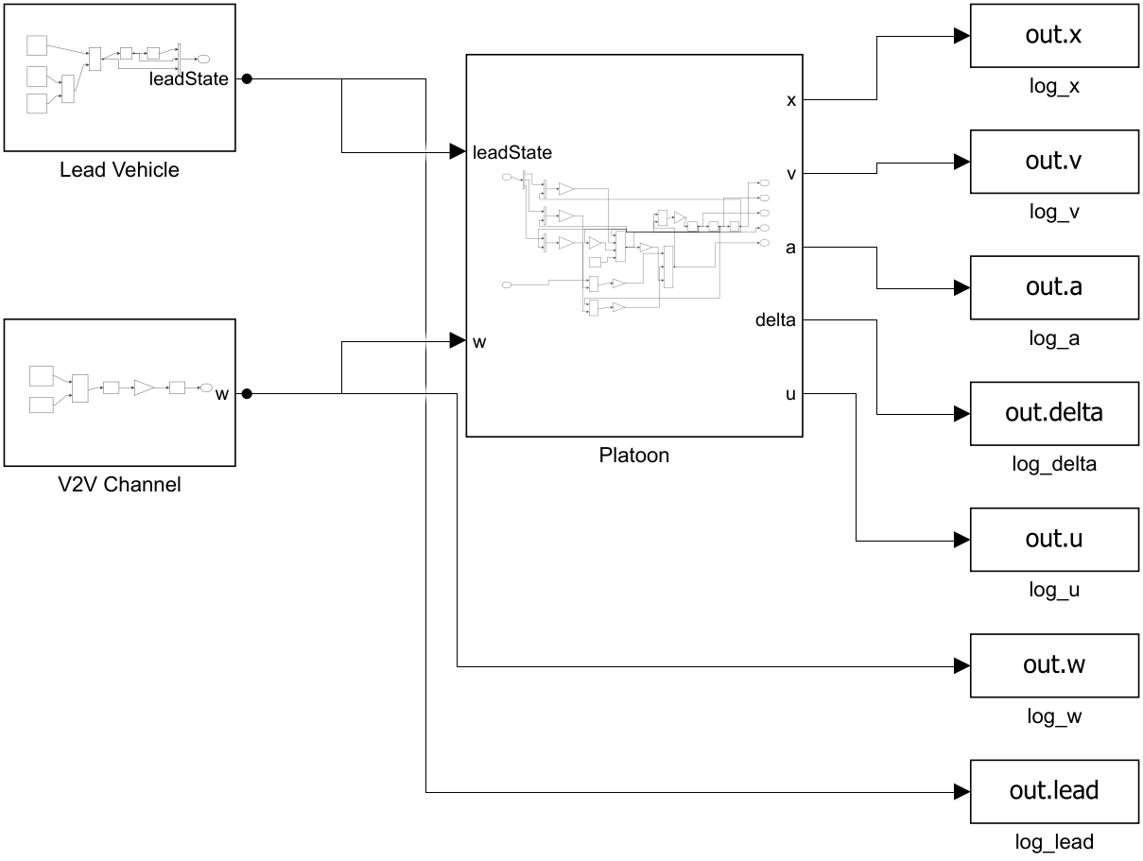
Simulation — the Simulink model
matlab/models/cacc_platoon.slx — the top level, exported straight from the model
ONE model, twelve vehicles, no copy-paste
▪ The whole platoon is VECTORISED to width N = 12: every signal line carries 12 lanes, so there is exactly one integrator chain and one control law in the diagram, not twelve.
Predecessor coupling is a matrix, not wiring
▪ PredSel = [I_{N} | 0] shifts the stacked state by one vehicle, so a_{pred} = PredSel·[a_{lead}; a] — the look-ahead topology is a single gain block that can be changed without rewiring.
Three blocks, three responsibilities
Lead Vehicle — a₀(t) = 0.5 sin(0.1(t−10)) over exactly one period, then constant
V2V Channel — the 16-bit multiplicative w of eq. (5)
Platoon — δ = x − x_{pred} + h_{w} v + d ; u = k_{a}(w·a_{pred}) − k_{v}(v−v_{pred}) − k_{p} δ ; ȧ = (u−a)/τ
The .slx is a build artefact, not the source
▪ the model is BUILT PROGRAMMATICALLY by matlab/models/build_cacc_model.m (~300 lines of add_block / add_line). The reviewable, diffable, version-controlled artefact is the .m file; the .slx is regenerated from it.
▪ That is why a third backend is worth having at all: it is an independent re-derivation of the same equations, not a re-run of the same code.
The simulation
CACC under noisy V2V | 14

Slide 17
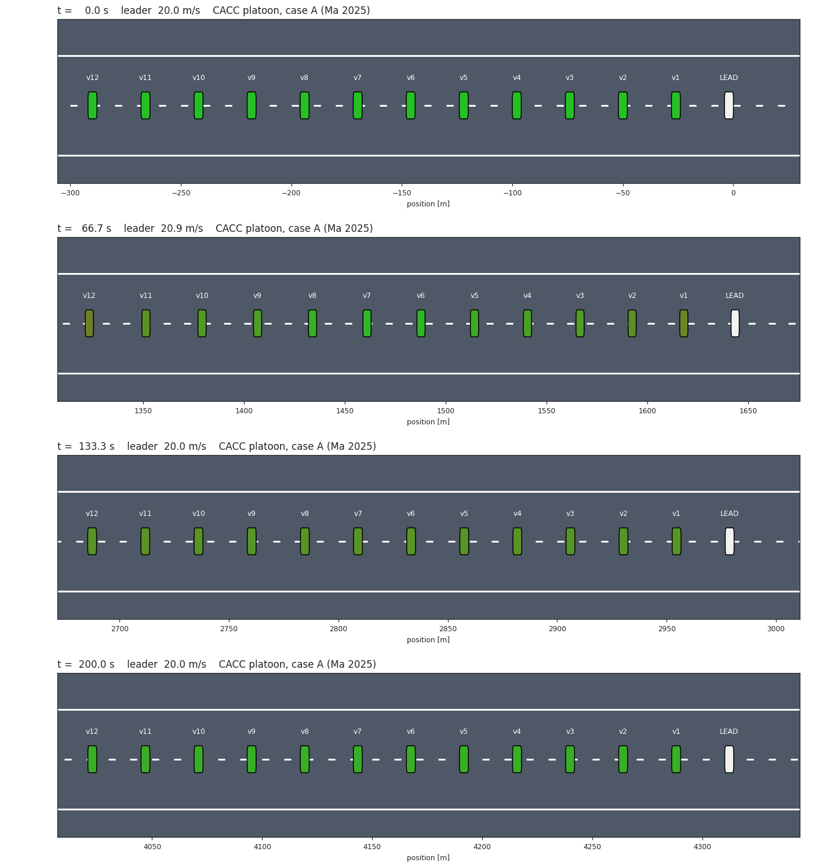
Simulation — the platoon in motion
scenarios/ma2025_sine.yaml, case-A gains — the reproduction run, animated
Twelve followers behind one leader, top-down, to scale
▪ Four instants of the same 200 s run: t = 0, 67, 133, 200 s. Cars are drawn at their true 4 m length; colour encodes the spacing error (green tight, red |e| ≥ 1 m).
What the animation is for — and what it is NOT for
▪ It shows the manoeuvre is physically sensible: the wave travels backwards, gaps open and close, nothing collides.
▪ It CANNOT show string stability. A per-hop gain of 1.0035 compounds to 1.039× over 11 vehicles — invisible to the eye. That is why the verdict is always taken in the frequency domain and the animation is used only as a sanity check.
Generated from the same core, not a separate model
▪ scripts/render_platoon_video.py simulates the scenario through cacc.platoon and animates the result, so the picture and the numbers cannot disagree.
python scripts/make_sim_assets.py
▪ It also renders MP4/GIF at 10× time-lapse, and the ROS 2 backend drives the same scene live in rviz2 / Gazebo.
The simulation
CACC under noisy V2V | 15

Slide 18
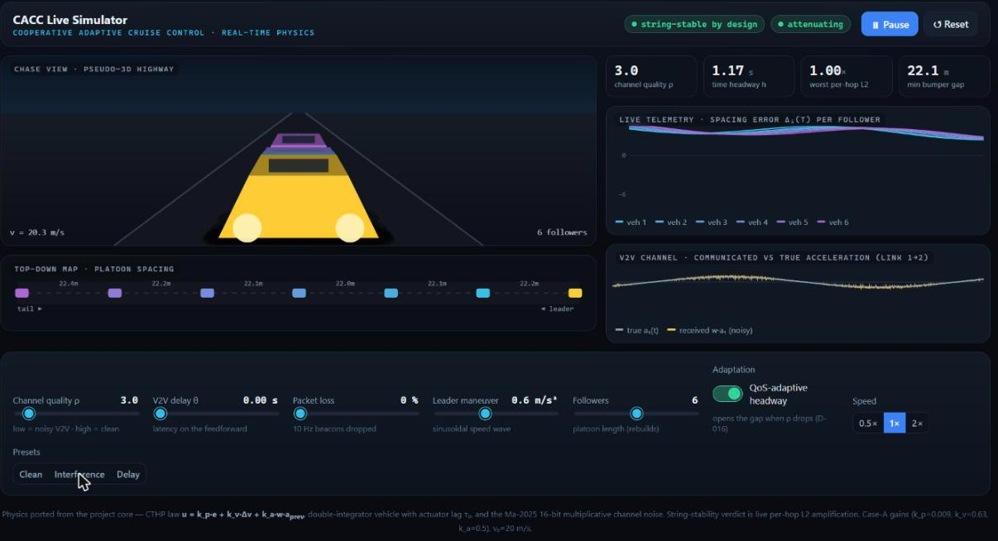
Simulation — the live, interactive demo
A live simulator, not a recording — the noise, the delay and the adaptation are all running while you watch
Real-time physics in the browser — drive it during the talk
▪ demo/cacc_live_sim.html — the CTHP law, the double-integrator vehicle with lag τ, and the 16-bit multiplicative channel, ported from the project core and integrated live.
What the sliders do
channel quality ρ · V2V delay θ · packet loss · leader manoeuvre · platoon length · QoS-adaptive headway on/off
The captured state above: the Interference preset
▪ ρ dropped 5.0 → 3.0, and with QoS adaptation ENABLED the headway opened 0.95 → 1.17 s on its own; worst per-hop L₂ held at 1.00× and the minimum bumper gap stayed at 22.1 m.
▪ That is Phase 3 (D-016) happening live: the platoon detects a degraded channel it was never told about and buys back the margin in headway.
▪ The V2V panel shows it directly — the received w·a₁ trace visibly thickens into a noise band around the true a₁(t).
▪ Turn adaptation OFF at the same ρ and the per-hop L₂ climbs above 1 — the failure the base paper predicts, on demand.
The simulation
CACC under noisy V2V | 16

Slide 19
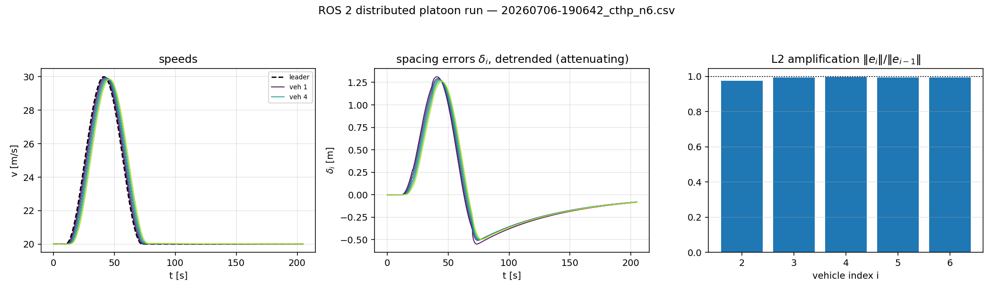
Simulation — the ROS 2 distributed backend, live
ros2 launch cacc_platoon platoon.launch.py — one OS process per vehicle, running the same control code as every other backend
Noiseless case A, 6 followers, 200 s, recorded off the live node graph. Per-hop L₂ amplification [0.976, 0.994, 0.996, 0.994, 0.994] against the offline core's uniform 0.9973 — every bar below 1, so the equations survive being distributed across OS processes.
THIS IS NOT A LOOP OVER TWELVE VEHICLES — IT IS TWELVE PROGRAMS
▪ leader · v2v_{channel} · recorder · vehicle_1…N (+ viz), each its own process, discovering each other over DDS. No shared memory, no global clock.
▪ The vehicle nodes IMPORT cacc.vehicle and cacc.controllers, so they run LITERALLY the same control-law code as the offline core — no second implementation to drift.
What the live view shows
▪ rviz2 — markers coloured green→red by |spacing error|, camera riding the platoon. Gazebo (gz-sim Harmonic) — a 3-D highway; cars are KINEMATIC, teleported to their CACC positions each tick, so it RENDERS the validated dynamics without simulating them.
What distribution costs — and why it still agrees
▪ Per-vehicle RK4, neighbour inputs held at 100 Hz, radar extrapolated by message age. WSL2 freezes every process ≈1.4 s per ≈32 s, so nodes integrate over MEASURED elapsed time and a stall causes no frame mismatch.
▪ Agreement with the core stays inside 2 % per hop under real OS jitter — the Phase-2 claim, and the run that backs it.
Under ρ = 5 noise each link draws its own realisation, so the per-hop ratios scatter around 1 (the core, run with w held 40 ms like the 25 Hz beacons, scatters over [0.948, 1.028] and brackets the ROS observations). The crisp string-stability verdict is therefore taken on the noiseless config.
The simulation
CACC under noisy V2V | 17

Slide 20
Results — the base paper reproduced, number by number
Every printed number in §IV, checked against our Simulink run (matlab/results/run_all_log.txt)
Quantity
Paper
Ours
Rel. err
Verdict
h_{w,lb} (k_{a} = 0.5)
0.9375
0.937500
0.00 %
EXACT
k_{a}* (eq. 18)
0.3183
0.318305
0.00 %
EXACT
h*_{w,lb} (eq. 19)
0.8727
0.872678
0.00 %
EXACT
k_{a} upper bound 1/(1+1/ρ)
0.8333
0.833333
0.00 %
EXACT
Case 1 max|δ₁| → max|δ₁₂|
1.593 → 1.535
1.5959 → 1.5436
0.18 / 0.56 %
attenuating
Case 2 max|δ₁| → max|δ₁₂|
0.882 → 0.886
0.8821 → 0.8872
0.02 / 0.13 %
AMPLIFYING
Case 3 max|δ₁| → max|δ₁₂|
0.802 → 0.798
0.9256 → 0.9208
15.4 %
open item
Case 4 platoon length, h = 0.95 / 0.88 s
345.0 / 324.0 m
345.00 / 324.00 m
0.00 %
EXACT
Case 5 max|a₁| → max|a₁₂|, heterogeneous τᵢ
≈0.49 → ≈0.455
0.4962 → 0.4523
≈1 %
τ∈(0,τ₀] holds
Independent cross-checks, each by a DIFFERENT route: eq. (25) residual 1.8e−12 · a 400 001-point grid search puts k_{a}* at 0.318304 vs the closed form 0.318305 · Routh–Hurwitz agrees with roots(D) · Remark 4 limits recover 0.6667 / 1.0000 / 0.5000 as ρ → ∞ · and a counterexample (k_{a}=0.5, k_{v}=0.70, k_{p}=0.009, h_{w}=1.50) fails (28a) yet has ‖H̃‖∞ = 1.000000, confirming the conditions are SUFFICIENT, not necessary.
Results
CACC under noisy V2V | 18

Slide 21
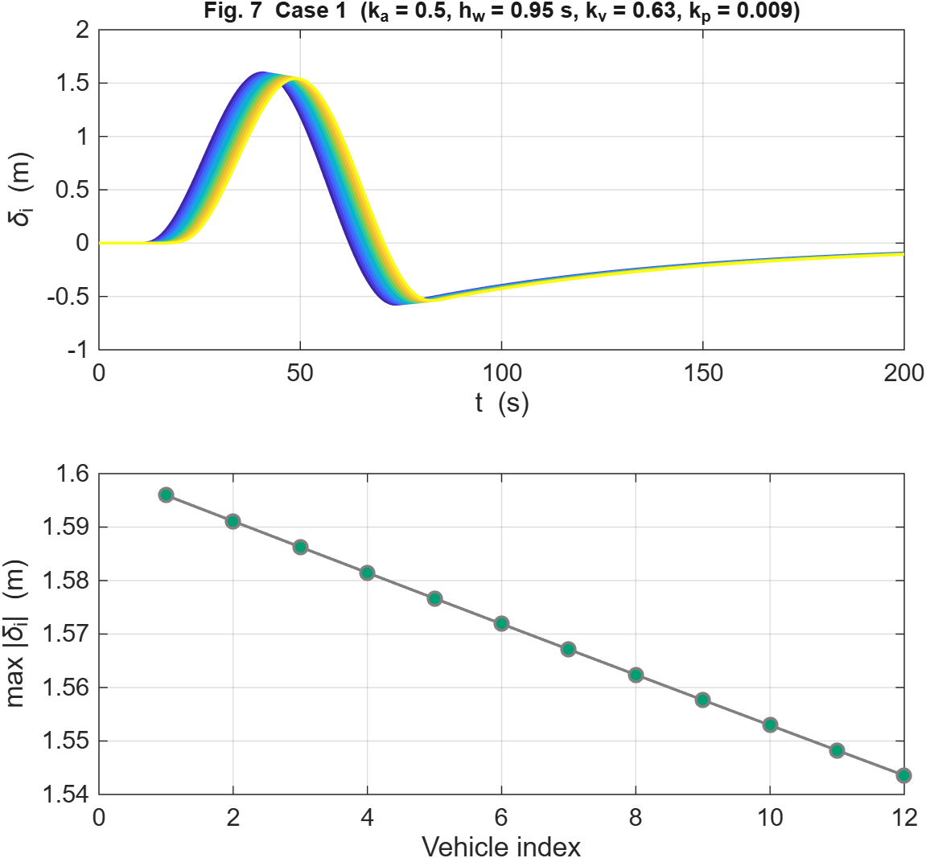
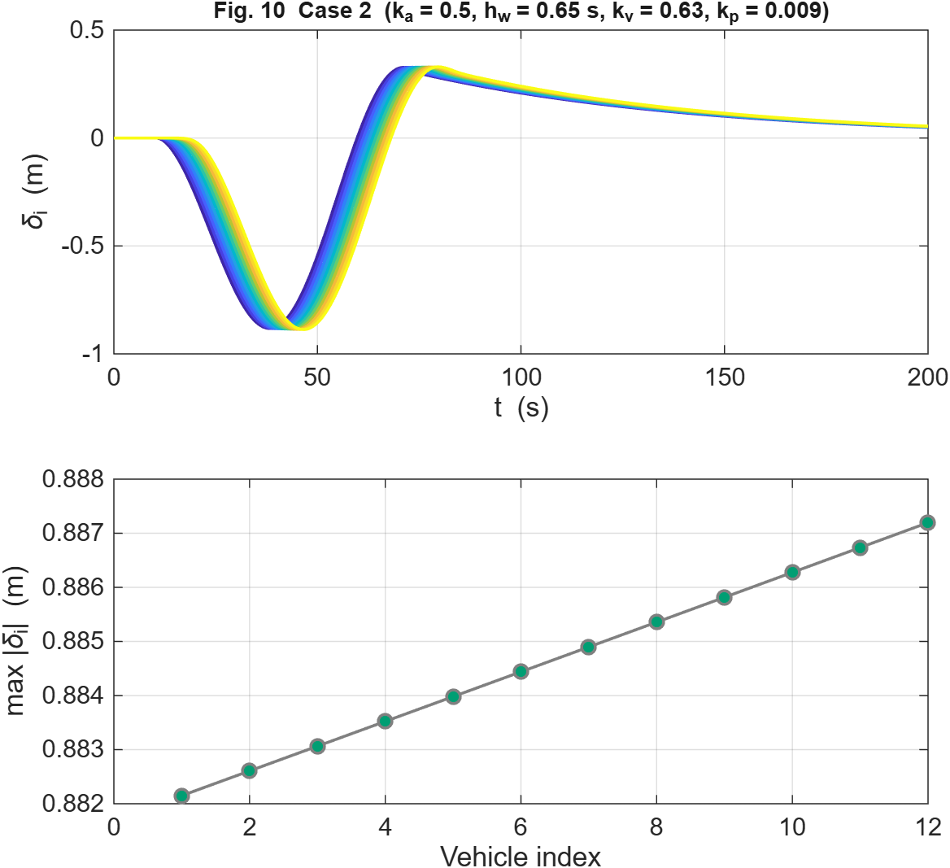
Results — time domain: attenuating vs amplifying
12 followers, 200 s, identical leader manoeuvre — only the headway differs
Case 1, h_{w} = 0.95 s > h_{lb} = 0.9375 s. Peaks SHRINK down the string: 1.5959 → 1.5436 m.
Case 2, h_{w} = 0.65 s < h_{lb}. Same gains, same leader. Peaks GROW: 0.8821 → 0.8872 m.
▪ Case 2 is the strongest single check in the whole reproduction: the headway is violated by only 6 % and the growth is 0.5 % over 11 hops, yet we match the paper to 0.02 % INCLUDING the direction of the trend.
▪ Finding — the paper's time-domain figures come from the EQUIVALENT DETERMINISTIC system (eq. 13 / Remark 5), not from stochastic realisations. We proved this by running all three channel modes: only 'mean' mode gives the monotone max|δᵢ| profiles the paper prints.
Results
CACC under noisy V2V | 19

Slide 22
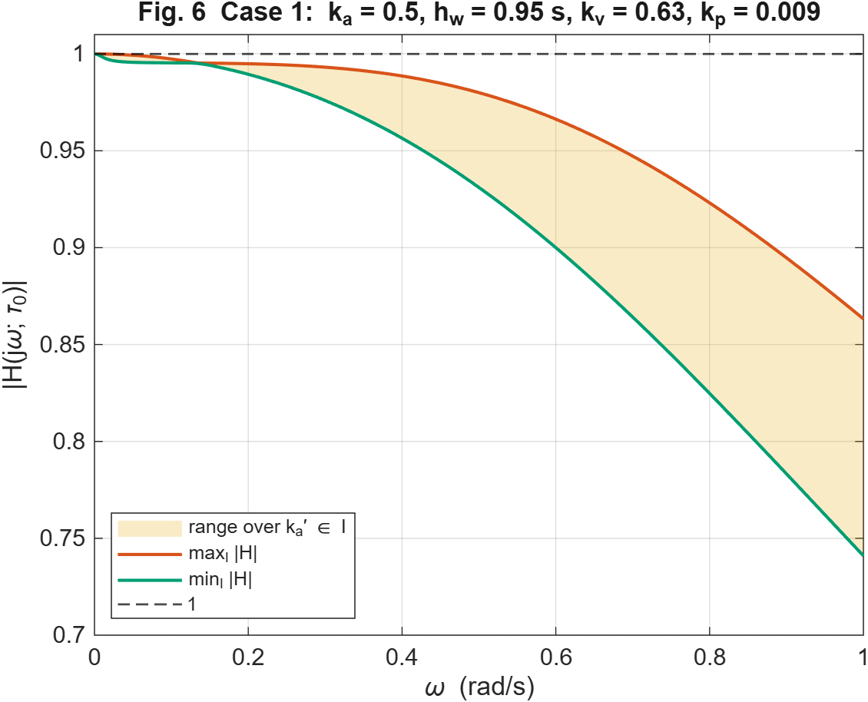
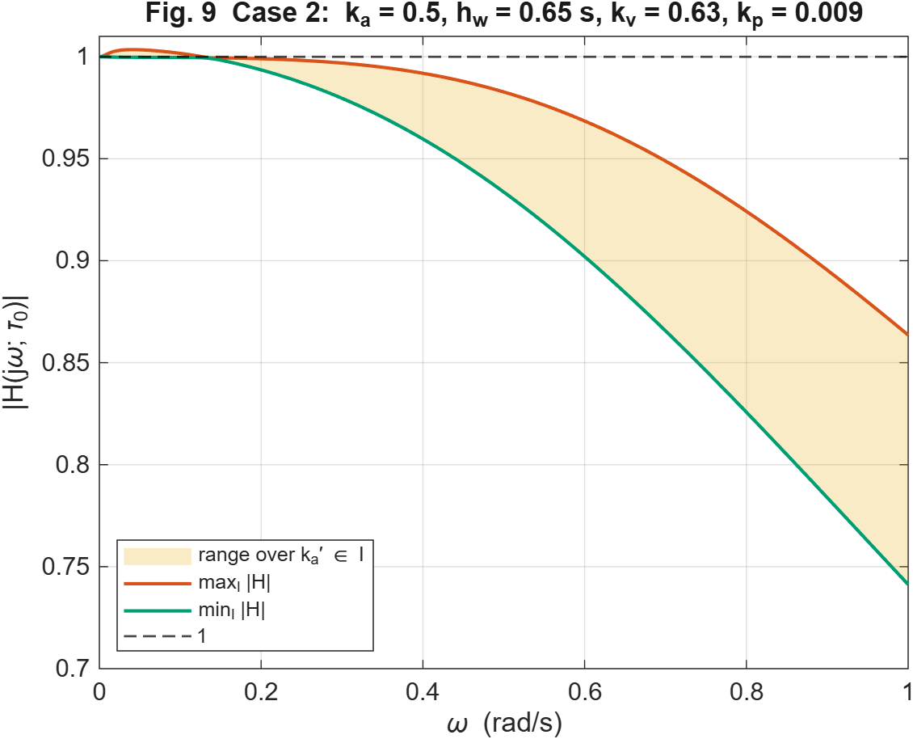
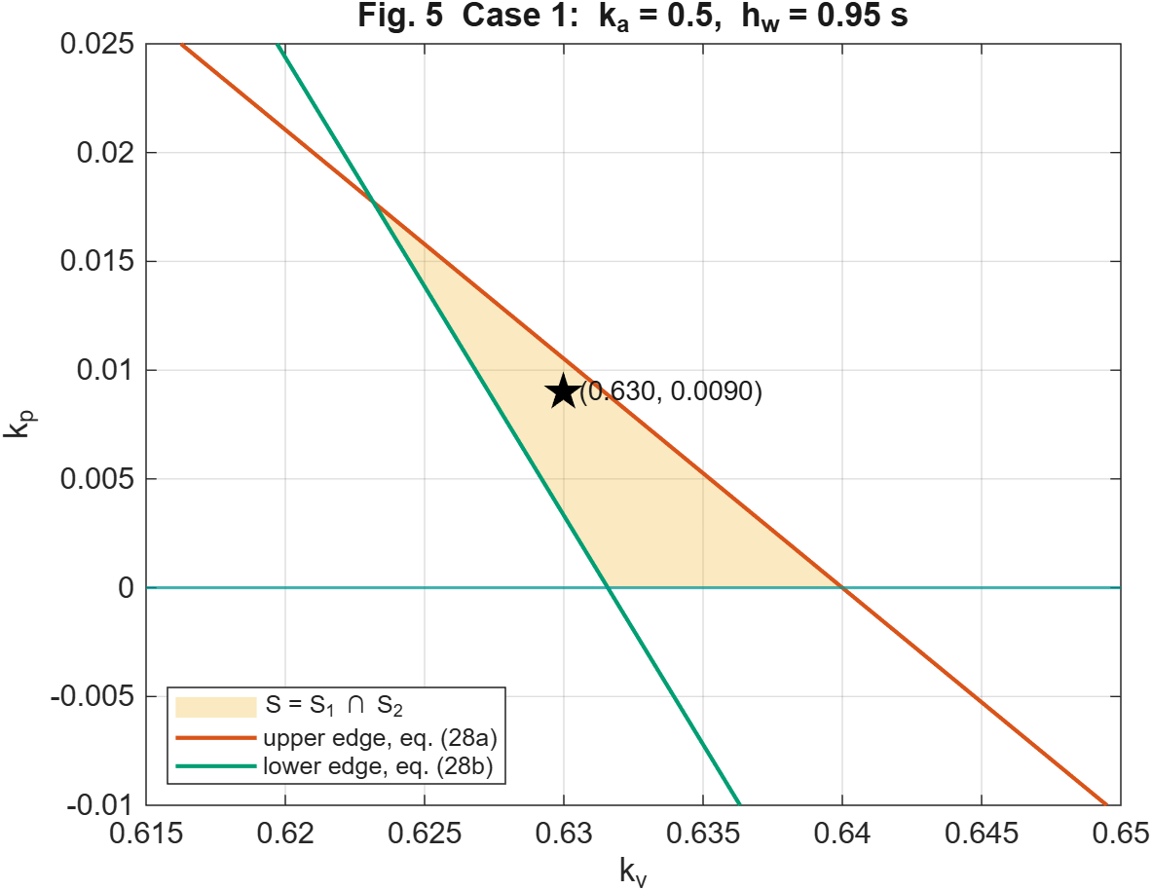
Results — frequency domain and the design space
The verdict the time traces cannot give: ‖H̃‖∞ over the whole uncertainty interval I = [(1−1/ρ)k_{a}, (1+1/ρ)k_{a}]
Case 1: sup over I and ω of |H̃| = 1.000000 → robustly string stable.
Case 2: 1.003500, i.e. 0.35 % above unity → string UNSTABLE.
The feasible (k_{v}, k_{p}) polygon; a₁/a₂ = 1.0133 > 1 ⟹ non-empty.
▪ THE LOW END OF I BINDS. Case 2 gives 1.003500 at k̃_{a} = 0.40, 1.001164 at the mean, and 1.000000 at k̃_{a} = 0.60 — so evaluating only at E[w] understates the violation 3×, and evaluating at the high end declares the design SAFE.
▪ This is why hinf_worst grids k̃_{a} across the whole interval I = [0.4, 0.6] instead of assuming which endpoint is worst.
Results
CACC under noisy V2V | 20

Slide 23
Results — the gaps we found, and what closed them
Phases 1–4 — each an assumption of the base paper, removed and measured
Phase
Gap found in the paper's design
With our extension
What it buys
1 delay
& loss
at FIXED case-A gains: noiseless h_{min}(0) = 0.789 s, and h_{min} ≤ 0.95 s only until θ ≈ 0.23 s.
packet loss 0 → 50 %: L₂ amplification 1.007 → 1.013
with the timestamp predictor at θ = 0.15 s:
‖H̃‖∞ 1.00923 → 1.00000, and h_{min}(θ) FLATLINES
DELAY, not noise, is the binding constraint — the paper's own design keeps only ≈0.2 s of budget. Loss degrades gracefully.
2 distribute
a monolithic simulator hides everything real execution adds: OS scheduling jitter, message age, per-vehicle clock skew
one OS process per vehicle on ROS 2, wall-clock substepped RK4, radar extrapolated by message-stamp age
< 2 % per-hop agreement with the offline core under real jitter — the equations survive being distributed
3 adapt
an interference zone ρ 10 → 3 → 10 with a FIXED headway leaves the platoon string-unstable for the whole time it is inside the zone
ρ̂ median {10.4, 3.1, 10.7} vs true {10, 3, 10};
median zone tracking error 4.75 %; headway opens and recovers
the channel IS estimable online from radar-vs-beacon residuals, and the estimator is conservative by construction
4 re-tune
ρ = 2 zone, headway-only adaptation:
h settles at 2.50 s with k_{v} = 0.63, in-force ‖H̃‖∞ = 1.019
⟹ STILL UNSTABLE at any headway
joint gain + headway adaptation:
h = 2.331 s, k_{v} = 0.353, ‖H̃‖∞ = 0.99999
(28a) caps γ INDEPENDENTLY of h_{w}, so below ρ* ≈ 1.8 only re-tuning works — and it lands at a SHORTER headway
Results
CACC under noisy V2V | 21

Slide 24
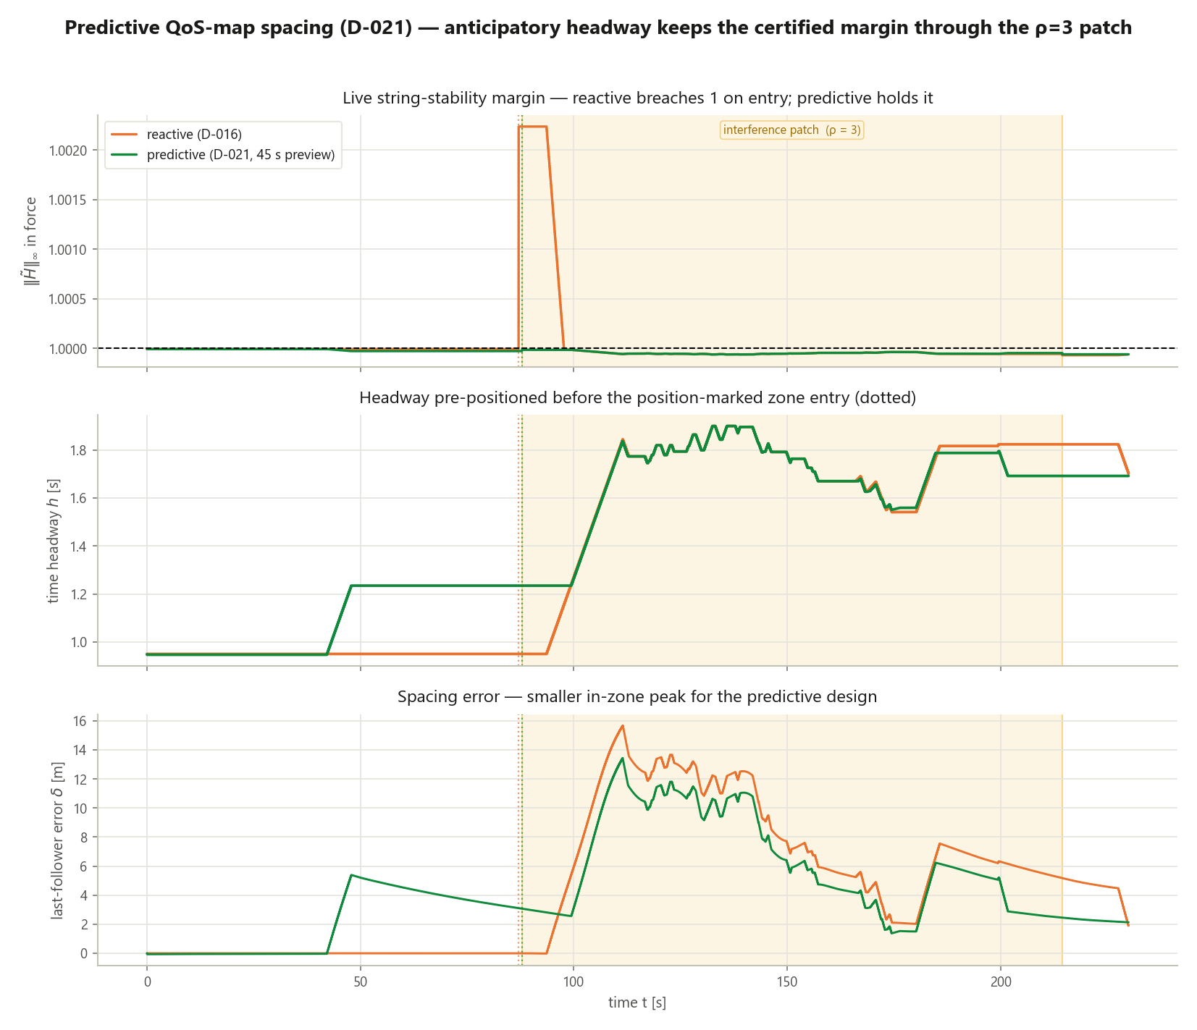
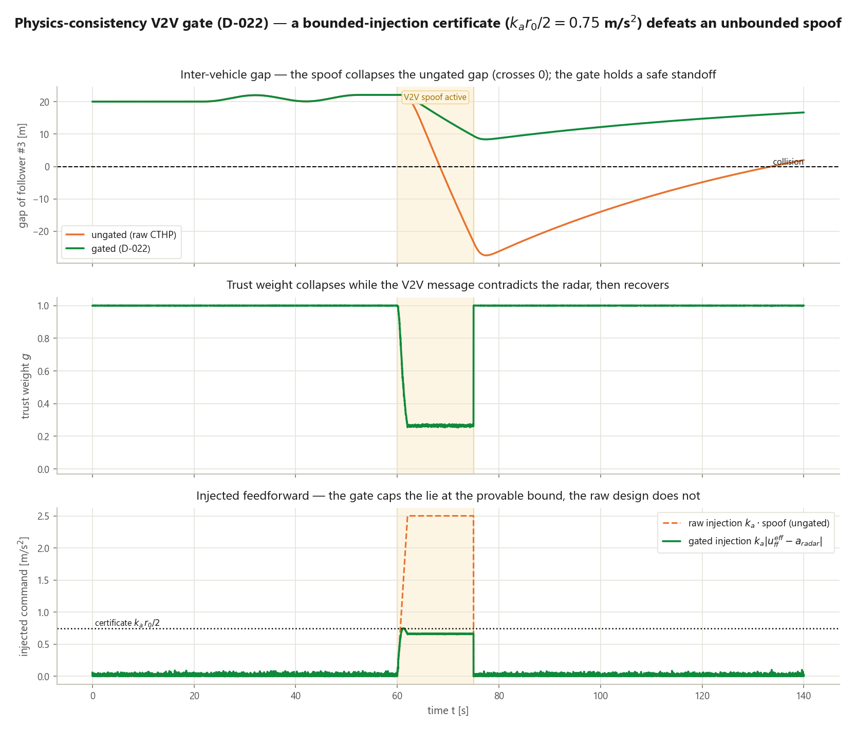
Results — flagship A and B: prediction, and surviving a liar
Predictive QoS map (D-021) · physics-consistency V2V trust gate (D-022)
5A — REACTIVE: h = 0.95 s at zone entry, ‖H̃‖∞ = 1.0022, 6.9 % of in-zone time string unstable, peak error 17.23 m. PREDICTIVE (45 s look-ahead on the ρ(x) map): h = 1.234 s already at entry, ‖H̃‖∞ = 1.0000, 0.0 % unstable, peak error 14.23 m.
5B — UNGATED under a +5 m/s² bias injected for 15 s: minimum gap −27.4 m, i.e. a COLLISION, peak error 50.5 m. GATED: minimum gap +8.37 m, no collision, peak error 14.24 m, injection capped, minimum trust weight 0.254.
▪ 5A — the platoon is already at the right headway BEFORE it enters the degraded zone, so the instability is ELIMINATED rather than merely shortened. Reacting to a channel you have already entered is late by one adaptation time constant.
▪ 5B — a predecessor-following chain has no neighbours to vote with, so consensus filtering is unavailable. The gate uses the fact that the same quantity arrives TWICE — over the radio and off the radar — and trusts the radio only as far as physics allows.
Results
CACC under noisy V2V | 22

Slide 25
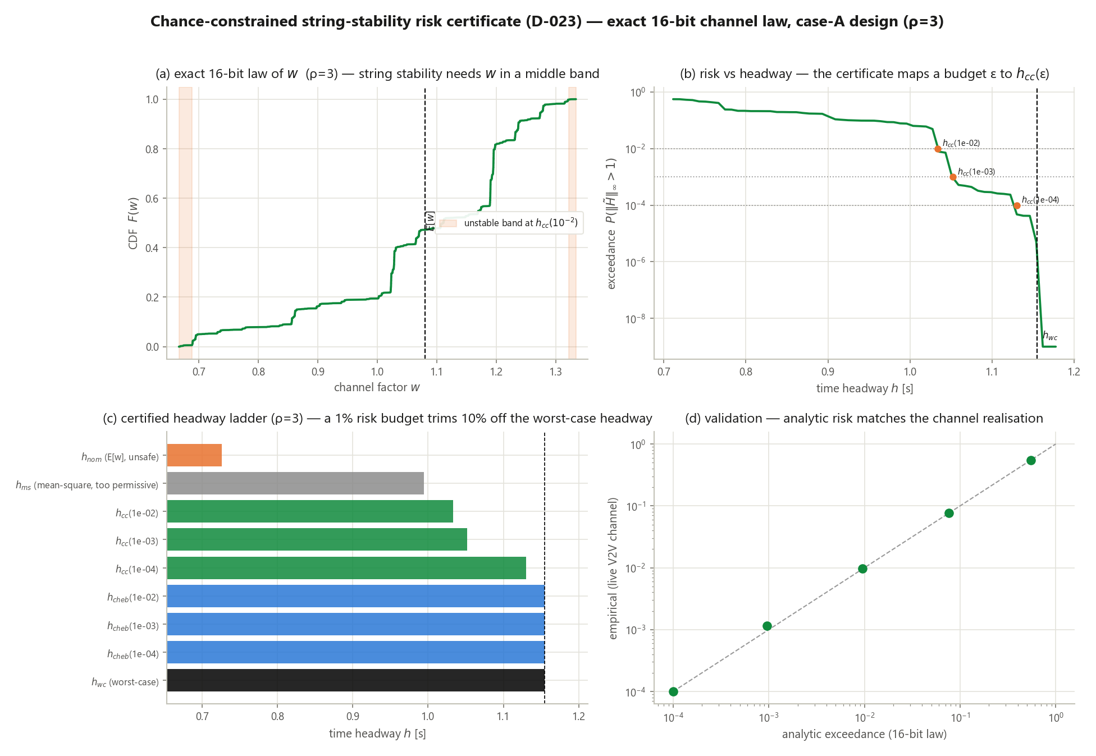
Results — flagship C: a binary verdict replaced by a priced risk
Chance-constrained string-stability certificate (D-023) — exact 16-bit channel law, case-A design
The law of w is known EXACTLY
▪ 2¹⁶ = 65 536 atoms, obtained by convolving the 16 Bernoulli bit laws. So there is no need to BOUND — we can INTEGRATE.
At ρ = 3, case-A gains
worst case h = 1.1544 s (exceedance 0)
chance-constrained h = 1.0334 s (exceedance 0.0095)
chance-constrained h = 1.0522 s (exceedance 0.0010)
mean-square h = 0.9944 s (exceedance 0.076)
▪ −10.5 % headway for a calibrated 1-in-100 risk budget; the analytic and Monte-Carlo exceedances agree to 3–4 decimals.
▪ The mean-square criterion is reported but REJECTED: 7.6 % exceedance at ρ = 3 is far too permissive to certify with.
Worst-case design pays full price for events of probability 10⁻⁶. This states the price instead — a regulator sets ε, and the method returns the headway.
Results
CACC under noisy V2V | 23

Slide 26
The verdict, and what this project concludes
Monte-Carlo certification harness (D-018) — and the six things this project claims
CERTIFIED
0.00 %
87
1e−4
the harness verdict
reproduction error
unit tests green
Python ↔ Simulink
4 scenario families × seeds;
11 numeric checks, ALL PASS
on all four of the paper's
closed forms
the paper's printed numbers
pinned as assertions
an independent re-derivation,
not a re-run of the code
▪ Three criteria per certification run — theory (in-force ‖H̃‖∞ ≤ 1), time domain (per-hop L₂), and SAFETY: minimum gap on the NONLINEAR simulation, because actuator saturation sits outside the linear envelope ‖H̃‖∞ describes.
▪ 1. The base paper reproduces EXACTLY — the credibility anchor for everything else.
▪ 2. Its guarantee is real but THIN, and it is DELAY, not noise, that consumes the margin.
▪ 3. A fixed design cannot survive a changing channel — and headway alone cannot save it below ρ* ≈ 1.8.
▪ 4. The channel IS estimable online, and the estimate is conservative by construction.
▪ 5. A calibrated risk budget is cheaper AND more honest than a worst case.
▪ 6. Reproducibility is the deliverable — 87 pinned tests, seeded noise, three independent backends.
Verdict
CACC under noisy V2V | 24

