Slide 1

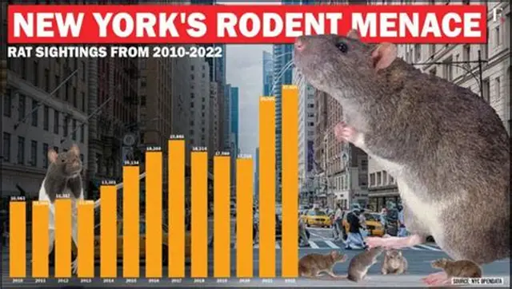
RatGuard NYC
CS101
Technical Design Project
Samuel Reyes
Prof. Hasan Hessvacio

Slide 2
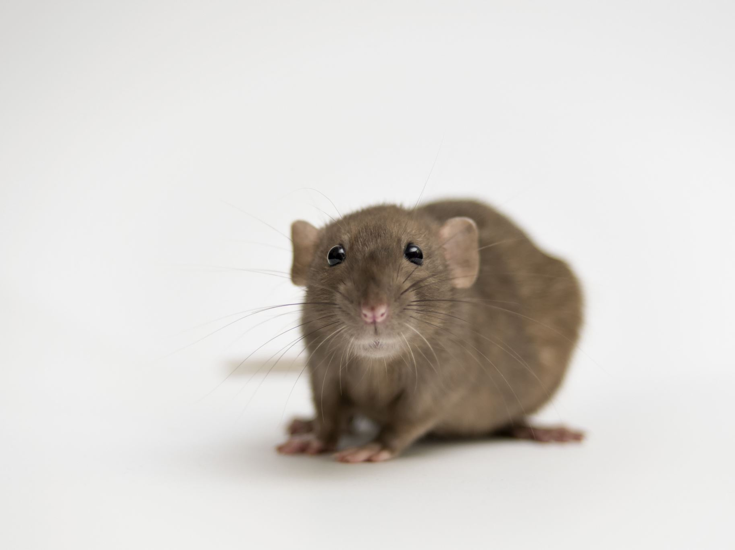
The Problem
NYC faces persistent rat infestations causing health risks and sanitation issues.

Slide 3

Why It Matters
Public health threats
Damage to businesses
• Increased city costs
• Quality of life impact

Slide 4

The Solution
Camera-based rat detection system using AI + C++ logic for risk assessment and alerts.

Slide 5

How It Works
1. AI analyzes city camera video
2. Sends detectedRats value
3. C++ processes inputs
4. Outputs risk level and actions

Slide 6
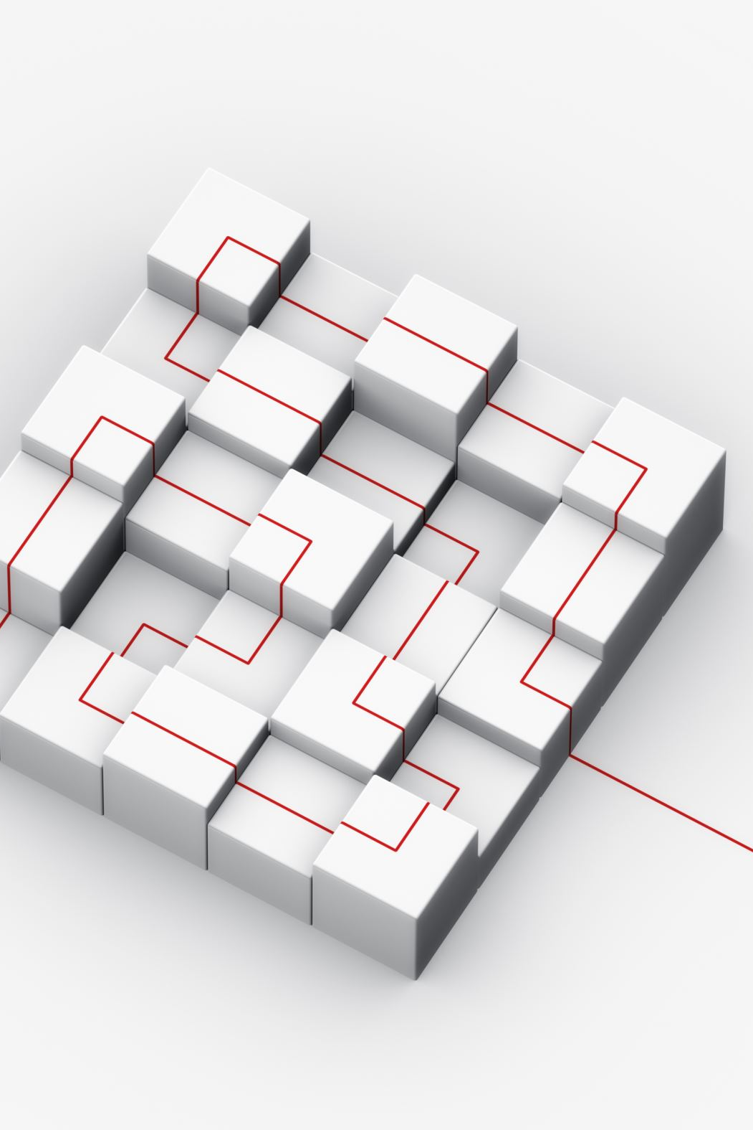
Architecture
Inputs: detectedRats, trashLevel, userReports, isNightTime
Outputs: risk level + recommended actions

Slide 7
Pseudocode Summary
IF detectedRats > 3 → HIGH
IF trashLevel > 80 AND isNightTime → HIGH
Else → MEDIUM/LOW

Slide 8
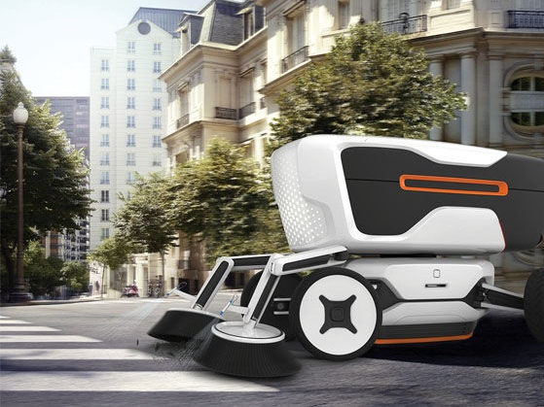
Impact
Cleaner streets, safer neighborhoods, proactive rat control, scalable solution
This Photo by Unknown Author is licensed under CC BY-NC

