Slide 1
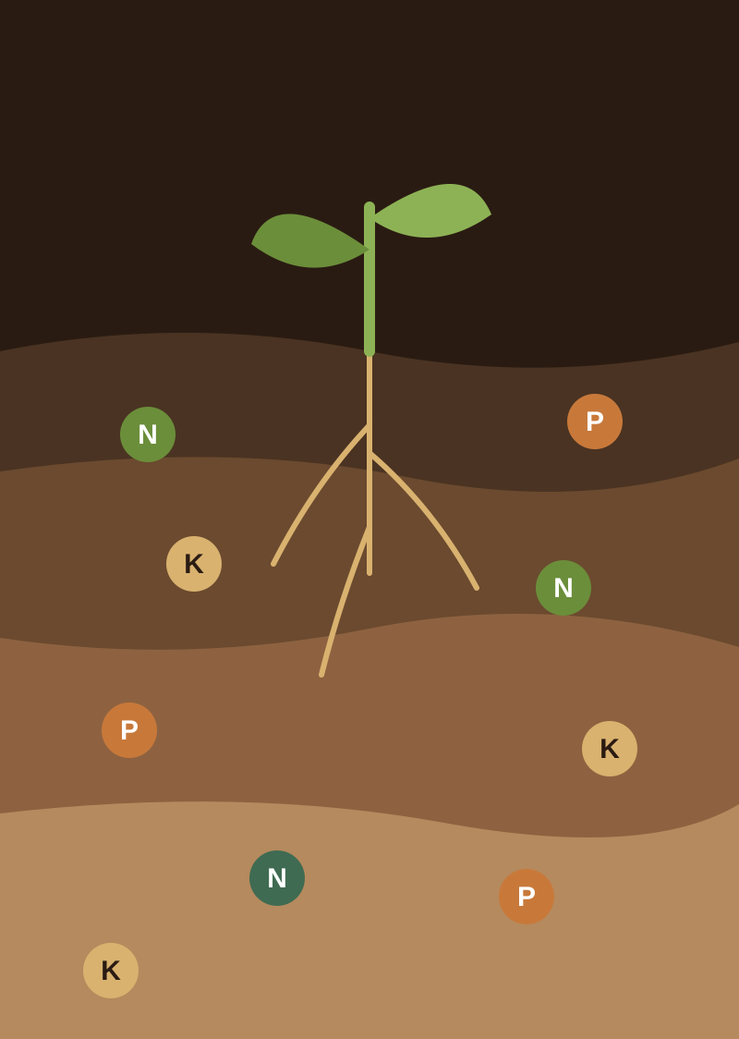
Soil Nutrients with PCA and Feature Engineering
Data cleaning, feature engineering and dimensionality reduction for soil analysis
Team 17
M. Mohana Asmitha | 2520030486
D. Khyathi Saranya | 2520030488
R. Bhavitha | 2520030489

Slide 2
Abstract and introduction
Abstract
Introduction
This project analyses soil nutrient data in three stages. Data cleaning handles missing values, duplicates and invalid readings. Feature engineering builds meaningful attributes from nitrogen, phosphorus, potassium, pH and moisture. PCA then reduces the correlated features to a few principal components that keep the key patterns, revealing the major factors behind soil nutrient variation.
Soil quality drives crop growth, but soil data has many correlated measurements that are hard to interpret together. Clean data and well-designed features make the analysis reliable, and PCA gives a simpler view of the same information. The result supports visualisation, soil classification and better agricultural decisions.

Slide 3





Software requirements
Operating system
Windows / Linux / macOS (any system that runs Node.js)
Language
TypeScript with React 19
Tools and libraries
Vite, Tailwind CSS, Lucide icons, Motion
Algorithms
PCA (Jacobi eigenvalue method) and k-NN, built from scratch
Dataset
Crop-recommendation soil data: N, P, K, temperature, humidity, pH, rainfall

Slide 4
Project execution: end to end
1
2
3
4
Data collection
Data cleaning
Outlier check
Feature engineering
470 soil samples across 22 crops: N, P, K, climate, pH
Impute missing values, drop duplicates, fix invalid readings
IQR fences flag unusual samples for review
8 derived features such as moisture index and N:P ratio
5
6
7
8
Standardisation
PCA
Major factors
Validation
Z-score scaling puts all features on one scale
Covariance matrix and eigen-decomposition give the components
Loadings show what drives each component
k-NN on all features versus 3 components

Slide 5
Dataset: attributes taken and cleaned
Stage | Source data | Stress test (noise added)
Total records (rows) | 470 | 470
Original attributes (7 numeric + crop label) | 8 | 8
Missing values imputed (median) | 0 | 37
Duplicate records removed | 0 | 0
Invalid values corrected (clamped) | 0 | 43
Outliers flagged (IQR, 1.5 x) | 89 | 99
Engineered features added | 8 | 8
Features used in PCA | 7 | 7
The stress test injects synthetic missing and invalid values to show each cleaning step working. Outliers are flagged, not removed.

Slide 6
Modules and why they exist
Module | Purpose | Why needed
Data cleaning | Impute, de-duplicate, fix invalid values | Bad readings distort every later step
Feature engineering | Moisture index, NPK ratios, fertility index | Raw values miss nutrient relationships
Standardisation | Z-score scaling of every feature | PCA is sensitive to differing units
PCA engine | Covariance matrix and eigenvectors | Compresses correlated features
Factor analysis | Loadings and variance per component | Explains what drives soil variation
ML check | k-NN on original vs PCA features | Tests what information PCA keeps
Yield predictor | Crop suitability and expected yield | Turns analysis into advice

Slide 7

Why feature engineering and PCA?
Feature engineering
Principal Component Analysis
Combines raw readings into indicators such as the moisture index and N:P ratio
Z-score scaling gives every feature equal weight
Flags unusual samples and corrects impossible values
Turns correlated features into uncorrelated components
Packs the largest variance into the first few components
Makes 7 features viewable in 2D or 3D plots
Together: clean, well-designed features give PCA a reliable input, so a few components capture the main patterns in soil nutrient variation.

Slide 8
PCA results: variance explained
72.8%
of variance kept by 3 components (orange), cutting 7 features to 3
96.9%
of variance kept by 5 components

Slide 9
Major factors behind soil variation
Component | Variance | Main drivers | Soil factor
PC1 | 31.8% | Moisture index, rainfall, humidity | Water availability
PC2 | 26.5% | Potassium, phosphorus | K-P nutrient reserve
PC3 | 14.5% | Humidity, nitrogen (against rainfall) | Humidity-nitrogen balance
PC4 | 13.3% | Soil pH | Soil acidity
PC5 | 10.8% | Nitrogen, phosphorus (against humidity) | N-P supply
Together, PC1 to PC5 explain 96.9% of the variance in the standardised soil data.

Slide 10
Evaluation and validation
k-NN (k = 5) predicts the crop from soil features across 22 classes
Fixed 80/20 split: 376 training and 94 test samples
3 components keep 72.8% of variance and about 86% of the full-feature accuracy
The stress test shows the same pattern (87.2% vs 75.5%)

Slide 11



Conclusion and future work
Cleaning, feature engineering and PCA turn 7 correlated soil features into 3 components that keep 72.8% of the variation
Water availability, the potassium-phosphorus reserve and pH emerge as the main factors behind soil nutrient variation
Future work: soil classification models, more soil properties and real field data, and decision support for fertiliser planning

Slide 12
Thank you
Questions?
M. Mohana Asmitha | D. Khyathi Saranya | R. Bhavitha

