Slide 1

The Action Potential
Dr David Benton

Slide 2
Summary…..
The Na-K- ATPase:
transports Na and K ions across the cell membrane
establishes ionic gradients across the cell membrane
Electrogenic- generates a potential difference across cell membrane
Selective ion channels allow Na⁺ and K⁺ ions to pass through the membrane
At rest:
K⁺ ions are near equilbrium. M.P. ~ -70 mV
Na⁺ ions out of equilibrium – net gradient into the cell

Slide 3
Action potential
+30
0
Membrane potential (mV)
B
C
Threshold
-50
A
A
-100
D
1
2
3
4
5
Time (ms)

Slide 4
Action
Potential
basis
Na channel
K channel
B
C
Na⁺
A
A
Resting
membrane
D
A
K⁺
Channel activation gate
Na⁺
B
Depolarisation
K⁺
Inactivation gate
Na⁺
C
Repolarisation
K⁺
Na⁺
D
After-hyperpolarisation
K⁺

Slide 5
Action potential conduction
Na⁺
UNMYELINATED
_
+
_
AXON
Depolarised region
AXON
_
_
MYELINATED
+
Myelin sheath
Saltatory conduction
Depolarised node

Slide 7
Multiple Sclerosis
AXON
AXON
TEA- tetraethylammonium
4-AP- 4-aminopyridine

Slide 8


Slide 9
Local anaesthetics block conduction of action potentials
Chemical
Structure
Aromatic
Group
Ester or
Amide
Basic side chain
2º/3º amine
O
H
2
N
O
C
H
3
N
PROCAINE
C
H
3
C
H
3
N
H
N
C
H
3
LIGNOCAINE
(LIDOCAINE)
O
C
H
C
H
3
3

Slide 10
Local anaesthetics: Site of Action
LA + H⁺
LA⁺
Axon
LA + H⁺
LA⁺
Schwann cell
LA + H⁺
LA⁺
Na⁺
Na
channel

Slide 11
Local anaesthetics: Mechanism of Action
Outside
Membrane
Inside
LA
LA + H⁺
Hydrophilic
pathway
Na⁺
OPEN Na
Channel
LA⁺
Hydrophobic
pathway
LA⁺
CLOSED Na
Channel
LA
LA

Slide 12
Administration of Local anaesthetics
TOPICAL – Skin, Cornea, Oropharynx
(b) INFILTRATION – Injection around nerve endings
(c) PERIPHERAL NERVE BLOCK – Injection close to major sensory nerve trunks
(d) CENTRAL NERVE BLOCK – Injection into:
Subarachnoid space to produce SPINAL anaesthesia
(ii) EPIDURAL anaesthesia to anaesthetise specific nerve roots in the
lumber region of the vertebral column.

Slide 13
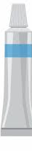
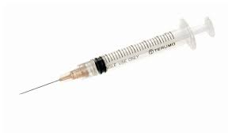
Local anaesthetics routes of administration - Peripheral
Topical
Intradermal
Subcutaneous
Epidermis
Dermis
Subcutaneous
Muscle

Slide 14
Local anaesthetics routes of administration - Central
Vertebral column
Spinal cord
Dura mater
Arachnoid membrane
Lumbar 2 = L2
Subarachnoid
space
L3
Spinal nerves
L4
Epidural injection
L5
Intrathecal injection
Spinal anaesthesia
CSF
Filum terminale

Slide 15
Local Anaesthetics
Local Anaesthetic | Ester (E) or Amide (A) linkage | Use | Duration of Action
Cocaine | E | Not used | Short (<30min)
Procaine | E | b - d | Short
Lignocaine (Lidocaine) | A | a - d | Intermediate (2-3 hr)
Prilocaine | A | a - d | Intermediate
Amethocaine (Tetracaine) | E | a | Long (>3hrs)
Bupivacaine | A | c, d | Long
Benzocaine | E | a | Long
a – Topical
b - Infiltration
c - Peripheral block
d – Central block

Slide 16
SYNAPSE
AXON
Na
channels
Na⁺
Ca
channels
Synaptic
Cleft
Muscle
Acetylcholine receptors - Nicotinic

Slide 17
End plate potential & ACh concentration
+50
Muscle action potential (all-or-nothing)
0
Membrane potential (mV)
Transmission success
Transmission failure
-50
Threshold for action potential
Nerve stim
End plate potential (graded amplitude)
Synaptic delay
-100
0
5
10
Time (ms)

Slide 18
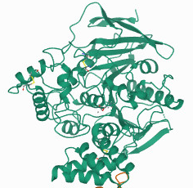
Termination of
transmitter
action
AXON
Choline uptake carrier
ACh
Choline
ACh
ACh
Na⁺
Na⁺
Acetate
ACh
ACh
ACh
Na⁺
Muscle
K⁺
Acetylcholine receptor - Nicotinic

Slide 19
Synthesis of transmitter
AXON
AcCoA = Acetyl Coenzyme A
mitochondria
Choline uptake carrier
Vesicular
Acetylcholine
Transporter
(VAChT)
Acetate
Choline
AcCoA +
Choline acetyltransferase
Na⁺
H⁺
ACh
Na⁺
ACh
ACh
Acetate
Na⁺
Muscle
Acetylcholinesterase
K⁺
Acetylcholine receptor - Nicotinic

Slide 20
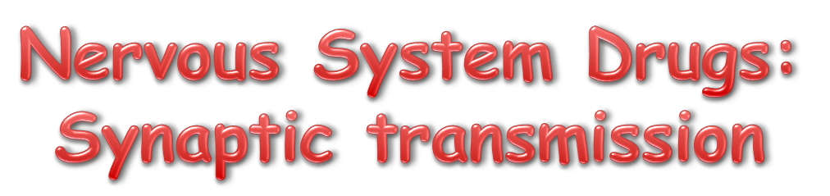

Slide 21
Drugs affecting Neurotransmission
Site of Action
1. Affecting neurotransmitter synthesis (presynaptic)
2. Inhibiting neurotransmitter release (presynaptic)
3. Affecting nicotinic acetylcholine receptors (postsynaptic)

Slide 22
Drugs affecting
neurotransmitter
synthesis
AXON
Choline
acetyltransferase
Choline uptake carrier
Triethylcholine (TEC)
Hemicholinium
Choline
ATEC
ACh
Choline
Na⁺
Na⁺
Na⁺
Na⁺
ATEC
ACh
Na⁺
Muscle
False
transmitter
K⁺
Reduced ACh
Acetylcholine receptors

Slide 23
Drugs affecting transmitter release – presynaptic site(s)
Inhibitors of Release
1. Local anaesthetics
2. Divalent cations – Mg, Cd, Co, Mn
3. Toxins – Botulinum toxin, β-bungarotoxin, tetrodotoxin
4. Antibiotics – Aminoglycoside antibiotics:
streptomycin, neomycin, kanamycin
Potentiators of Release
K⁺ channel blockers: Tetraethylammonium, 4-Aminopyridine

Slide 24
Drugs affecting neurotransmission – postsynaptic site(s)
Neuromuscular blockers / muscle relaxants
1. Non-Depolarizing, Competitive blockers
2. Depolarizing, Non-Competitive blockers

Slide 25
1. Non-Depolarizing, Competitive blockers (B)
NORMAL
+ BLOCKER
ACh
ACh
B
B
Outside
Membrane
Inside
Na⁺
Na⁺
K⁺
K⁺
Acetylcholine receptor
Ion channel

Slide 26
2. Depolarizing, Non-Competitive blockers (D)
ACh
D
D
Outside
Prior to Block
Membrane
Inside
Na⁺
Initial stage of Block
K⁺

Slide 27
2. Depolarizing, Non-Competitive blockers (D)
Na⁺
Na⁺
D
D
Later stages
of Block
D
K⁺
K⁺
Channel Block
Receptor Desensitisation

Slide 28
Non-Depolarizing Neuromuscular Blockers
Blocker | Relative Potency | Duration of Action
Tubocurarine | 1 | Medium-Long (20-30min)
Pancuronium | 5 | Medium
Gallamine | 0.2 | Medium
Alcuronium | 1 | Medium-Long
Atracurium | 0.9 | Medium
Vecuronium | 3 | Short-Medium (<20 min)

Slide 29
Depolarizing Neuromuscular Blockers
Blocker | Use | Duration of Action
Suxamethonium | Clinically used for intubation | Few mins broken down by esterases
Decamethonium | Expt use only | -
Suxethonium | Expt use only | -

