Slide 1
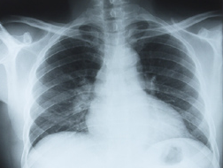
PHOL0001
Structure and Function of the
Respiratory System
Structure and Function of the
Respiratory System
Dr Jigisha Patel
Image:Photos.com

Slide 2
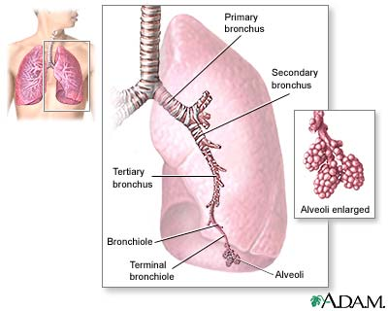
Respiratory System Structure
The major features of the lungs include the bronchi, the bronchioles and the alveoli. The alveoli are the microscopic blood vessel-lined sacks in which oxygen and carbon dioxide gas are exchanged.
  Nasal cavity / Mouth
  Trachea (generation 1)
  Bronchi (3-4,5-11)
  Bronchioles (12-16)
  Respiratory Bronchioles (17-19)
  Alveoli (23)
  ~17 million branches,
  ~300 million alveoli and
  60- 80m² surface area.
Notes:
The major features of the lungs include the bronchi, the bronchioles and the alveoli. The alveoli are the microscopic blood vessel-lined sacks in which oxygen and carbon dioxide gas are exchanged.

Slide 3
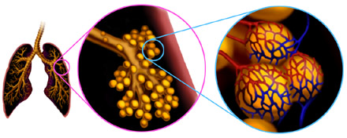
Lung Structure
http://www.smm.org/heart/lessons/lesson7.htm

Slide 4
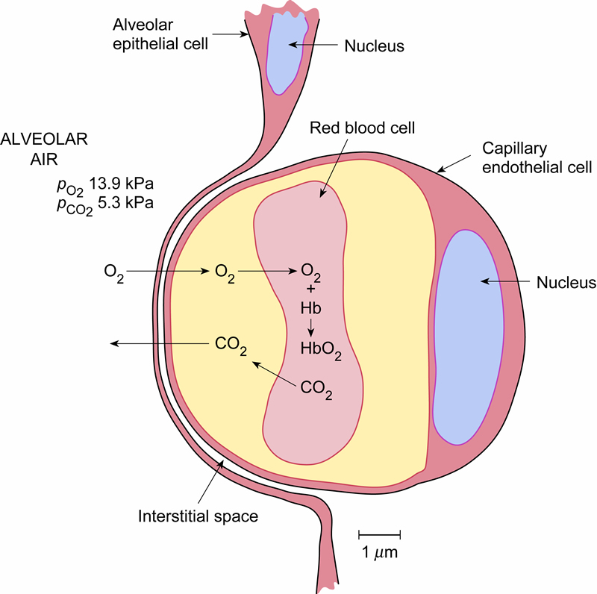
Alveolar Epithelial Structure

Slide 5
What is Boyle’s Law?
This theory was discovered by Sir Robert Boyle, a 17th century scientist. The theory known as Boyle's Law states:
If the temperature remains constant, the volume of a given mass of gas is inversely proportional to the absolute pressure.

Slide 6
PV=kT Pressure * Volume = Constant * Temperature
Boyle's Law involves a relationship between three properties of a gas in a container.
The volume of the container -- denoted V. Volume is measured in units of length^3 – cubic centimeters or cubic inches.
The pressure of the gas -- denoted P. Pressure is measured in units of force per area -- pounds per square inch.
The temperature of the gas -- denoted T.
Temperature is in many ways more complicated than pressure or volume.– degrees Fahrenheit, degrees Celsius, or degrees Kelvin.

Slide 7
how do we explain Boyle’s Law?
Pressure is inversely proportional to the volume of the container, assuming the temperature remains the same, in other words, constant.
Pressure increases when the volume goes down.
Pressure decreases when the volume goes up.

Slide 8

Boyle’s Law P=1/v and every day life?
When you have a timed test (the “volume of time” is decreased) will your pressure increase or decrease?
When the “volume” of exams increases how is your pressure?

Slide 9

p₁v₁ = p₂v₂ helps calculate the decrease or increase of the pressure of the people in the box
P=1/v or pressure is inversely proportional to volume
Imagine if each of these people were molecules and we kept squeezing the box of people smaller. What would happen?

Slide 10
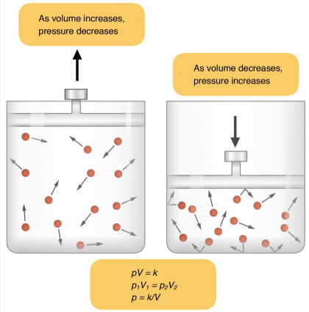
BOYLE’S LAW
Boyle’s law describes the relationship between volume and pressure in a gas at a constant temperature.
Boyle discovered that the pressure of a gas is inversely proportional to its volume: If volume increases, pressure decreases.
Ventilation is dependent on three types of pressure:
  atmospheric
  intra-alveolar
  interpleural.
https://courses.candelalearning.com/anatomyphysiology/chapter/chapter-22-the-respiratory-system-2/

Slide 11
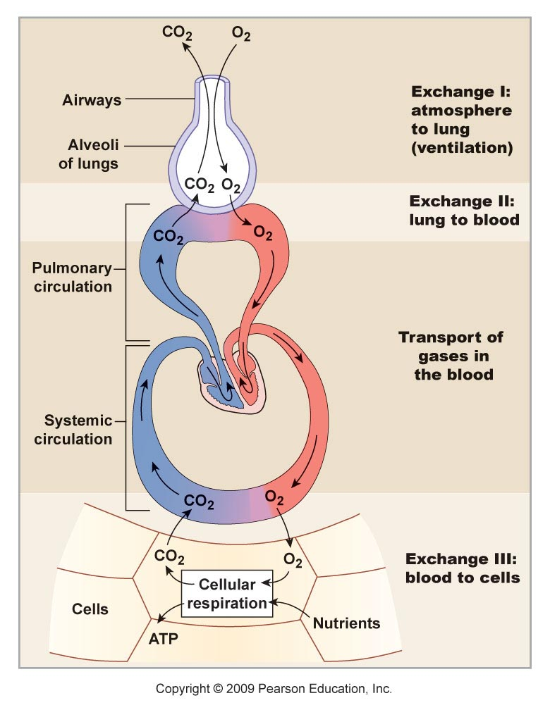
Schematic View of Respiration
External Respiration
Internal Respiration

Slide 12
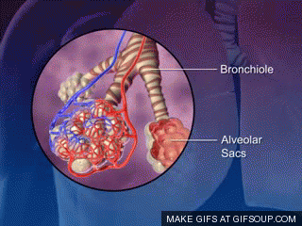
RESPIRATORY MOVEMENTS
Respiration occurs in two phases namely inspiration and expiration.
INSPIRATION
thoracic cage enlarges and lungs expand so that air enters the lungs easily.
EXPIRATION
the thoracic cage and lungs decrease in size
attain the pre inspiratory position so that air leaves the lungs easily.

Slide 13
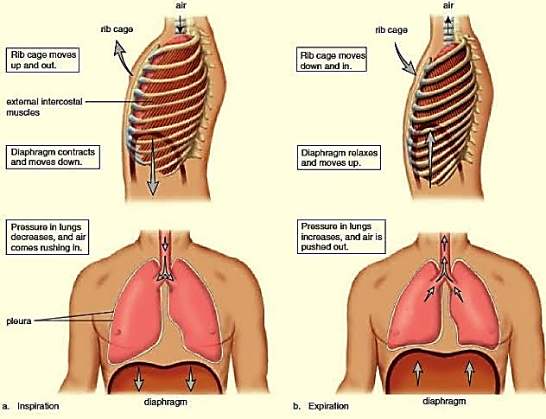

Slide 14
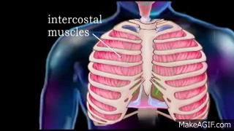
MUSCLES OF RESPIRATION
Muscles involve in respiratory movements are two types
Inspiratory muscle
Expiratory muscle
Each muscle subdivided into two categories
Primary or major respiratory muscles-responsible for change in size of thoracic cage
2. Accessory respiratory muscles - help primary respiratory muscles during forced respiration.

Slide 15
Inspiratory Muscles
Muscles involved in inspiratory movements are known as inspiratory muscles.
Primary inspiratory muscles
the diaphragm, which is supplied by phrenic nerve (C3 to C5)
external intercostal muscles, supplied by intercostal nerves(T1 to T11).
Accessory inspiratory muscles
Sternocleidomastoid,
scalene,
anterior serrati,
elevators of scapulae and
pectorals

Slide 16
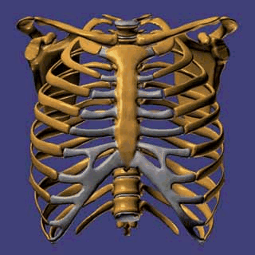
MOVEMENTS OF THORACIC CAGE
Inspiration causes enlargement of thoracic cage.
Thoracic cage enlarges because of increase in all diameters, viz. anteroposterior, transverse and vertical diameters.
Anteroposterior and transverse diameters of thoracic cage are increased by the elevation of ribs.
Vertical diameter is increased by the descent of diaphragm.
In general, change in the size of thoracic cavity occurs because of the movements of four units of structures:
1. Thoracic lid
2. Upper costal series
3. Lower costal series
4. Diaphragm.

Slide 17
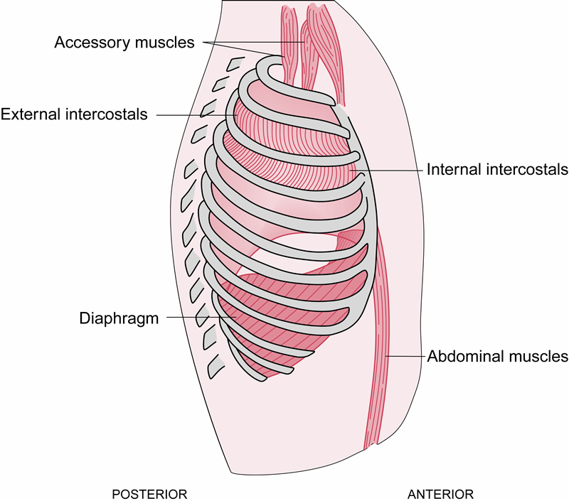
Inspiration
Intrapleural Pressure is < atmospheric pressure
(Boyle’s Law)
Muscles used:
    Diaphragm
    External intercostal
Thoracic volume increases
External Intercostals
Diaphragm
Notes:
For inspiration to occur the pressure in the alveoli has to be below that of the atmosphere. Inspiration is initiated by the contraction of the diaphragm and the inspiratory intercostal muscles. The enlargement of the lung causes an increase in size of the alveoli throughout the lung, the pressure within the alveoli drops below atmospheric (Boyle's law) and the difference in pressure causes a bulk flow of air into the alveoli. By the end of inspiration the pressure in the alveoli is again atmospheric.

Slide 18
Expiration
Alveolar pressure is > atmospheric pressure
• Passive at rest
• Muscles used during exercise
  Internal intercostal
  Abdominal
Internal Intercostal
Abdominal Muscles
Notes:
At the end of inspiration the nerves to the diaphragm and inspiratory intercostal muscles progressively cease firing and these muscles smoothly relax. As the lungs shrink, air in the alveoli becomes temporarily compressed and therefore alveolar pressure exceeds atmospheric. Therefore air flows from the alveoli through the airways out into the atmosphere. Thus expiration at rest is a passive process.
Under certain conditions (during exercise for example) expiration of larger volumes is achieved by contraction of the internal intercostal muscle and the abdominal muscles which actively decrease the volume of the thorax.

Slide 19
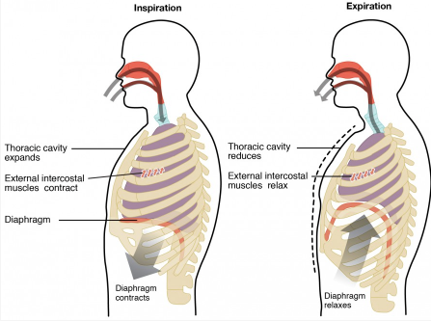

Inspiration/Expiration
Inspiration Expiration
Bucket
handle
Increased lateral diameter of the thoracic cavity
Thoracic cavity
expands
Thoracic cavity
reduces
External intercostal muscles contract
External intercostal muscles relax
Diaphragm
Diaphragm
contracts
Diaphragm
relaxes
https://courses.candelalearning.com/anatomyphysiology/chapter/chapter-22-the-respiratory-system-2/
Notes:
There are different types, or modes, of breathing that require a slightly different process to allow inspiration and expiration. Quiet breathing, also known as eupnea, is a mode of breathing that occurs at rest and does not require the cognitive thought of the individual. During quiet breathing, the diaphragm and external intercostals must contract.
In contrast, forced breathing, also known as hyperpnea, is a mode of breathing that can occur during exercise or actions that require the active manipulation of breathing, such as singing. During forced breathing, inspiration and expiration both occur due to muscle contractions. In addition to the contraction of the diaphragm and intercostal muscles, other accessory muscles must also contract. During forced inspiration, muscles of the neck, including the scalenes, contract and lift the thoracic wall, increasing lung volume. During forced expiration, accessory muscles of the abdomen, including the obliques, contract, forcing abdominal organs upward against the diaphragm.

Slide 20
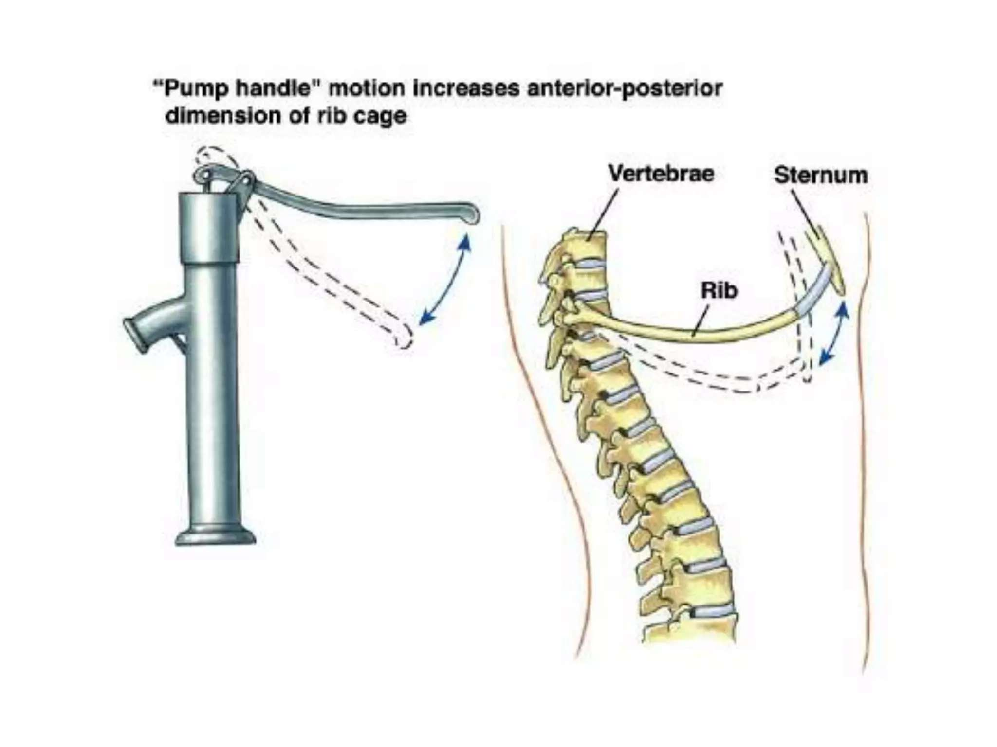
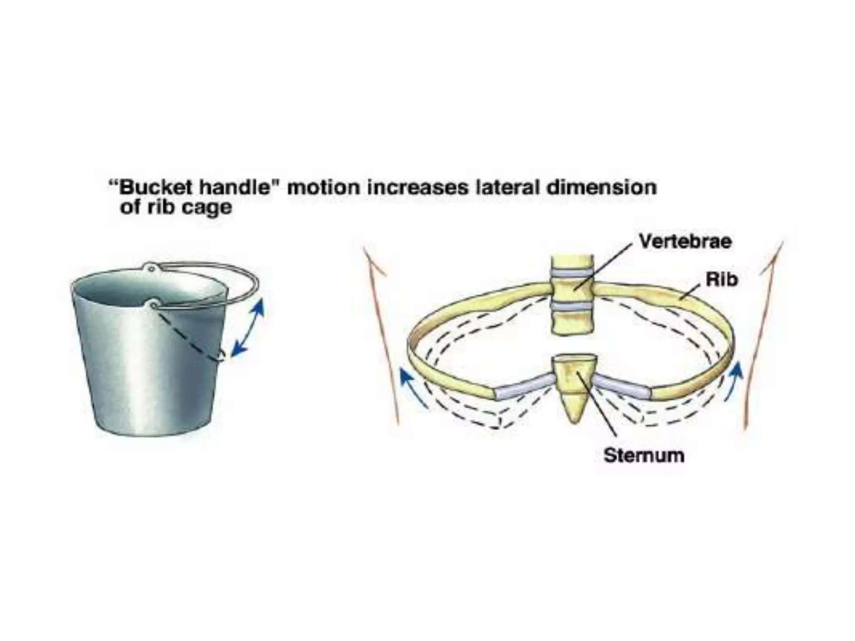

Slide 21
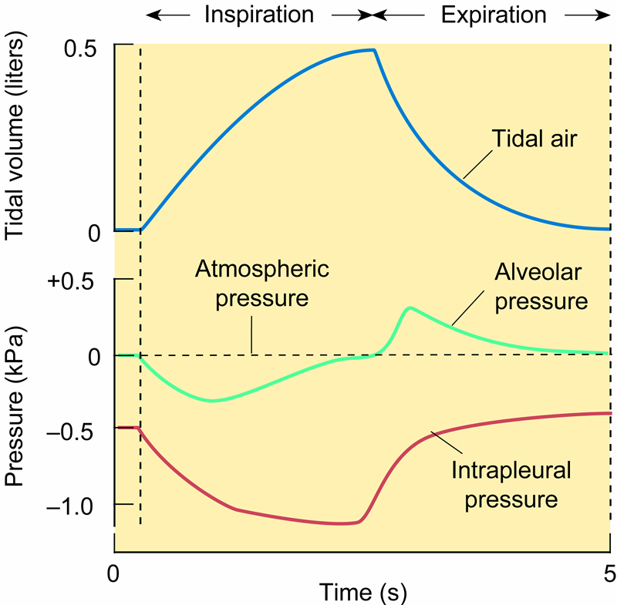
Pressure Changes During The Respiratory Cycle
Intrapleural pressures rises and the volume of the lung decreases
As the chest expands alveolar and intrapleural pressures fall

Slide 22
How Much Work Do The Lungs Have To Do?
Lung Compliance
“The change in the volume of the chest that results from a given change in intrapleural pressure is called compliance”.

Slide 23
What Is Compliance?
Lung compliance is a measure of the ease with which the lungs can be inflated:-
Compliance (C) = Change in lung volume Change in inflation pressure
Compliance = L/cmH₂O or L/kPa
Change in lung volume = ΔV
Change in inflation pressure = ΔP
Thus: C = ΔV
ΔP

Slide 24
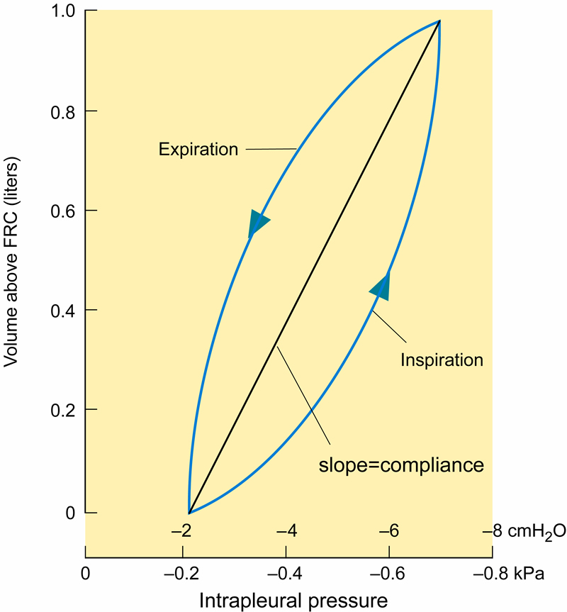
Lung Compliance
Functional
Residual
Capacity

Slide 25
Lung Compliance
Lung compliance depends equally on:
the elasticity of the lung tissue and,
the surface tension forces at the gas/liquid interface within the lung i.e. within the alveoli.
To provide the required changes in lung volume and changes in inflation pressure required for breathing.

Slide 26
Laplace’s Law
The relationship between the radius (r) of a small bubble of air in liquid, the transmural pressure (P) across the wall of the bubble and the surface tension (T) at the air/liquid interface is described by Laplace's equation:
P = 2T
r
Chest
wall
Elastic tissue
Gas
Surface
tension
Notes:
Remember to Pronounce name as French “La Plaaase”!

Slide 27
Consequences Of Laplace’s Law
  P = 2T
r
If T is constant, then the pressure in small alveoli will be greater than that in larger alveoli. As a result air will move from small to large alveoli.
Thus small alveoli will require higher pressures to inflate them.

Slide 28
Surface Tension
  The most important determinant of lung compliance is surface tension at the air/water interfaces within the alveoli.
  Fortunately the type II alveolar cells produce a phospholipid known as pulmonary surfactant which markedly reduces the cohesive forces on the alveolar surface.
  Therefore surfactant lowers the surface tension and increases lung compliance, making the lungs easier to expand.
Hydrohphobic
Hydrohphilic

Slide 29
Surfactant
A mixture of phospholipids - mainly dipalmitoyl lecithin
Continuously produced by TYPE II Alveolar cells
It is used and then broken down
Amount present is a balance between production and breakdown rates - these may vary - e.g trauma and hypoxia (low oxygen levels) increase breakdown
Activity depends on surface area - larger effect on smaller areas
First produced about 4th month gestation but not fully produced until about 7th month
Problems of insufficiency - collapse of alveoli and difficulty expanding small ones (Infant Respiratory Distress Syndrome)

Slide 30
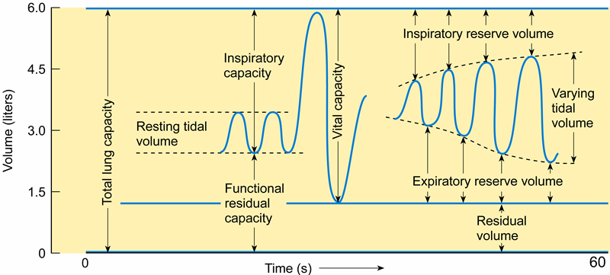
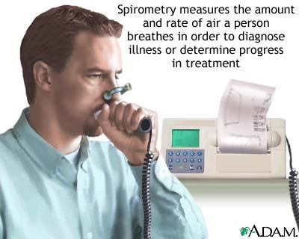
Static Lung Volumes
Notes:
http://www.healthscout.com/ency/1/imagepages/1142.html

Slide 31
Static Lung Volumes
Lung volumes can be either static or dynamic.
Static volumes are independent of the speed with which they are measured:-
    Tidal Volume (VT)
    Functional Residual Capacity (FRC)
    Total Lung Capacity (TLC)
    Residual Volume (RV)
    Vital Capacity (VC)
    Dead Space
Also:- Inspiratory Capacity (IC) = TLC - FRC
Inspiratory Reserve Volume (IRV) = TLC - (VT + FRC)
Expiratory Reserve Volume (ERV) = FRC - RV

Slide 32
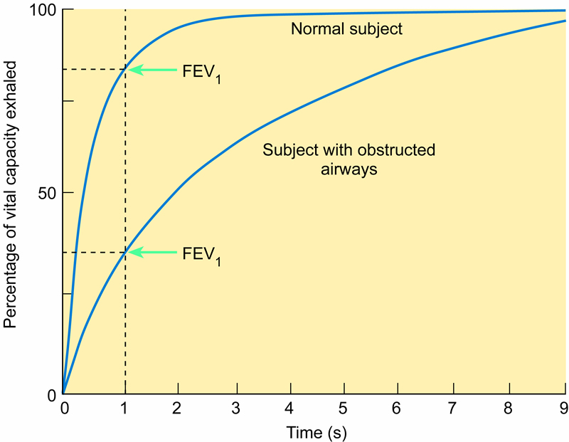
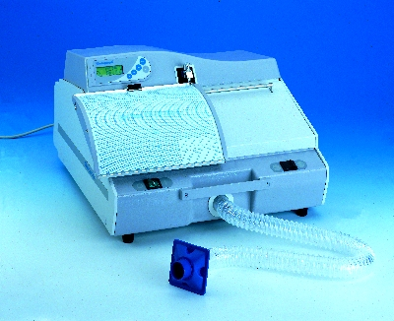
Dynamic Lung Volumes
A low FEV₁/FVC ratio is indicative of an OBSTRUCTIVE disease

Slide 33
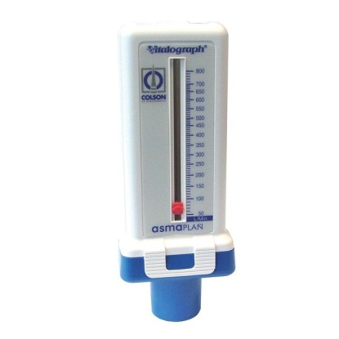
Dynamic Lung Volumes
Dynamic lung volumes:-
  Forced Vital Capacity (FVC)
  Forced Expired Volume in 1 second (FEV₁)
FEV₁ Forced Expiratory Ratio
FVC
PEFR Peak expiratory flow rate - (Maximum rate at which expiration occurs)

Slide 34
GAS TRANSPORT
  OXYGEN
  CARBON DIOXIDE

Slide 35
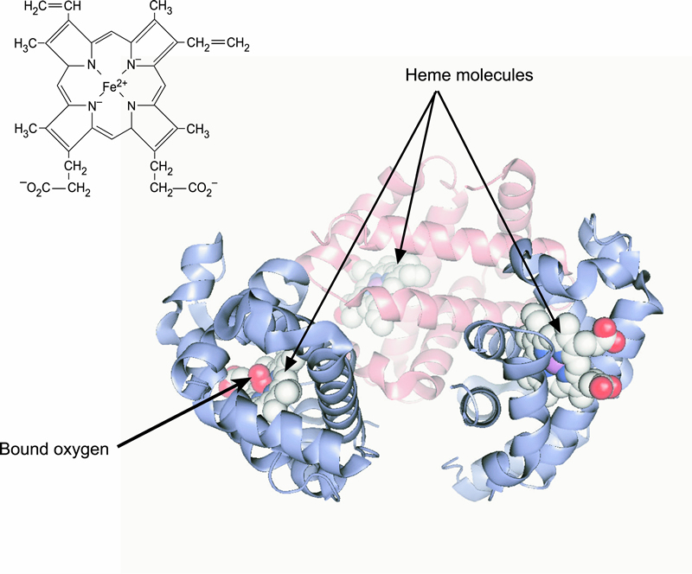
HAEMOGLOBIN – O2 BINDING
Each haem group
contains Fe2+
that can combine
with O2
Hb contains
4 globin
molecules
each with a
haem group

Slide 36
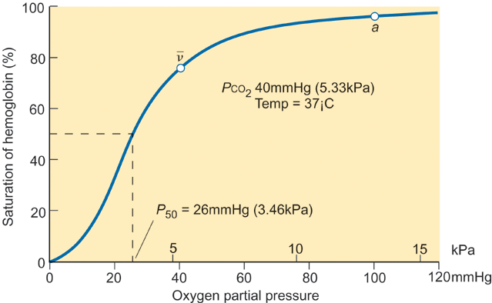
HAEMOGLOBIN SATURATION
Venous Blood-
75% saturation
Arterial Blood-
97% saturation

Slide 37
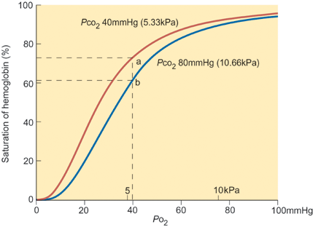
O₂ DISSOCIATION CURVE
Bohr effect
The shift to the right decreases the affinity of haemoglobin for oxygen

Slide 38
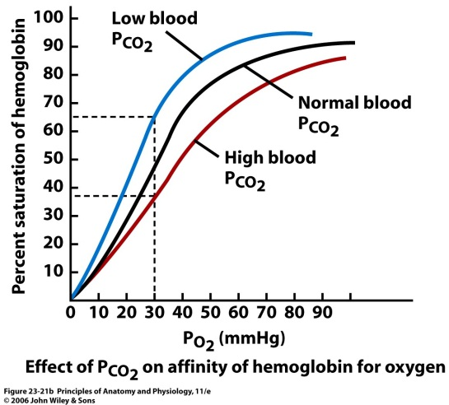
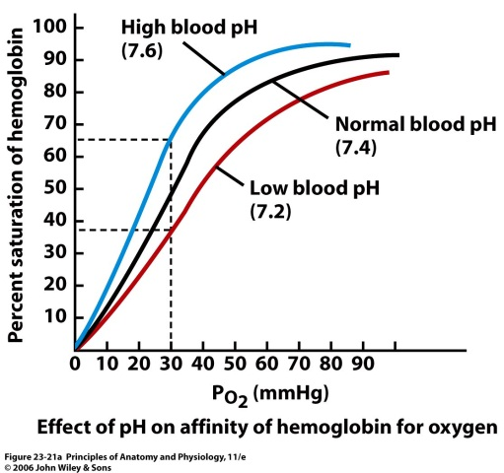
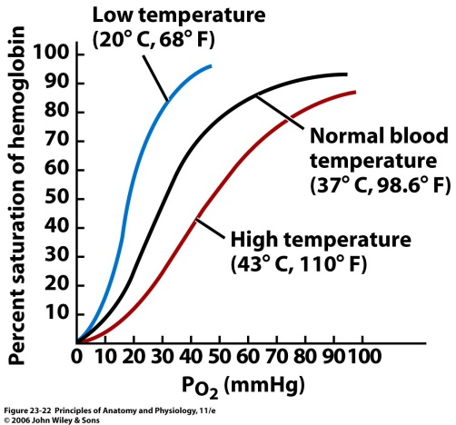
OXYGEN/ HAEMOGLOBIN DISSOCIATION CURVES
Oxygen/Haemoglobin dissociation curves are affected by:-
PCO₂ Acidity Temperature
And, 2,3 BPG (2,3-bisphosphoglycerate) formerly known as 2,3-DPG (diphosphoglycerate)

Slide 39
O₂ DISSOCIATION CURVE
Bohr effect
Increasing Pco₂, [H⁺], Temperature & 2,3-BPG
The shift to the right decreases the affinity of haemoglobin for oxygen

Slide 40
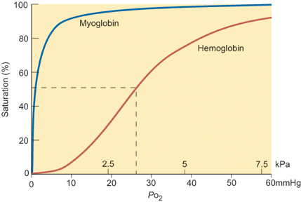
CHANGES IN O₂ AFFINITY
Myoglobin
Fetal
Haemoglobin
Adult
Haemoglobin

Slide 41
GAS TRANSPORT
  OXYGEN
  CARBON DIOXIDE

Slide 42
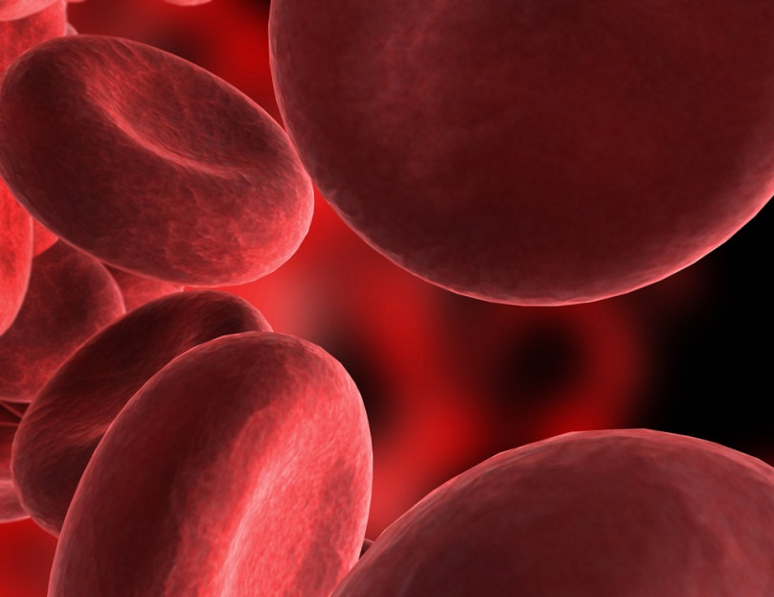
CARBON DIOXIDE
Carbon dioxide is carried in the blood in THREE different forms -
  Dissolved gas
  Bicarbonate
  Carbamino compounds
5-10%
CO₂ dissolved in plasma
80-90%
Carried as HCO₃⁻ in red blood cells
5-10%
CO₂ chemically combined with Hb

Slide 43
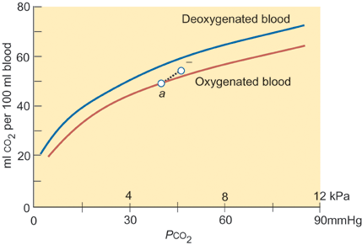
CO₂ DISSIOCIATION CURVE
CO₂ has an increased solubility as at a given partial pressure there is 50ml CO₂/100ml compared to 15ml O₂/100ml
No plateau
Normal Range
(narrower than
O₂ 5.3-13kPa)

Slide 44
CO₂ DISSIOCIATION CURVE
Venous Blood-
75% saturation
Haldane effect
This shift means that the uptake of CO₂ from tissues is increased.
Arterial Blood-
97% saturation

Slide 45
LEARNING OBJECTIVES
The basic anatomical organisation of the respiratory system
Defining the muscle mechanisms of breathing
Be able to annotate a spirometry trace
Understand lung compliance
Define Laplaces’s law and the role of surfactant
Understand gas transport and dissociation in blood

Slide 46
Breathing Animation
Basic
https://www.youtube.com/watch?v=ktroUMRxS9Y
Overview
https://www.youtube.com/watch?v=3oYFCQvC-0Q
Notes:
The two lungs are the primary organs of the respiratory system. Other components of the respiratory system conduct air to the lungs, such as the trachea (windpipe) which branches into smaller structures called bronchi.
The process of breathing (respiration) is divided into two distinct phases, inspiration (inhalation) and expiration (exhalation). During inspiration, the diaphragm contracts and pulls downward while the muscles between the ribs contract and pull upward. This increases the size of the thoracic cavity and decreases the pressure inside. As a result, air rushes in and fills the lungs.
During expiration, the diaphragm relaxes, and the volume of the thoracic cavity decreases, while the pressure within it increases. As a result, the lungs contract and air is forced out.

