Slide 1
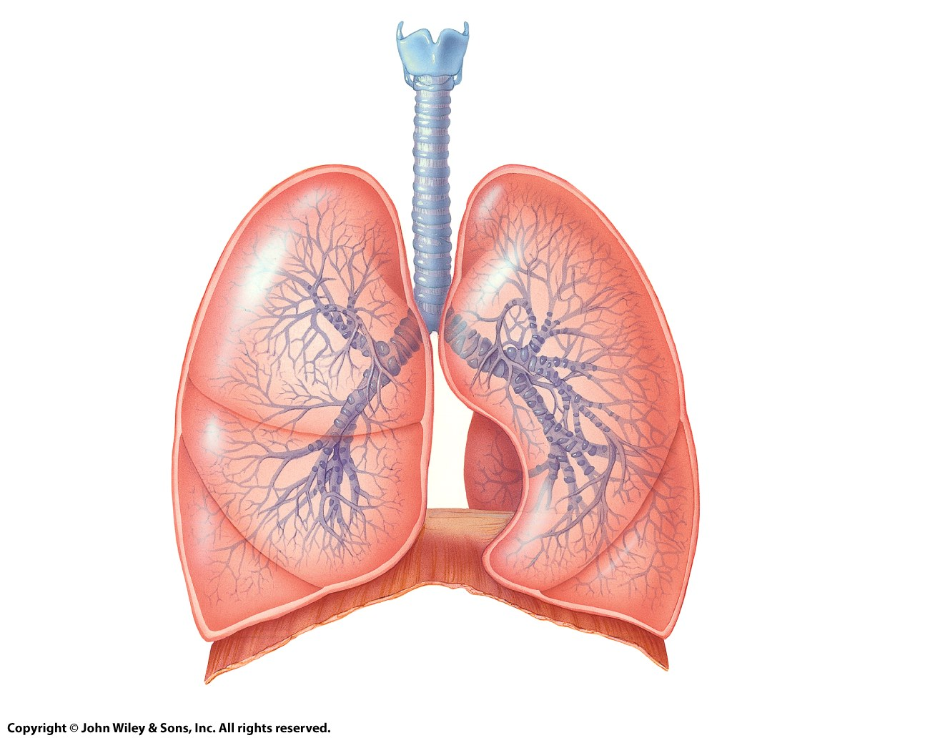
GAS TRANSPORT
AND
EXCHANGE
GAS TRANSPORT
AND
EXCHANGE
Dr Jigisha Patel

Slide 2
LEARNING OBJECTIVES
Gas transport and gas exchange:
Understand the principles of gas exchange between the alveoli and the pulmonary capillaries
Understand the ventilation perfusion ratio and how is alters across the lung
Be able to calculate the partial pressures of gasses
Explain pulmonary blood flow and its regulation
Understand Fick’s Law
Define the alveolar ventilation and dead space
Explain airway resistance and Poiseuille’s Law.

Slide 3
GASEOUS EXCHANGE
Oxygenated blood returned to heart
Air movement
Deoxygenated blood from heart
Alveolar Sac
Alveoli
CO₂
O₂

Slide 4
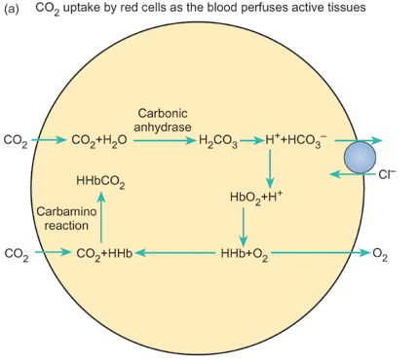
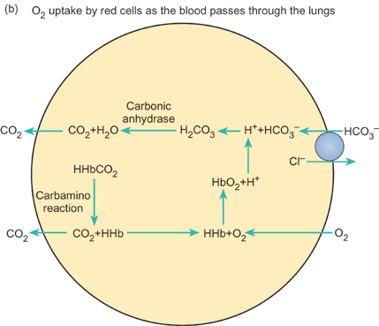
CO₂ AND O₂ EXCHANGE
Notes:
Unlike the systemic circulation the pulmonary circulation is a low pressure, low resistance system in which the pulmonary capillaries offer the greatest resistance to blood flow at rest.
Oxygen must move across the alveolar membranes into the pulmonary capillaries, be transported by the blood to the tissues, leave the tissue capillaries and enter the extracellular fluid, and finally cross plasma membranes to enter the cells. Carbon dioxide must follow a similar path in reverse.

Slide 5
ALVEOLAR GASES
Room air is mainly a mixture of nitrogen and oxygen with variable amounts of water and a tiny percentage of carbon dioxide. Alveolar gases differ from the air we breath in as it is saturated with water, the levels of oxygen is reduced as it diffuses into the pulmonary circulation and thus carbon dioxide concentrations rise.
 | Nitrogen | Oxygen | CO₂ | Water
Inspired air | 78.5% | 20.9% | 0.04% | 0.5%
Expired air | 74.5% | 15.8% | 3.5% | 6.2%
Alveolar air | 74.9% | 13.7% | 5.2% | 6.2%

Slide 6
SOLUTE EXCHANGE
Most solute exchange between plasma in the capillaries occurs by diffusion.
As the capillaries are the principle exchange vessels there density determines the total surface area for exchange.
If the density is high there will be a large surface area and a relatively short distance between capillaries. Consequently the delivery of oxygen and other nutrients is very efficient.
The exchange is passive and can be described by Fick’s Law.

Slide 7
FICK’S LAW OF DIFFUSION
Fick’s Law States :
“The amount of a substance moving from one region to another depends on the area available for diffusion, the concentration gradient, and a constant known as the diffusion coefficient”. Thus:
Amount moved = area X concentration gradient x diffusion coefficient
Membrane
Concentration 1
Concentration 2
Area

Slide 8
FICK’S LAW OF DIFFUSION
Substances move from the plasma to the tissues or from the tissues to the plasma by diffusion down their concentration gradients. Diffusion is a passive process.
Fick’s Law States :
“The amount of a substance moving from one region to another depends on the area available for diffusion, the concentration gradient, and a constant known as the diffusion coefficient”. Thus
Amount moved = area X concentration gradient x diffusion coefficient
Or J = - D A dC
dx
The negative sign indicates that diffusion occurs from a region of high to a region of low concentration. Thus the diffusion coefficient becomes smaller as the molecular size increases so that large molecules diffuse more slowly than small ones.

Slide 9
DIFFUSION CAPACITY
Thus the rate of diffusion across the alveolar membranes is governed by Fick’s Law.
The ability of the lungs to ensure equilibration between the blood in the pulmonary capillaries and the alveolar air is measured by its diffusion capacity.
The diffusion capacity is defined as the volume of gas that diffuses through the alveolar membranes per time for a given partial pressure difference.
Diffusion capacity = volume of gas diffusing between the alveoli and blood
partial pressure in alveolar air – partial pressure in pulmonary capillaries
To estimate this we use Carbon monoxide as in alveolar capillaries this will be zero as it binds so strongly to Hb. Thus:
Diffusion capacity = volume of CO
partial pressure in the alveoli of CO

Slide 10
DIFFUSION CAPACITY
In a normal health individual diffusion capacity for CO measured by the single-breath method give values of :
225ml min⁻¹ kPa⁻¹ or 30ml min⁻¹ mmHg⁻¹ at rest.
The diffusion capacity for Oxygen = CO X 1.23
The diffusion capacity for CO₂ = O₂ X 20, as it is much more soluble in alveolar membranes.
However the equilibration rate in the lungs is similar to oxygen as the pressure gradient for CO₂ is much smaller, and it takes longer to release the chemical bonds.

Slide 11
Movement of CO₂ and O₂ depend on:
Pressure Gradients
The Diffusion Coefficient
Tissue Properties

Slide 12
GAS LAWS
IMPORTANT IN RESPIRATORY PHYSIOLOGY

Slide 13
Movement of Gases
There are factors that influence the movement of gases from air into liquid
Pressure gradient: drives gas flow
Solubility: the gas must be able to dissolve in the liquid, ddiffusion will continue until it reaches equilibrium, increased pressure may dissolve some gas if solubility is low.
Temperature: temperature is constant so it doesn’t play a role in the body unless there is pathology

Slide 14
GAS LAWS IMPORTANT IN RESPIRATORY PHYSIOLOGY
Boyle’s Law “The pressure a given mass of gas exerts is inversely proportional to its volume if the temperature is constant”. P∞1/V
Charles’ Law “The volume of a given mass of gas is directly proportional to its absolute temperature if the pressure is kept constant”. V∞T
Ideal Gas Equation P₁ V₁ = P₂ V₂
T₁ T ₂

Slide 15
GAS LAWS IMPORTANT IN RESPIRATORY PHYSIOLOGY
Dalton’s Law “In a mixture of gases the pressure exerted by each individual gas is the same pressure as it would exert if it occupied the volume alone”.
P_{T} = P_{N2} + P_{O2} + P_{CO2} + P_{H2O}
Henry’s Law “At equilibrium, the amount of gas dissolved in a liquid with which it does not chemically combine is proportional to the partial pressure of the gas to which it is exposed”. V = sP
Amount dissolved = solubility coefficient x Partial Pressure of the gas

Slide 16
GAS LAWS IMPORTANT IN RESPIRATORY PHYSIOLOGY
Henry’s Law “At equilibrium, the amount of gas dissolved in a liquid with which it does not chemically combine is proportional to the partial pressure of the gas to which it is exposed”.
V = sP
For oxygen at body temperature (37⁰C), s=0.225 ml l⁻¹ kPa⁻¹ (0.03ml l⁻¹ mmHg⁻¹). Thus the volume V of oxygen dissolved in 1 litre of plasma when PO₂ is 13.33kPa (100mm Hg) is:
V = 0.225 x 13.33 = 3ml/L or 0.3ml/dL
S is the solubility coefficient,
V is the volume of dissolved gas
P is the partial pressure

Slide 17
GAS CONTENT
Oxygen content (CaO₂) = the amount bound to Hb + the amount dissolved in plasma
CaO₂ (ml O₂/dL) = (1.34 x Hb conc x SaO₂) + (0.0225 x PaO₂)
= (1.34 x 15 x 0.97) + (0.3)
= 19.5 + 0.3 = 19.8ml / dL
O₂ content in arterial blood is 20ml per 100ml (1dL)
O₂content in venous blood is 15ml per 100ml (1dL)
CO₂content in arterial blood is 48ml per 100ml (1dL)
CO₂content in venous blood is 52ml per 100ml (1dL)
Usually you release 4ml of CO₂ for every 5ml of O₂ taken up, this is referred to as the “respiratory exchange ratio”.
Ideally 0.8.
Notes:
1 g of Hb can carry 1.34 ml O2, HB conc is 15g/dL.

Slide 18
FRACTIONAL CONCENTRATION
Denotes the relative quantities of gases in any mixture; thus
FO₂ is 0.21 (as there is 21% in dry air), or
FN₂ is 0.79.

Slide 19
GAS SOLUBILITY
In respiratory physiology the concentration of dissolved gases is usually given as their partial pressures even when they are present in a solution (i.e. blood).
Partial pressure = Total Pressure x Fractional Conc.
e.g. PO₂ = 101kPa (760mmHg)x 0.21
= 21.2kPa (160mmHg)

Slide 20
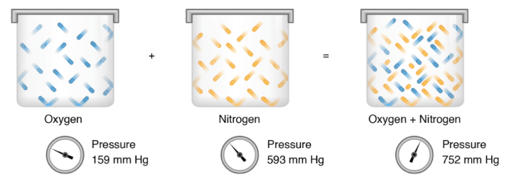
PARTIAL PRESSURE OF A GAS
Dalton's law of partial pressures
Dalton's law of partial pressures states that the total pressure of a mixture of gases is the sum of the partial pressures of its components:
P_{(Total)} =P_{(gas 1)} + P_{(gas 2)} + P_{(gas 3)} …
where the partial pressure of each gas is the pressure that the gas would exert if it was the only gas in the container. That is because we assume there are no attractive forces between the gases.
Notes:
The partial pressure of a gas in a mixture is the same as the pressure of the gas in the container by itself. The sum of the partial pressures gives the total pressure of the gas mixture. Image adapted from OpenStax, CC BY 3.0

Slide 21
PARTIAL PRESSURE OF A GAS
How do you calculate it?
In any mixture of gases the pressure exerted by any one gas (its Partial Pressure) is equal to the total multiplied by the fractional concentration of that gas in the mixture.
P_{x} = X% x (P_{total} – 6.28) kPa
100
P_{x} = X% x (P_{total} - 47) mmHg
100

Slide 22
PARTIAL PRESSURES
Since gas entering the lung is at body temperature and saturated with water allowance must be made for the water vapour pressure at 37⁰C, which is 6.28 kPa (47 mmHg).
Alveolar gas pressures:- Atmospheric air pressures:-
PO₂ = 13.9kPa (105 mmHg) PO₂ = 21.2kPa (160 mmHg)
PCO₂ = 5.3kPa (40 mmHg) PCO₂ = 0.04kPa (0.3 mmHg)

Slide 23
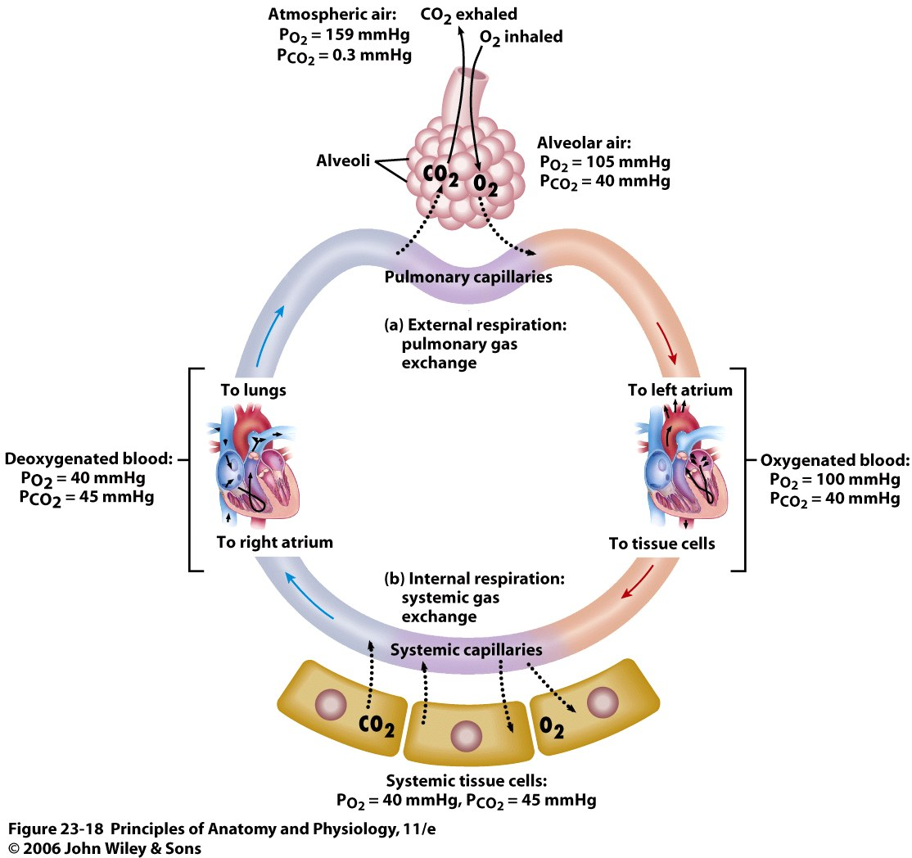
Gas
Exchange
Po₂ =21.2 kPa
Pco₂ =0.04kPa
Po₂ =13.7 kPa
Pco₂ =5.3 kPa
Po₂ =5.3 kPa
Pco₂ =6 kPa
Po₂ =13.2 kPa
Pco₂ =5.3 kPa
Po₂ =5.3 kPaPco₂ =6 kPa

Slide 24
GAS EXCHANGE IN THE LUNGS
Gas exchange depends on:
The partial pressure gradients between alveolar air and pulmonary blood for both O2 and CO2
Easy diffusion between the alveoli and blood
Appropriate balance between ventilation and perfusion

Slide 25
PULMONARY
BLOOD FLOW
AND
REGULATION

Slide 26
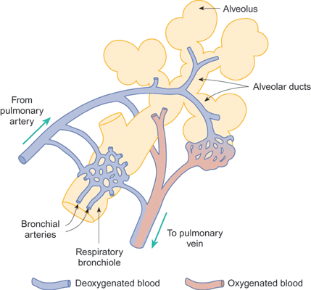
PULMONARY AND BRONCHIAL CIRCULATION

Slide 27
PULMONARY BLOOD FLOW
The pulmonary arterioles do not appear to be subject to autonomic regulation to any great extent, but are regulated by alveolar Po₂ and Pco₂.
In areas of the lung with low Po₂ or a high Pco₂ the arterioles constrict and blood is diverted to better oxygenated areas.
This response is the opposite of that seen in other vascular beds!

Slide 28
PULMONARY BLOOD FLOW
The flow of blood to different parts of the lung is determined by three pressures:
The hydrostatic pressure in the pulmonary arteries in different parts of the lung
The pressure in the pulmonary veins
The pressure of the air in the alveoli.

Slide 29
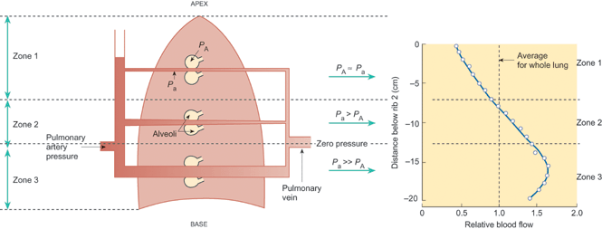
HYDROSTATIC AND ALVEOLAR PRESSURES
P_{a} = Pressure in the pulmonary arteries P_{A} = Alveolar pressure

Slide 30
ALVEOLAR PERFUSION
BLOOD FLOW THROUGH THE UPRIGHT LUNG IS GREATEST AT THE BASE AND LEAST AT THE APEX.

Slide 31
MATCHING PULMONARY BLOOD FLOW
AND ALVEOLAR VENTILATION

Slide 32
VENTILATION:PERFUSION RATIO
Normal gas exchange requires both that alveoli are adequately ventilated and perfused with pulmonary blood at the appropriate rate. To quantify this relationship is to measure alveolar ventilation:perfusion ratio:
.
V_{A} = Alveolar ventilation rate
Q Pulmonary blood flow

Slide 33
VENTILATION:PERFUSION RATIO
Normal Dead space Dead space effect Shunt effect Anatomical Shunt
(No perfusion) (No ventilation)
V._{A} = Normal
Q = Normal
V._{A}/Q = ~1
V._{A} = Normal
Q = 0
V._{A}/Q = infinity
V._{A} = Normal
Q = Low
V._{A}/Q = High
V._{A} = Low
Q = Normal
V._{A}/Q = Low
V._{A} = 0
Q = Normal
V._{A}/Q = 0
If an area of the lung is perfused but inadequately ventilated, V._{A}/Q will be reduced. As a result the alveolar PO₂ falls and PCO₂ rises as less fresh air is brought into the alveoli. If V._{A}/Q =0 there is perfusion and no ventilation, as PO₂ falls there will be more shunting of blood away from those areas of the lungs as seen in respiratory disease.
If the alveoli are ventilated but inadequately perfused, V._{A}/Q will be increased. As a result the alveolar PO₂ rises and PCO₂ falls. If pulmonary flow = 0 there is no perfusion with ventilation, and alveolar pressure and that of humidified room air become equal as seen in pulmonary embolism.

Slide 34
VENTILATION:PERFUSION RATIO
Normal Dead space Dead space effect Shunt effect Anatomical Shunt
(No perfusion) (No ventilation)
V._{A} = Normal
Q = Normal
V._{A}/Q = ~1
V._{A} = Normal
Q = 0
V._{A}/Q = infinity
V._{A} = Normal
Q = Low
V._{A}/Q = High
V._{A} = Low
Q = Normal
V._{A}/Q = Low
V._{A} = 0
Q = Normal
V._{A}/Q = 0
If an area of the lung is perfused but inadequately ventilated, V._{A}/Q will be reduced. As a result the alveolar PO₂ falls and PCO₂ rises as less fresh air is brought into the alveoli. If V._{A}/Q =0 there is perfusion and no ventilation, as PO₂ falls there will be more shunting of blood away from those areas of the lungs as seen in respiratory disease.
If the alveoli are ventilated but inadequately perfused, V._{A}/Q will be increased. As a result the alveolar PO₂ rises and PCO₂ falls. If pulmonary flow = 0 there is no perfusion with ventilation, and alveolar pressure and that of humidified room air become equal as seen in pulmonary embolism.

Slide 35
VENTILATION:PERFUSION RATIO
In the lungs under normal conditions the mean value is:
.
VA = Alveolar ventilation rate
Q Pulmonary blood flow
= 4L min⁻¹
5L min⁻¹
= 0.8
This varies across the lung.

Slide 36
HYDROSTATIC AND ALVEOLAR PRESSURES
V._{A}/Q = 3.0
V._{A}/Q = 0.6

Slide 37
DEAD SPACE
The respiratory system can be considered to consist of two parts:
    Conducting airways
    Area of gas exchange
Not all the air taken in in one breath reaches the alveolar surface, some must occupy the airways that connect the respiratory surface to the atmosphere.
This air is known as anatomical dead space.

Slide 38
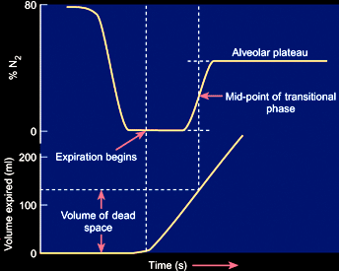
DETERMINATION OF ANATOMICAL DEAD SPACE
Take a
breath of
pure O₂
Expired
Alveolar
gas
Expired
Pure O₂
Anatomical
Dead Space

Slide 39
PHYSIOLOGICAL DEAD SPACE
The determination of physiological dead space can be carried out using CO₂ and O₂ rather than N₂.
As the concentration of CO₂ is almost zero in inspired air then the CO₂ breathed out will eventually give us the concentration in alveolar air.
Therefore we can calculate the dilution factor between expired air and alveolar air
Physiological dead space is a functional measure

Slide 40
VENTILATION
Pulmonary ventilation is the act of breathing, which can be described as the movement of air into and out of the lungs.
The major mechanisms that drive pulmonary ventilation are:
  Atmospheric pressure
  Alveolar pressure
  Intrapleural pressure
The flow of air is also affected by the airway resistance as seen in respiratory diseases.

Slide 41
AIRWAY RESISTANCE
Airway resistance is directly proportional to the pressure difference between the atmosphere and the alveoli and inversely proportional to the airflow:-
R = ΔP (Poiseuille's Law)
V
where R is the airway resistance; ΔP is the difference in pressure between atmospheric and the alveoli and V is the airflow.

Slide 42
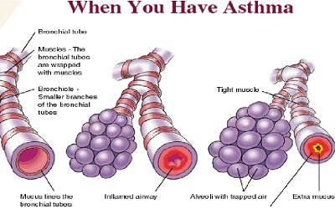
POISEUILLE’S LAW
Quantitatively relates to the flow of a liquid through a rigid tube.
R = 8 ηl
πr⁴
where η is viscosity and r is the radius of the airway and l is the length of the airway.
Thus for any given fluid (in our case air) the larger the diameter of the tube the higher the flow rate will be for a given pressure difference.
As the flow rate depends on the fourth power of the radius then halving the diameter will lead to a 16-fold reduction in flow rate. This is extremely important as small levels of bronchiole constriction will markedly reduce air flow, as occurs in asthma and allergic reactions.

Slide 43
LEARNING OBJECTIVES
Understand the principles of gas exchange between the alveoli and the pulmonary capillaries
Understand the ventilation perfusion ratio and how is alters across the lung
Be able to calculate the partial pressures of gasses
Explain pulmonary blood flow and its regulation
Understand Flick’s Law
Define the alveolar ventilation and dead space
Explain airway resistance and Poiseuille’s Law.

