Slide 1

PHOL0001
Body Fluid Compartments
Dr. Jigisha Patel

Slide 2
Body Fluid Compartments
This lecture will discuss:
The chemical composition of the body
The properties of water as a biological solvent
The osmotic pressure and tonicity of aqueous solutions
How body water is distributed between the various fluid compartments
How the volumes of the compartments can be measured

Slide 3
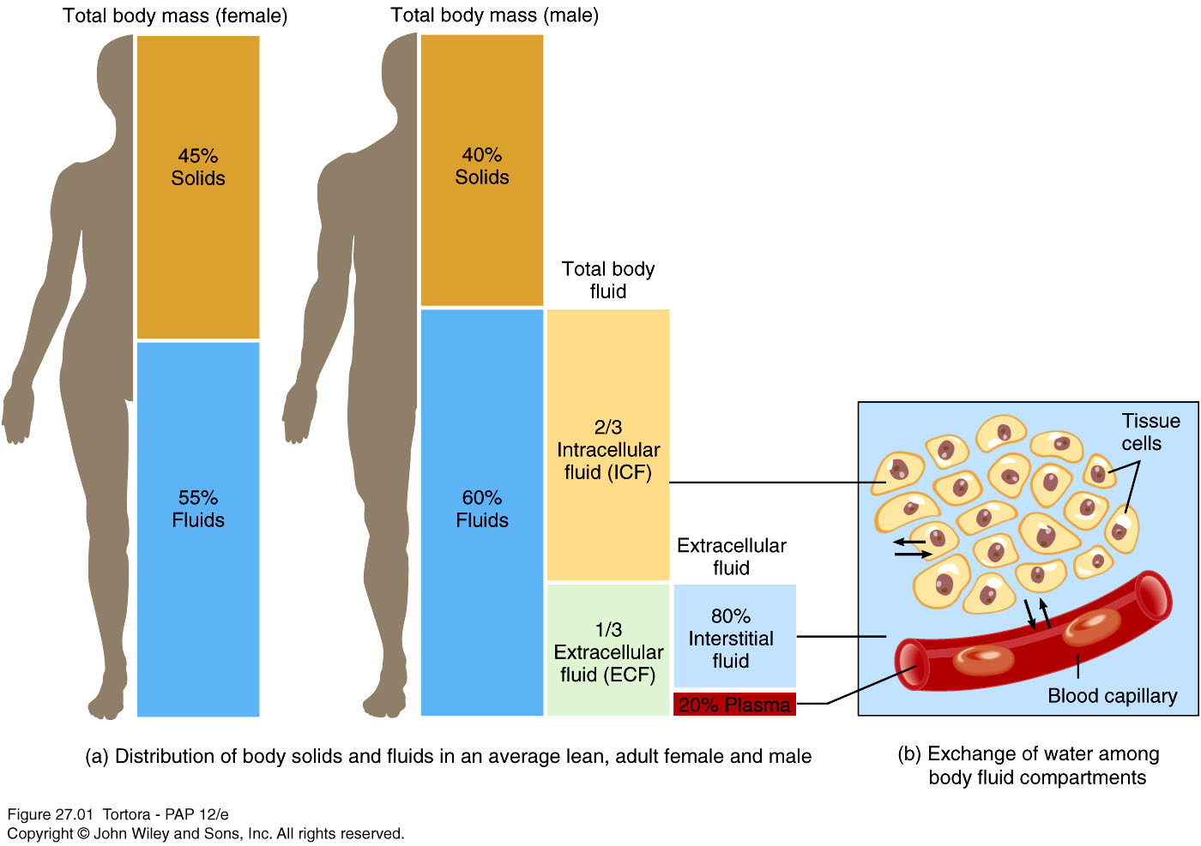
Body Fluid Compartments

Slide 4
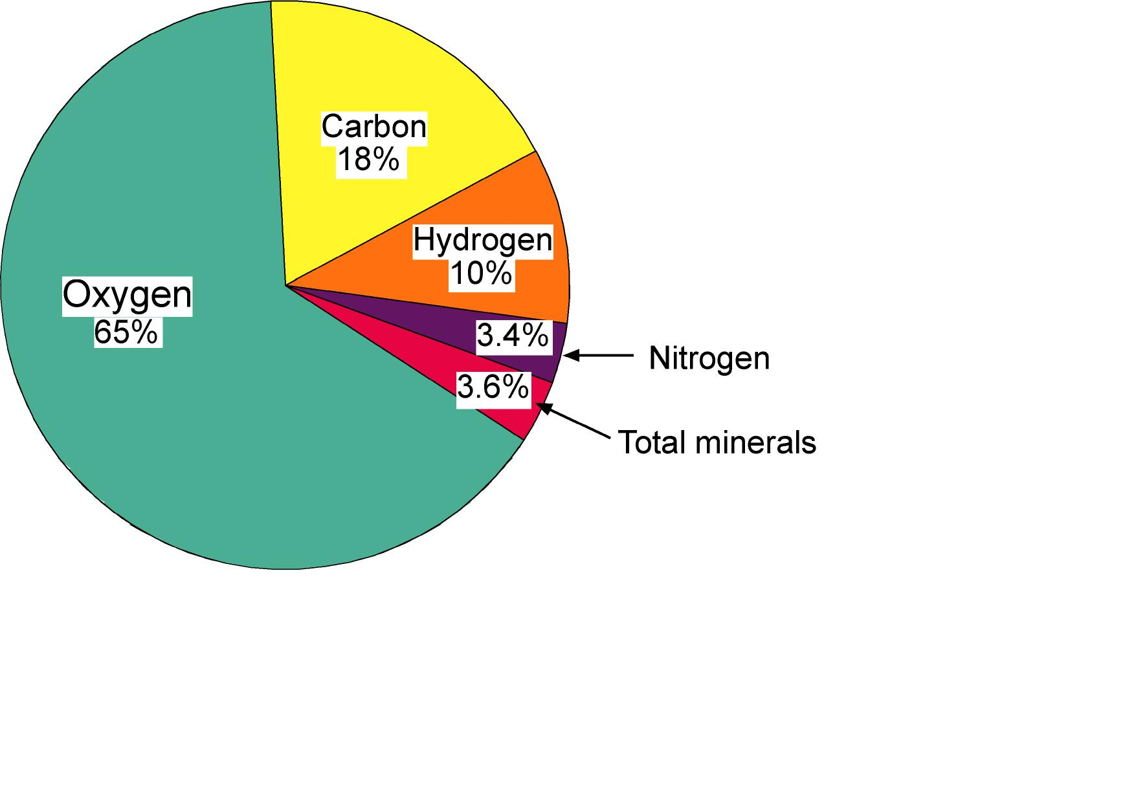
Body Composition
The body largely consists of oxygen, carbon, hydrogen and nitrogen:
Percentages are expressed as per cent body weight

Slide 5
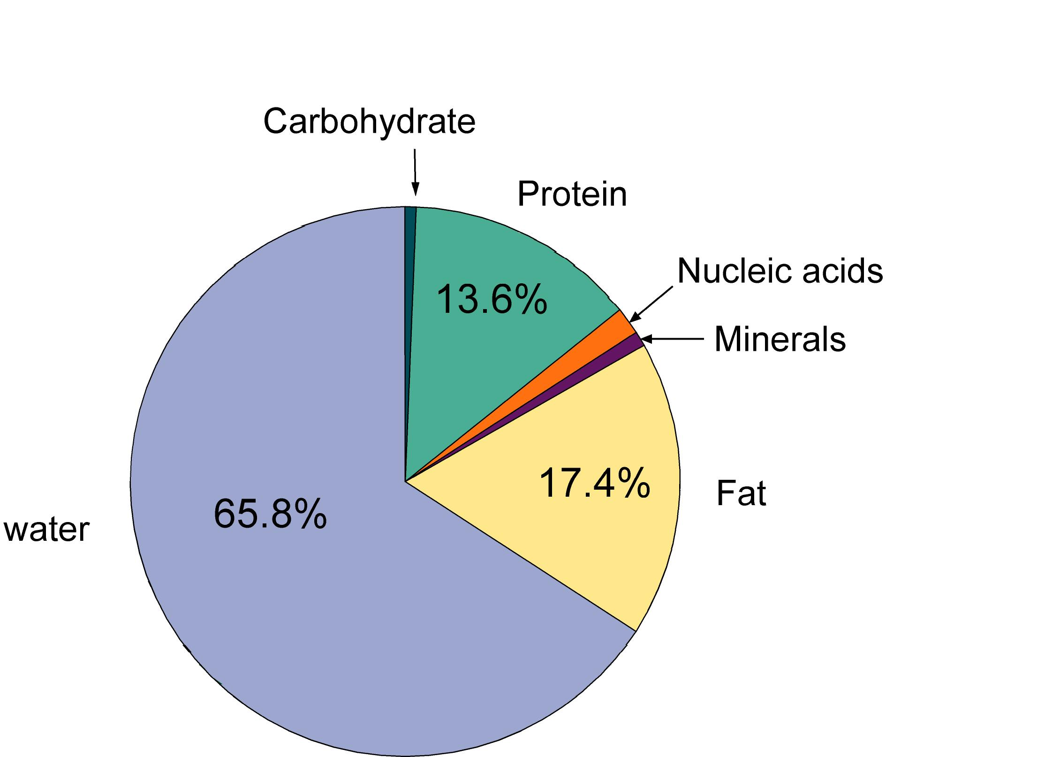
Body Mass
Water accounts for about two thirds of lean body mass.

Slide 6
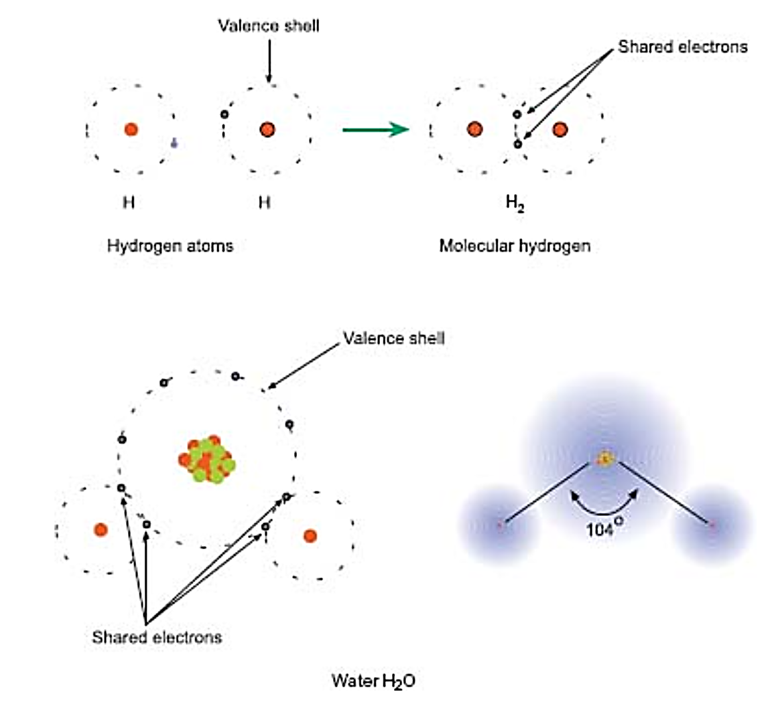
Water- the Universal Solvent
The electronegativity of oxygen and the fact that the atoms in water are not linear result in the molecule being polar.
The charge difference allows the molecule to ‘hydrogen bond’ with other water molecules and dipoles in other molecules. This explains many of the properties of water, such as its solvent properties.

Slide 7
Classification
Chemical species can be divided into three classes:
  Those that dissolve readily in water (hydrophilic substances). These molecules are polar in nature e.g. glucose, Na⁺, many proteins.
  Those that are insoluble in water (hydrophobic substances) e.g. fats and waxes. Such molecules are non-polar.
  Those that have mixed properties - one part of the molecule is polar and the other is non-polar. Such molecules are known as amphiphilic substances. Examples are the long chain fatty acids and the phospholipids.

Slide 8
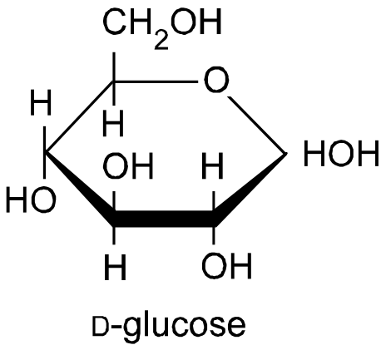
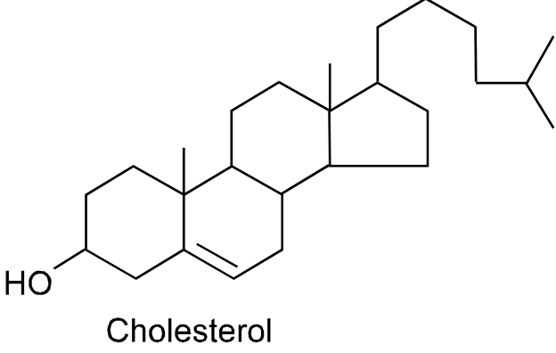
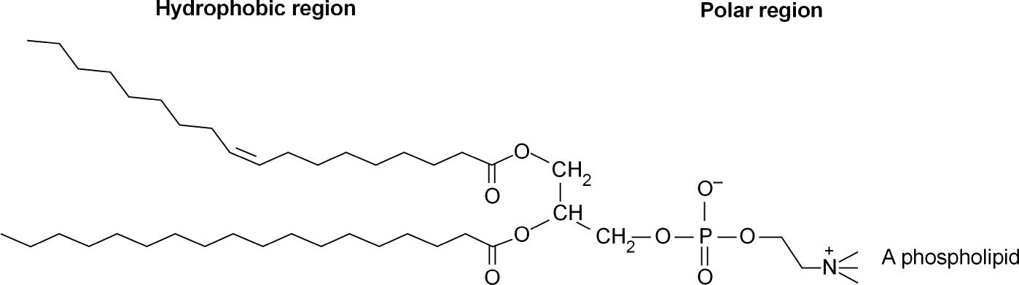
Structure
Hydrophilic (polar)
Hydrophobic (non-polar)
Amphiphilic

Slide 9
Diffusion
When in solution, substances disperse in a random process called diffusion.
The rate of diffusion depends on:
The concentration gradient
The area available for diffusion
The molecular mass of the solute
The diffusion coefficient
  This is a physical constant that reflects the specific molecular characteristics of both solute and solvent. This constant also depends on temperature.

Slide 10
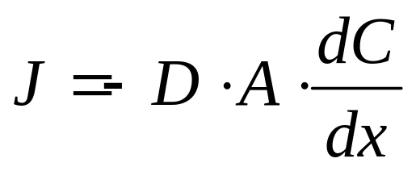
Diffusion
The formal relationship is:
Amount moved = Diffusion coefficient x Area x Concentration gradient
Or in symbols:
D is the diffusion coefficient, A is the area over which diffusion can occur and dC/dx is the concentration gradient.
The negative sign indicates that diffusion occurs from a region of high concentration to one of low concentration. The diffusion coefficient becomes smaller as the molecular size increases so that large molecules diffuse more slowly than small ones.

Slide 11
Osmotic Pressure
Osmotic pressure is a property of solutions that is of particular importance in cellular biology because of the role it plays in the transport of molecules across membranes.

Slide 12
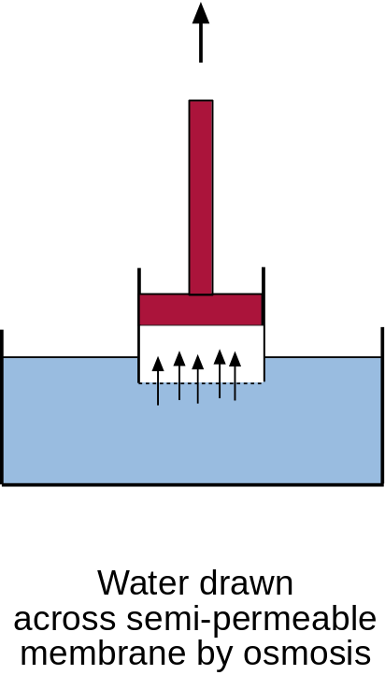
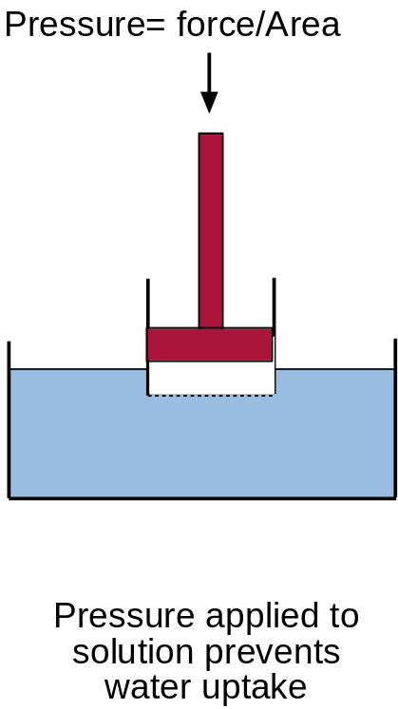
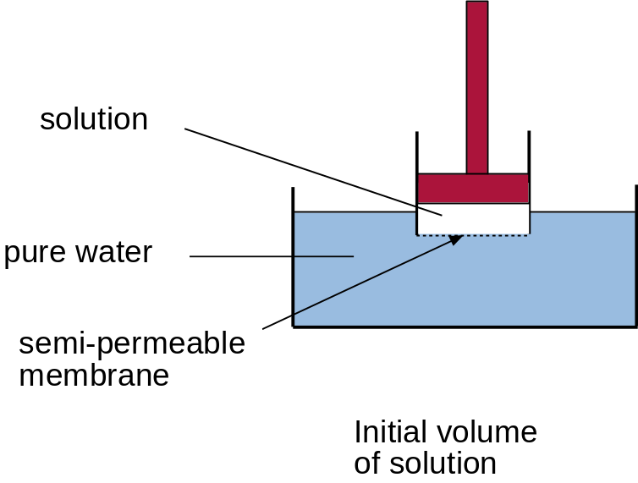
Osmotic Pressure
Substances in solution exert an osmotic pressure
The osmotic pressure of a solution is the pressure that is just sufficient to prevent the movement of water into a solution across a semi-permeable membrane.

Slide 13
Osmotic Pressure
Osmotic pressure (π) = MRT
Where M is the molarity, R is the gas constant, where R = 0.08206 L · atm · mol-1 · K-1 , T is the thermodynamic temperature (formerly called absolute temperature)
Osmotic pressure depends on the number of particles present per unit volume of solvent and NOT on their chemical makeup.
Salts separate into their constituent ions, so the osmotic pressure that a salt such as sodium chloride will exert will be twice its molar concentration.

Slide 14
Reverse Osmosis
Osmotic pressure is the basis of reverse osmosis, a process commonly used to purify water. The water to be purified is placed in a chamber and put under an amount of pressure greater than the osmotic pressure exerted by the water and the solutes dissolved in it. Part of the chamber opens to a differentially permeable membrane that lets water molecules through, but not the solute particles.
The osmotic pressure of ocean water is about 27 atm. Reverse osmosis desalinators use pressures around 50 atm to produce fresh water from sea water.

Slide 15
Osmotic Pressure
Rather than measure osmotic pressure directly, it is more convenient to state the osmolarity (moles per litre of a solution) or its osmolality (moles per kg of water).
In clinical medicine, osmotic pressures of body fluids are generally expressed as osmolality.
By Definition:
One gram mole of a non-dissociating substance in 1kg of water exerts an osmotic pressure of 1 Osmole (abreviated to 1Osmol kg⁻¹).

Slide 16
The total osmolality of a solution is the sum of the osmolality due each of the constituents of the solution
Osmolality
The blood plasma has an osmolality of around 300 mOsmol kg⁻¹
The principal ions (Na⁺, K⁺, Cl⁻, HCO₃⁻) contribute most of this (around 290 mOsmol kg⁻¹)
Glucose and other small molecules contribute just under 10 mOsmol kg⁻¹.
Proteins contribute only about 1 mOsmol kg⁻¹ (less than 0.5% of total plasma Osmolality)

Slide 17
Why proteins exert such a small osmotic pressure
Osmotic Pressure
Each kg of plasma contains about 6.76 g of NaCl and 47.4g of albumin
Osmotic pressure due to NaCl:
  2(6.76/58.4) = 0.231 Osmol kg⁻¹ or
  231 mOsmol kg⁻¹
Osmotic pressure due to albumin:
  47.4/69,000=0.687 mOsmol kg⁻¹

Slide 18
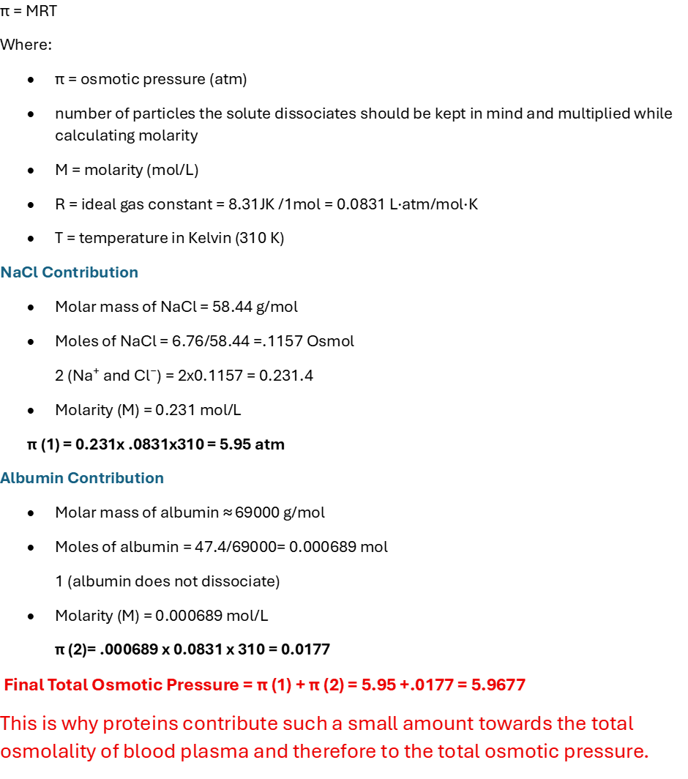

Slide 19
Iso-osmotic vs Iso-tonic
The tonicity of a solution refers to the influence of its osmolality on the volume of cells.
Two solutions with the same osmolality are said to be iso-osmotic
Under normal circumstances, the volume of cells remains constant so that the intracellular fluid must have the same osmolality as the extracellular fluid. The two solutions are said to be isotonic with each other.
Fluids which are isotonic are also iso-osmotic
However, not all iso-osmotic solutions are isotonic with cells
  iso-osmotic solutions of urea cause cells to swell

Slide 20
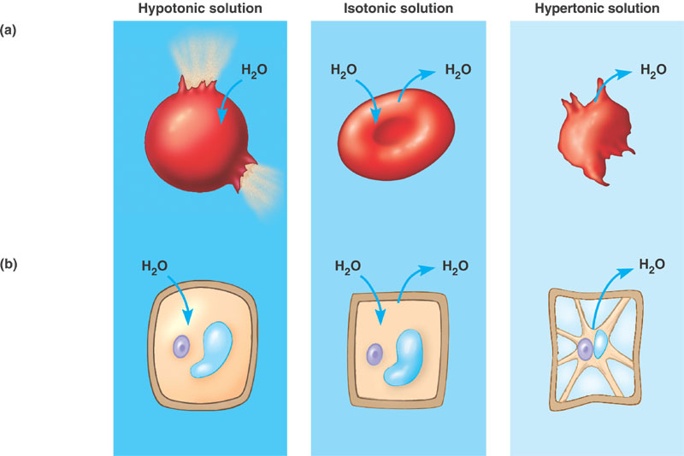
Iso-osmotic vs Iso-tonic
http://kvhs.nbed.nb.ca/gallant/biology/water_balance.jpg

Slide 21
Osmotic Phenomenons
Cells have to constantly cope with osmotic phenomenons.
Cells without walls that live in aqueous solutions are usually hypertonic. They are subject to a continuous influx of water that results in a pressure on the inside of the membrane. Some ciliates (like Paramecium) and flagellates (Euglena) have a special organ, a pulsating vacuole, that pumps the water out again and has to be supplied with energy.
Red blood cells (erythrocytes) occur normally in isotonic surroundings (blood plasma). The cells burst if the blood is diluted with water since their membranes cannot face the osmotic pressure within the cells. Blood is therefore always diluted with an isotonic (0.9%) NaCl-solution.

Slide 22
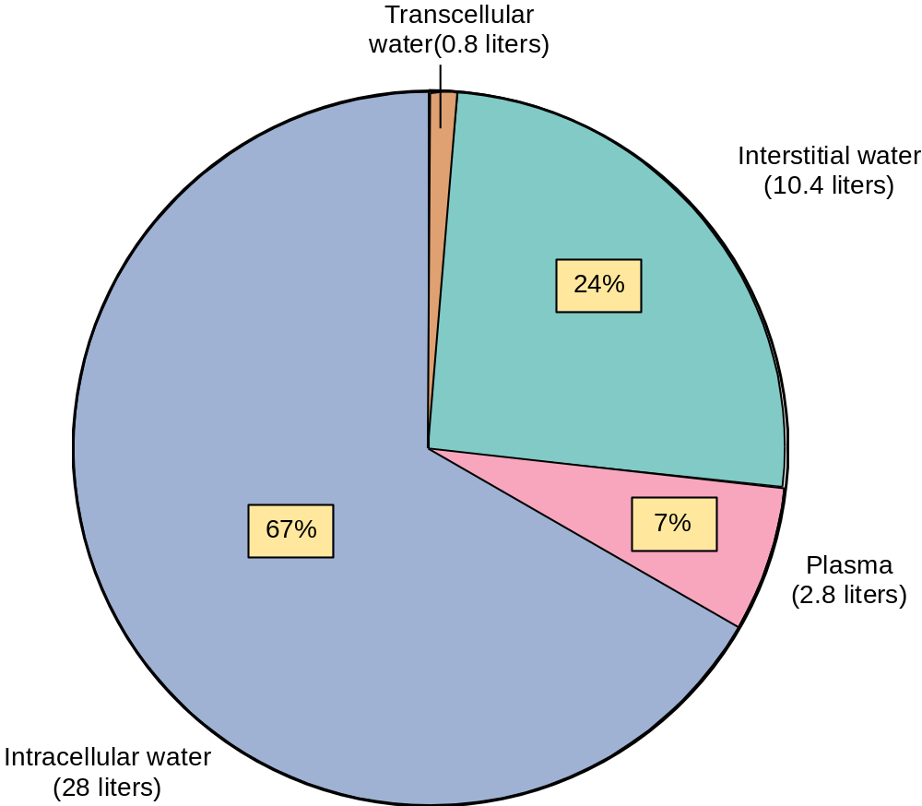
Body Water
Transcellular water (0.8L)
The extracellular fluid in spaces such as
the brain ventricles, peritoneal cavity,
joint capsules and eyes
Interstitial water (10.4L)
The extracellular fluid that
lies outside the blood
vessels and bathes the cells
Extracellular water
The water around cells
Plasma (2.8L)
The extracellular fluid
of the blood
Intracellular water (28L)
The water within cells

Slide 23
Total Body Water
Total body water = extracellular fluid + intracellular fluid
Extracellular fluid = plasma + interstitial fluid
If we can measure total body water, the plasma volume and the volume of the extracellular fluid, we can calculate the volumes of the interstitial and intracellular compartments.
If total body water is 43 litres, the plasma volume is 3 litres and the extracellular fluid volume is 16 litres
Intracellular fluid volume = 43 - 16 = 27 L
Interstitial fluid volume = 16 - 3 = 13 L

Slide 24
Body Fluid Compartments

Slide 25
Measurement of body fluid volumes
Body Fluid Volumes
Volumes of irregularly shaped objects can be measured by dilution methods.
  Concentration = mass/volume
  ∴volume= mass/concentration
Total body water can be measured using ³H₂O
Plasma volume can be measured using the dye Evans Blue
Extracellular volume can be measured using a plant polysaccharide called inulin (NOT insulin)

Slide 26
Example
10 ml of a 1% solution of Evans Blue was injected into a subject’s vein.
After 5 min a sample of blood was taken and the plasma was found to have 0.037 mg of dye per ml of blood.
mass of dye given = 0.1 g or 100 mg
As volume = mass/concentration
Plasma volume = 100/0.037 = 2702 ml

Slide 27
Summary
Water accounts for 50-60% of total body mass
It is the chief solvent of the body
It is divided between two main compartments: the intracellular fluid and the extracellular fluid
The extracellular fluid is made up of the plasma and the interstitial fluid
The volumes of these compartments can be measured using dilution methods
When substances dissolve in water, they exert an osmotic pressure that is proportional to their molar concentration
The intracellular and extracellular fluids are isotonic with each other
Cells swell (or burst) by placing them in distilled water and shrink cells by placing them in concentrated salt solutions.

