Slide 1
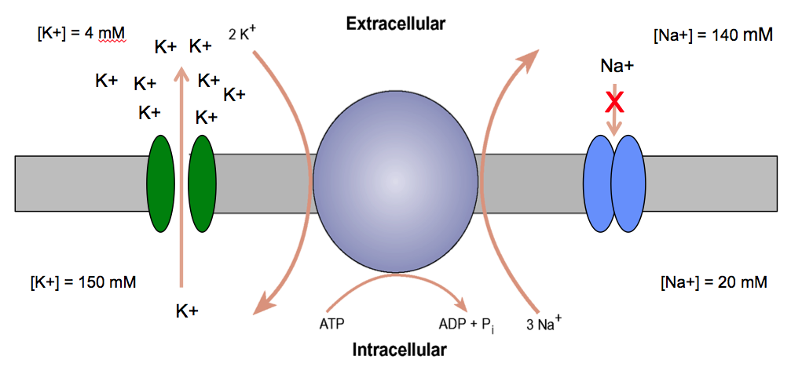
PHOL1001
The Membrane Potential
Dr Jigisha Patel
jigisha.a.patel@ucl.ac.uk

Slide 2
Membrane Potential
This lecture will discuss:
The origin of the membrane potential.
The relationship between the ionic permeability of the membrane and the membrane potential.
The properties of ion channels:
  ligand-gated channels.
  voltage-gated channels.
The action potential.

Slide 3
Membrane Potential
Membrane potential is a difference in electrical potential across the cell membrane.
There exists a potential difference across the membrane of all living cells with inside being negative in relation to the outside, i.e. the cations and anions arrange themselves along the outer and inner surfaces of the cell membrane.
The build up of charges occurs only very close to cell membrane. The ECF and ICF are else where contains equal number of +ve and –ve charges and is electrically neutral.
Thus, the actual number of ions responsible for membrane potential is minute fraction of the total number present across the cell membrane in each respective compartment.
The greater the difference across the membrane, the larger the membrane potential.

Slide 4
Membrane Potential
The membrane potential at rest is called resting membrane potential. It is written with minus sign, signifying that inside is negative relative to exterior.
The membrane potential measured during the excited state of cell is called action potential. It is written with plus sign, signifying that outside is negative relative to interior.
All living cells have resting membrane potentials. Whereas action potentials are produced only in excitable cells (such as nerve and muscle cells).

Slide 5
Membrane Potential
All mammalian cells have a membrane potential.
In quiescent cells it is called the resting membrane potential.
The resting membrane potential is always negative with respect to the outside.
It varies in magnitude from one kind of cell to another but generally lies within the range -40 to -90 mV.
In “excitable” cells the membrane potential changes in response to appropriate signals to produce specific dynamic phenomena called action and graded potentials.
    –it is a physiological variable.

Slide 6
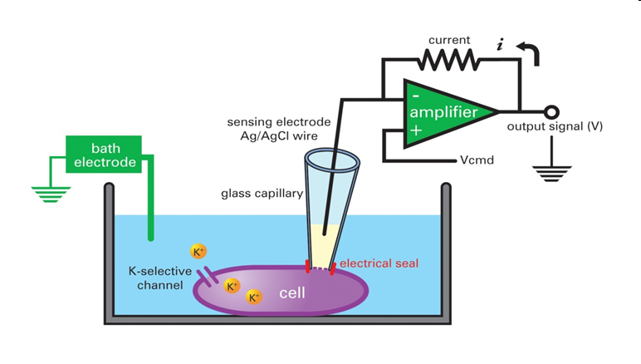
Whole-cell voltage-clamping in single isolated smooth muscle cell
When one electrode is placed on the surface of the cell and another electrode is inserted into interior of the cell, both are connected through a suitable amplifier to a cathode ray oscilloscope (CRO), a constant (or steady) potential difference is observed between the inside and outside of the cell at rest, called as the resting membrane potential.
Electrode penetrates cell here
0
Membrane
potential (mV)
-70
Time
Notes:
To be able measure ions (in this case potassium) flowing across a cell, a microelectrode (filled with a pseudo intracellular solution) has to form a high resistance seal with a patch of cell membrane, which can be subsequently ruptured (with suction) to give the electrode electrical access to the whole cell and where the contents of the pipette will diffuse into the cell. Voltage is then applied, clamping the membrane at a particular potential (voltage clamp), and allowing for the membrane current to be recorded/measured at this potential via an amplifier.
This technique can also be utilised in the current clamp mode where changes in membrane potential can be recorded under basal conditions or in response to current injection.
Voltage or current changes across cell membranes can be altered by applying compounds that block or open channels. These techniques enable us to understand how ion channels behave both in normal and disease states and how different drugs, ions, or other analytes can modify these conditions.

Slide 7
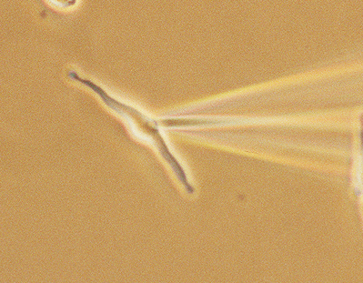
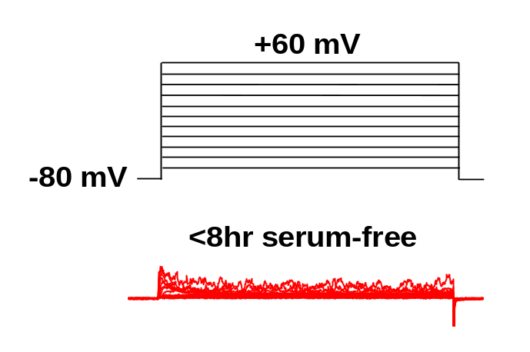
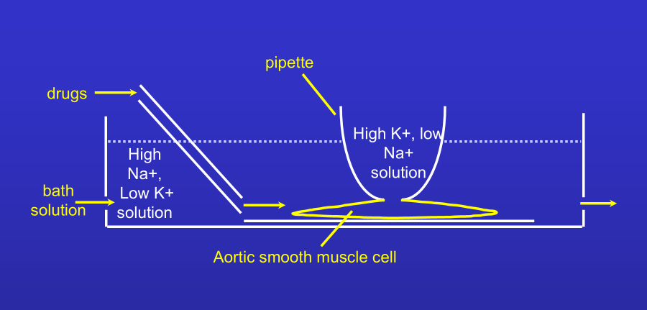
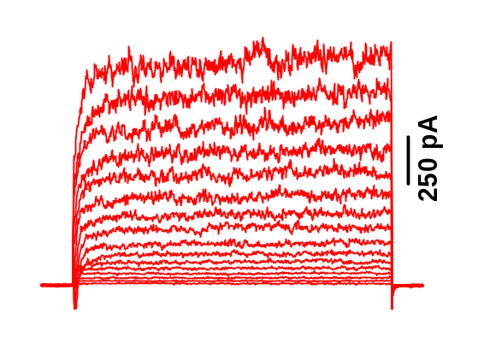
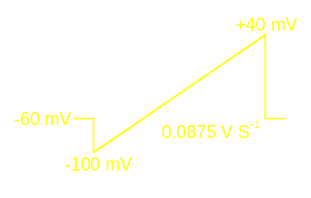
Whole-cell voltage-clamping in single isolated smooth muscle cells
This is an example of a whole-cell voltage- clamp experiment in a single pulmonary artery smooth muscle cell that has been enzymatically isolated.
140 KCl
+80 mV
5 KCl
Notes:
This is an example of a whole-cell voltage- clamp experiment in a single pulmonary smooth muscle cell that has been enzymatically isolated from an artery. Here the cell is dialysed with a quasi physiological internal solution (high K+, low Na+) and bathed in a physiological salt solution (high sodium, low potassium). With this configuration, the normal gradient allows for potassium to leave the cell. On the left, shows how the magnitude of whole-cell outward current increases as the membrane potential is voltage-clamped at more and more positive membrane potentials.

Slide 8
Membrane Potential
In a particular cell also membrane potential varies according to its functional status. For example, a nerve cell has a membrane potential of -70 mV (inside negative) at rest , but when it gets excited, the membrane potentials becomes +30 mV (inside positive).
Typical membrane potentials:
Cell type Resting potential
Skeletal Muscle -90 mV
Smooth muscle cells -60 mV
Astroglia -80 to -90 mV
Neurons -60 to -70 mv
Erythrocytes -9 mV
Photoreceptors -40 mV

Slide 9
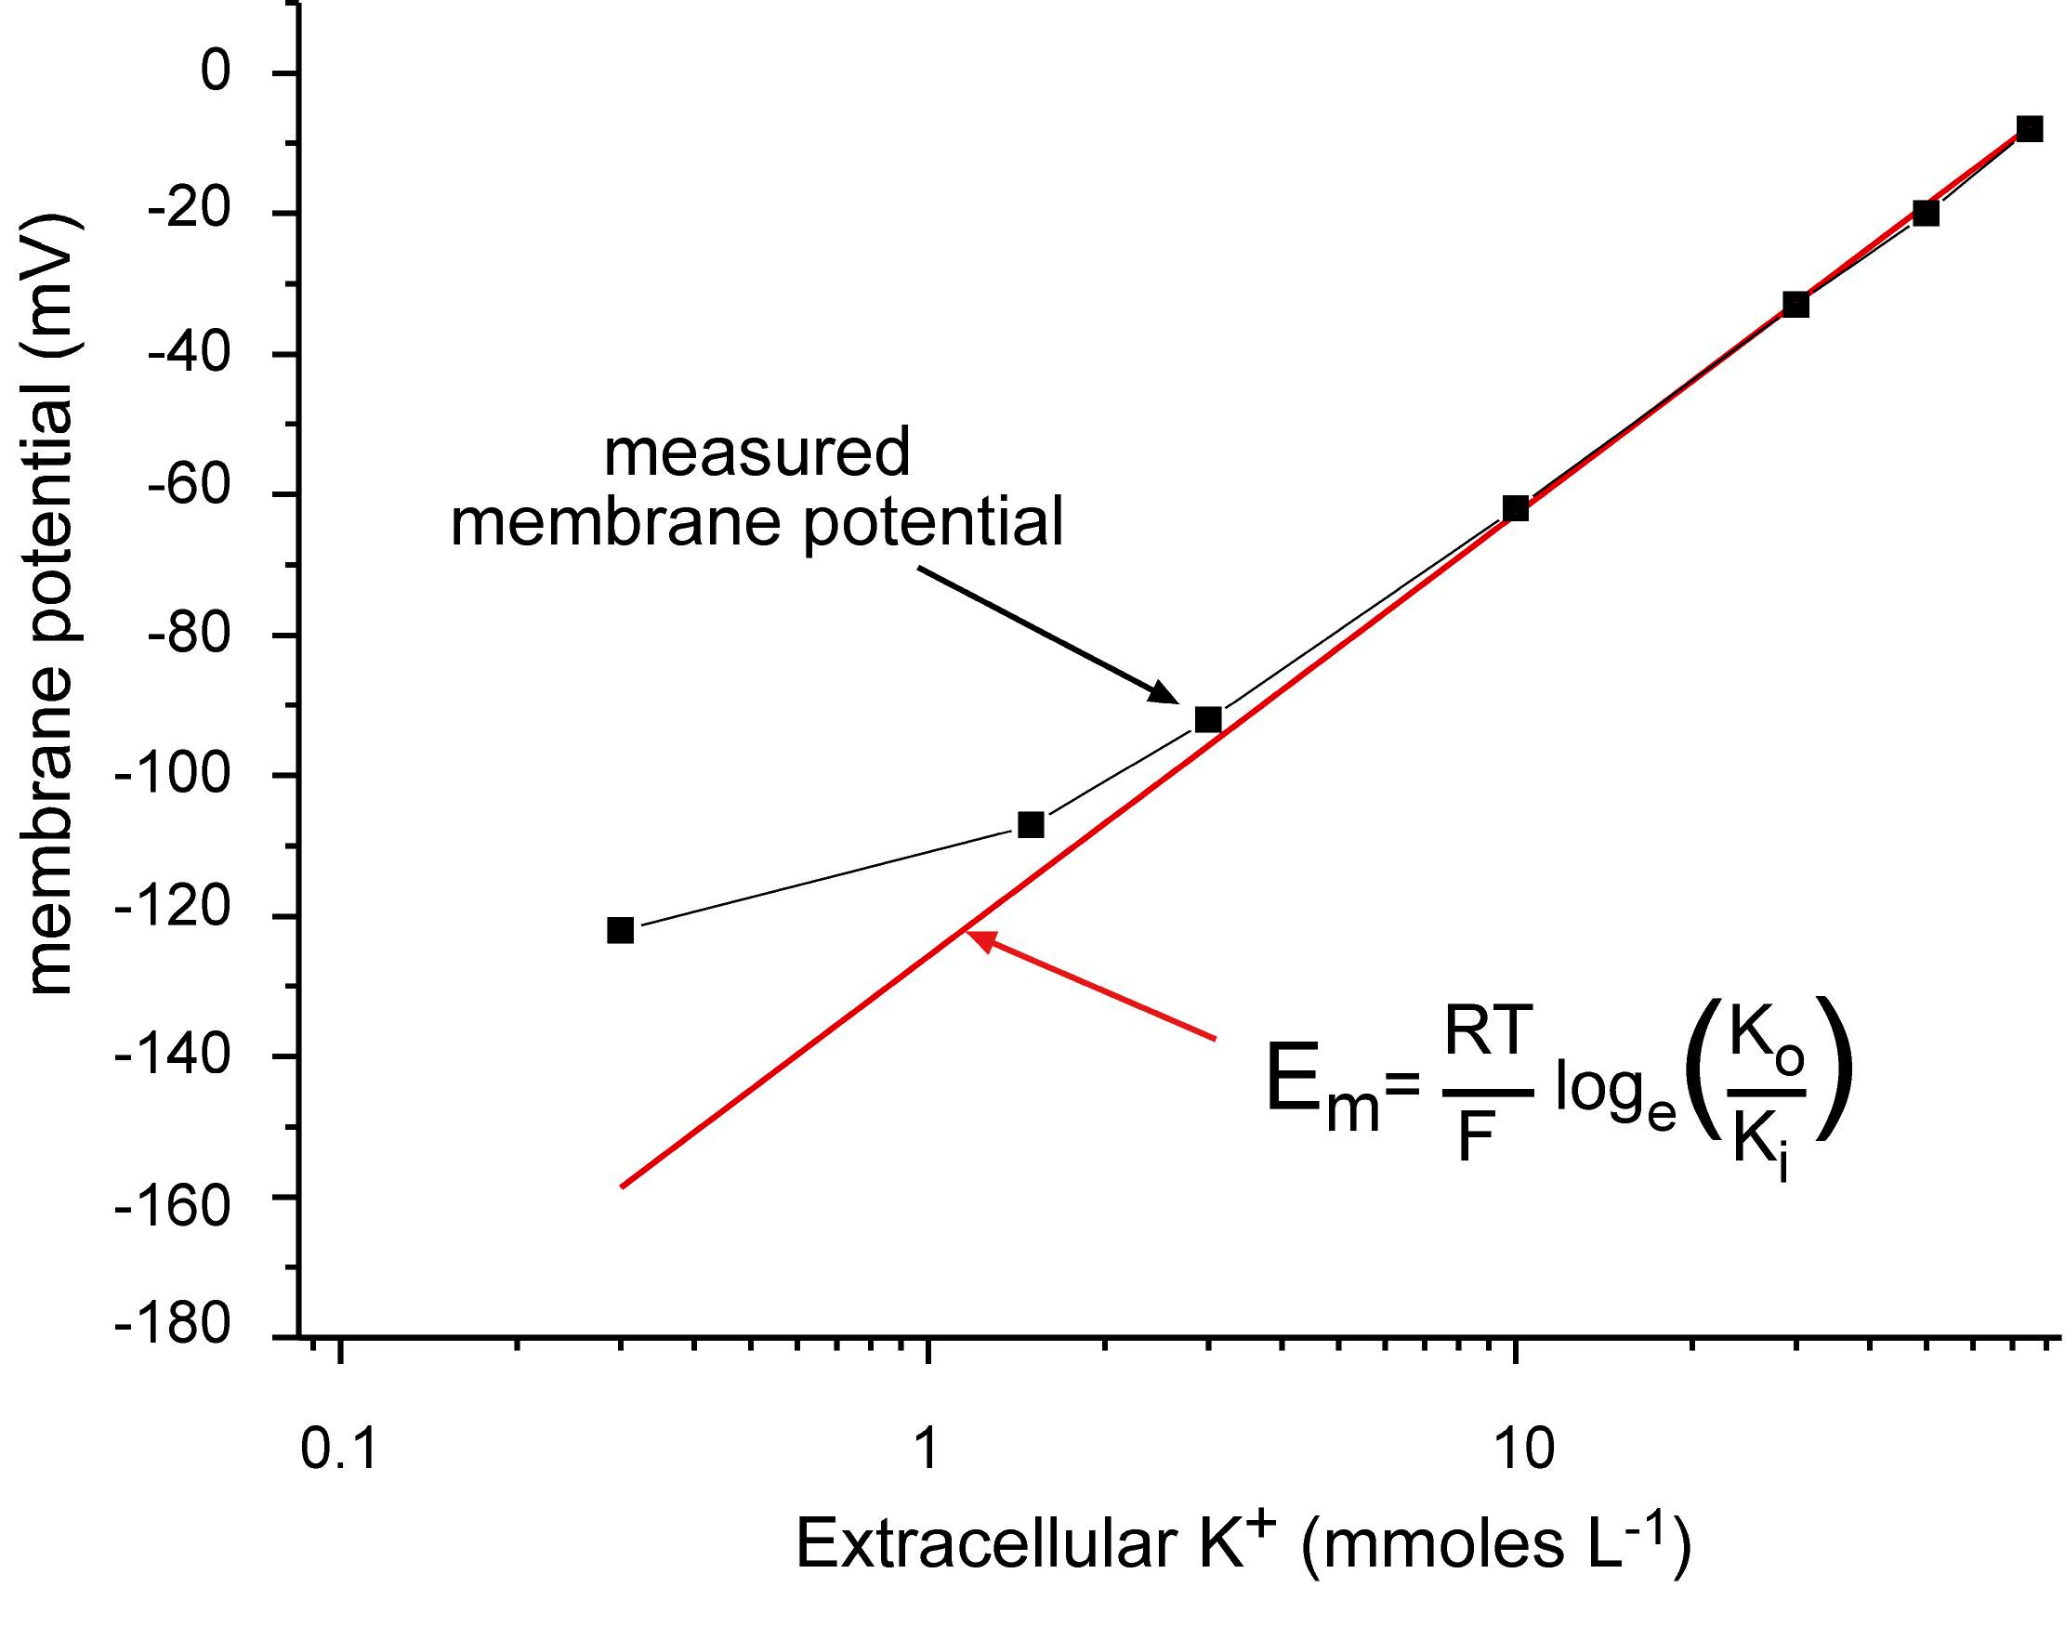
The resting membrane potential is mainly determined by the potassium gradient across the plasma membrane.
Membrane Potential

Slide 10
The resting membrane potential is mainly determined by the potassium gradient across the plasma membrane.
Membrane Potential

Slide 11
Membrane Potential
Diffusible Ions
Na⁺, K⁺, Cl⁻, and HCO₃⁻ are considered diffusible ions because they can move across the cell membrane under certain conditions.
Their movement is governed by electrochemical gradients and membrane permeability, which varies by ion and cell type.
Membrane Permeability
The cell membrane is selectively permeable, not freely permeable to most ions.
K⁺ permeability is indeed much higher than that of Na⁺ — estimates range from 50 to 100 times greater, depending on the cell and physiological state.
Cl⁻ permeability is variable and often passive, influenced by membrane potential and chloride channels.
Na⁺ permeability is low at rest, but increases during action potentials due to voltage-gated Na⁺ channels.

Slide 12
Membrane Potential
The activity of the sodium pump leads to the accumulation of potassium ions inside cells.
[K+] = 4 mM
[Na+] = 140 mM
[K+] = 150 mM
[Na+] = 20 mM

Slide 13
Membrane Potential
Some of these potassium ions leak out of the cells via potassium channels in the plasma membrane.
[K+] = 4 mM
[Na+] = 140 mM
[K+] = 150 mM
[Na+] = 20 mM
K+

Slide 14
Membrane Potential
However, the membrane is much less permeable to sodium ions (10 – 100 times). So sodium ions are unable to replace all the lost potassium ions.
[K+] = 4 mM
[Na+] = 140 mM
Na+
X
[K+] = 150 mM
[Na+] = 20 mM
K+

Slide 15
Membrane Potential
As the potassium ions diffuse out of the cell there is a build-up of negative charge inside the cells that can be detected as a potential difference across the plasma membrane - a membrane potential.
[K+] = 4 mM
K+
[Na+] = 140 mM
K+
Na+
K+
K+
K+
K+
X
+
K+
K+
[K+] = 150 mM
[Na+] = 20 mM
K+

Slide 16
Summary
Potassium ions tend to move down their concentration gradient out of cells.
This is offset by the negative membrane potential that tends to attract potassium ions back into the cell.
The potential at which these two tendencies exactly balance is known as the potassium equilibrium potential (E_{K}), which can be calculated using the Nernst equation.
The potassium equilibrium potential (E_{K}) is usually very close to the measured resting membrane potential.
The Nernst equation can also be used to calculate the equilibrium potential of other ions e.g. sodium.

Slide 17
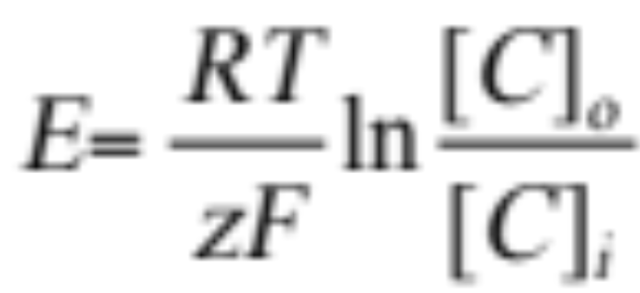
The Nernst Equation
E is the equilibrium potential; ln is the natural logarithm [C]_{o} and [C]_{i} are the extracellular and intracellular concentrations of the ion in question.
R is the gas constant (8.31 Joules °K⁻¹ mol⁻¹) , T the absolute temperature, z the charge of the ion, F the Faraday constant (96,487 coulombs. mol⁻¹).
At 37°C the term RT/F = 26.7 mV
E=-61mV.log([C]_{i}/ [C]_{o})

Slide 18
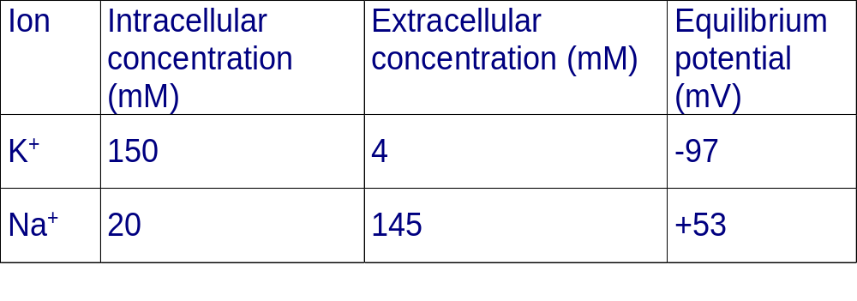
Equilibrium Potentials
This data is for mammalian skeletal muscle which has a resting membrane potential of about -90 mV.
Why is the resting membrane potential different from the potassium equilibrium potential (E_{K})?

Slide 19
Membrane Potential
The exact membrane potential is determined by the ion gradients across the plasma membrane and by the number and type of channels that are open.
[K+] = 4 mM
[Na+] = 140 mM
[Cl⁻] = 114 mM
K+
Na+
Cl⁻
+
Extracellular
Intracellular
⁻
⁻
⁻
⁻
PROTEINS
⁻
⁻
K+
Na+
Cl⁻
⁻
⁻
⁻
⁻
⁻
[K+] = 150 mM
[Na+] = 20 mM
[Cl⁻] = 3 mM
Resting membrane potential of about -90 mV

Slide 20
Membrane Potential
The exact membrane potential is determined by the ion gradients across the plasma membrane and by the number and type of channels that are open.
[K+] = 4 mM
[Na+] = 140 mM
[Cl⁻] = 114 mM
K+
Na+
Cl⁻
+
Extracellular
Intracellular
⁻
⁻
⁻
⁻
PROTEINS
⁻
⁻
K+
Na+
Cl⁻
⁻
⁻
⁻
⁻
⁻
[K+] = 150 mM
[Na+] = 20 mM
[Cl⁻] = 3 mM
Membrane potential of about +75 mV

Slide 21
Membrane Potential
The resting membrane potential is not an equilibrium potential because it relies on the constant expenditure of energy via ion pumps - it is a dynamic diffusion potential.
The measured membrane potential depends both on the ionic gradients across the cell membrane and the permeability of the membrane (how many channels are open) to the different kinds of ion present.
The precise relationship is given by the Goldman equation (also known as Goldman–Hodgkin–Katz voltage equation) which takes into account both the ionic gradients that exist across the membrane and the permeability of the membrane to the different ions.

Slide 22
The Nernst equation helps in calculating the equilibrium potential for each ion individually.
However, the magnitude of membrane potential at any given time depends on distribution and permeability of Na⁺, K⁺ and Cl⁻ ions.
The integrated role of different ions in the generation of membrane potential can be described accurately by the GOLDMANN-HODGKIN-KATZ (GHK) equation.

Slide 23
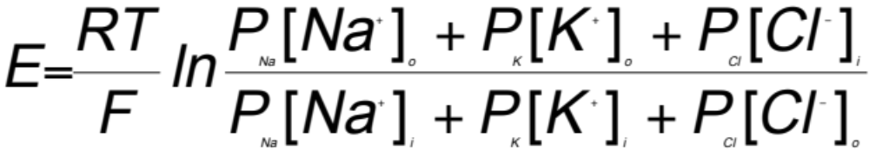
Goldman Equation
R, T and F are physical constants (the gas constant, the absolute temperature and the Faraday constant) while P_{Na}, P_{K} and P_{Cl} are the permeability coefficients of the membrane to Na⁺, K⁺ and Cl⁻ respectively. [Na⁺]_{o}, [Na⁺]_{i} etc. are the extracellular and intracellular concentrations of Na⁺, K⁺ and Cl⁻.
Note that [Cl⁻]_{i} and [Cl⁻]_{o} are reversed compared to [Na⁺]_{i}, [Na⁺]_{o} and [K⁺]_{i} , [K⁺]_{o} as chloride has a negative charge.

Slide 24
Terminology
When a cell is quiescent, the membrane potential is called the resting membrane potential.
0
Time
Membrane
potential (mV)
Resting membrane potential
-70
Depolarization
During physiological activity, the membrane potential may become less negative than it was at rest.
0
Time
Membrane
potential (mV)
-70
In some cells, it may become more negative than the resting membrane potential.
Hyperpolarisation

Slide 25
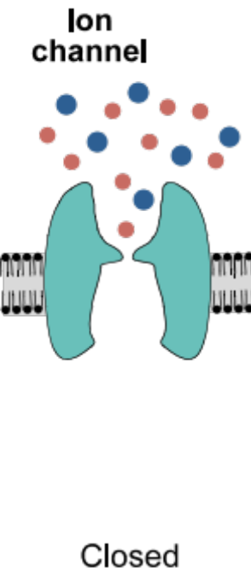
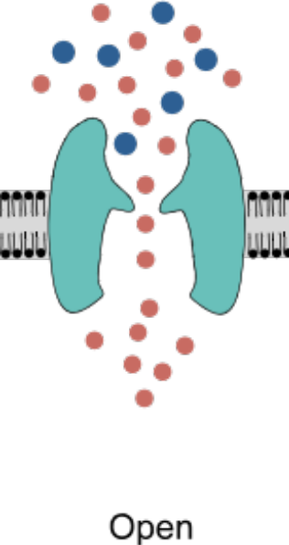
Ion Channels
Have a central pore that provides a pathway for ions to diffuse down their electrochemical gradient.
Are selective for particular ions.
Generally have a high capacity for transport.
  K+ channel up to 10⁸ ions/sec compared to 10²-10⁴ ions/sec via carriers.
Are often named after the principal ion they transport.
Ion channels exist in two basic states: open and closed.

Slide 26
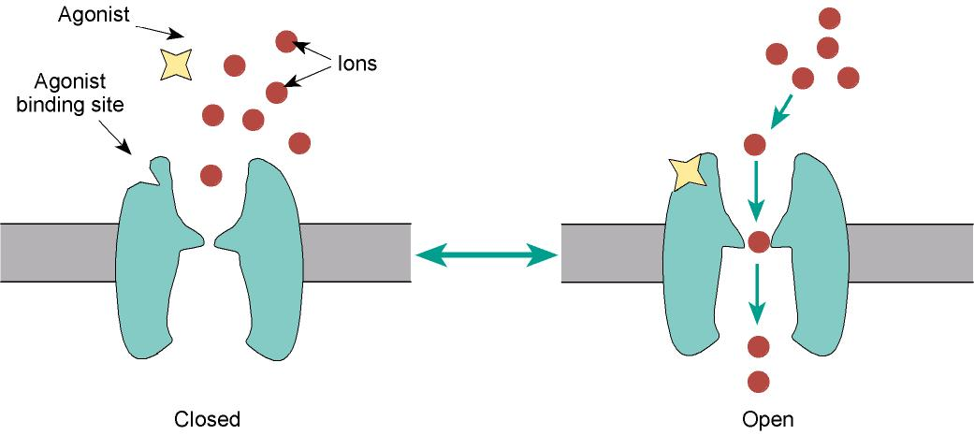
Ligand-Gated Channels
Ligand gated channels open in response to specific chemical signals e.g. nicotinic acetlycholine receptor.

Slide 27
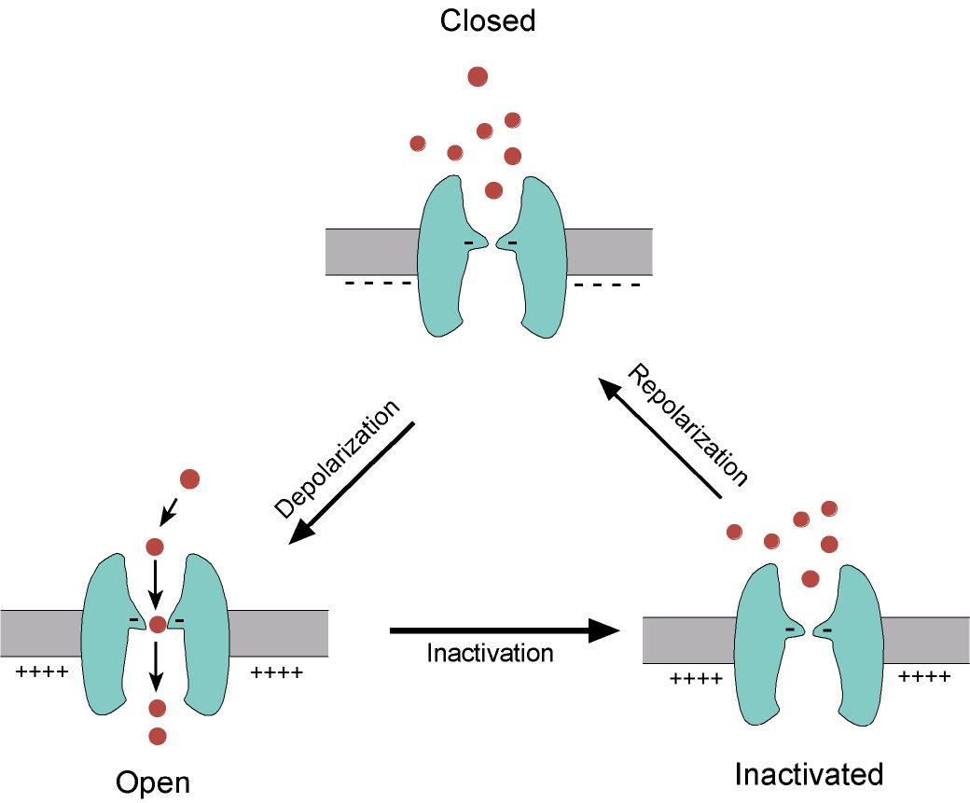
Voltage-Gated Channels
Voltage-gated channels open in responses to changes in the membrane potential e.g. sodium and potassium channels in the axon of a neuron.

Slide 28
Action Potential
An action potential is a rapid rise and subsequent fall in voltage or membrane potential across a cellular membrane with a characteristic pattern.
It occurs in different cells, called excitable cells, which include neurons, muscle cells, endocrine cells etc.
5 Steps of Action Potential
Resting Membrane potential
Threshold (early depolarization)
Depolarization
Repolarization
Hyperpolarization (Undershoot) &
Refractory period (Na⁺/K⁺ Pumps)

Slide 29
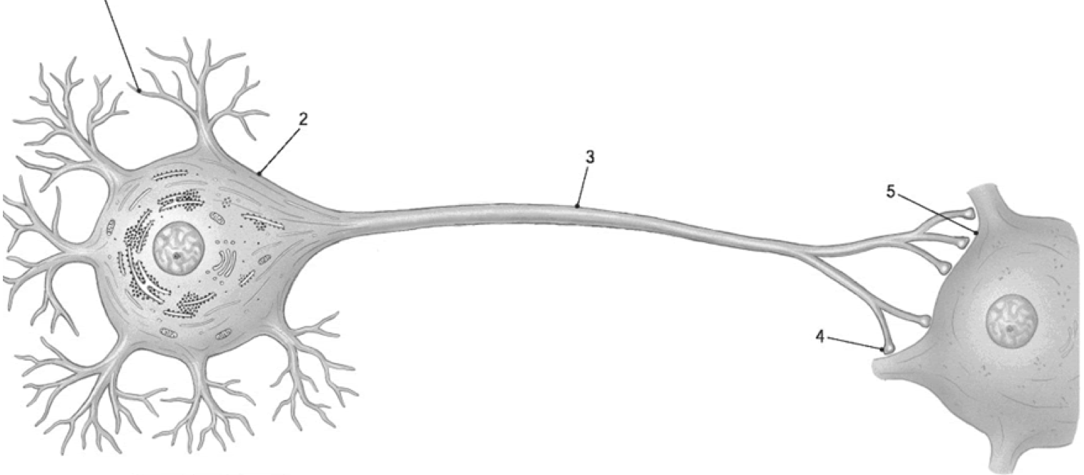
Step-1 Resting Membrane Potential
During resting state of neuron,
K⁺ concentration is higher inside the cell membrane with anionic proteins &
Na⁺ & Clˉ concentration is higher outside the membrane.
Dendrite
Soma
Axon
Post synaptic cell
Axon terminal
The resting membrane potential of a neuron is about -70 mV (mV means millivolt). It means that the inside of the neuron is 70 mV less than the outside.

Slide 30
Step-2 Threshold
The threshold refers to the critical level of membrane depolarization required to initiate an action potential. At rest, a neuron typically maintains a membrane potential of approximately –70 mV. When a stimulus is applied, this potential begins to rise toward zero.
If the membrane potential reaches around –55 mV, voltage-gated sodium (Na⁺) channels open. This marks the threshold level, and once it is reached, an action potential is triggered. If the depolarization does not reach this threshold, no action potential will occur.
Upon reaching threshold, Na⁺ ions rapidly enter the neuron through open sodium channels, driven by both concentration and electrical gradients.
Since sodium carries a positive charge, its influx causes the inside of the neuron to become more positive, leading to further depolarization. Simultaneously, the outside of the neuron becomes relatively negative, reinforcing the electrical polarity change.

Slide 31
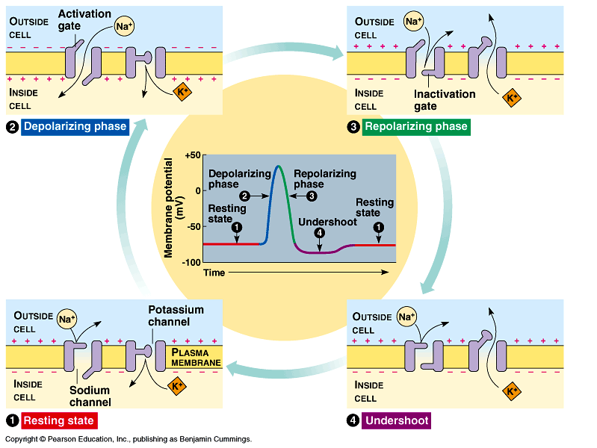
Step-3 Depolarization
Once the membrane potential reaches the threshold level (approximately –55 mV), additional voltage-gated sodium channels open.
This leads to a rapid influx of Na⁺ ions into the neuron, driven by both the concentration gradient and the electrical gradient.
As positively charged sodium ions enter the cell, the intracellular environment becomes increasingly positive, resulting in further depolarization.
This phase continues until the membrane potential peaks at around +40 mV.

Slide 32
Step-4 Repolarization
Following depolarization, when the membrane potential peaks at approximately +40 to +50 mV due to the influx of Na⁺ ions, voltage-gated sodium channels become inactivated.
Simultaneously, voltage-gated potassium channels open, allowing K⁺ ions to exit the neuron down their electrochemical gradient.
Causes the intracellular environment to become less positive, initiating repolarization of the membrane.
Additionally, chloride ions (Cl⁻) may enter the cell, contributing further to the restoration of a negative internal charge.
As a result, the membrane potential gradually returns to its resting level, falling from +40 mV back to approximately –70 mV.

Slide 33
Step-5 Hyperpolarization& Undershoot
During hyperpolarization, the voltage-gated potassium (K⁺) channels remain open slightly longer than necessary to restore the membrane to its resting potential.
Meanwhile, sodium (Na⁺) channels are closed, preventing further Na⁺ influx.
As a result, excess K⁺ continues to exit the cell, causing the membrane potential to become more negative than the resting level—typically dropping to around –75 mV. This phase is known as the undershoot.
Eventually, the K⁺ channels close, halting further potassium efflux. The membrane potential then stabilizes and returns to its resting value of approximately –70 mV, completing the action potential cycle.
Refractory Period and Directionality of Action Potentials
During the refractory period, both voltage-gated sodium (Na⁺) and potassium (K⁺) channels are closed or inactivated, preventing the initiation of another action potential.

Slide 34
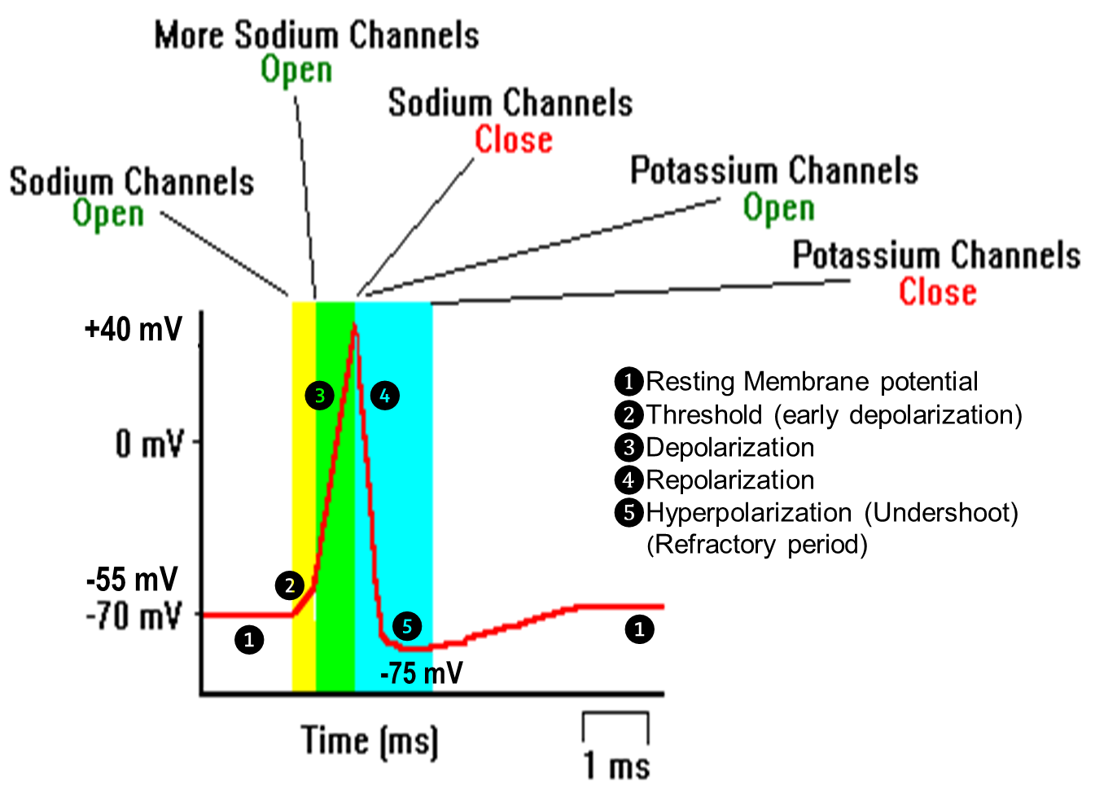

Slide 35
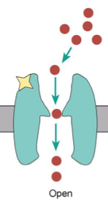
Action Potential
Dendrite
Soma
Axon
Post synaptic cell
Axon terminal
ligand gated channels
voltage-gated channels

Slide 36
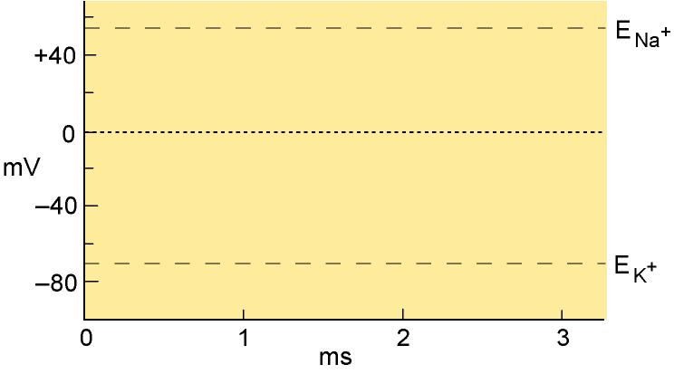
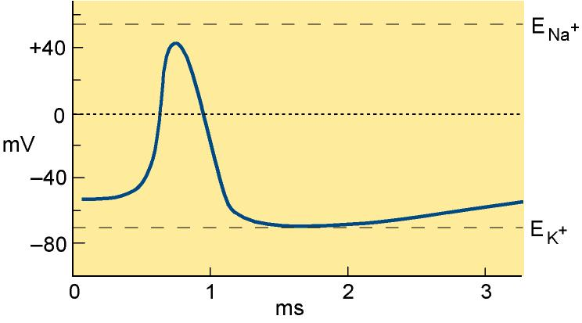
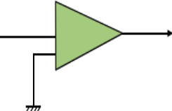

Action Potential
Dendrite
Soma
Axon
Post synaptic cell
Axon terminal
ligand gated channels voltage-gated channels

Slide 37
Action Potential
Action
Action potentials are “all or nothing” self-regenerating waves of electrochemical activity.

Slide 38
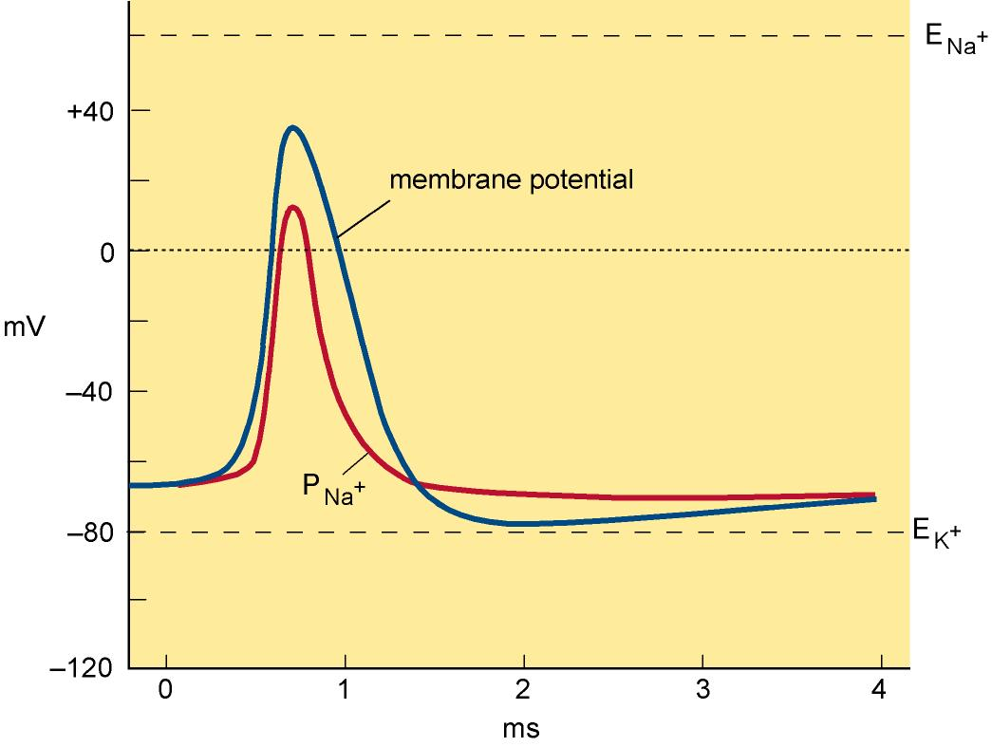
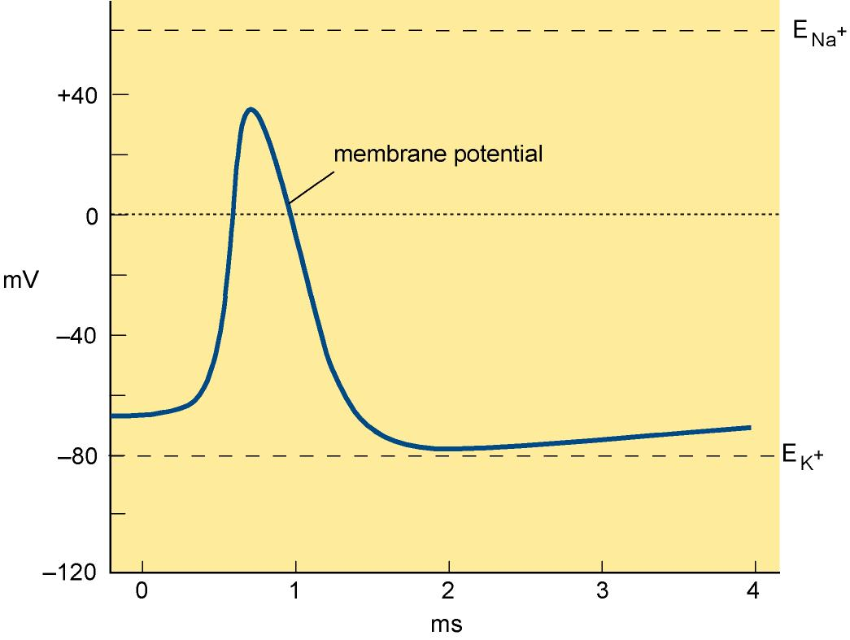
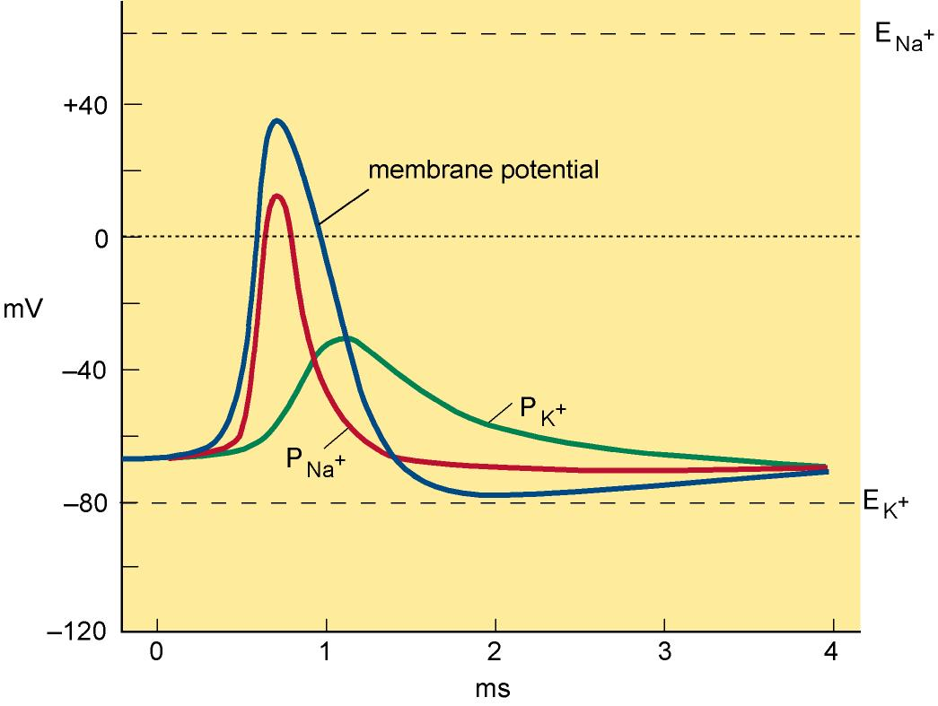
The AP depends on changes in the permeability of the axon membrane to Na⁺ and K⁺
Action Potential
Absolute refractory period
Relative refractory period

Slide 39
A thought…
Given that the threshold potential of excitable cells is typically between –40 and –55 mV and that the extracellular potassium ion concentration mainly determines the resting membrane potential of most cells, why do you think hyperkalemia can be dangerous?
Membrane Potential

Slide 40
Summary 1
The resting membrane potential largely arises as a consequence of the K⁺ gradient generated by the activity of the sodium pump.
The resting membrane potential of a cell is always negative and lies between -40 and -90 mV -depending on cell type.
Its value at any instant is determined both by the ionic gradients and by the permeability of the plasma membrane to the various ions.
The permeability of the membrane can be altered by opening ligand gated or voltage gated channels.
The membrane potential is therefore a physiological variable which varies according to cell activity.

Slide 41
Summary 2
The action potential is one example of the membrane potential as a physiological variable.
It is used to transmit signals quickly over relatively long distances to control physiological events such as the contraction of skeletal muscle.
It depends on the sequential activation of two sets of voltage gated ion channels - sodium and potassium channels.

Slide 42
Reading
Human Physiology
Gillian Pocock, Christopher Richards and David Richards
4th edition, pages 72-79
3rd edition, pages 40-43
2nd edition, pages 49-49; 78-79

