Slide 1
PHAR0002: An Introduction to the Mechanisms of Drug Action
Welcome to the course!
Dr David Benton
Notes:
Click to add Notes

Slide 2
Aims of the course
• To provide you with an introductory overview of pharmacology and some of the most important mechanisms of drug action.
• To illustrate these actions for you with specific examples of important drugs.
• To provide you with a foundation in some of the basic theory for pharmacology.
• To provide you with some basic laboratory experience that illustrates the lecture material.
• To familiarise you with some basic principles of laboratory practice and safety.
• To introduce you to some first steps in data analysis for pharmacology.

Slide 3
How is teaching delivered?
Lectures - 22
Tutorials - 4
Practicals - 2
Workshops-2

Slide 4
Outcomes of the course
Describe the fundamental mechanisms of drug action and their significance in pharmacology.
Explain these mechanisms with reference to specific, clinically important drugs.
Demonstrate a foundational understanding of basic pharmacological theory.
Apply key principles of pharmacology in a laboratory setting, using basic experimental skills.
Demonstrate safe laboratory practice in line with standard safety principles.

Slide 5
Assessment
Mid-term MCQ examination 5 % of final mark
Summer examination-in person 95 %
Affiliate students take the MCQ and complete a written exam at the end of term 1

Slide 6
What do we expect from you?
Attendance- tutorials and practicals are compulsory
Engagement- don’t be afraid to ask questions
Enjoy the course!

Slide 7
Getting Information….
Moodle is your friend……
Check the pages for updates and
information about lecture material.
Check the Common timetable for changes to locations and times...

Slide 8

What is Pharmacology?
Medicine
Drug Discovery
Pharmacology
The study of drug action..
What effect do they have?
How do they cause these effects?
Where do they have effects?
‘Pharmakon’
‘Pharmakon’

Slide 9
What is a drug?
… a chemical substance of known structure...which, when administered to a living organism, produces a biological effect….

Slide 10
What is a Drug?
All drugs are chemicals, but not all chemicals are drugs…...
All drugs are poisons but not all poisons are drugs……..
Not all drugs are medicines……
But all medicines are drugs…...

Slide 11
What do we need to know about a drug?
Mechanism – How does the drug work?
Dose (ineffective, clinically effective, toxic, ‘therapeutic window’)
Selectivity (drugs with only one target are rare)
Side Effects (toxicity useful- antibiotics, anticancer drugs
benzodiazepines – anxiolytic, hypnotic, muscle relaxant, amnesic)
Absorption, distribution and fate (how do we administer the drug, how long will it be present in the body…)
Risk/benefit ratio (quality of life, age, seriousness of illness)

Slide 12
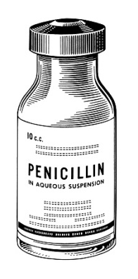
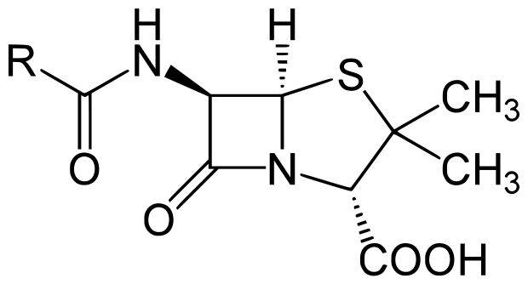
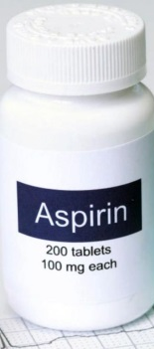
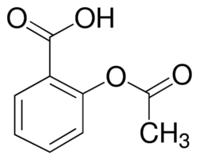

Mechanism of Action
We know:
Penicillin cures bacterial infections
Aspirin reduces inflammation
But how?
Penicillin cures bacterial infections
Aspirin reduces inflammation
X
Pain
Heat
Swelling
Loss-of-function
Cyclooxygenase
Mediators
Blood
vessel
Platelets
Plaque (Atherosclerosis)

Slide 13
Mechanism of Action
Drug targets :
Hormone/Neurotransmitter receptors eg anti-histamines
Enzymes eg neostigmine inhibits AChEase
Ion channels eg local anaesthetics block neuronal Na channels
Transporters eg cocaine inhibits uptake of noradrenaline
Nucleic acids eg cisplatin bind to DNA anti-cancer agent

Slide 14
Level of Study:
Single molecules- interaction between drug and target molecule
Cells – ‘native’ cells isolated from tissues- genetic modification
Tissues- isolated tissues/organs
Organisms- how do drugs affect whole system?
Populations- genetic variation-personalised medicine

Slide 15
Drug Safety
Teratogenicity
Rubella infection known since 1940s to cause foetal abnormality
Thalidomide (1960s, hypnotic, morning sickness) - limb malformation
Anti-angiogenic drug for cancer treatment
Drug regulatory bodies – Medicines & Healthcare Regulatory Agency (MHRA)
Committee on Human Medicines (CHM)
1982 Opren- withdrawn due to side effects.

Slide 16
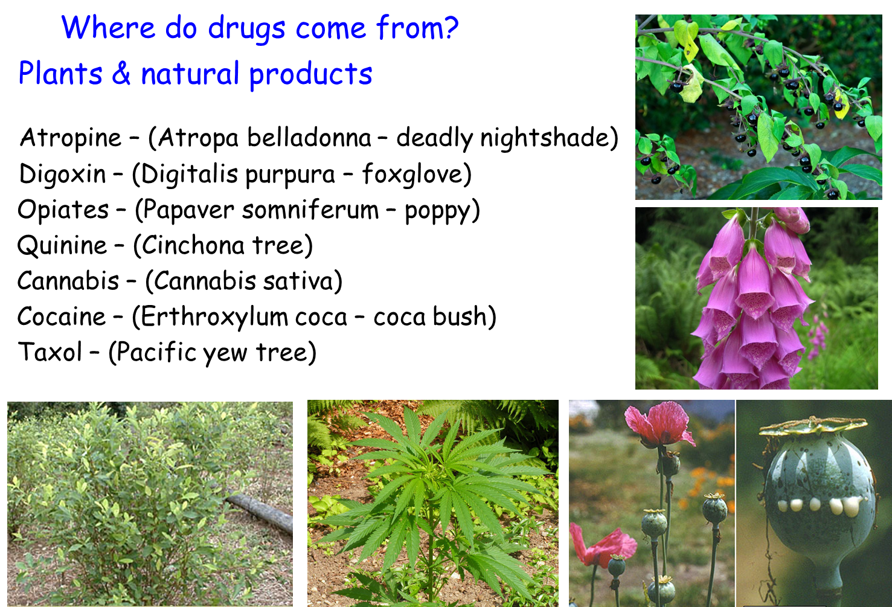

Slide 17
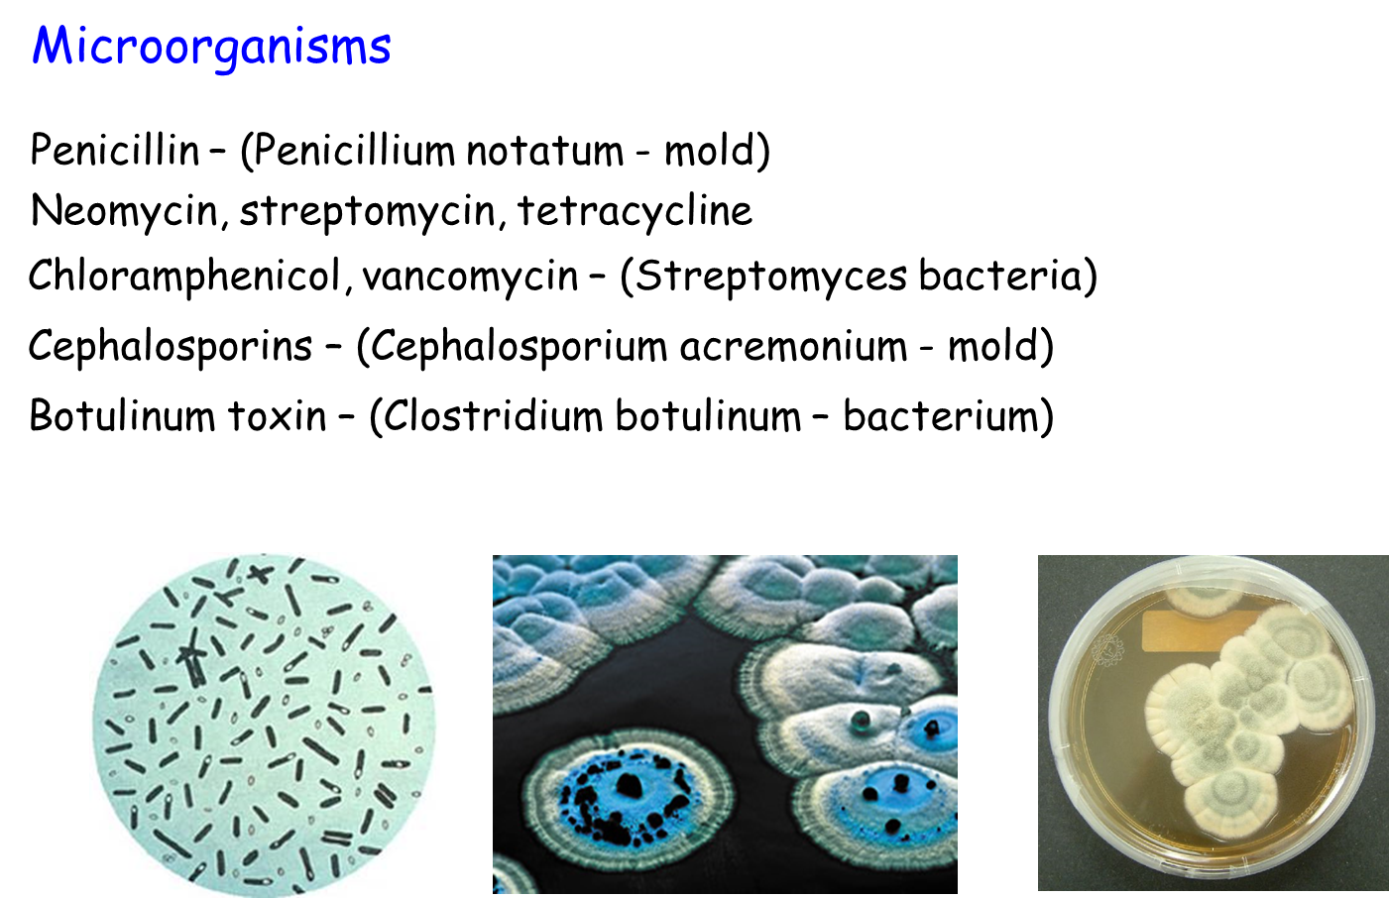

Slide 18
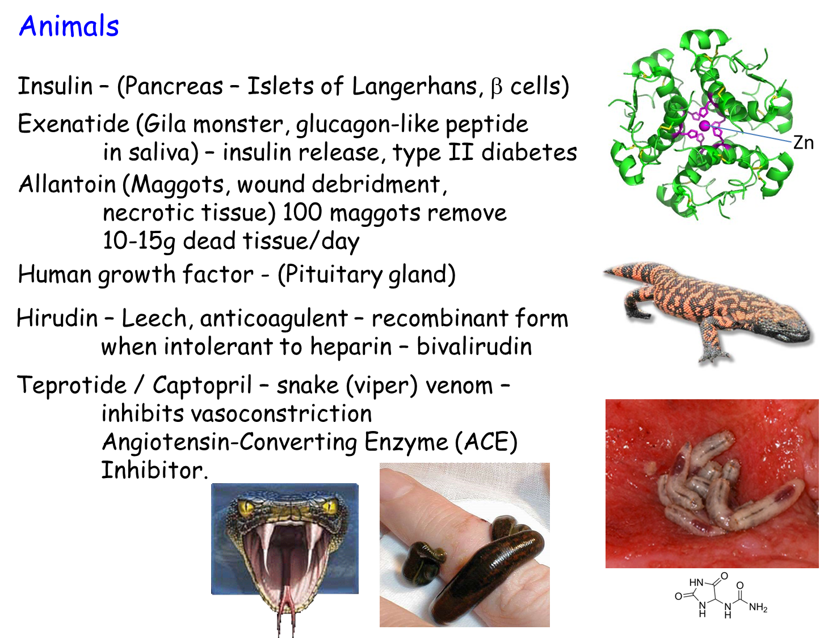

Slide 19
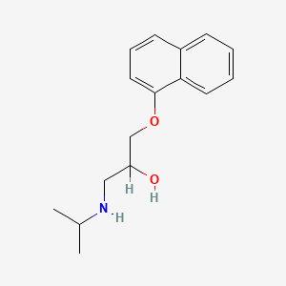
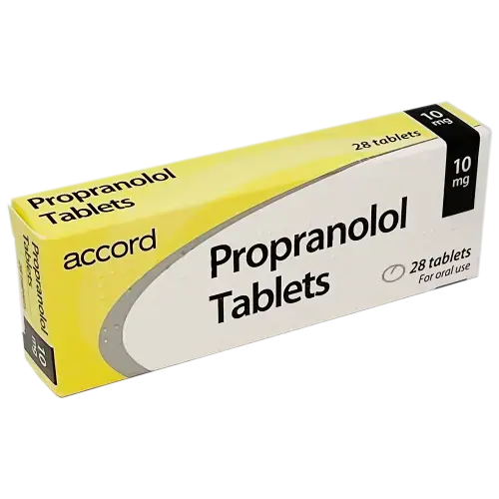
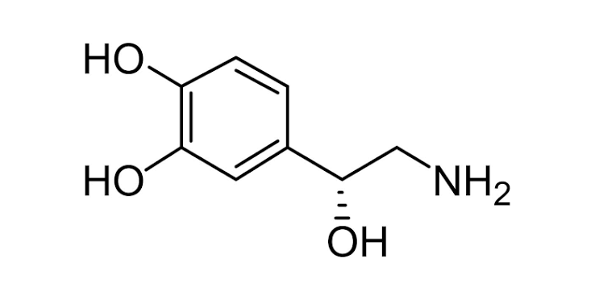
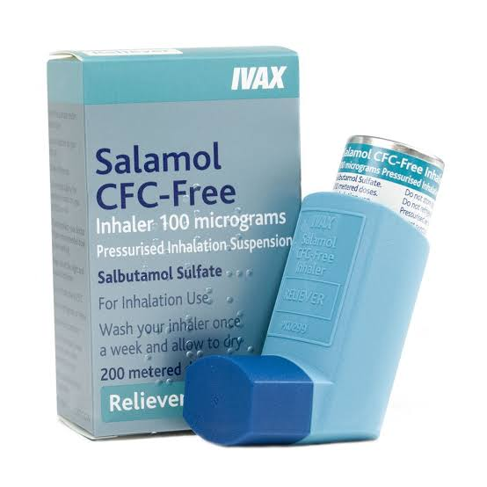
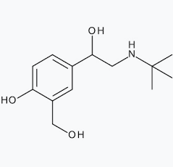
Synthetic compounds
NOREPINEPHRINE

Slide 20
Classifying Drugs…
Example…..Amphetamine (and dexamphetamine)
Medical Doctor, Pharmacist – Appetite Suppressant (anorexigenic) / ADHD / Narcolepsy
Pharmacologist – Above terms plus a Sympathomimetic
Chemist – 2-amino 1-phenylpropane
Barrister / Solicitor / Legal team – Psychotropic Substance, Controlled drug under Misuse of Drugs Act 1971, Psychoactive substances Act 2016 (Class B, Schedule 2)
Psychologist – Brain stimulant
Public - Speed

Slide 21
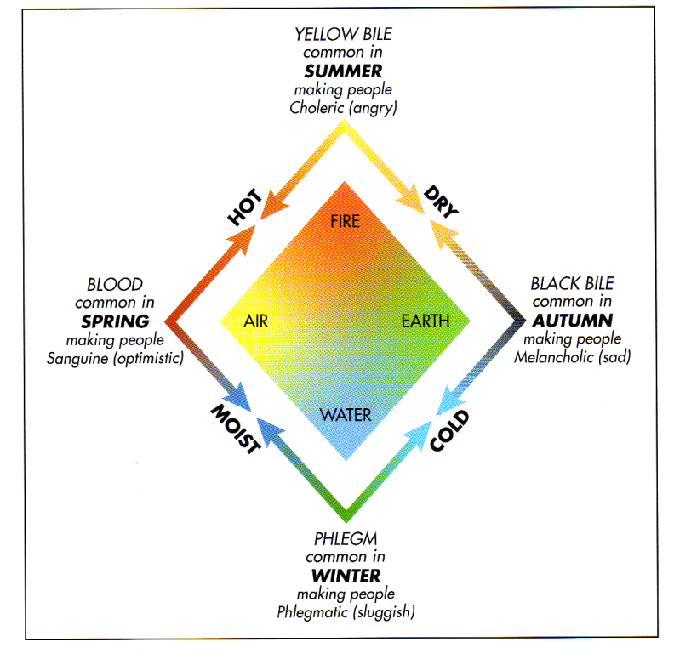
Milestones in Drug Therapy
1600BC Egyptian medical papyrus – Castor oil and opium
200AD Galen Theory of disease – Blood, phlegm, yellow bile and black bile

Slide 22
Milestones in Drug Therapy
Van Hohenheim – active principles in natural products,
questioned Galen’s ideas.
1805 Serturner – Isolated morphine – first pure drug
1909 Erhlich – Organic synthesis of arsenical compounds - syphillis
1935 Damagk – Antibacterials, sulphonamides, first selective antimicrobials
1945 Fleming, Chain & Florey – introduction of penicillin – first antibiotic
s Black – Structure-function studies of drugs, β blockers (propanolol),
H₂ antagonists (cimetidine)
2000s Biologics – Antibodies used to treat disease, eg, rheumatoid arthritis
Etanercept, Infliximab

Slide 23
Next time:
Drugs and the nervous system

