Slide 1

Dr David Benton

Slide 2
PLAN
Anatomy
Physiology of nervous system
Transmission
Conduction
Neuron/
Nerve cell
Voluntary muscle
Drugs
Drugs
Diseases
Diseases

Slide 3
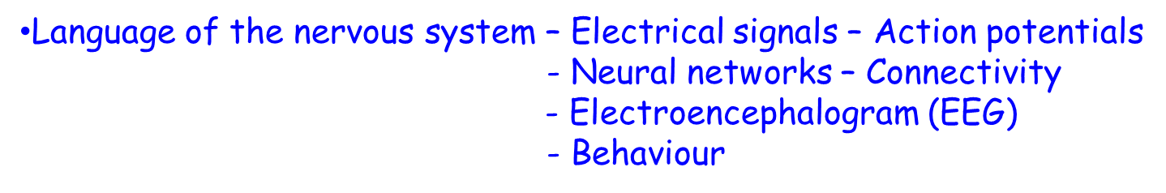
Anatomy, Physiology of the Nervous system
Function – communications network – receiving information – initiates actions
Specialised cells – Neurons- ~ 86 billion (or 86,000 million (role – communication/memory)
        - Glia (Neuroglia)– ~ number of neurons (role – support and communication)

Slide 4
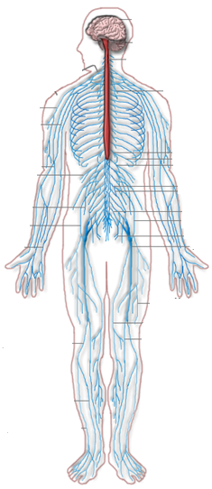
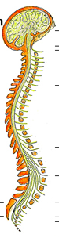
Nervous system - Divisions
Brain
Central Nervous System
Spinal
Cord
Peripheral Nervous System
Somatic
Nervous System
(muscle control)
Autonomic
Nervous System:
Sympathetic
Parasympathetic
(involuntary control)
Sensory
Nervous System
(sensory-skin, viscera)

Slide 5
Neuron
Neuron
Dendrites
Nucleus
Soma
Nucleus
Axon initial segment
Axon initial segment
Axon
Normal direction of
Impulse traffic
Axon Terminals
Synapse

Slide 6
Nerve Fibres
Cross-section
Longitudinal
UNMYELINATED
Axon
AXON
Schwann Cell
Nucleus
MYELINATED
Myelin sheath
Axon
AXON
Myelin sheath
Node of Ranvier
Internode
Connective tissue

Slide 7
PLAN
Anatomy
Physiology of nervous system
Transmission
Conduction
Neuron/
Nerve cell
Voluntary muscle
Drugs
Drugs
Diseases
Diseases
MEMBRANE POTENTIAL

Slide 8
What we know so far…..
The nervous system is a complex network of neurons.
Communication between neurons requires electrical signals.
Next question- How are these signals generated?
Ionic permeability of the cell membrane
Ionic gradients
Membrane potential

Slide 9
Membrane ionic permeability
K⁺
Na⁺
Outside
Cell membrane
Phospholipid bilayer
Inside
K⁺
Ion channel protein
Na⁺
Outside
Lipophilic
Hydrophilic
Inside
K⁺

Slide 10
Na-K ATP-ase/ Na-K pump / Sodium pump
2K⁺
Outside
+
Membrane
PUMP
_
Inside
3Na⁺
Electrogenic
ATP
ADP + Pi
CO₂ + H₂0
O₂, glucose

Slide 11
Ionic gradients
Extracellular
Intracellular
Concentration
gradients
120mM Na⁺
Na⁺ 10mM
5mM K⁺
K⁺ 125mM
125mM Cl⁻
Cl⁻ 5mM
A⁻ 130mM
Neurone

Slide 12
Membrane potential
Outside
Inside
Membrane
_
+
Electrical
gradient
K⁺
K⁺
Net gradient
Concentration
gradient

Slide 13
Membrane potential
Outside
Inside
Membrane
_
+
Electrical
gradient
K⁺
K⁺
No net gradient
Concentration
gradient
Nernst or Equilibrium potential for K⁺
E_{K} = (RT/zF) . ln ([K]_{o}/[K]_{i})
E_{K} ~ -70mV

Slide 14
Membrane potential
Outside
Inside
Membrane
_
+
Electrical
gradient
Na⁺
Net gradient
Na⁺
Concentration
gradient
E_{Na} = (RT/zF) . ln ([Na]_{o}/[Na]_{i})
E_{Na} ~ +30mV

Slide 15
Summary…..
The Na-K- ATPase:
transports Na and K ions across the cell membrane
establishes ionic gradients across the cell membrane
Electrogenic- generates a potential difference across cell membrane
Selective ion channels allow Na⁺ and K⁺ ions to pass through the membrane
At rest:
K⁺ ions are near equilbrium. M.P. ~ -70 mV
Na⁺ ions out of equilibrium – net gradient into the cell

Slide 16
Action potential
+30
0
Membrane potential (mV)
B
C
Threshold
-50
A
A
-100
D
1
2
3
4
5
Time (ms)

