Slide 1

Auto Regressive Next Token Predictors are Universal Learners
Jacopo Peroni, Aryan Rahbari

Slide 2






Auto-regressive Learning
An auto-regressive next-token predictor has the following form:
We say that a function
is computed by
if
Trained with chain of thought s.t. next token prediction becomes learnable for H

Slide 3


Linear Decoders
A particular example of AR models are linear decoders defined as follows
Where the functional space is
Theorem: Every Turing computable function is AR computable with respect to

Slide 4


Length Complexity
Given a function
we say
computes
with length complexity T if
Theorem: Any
that is Turing computable in time T(n) and any distribution
over inputs of size n, there is a dataset of strings of tokens of length poly(T(n)), such that training
a linear AR model over this dataset leads to a function that computes
Trade off between computational and length complexity

Slide 5
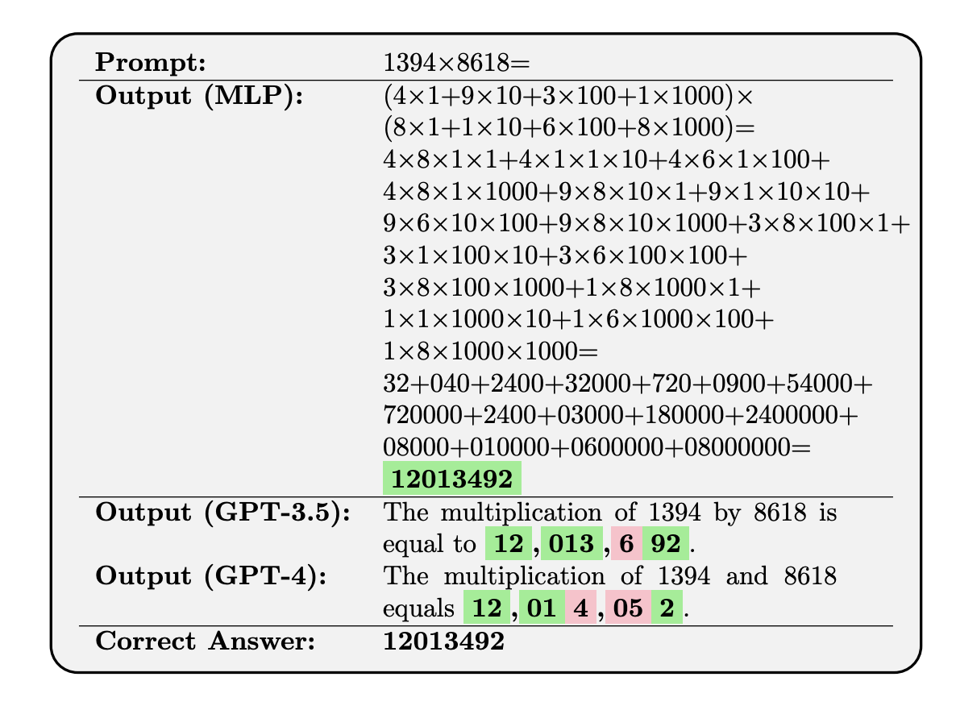
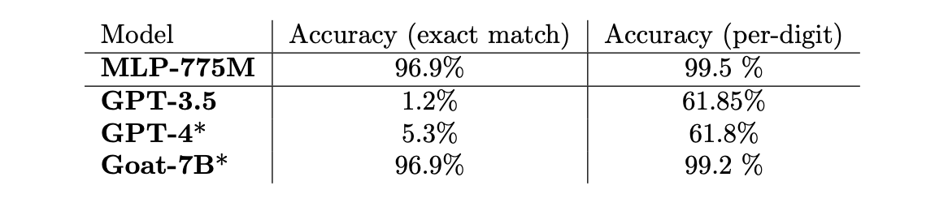
Experiment
Length complexity T = 307

Slide 6
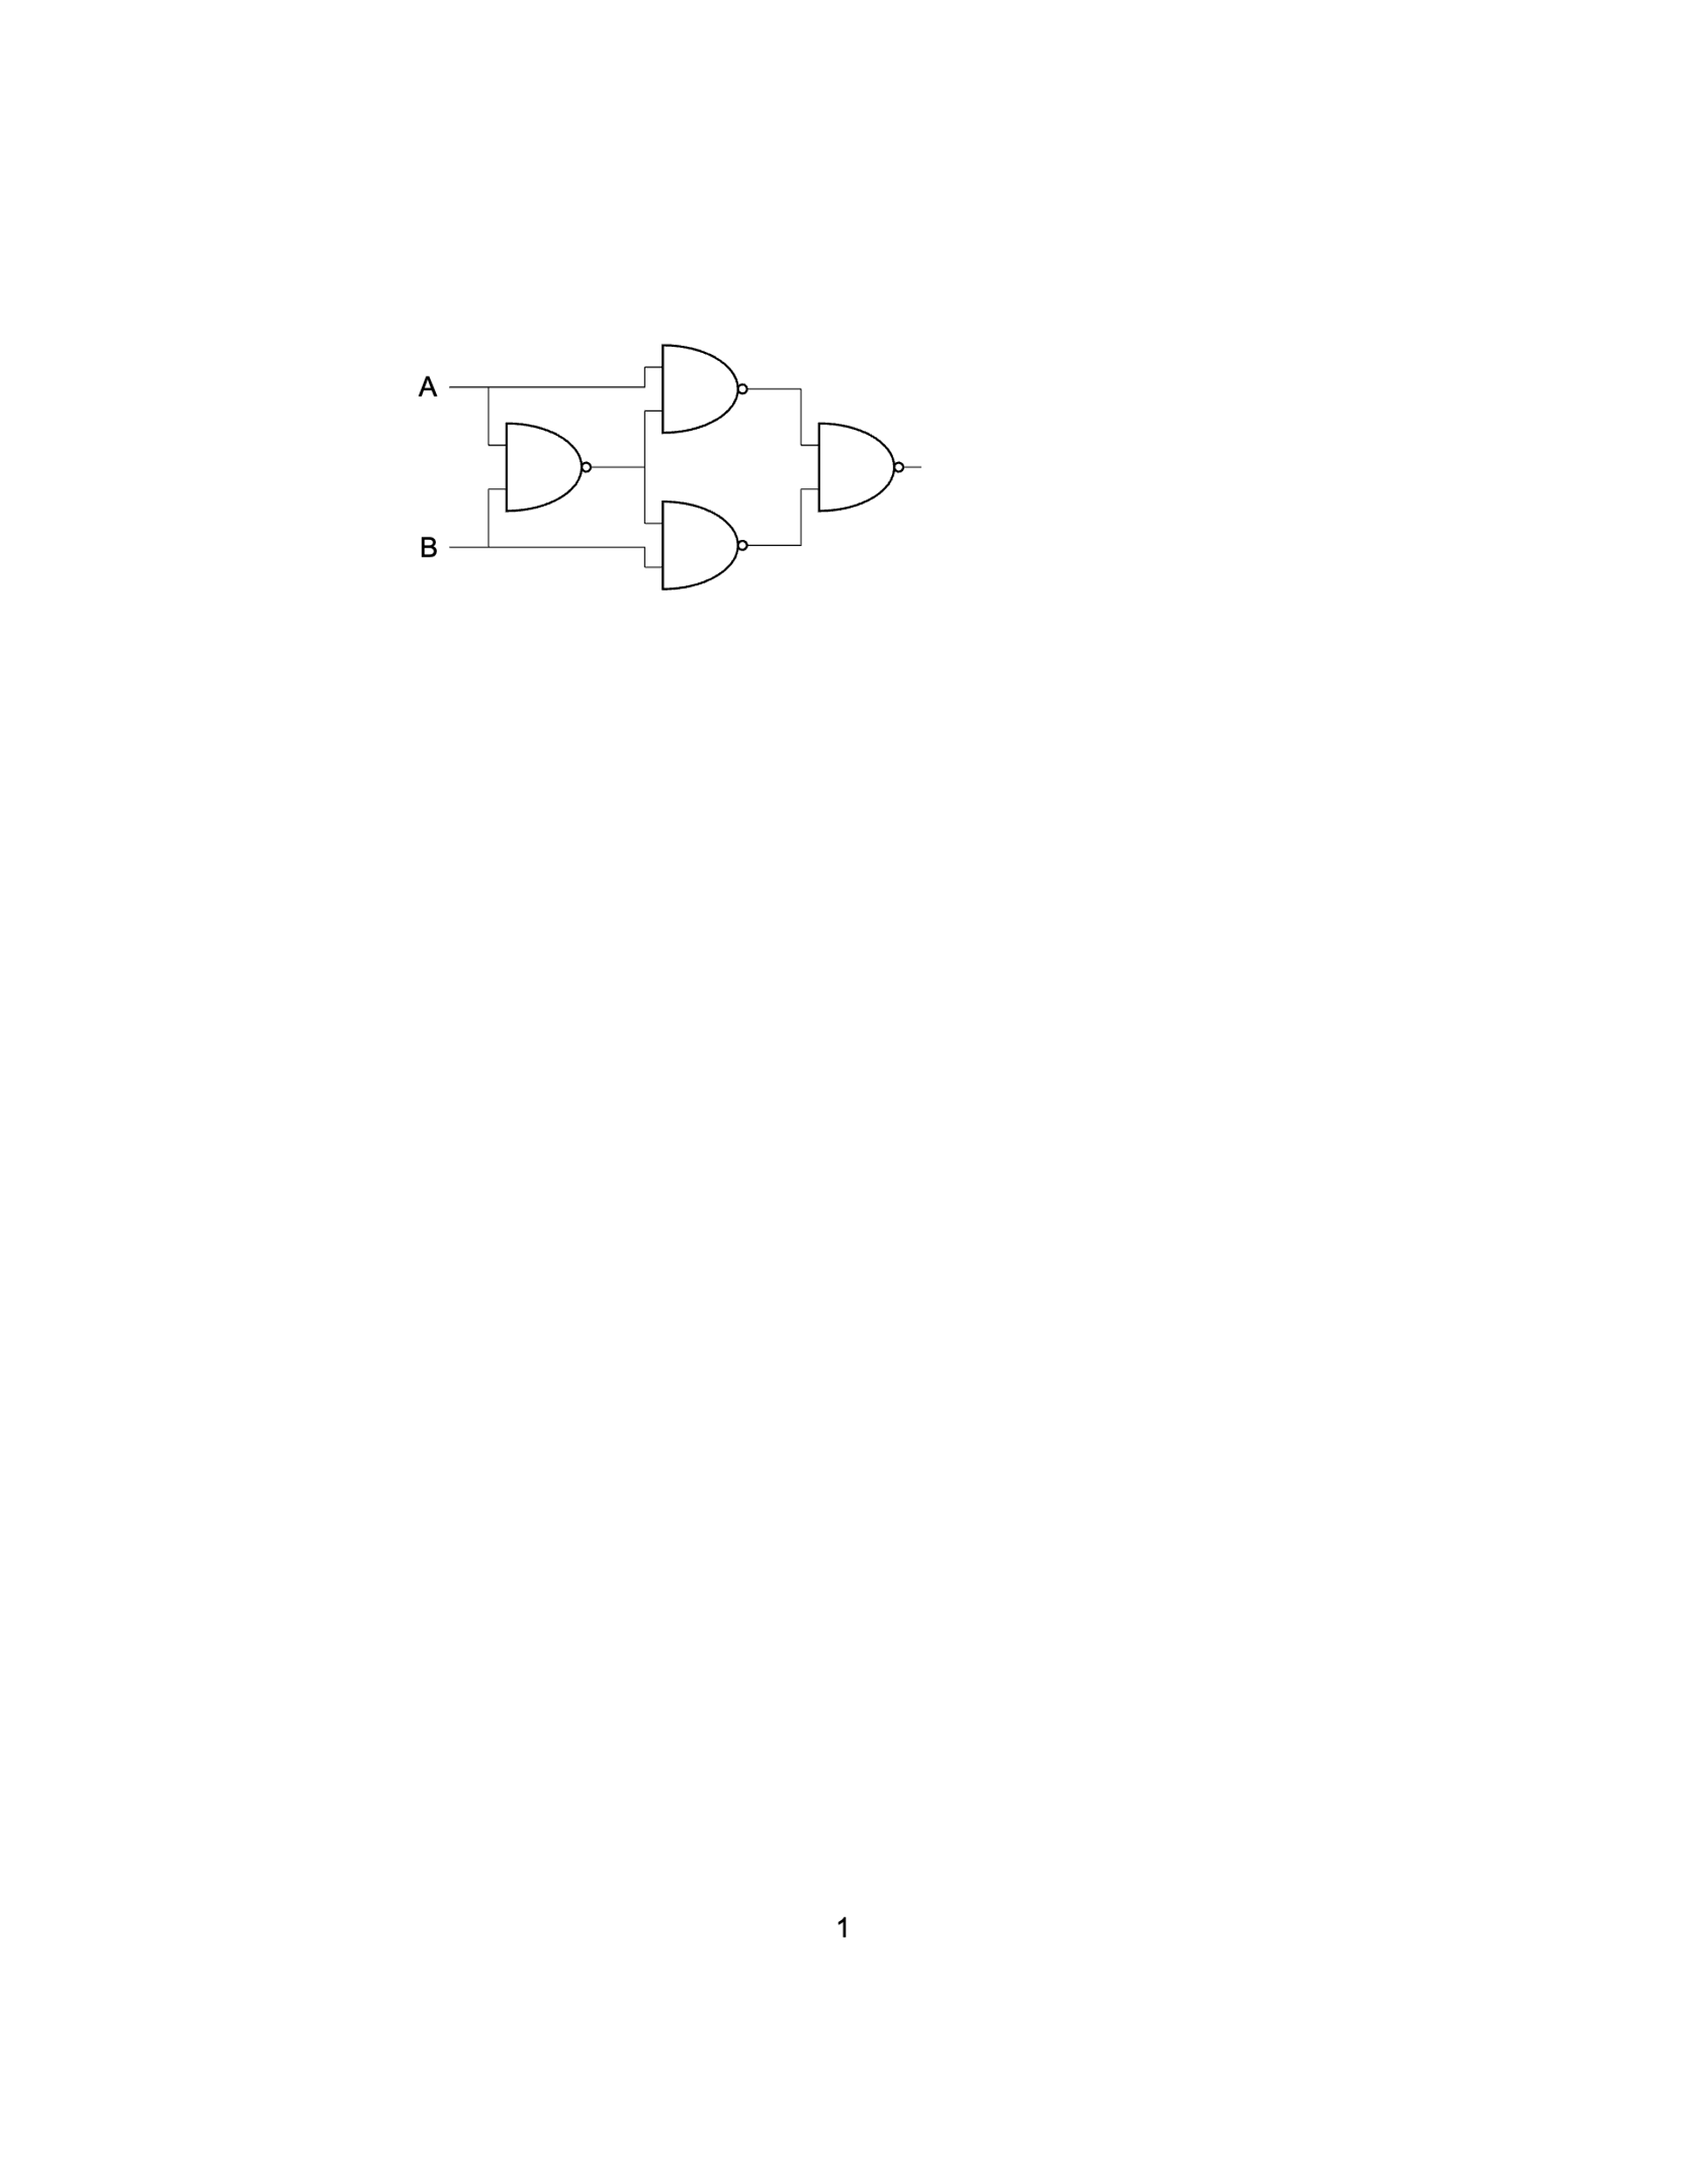
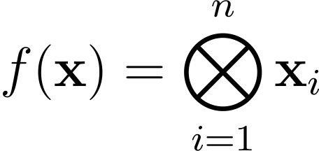
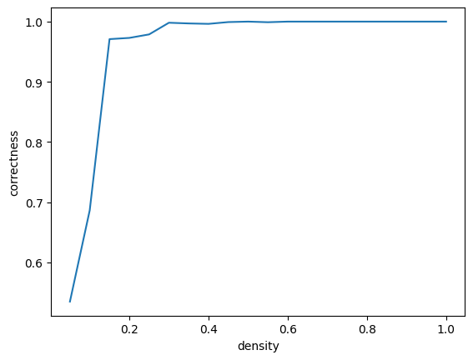
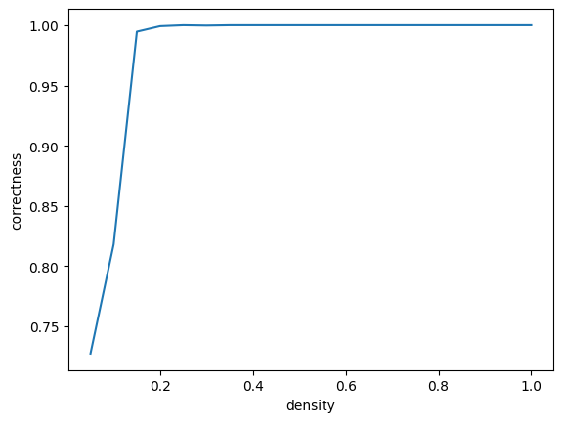
Experiment
Multiple XOR function
n=10, 20 densities, 50 cases / density
n=12, 20 densities, 50 cases / density
XOR circuit with NAND gates

Slide 7
Conclusions
Every Turing computable function can be learned if long enough chain of thought is given.
The main problem is the generation of the chain of thought data.
Small amount of input data the model acts well => faster way to compute the samples.
Chain of thought data from the internet makes this process faster than usal ML methods.

Slide 8
Thanks for your attention

