Slide 1


Welcome
from python import LIE
Python Language Immersion & Education Group

Slide 2
Motivation
Less than 10% of us will go on to academia. While we may be able to do research, many of us do not know formal programming skills relevant to industry.
LIE is meant to make us more viable in the job market by teaching advanced concepts and key skills in program development

Slide 3
Some of the topics to be covered
Writing proper functions/classes
“dunder” methods (e.g. __repr__() )
Iterators and Generators
Parallel processing and multi-threading
Documentation
Annotation and docstrings
Testing
Implementations & optimizations (i.e. PyPy & Cython)
Package submission

Slide 4
Hard & Soft Skills
Code review
How to read AND critically assess someone else’s code
Critical thinking
Both coding challenges and thought experiments
Interview expectations & etiquette

Slide 5
Resources

Slide 6



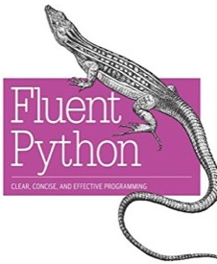










Websites
Deployment
Books
Style Guide
/

Slide 7
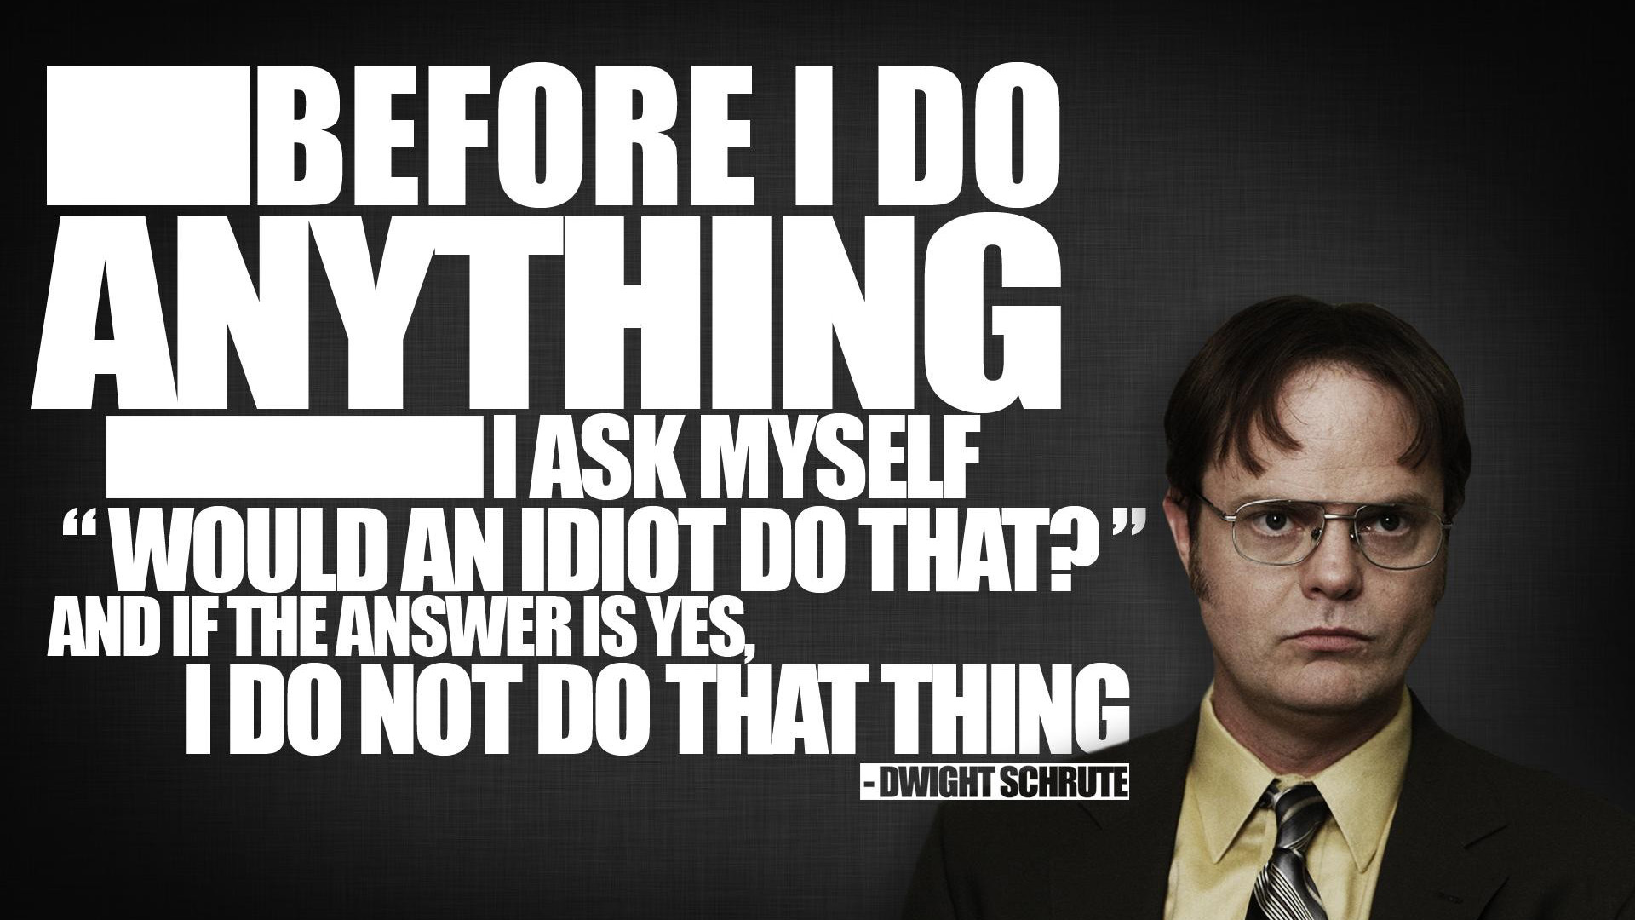

Slide 8


Shameless plug
mdsherman@betteridiot.tech
betteridiot
@better_idiot

Slide 9
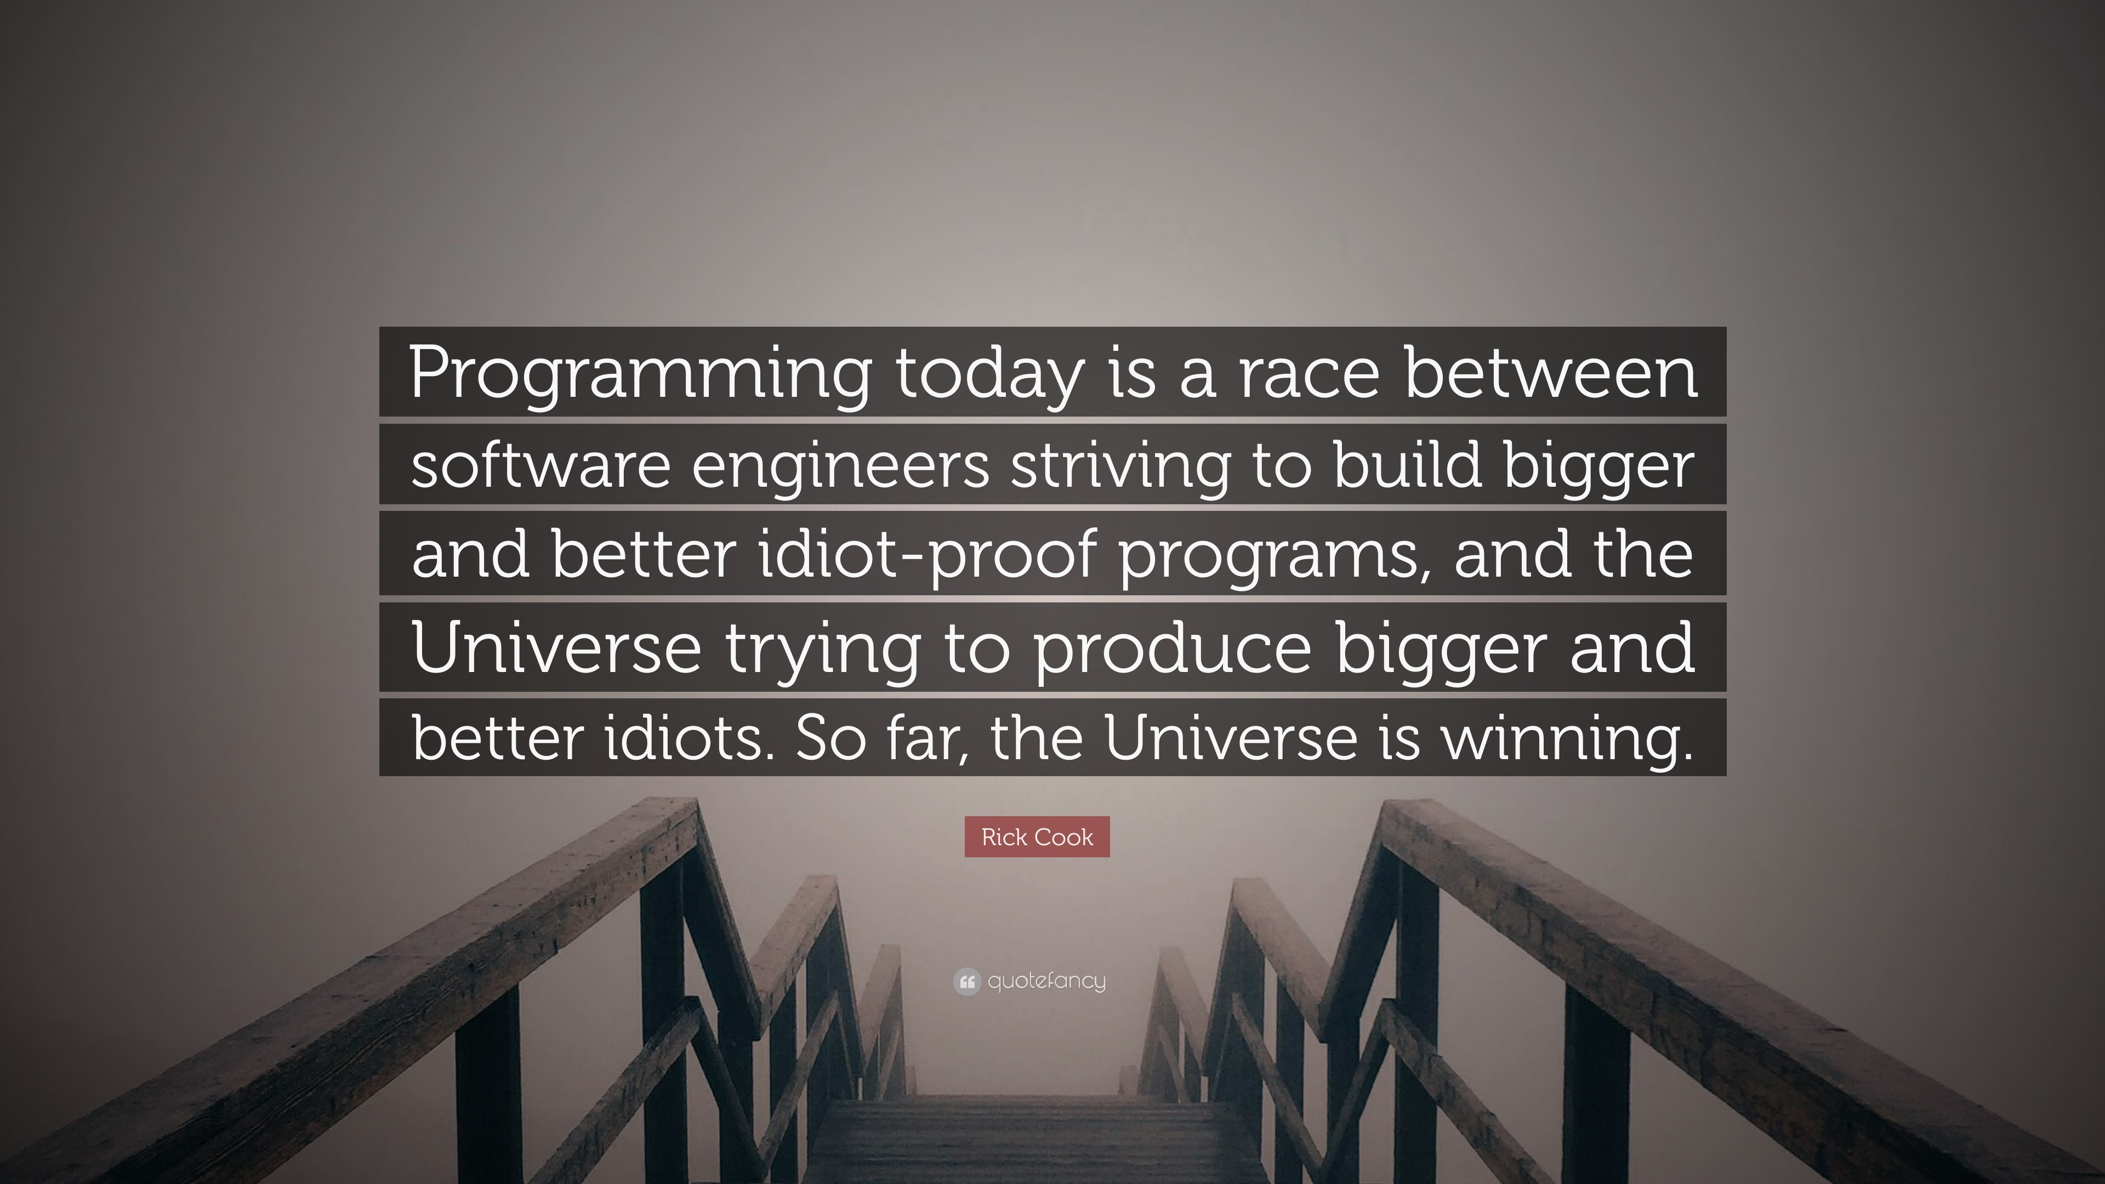

Slide 10

Code_Fight(P1, P2)

Slide 11
Code_Fight()
Next time, we will be picking two volunteers that will go head-to-head over a difficult coding problem
E.g. given an array of positive numbers and a number N :
Output the number at the N^{th} index raised to N^{th} power. If N is outside the dimensions of the array, report -1
The specifics of what the winner will get is still in the air, but the loser will get free coffee for two—and a responsibility!

Slide 12
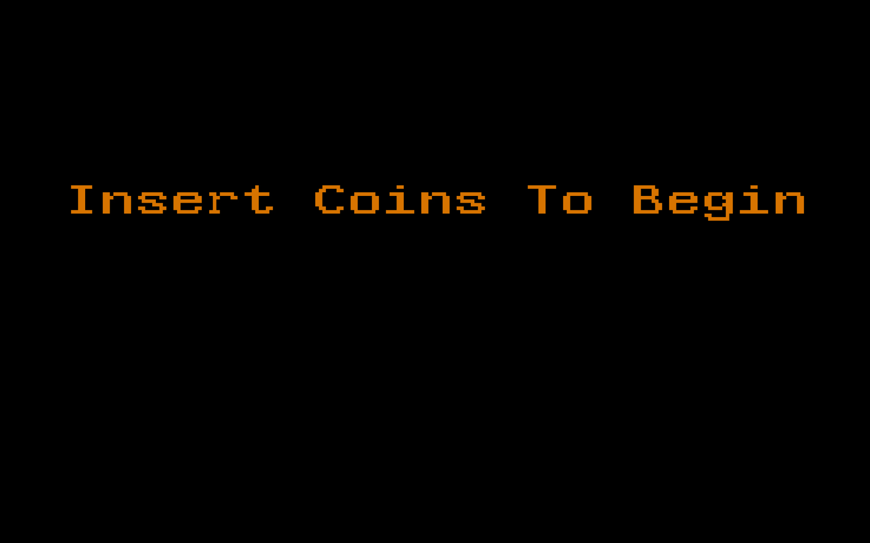

Slide 13
non_uniq(data)
Write a function that takes an list/array of positive integers and returns the non-unique values in the array as a list.
Args:
data (list): list of positive integers
Returns:
out (list): list of non-unique values from data
>>> non_uniq([1,2,3,3,4,5,4])
[3,4]

Slide 14


Slide 15
Interview Question
At the end of each meeting, I will present a question that has been used in job interviews.
These questions are meant to challenge your critical thinking skills or technical knowledge of programming.
At the next meeting, we will discuss the different approaches that you have come up to answer the questions

