Slide 1
NEUROFORGE ENTERPRISE
SDLC PLATFORM
PROJECT MODULES
PRESENTED BY :
Mannuru Prethika
July 29, 2026
01 / 08

Slide 2
DEVELOPMENT METHODOLOGY: AGILE
Sprint Planning
Project Duration
Sprint Duration
Total Sprints
The NeuroForge Enterprise SDLC Platform will be developed using the Agile Software Development Methodology, which emphasizes iterative development, continuous collaboration, and frequent delivery of working software. Instead of building the entire system at once, the project is divided into 4 sprints, with each sprint lasting 2 weeks. At the end of every sprint, a functional module is completed, tested, reviewed, and improved based on stakeholder feedback.
8 Weeks
2 Weeks
4
Plan
→
Build
→
Test
→
Review
→
Improve
Each sprint delivers a tested, reviewable increment and incorporates stakeholder feedback before the next iteration.
02 / 08

Slide 3
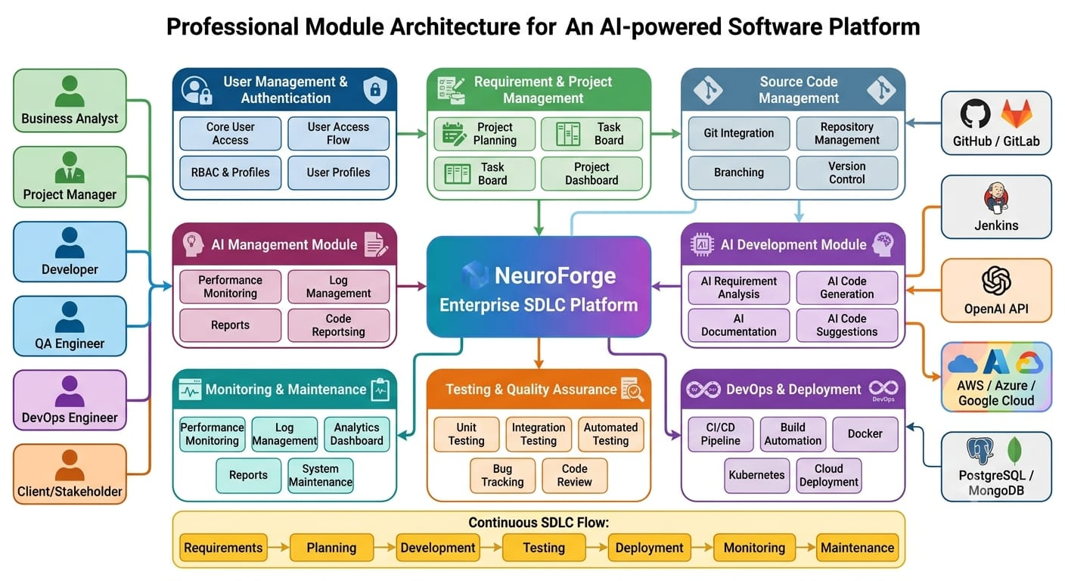
MODULE ARCHITECTURE
03 / 08

Slide 4
FOUNDATION & PROJECT MANAGEMENT
Sprint 1 (Weeks 1-2)
Objective
Deliverables
Build the foundation of the platform by implementing user management, authentication, and project planning capabilities.
• Secure user registration and login
• Different user roles (Admin, Manager, Developer, Tester, etc.)
• Project creation and configuration
• Requirement collection and management
• Sprint and task creation
Modules
• User Authentication & Login
• Role-Based Access Control (RBAC)
• User Management
• Requirement Management
• Project & Sprint Planning
04 / 08

Slide 5
DEVELOPMENT & COLLABORATION
Sprint 2 (Weeks 3-4)
Objective
Deliverables
Develop modules that improve collaboration and assist developers during software development.
• Assign and track development tasks
• AI-assisted code generation
• Automatic technical documentation
• Git repository integration
• Team notifications and collaboration features
Modules
• Task Assignment & Sprint Management
• AI-Powered Code Generation
• Documentation Management
• Git Integration & Version Control
• Team Collaboration
05 / 08

Slide 6
TESTING & DEVOPS
Sprint 3 (Weeks 5-6)
Objective
Deliverables
Implement quality assurance and DevOps capabilities to automate testing and software deployment.
• Automated unit and integration testing
• Bug reporting and issue management
• AI-assisted code quality analysis
• Continuous Integration and Continuous Deployment
• Automated software deployment
Modules
• Automated Testing
• Bug Tracking
• Code Review
• CI/CD Pipeline
• Deployment Module
06 / 08

Slide 7
MONITORING, ANALYTICS & FINAL DEPLOYMENT
Sprint 4 (Weeks 7-8)
Objective
Deliverables
Complete the platform by implementing monitoring, analytics, reporting, and maintenance features before final deployment.
• Live project monitoring dashboard
• Performance and resource monitoring
• Project and productivity reports
• System maintenance and update support
• Final integration, User Acceptance Testing (UAT), and production deployment
Modules
• Real-Time Dashboard
• Performance Monitoring
• Reporting & Analytics
• Maintenance Module
• Final System Integration
07 / 08

Slide 8
THANK YOU!
NeuroForge Enterprise SDLC Platform
08 / 08

