Slide 1
NeuroForge Enterprise SDLC Platform

Slide 2
Unified Modeling Language (UML)
What is UML?
UML stands for Unified Modeling Language.
It is a standard graphical modeling language used to visualize, design, document, and communicate the structure and behavior of a software system.
UML helps developers understand the system before coding by representing it through different diagrams.
It is widely used in Object-Oriented Software Development (OOSD).
UML was developed by the Object Management Group (OMG).

Slide 3
Why is UML Used?
Unified Modeling Language (UML) is used to plan, analyze, and design a software system before the coding process begins. It provides a clear visual representation of the system, making it easier for developers, designers, clients, and stakeholders to understand the system architecture and functionality. UML helps simplify complex software designs, improves communication among team members, and identifies design errors at an early stage, reducing development time and cost. It also serves as a valuable documentation tool for future maintenance and upgrades while supporting software testing, debugging, and object-oriented software development.

Slide 4
Benefits of UML
Standardized modeling language
Easy to understand and communicate
Platform independent
Improves software quality
Detects design errors early
Reduces development cost
Supports object-oriented development
Enhances project documentation
Simplifies maintenance and future upgrades

Slide 5
Types of UML Diagrams
Structural Diagrams | Behavioral Diagrams
Class Diagram | Use Case Diagram
Object Diagram | Activity Diagram
Component Diagram | Sequence Diagram
Package Diagram | Communication Diagram
Deployment Diagram | State Machine Diagram
Composite Structure Diagram | Interaction Overview Diagram
Profile Diagram | Timing Diagram

Slide 6
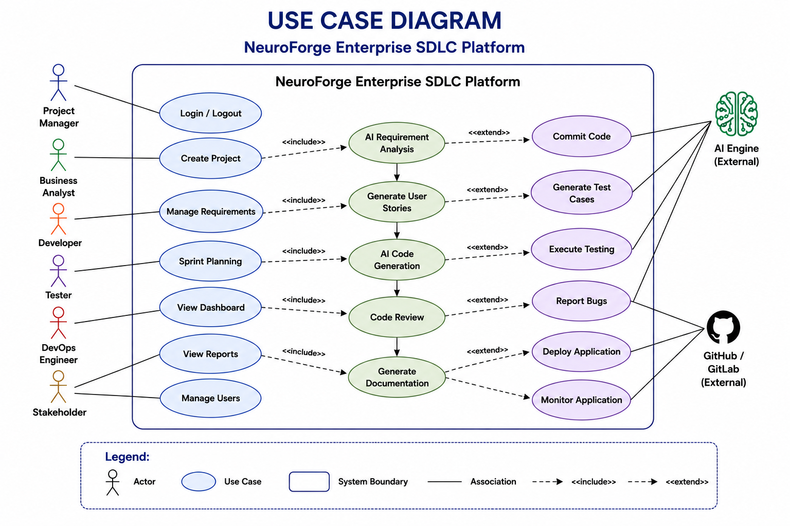
Use Case Diagram

Slide 7
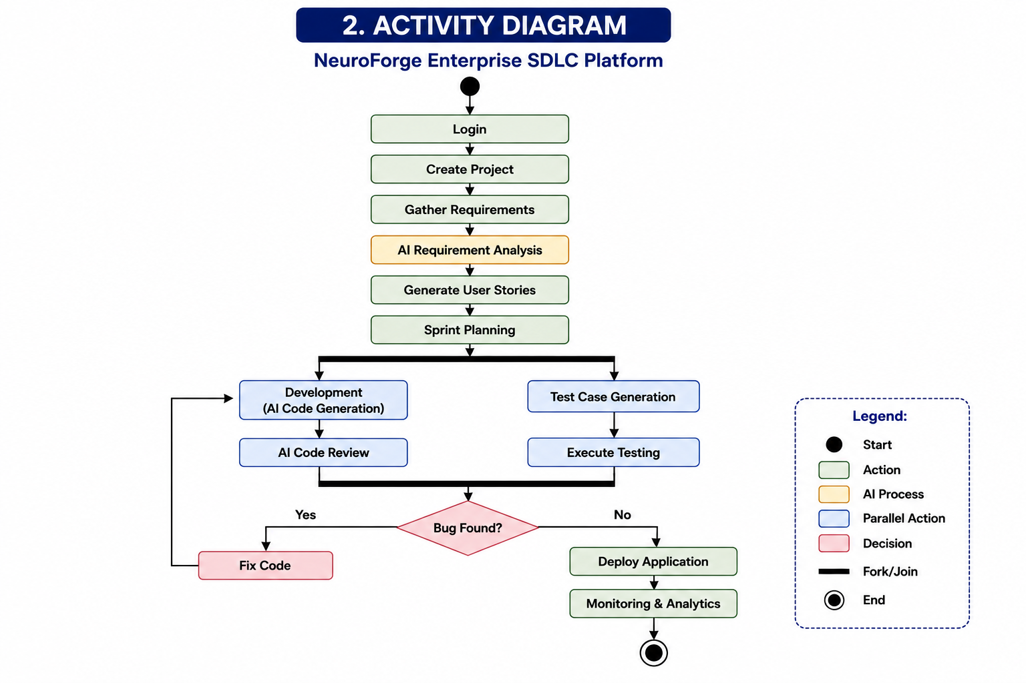
Activity Diagram

Slide 8
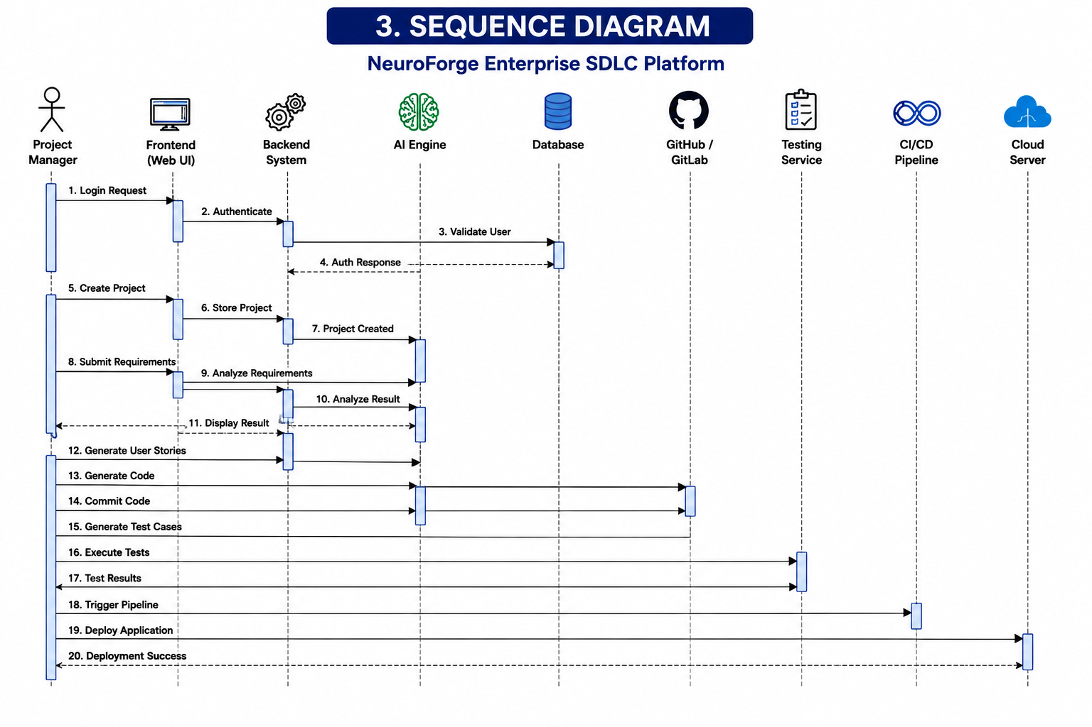
Sequence Diagram

Slide 9
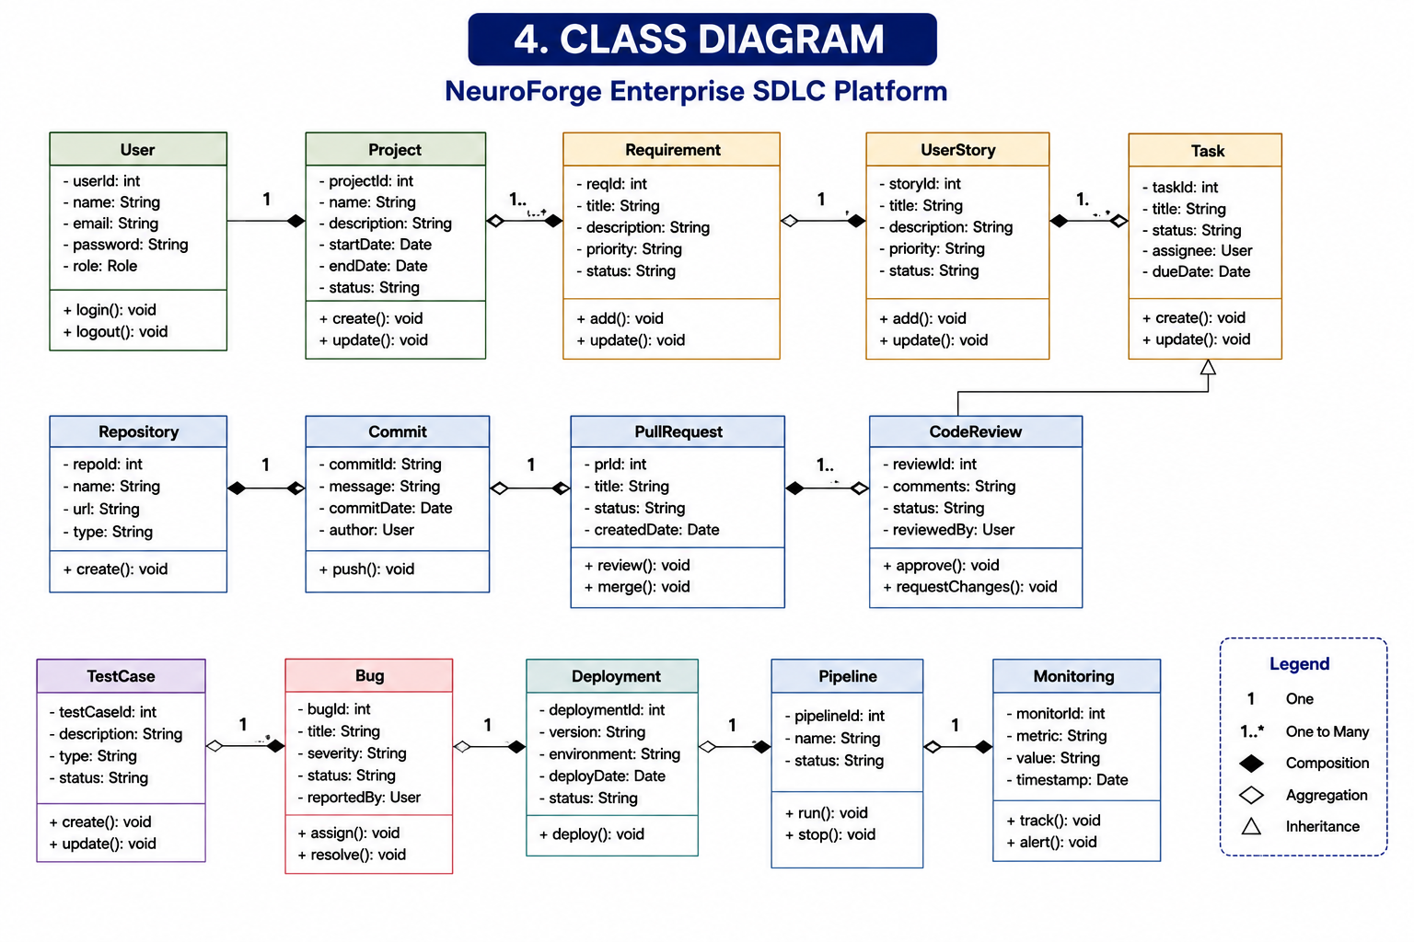
Class Diagram

Slide 10
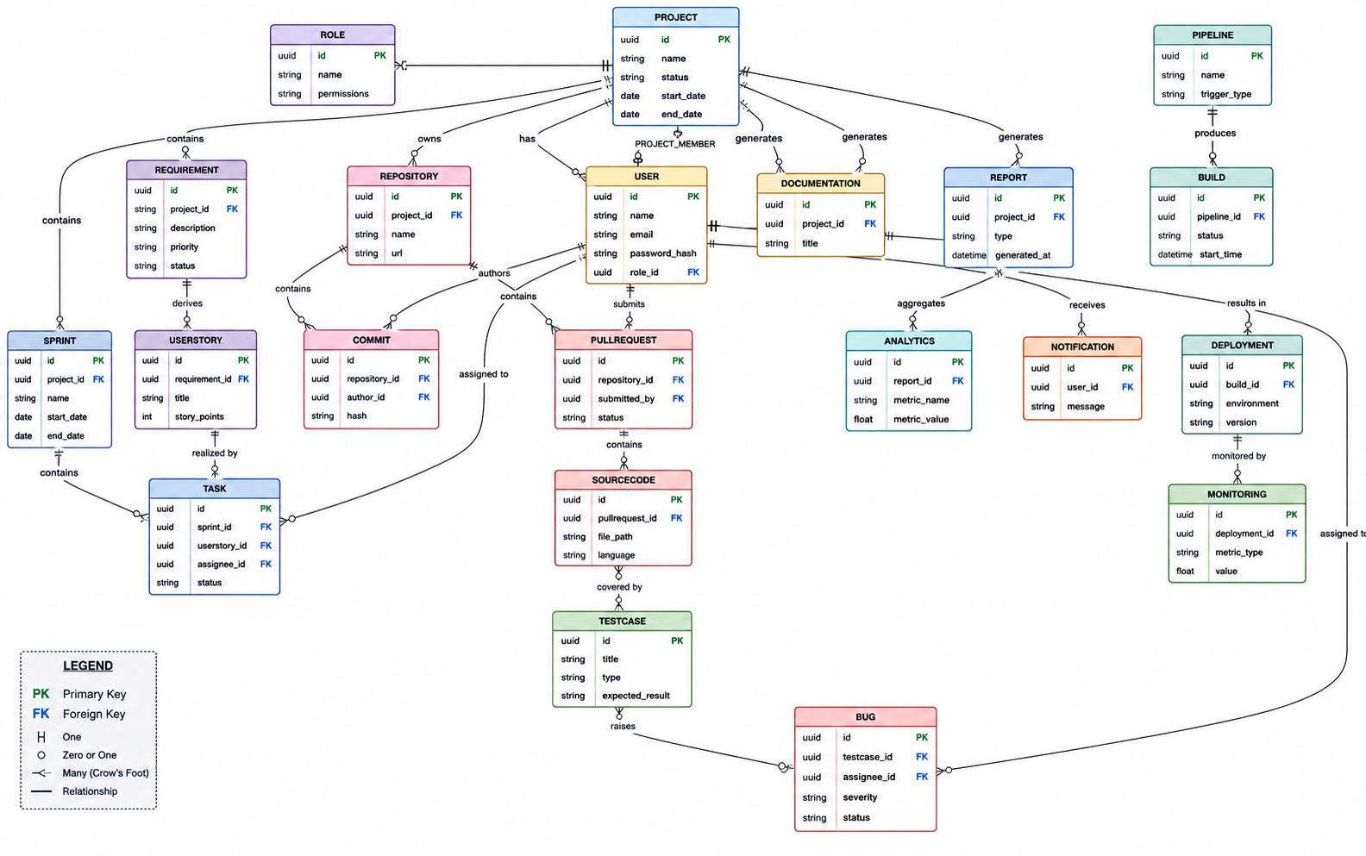
ER Diagram

Slide 11
THANK YOU

