Slide 1
Workshop
.NET and C#

Slide 2
How will this workshop be organized?
Explanation about .NET
Explanation about C#
Exercises in C# with .NET Core
Showcase of more complex projects and where to continue (WPF, Unit Testing, Web API’s, ASP.NET, LINQ)
Resources

Slide 3
.NET
What is .NET?
How does .NET work?
What’s .NET Framework, .NET Core?
What are NuGet Package Manager & .NET Standard?

Slide 4
What is .NET?
.NET is a free, cross-platform, open source framework for building many different applications
You can write in 11 Microsoft or 50 non-Microsoft developed languages
A high-level language
Compiles your source code into assembly code for your processor to run
Availability of a huge Class Library

Slide 5
How does .NET work?
Common Language Runtime is a run-time environment for .NET
Source code is compiled with a language-specific compiler to Microsoft Intermediate Language (MSIL) and metadata
MSIL can have references to the base Class Library and other libraries
MSIL is further compiled into assembly code for the specific processor
.NET has their own garbage collection exception handling

Slide 6
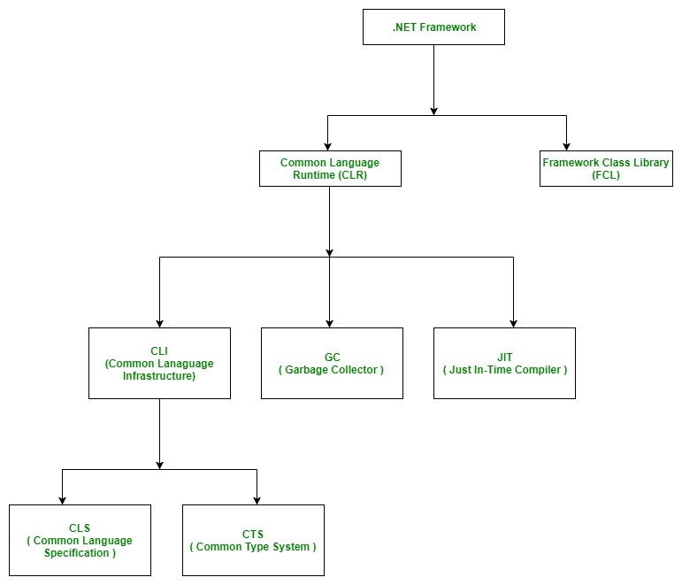
How does .NET work?

Slide 7
.NET Framework
First version of .NET released in 2000 by Microsoft
Availability huge quantity of Microsoft and third-party libraries
Applications can only be executed in a Windows environment
Notes:
Intel helped to work on CLI and C#

Slide 8
.NET Core
Release by Microsoft in 2016
Has a faster CLR than .NET framework
Cross platform and open source
A lot of support for Microsoft Azure
Deploy microservices well on Azure and Docker
Future of .NET environment with anticipated .NET 5 release in 2020

Slide 9
NuGet
Package manager for Visual Studio environment
Packages are compiled libraries with metadata written in a .NET language
Developers can create, share and consume different packages in the .NET environment
Beware to check if the package works in Framework or Core

Slide 10
.NET Standard
Framework and Core have their own Class Libraries from which all NuGet packages derive their code from
Packages made in Framework don’t work in Core applications and vice versa
Base Class Library (BCL) is a part of Framework Class Library and Core Class Library
Packages written in .NET Standard work on Framework and Core applications

Slide 11
C#
What is C#?
What is Visual Studio?
How do you start a .NET application in C#?
What’s the difference between solutions, projects and namespaces?
Exercises

Slide 12
What is C#?
Programming language developed in 2000 to be used in the .NET environment with the CLI
Strong typed and object oriented
General purpose language; you can build almost anything with it

Slide 13
What is Visual Studio?
Integrated Development Environment (IDE) created by Microsoft
Microsoft Visual Studio has 3 IDE for Windows and Visual Studio Code
Visual Studio Code is light-weight and faster
Microsoft Visual Studio has more features but slower

Slide 14
How to start a .NET application (Windows)
Open Microsoft Visual Studio Community 2019
Click ‘Create New Project’
Double Click on ‘Console App (.NET Core)’
Give a project and a solution name
Click on ‘Create’
Click on the green start button at the top center

Slide 15
How to start a .NET application (Linux)
Open terminal
Move through the terminal to the folder where you want to place your solution
Type ‘dotnet new sln –n “Solution Name”’
Type ‘dotnet new console –n “Project Name”’
Type ‘dotnet sln “Solution Name”.sln add **/*.csproj’
Change your directory to your project with ‘cd Project Name’
Type ‘dotnet run’ to run the program
Type ‘code .’ to open the solution or project in Visual Studio Code
If on the bottom right, there’s a popup to create build and debug options, click yes

Slide 16
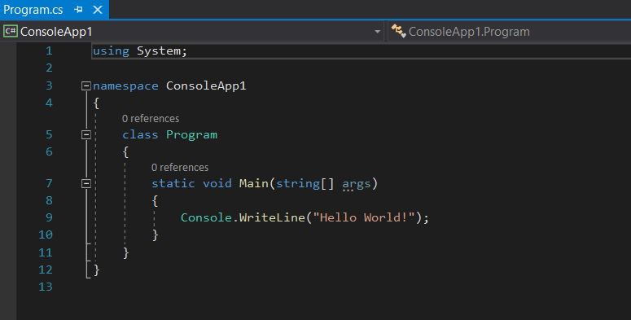
How to start a .NET application
Reference / Dependency to be used
Namespace, referring to the project name
Class Name
Entry point of a project
Scope of your code

Slide 17
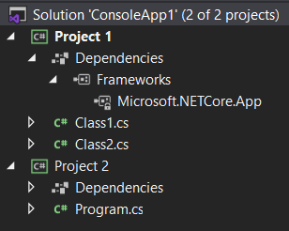
Solution vs Project vs Class
Solution groups several related projects
You open Visual Studio from the solution level
Projects is where you group code related classes together
Class is where you write your code

Slide 18
Exercises
Console Class
Data Types
Functions
Control structures
Collections (Array, List, etc.)
Access modifiers
Classes

Slide 19
Console Class
Console is a class to easily write and read data from the terminal
Examples
Console.Write(“”); -> Write data on the console
Console.WriteLine(“”);-> Write data on the console and add extra line
Console.ReadLine(); -> Reads data on console after pressing enter
Tips
Check what \n and \r do

Slide 20
Console Class
Exercise 1:
Show your own name in the console (windows) or terminal (linux)
Exercise 2:
After pushing enter 5 times in the console show your name in the console

Slide 21
Data Types
To declare a variable you have to say what type of variable
You can use var for type declaration and it will guess the datatype
Data Type | Size | Description
int | 4 bytes | Stores whole numbers from -2,147,483,648 to 2,147,483,647
long | 8 bytes | Stores whole numbers from -9,223,372,036,854,775,808 to 9,223,372,036,854,775,807
float | 4 bytes | Stores fractional numbers. Sufficient for storing 6 to 7 decimal digits
double | 8 bytes | Stores fractional numbers. Sufficient for storing 15 decimal digits
bool | 1 bit | Stores true or false values
char | 2 bytes | Stores a single character/letter, surrounded by single quotes
string | 2 bytes per character | Stores a sequence of characters, surrounded by double quotes

Slide 22
Data Types
Examples
int number = 2; -> create integer called number with value 2
string text = “Hello!”; -> create string called text with value Hello!
bool boolean; -> create Boolean with no value
Console.Write(text); -> shows Hello! in console
Tips
Check what + operator does in brackets of Console.Write();
Check how to combine different variables in one line via composite formatting & string interpolation
Check how to convert a variable name through Convert class
Check what happens when you type the variable name and add a ‘.’

Slide 23
Data Types
Exercise 1
Declare 2 integers and show the sum on the console
Exercise 2
Declare 2 strings and show them on one line in the console (do this with 3 or less lines of code)
Exercise 3
Declare 1 char with no value; give it a value through the console
Show in the console “My favorite character is ‘.’ because …”
Exercise 4 (Difficult)
What happens if you give a decimal number to an integer? Show the value in the console
What is the maximum value you can give to ushort? What if you assign a bigger number? Show the value in the console

Slide 24
Functions
Function is code that’s written in a way that you can reuse it several times
Functions can be written inside the scope of static Main() function
Function can also be inside the scope of the class
You always need to define the visibility, return type and name; parameters are optional
Examples:
Public void Hello() { Console.WriteLine(“Hello!”);
Public int Sum(int a) { return a * 2};
Hello(); -> prints out Hello! in console
Sum(5); -> returns 10

Slide 25
Functions
Exercise 1
Have the console ask for your name; use a function to display the following message: Hello name!
Exercise 2
Have the console ask for 3 numbers
Have a function multiply those numbers and return the result
Exercise 3 (difficult)
Create two functions with the same name but with different parameters (can be string vs int; 1 or 2 parameters)
When calling the function which function is called?

Slide 26
Control structures
Control structure is a block of programming where you can choose which code is used and how many times you can use them
If, switch and loops are control structures
Control structures always have condition(s) in them deciding if the code is to run or not
Operators are used to define conditions
var a == var b -> values are equal
var a != var b -> values are unequal
var a > var b -> a is greater than b
var a <= var b -> b is greater or equal to a
Tips
Check the difference between do while loop & while loop
Check how to run code indefinitely with a while loop

Slide 27
Control structures
Exercise 1
Create a loop that counts 1+2+..+5 and gives you the result
Tip: use the for loop
Can you ask a user through the console until what number he has to count?
Exercise 2 (difficult)
Ask through the console which calculation to do: addition, reduction, multiplication or division
Ask through the console 2 numbers
Show result in the console
Tip: use if or switch structure
Can you add extra features? Add an extra option to quit

Slide 28
Collections
Collections are datatypes where you can group related objects
All datatypes are objects so you can also group specific items (for example have a collection of only integers)
Examples
String[] array1 = new int[5] -> declares empty array with 5 length
List<T> object = new List<T>() -> declares empty list of type T
ArrayList test = new ArrayList() -> declares ArrayList
Tips
Check what’s the difference between array & list; how does arraylist play into them?

Slide 29
Collections
Exercise 1
Instantiate a list and add everybody’s name in this workshop to that list. Show all those names in the console.
Can you find the different ways to add a name to the list?
Can you find different ways to show the names in the console?
Exercise 2
Make 2 arrays with 10 random numbers. Put the quotient in a new array. Show the whole division and quotient in the console.
Tip: check the Random class documentation on generating random numbers
Exercise 3 (difficult)
What are Queue<T> and Stack<T>? What is the difference between LIFO and FIFO?

Slide 30
Access Modifiers
Protects code from being accessible to other projects, classes and scopes
This is C# specific and other languages can use other keywords
Examples
Private => Accessible only if it’s in the same class or scope
Protected => Accessible in derived classes
Internal => Accessible in the same assembly / project
Public => Accessible everywhere
Exercise 1
What does protected internal mean?

Slide 31
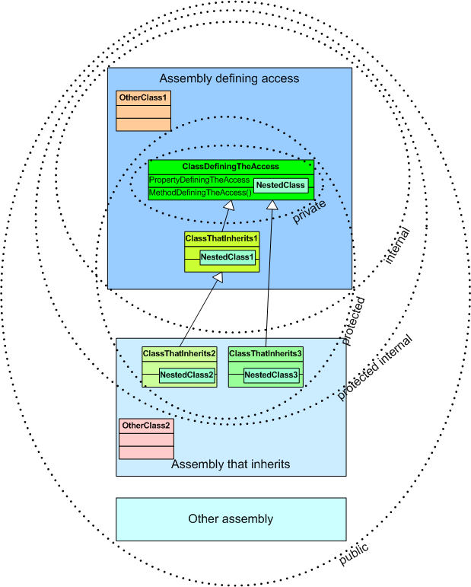
Access Modifiers

Slide 32
Class
Blueprint for creating a specific object
Why?
Abstraction; keep everything separated
State which properties an object can have
Create specific methods (functions) for that class
Classes are divided in 3 components:
Properties => define which variables an instance/object of that class will have
Constructor => defines how an instance/object of a class can be made
Methods => defines which functions are accessible to the objects belonging to that class

Slide 33
Class
Example
public class Student { // properties string name (get; set;) string class (get; set;) int age (get; set;) // constructor public Student(string Name, string Class, int Age) { this.name = Name; this.class = Class; this.age = Age; } // methods public void Details() { Console.WriteLine($”Name: {this.name}”); Console.WriteLine($”Class: {this.class}”); Console.WriteLine($”Age: {this.age}”); } }

Slide 34
Class
Example (continued)
Using System; Using Student; …. static void Main() { Student manny = new Student(“Manny Apsel”, “Lammarr”, ConsoleWrite(manny.age); => gives 24 in the console } ….

Slide 35
Class
Exercise 1
Create a class Animal with three or more properties; one of the properties should be name
Create an instance of the animal class in the main method
Show name of instance in the console through a class method
Exercise 2
Use the class Animal from the previous exercise
Add sound property
Create a list from animals
Add at least 3 animals to the list
Show in the console all animals name and the sound they make
Exercise 3 (difficult)
Create class Lion
Make it inherit from the animal class
Create a lion object in the main method without sound property because all lions go ‘raaargh’
Add it to the list of exercise 2
Show all animals name and the sound they make
Tip: Read about inheritance and polymorphism

Slide 36
Showcase
WPF
Creates windows application interface
Written in XAML
Visual Studio provides a toolbox to slide buttons and textboxes to the screen
NuGet
Package manager for .NET
Can write library in any .NET language and put it accessible for other .NET languages through NuGet marketplace
Resembles apt, apt-get (linux) or composer (php)
ASP.NET
Web framework for building web apps & services in .NET
Selection of boiler plates:
Empty
API
Web app with MVC boiler plate
Angular
React
Node.JS

Slide 37
Language-Integrated Query ( LINQ)
Set of technologies to query data for all .NET languages
Can write easy CRUD operations on collections of objects, relational databases and XML and other data sources independent of learning their query language
You can use LINQ in query or lambda method
Example
Var longWords = from word in words where word.Length > 10 => Query method select word;
Var longWords = words.Where(x => x.length > 10) => Lambda method

Slide 38
Language-Integrated Query ( LINQ)
Query keywords
from specifies from where data is coming
where filters data through Boolean expression (like an if statement)
orderby orders data in ascending or descending order
select specifies what elements in data to select
Lamda keywords
.Contains() checks if any data contains inserted value
.Where() filters data through Boolean expression (like an if statement)
.Orderby() orders data in ascending or descending order

Slide 39
Resources
https://docs.microsoft.com/ => Official Microsoft C# documentation
Tim Corey Youtube Channel => Excellent tutorials and provides a lot of context about the code
https://csharp.net-tutorials.com/ => Complete tutorial about C# from absolute start, has continuation tutorial about ASP.NET

