Slide 1
Workshop
.NET and C#

Slide 2
How will this workshop be organized?
Explanation about .NET
Explanation about C#
Exercises in C# with .NET Core
Showcase of more complex projects (WPF, NuGet, ASP.NET)

Slide 3
.NET
What is .NET?
How does .NET work?
What’s .NET Framework, .NET Core?
What are NuGet Package Manager & .NET Standard?

Slide 4
What is .NET?
.NET is a free, cross-platform, open source framework for building many different applications
You can write in 11 Microsoft or 50 non-Microsoft developed languages
A high-level language
Compiles your source code into assembly code for your processor to run
Availability of a huge Class Library

Slide 5
How does .NET work?
Common Language Runtime is a run-time environment for .NET
Source code is compiled with a language-specific compiler to Microsoft Intermediate Language (MSIL) and metadata
MSIL can have references to the base Class Library and other libraries
MSIL is further compiled into assembly code for the specific processor
.NET has their own garbage collection exception handling

Slide 6
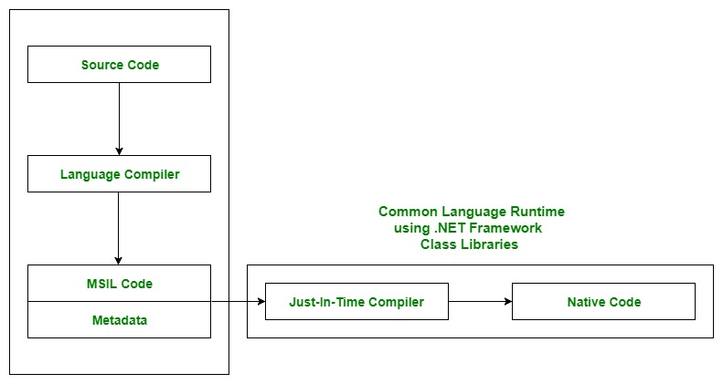
How does .NET work?

Slide 7
.NET Framework
First version of .NET released in 2000 by Microsoft
Availability huge quantity of Microsoft and third-party libraries
Applications can only be executed in a Windows environment
Notes:
Intel helped to work on CLI and C#

Slide 8
.NET Core
Release by Microsoft in 2016
Has a faster CLR than .NET framework
Cross platform and open source
A lot of support for Microsoft Azure
Deploy microservices well on Azure and Docker
Future of .NET environment with anticipated .NET 5 release in 2020

Slide 9
NuGet
Package manager for Visual Studio environment
Packages are compiled libraries with metadata written in a .NET language
Developers can create, share and consume different packages in the .NET environment
Beware to check if the package works in Framework or Core

Slide 10
.NET Standard
Framework and Core have their own Class Libraries from which all NuGet packages derive their code from
Packages made in Framework don’t work in Core applications and vice versa
Base Class Library (BCL) is a part of Framework Class Library and Core Class Library
Packages written in .NET Standard work on Framework and Core applications

Slide 11
C#
What is C#?
What is Visual Studio?
How do you start a .NET application in C#?
What’s the difference between solutions, projects and namespaces?
Exercises

Slide 12
What is C#?
Programming language developed in 2000 to be used in the .NET environment with the CLI
Strong typed and object oriented
General purpose language; you can build almost anything with it

Slide 13
What is Visual Studio?
Integrated Development Environment (IDE) created by Microsoft
Microsoft Visual Studio has 3 IDE for Windows and Visual Studio Code
Visual Studio Code is light-weight and faster
Microsoft Visual Studio has more features but slower

Slide 14
How to start a .NET application (Windows)
Open Microsoft Visual Studio Community 2019
Click ‘Create New Project’
Double Click on ‘Console App (.NET Core)’
Give a project and a solution name
Click on ‘Create’
Click on the green start button at the top center

Slide 15
How to start a .NET application (Linux)
Open terminal
Move through the terminal to the folder where you want to place your solution
Type ‘dotnet new sln –n “Solution Name”’
Type ‘dotnet new console –n “Project Name”’
Type ‘dotnet sln “Solution Name” add **/*.csproj’
Change your directory to your solution with ‘cd Solution Name’
Type ‘dotnet run’ to run the program
Type ‘code .’ to open the solution or project in Visual Studio Code
If on the bottom right, there’s a popup to create build and debug options, click yes

Slide 16
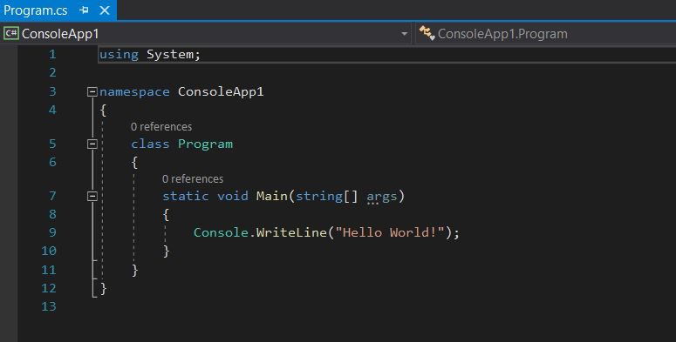
How to start a .NET application
Reference / Dependency to be used
Namespace, referring to the project name
Class Name
Entry point of a project
Scope of your code

Slide 17
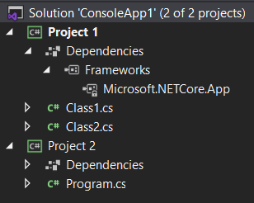
Solution vs Project vs Class
Solution groups several related projects
You open Visual Studio from the solution level
Projects is where you group code related classes together
Class is where you write your code

Slide 18
Exercises
Console Class
Data Types
Functions
Control structures
Collections (Array, List, etc.)
LINQ
Classes
Access modifiers
Unit Testing
NuGet Packages

Slide 19
Console Class
Console is a class to easily write and read data from the terminal
Examples
Console.Write(“”); -> Write data on the console
Console.WriteLine(“”);-> Write data on the console and add extra line
Console.ReadLine(); -> Reads data on console after pressing enter
Tips
Check what \n and \r do

Slide 20
Console Class
Exercise 1:
Show your own name in the console (windows) or terminal (linux)
Exercise 2:
After pushing enter 5 times in the console show your name in the console

Slide 21
Data Types
To declare a variable you have to say what type of variable
You can use var for type declaration and it will guess the datatype
Data Type | Size | Description
int | 4 bytes | Stores whole numbers from -2,147,483,648 to 2,147,483,647
long | 8 bytes | Stores whole numbers from -9,223,372,036,854,775,808 to 9,223,372,036,854,775,807
float | 4 bytes | Stores fractional numbers. Sufficient for storing 6 to 7 decimal digits
double | 8 bytes | Stores fractional numbers. Sufficient for storing 15 decimal digits
bool | 1 bit | Stores true or false values
char | 2 bytes | Stores a single character/letter, surrounded by single quotes
string | 2 bytes per character | Stores a sequence of characters, surrounded by double quotes

Slide 22
Data Types
Examples
int number = 2; -> create integer called number with value 2
string text = “Hello!”; -> create string called text with value Hello!
bool boolean; -> create Boolean with no value
Console.Write(text); -> shows Hello! in console
Tips
Check what + operator does in brackets of Console.Write();
Check how to combine different variables in one line via composite formatting & string interpolation
Check how to convert a variable name through convert

Slide 23
Data Types
Exercise 1
Declare 2 integers and show the sum on the console
Exercise 2
Declare 2 variables and show them on one line in the console (do this with 3 or less lines of code)
Exercise 3
Declare 1 char with no value; give it a value through the console
Show in the console “My favorite character is: .”
Exercise 4 (Difficult)
What happens if you give a decimal number to an integer? Show the value in the console
What is the maximum value you can give to ushort? What if you assign a bigger number? Show the value in the console

Slide 24
Functions
Function is code that’s written in a way that you can reuse it several times
Functions can be written inside the scope of static Main() function
Function can also be inside the scope of the class
You always need to define the visibility, return type and name; parameters are optional
Examples:
Public void Hello() { Console.WriteLine(“Hello!”);
Public int Sum(int a) { return a * 2};
Hello(); -> prints out Hello! in console
Sum(5); -> returns 10

Slide 25
Functions
Exercise 1
Have the console ask for your name; use a function to display the following message: Hello name!
Exercise 2
Have the console ask for 3 numbers and multiply them through a function; show the result in the console
If you put the function in the Main() scope put it in the Class scope and thus outside the Main() scope; what’s the difference between both functions?
Exercise 3 (difficult)
Create two functions with the same name but with different parameters (can be string vs int; 1 or 2 parameters)
When calling the function which function is called?

Slide 26
Control structures
Control structure is a block of programming where you can choose which code is used and how many times you can use them
If, switch and loops are control structures
Control structures always have condition(s) in them deciding if the code is to run or not
Operators are used to define conditions
var a == var b -> values are equal
var a != var b -> values are unequal
var a > var b -> a is greater than b
var a <= var b -> b is greater or equal to a
Tips
Check the difference between do while loop & while loop
Check how to run code indefinitely with a while loop

Slide 27
Control structures
Exercise 1
Create a loop that counts 1+2+..+5 and gives you the result
Tip: use the for loop
Can you ask a user through the console until what number he has to count?
Exercise 2 (difficult)
Build 4 functions for addition, subtraction ,multiplication and division; ask through the console which calculation they want to perform and then ask them two numbers and give the result
Tip: use if or switch structure
Can you add this extra features? Have the console ask if the user wants to do another calculation. At the start of the exercise ask the user to give his name; when the user decides for no new calculation print out a message telling him goodbye with his name

