Slide 1



















Real-Time News Sentiment Analysis Pipeline

Slide 2
Table of Contents
Objective
Tools
What Is Sentiment Analysis?
Data
Data Infrastructure
Sentiment Results
Real-Time Sentiment Analysis Dashboard
Conclusion & Next Steps

Slide 3
Objective
With all the negativity in news headlines recently, it can be a real strain on mental health when you are constantly bombarded with negative news articles and headlines. This project was intended to assist, when you just need a break from negative news articles and want to filter news by positive, neutral or negative sentiment. This was the problem I wanted to create a solution for and by developing a pipeline that performs real-time sentiment analysis on news articles and allows for the user to filter results based on positive or negative sentiment of each article.

Slide 4



Tools

Slide 5

What is Sentiment Analysis?
“Sentiment Analysis is a computational process to determine the overall sentiment of a piece of text. This sentiment is usually categorized into 3 main output’s, Positive, Neutral and Negative. This process can help determine the “mood” of the text and this can be extremely useful in a variety of use cases.”

Slide 6

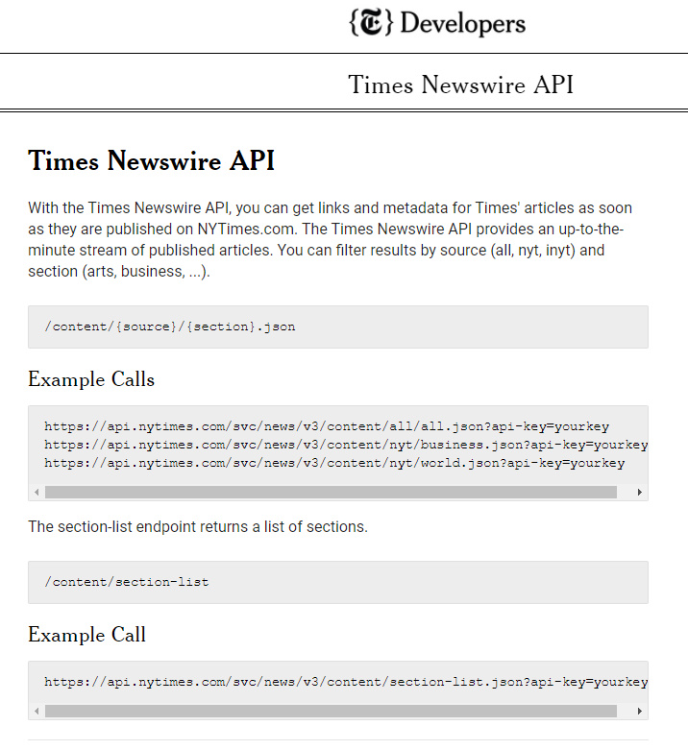
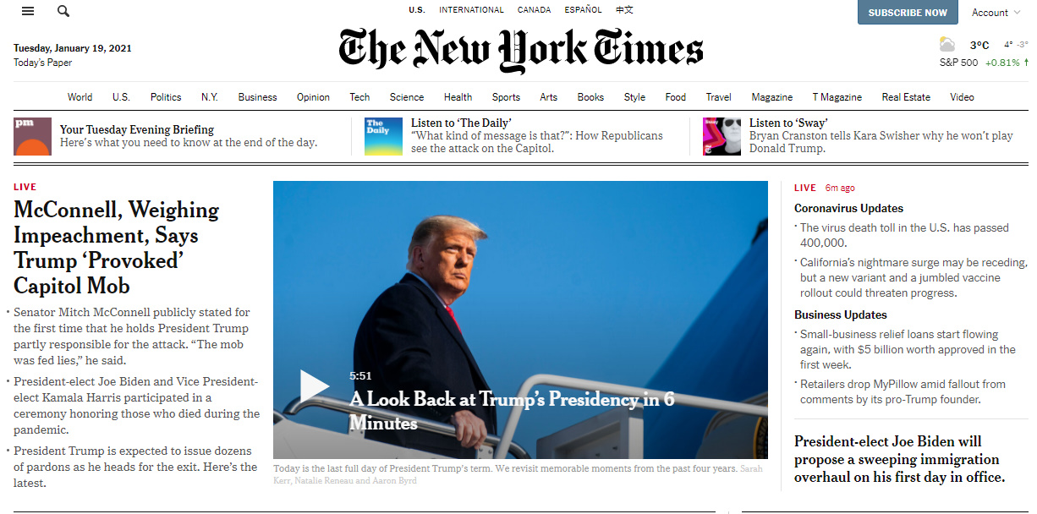
Data
*Data is returned as a Json object
Tiger Woods Announces He Had Fifth Back Operation | Sports | 19tiger | BY ELENA BERGERON | Article | News | ['Golf'] | ['PGA Tour Inc'] | ['Woods, Tiger'] | null | Woods, 45, has had five operations on his spine in the past seven years. He expects to miss the first two months of the PGA Tour. | 2021-01-19 22:15:24 UTC | https://www.nytimes.com/2021/01/19/sports/golf/tiger-woods-back-surgery.html

Slide 7
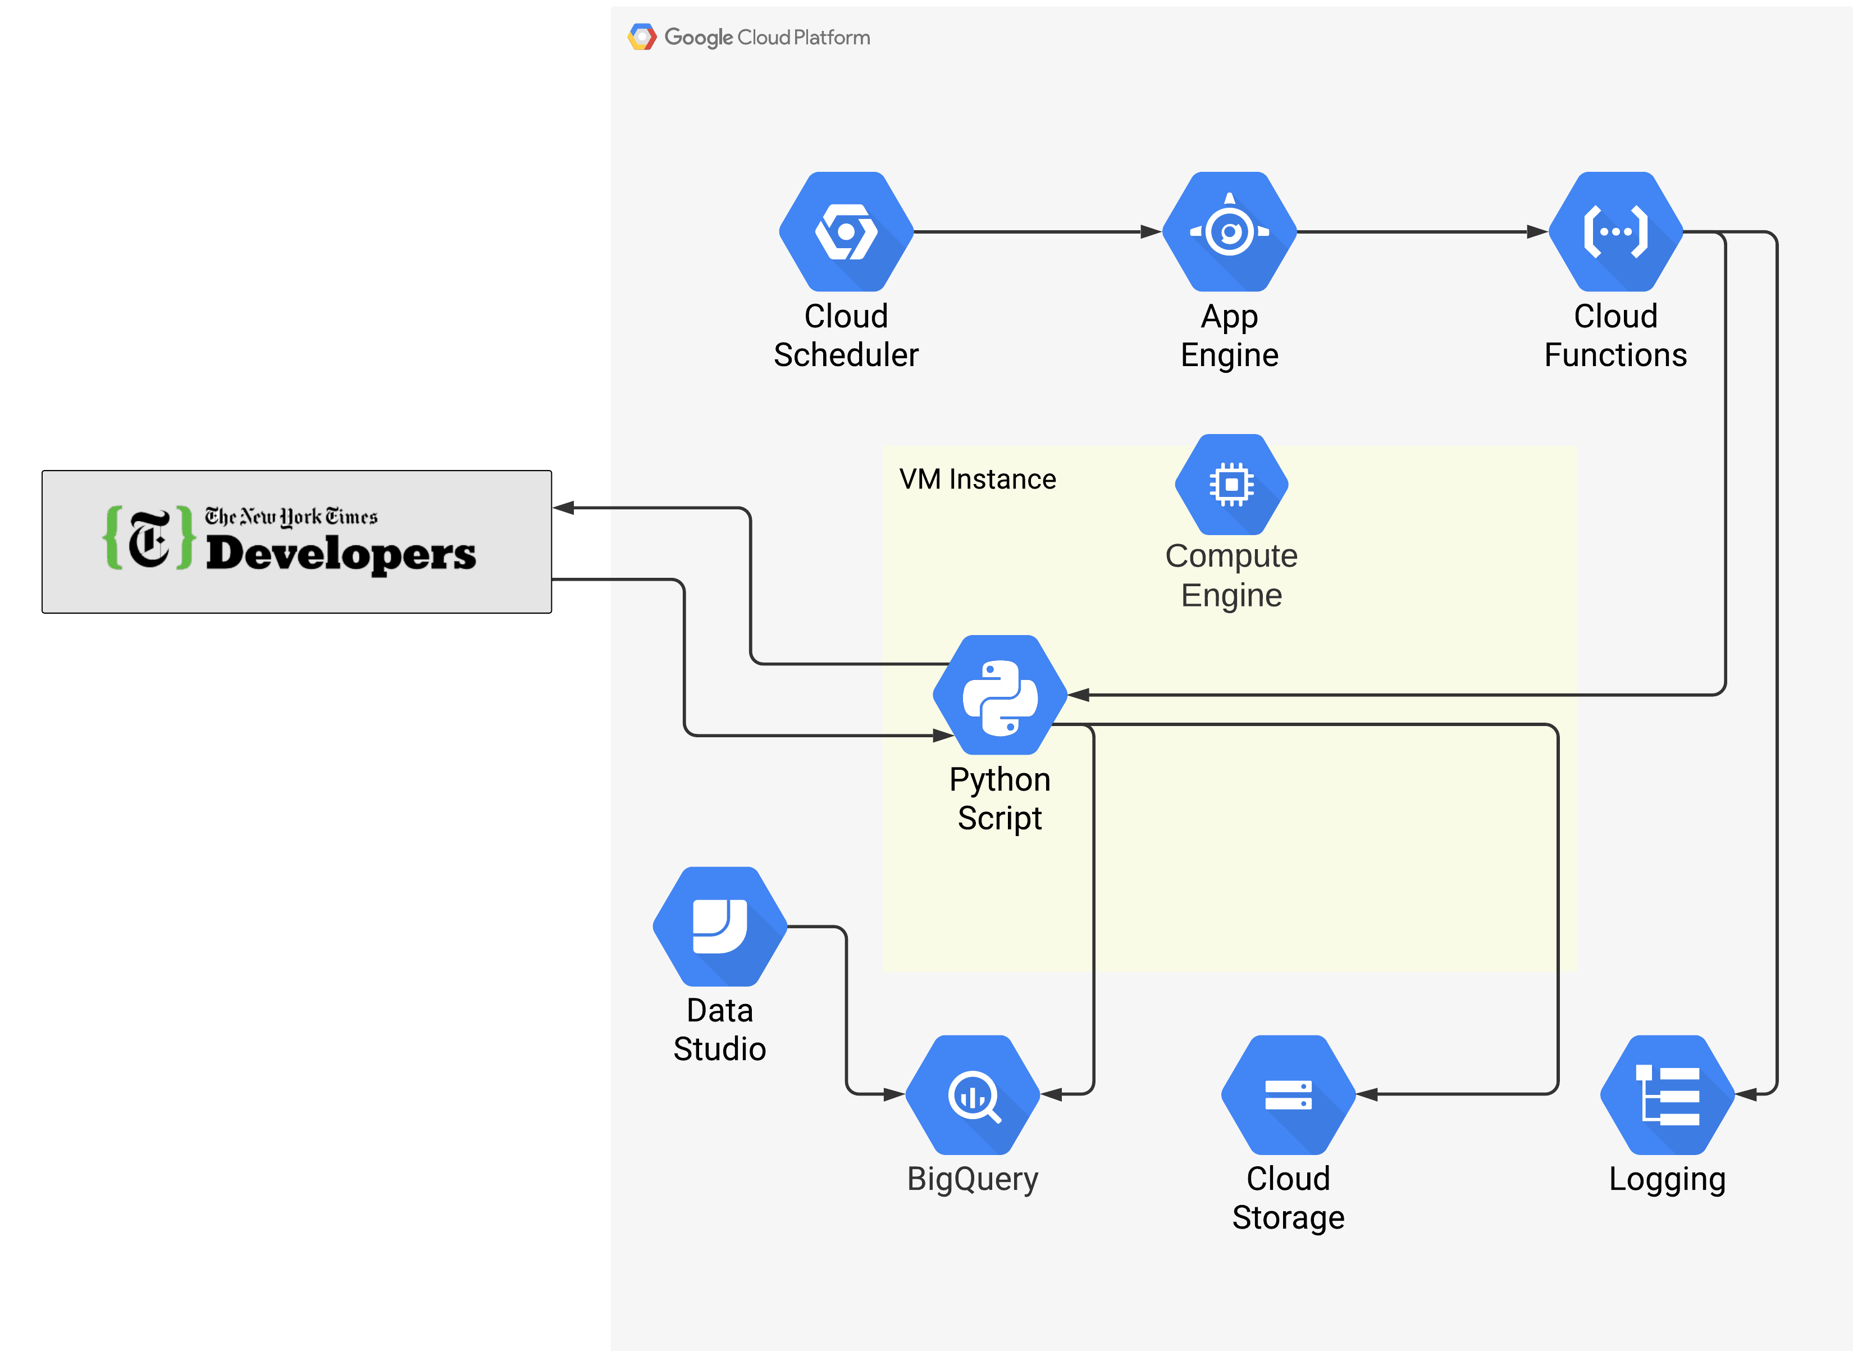
Data Infrastructure
Cloud Scheduler is used to schedule the pipeline execution via a cronjob and using HTTP App Engine to run a Cloud Function which will execute a python script hosted on a VM Compute Engine and will log the function run data. The script returns news headlines data from the real-time Timeswire API. Next the script processes the data and utilizes VADER Sentiment analysis to analyze the title and abstract columns. Creates a aggregated sentiment score for each article. Then the data is stored as a CSV file and uploaded to a GCP Cloud Storage Bucket and also the data is loaded into a BigQuery table. Finally the BigQuery table is accessed by the DataStudio dashboard and data is refreshed every few minutes, for a real-time sentiment analysis dashboard.

Slide 8
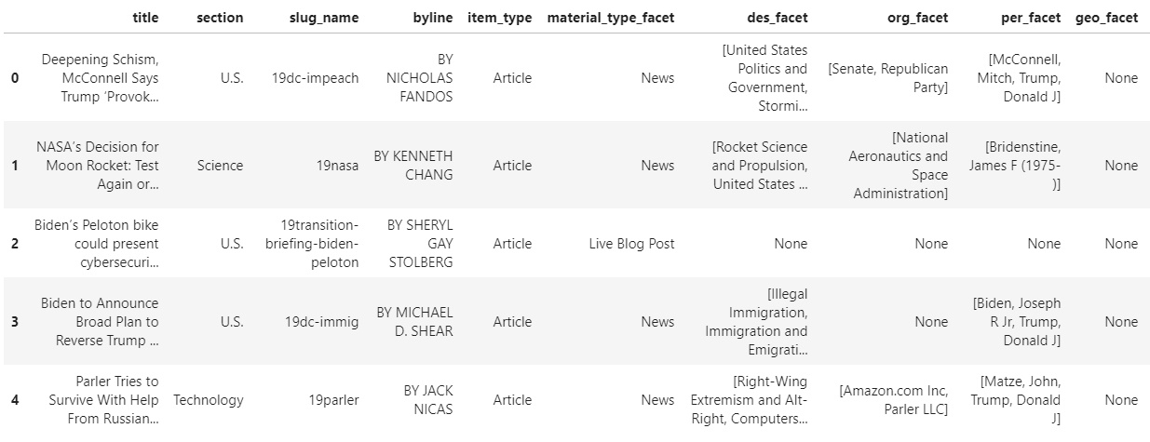
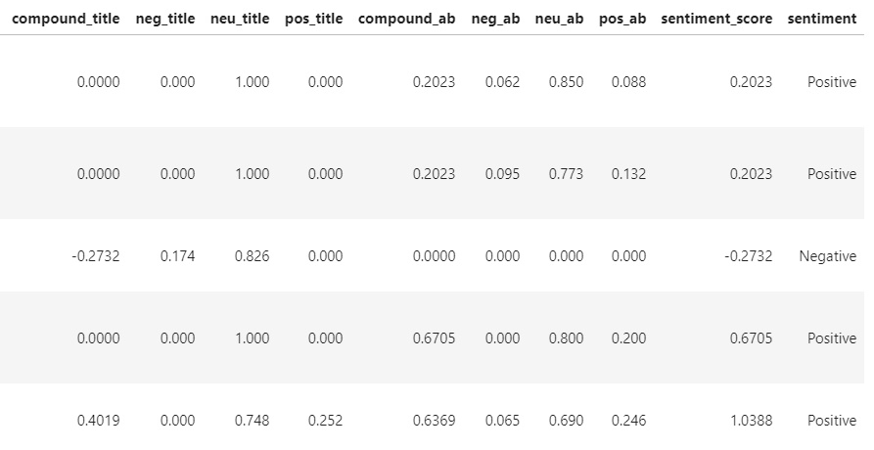
Sentiment Results
VADER Sentiment Analysis Results

Slide 9
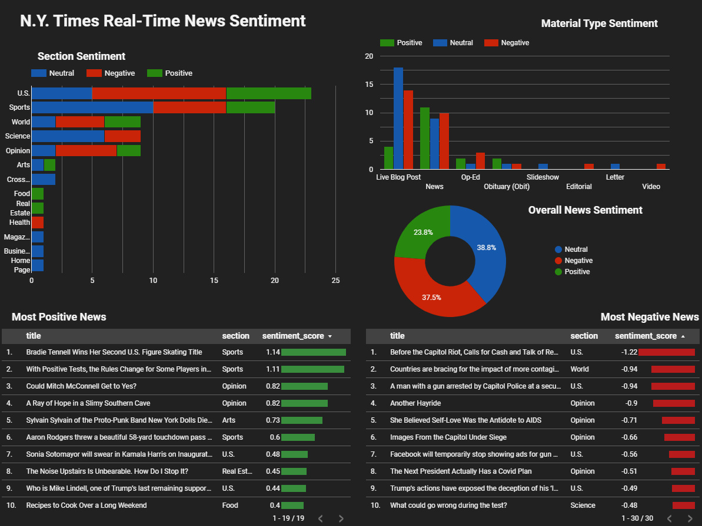
Real-Time Sentiment Dashboard
*Click Here For Live Dashboard*

Slide 10
Conclusion & Next Steps
Conclusion:
In conclusion the project was successful and I was able to make use of the real-time news sentiment analysis and although the model does work fairly well, I am looking forward to improving the sentiment analysis results.
Next Steps:
The next steps for this project would be to create a Streamlit app to be able to access the article’s and for a more user friendly application.
Improving the Sentiment model using Google Natural Language Processing API

