Slide 1
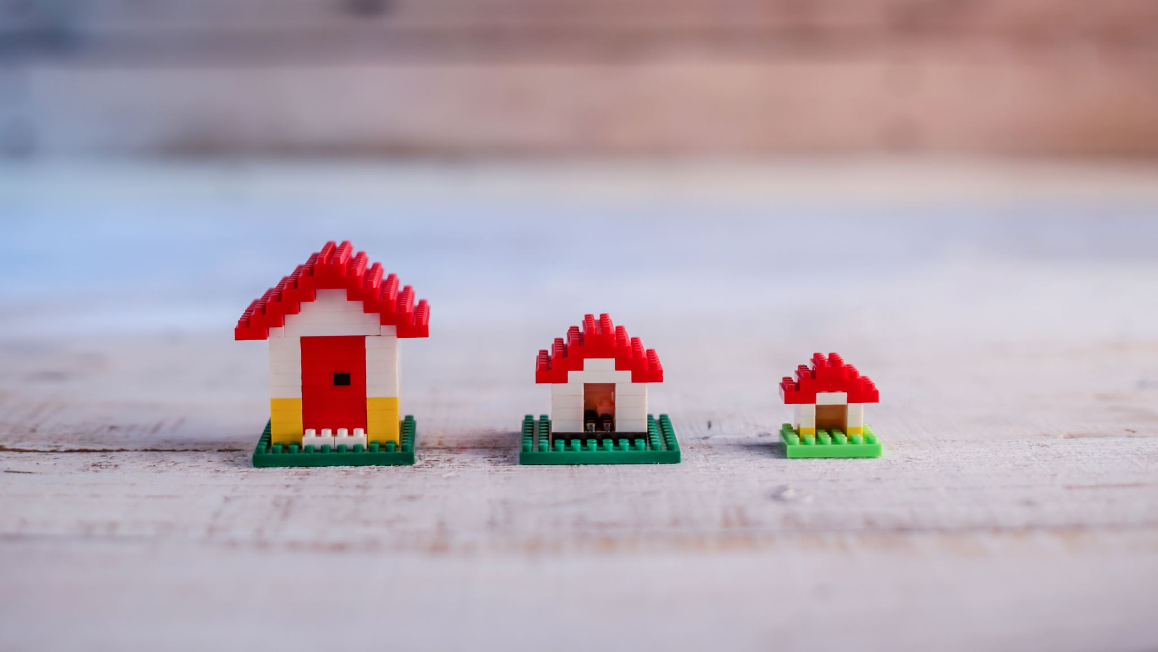
VM2Docker
Emmanuel Rodriguez

Slide 2
VM2Docker Presentation & Source code
https://github.com/Manny2014/vm2docker/blob/master/manny/00-Index.md

Slide 3
What did I learn
- I learned how docker leverages all the low-level concepts we learned in class such as:
- overlayfs -> shared mounting
- namespaces -> container run and how it uses the same files leveraging mounting
Docker remote socket configuration
- I learned about some limitations of docker
- I've been working with docker for a few years now and I've never tried to do an ADD on a large .tar and didn't realize this could cause problems
- If time wasn't an issue, i feel like i could figure this out but was not able to.
- Dependency Dection
- I thought the way that the developers of the VM2Docker program were very about their implementation, specifically around package detection

Slide 4
Conclusion
What do I think about vm2docker as a product?
Not practical for real world use cases
Better off doing analysis and iterating off of a smaller base image such as alpine
Great for learning
Diff/Changes: https://github.com/ecbtln/vm2docker/compare/master...Manny2014:master

