Slide 1

A Discussion on Potential Learning Agenda Priority Questions
AGENCY OR DEPARTMENT NAME
Authored by: Office or Team Name

Slide 2
Agenda
Overview of the Stakeholder Engagement Process
Developing Priority Questions for the Learning Agenda
Categories of Questions
Questions for [Insert Category #1]
Questions for [Insert Category #2]
Questions for [Insert Category #3]
Questions for [Insert Category #4]
Questions for [Insert Category #5]
Next Steps

Slide 3










Overview of the Stakeholder Engagement Process
# of Listening Sessions
# of E-mail Responses
# of Roundtables
# of Survey Responses
# of Interviews
# of Public Comments
# Potential
Learning Agenda Questions
# of Internal Stakeholders Consulted
# of External Stakeholders Consulted
# of Organizations Represented

Slide 4
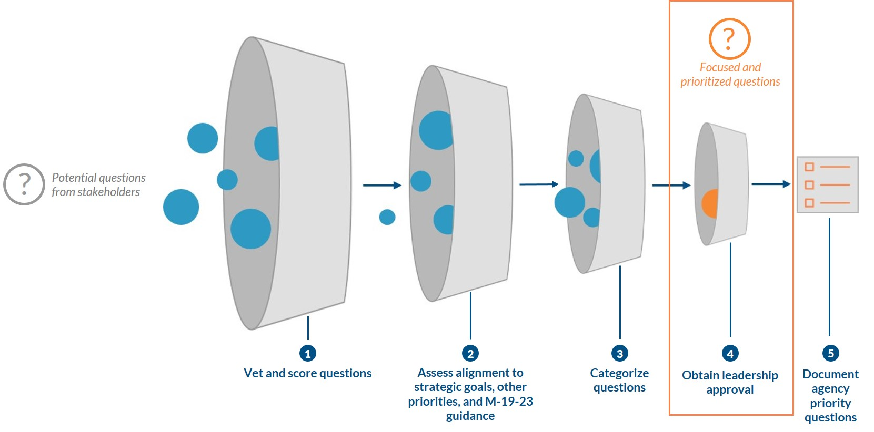
Developing Priority Questions for the Learning Agenda

Slide 5
[Category Type]
[Category Type] | Number of Questions

Slide 6
Draft Priority Questions by [Category Name]
[Category Name]
Question 1…
Existing Evidence and Recent Studies Include any information relevant to the focus area and questions.
Strategic Goals and Leadership Priorities Use this space to show alignment between the focus area and agency priorities.

Slide 7
Next Steps

