Slide 1
Language engineering applied to matrix algebra debugging in Python
Clarifying and explaining matrix algebra visually with TensorSensor
Terence Parr University of San Francisco

Slide 2
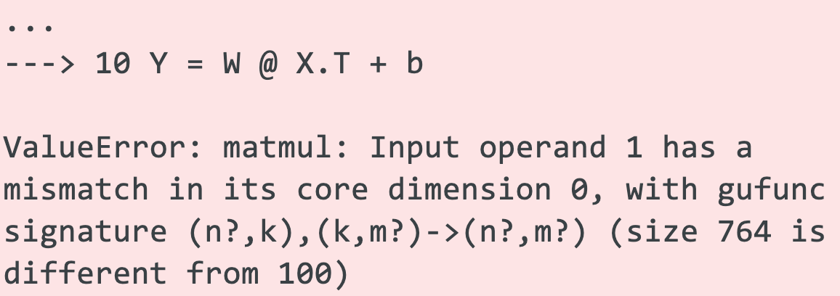
What's the problem?
Implementing deep learning neural networks means matching dimensions of layers and, more generally, matrix dimensions
It's easy to lose track of matrix/tensor dimensionality in even simple expressions (even in statically-typed languages)
Upon error, we get less than helpful exception messages
Which operator?
Which operand?
(numpy message)

Slide 3
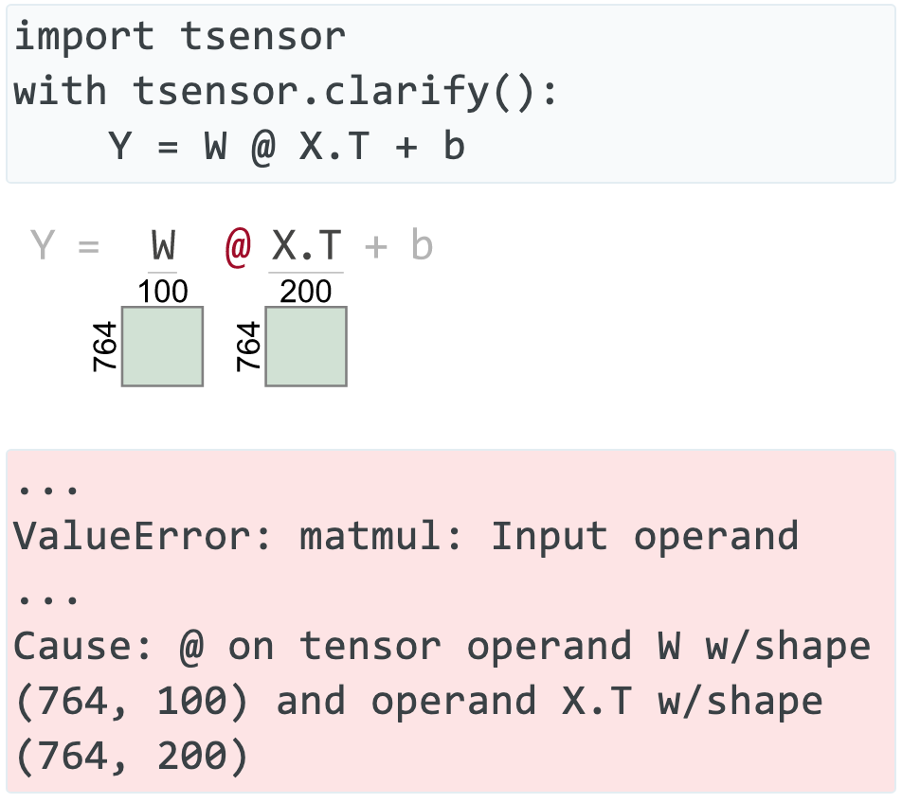
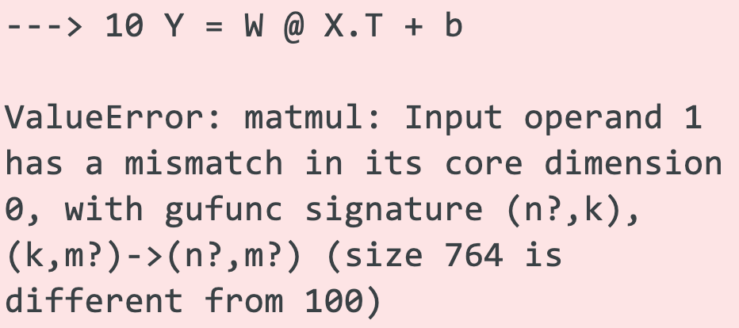
Clarifying errors visually & textually
🎉
😿
https://explained.ai/tensor-sensor/index.html

Slide 4
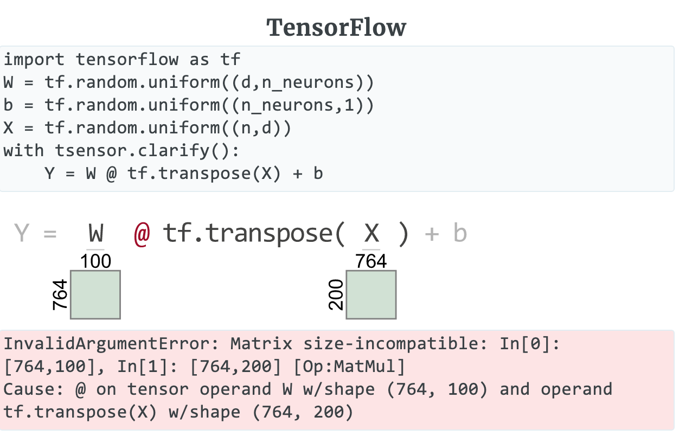
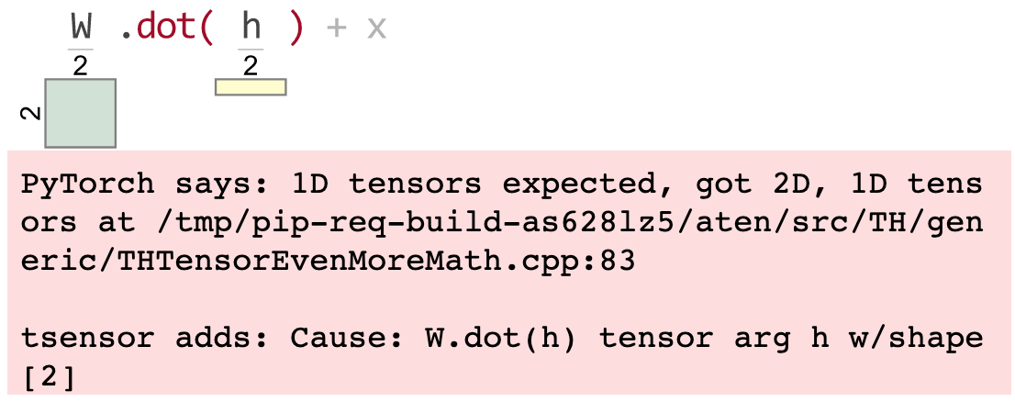
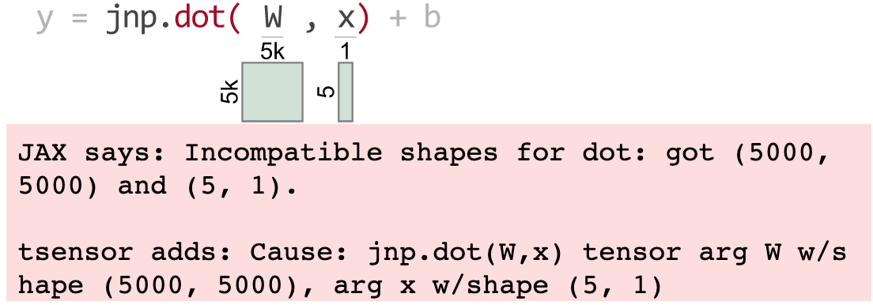
Requirement: support multiple libraries
(Vectors are yellow)
PyTorch
JAX

Slide 5
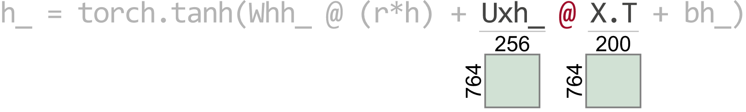
Requirement: support complex expressions
We need to know which operator and operands failed so let's highlight the offending elements:
(Oops: The columns of Uxh_ must match the rows of X.T)

Slide 6
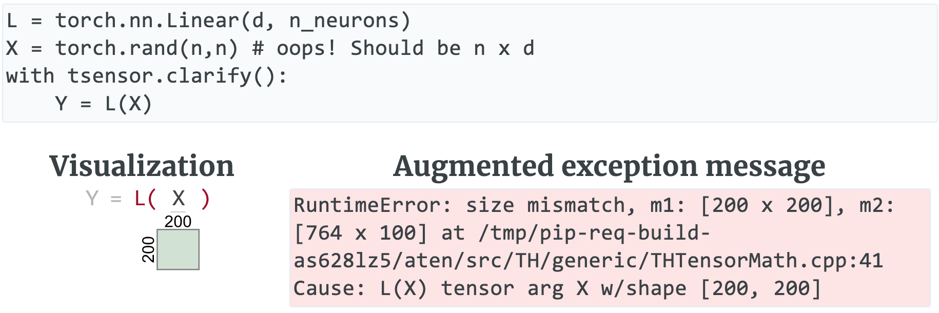
Requirement: support prebuilt layers
Should highlight error in user code not library code
(Note unhelpful C++ reference)

Slide 7
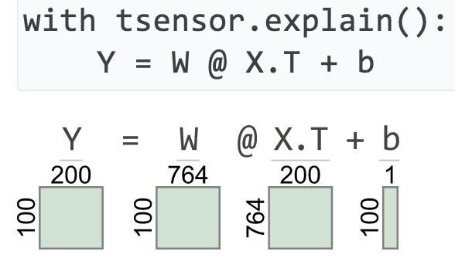
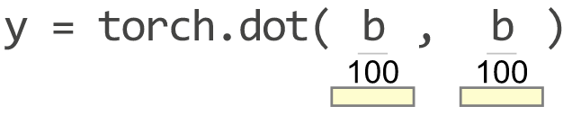
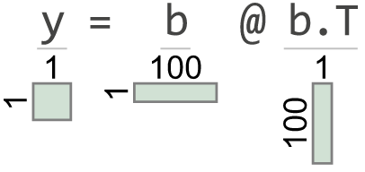
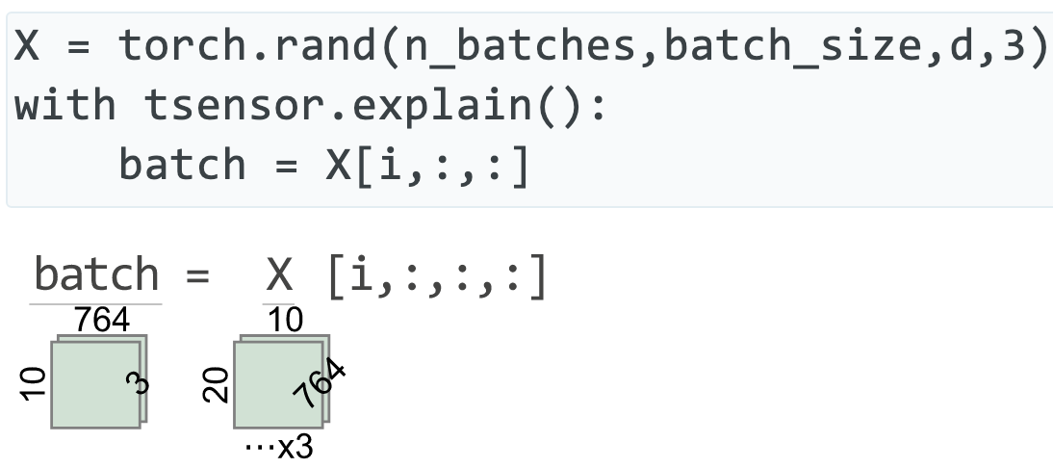
Requirement: explain code w/o errors
Greater than 2 and 3 dimensions

Slide 8
Implementation

Slide 9
Key questions to answer
Python traps exceptions at the statement level, so how can we identify offending operators and operand values?
How can we trap exceptions without requiring try/except blocks around statements with potential dimension problems? (Also want to ignore non-matrix related exceptions; user shouldn't need to know Python internal execution details)
How can we generate matrix visualizations w/o explicit calls?
Can we make use of library zero cost until an exception?
In other words, how do we make this precise and unobtrusive?

Slide 10
Screams for code instrumentation, right?
I considered injecting Python bytecode to track subexpression evaluation and to get finer-grained exception handling
That might require a separate tool and preprocessing, rather than simply importing a library
Injected code could slow down entire program execution significantly
Injected code might affect Python optimization / concurrency
It seemed like a lot of work to learn and implement for a skill I probably would never need again

Slide 11
Getting operator-level exceptions w/o bytecode instrumentation requires a total hack
We can get (1) the full execution stack and (2) the offending line of source code
To identify the individual operator and operands that triggered an exception use brute-force:
reevaluate each operation in the line piece-by-piece in proper order and in the correct execution context (must pick correct stack frame)
Wait for an operator to cause an exception, report op/opnds
Zero cost until error, but assumes side-effect free functions
Even if side-effecting, who cares (usually)? Program is about to terminate

Slide 12
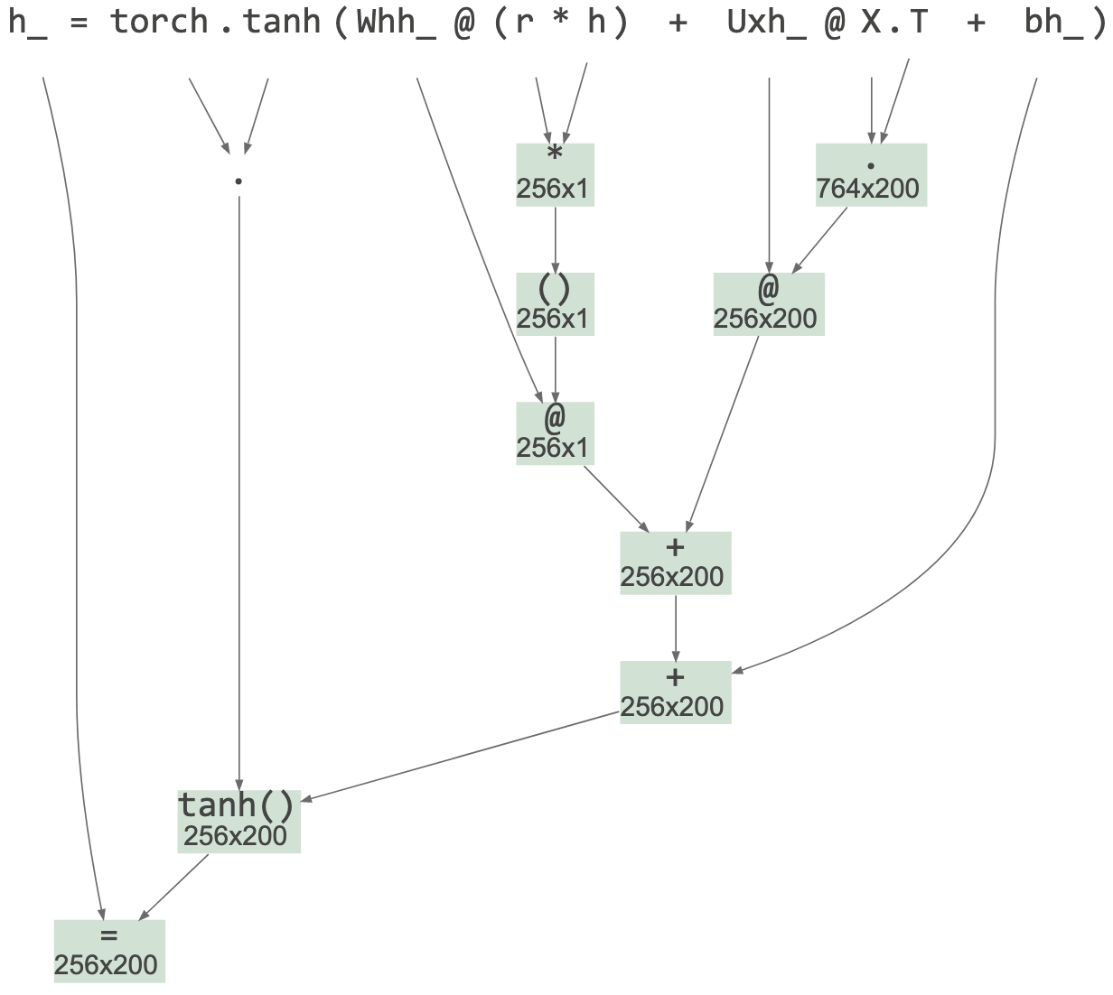
Reevaluation mechanism
First, check if exception is tensor-related or if exec stack descends into a known tensor lib
If so, parse deepest user-level offending statement and build an appropriate AST with operators as subtree roots
Uses built-in Python tokenizer
Handbuilt Python parser for subset of statements / exprs
Avoided ANTLR to avoid introducing a lib dependency
Avoided built-in Python parser since reorg'ing AST is same work as rolling my own parser

Slide 13
Reevaluation mechanism continued
Evaluate operators of AST bottom-up in proper exec order
Call eval() on source subexpressions using the appropriate execution contexts, saving results in associated nodes
Trap and absorb exception from eval(), record that exception and offending AST node
Augment original exception message with info derived this new exception and op, operands

Slide 14
Picking the right execution context
The goal is to identify user code not library code that resulted in a tensor-related exception
TensorSensor descends into any user code function calls, stopping only when it reaches a tensor library function
Source file prefix indicates user code boundary, such as: .../lib/python3.8/site-packages/tensorflow
Boundary frame is any whose package in ['numpy','torch','tensorflow','jax']

Slide 15
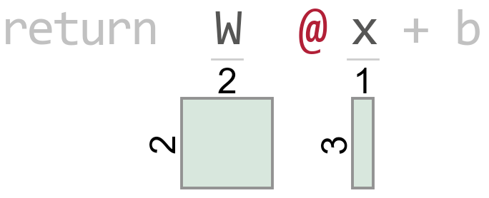
Example picking execution frame boundary
t.py source
Execution stack
def f(x): W = tf.constant([[1, 2], [3, 4]]) b = tf.reshape(tf.constant([[9, 10]]), (2, 1)) return W @ x + b # line 4 with tsensor.clarify(): x = tf.reshape(tf.constant([[8, 5, 7]]), (3, 1)) y = f(x) # line 8
t.py:8
t.py:4
math_ops.py:1124
dispatch.py:201
math_ops.py:3253
gen_math_ops.py:5624
ops.py:6843
Raises exception

Slide 16
Simplifying the user code interface
My prototype used try/except but it was unwieldy for the user
And, the code looks like error handling, which obscures purpose
Python "with b" blocks call __enter__(), __exit__() on object b and exit method receives exception object and execution stack
Exception handling code can automatically gen visualization
Prototype
Current
try:
myprogram()
except Exception as e:
tsensor.do_everything(e)
with tsensor.clarify(): myprogram()

Slide 17
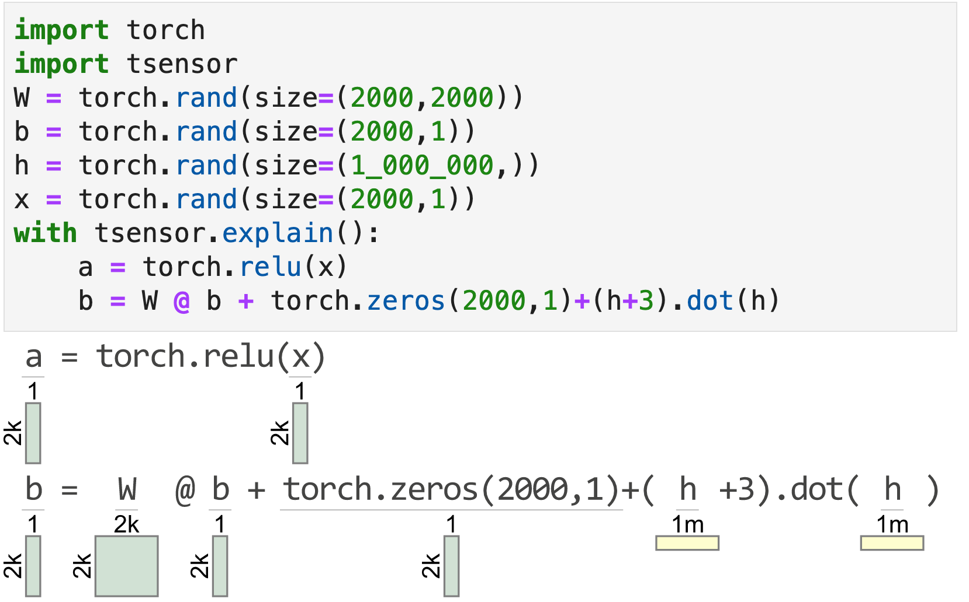
Explaining correct matrix code
clarify() has no effect unless tensor code triggers an exception
To aid reading matrix code, explain() gens a visualization for each statement within the block

Slide 18
Visualizing Python code on-the-fly
Method explain() creates a tracer object and registers it with Python via sys.settrace()
The tracer is notified upon each source line execution
Using the same mechanism as clarify(): parse source line, build AST, evaluate AST subexpressions to identify operand shapes
Even in loop within with block, statements visualized just once
Slows down execution (a lot) but it's still useful
Watch out for side effects; this prints "hi" twice:
with tsensor.explain(): print("hi")

Slide 19
Key ingredients
Python "with b" blocks call __enter__(), __exit__() on object b and exit method receives exception object and execution stack; exception handling code can automatically generate visualization
Python eval() to evaluate snippets of source code
Python sys.settrace(); notifies listener upon each source line exec
with tsensor.clarify(): myprogram()
See https://docs.python.org/3/library/sys.html#sys.settrace

