Slide 1
Clarifying matrix algebra issues visually with TensorSensor
Examples and implementation details
Terence Parr University of San Francisco
See https://github.com/parrt/tensor-sensor

Slide 2
Demo in notebook
https://github.com/parrt/tensor-sensor/blob/master/talks/demo.ipynb

Slide 3
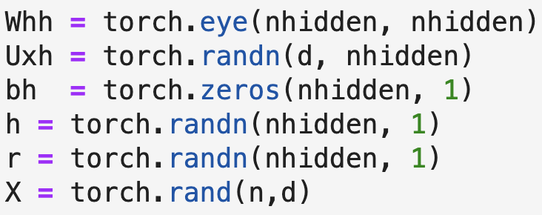
The problem
It's easy to lose track of matrix/tensor dimensionality in matrix algebra expressions (even in statically-typed languages)
Upon error, we often get less than helpful exception messages, such as this (PyTorch) message:
The offending operator and operands are not identified, since Python exceptions occur at the line level rather than the operator level

Slide 4
We could rerun using the debugger but…
Python debuggers seem much slower than normal execution
Even regular execution could take hours before faulting
Sometimes it's hard to set a breakpoint on the right statement when it's in a loop
Conditional breakpoints are challenging when the values are high-dimension matrices
Debugger still does not tell us which subexpression caused the exception, due to line-level granularity of Python exceptions (Must write down shape of all operands and lineup dimensions)

Slide 5
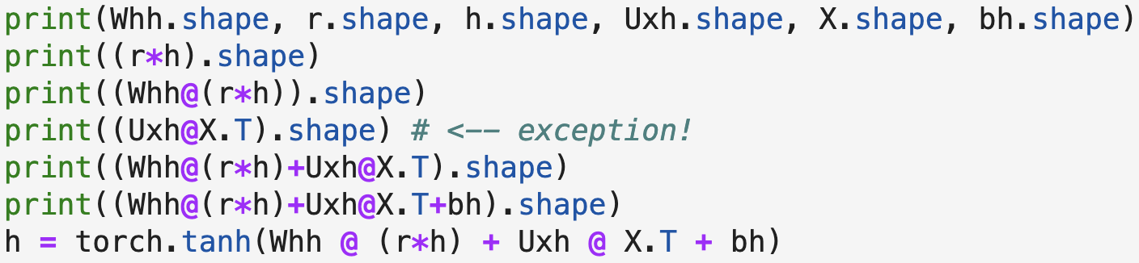
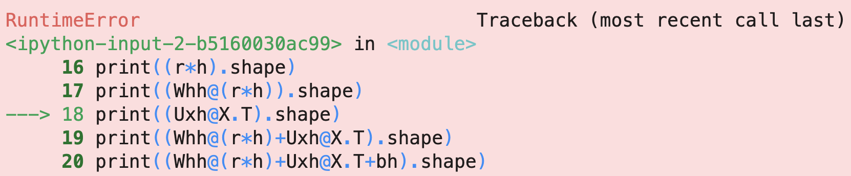
Most common solution
Most data scientists laboriously inject code and rerun to isolate:

Slide 6
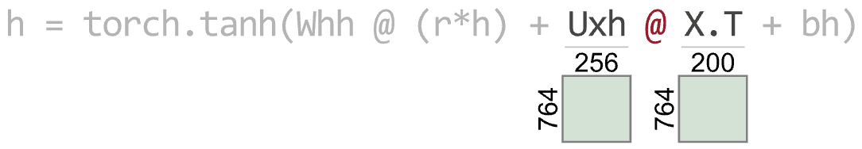
What we need
First, augment the exception message to identify operation
But we can help programmers even more…
We need to line up dimensions so let’s do that visually!

Slide 7
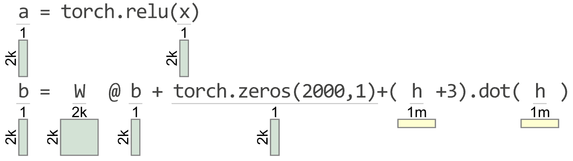
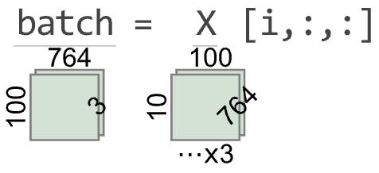
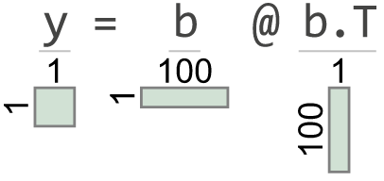
A nice-to-have feature: viz correct code
Very helpful when trying to read (even correct) code
Greater than 2 and 3 dimensions

Slide 8
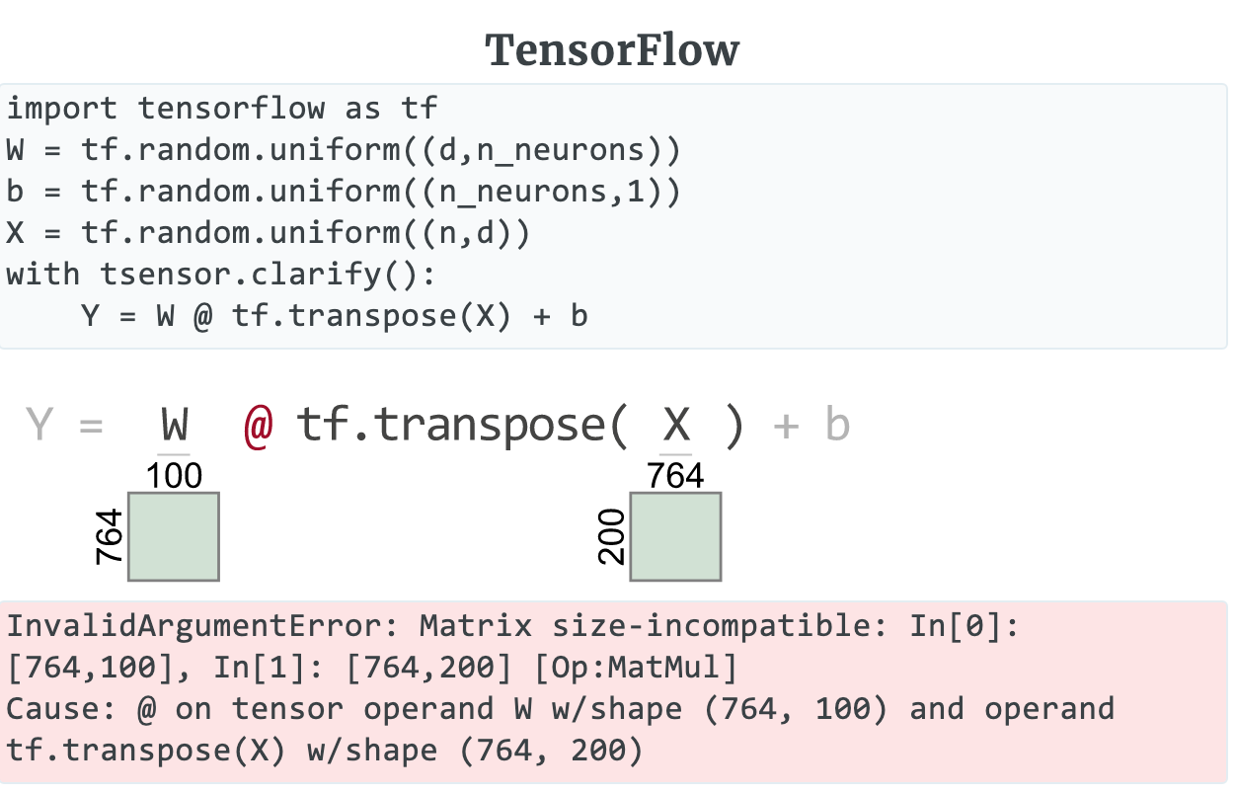
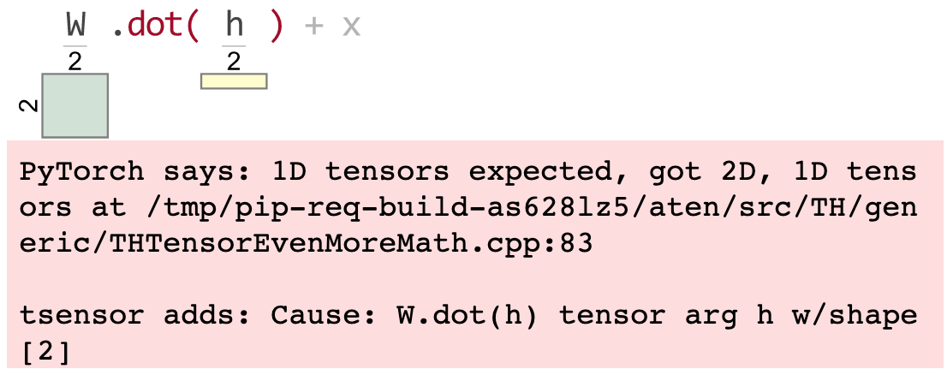
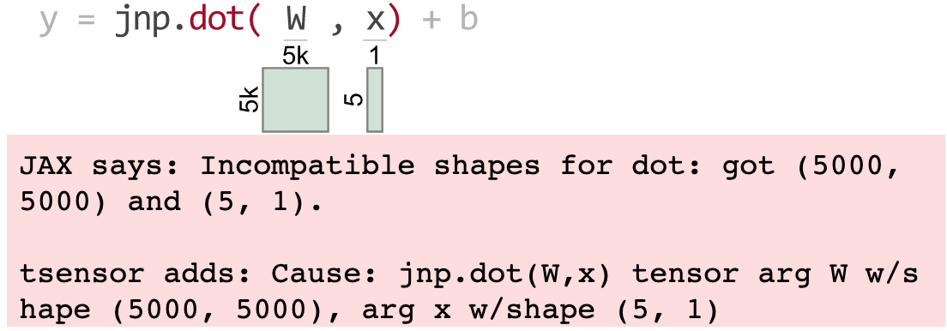
Oh, and support multiple libraries
(1D vectors are yellow)
PyTorch
JAX

Slide 9
What’s the right programmer interface?
Should be as unobtrusive as possible with least programmer effort
(Ideally, implementation would be simple)
How can we generate matrix visualizations w/o explicit calls?
Can we make use of library zero cost until an exception?

Slide 10
We need an automated solution
The goal is to replicate the print injection
Exceptions are usually triggered in C++ lib, which cannot easily indicated Python variable names in error messages
Python exceptions also occur at the line level rather than the operator level so error messages cannot identify offending subexpressions within complicated matrix algebra statements
What’s the best programmer interface?

Slide 11
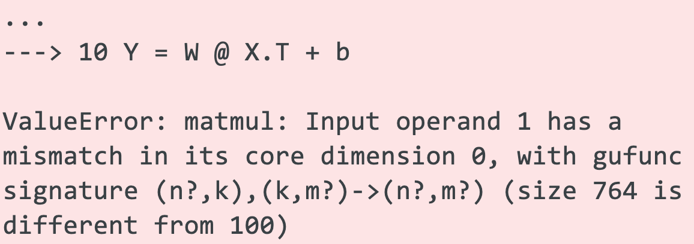
Current programmer aids are weak
It's easy to lose track of matrix/tensor dimensionality in even simple expressions (even in statically-typed languages)
Upon error, we often get less than helpful exception messages
E.g., here's a sample NumPy message:
Which operator?
Which operand?

Slide 12
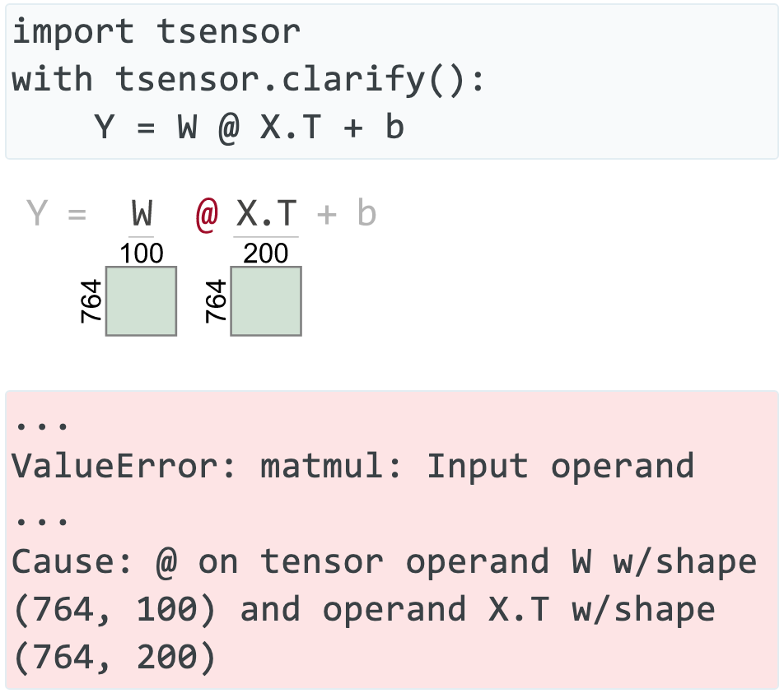
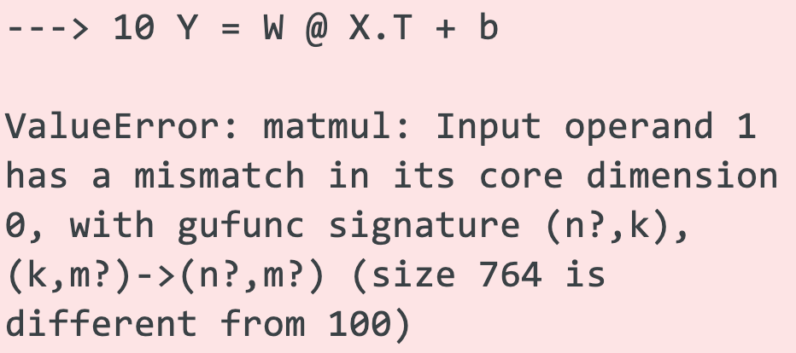
Clarifying errors visually & textually
🎉
😿
TensorSensor generates visual cues to matrix dimensions and offending operator / operands
TensorSensor augments
exception messages
https://explained.ai/tensor-sensor/index.html

Slide 13
Requirement: support multiple libraries
(1D vectors are yellow)
PyTorch
JAX

Slide 14
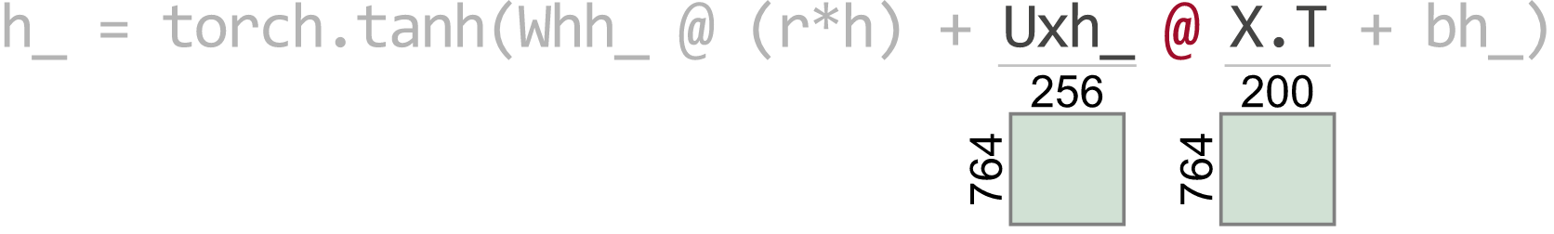
Requirement: support complex expressions
We need to know which operator and operands failed so we should highlight the offending elements:
(Oops: The columns of Uxh_ must match the rows of X.T)

Slide 15
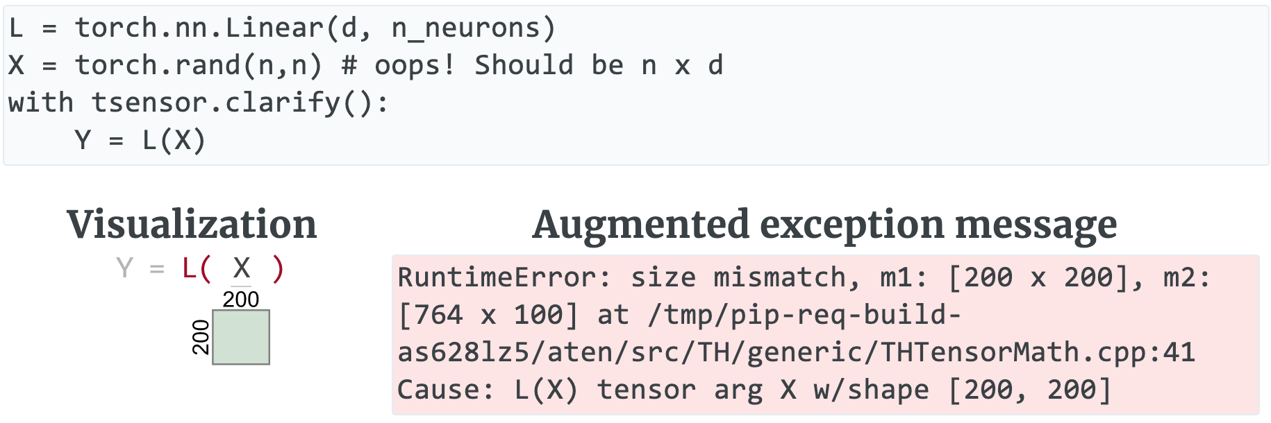
Requirement: support prebuilt layers
Should highlight error in user code not library code
(Note unhelpful C++ reference)
(TensorSensor augments message)

Slide 16
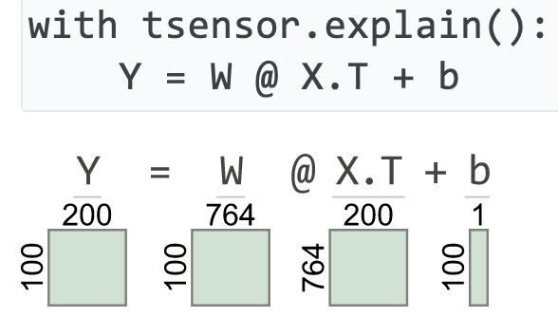
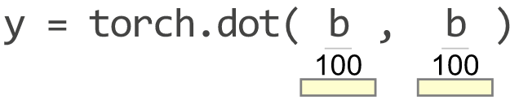
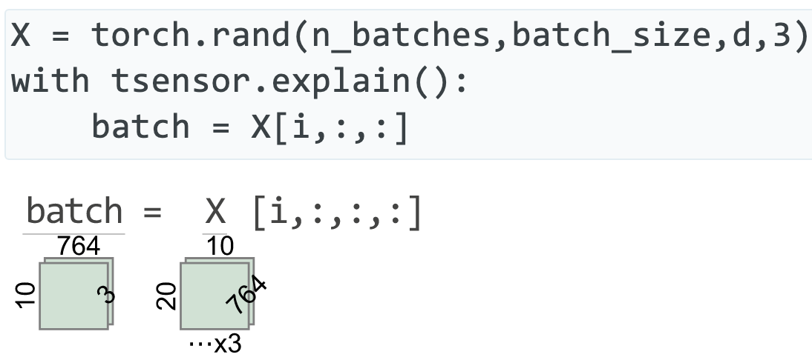
Requirement: explain code w/o errors
Very helpful when trying to read (even correct) code
Greater than 2 and 3 dimensions

Slide 17
Language engineering related implementation

Slide 18
Key questions to answer
Python traps exceptions at the statement level, so how can we identify offending operators and operand values?
How can we trap exceptions without requiring try/except blocks around statements with potential dimension problems? (Also want to ignore non-matrix related exceptions; user shouldn't need to know Python internal execution details)
How can we generate matrix visualizations w/o explicit calls?
Can we make use of library zero cost until an exception?
In other words, how do we make this precise and unobtrusive?

Slide 19
Screams for code instrumentation, right?
I considered injecting Python bytecode to track subexpression evaluation and to get finer-grained exception handling
But, that might require a separate tool and a preprocessing step, rather than simply importing a library
Injected code could slow down entire program execution significantly
Injected code might affect Python optimization / concurrency
It seemed like a lot of work to learn and implement for a skill I probably would never need again

Slide 20
Getting operator-level exceptions w/o bytecode instrumentation requires a total hack
We have: (1) the full execution stack and (2) the offending line of source code
To identify the individual operator and operands that triggered an exception use brute-force:
reevaluate each operation in the line, piece-by-piece, in proper order, and in the correct execution context (must pick correct stack frame)
Wait for an operator to cause an exception, report op/opnds
Zero cost until error, but assumes side-effect free functions
Even if side-effecting, who cares (usually)? Program is about to terminate

Slide 21
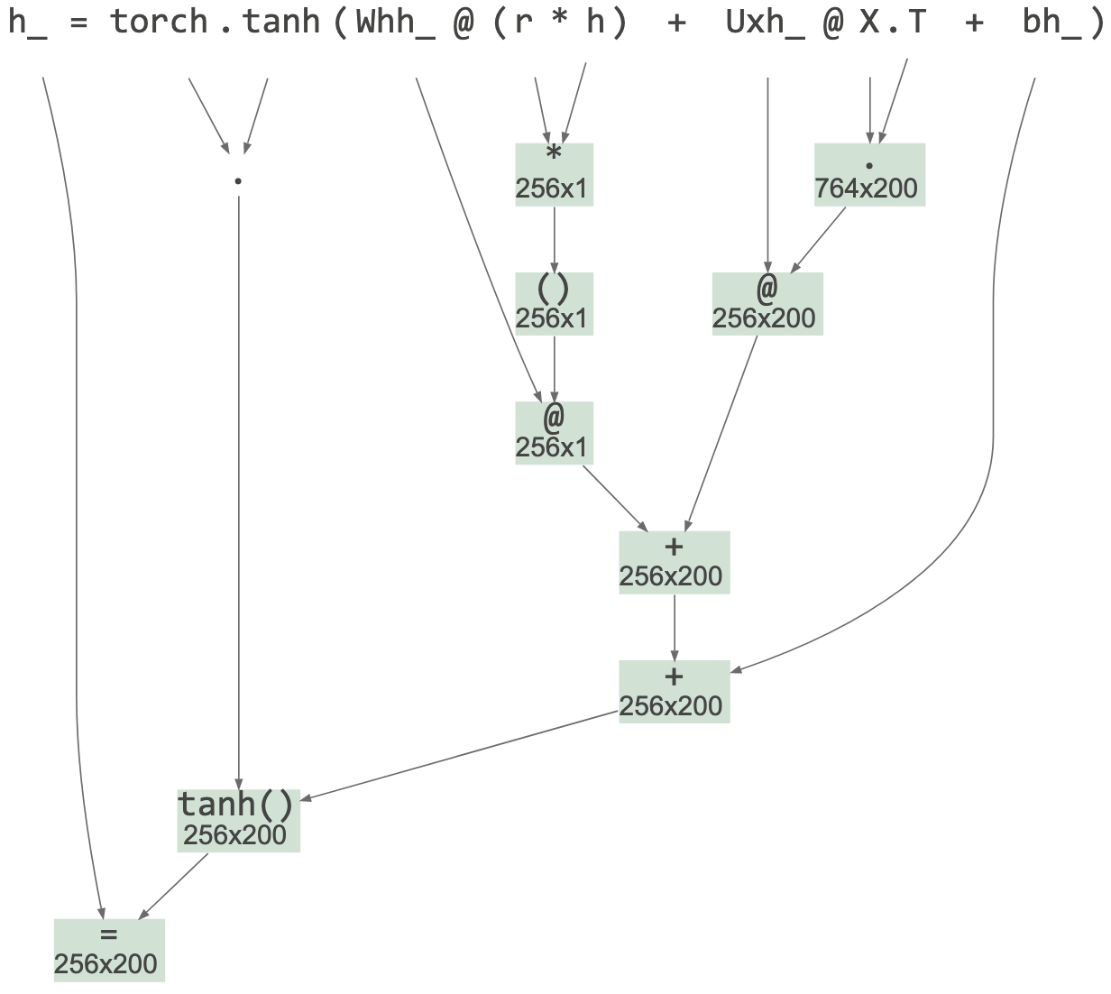
Reevaluation mechanism
First, check if exception is tensor-related or if exec stack descends into a known tensor lib
If so, find and parse deepest user-level offending statement and build an appropriate AST with operators as subtree roots
Uses built-in Python tokenizer
Uses handbuilt Python parser for subset of statements / exprs
Avoided ANTLR to avoid introducing a lib dependency
Avoided built-in Python parser since reorg'ing its AST is same work as rolling my own "parrser"
🤣
(also from TensorSensor lib)

Slide 22
Reevaluation mechanism continued
Evaluate operators of AST bottom-up in proper exec order
Call eval() on Python source of subexpressions using the appropriate execution contexts, saving results in associated nodes
Trap and absorb exception from eval(), record that exception and offending AST node
Augment original exception message with info derived this new exception, op, operands

Slide 23
Picking the right execution context
The goal is to identify user code not library code that (eventually) triggers a tensor-related exception
TensorSensor clarify() descends into any user code function calls, stopping only when it reaches a tensor library function
Source file prefix indicates user code boundary, such as: …/lib/python3.8/site-packages/tensorflow/…
Boundary frame is any whose package is in {numpy, torch, tensorflow, jax}

Slide 24
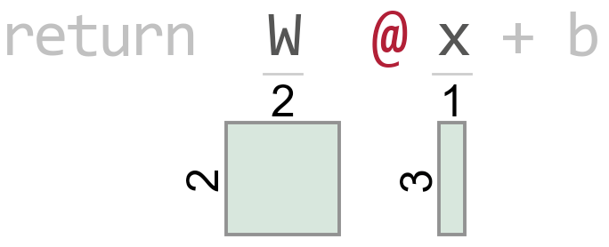
Example: Picking the execution frame boundary
t.py source
Execution stack
def f(x): W = tf.constant([[1, 2], [3, 4]]) b = tf.reshape(tf.constant([[9, 10]]), (2, 1)) return W @ x + b # line 4 with tsensor.clarify(): x = tf.reshape(tf.constant([[8, 5, 7]]), (3, 1)) y = f(x) # line 8
t.py:8 (in main)
t.py:4 (in f)
math_ops.py:1124
dispatch.py:201
math_ops.py:3253
gen_math_ops.py:5624
ops.py:6843
Raises exception

Slide 25
Simplifying the user code interface
My prototype used try/except but was unwieldy for the user
And, the code looked like error handling, which obscured purpose
Python "with b" blocks call __enter__(), __exit__() on object b and exit method receives exception object and execution stack
Exception handling code can automatically gen visualization
Prototype
Current
try:
myprogram()
except Exception as e:
tsensor.do_everything(e)
with tsensor.clarify(): myprogram()
(might not be able to hide everything here, like reraising e)

Slide 26
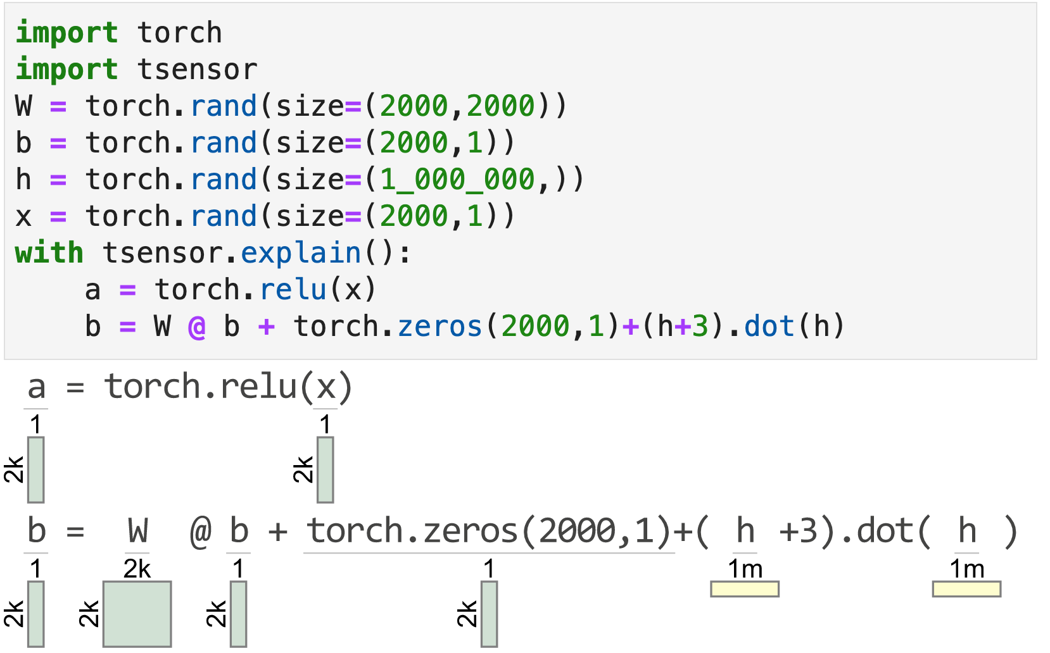
Explaining correct matrix code
clarify() has no effect unless tensor code triggers an exception
To aid reading matrix code, explain() gens a visualization for each statement within the block
(From within a Jupyter notebook)

Slide 27
Visualizing Python code on-the-fly
explain() object's __enter__() method creates a tracer object and registers it with Python via sys.settrace() [1]
The tracer is notified upon each source line execution
Using the same mechanism as clarify(): parse source line, build AST, evaluate AST subexpressions to identify operand shapes
Even in loop within with block, statements visualized just once
Slows down execution (a lot) but it's still useful
Watch out for side effects; this prints "hi" twice:
with tsensor.explain(): print("hi")
[1] https://docs.python.org/3/library/sys.html#sys.settrace

Slide 28
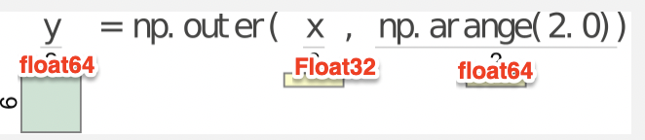
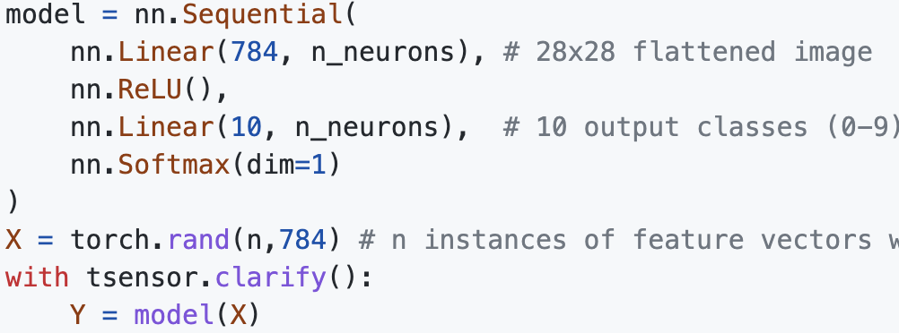
Examples of future work
Lots of meat still on the bone
Add tensor element type to messages and visualizations
we don’t want integers becoming floats if they are used as indexes
might need to restrict to 32 bits etc…
Viz errors in predefined layers; currently highlights model(X) not layer in nn.Sequential

Slide 29
Summary
Language engineering is useful far beyond building compilers and interpreters
TensorSensor users think that visualization was the hard part, but that was just painful not hard (I abused matplotlib horribly!)
The tricky bit was getting fine-grained exceptions from Python
The key idea is to reevaluate the offending line operator-by-operator and wait for the exception to happen again
Involves extracting source line, parsing into an AST, then calling eval()
Finding and implementing an unobtrusive mechanism also took a lot of experimentation
Article: https://explained.ai/tensor-sensor/index.html
Code: https://github.com/parrt/tensor-sensor

