Slide 1
Clarifying matrix algebra issues visually with TensorSensor
Examples and implementation details
Terence Parr University of San Francisco
See https://github.com/parrt/tensor-sensor

Slide 2
Demo in notebook
https://github.com/parrt/tensor-sensor/blob/master/talks/demo.ipynb

Slide 3
The problem
It's easy to lose track of matrix/tensor dimensionality in matrix algebra expressions (even in statically-typed languages)
Upon error, we often get less than helpful exception messages, such as this PyTorch message:
The offending operator and operands are not clear

Slide 4
Current solution(s)

Slide 5
Problems
cannot easily reference Python variable names in error messages
Python exceptions also occur at the line level rather than the operator level so error messages cannot identify offending subexpressions within complicated matrix algebra statements
What’s the best programmer interface?

Slide 6
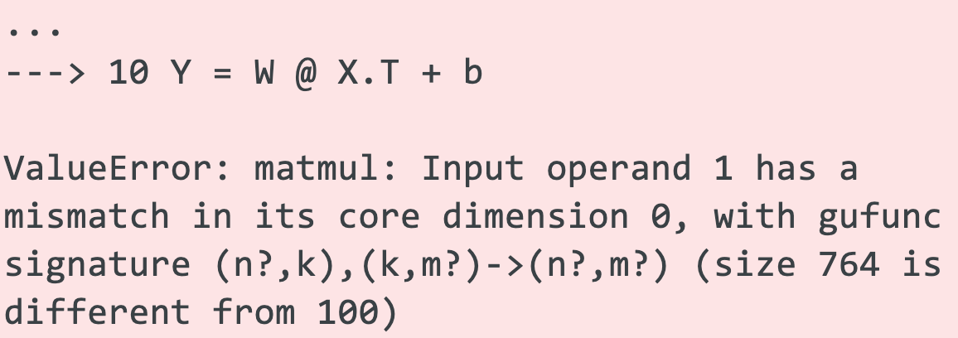
Current programmer aids are weak
It's easy to lose track of matrix/tensor dimensionality in even simple expressions (even in statically-typed languages)
Upon error, we often get less than helpful exception messages
E.g., here's a sample NumPy message:
Which operator?
Which operand?

Slide 7
We could rerun using the debugger but…
Python debuggers seem much slower than normal execution
Even regular execution could take hours before faulting
Sometimes it's hard to set a breakpoint on the right statement when it's in a loop
Conditional breakpoints are challenging when the values are high-dimension matrices
Debugger does not tell us which subexpression caused an exception, due to line-level granularity Python (Must write down shape of all operands and lineup dimensions)

Slide 8
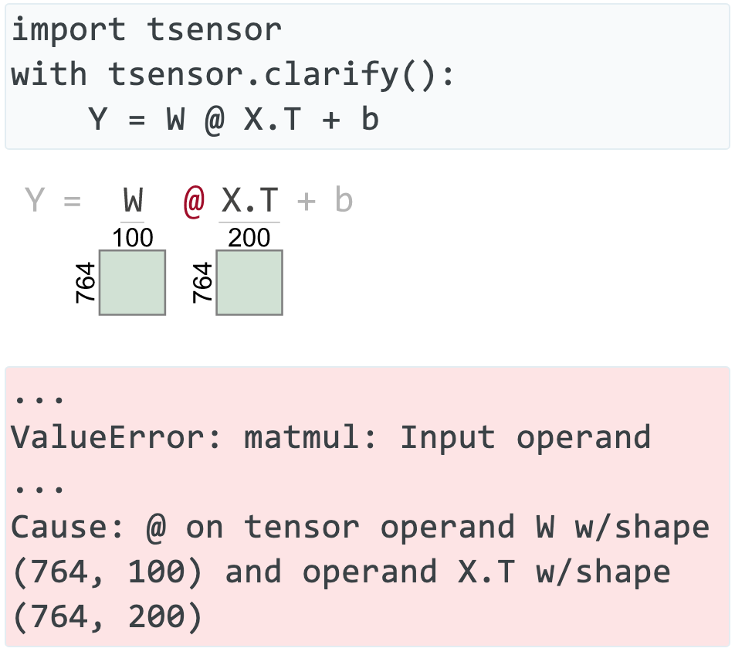
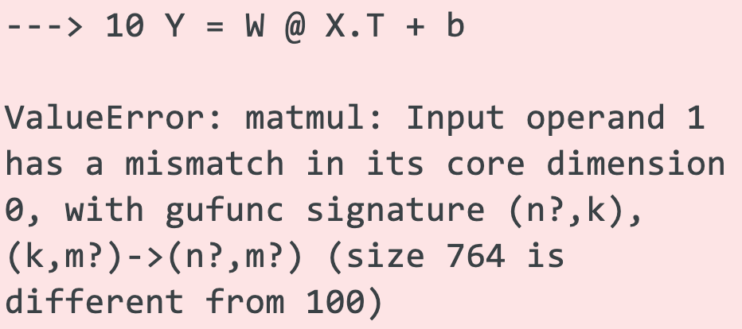
Clarifying errors visually & textually
🎉
😿
TensorSensor generates visual cues to matrix dimensions and offending operator / operands
TensorSensor augments
exception messages
https://explained.ai/tensor-sensor/index.html

Slide 9
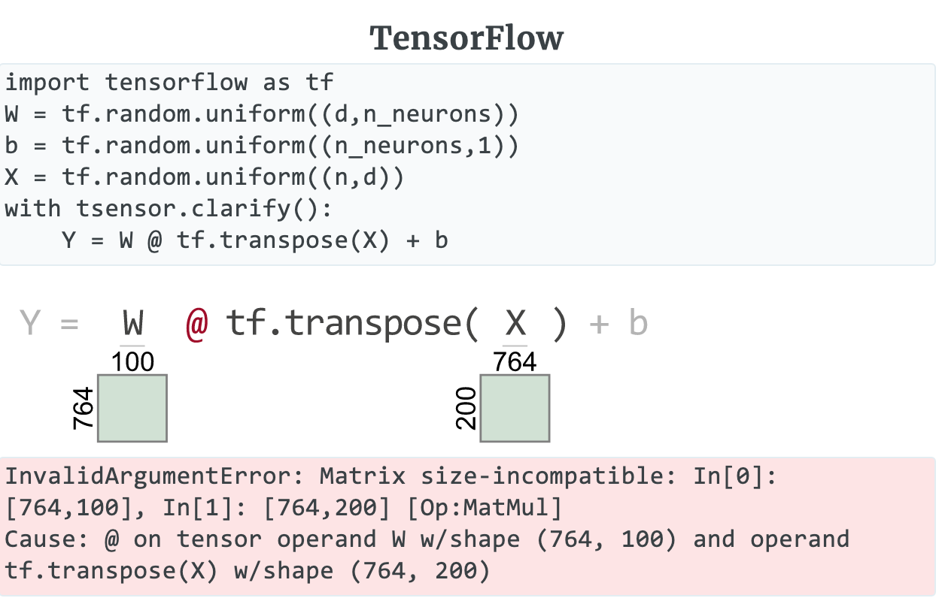
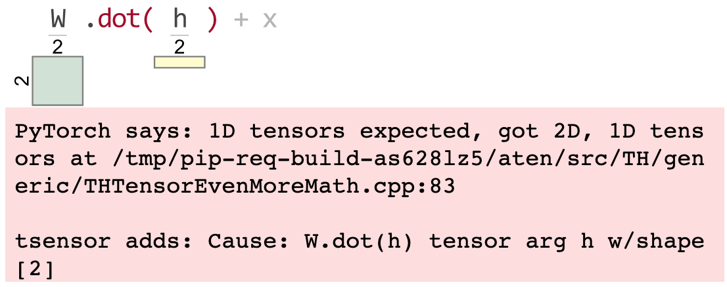
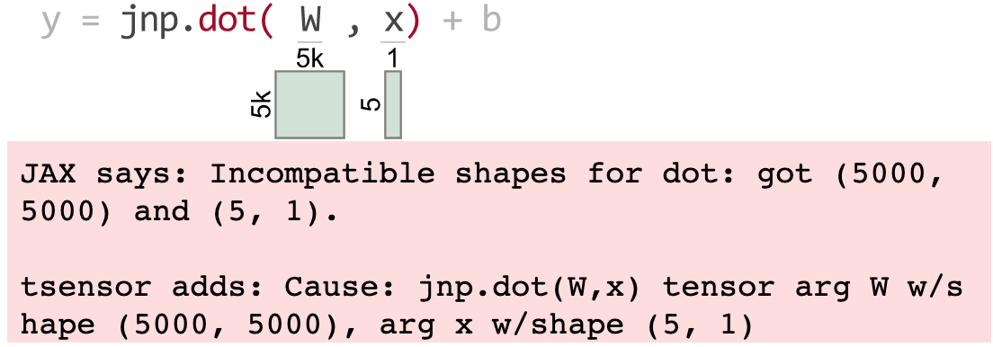
Requirement: support multiple libraries
(1D vectors are yellow)
PyTorch
JAX

Slide 10
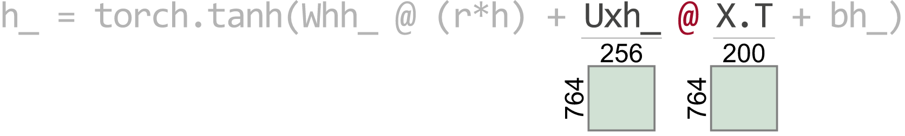
Requirement: support complex expressions
We need to know which operator and operands failed so we should highlight the offending elements:
(Oops: The columns of Uxh_ must match the rows of X.T)

Slide 11
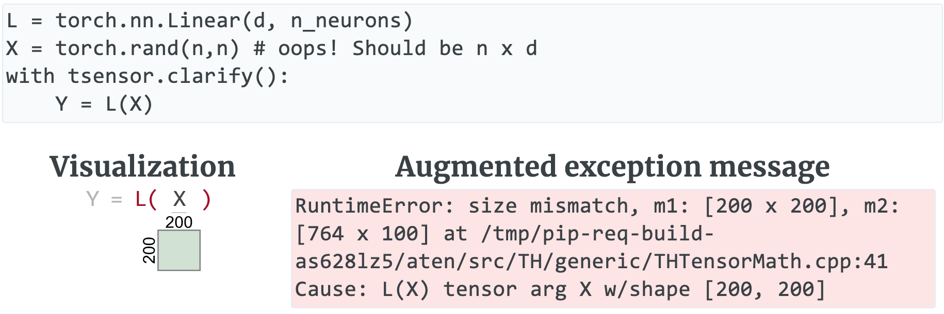
Requirement: support prebuilt layers
Should highlight error in user code not library code
(Note unhelpful C++ reference)
(TensorSensor augments message)

Slide 12
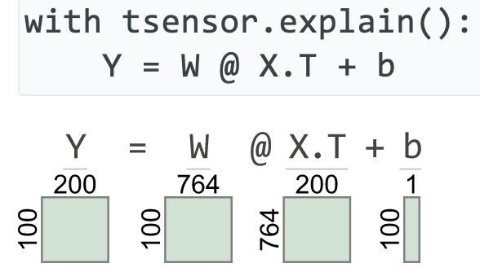
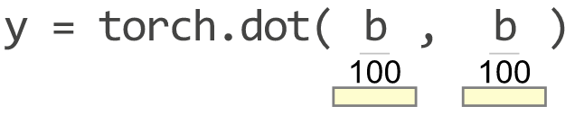
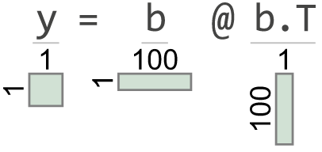
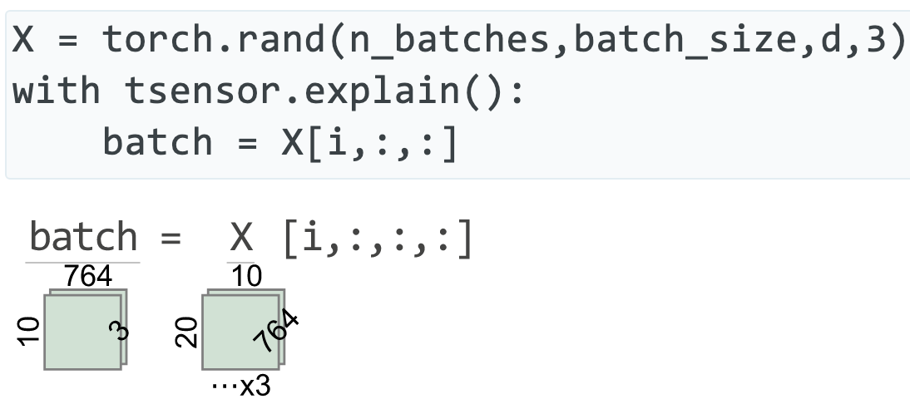
Requirement: explain code w/o errors
Very helpful when trying to read (even correct) code
Greater than 2 and 3 dimensions

Slide 13
Language engineering related implementation

Slide 14
Key questions to answer
Python traps exceptions at the statement level, so how can we identify offending operators and operand values?
How can we trap exceptions without requiring try/except blocks around statements with potential dimension problems? (Also want to ignore non-matrix related exceptions; user shouldn't need to know Python internal execution details)
How can we generate matrix visualizations w/o explicit calls?
Can we make use of library zero cost until an exception?
In other words, how do we make this precise and unobtrusive?

Slide 15
Screams for code instrumentation, right?
I considered injecting Python bytecode to track subexpression evaluation and to get finer-grained exception handling
But, that might require a separate tool and a preprocessing step, rather than simply importing a library
Injected code could slow down entire program execution significantly
Injected code might affect Python optimization / concurrency
It seemed like a lot of work to learn and implement for a skill I probably would never need again

Slide 16
Getting operator-level exceptions w/o bytecode instrumentation requires a total hack
We have: (1) the full execution stack and (2) the offending line of source code
To identify the individual operator and operands that triggered an exception use brute-force:
reevaluate each operation in the line, piece-by-piece, in proper order, and in the correct execution context (must pick correct stack frame)
Wait for an operator to cause an exception, report op/opnds
Zero cost until error, but assumes side-effect free functions
Even if side-effecting, who cares (usually)? Program is about to terminate

Slide 17
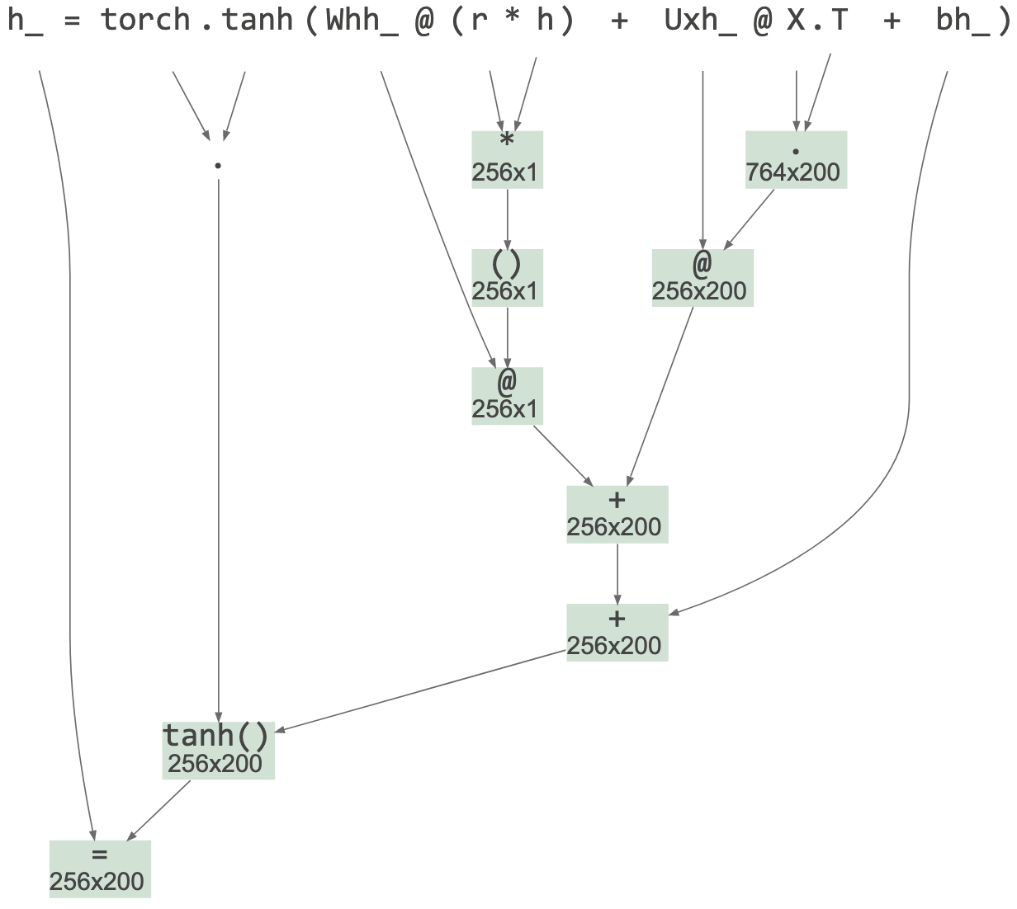
Reevaluation mechanism
First, check if exception is tensor-related or if exec stack descends into a known tensor lib
If so, find and parse deepest user-level offending statement and build an appropriate AST with operators as subtree roots
Uses built-in Python tokenizer
Uses handbuilt Python parser for subset of statements / exprs
Avoided ANTLR to avoid introducing a lib dependency
Avoided built-in Python parser since reorg'ing its AST is same work as rolling my own "parrser"
🤣
(also from TensorSensor lib)

Slide 18
Reevaluation mechanism continued
Evaluate operators of AST bottom-up in proper exec order
Call eval() on Python source of subexpressions using the appropriate execution contexts, saving results in associated nodes
Trap and absorb exception from eval(), record that exception and offending AST node
Augment original exception message with info derived this new exception, op, operands

Slide 19
Picking the right execution context
The goal is to identify user code not library code that (eventually) triggers a tensor-related exception
TensorSensor clarify() descends into any user code function calls, stopping only when it reaches a tensor library function
Source file prefix indicates user code boundary, such as: …/lib/python3.8/site-packages/tensorflow/…
Boundary frame is any whose package is in {numpy, torch, tensorflow, jax}

Slide 20
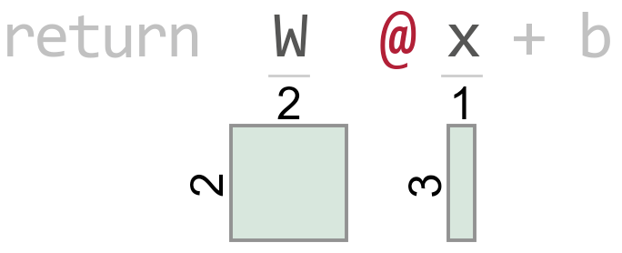
Example: Picking the execution frame boundary
t.py source
Execution stack
def f(x): W = tf.constant([[1, 2], [3, 4]]) b = tf.reshape(tf.constant([[9, 10]]), (2, 1)) return W @ x + b # line 4 with tsensor.clarify(): x = tf.reshape(tf.constant([[8, 5, 7]]), (3, 1)) y = f(x) # line 8
t.py:8 (in main)
t.py:4 (in f)
math_ops.py:1124
dispatch.py:201
math_ops.py:3253
gen_math_ops.py:5624
ops.py:6843
Raises exception

Slide 21
Simplifying the user code interface
My prototype used try/except but was unwieldy for the user
And, the code looked like error handling, which obscured purpose
Python "with b" blocks call __enter__(), __exit__() on object b and exit method receives exception object and execution stack
Exception handling code can automatically gen visualization
Prototype
Current
try:
myprogram()
except Exception as e:
tsensor.do_everything(e)
with tsensor.clarify(): myprogram()
(might not be able to hide everything here, like reraising e)

Slide 22
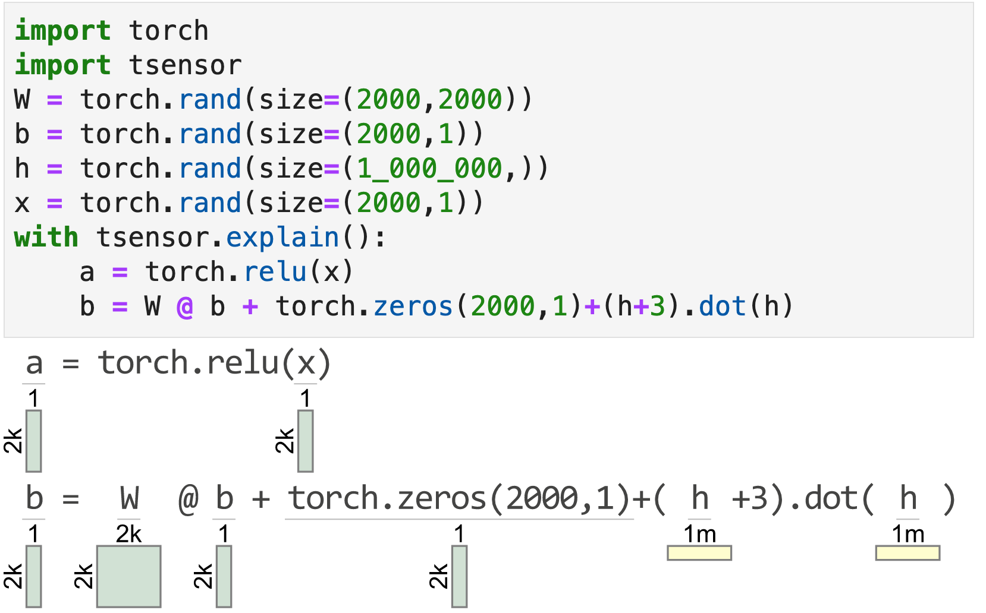
Explaining correct matrix code
clarify() has no effect unless tensor code triggers an exception
To aid reading matrix code, explain() gens a visualization for each statement within the block
(From within a Jupyter notebook)

Slide 23
Visualizing Python code on-the-fly
explain() object's __enter__() method creates a tracer object and registers it with Python via sys.settrace() [1]
The tracer is notified upon each source line execution
Using the same mechanism as clarify(): parse source line, build AST, evaluate AST subexpressions to identify operand shapes
Even in loop within with block, statements visualized just once
Slows down execution (a lot) but it's still useful
Watch out for side effects; this prints "hi" twice:
with tsensor.explain(): print("hi")
[1] https://docs.python.org/3/library/sys.html#sys.settrace

Slide 24
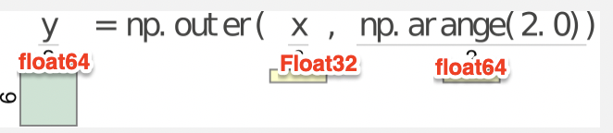
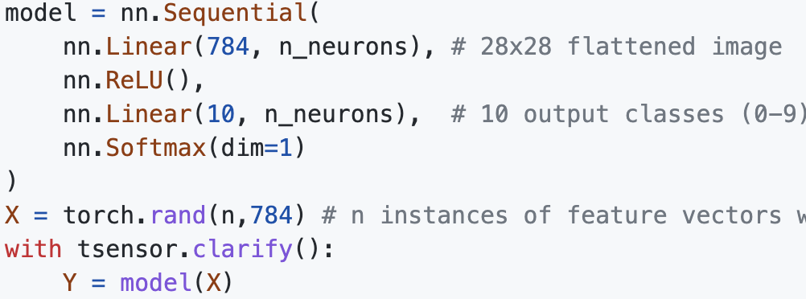
Examples of future work
Lots of meat still on the bone
Add tensor element type to messages and visualizations
we don’t want integers becoming floats if they are used as indexes
might need to restrict to 32 bits etc…
Viz errors in predefined layers; currently highlights model(X) not layer in nn.Sequential

Slide 25
Summary
Language engineering is useful far beyond building compilers and interpreters
TensorSensor users think that visualization was the hard part, but that was just painful not hard (I abused matplotlib horribly!)
The tricky bit was getting fine-grained exceptions from Python
The key idea is to reevaluate the offending line operator-by-operator and wait for the exception to happen again
Involves extracting source line, parsing into an AST, then calling eval()
Finding and implementing an unobtrusive mechanism also took a lot of experimentation
Article: https://explained.ai/tensor-sensor/index.html
Code: https://github.com/parrt/tensor-sensor

