Slide 1
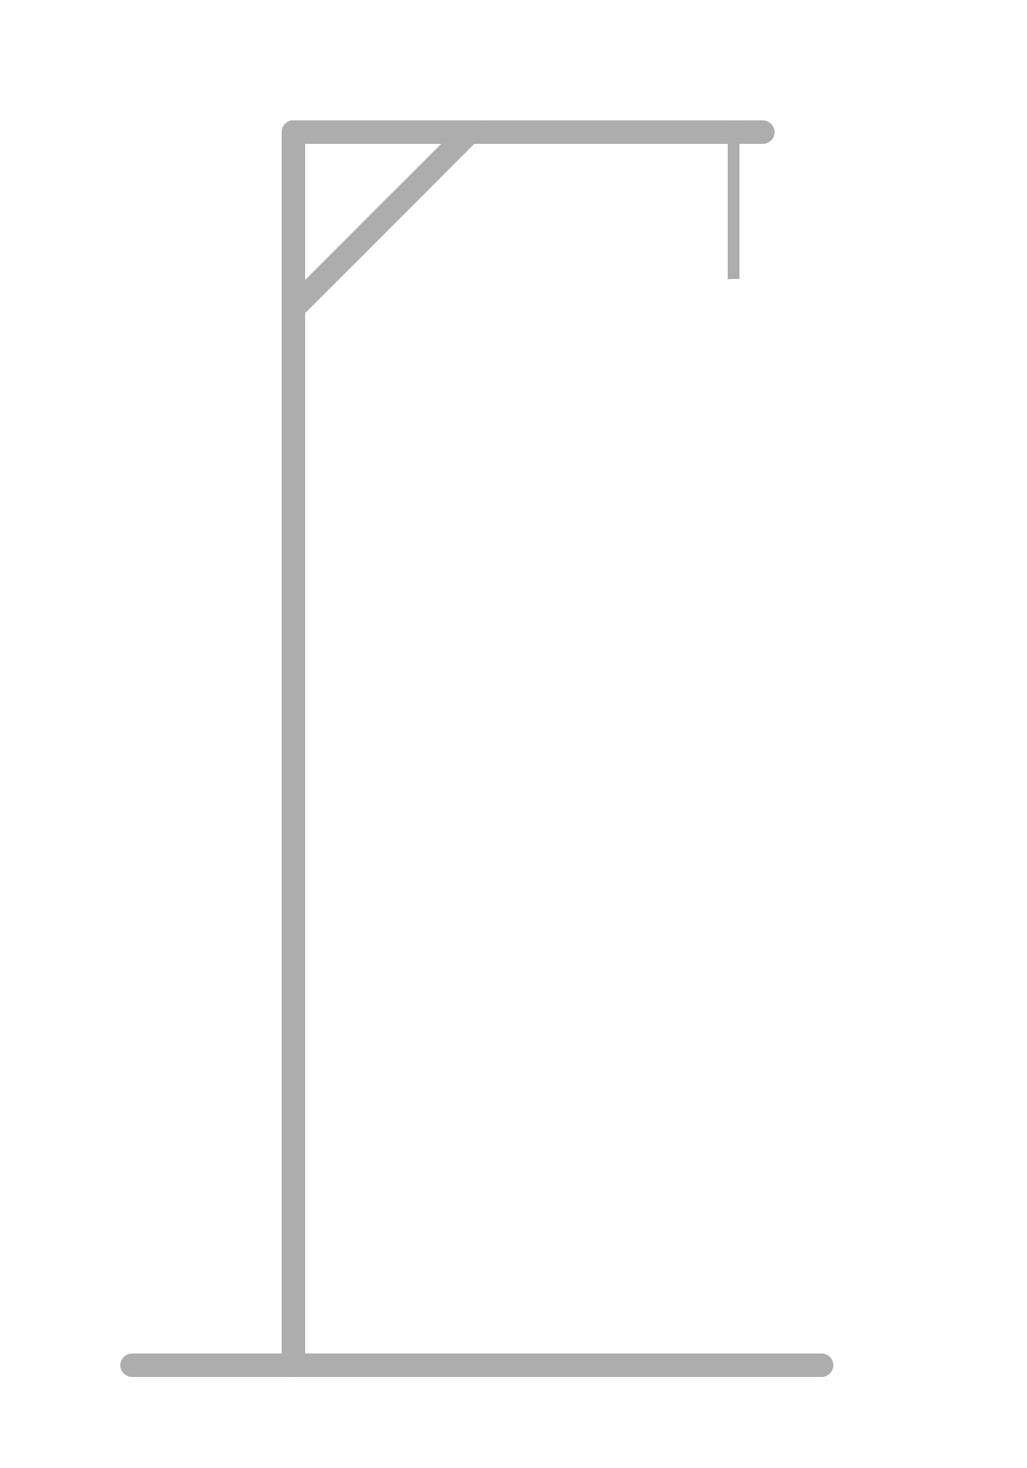
Hangman.c
Team 5
Cesar Marquez-Garcia · Manuel Barnett · Christopher Rodriguez · Jesse Garcia · Ean Chino

Slide 2
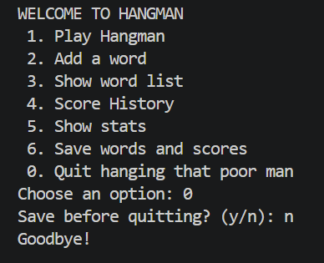
Program Overview
Menu-driven Hangman game for the terminal. Guess a randomly selected word one letter at a time, you get six wrong guesses to save Hangman.

Slide 3
Design Elements (How the files connect)
Hangman.h (Cesar)
Contains libraries, limits, game record struct and every prototype. Include in every .c file
Main.c (Manny)
Contains menu, data calls, and game flow. Calls all functions
Input.c (Christopher)
Handles checks on what users type and rejects invalid inputs.
Words.c (Jesse)
Contains word list, loads and saves any new words.
Game.c (Ean)
Contains game logic and score computation.
Scores.c (Cesar)
Contains score data, loads and saves scores.

Slide 4
Functions Highlight
Input.c (Christopher)
Game.c (Ean)
void playGame(char words[][WORD_SIZE], int wordCount, GameRecord history[], int *gamecount);
int alreadyGuessed(char guessed[], char letter);
Main.c
Scores.c (Cesar)
void playGame(char words[][WORD_SIZE], int wordCount, GameRecord history[], int *gameCount)
int loadScores(GameRecord history[])
Words.c (Jesse)
int loadWords(char (**words)[WORD_SIZE])

Slide 5
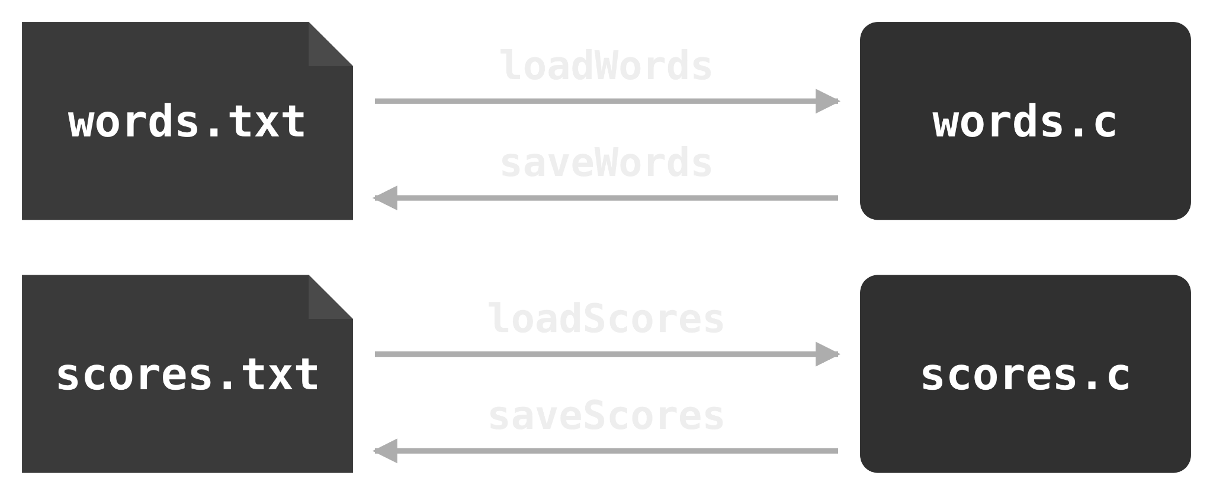
Design Elements (How the data is stored)
GameRecord Struct:
File operations:
typedef struct {
char player[WORD_SIZE];
char word[WORD_SIZE];
int won; // 1 = win, 0 = loss
int wrong; // wrong guesses
int score;
} GameRecord;

Slide 6



Demo
0. Start with a new build

Slide 7
QA: # | Checks | What to Type | Expected Output | Pass/Fail
1 | Code checks for special characters ( only letters allowed) | Any special character | Warning to re-enter an appropriate letter. “X” is not a letter | P
2 | Code checks lowercase uniformity of each letter from the user ( only lowercase letters allowed) | Any uppercase letter | Automatically makes uppercase lowercase | P
3 | Code checks for length of word (Less than 20 characters, no spaces!) | Word with more than 20 characters | Warning to enter a word less than 20 letters long | P
4 | Code checks for appropriate menu inputs | Number outside of the range of menu options | Warning to enter numbers within the range “%d” -> “%d” | P
5 | Game loads pre-loaded words without issue | Restart game | Game should begin with a preloaded word bank | P
6 | Code does not allow two of the same guess during round | Guess the same letter twice during a round | No penalty suffered in the game, but the user is notified. | P
7 | Code saves and loads user game-history | Exit and re-enter game having played a round | User information is saved | P
8 | User can only answer questions through Y/N (Yes or No). | Attempt to type anything other than Y or N when prompted by a question | User is prompted to enter ‘y’ or ‘n’ | P
*

Slide 8
Lessons Learned
Transitioning from a fixed sized array to dynamically sized array is difficult.
Beginning with the same header file saves time in implementation.
Github = good time
Newlines “\n” and terminating strings “\0” can result undefined behaviour that can lead to segmentation faults and unintended program termination during run time.
Open & consistent communication is of utmost importance.

Slide 9
Q&A

