Slide 1
AICUP - Project 32
Vehicle Tracking Competition
Amina Enkhbayar - Manuel Salgueiro
Deep Learning

Slide 2
Introduction and Goals
This semester we’ve been introduced to the AICUP, a competition that offers different Deep Learning tasks to which participants can join.
The aim for the final project of this course and these tasks was to successfully submit the results of the training and testing to the competition’s website and get the better score against other participants.
In our case, we chose to work on project 32 : AI drives the future of mobility: cross-camera multi-objective vehicle tracking competition - Model Group.
In order to achieve this task, we were presented with a baseline jupyter notebook project by ricky-696, which we took as a template to work with. We will describe out observations and experience with the tools presented in this template.

Slide 3
Table of Contents
Introduction and Goals
Pipeline
RESOURCES in the pipeline
Frameworks and Models
Implementation
Setup
Errors and Solutions
Major roadblocks
Final results
Conclusion

Slide 4
RESOURCES in the pipeline
Libraries
PythonAPI (COCO) - Not in use.
TensorRT, Cython and FaissGPU - Accelerate computation and enhance efficiency.
ONNX - helps with model formatting for interoperability.
Other libraries are installed through requirement.txt.

Slide 5

RESOURCES in the pipeline
Datasets
AICUP (train) Dataset - images and labels
Split to generate the train and test for different models.

Slide 6
ReID dataset
The AICUP dataset is adapted for the ReID format via script.
The ratio for the train and test sets is 0.8 and 0.2.
Images are converted to a specific resolution (720x1280) and Bitmap loss-less format.
Labels are batched onto these Bitmpa images.
All parched files then split in /train and /test directories.
YOLOv7 dataset
The AICUP dataset is adapted for the YOLOv7 format via script.
The ratio for the train and validation sets is 0.8 and 0.2.
No change in sizes, just renaming to corresponding /label text file names.
All renamed images split into /images and /labels for both training and validation.

Slide 7
Frameworks and Models
Fast_ReID Framework
Framework: offers a set of pre-trained models and tools for Person Re-ID
Models in the repository implement popular architectures:
ResNet - CNN
OSNet - Handles variation detection
HRNet - Maintains High-Res features for better identification
Also popular Re-ID algorithms:
Triplet Loss: Loss function - Embeds same people’s features together - others’ features apart
SphereNet: Learns discriminative features.
Margin Loss: Loss function - Establishes margins between same people’s features against others’.

Slide 8
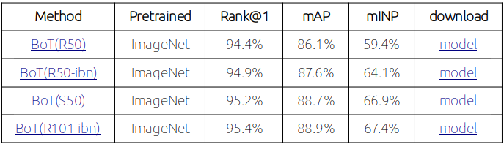
Fast_ReID Models
Fast-ReID allows you to choose models, that implement different architectures, algorithms and loss functions, to train them on your own datasets. These “baselines” are available for download at https://github.com/JDAI-CV/fast-reid/blob/master/MODEL_ZOO.md. Sample from Github:

Slide 9
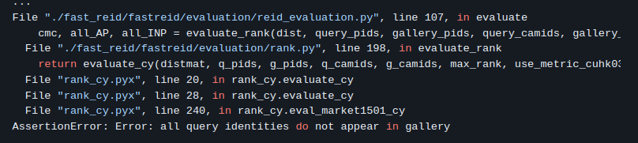
Fast_ReID implementation in the pipeline
Despite the Fast_ReID dataset and framework being implemented, both the author and us get an error during execution. This error is documented in the READ_ ME file:
The lack of two datasets (query and gallery) stops the training process, never training past epoch 2.
Possibly, the author tried to implement the framework unsuccessfully, as the results of it are never dealt with in later stages of the pipeline.

Slide 10
Frameworks and Models
YOLOv7
It’s a real-time object detection model.
As of 2024, the last version available is YOLOv10.
It raises efficiency by reducing parameters and computing, enabling cheaper HW.
It can be trained fast on small datasets without the need of pretrained weights.
Relies in CNNs for feature extraction, object localization and classification.
It also implements the ELAN (Efficient Layer Aggregation Network) approach.

Slide 11
The ELAN approach
ELAN deals with gradients, information calculated during backpropagation, indicates level of adjustment needed to minimize error between the Network’s prediction and actual output.
Gradients vanish in CNNs as weights propagate through many layers.
ELAN tackles the issue by strategically controlling the path lengths of gradients within the network.
Methods:
Shuffling: prevent gradient getting stuck in different channels
Channel Splitting and Concatenation: splits channels into multiple channels with fewer branches, separating processes to recombine the features later through concatenation.
Efficient Transition Blocks: blocks that help with transitioning efficiently with different stages of the network

Slide 12
YOLOv7 stages
Backbone feature extraction
Extracts hierarchical features from the images like detail, shape, parts, etc-
Neck (Feature fusion)
Combines and merges features, creating new features that better represent objects
Up-Sampling techniques for different resolution features.
Head (Prediction)
It makes two predictions per potential object:
Bounding Box Prediction: predicts location and size, tagging the object.
Class Prediction: assigns the class label to the object.

Slide 13
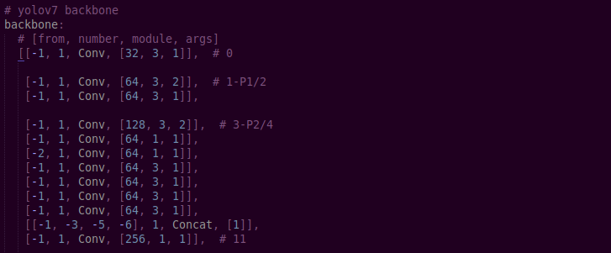
YOLOv7 Implementation in the pipeline
Regarding further references in the pipeline, this seems to be the author’s choice for the AICUP.
The configuration for the convolutional layer’s parameters is located in yolov7-AICUP.yaml:

Slide 14
Implementation
Setup
First implementation was with Conda and VsCode
Issues with downloading the dependencies
The numerous libraries and packages each had to be troubleshooted
Eventually decided it would be better to switch.
Final setup with Google Collab
More straightforward
Far more suited for handling model training jobs.
Issues with memory, and slow training.
As session would expire, changes could be lost, unless saved.

Slide 15
Implementation
Errors and Solutions
Errors in the Code
Incongruency with past and present Python versions, certain libraries, etc.
Numerous files needed to be updated.

Slide 16
Errors and Solutions: for the the training script for FastReID
ImportError: cannot import name 'Mapping' from 'collections'
Due to changes in Python 3.10 where Mapping has been moved from collections to collections.abc.
/fast_reid/tools/ train_net.py.
/fast_reid/fastreid/engine/__init__.py
/fast_reid/fastreid/engine/hooks.py
/fast_reid/fastreid/evaluation/__init__.py
/fast_reid/fastreid/evaluation/testing.py
ModuleNotFoundError: No module named 'torch._six'
Error is due to the fact that the torch._six module was removed in more recent versions of PyTorch.
Must replace instead with “string_classes = str”

Slide 17
Errors and Solutions for the the training script for YOLOv7
AttributeError: module 'numpy' has no attribute 'int'
The use of np.int has been deprecated in NumPy version 1.20.
We had to replace ‘np.int’ with ‘int’
NameError: name 'int16' is not defined
Indicates that 'int16' is not defined in the script.
The numpy integer type alias 'np.int16' should be used instead.
NameError: name 'interp' is not defined
the function interp is not defined or imported in the script.
need to use ‘numpy.interp.’
yolov7/utils/datasets.py
yolov7/utils/general.py
The config file, AICUP.yaml had to be updated
Due to issues with the dataset’s structure, the model was unable to find it.

Slide 18
Implementation
Major Roadblocks
Torch cuda running out of memory
Limited memory forcing small batches
Very long training time
Limited time to fix errors, re-train and re-try.
We abandoned FastReID for this reason as we encountered the error
AssertionError: Error: all query identities do not appear in gallery

Slide 19
Major Roadblocks
After the first successful set up, the main issue became memory and a long training time.
When we would run out of memory we’d have to reduce the batch size, the image size and the epochs, no-doubt resulting in poorer performing models, and longer training time.
For FastReID, 20 epochs took 12 hours to complete, and it ended in an error.
For YOLOv7, 10 epochs took 6.7 hours to complete, and the results we submitted were rejected due to an error with missing files.
Our efforts to correct our errors, would take far too long, resulting in us being unable to submit again.
New errors, would crop up.
The session would expire.
Out of memory again.
We were ultimately hampered by the rigid time constraint, and the limitations of our resources.

Slide 20
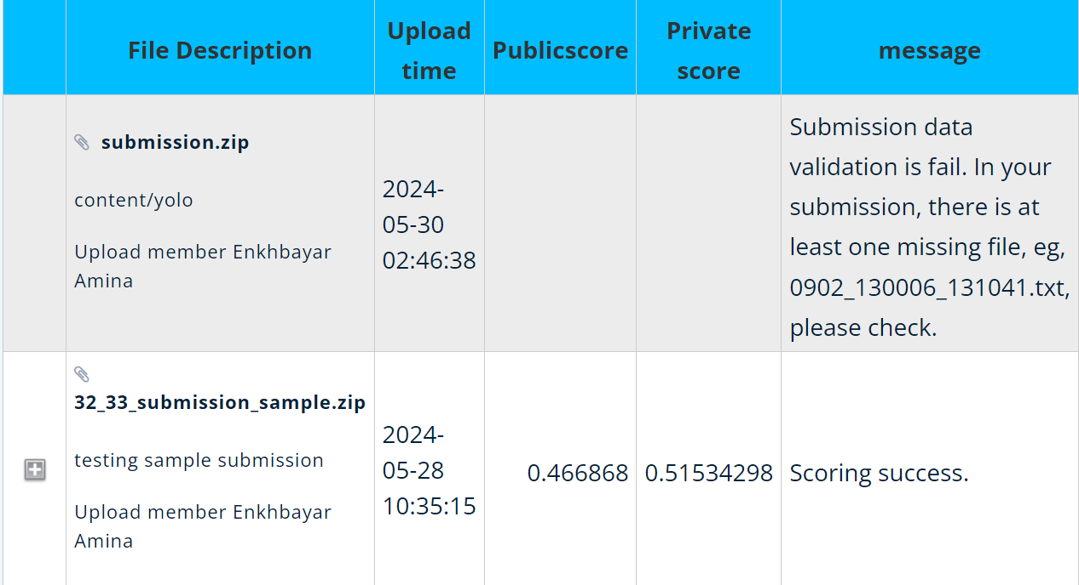
Implementation
Final Results

Slide 21
Implementation
Final Results
Submission error
The final submission file was not accepted.
The official reason was due to a missing file.
Submission sample
The file that was accepted was NOT of our own make.
It was the sample submission file, uploaded to see what the process would be like.

Slide 22
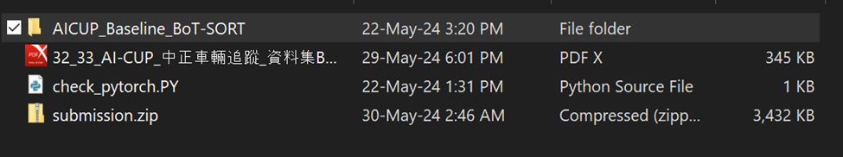
Final Results
We reviewed the error, and looked closer to the differences between the submitted files.

Slide 23
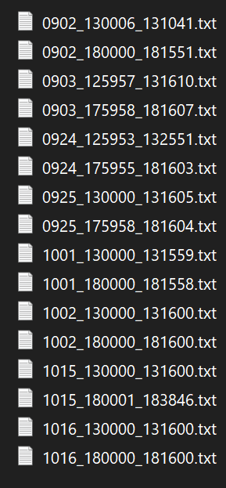
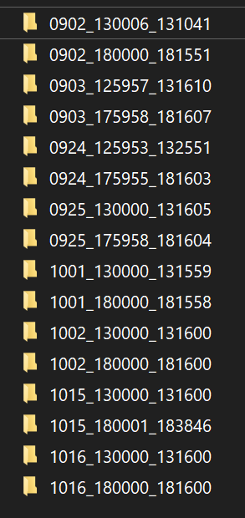
Final Results
Sample Submission txt files.
32_33 AICUP test dataset.

Slide 24
Conclusions
We have not successfully submitted the results of our training and testing.
We have submitted our trial submission example, purely as a way to test the submission process.
The final submission file we uploaded was rejected as it was missing a number of files. And while we did attempt to solve the mistake and upload again. We simply ran out of time during the training process.
Even so, the submission sample did get scored.
We’ve placed at 82nd out of 101 final entries.

Slide 25
Thank you.

