Slide 1
Final Masks
Presantation options

Slide 2
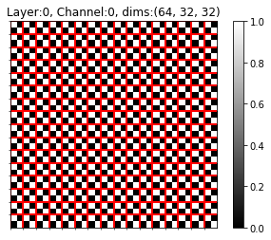
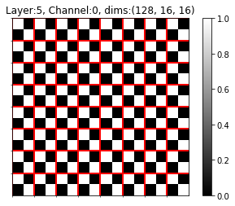
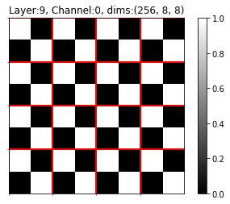
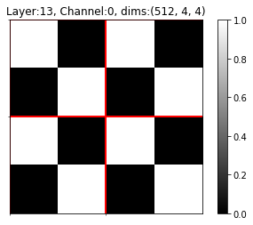
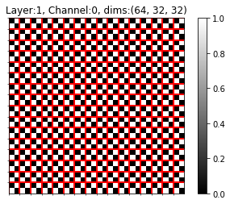
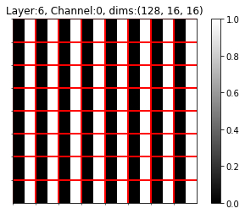





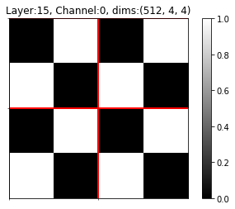





Uniform Layer Result – ResNet18, CIFAR10, PS2

Slide 3
Uniform Layer Result – ResNet18, CIFAR10, PS2

Slide 4
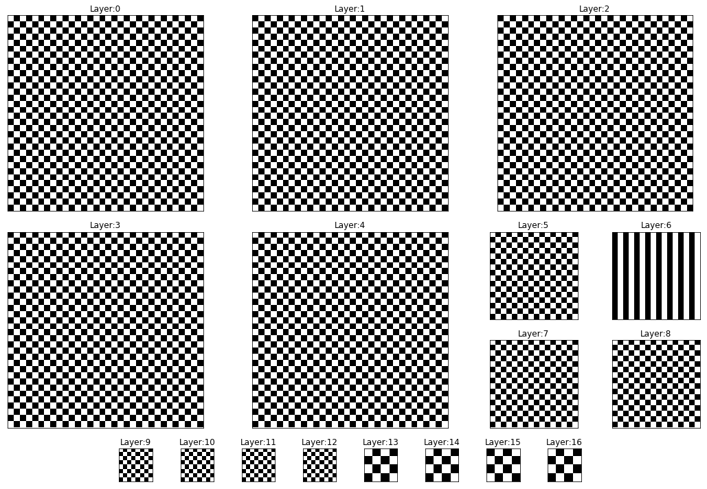
Uniform Layer Result – ResNet18, CIFAR10, PS2

Slide 5
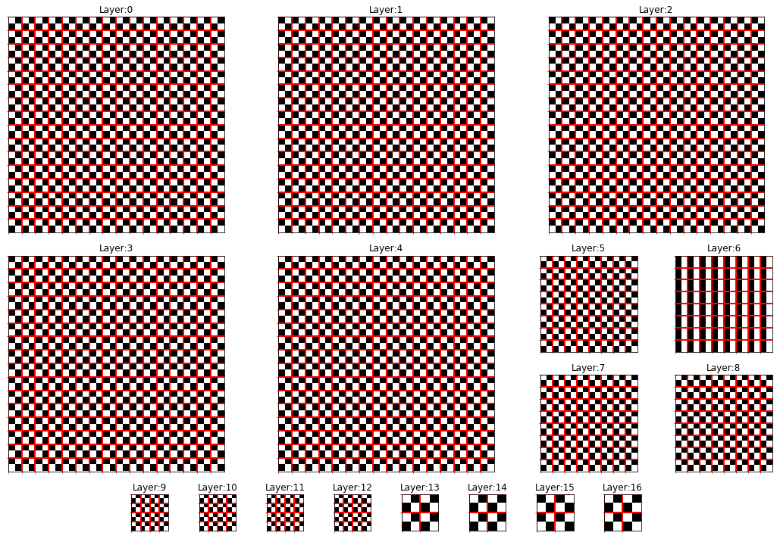
Uniform Layer Result – ResNet18, CIFAR10, PS2

Slide 6
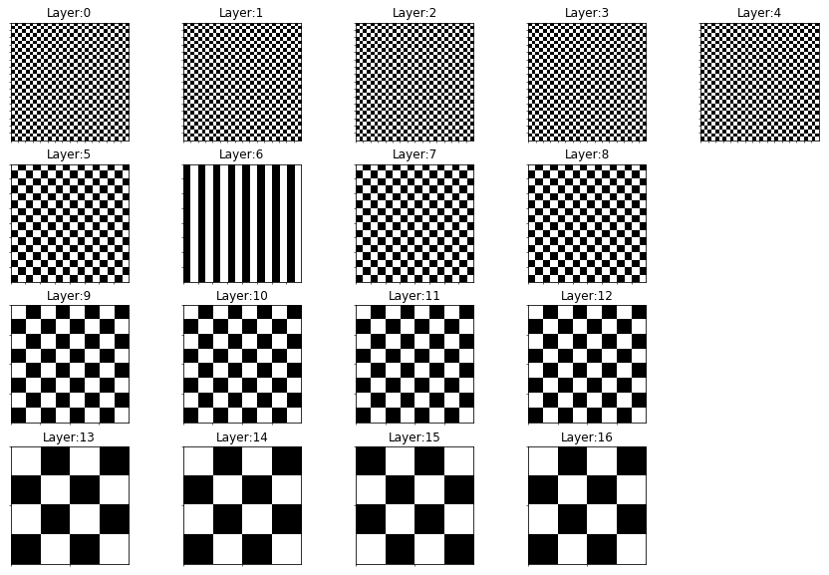
Uniform Layer Result – ResNet18, CIFAR10, PS2

Slide 7
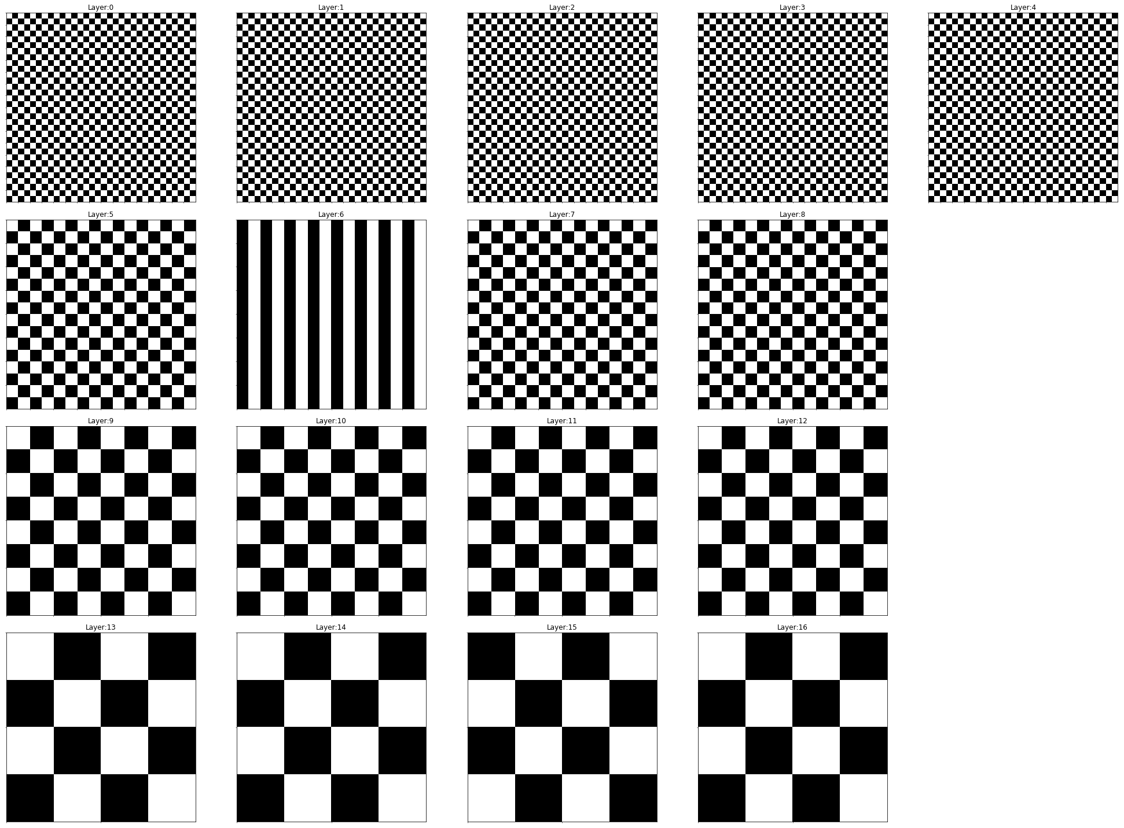
Uniform Layer Result – ResNet18, CIFAR10, PS2

Slide 11
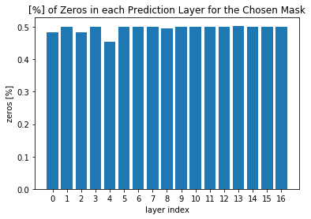
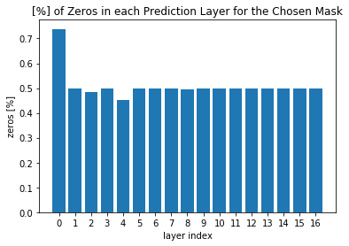
% of Zeros
Max Granularity
operations saved: 23.243%
with accuracy of: 90.1%
Uniform Patch
operations saved: 25.322%
with accuracy of: 90.5%

Slide 12
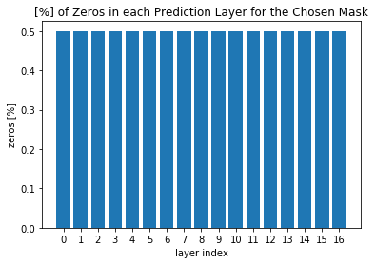
% of Zeros
Uniform Filters
operations saved: 23.712%
with accuracy of: 90.1%
Uniform Layer
operations saved: 23.669%
with accuracy of: 90.1%

Slide 13
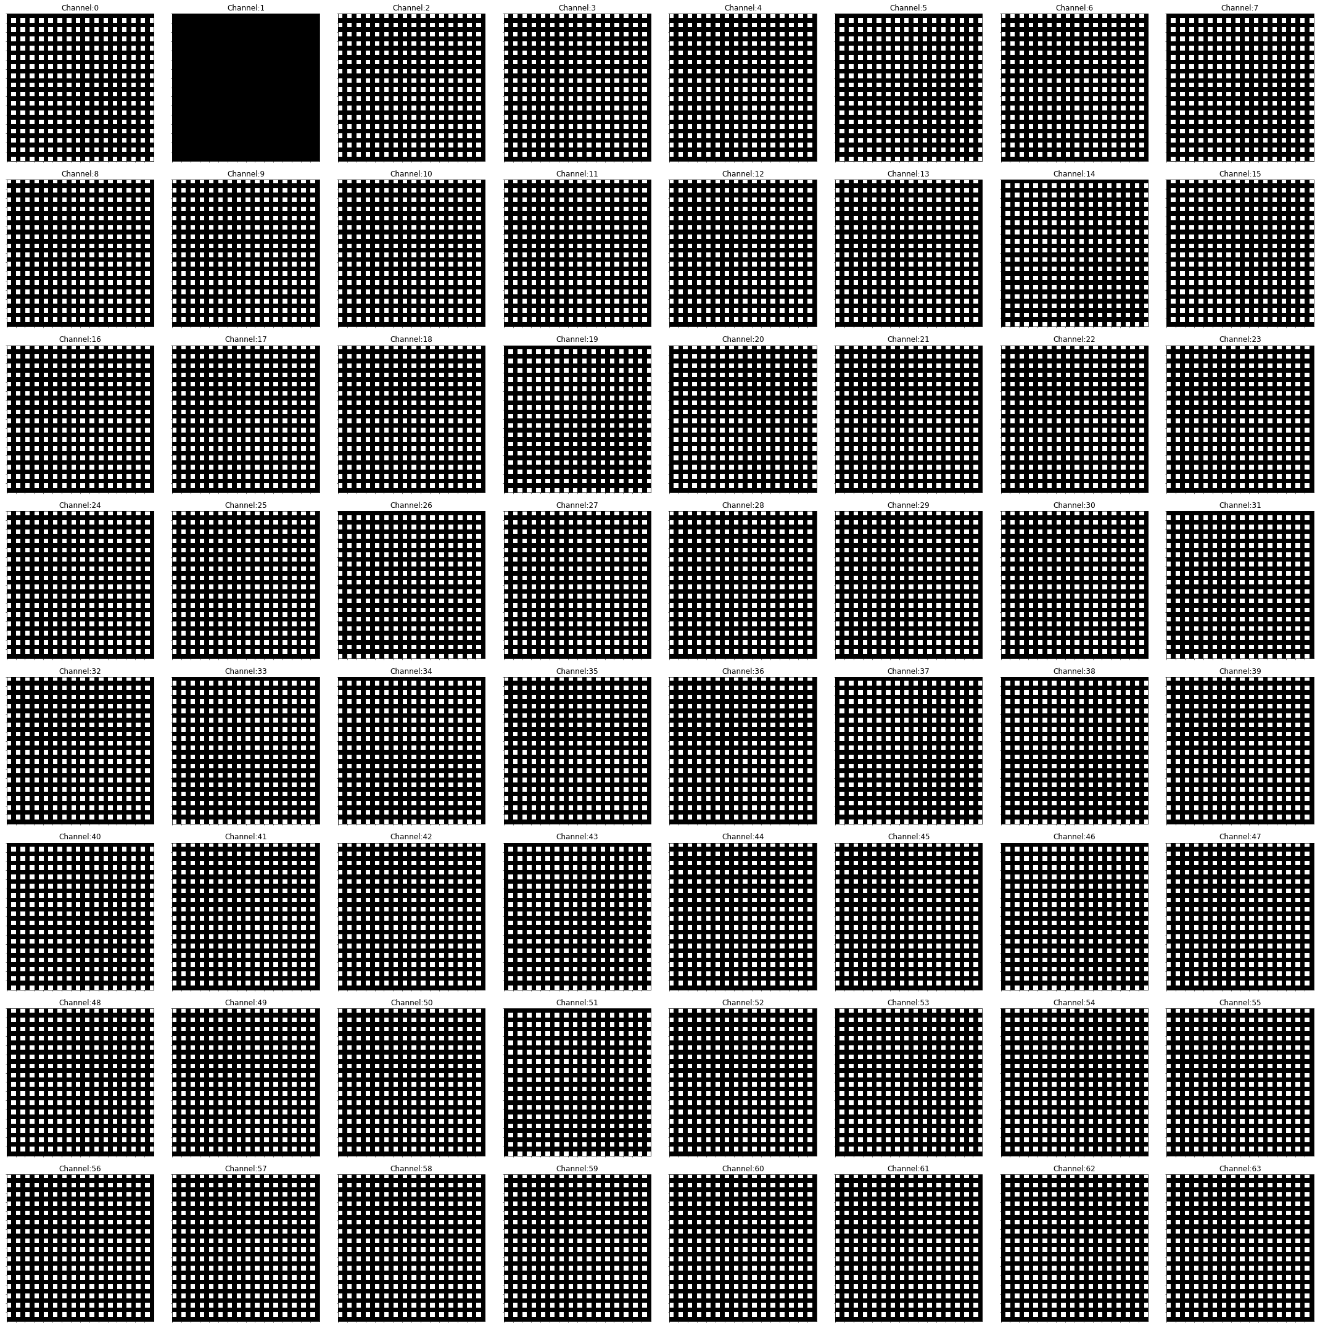
Uniform Patch Result – ResNet18, CIFAR10, PS2, Layer: 0

Slide 14
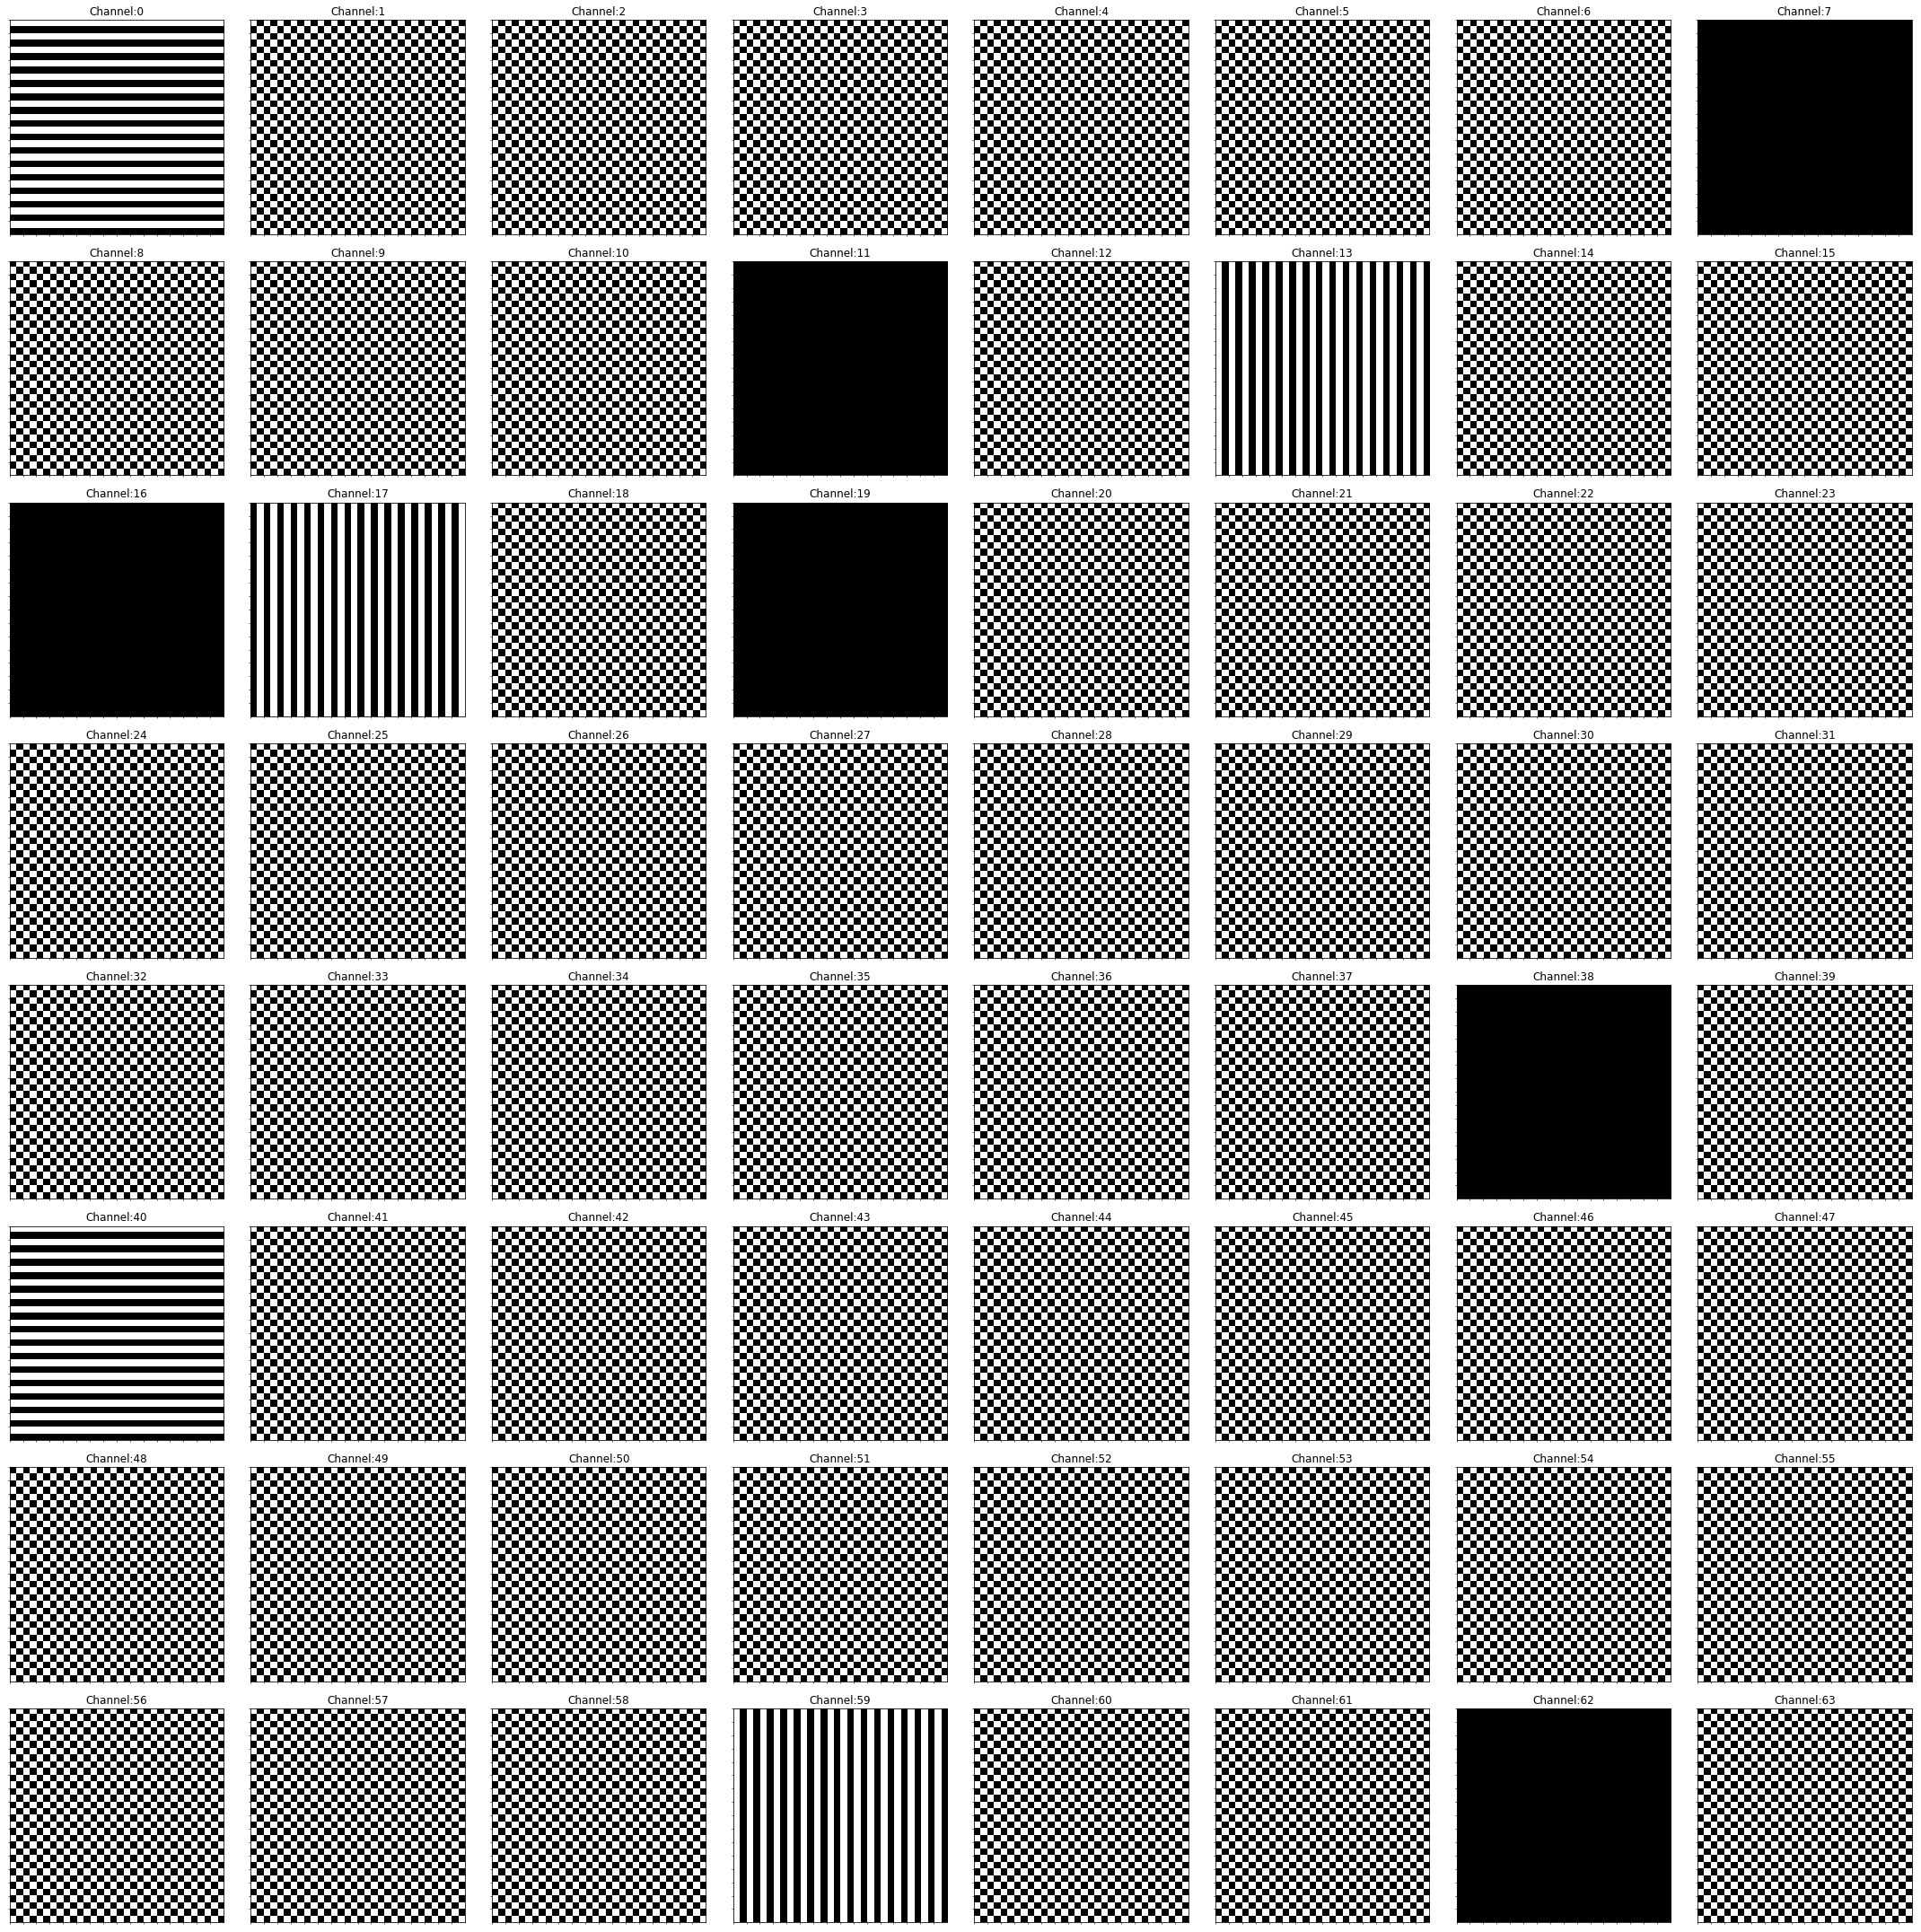
Uniform Patch Result – ResNet18, CIFAR10, PS2, Layer: 4

Slide 15
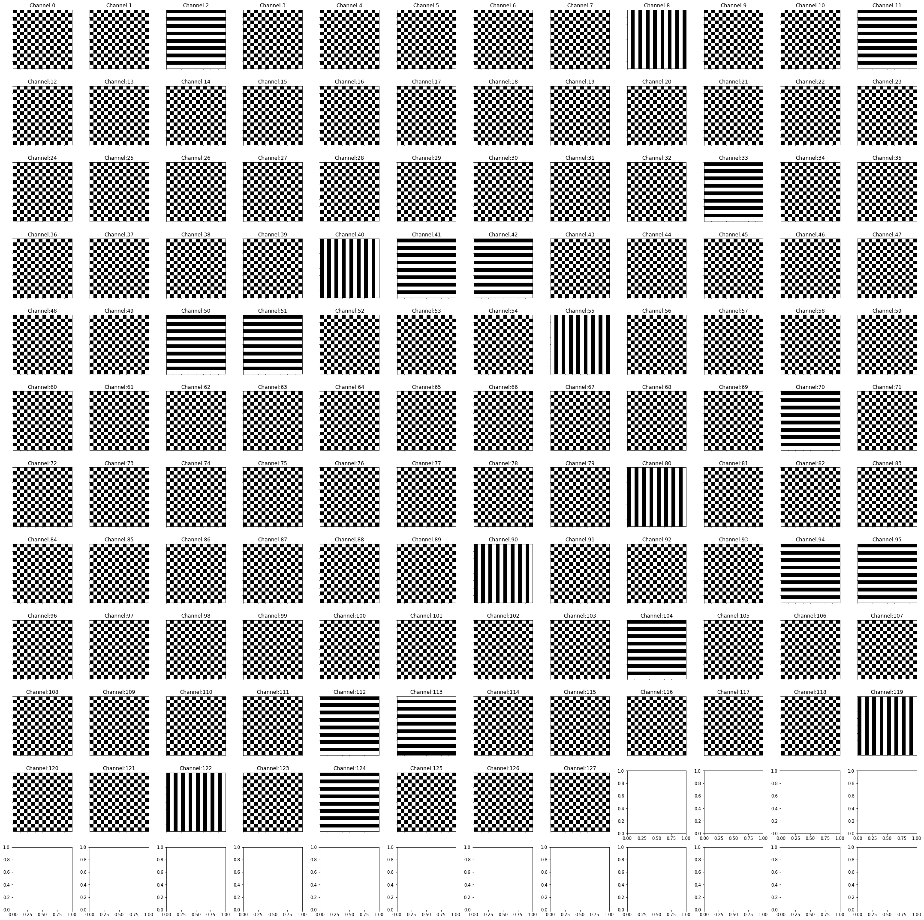
Uniform Patch Result – ResNet18, CIFAR10, PS2, Layer:7

Slide 16

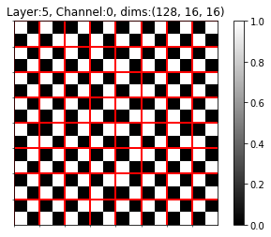
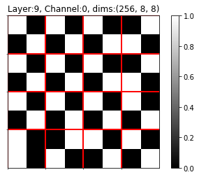
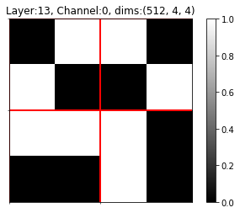
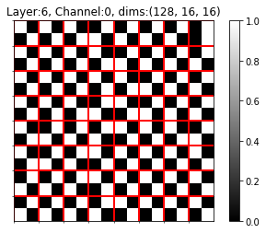
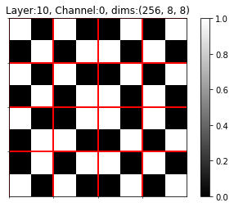

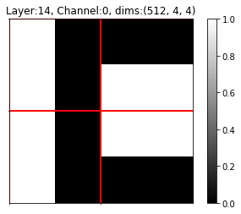
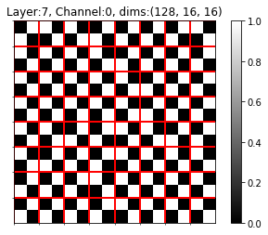
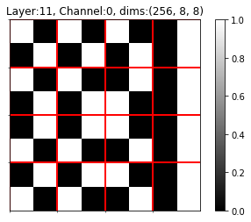
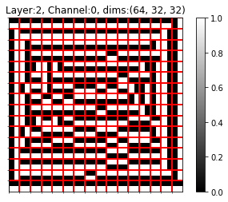
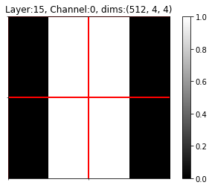
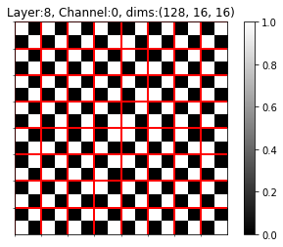
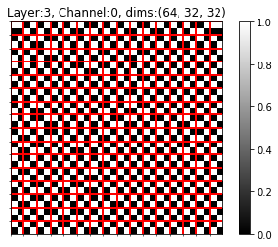
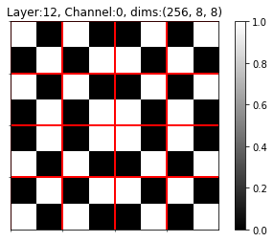
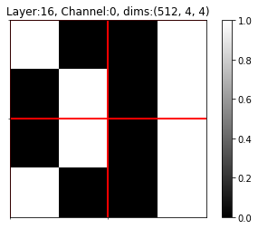

Uniform Filters Result – ResNet18, CIFAR10, PS2

