Slide 1
Final Masks
Presentation options

Slide 2
Uniform Layer

Slide 3
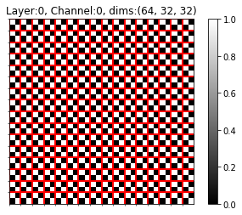
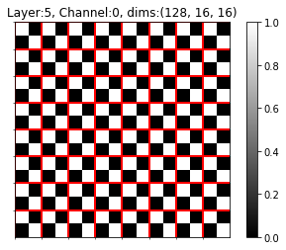
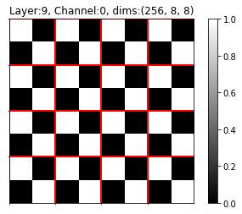
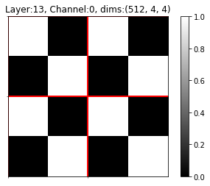
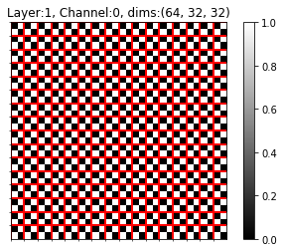
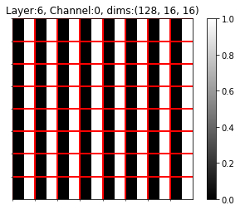





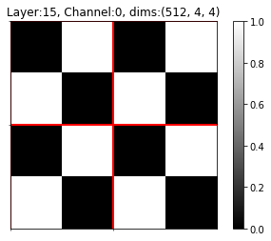





Uniform Layer Result – ResNet18, CIFAR10, PS2 separate layers

Slide 4
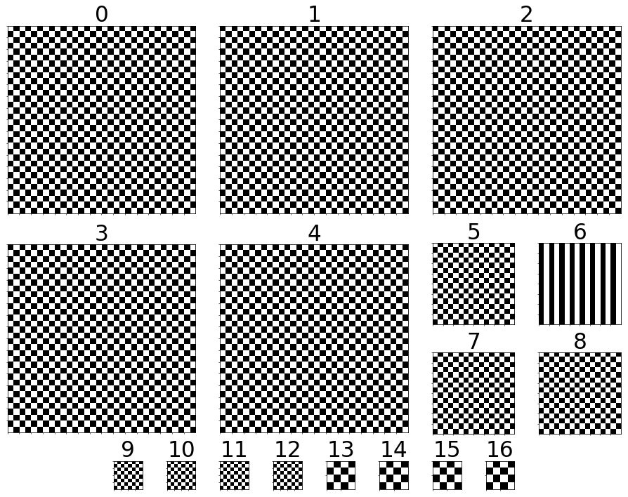
Uniform Layer Result – ResNet18, CIFAR10, PS2

Slide 5
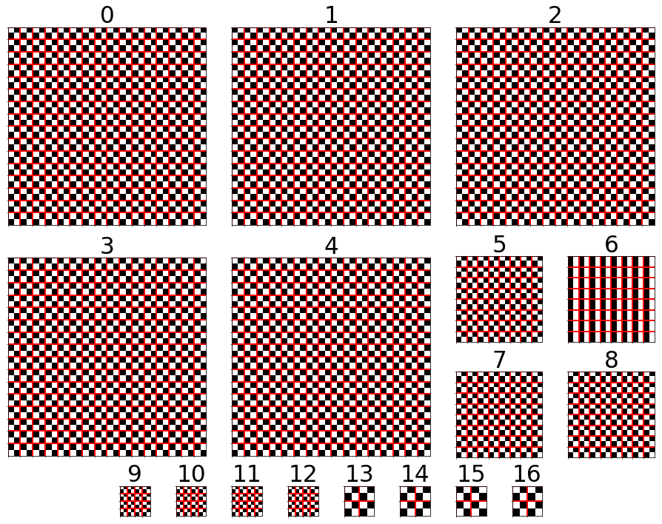
Uniform Layer Result – ResNet18, CIFAR10, PS2

Slide 6
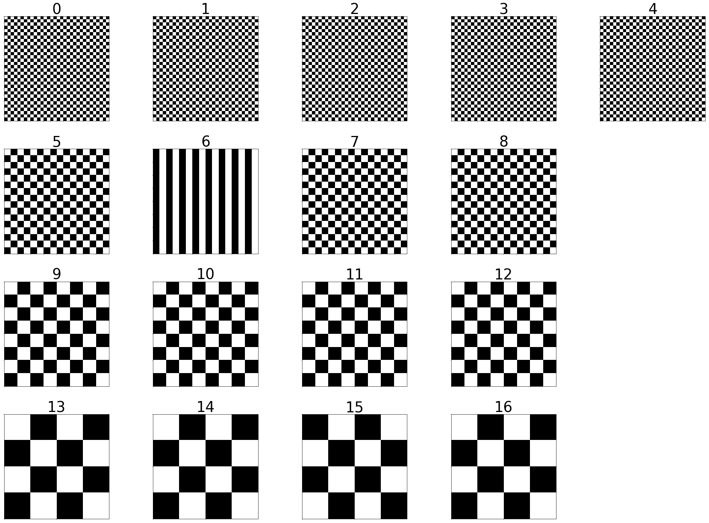
Uniform Layer Result – ResNet18, CIFAR10, PS2

Slide 7
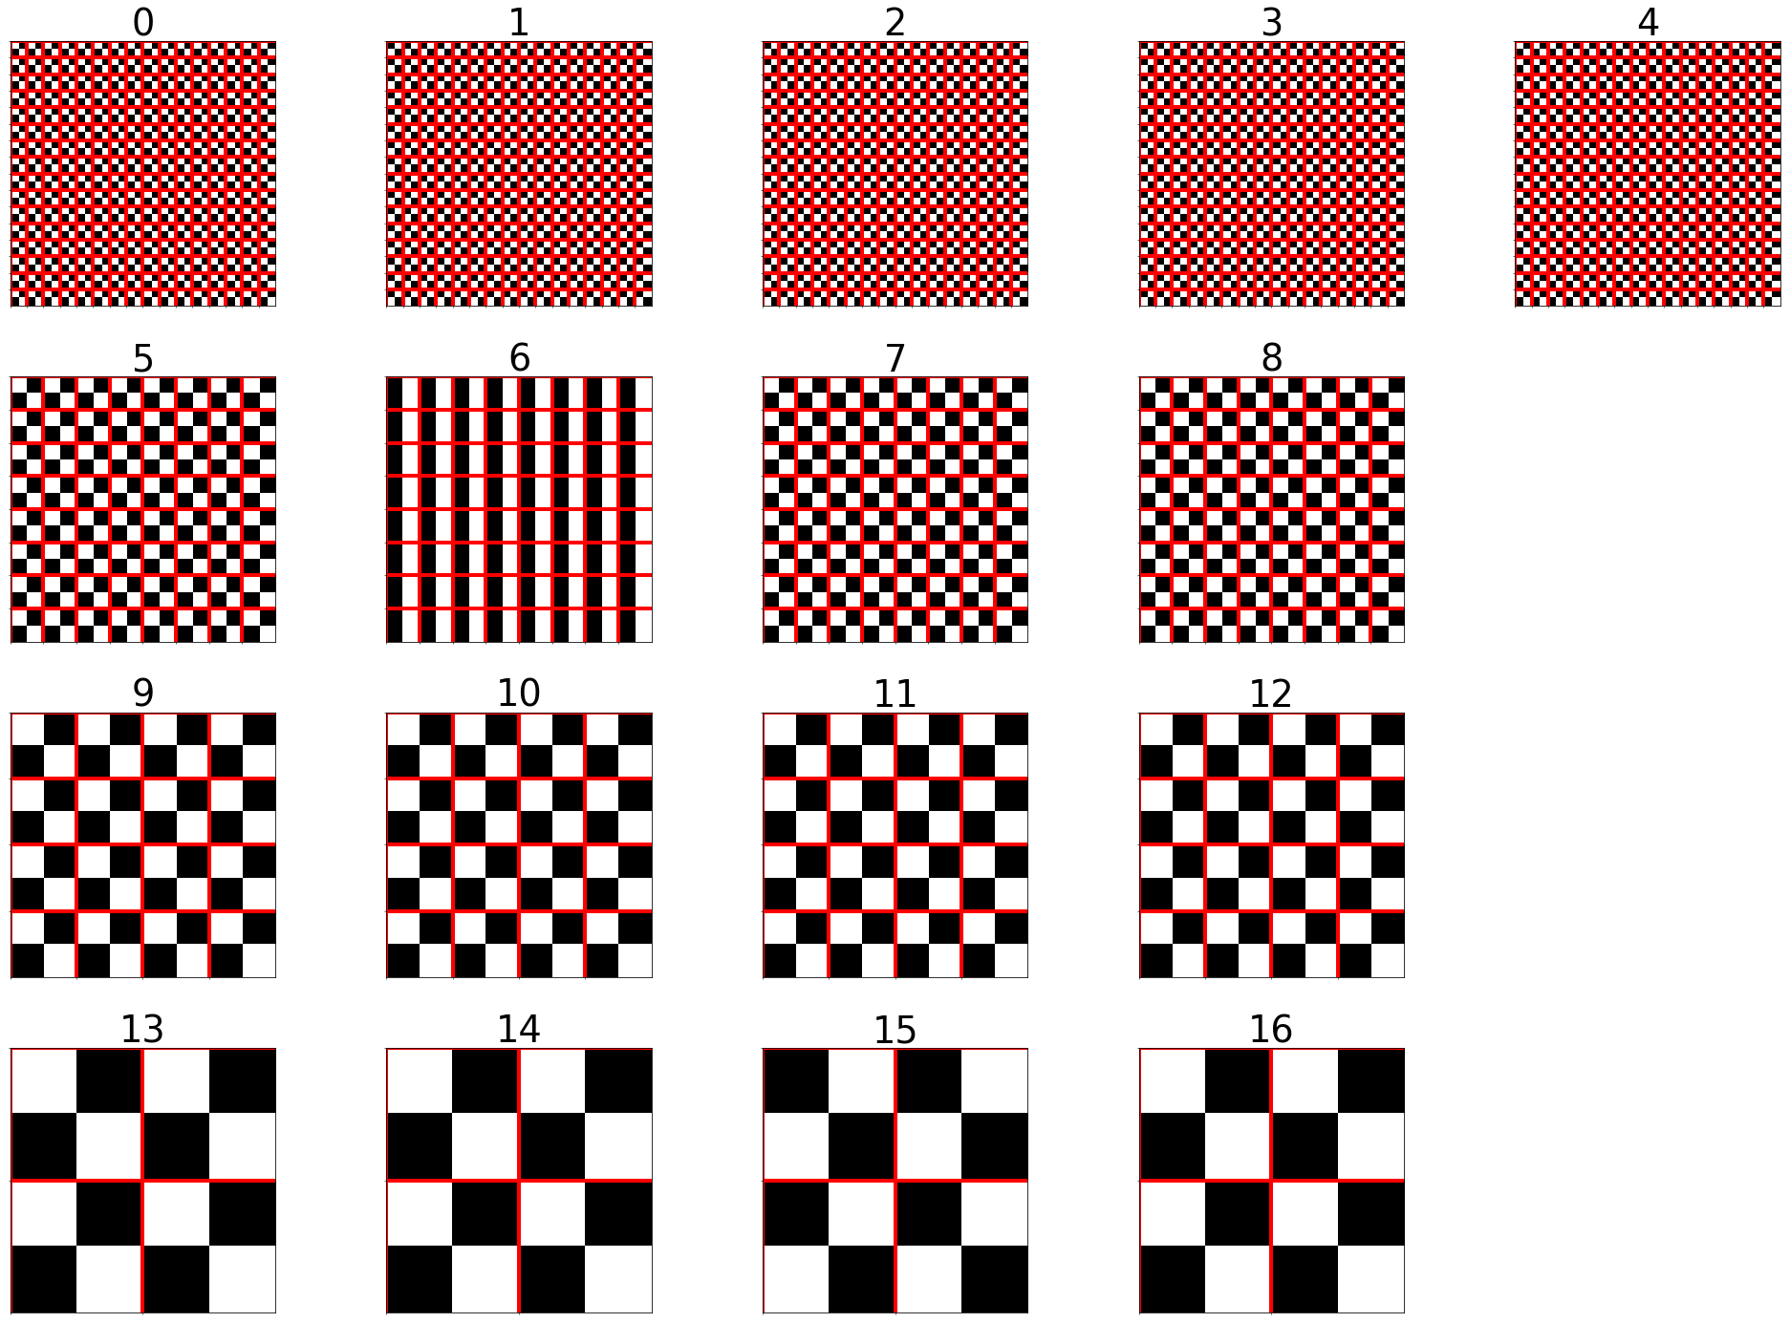
Uniform Layer Result – ResNet18, CIFAR10, PS2

Slide 8
Uniform Filters

Slide 9

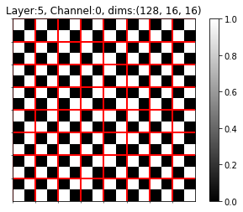
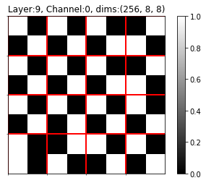
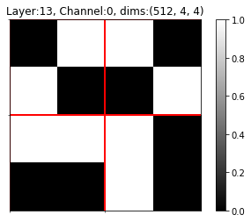
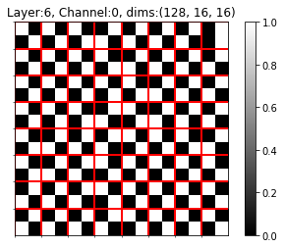
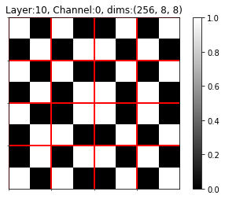

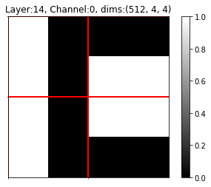
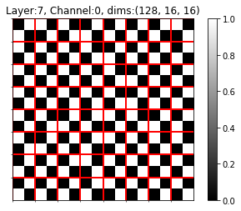
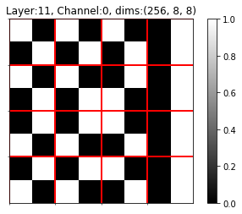
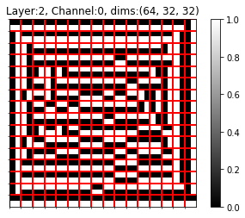
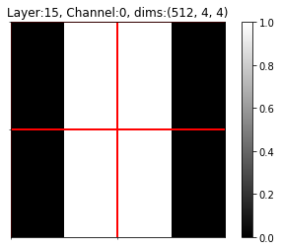
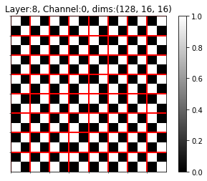
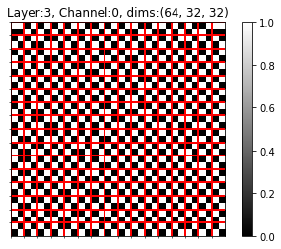
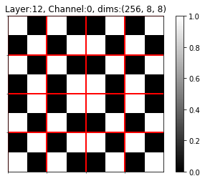
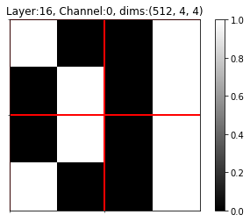

Uniform Filters Result – ResNet18, CIFAR10, PS2

Slide 10
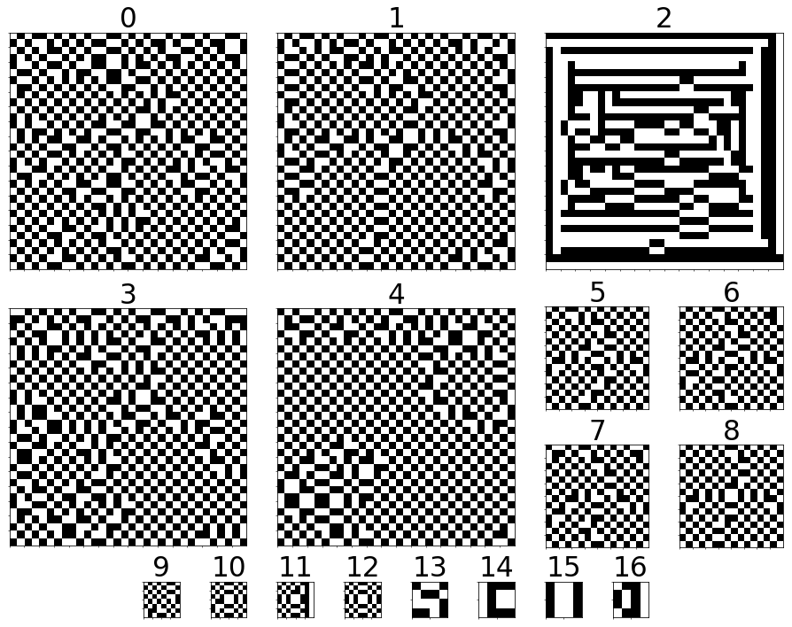
Uniform Filters Result – ResNet18, CIFAR10, PS2

Slide 11
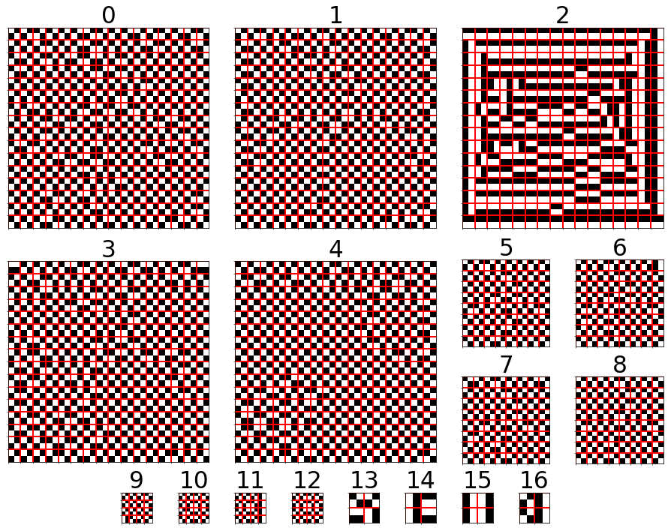
Uniform Filters Result – ResNet18, CIFAR10, PS2

Slide 12
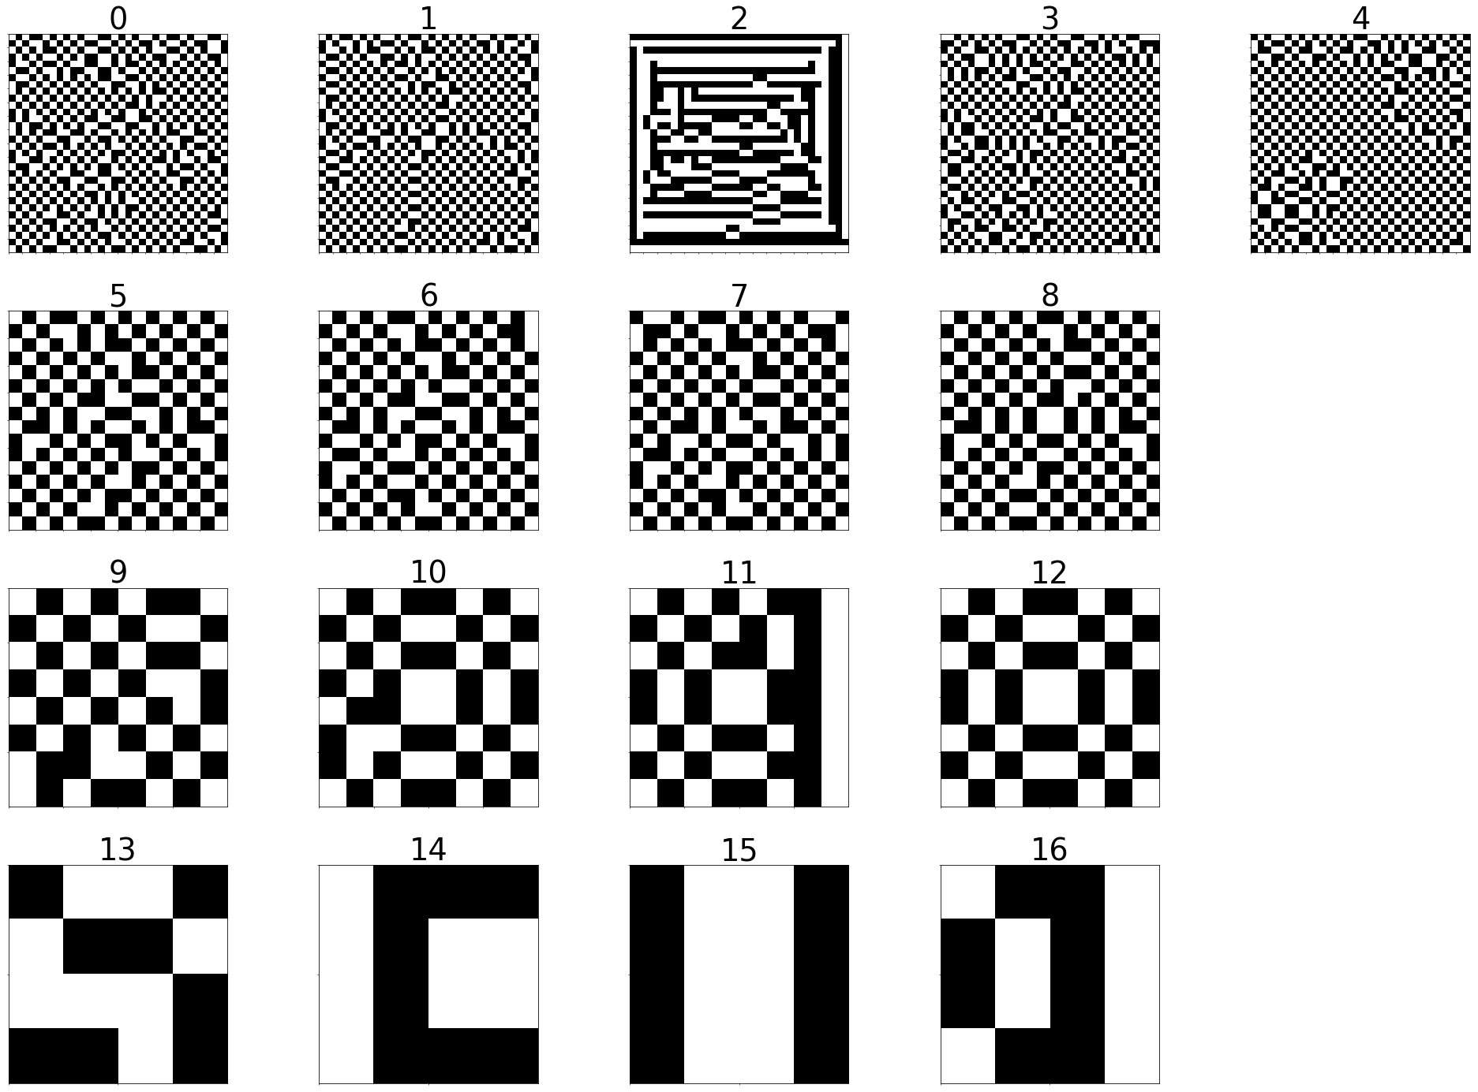
Uniform Filters Result – ResNet18, CIFAR10, PS2

Slide 13
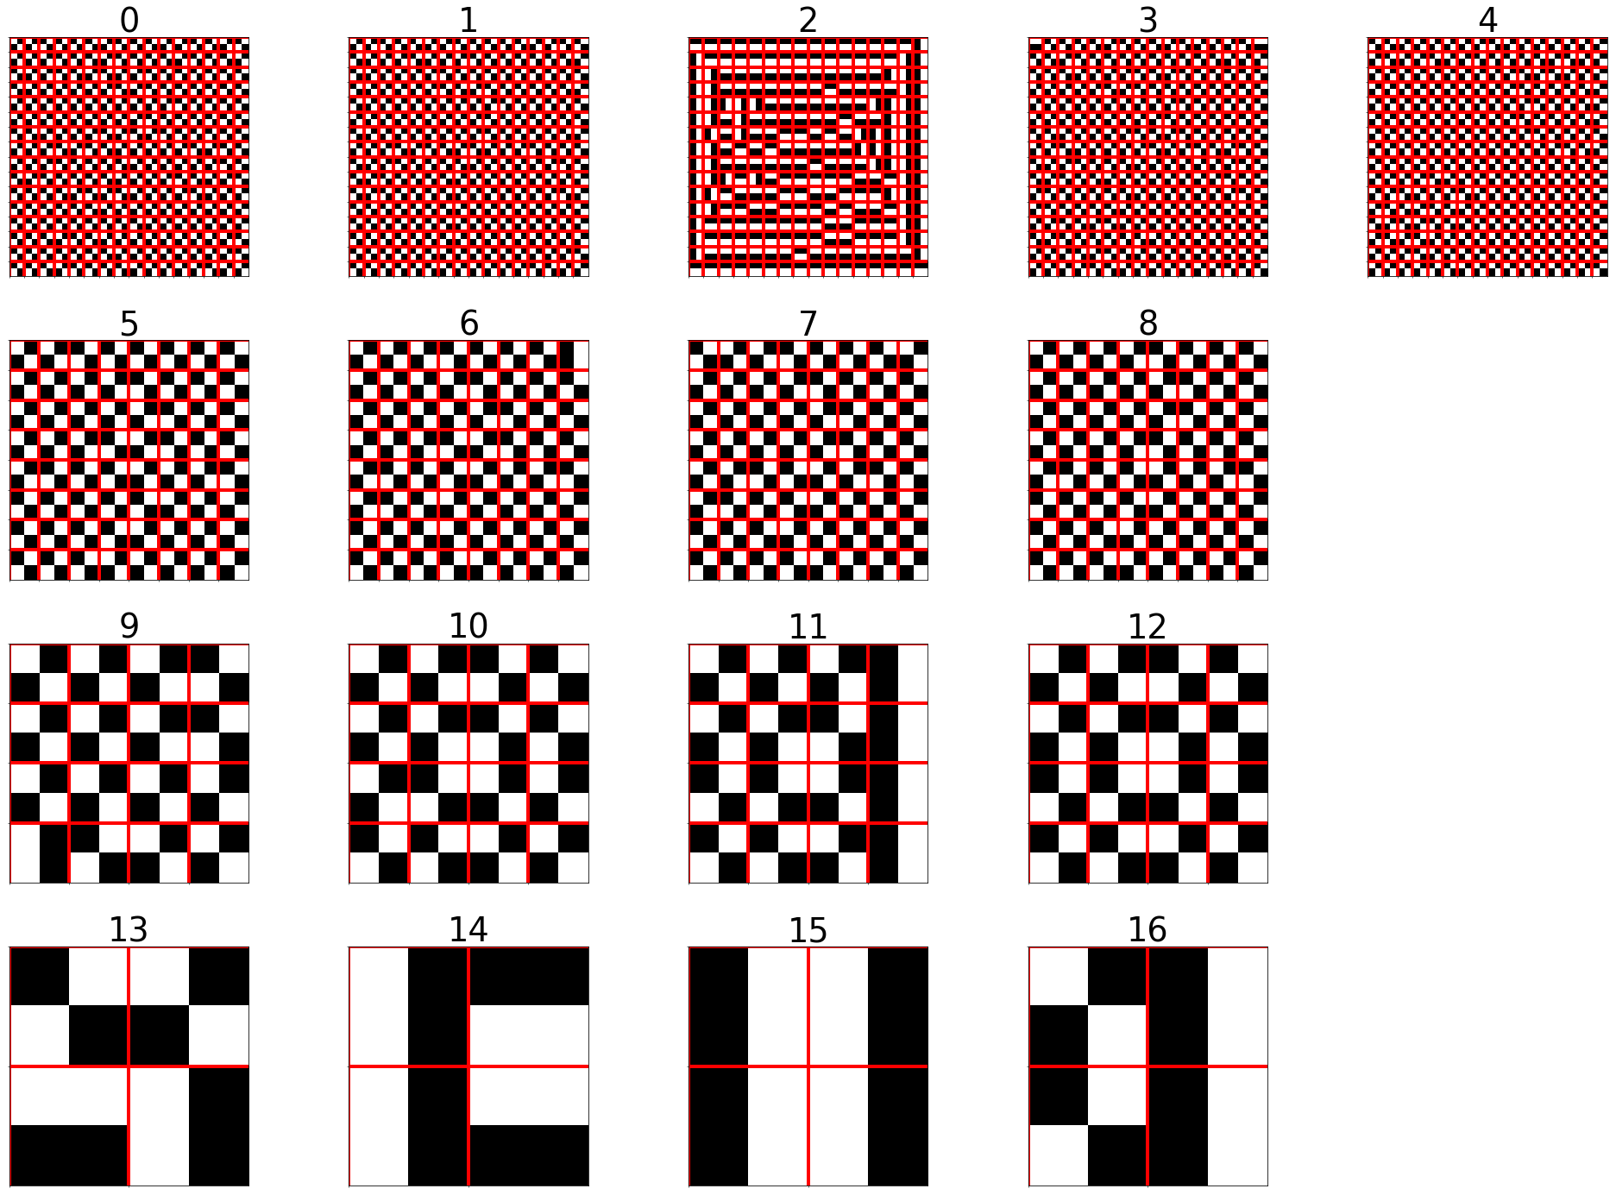
Uniform Filters Result – ResNet18, CIFAR10, PS2

Slide 14
Uniform Patch

Slide 15
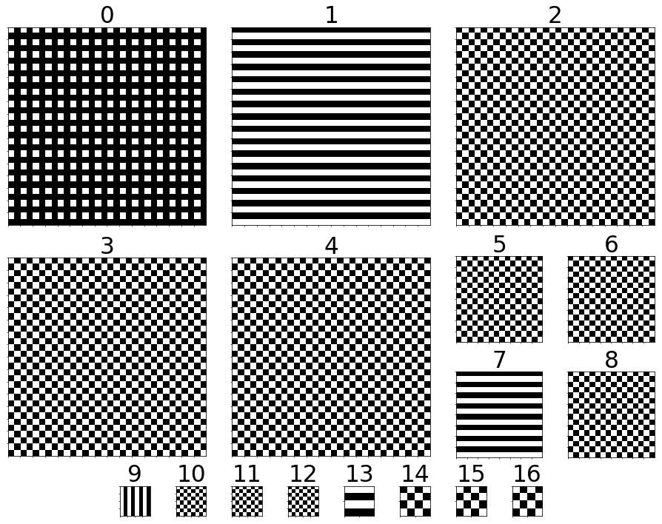
Uniform Patch Result – ResNet18, CIFAR10, PS2 Channel 0 of each layer

Slide 16
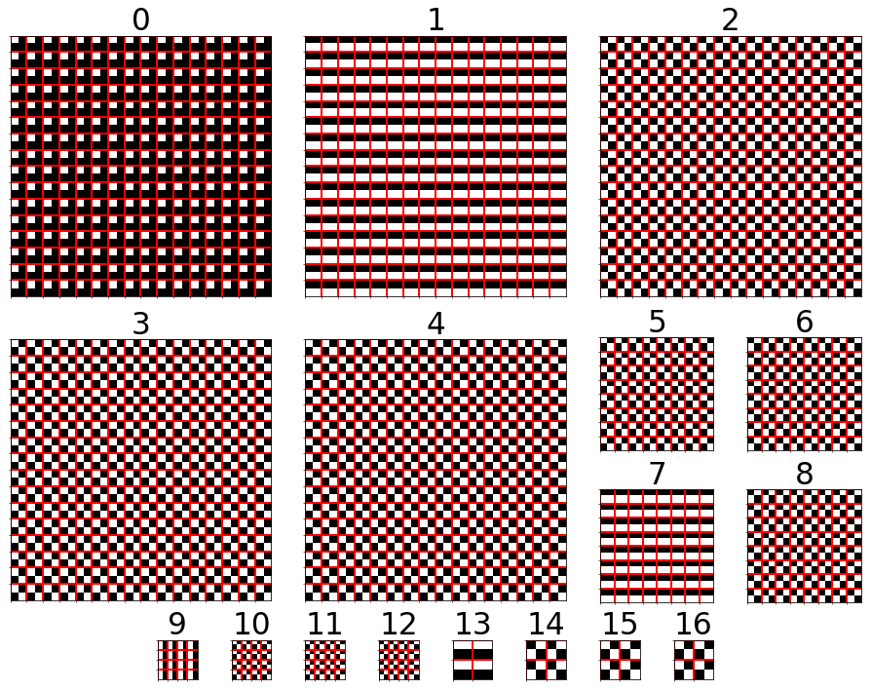
Uniform Patch Result – ResNet18, CIFAR10, PS2 Channel 0 of each layer

Slide 17
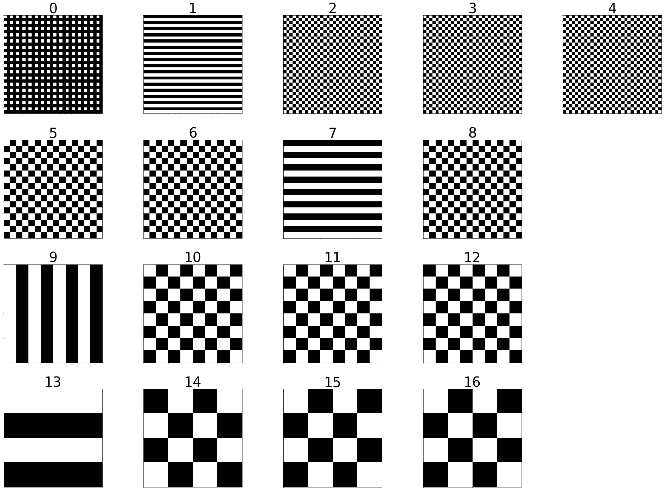
Uniform Patch Result – ResNet18, CIFAR10, PS2 Channel 0 of each layer

Slide 18
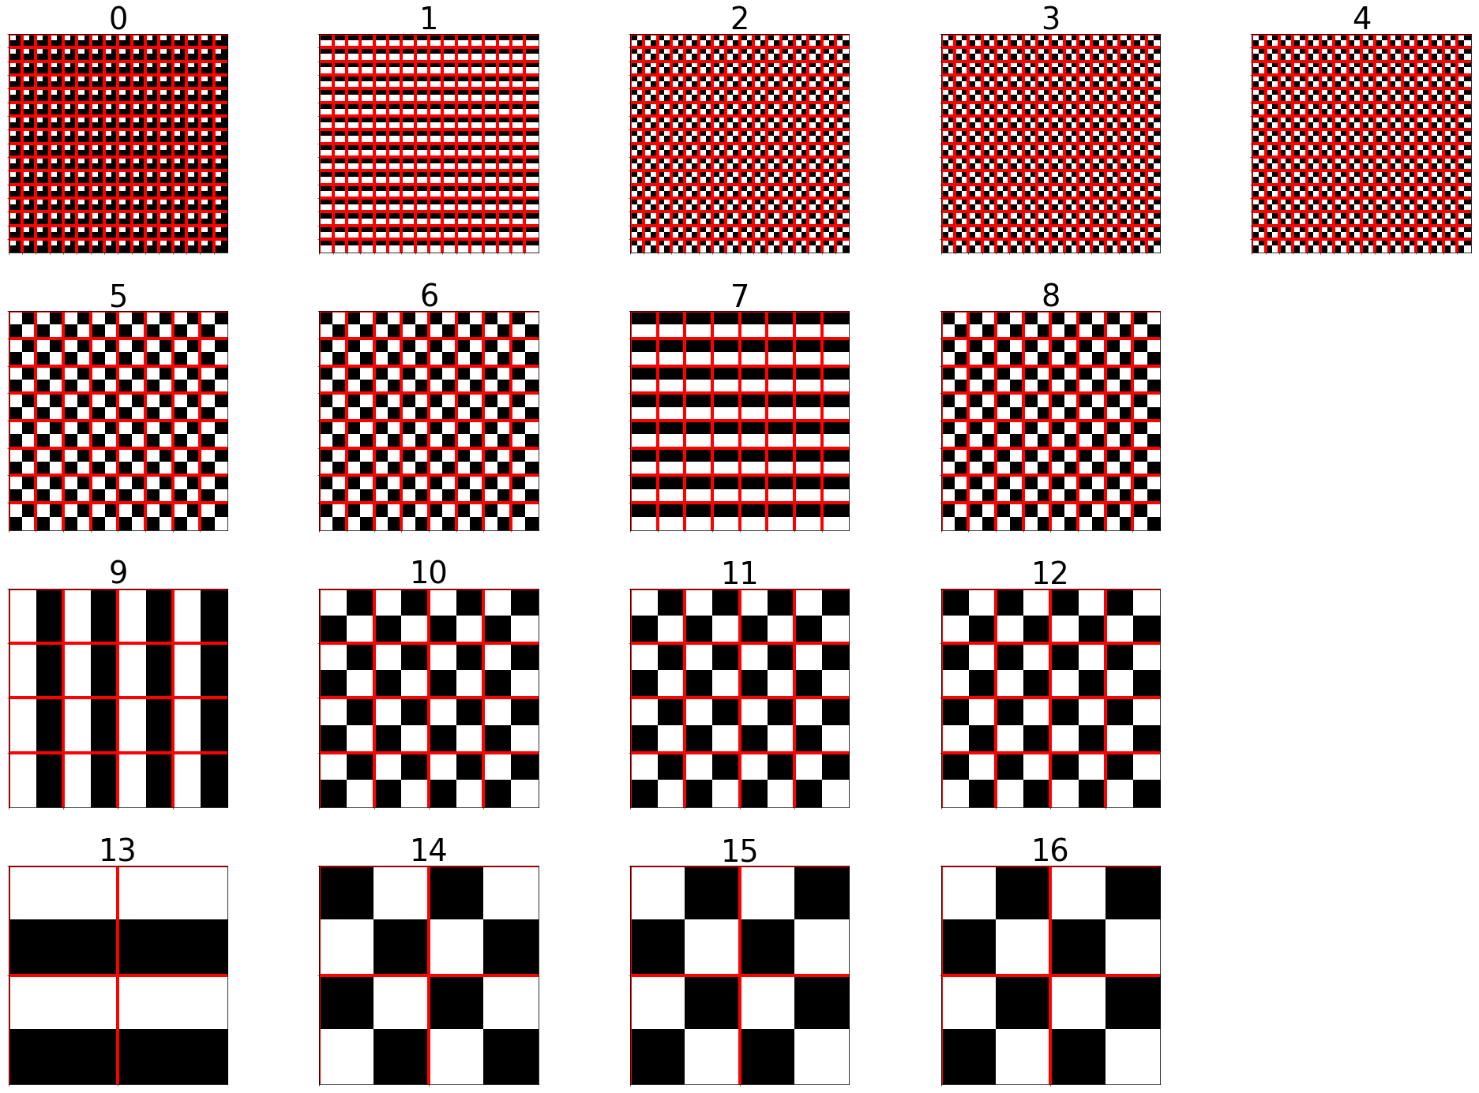
Uniform Patch Result – ResNet18, CIFAR10, PS2 Channel 0 of each layer

Slide 19
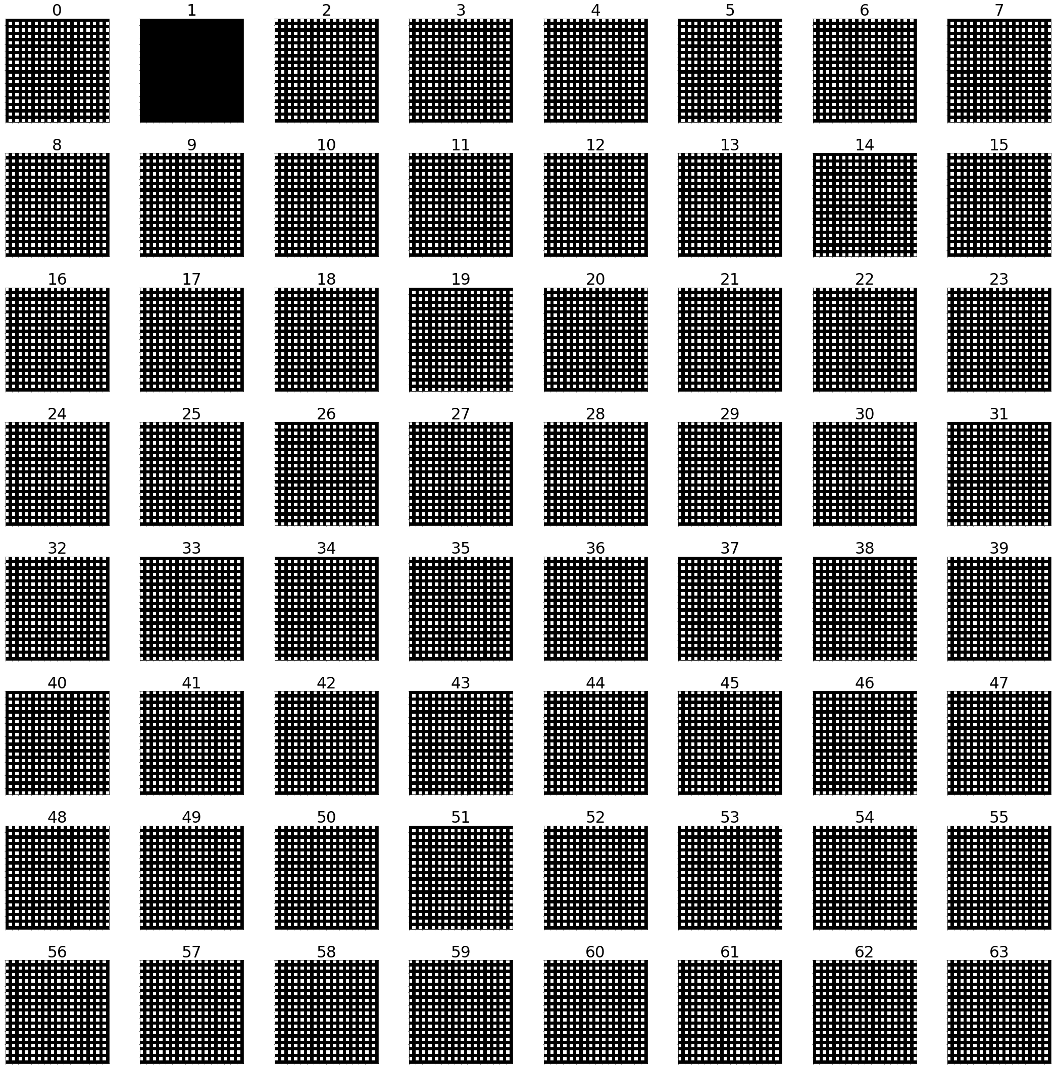
Uniform Patch Result – ResNet18, CIFAR10, PS2, Layer: 0

Slide 20
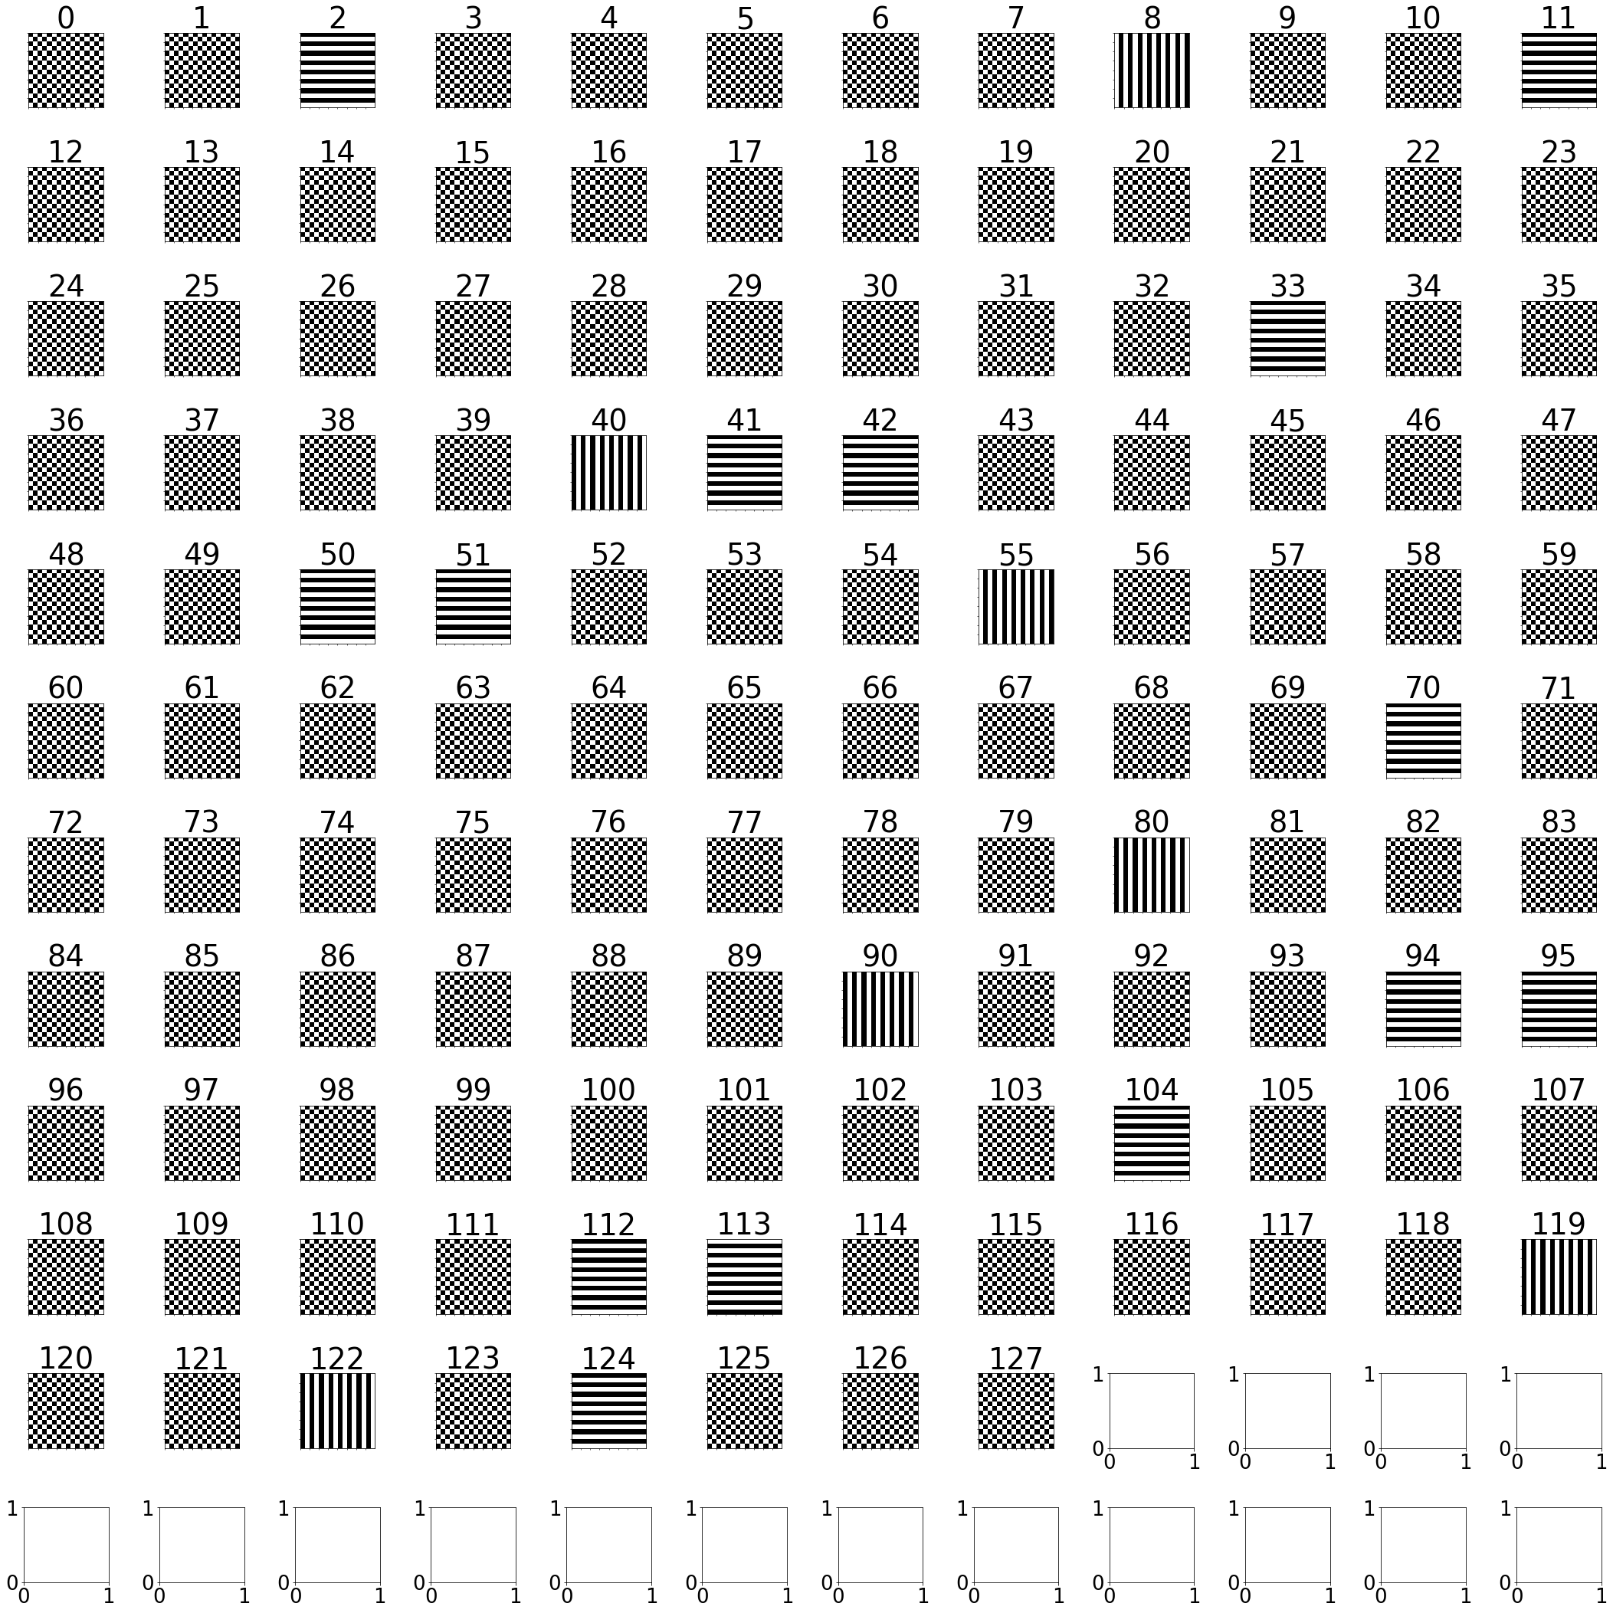
Uniform Patch Result – ResNet18, CIFAR10, PS2, Layer:7

Slide 21
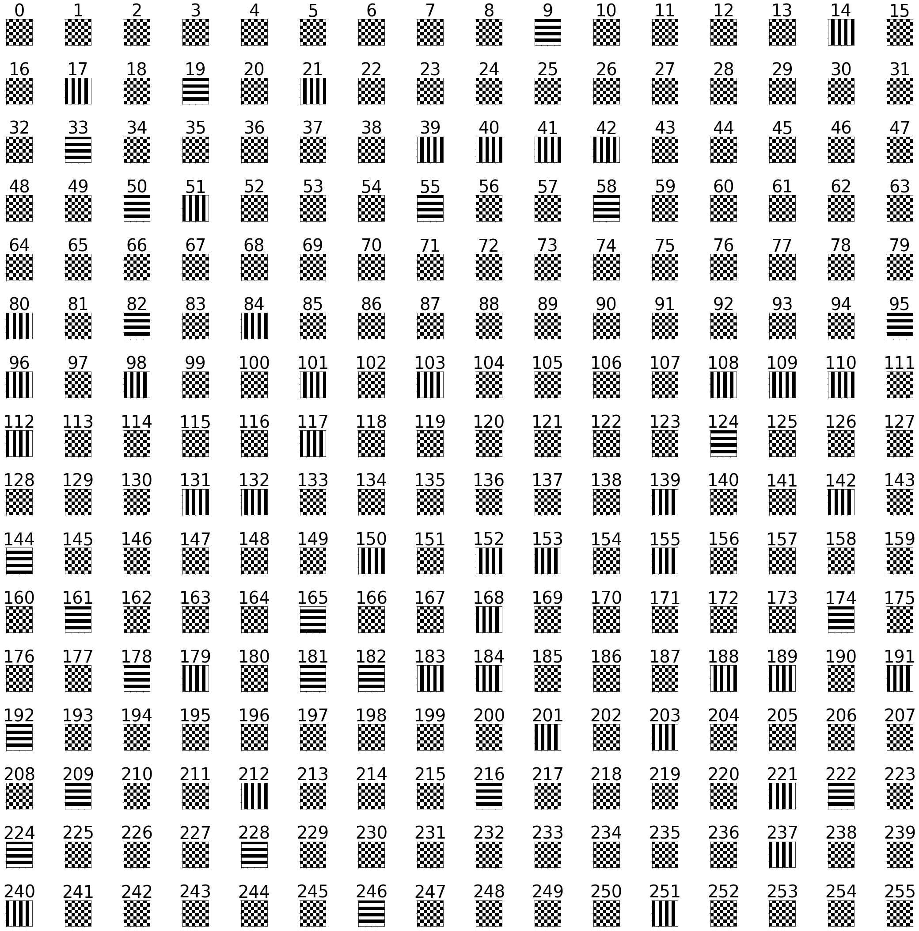
Uniform Patch Result – ResNet18, CIFAR10, PS2, Layer:10

Slide 22
Max Granularity

Slide 23
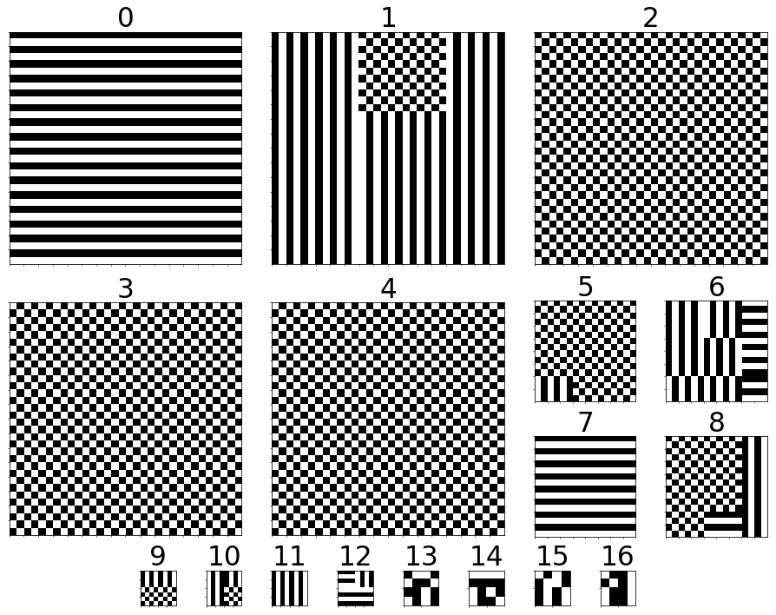
Max Granularity Result – ResNet18, CIFAR10, PS2 Channel 0 of each layer

Slide 24
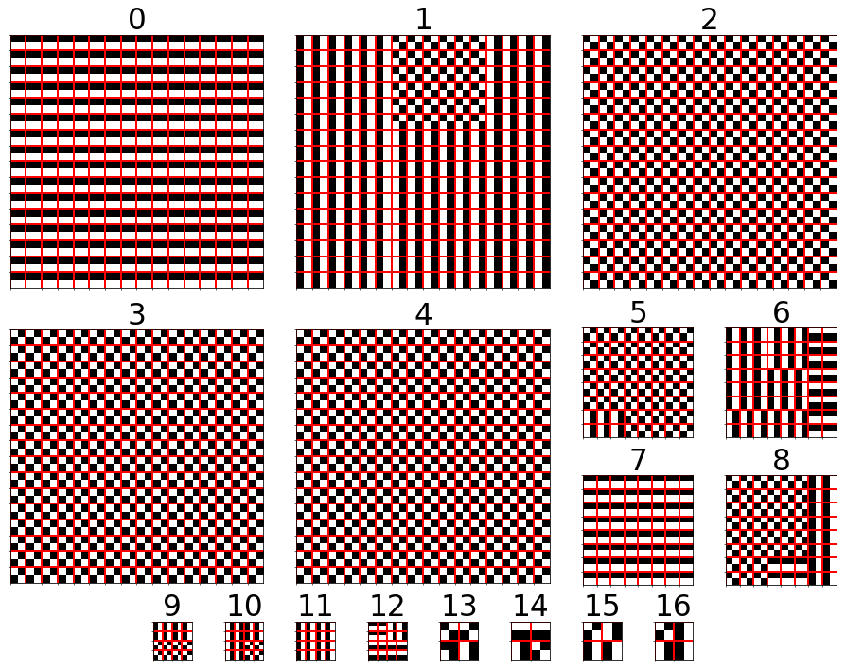
Max Granularity Result – ResNet18, CIFAR10, PS2 Channel 0 of each layer

Slide 25
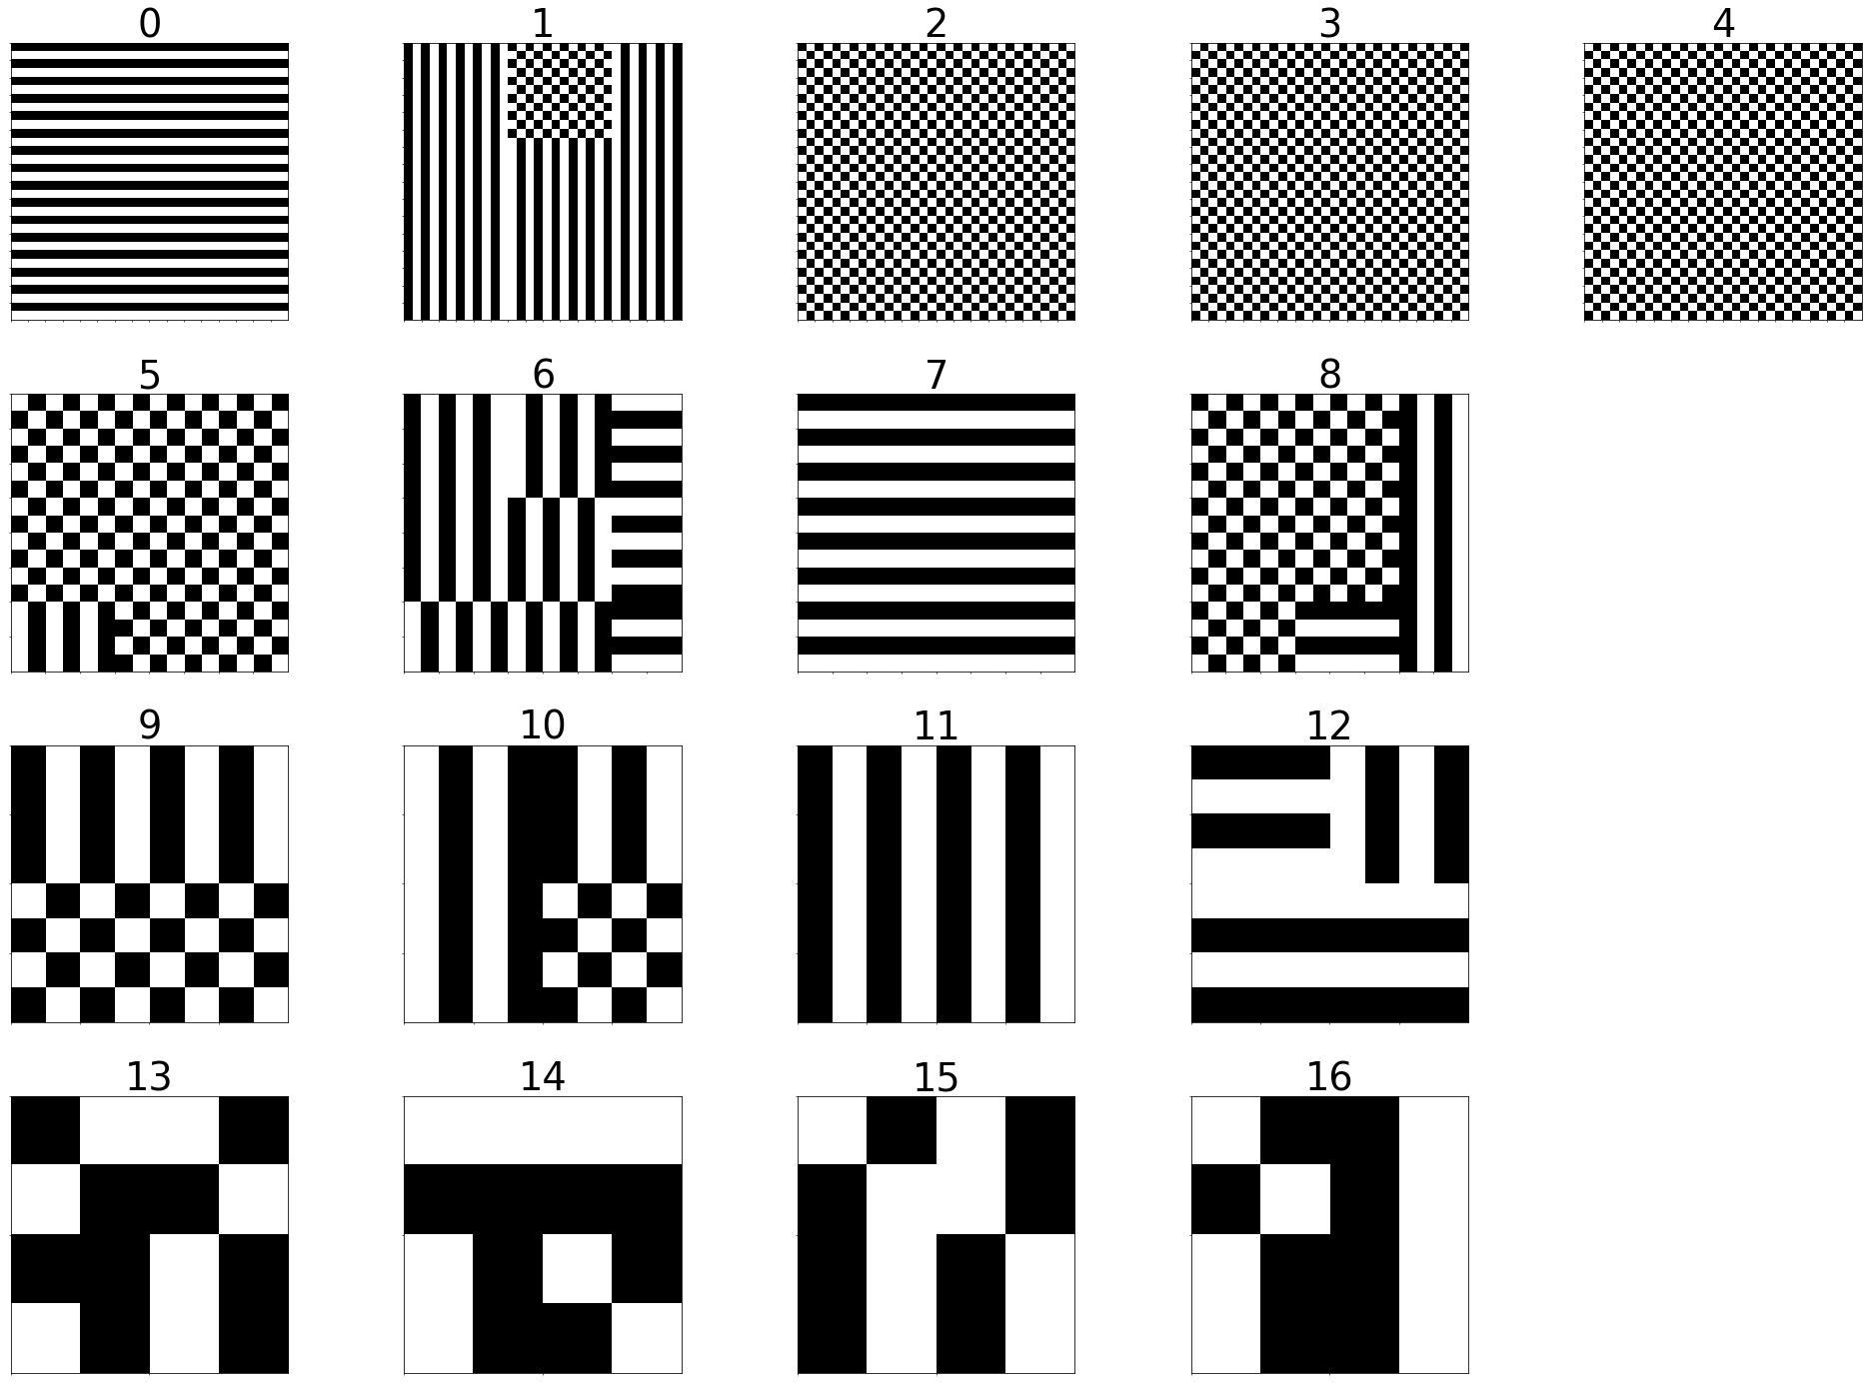
Max Granularity Result – ResNet18, CIFAR10, PS2 Channel 0 of each layer

Slide 26
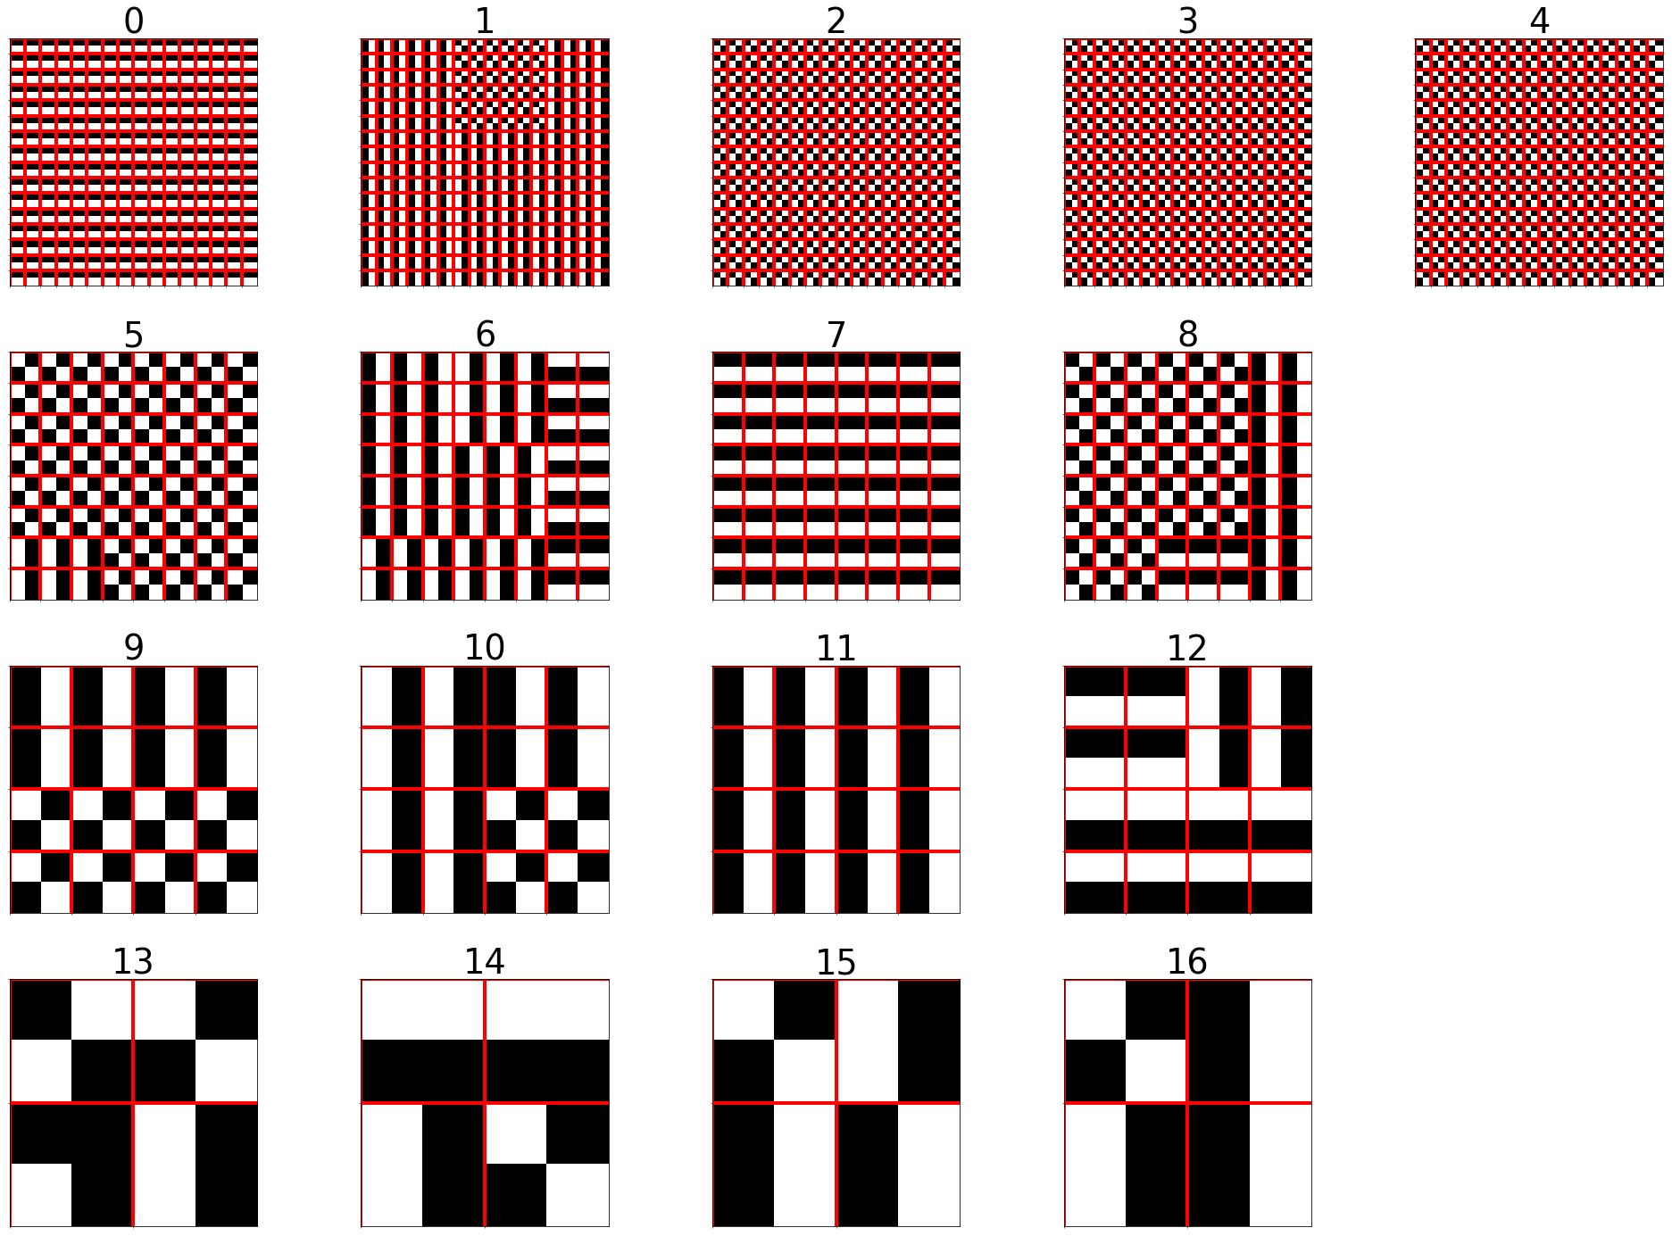
Max Granularity Result – ResNet18, CIFAR10, PS2 Channel 0 of each layer

Slide 27
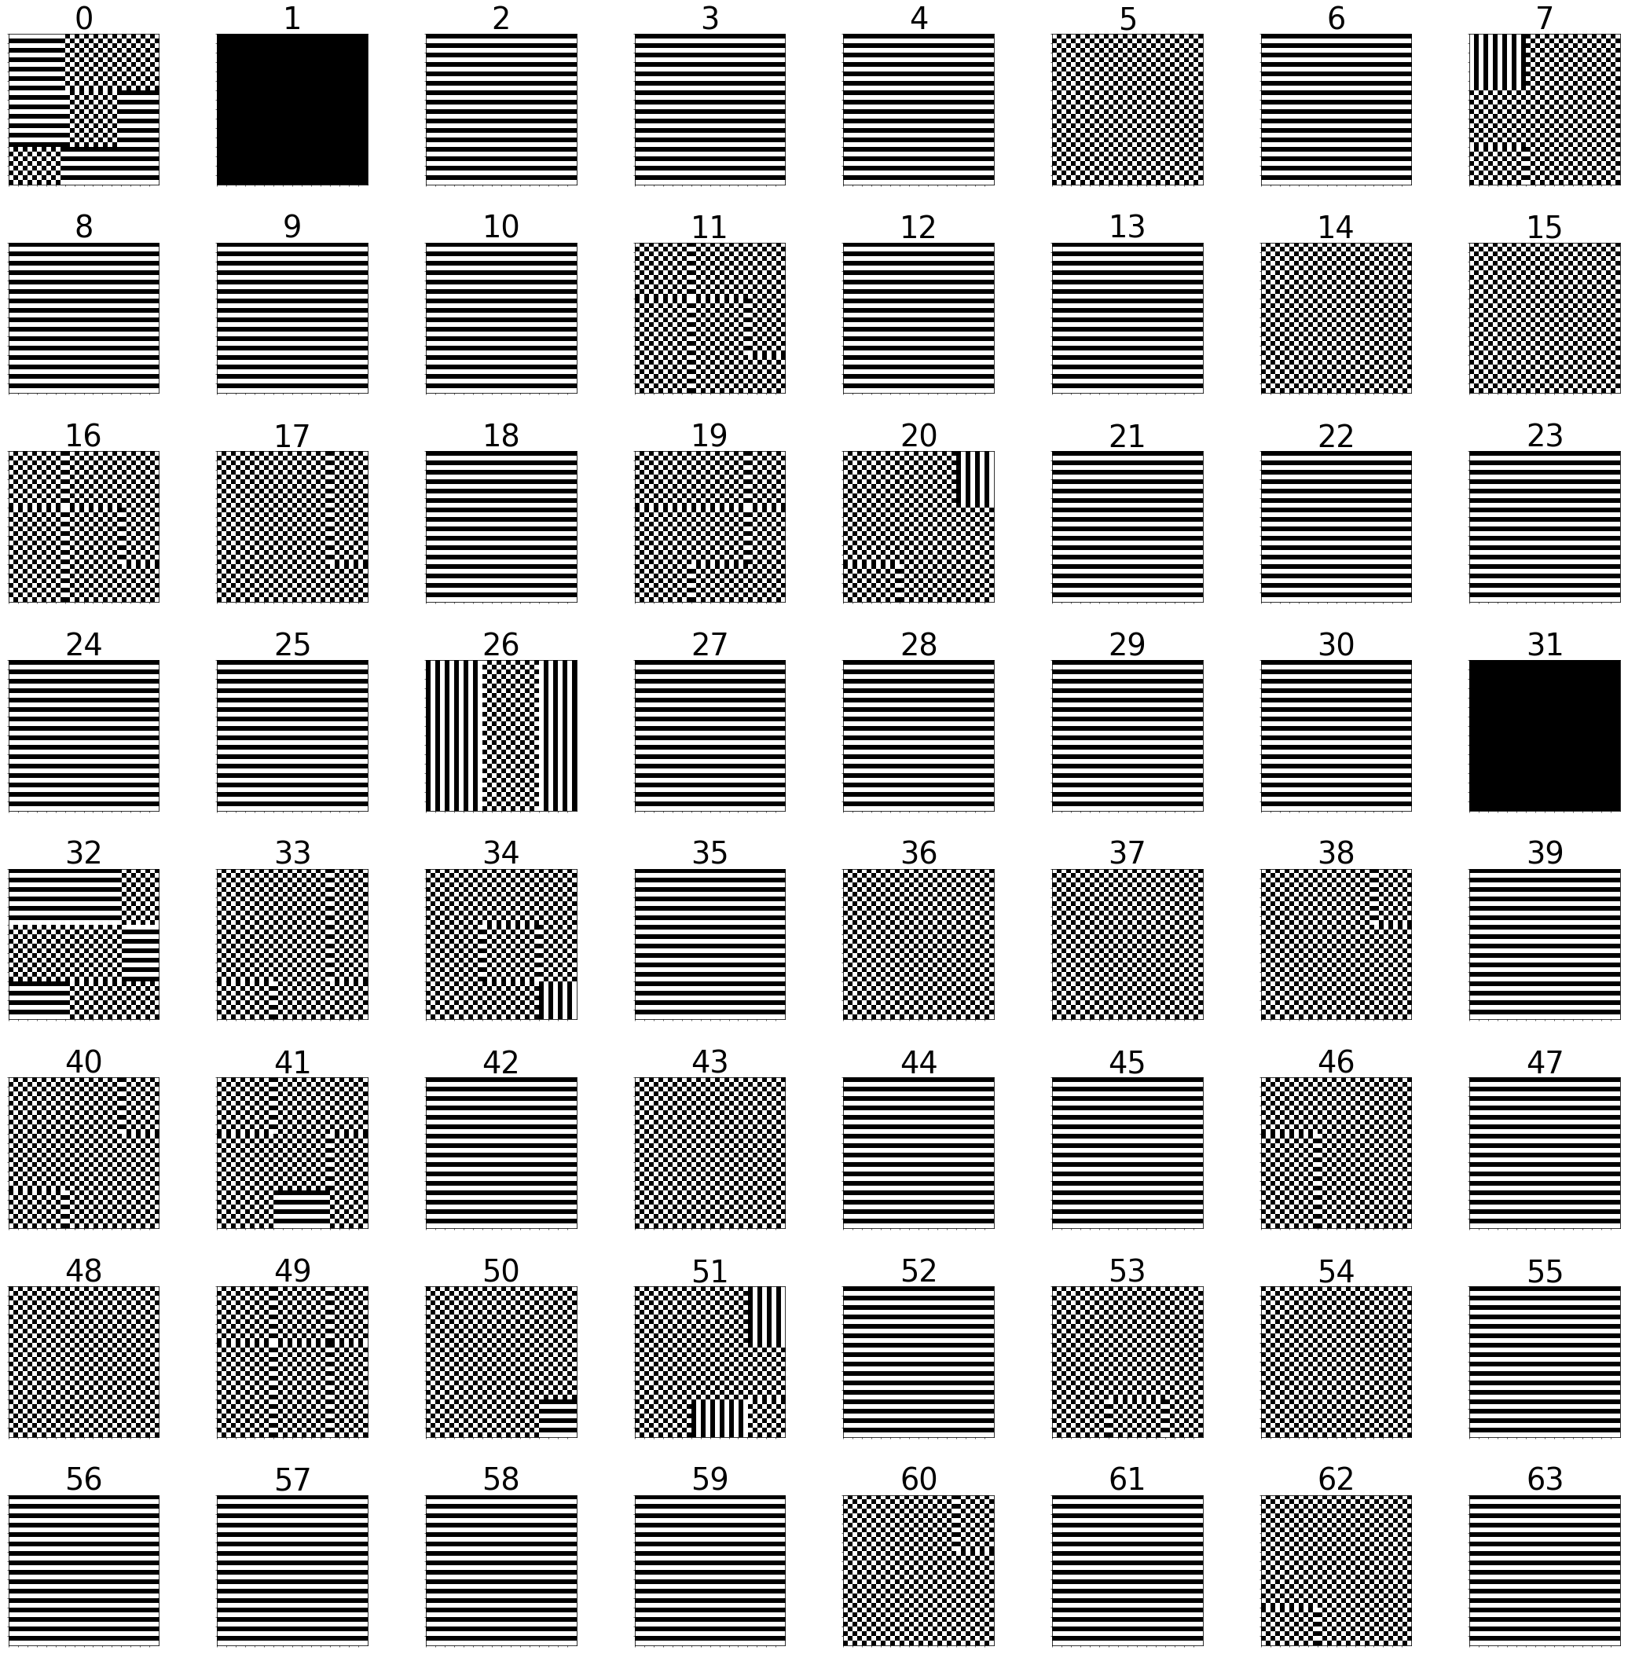
Max Granularity Result – ResNet18, CIFAR10, PS2, Layer: 0

Slide 28
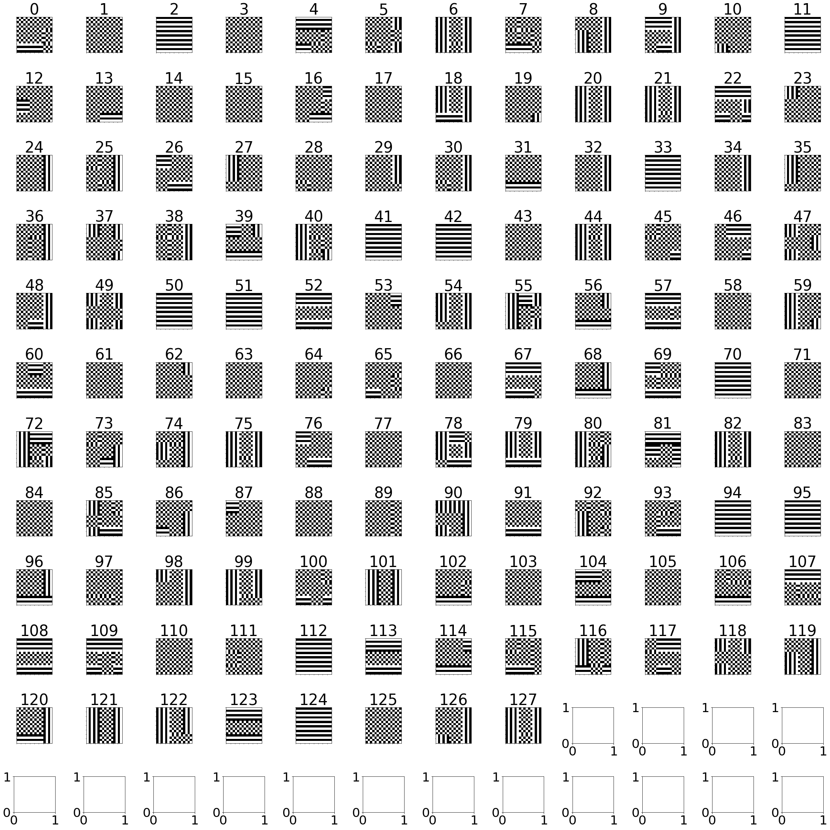
Max Granularity Result – ResNet18, CIFAR10, PS2, Layer:7

Slide 29
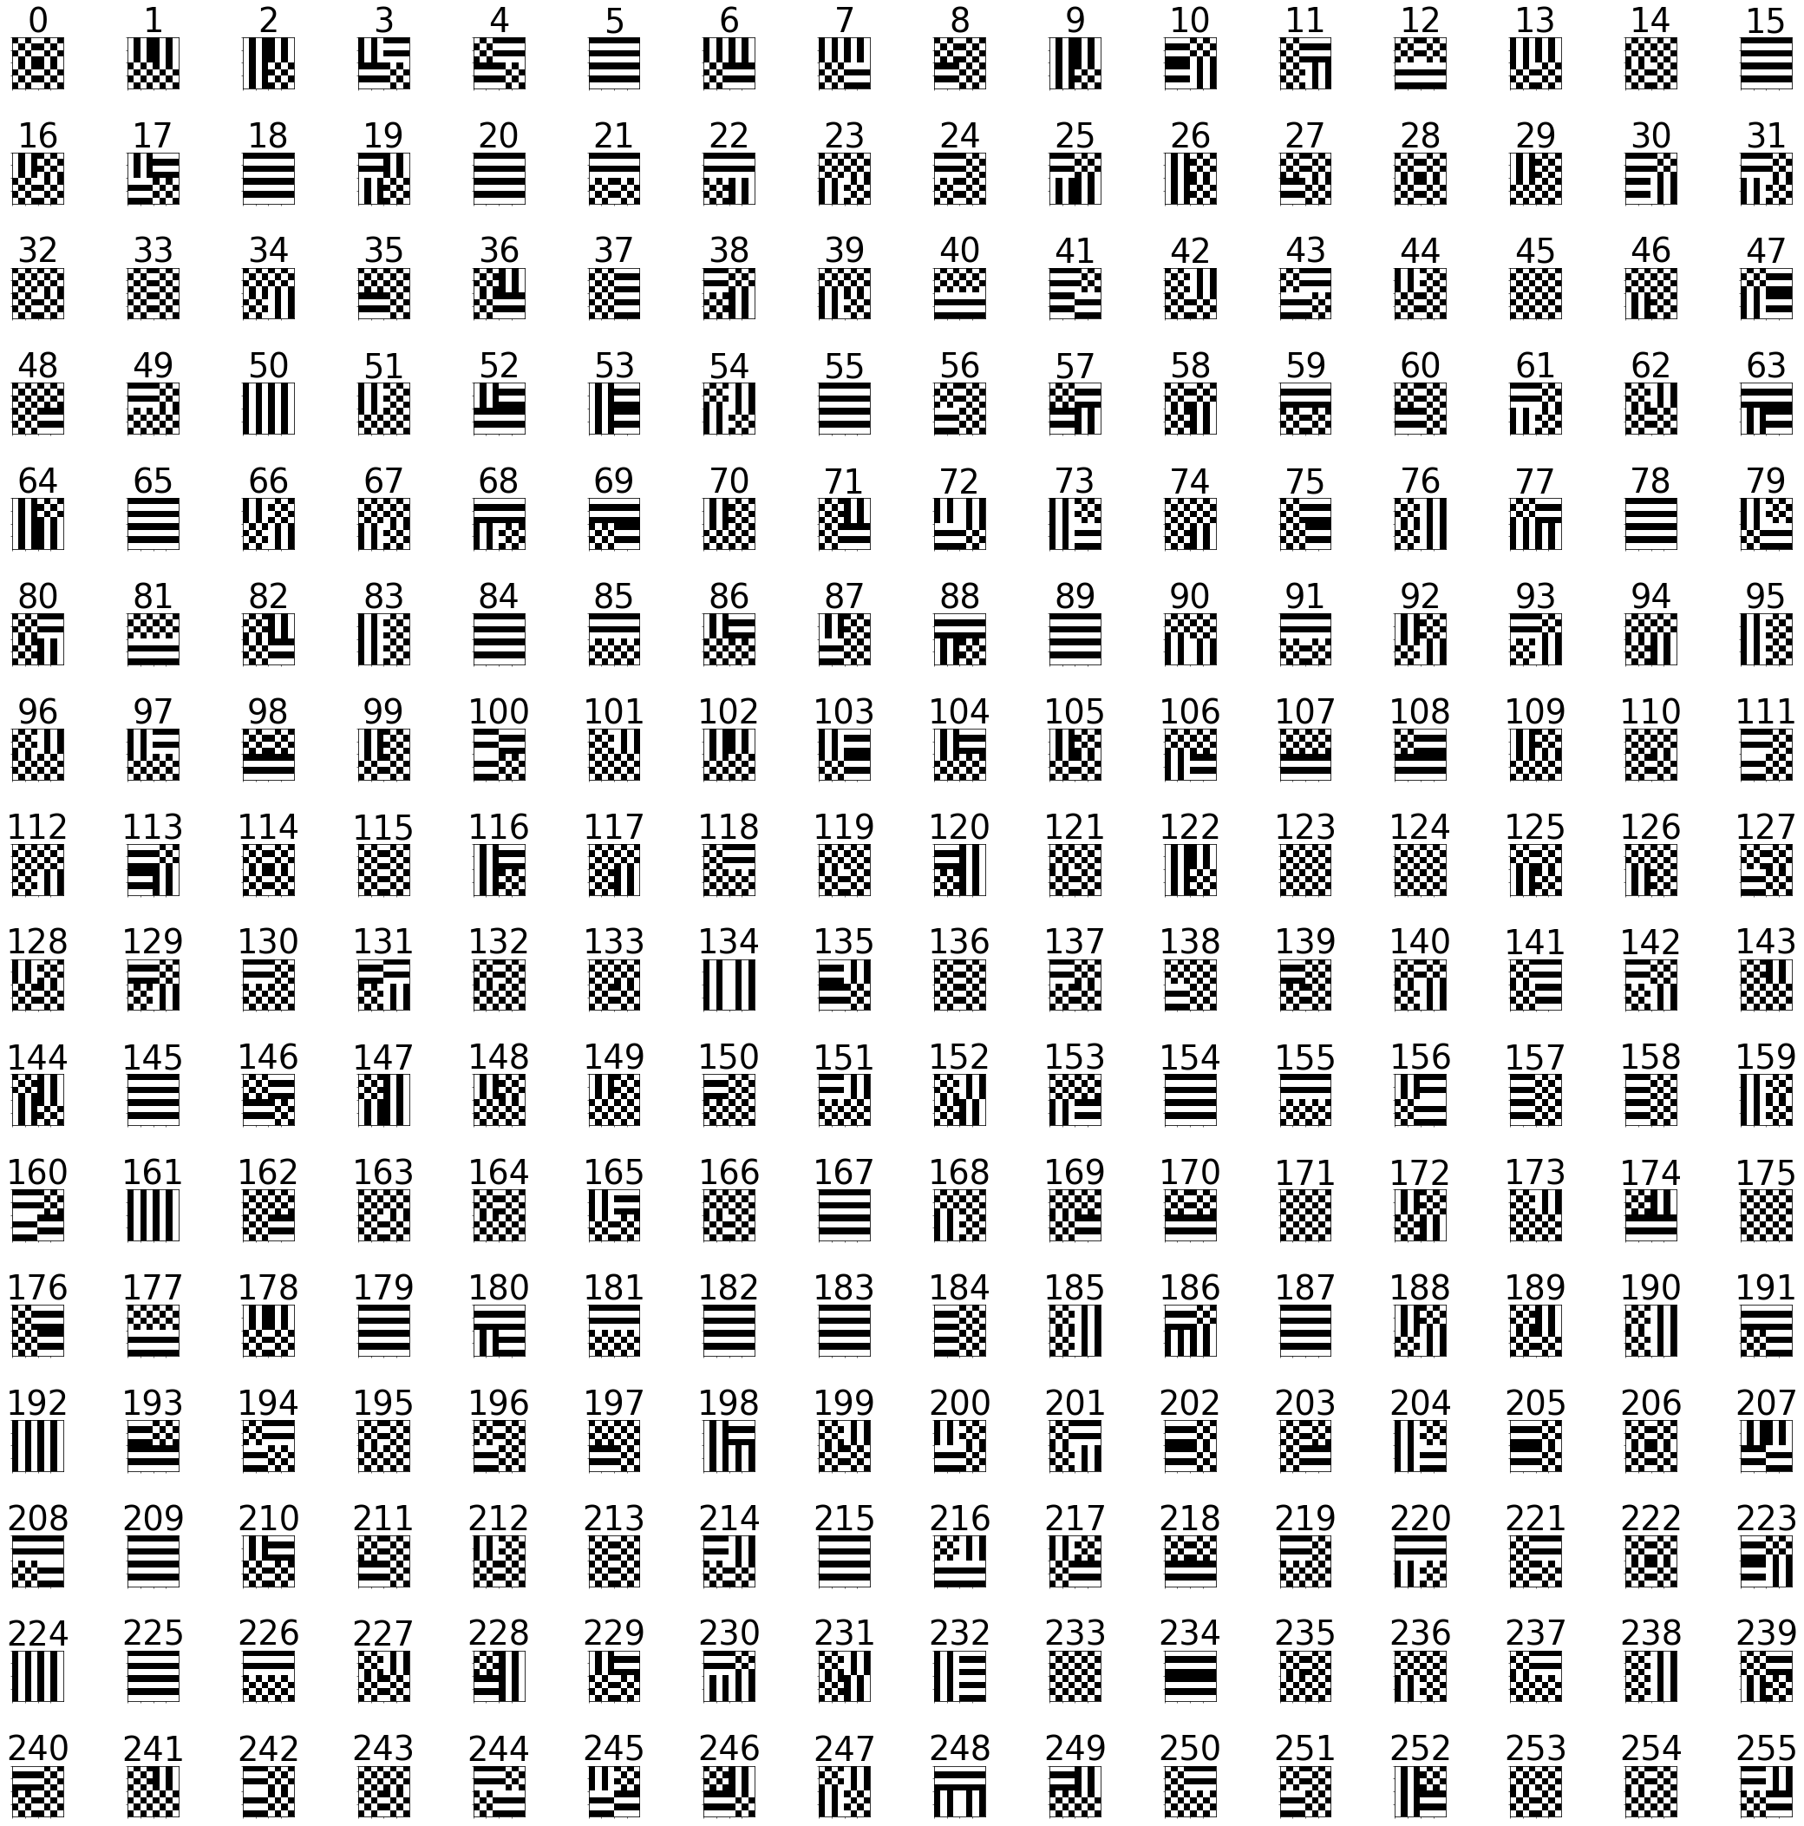
Max Granularity Result – ResNet18, CIFAR10, PS2, Layer:10

Slide 30
% of saved operations per layer in the final mask

Slide 34
General results

Slide 35
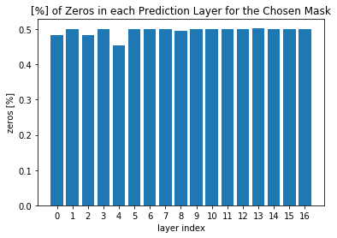
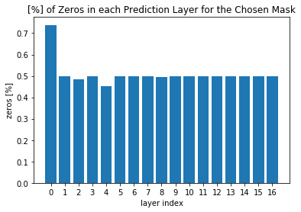
% of Zeros in masks
Max Granularity
operations saved: 23.243%
with accuracy of: 90.1%
Uniform Patch
operations saved: 25.322%
with accuracy of: 90.5%

Slide 36
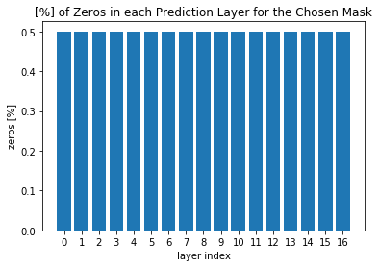
% of Zeros
Uniform Filters
operations saved: 23.712%
with accuracy of: 90.1%
Uniform Layer
operations saved: 23.669%
with accuracy of: 90.1%

