Slide 1
ISS Project
SECURE MEDICAL DATA SHARING IN CLOUD
16MIS0433 – Mano Bala.R
16MIS0020 – Thanga Prakash.M
16MIS0450 – Ramya.N

Slide 2
ABSTRACT
In the current society, the transfer of information using internet is rapidly raising up, because it is easier and faster and has also proved security to transfer the data to destination.
Security is a very important issue while transferring the sensitive data via internet because any unauthorized user can tamper the data and may make it useless or obtain the information unintended to him, especially in telemedicine.
With the proliferation of patient’s digital health records, and an increasing number of data breaches, protecting patient information is of utmost importance, with this respect lot of work has been done to secure medical data. Patient’s health information confidentiality was an issue even when it was stored on paper.
An unauthorized person could enter the hospital and steal the paper documents. Moreover, even any hospital staff can read paper documents which are not supposed to be viewed, as long as they have physical access to the document.
So it is very important to protect patient’s private information against unauthorized viewers by using cryptosystem confidentiality of these documents is enforced by putting them under some lock state and thereby enforcing physical access control to the document. So in this work, an attempt is made to provide high end security for the patient’s sensitive data .This approach dealt with the security for medical data by using a cryptography mechanism named as IB cryptosystem.
Keywords: Cloud Computing, Data Sharing, Revocation, Identity-Based Encryption, Ciphertext Update.

Slide 3
INTRODUCTION
To monitor the environment conditions in the wireless sensor networks use of large number of sensors and this can pass the information to the main location and this wireless sensor networks are mainly motivated by military applications and this sensor networks became very famous today and also used in many consumer and industrial areas, and now a days the promising fields like healthcare applications are maintained very well by these wireless sensor networks.
Now a days Wireless medical sensor networks certainly improve quality-of-care, so privacy is ensured. Several modern cryptography mechanisms have been proposed and implemented in recent works. However providing a high end security and maximizing the privacy for the patient's data becomes very much essential. So many experiments are going on with this regard.

Slide 4
PROBLEM STATEMENT
Wireless Sensor Networks (WSN) is an emerging technology that has the potential to transform the way of human life.
Healthcare applications are considered promising fields for Wireless Medical Sensor Network, where patient’s health can be monitored using Medical Sensors.
Wireless Medical Sensor Networks (WMSNs) are the key enabling technology in healthcare applications that allows the data of a patient’s vital body parameters to be collected by wearable biosensors.
Current WMSN healthcare research trends focus on patient reliable communication, patient mobility and energy-efficient routing. Wireless medical sensor networks are more vulnerable to eavesdropping ,modification, impersonation and replaying attacks than the wired networks. So protection is an important task for patient data.

Slide 5
OBJECTIVE
The aim of this project is to revocable storage identity-based encryption (RS-IBE) that fulfills the security requirements of data sharing,provide confidentiality and backward/forward secrecy simultaneously.
Furthermore, the method of decrypting and re-encrypting all the shared data can ensure forward secrecy.
Also revocable storage identity-based encryptions (RS-IBE) for building a cost-effective data sharing system that fulfills the security goals, and provide formal definitions for RS-IBE and its corresponding security mode.

Slide 6
EXISTING SYSTEM
Securing cloud data sharing but could not overcome the above security goals. Unauthorized users should be prevented from accessing the plaintext of the shared data stored in the cloud server. In addition, the cloud server, which is supposed to be honest but curious, should also be deterred from knowing plaintext of the shared data.
• Backward secrecy means that, when a user’s authorization is expired, or a user’s secret key is compromised, he/she should be prevented from accessing the plaintext of the subsequently Shared data that are still encrypted under his/her identity.
• Forward secrecy means that, when a user’s authority is expired, or a user’s secret key is compromised, he/she should be prevented from accessing the plaintext of the shared data that can be previously accessed by him/her.

Slide 7
CHALLENGES IN EXISTING SYSTEM
The process of frequent download-decrypt-re encrypt-upload can cause challenge in efficiency. This process cause high computation cost thus it is undesirable for cloud users with low capacity of computation and storage
Unfortunately, existing solution is not scalable, since it requires the key authority to perform linear work in the number of non revoked users. In addition, a secure channel is essential for the key authority and non revoked users to transmit new keys.
However, existing scheme only achieves selective security.
This kind of revocation method cannot resist the collusion of revoked users and malicious non-revoked users as malicious non-revoked users can share the update key with those revoked users.
Furthermore, to update the ciphertext, the key authority in their scheme needs to maintain a table for each user to produce the re encryption key for each time period, which significantly increases the key authority’s workload.

Slide 8
PROPOSED SYSTEM
In our proposed system using revocable identity-based encryption (RIBE) that fulfills the aforementioned security requirements for data sharing.
RIBE features a mechanism that enables a sender to append the current time period to the cipher text such that the receiver can decrypt the cipher text only under the condition that he/she is not revoked at that time period.
Such a data sharing system can provide confidentiality and backward secrecy.

Slide 9
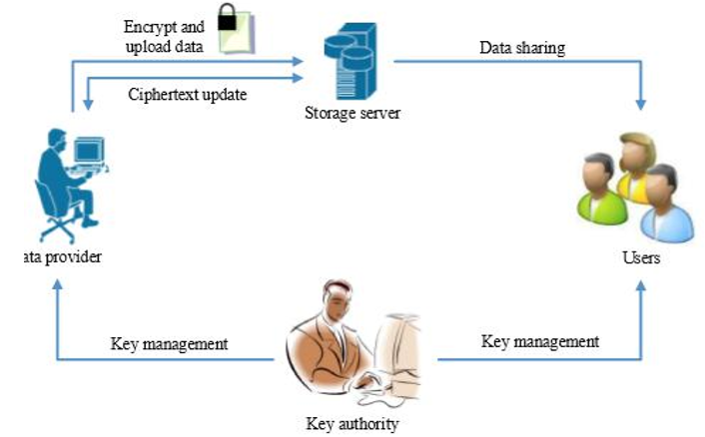
PROPOSED SYSTEM
Figure : A Natural RIBE based Data Sharing

Slide 10
PROPOSED SYSTEM
RIBE-based data sharing system works as follows:
Step 1: The data provider first decides the users who can share the data. Then, encrypts the data under the identities, and uploads the ciphertext of the shared data to the cloud server.
Step 2: When user wants to get the shared data, she/ he can download and decrypt the corresponding ciphertext. However, for an unauthorized user and the cloud server, the plaintext of the shared data is not available.
Step 3: when the users authorization gets expired, data provider can download the ciphertext of the shared data, and then decrypt-then-re-encrypt the shared data such that user whose authorization expired is prevented from accessing the plaintext of the shared data, and then upload the re-encrypted data to the cloud server again.

Slide 11
PROPOSED SYSTEM
This data sharing system can provide confidentiality and backward secrecy.
Furthermore, the method of decrypting and re-encrypting all the shared data can provide forward secrecy.This brings new challenges.
The process of decrypt-then-re-encrypt necessarily involves users’ secret key information, which makes the overall data sharing system vulnerable to new attacks, and it is inadvisable to update the ciphertext periodically by using secret key

Slide 12
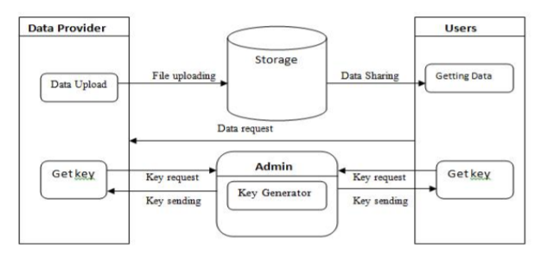
SYSTEM ARCHITECTURE

Slide 13
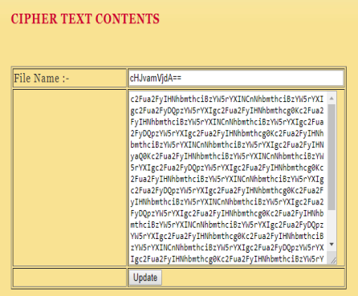
SCREENSHOTS
Encrypted Data

Slide 14
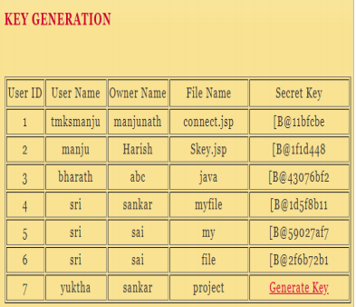
SCREENSHOTS
Key Generation

Slide 15
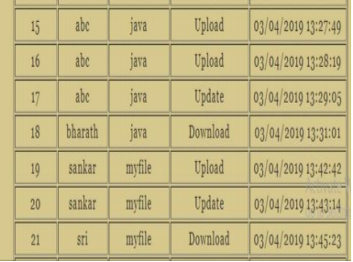
SCREENSHOTS
Key Authority Functions

Slide 16
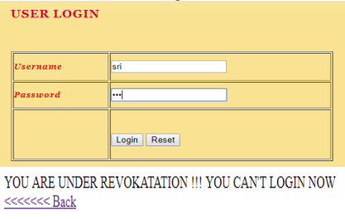
SCREENSHOTS
User Revocation

Slide 17
CONCLUSION
Cloud computing brings great convenience for people. Particularly, it perfectly matches the increased need of sharing data over the Internet.
To build a cost-effective and secure data sharing system in cloud computing, we proposed a notion called RS-IBE, which supports identity revocation and cipher text update simultaneously such that a revoked user is prevented from accessing previously shared data, as well as subsequently shared data.
Furthermore, a concrete construction of RS-IBE is presented.
In this paper The proposed RS-IBE scheme is proved adaptive-secure in the standard model. The results has advantages in terms of efficiency and functionality, and thus is more feasible for practical applications.

