Slide 1

Sociology
Socialization and Personality
Subject of
Presentation
Role and Status

Slide 2

Group Members | Topics
Laiba Javed 2225165013 | Role and Role Set
Mehnoor Fayyaz 2225165017 | Role Conflict and Role Strain
Walisha Tahir 2225165031 | Role Expectation and Role Performance
Nimra Khan 2225165021 | Status and Master Status
Laiba Zafar 2225165014 | Ascribed Status
Alishba Aymen 2225165001 | Achieved Status and Conclusion

Slide 3
SOCIOLOGY · GROUP 5
Role &
Role Set
Presented by Laiba Javed · 2225165013
Socialization & Personality · Status & Role

Slide 4
02
Socially Defined
★
What is a
Role?
Shaped by culture, norms & society — not by the individual alone.
Attached to Status
◎
Every position (status) carries at least one role attached to it.
"The behaviour expected from a
person who occupies a status."
— Ralph Linton, 1936
Dynamic & Learned
↻
Roles involve action and are learned through socialization over time.
💡 Status = WHO you are · Role = WHAT you do

Slide 5
03
What is a Role Set?
Role Set (Robert K. Merton, 1957) — The complete set of roles linked to ONE status. Each person in your role set expects different behaviour from you.
Principal
Parents
Report progress & follow rules
Update on student performance
Students
Colleagues
Teach, guide & assess
TEACHER
(Status)
Share resources & collaborate
One status → Many relationships → Different behaviour expected from each

Slide 6
04
Role Set in Real Life
Laiba Javed holds multiple statuses — each with its own role set:
📚
🏠
🤝
Student
Daughter
Group Member
People in Role Set
People in Role Set
People in Role Set
Teachers
Parents
Teammates
Classmates
Siblings
Course Instructor
Admin Staff
Extended Family
Audience
Expected Behaviour
Expected Behaviour
Expected Behaviour
Attend & participate
Show respect & care
Prepare your topic
Study & submit work
Help with chores
Cooperate & coordinate
Follow rules & schedule
Fulfil family duties
Present confidently

Slide 7
05
Key Takeaways
Role = Action side of Status
1
A role is what you are expected to DO because of the position you hold. Identified by Ralph Linton (1936).
Status defines; Role performs
2
Status is who you are (Teacher, Student, Parent). Role is the behaviour that comes with it.
Role Set = Web of relationships
3
One status connects you to many people — Robert Merton (1957). Each relationship demands different behaviour.
Role Sets explain social complexity
4
They show why people feel pulled in different directions, leading to Role Conflict (next topic!).
"Understanding roles helps us understand society itself."

Slide 8
Topic
Role Conflict and Role Strain
Mehnoor Fayyaz
2225165017

Slide 9

Role Conflict
Role conflict occurs when a person occupies two or more social roles that impose contradictory or incompatible demands at the same time.
Also known as Inter-role conflict the conflict is between different roles e.g., being a mother vs. being an PHD student on the same afternoon.
Example:
Employee
Deliver tasks, attend meetings and submit report
Ayesha
A 28 year old woman
Mother
Care, nurture, availability and motherly responsibilities
Her child falls sick on the day of a big work presentation. As a mother she must stay home, but as an employee she must attend and deliver the pitch deck. The two roles directly clash with each other. This is an inter-role conflict.
Choosing one means failing the other. The tension she experiences is not just logistical; it triggers a deep identity question.

Slide 10
Role Conflict
Impact on socialization & personality
Identity confusion
Role Exit/ Adaptation
Anxiety and Stress
Unsure which role defines the "true self"
Person drops, reshapes, or prioritizes roles
Emotional toll reduces social confidence
Role Exit
consciously abandoning a role to reduce conflict
Adaptation
which itself reshapes their sense of self

Slide 11






Role Strain
Role strain occurs when the demands of a single role are difficult to fulfil simultaneously. The conflict is within one role, not between roles.
A person who frequently experiences role strain contribute to anxiety, low-self esteem, and reduced social participation.
Grade Exams
Grade Assignments
Admin Duties
Teacher
Submit Result
Publish Research
Deliver Lectures

Slide 12
Role Strain
Through socialization, we internalize role expectations from family, school, peers, and media.
When these expectations clash (role conflict) or overwhelm (role strain), the socialization process becomes stressful.
It leads to burnout and emotional exhaustion.
Question?
Student
Daughter
Preparing for your important quiz.
Guests arrive unexpectedly and mother expects you to help.
Is this a role conflict or role strain ???

Slide 13
Topic
Role Expectation and Performance
Walisha Tahir
2225165031

Slide 14
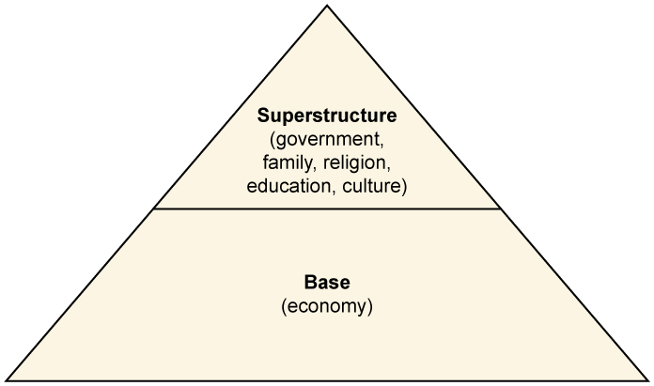
Role Expectation and Performance
Introduction
Society is made up of individuals with different roles.
Each role comes with expectations and responsibilities.
Understanding roles helps explain human behaviour and social order.

Slide 15
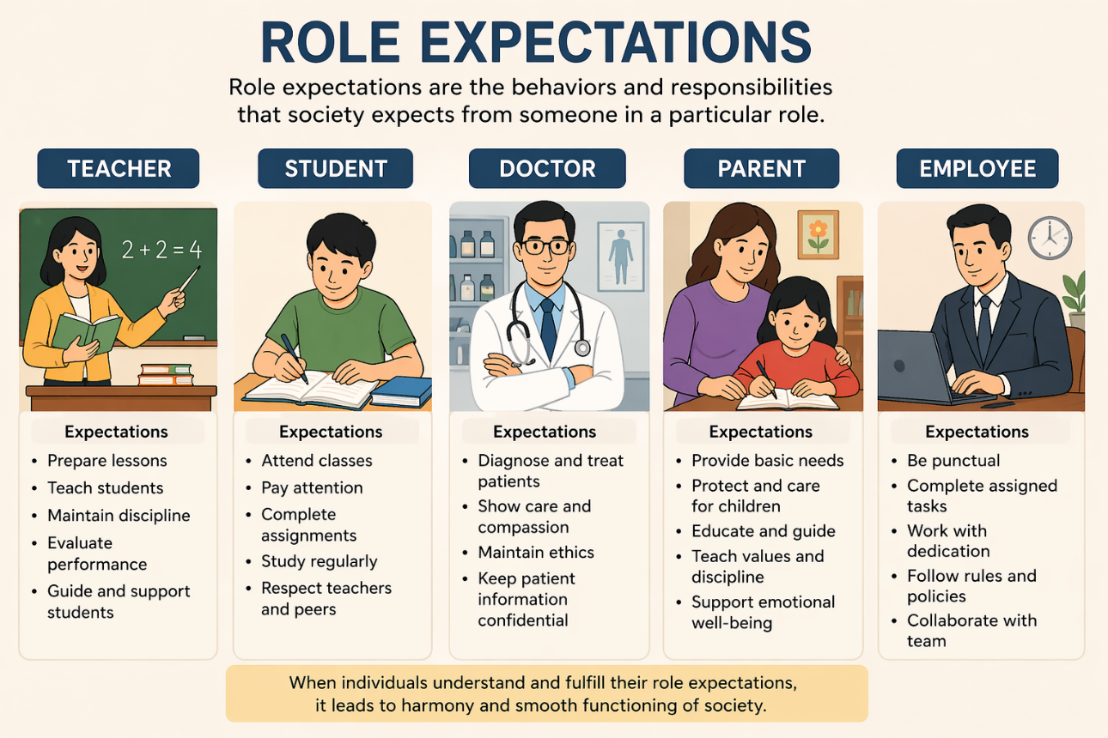
Role Expectation and Performance
Role Expectations refer to the behaviors, duties, and responsibilities that society expects from a person based on their social position (status).
For example:
A teacher is expected to educate students, maintain discipline, and guide them properly.
A student is expected to study, respect teachers, and follow rules. These expectations are shaped by cultural norms, values, and traditions.

Slide 16
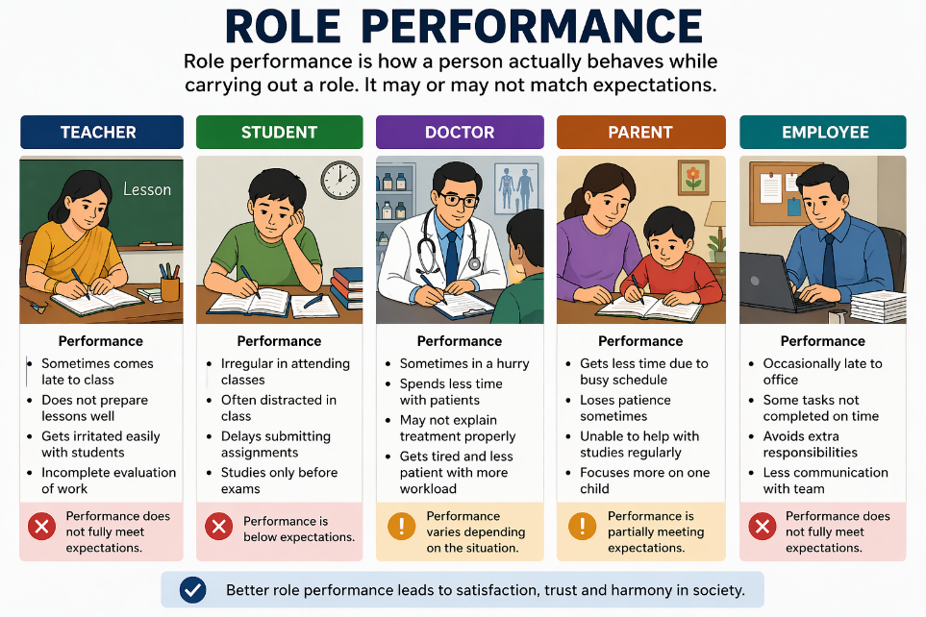
Role Expectation and Performance
They are shaped by culture, norms, and values.
Role expectations are social rules about how a person should behave.
These are based on status (e.g., teacher, student, parent).
Role Performance
How a person actually behaves in their role. It may or may not fully match the expectations.
For instance, a teacher might be expected to be punctual and organized, but in reality, they may sometimes come late or be less prepared. This difference shows that role performance can vary from person to person.
Example:
A student may be expected to study daily but may procrastinate.
A manager may be expected to lead well but may lack leadership skills.

Slide 17
Role Expectation and Performance
Difference Between Expectation and Performance
Role Expectations | Role Performance
Ideal behavior | Actual behavior
Set by society | Done by individual
Fixed standards | Can vary

Slide 18
Role Expectation and Performance
Case Study: Student Role Conflict
A university student is expected to:
Attend classes
Complete assignments
Prepare for exams
However, the same student:
Works part-time
Has family responsibilities
Result:
The student may fail to meet expectations fully.
This shows a gap between role expectation and role performance.

Slide 19

Role Expectation and Performance
Working Mother
Expectations:
Take care of children
Manage household
Perform well at job
Performance:
May feel stress balancing both roles
Sometimes one role is prioritized over another
Outcome:
Role strain and pressure

Slide 20
Role Expectation and Performance
Importance in Society
Maintains order and stability
Helps individuals understand their responsibilities
Reduces confusion in social interactions
Conclusion
Role expectations guide behavior.
Role performance shows real actions.
Both are essential for socialization and functioning of society.
Understanding them helps reduce conflict and improve social harmony.

Slide 21

Topic
What is Status and Master Status?
Nimra Khan
2225165021

Slide 22
Status
What is Status?
Status is a person’s position or role within society. It helps define:
Who we are
What role we perform
What behavior is expected from us
People usually hold multiple statuses at the same time (e.g., sibling, worker, community member).

Slide 23

Status
Example of Status
Consider a girl who simultaneously holds different roles:
Daughter at home
Student at university
Friend in her social circle
Each of these is a distinct status — different expectations apply in each setting.

Slide 24
Master Status
What is Master Status?
Master status is the single most important status that becomes a person’s main identity. It:
Dominates other roles
Shapes how others see and interact with the person
Can be positive or negative

Slide 25


Master Status
Example 1 — Student as Master Status
A university girl may be a daughter and friend, but within the university context she’s mainly seen as a student. For classmates and teachers, that role becomes her master status.
Master status here highlights expected behaviors like attending class, studying, and submitting assignments.

Slide 26


Master Status
Example 2 — Manager in Professional Life
A woman might be a mother and neighbor, but at work she is primarily known as a manager . That status becomes her master status in professional settings, influencing how others treat and expect leadership from her.
This master status can boost authority and confidence, shaping interactions and opportunities.

Slide 27
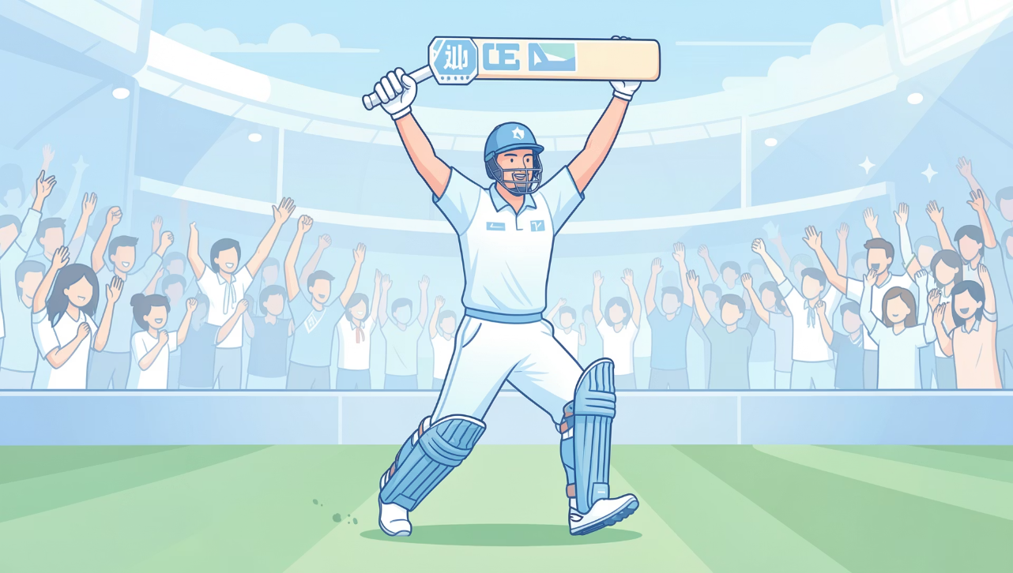

Master Status
Example 3 — Famous Personality
Babar Azam is a son and citizen, but most people recognize him as a cricketer. His public identity — his master status — is shaped by that role.
Master status for public figures often defines their social influence and public expectations.

Slide 28

Master Status
Example 4 — Negative Master Status
Someone may be a father, employee, and neighbor. But if they commit a crime, society might label them a criminal. That label can become their master status and strongly affect how others treat them.
Master status can be positive or negative
It influences social treatment, opportunities, and self-identity

Slide 29
Type of Status
Ascribed Status
Laiba Zafar
2225165014

Slide 30
Ascribed Status
What is Ascribed Status?
Ascribed status is a social position a person is assigned at birth or receives involuntarily later in life. It is not chosen and typically cannot be changed by the individual's actions.
Key idea: Ascribed = assigned by birth or circumstances beyond personal control.

Slide 31
Characteristics of Ascribed Status
Given Naturally
Assigned based on birth, family, or innate traits rather than choice.
Not Based on Effort
No personal achievement required to hold this status.
Mostly Fixed
Often stable across a person’s life, though social meanings can change.
Depends on Natural Factors
Examples: birth family, ethnicity, sex assigned at birth, and nationality.

Slide 32
Examples
Common Examples
Gender (male, female, intersex) — often assigned at birth
Age categories (child, adult, elder)
Family background (social class, ancestry)
Nationality or ethnicity
These attributes shape expectations and opportunities before a person can make choices that change them.

Slide 33
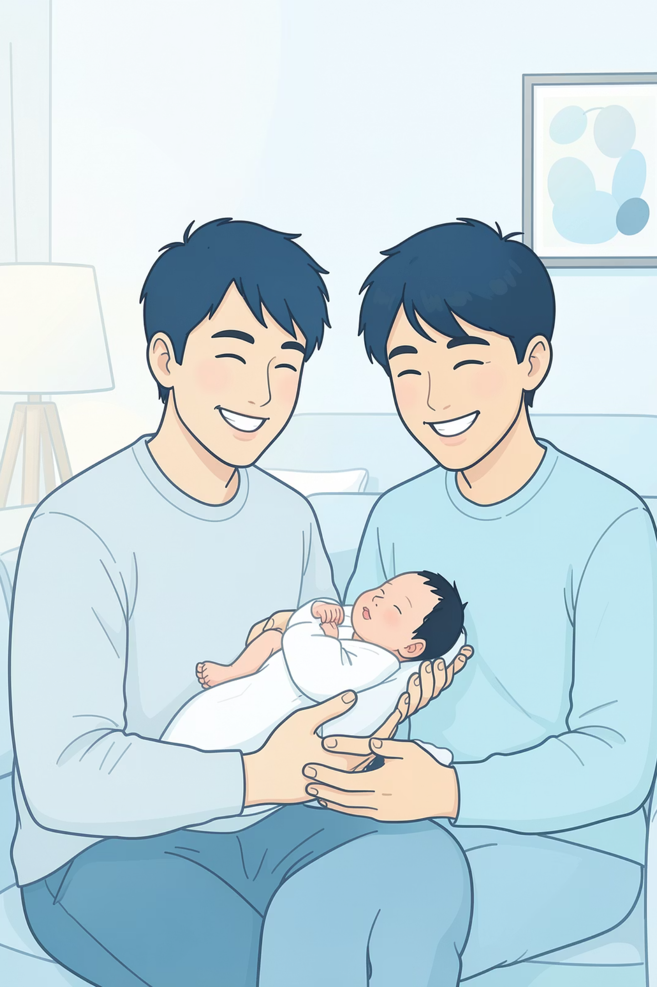
Examples
Simple Real-Life Example
When a baby is born, they automatically become someone's son or daughter. The child does not choose this family relationship — it’s an ascribed status. This status influences early identity and social roles within that family.
Think about how family expectations or responsibilities can follow a child from birth.

Slide 34

Gender as an Ascribed Status
Many societies assign gender at birth. This assignment often determines initial roles, norms, and expectations even though the individual did not choose it.
Contrast: Not everyone’s gender identity matches the ascribed category — social meanings can vary and change over time.
Ascribed Status – Effects (Key Points)
Shapes identity
Affects opportunities
Creates social expectations
Causes inequality
Creates pressure/stress

Slide 35
Type of Status
Achieved Status
Alishba Aymen
2225165001

Slide 36
Achieved Status
What Is Achieved Status?
Achieved status is earned through personal effort, skill, choices, or accomplishments — for example, becoming a doctor, a teacher, or a business owner. Unlike ascribed status, it can usually change during a person’s lifetime.
Achieved = earned. Ascribed = assigned.

Slide 37

Achieved Status
Doctor
Teacher
Requires years of education and training — an achieved status.
Earned through certification, study, and classroom experience.
Business Owner
Engineer
Built by taking risks, learning skills, and growing a company.
Attained through technical training and professional licensure.

Slide 38

Achieved Status
Real-Life: From Student to Doctor
A student studies hard, completes medical school and residency, and becomes a doctor. This status is achieved — it depends on effort, training, and credentials, not on birth.
Effort and persistence
Formal education and certification
Professional responsibilities and recognition

Slide 39
Conclusion
Status is the role or position a person has in society, and one person can have many statuses, like being a daughter, student, and friend.
Master status is the most important role that becomes a person’s main identity, such as being known mainly as a doctor or student.
There are two types of status: ascribed status, which is given by birth like gender and age, and achieved status, which is earned through hard work like becoming a teacher or engineer.
In conclusion, status shows our different roles, while master status shows our main identity in society.
Thank You!

