Slide 1


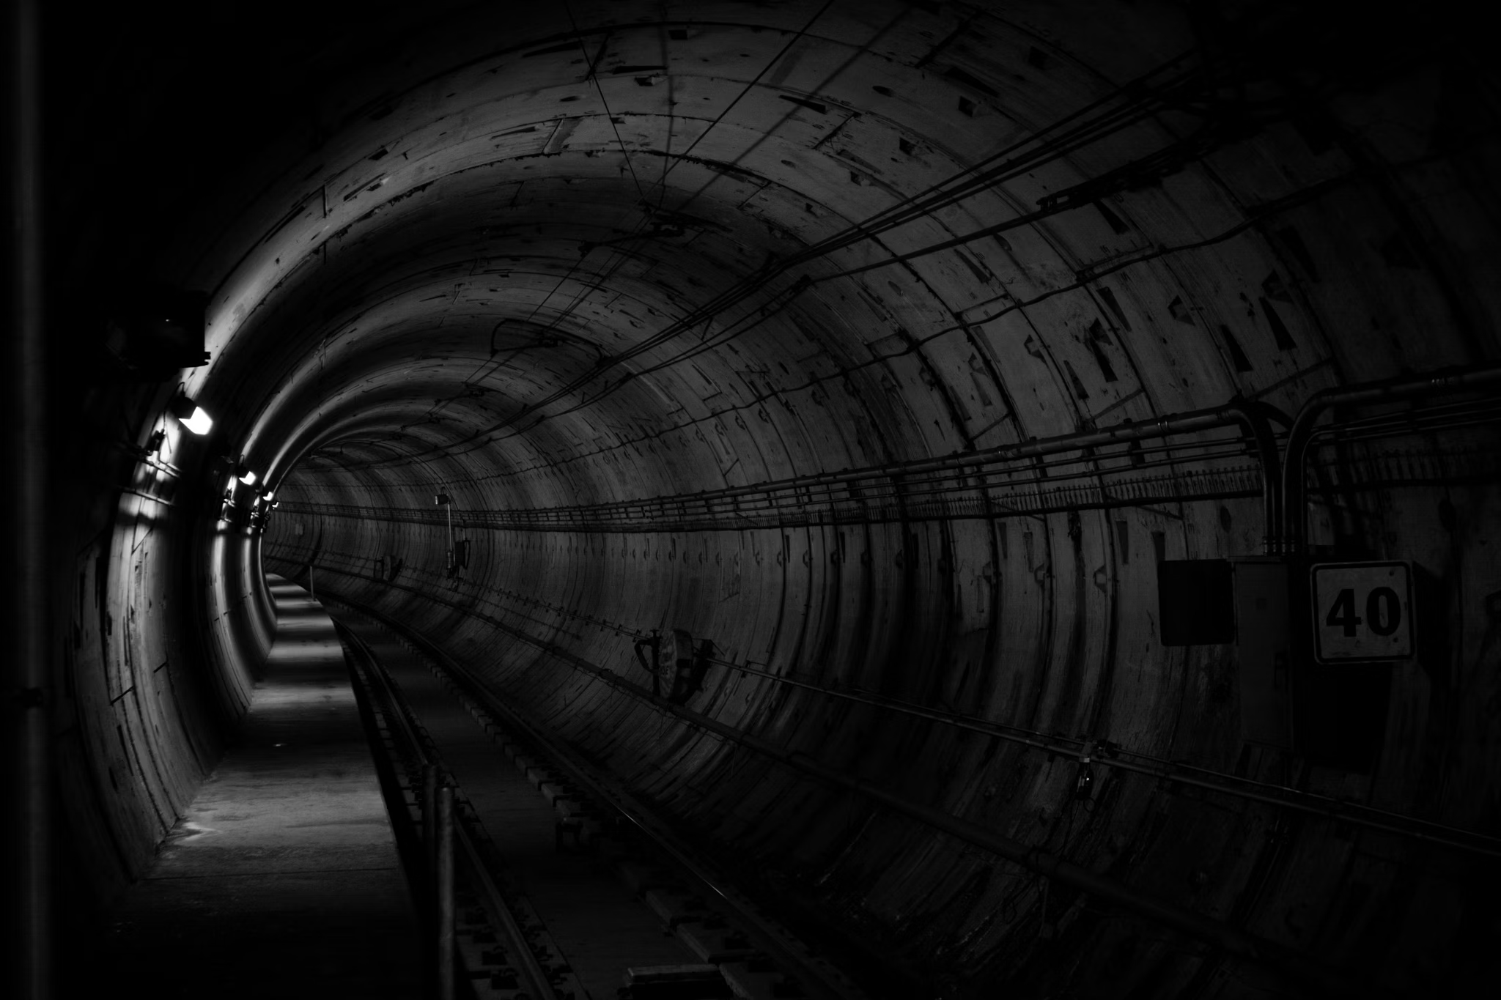

a
DARIA 3.0
-Ai Multimodel Chatbot for InfoTunnel
Team 14
Suraj Poldas
Saivarun Tanjore Raghavendra
Mano Sappa Harsha
Mohammed Tareq Sajjad Ali
Course Information
NLP AIT526 001
Dr. Lindi Liao
1

Slide 2

INTRODUCTION
DARIA 3.0
In today’s rapidly growing information age, retrieving accurate and relevant information from vast datasets is a critical challenge. General QA systems often lack domain-specificity, resulting in inefficient and irrelevant responses, which diminishes their utility in specialized fields. DARIA 3.0 (InfoTunnel) was created to address this gap by combining cutting-edge NLP and AI technologies to deliver fast, accurate, and domain-specific query resolutions.
The system utilizes Large Language Models (LLMs), including Meta’s Llama and Phi-3.5-mini-instruct, to understand and generate nuanced, context-aware responses. It also incorporates a powerful FAISS-based knowledge indexing system, which allows for efficient real-time retrieval of relevant information from raw and fine-tuned datasets. This ensures DARIA 3.0 can deliver precise answers tailored to complex domain-specific queries.
Going beyond text input, DARIA 3.0 integrates voice transcription capabilities using OpenAI’s Whisper model, making it versatile and accessible for users seeking hands-free interaction. Its deployment on a sleek Streamlit interface provides a seamless, interactive user experience, bridging the gap between advanced backend systems and everyday users.
DARIA 3.0 represents a transformative step in QA systems, offering a solution that balances speed, accuracy, and user engagement, ultimately enhancing how information is accessed in specialized fields.
2

Slide 3

OBJECTIVES
DARIA 3.0
These objectives lay the foundation for the DARIA 3.0 project by clearly outlining its goals and the technologies involved:
Core Functionality: The first objective focuses on creating a chatbot (DARIA 3.0) for domain-specific query resolution. This ensures that the system serves as an expert assistant within a specialized domain (e.g., tunnels, steel structures, testing methods).
Use of LLMs: The second objective explains how advanced language models (like Llama and Phi-3.5) are being utilized to help the system understand complex queries and generate responses that match the domain's knowledge base.
Search and Retrieval: The third objective outlines how the system retrieves the most relevant answers using FAISS for efficient information retrieval. Embedding the data allows for better representation of textual information for querying.
Voice Integration: The fourth objective emphasizes the inclusion of voice-to-text capabilities, allowing users to interact with the system more naturally.
User Interface: The last objective focuses on providing an intuitive user interface using Streamlit, making it accessible and easy to navigate for users.
3

Slide 4

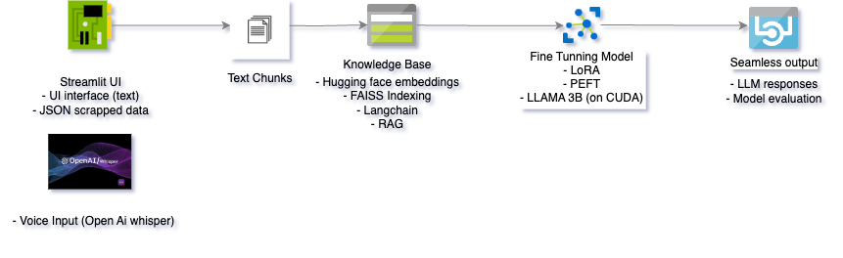
DARIA 3.0
SYSTEM ARCHITECTURE
4

Slide 5

DATASET OVERVIEW
DARIA 3.0
Source
Data scraped from InfoTunnel, focusing on nondestructive testing methods for tunnels and steel structures.
Format
JSON files, comprising raw scraped content and fine-tuned data for NLP tasks.
Key Fields
Context: Detailed descriptions of techniques and principles.
Question: Queries for QA training and testing.
Answer: Ground truth responses.
Prompt/Completion: Input-output pairs for model fine-tuning.
Images: URLs linking to visual data or technical illustrations.
Preprocessing
Cleaned data by removing duplicates and irrelevant entries.
Embedded text using sentence-transformer embeddings for FAISS-based indexing.
Leveraged LangChain for Retrieval-Augmented Generation (RAG) to enable efficient query resolution.
5

Slide 6
PROPOSED SOLUTION
DARIA 3.0
The DARIA 3.0 QA system employs cutting-edge technologies to deliver precise, domain-specific query resolution
Core Technologies
Meta’s Llama 3B and Phi-3.5 for accurate, context-aware responses.
FAISS Vector-based knowledge retrieval for efficient context indexing.
LangChain Retrieval-Augmented Generation (RAG) to combine embeddings with LLMs.
Whisper Model for enabling seamless voice-to-text interaction.
Work Flow
Data Processing:
JSON datasets are embedded and indexed using Hugging Face models.
Knowledge Retrieval:
FAISS retrieves relevant context, passed to LLMs for response generation.
User Interface:
Real-time responses via a sleek Streamlit platform for text and voice inputs.
Key Advantages
Accuracy: Tailored to domain-specific data.
Efficiency: Rapid retrieval and response generation.
User-Friendly: Intuitive interface supporting text and voice queries.
6

Slide 7
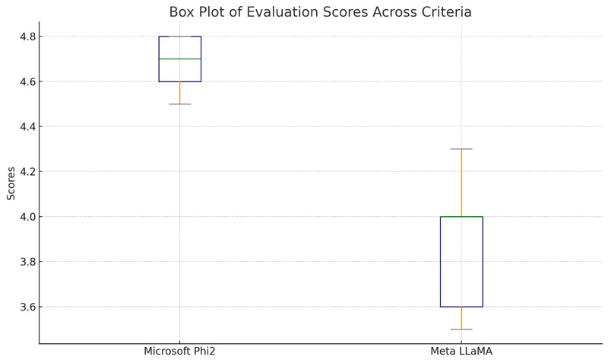
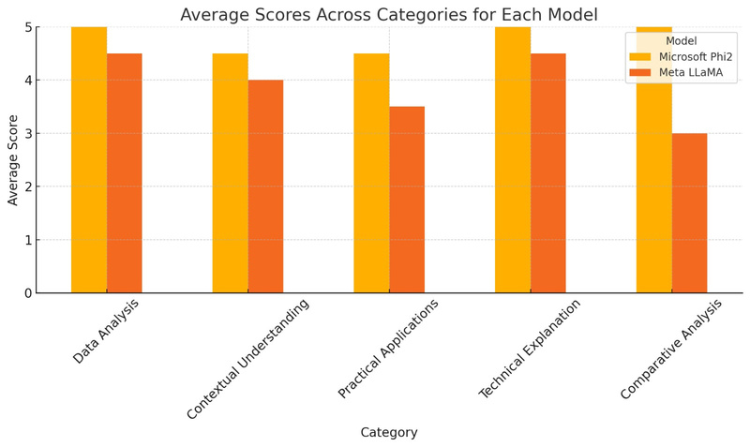
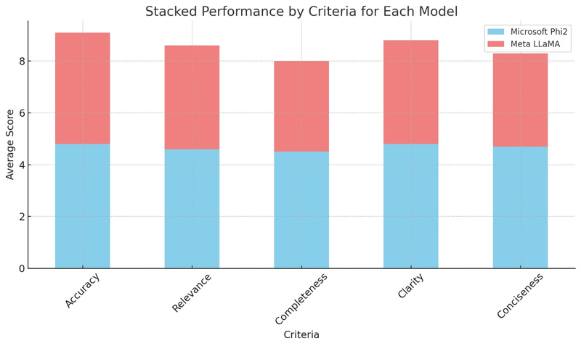
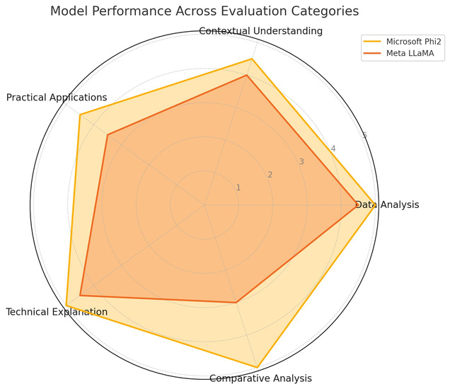
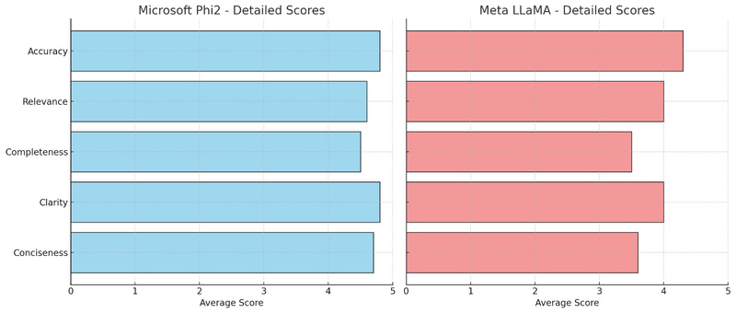
RESULTS ANALYSIS AND INTERPRETATION
DARIA 3.0
THE EVALUATION OF MICROSOFT PHI2 AND META LLAMA MODELS ACROSS VARIOUS CATEGORIES SHOWS THE FOLLOWING
KEY METRICS:
MICROSOFT PHI2
ACCURACY: 96%, RELEVANCE: 92%, CLARITY: 96%
META LLAMA
ACCURACY: 86%, RELEVANCE: 80%, CLARITY: 80%
INSIGHTS
MICROSOFT PHI2 EXCELS IN PROVIDING DETAILED AND ACCURATE RESPONSES, ESPECIALLY FOR COMPLEX QUERIES.
META LLAMA PERFORMS WELL IN BASIC QUERIES BUT STRUGGLES WITH TECHNICAL DEPTH AND COMPLETENESS.
7

Slide 8

DARIA 3.0
CONCLUSION
DARIA 3.0 has shown strong effectiveness in resolving domain-specific queries, but challenges persist in scaling the system and managing more complex queries. Key lessons learned include the importance of fine-tuning and data preprocessing, which significantly enhanced model performance. Notably, Phi2 outperformed LLaMA, though the latter requires further refinement. Future efforts will focus on re-fine-tuning LLaMA with a curated and diverse dataset, improving post-processing through consistency checks and grammar refinement, exploring multi-modal input capabilities, and optimizing prompting techniques.
8

Slide 9
DARIA 3.0
ACKNOWLEDGMENT
We deeply thank our professor for her guidance and support throughout this project. Her expertise and valuable advice made a significant difference.
Dr. Lindi Liao
We deeply thank our professor for her guidance and support throughout this project. Her expertise and valuable advice made a significant difference.
FHWA (Federal Highway Administration)
For maintaining the InfoTunnel database, which served as the foundation for our domain-specific knowledge base.
GTA Support
Special thanks to the Graduate Teaching Assistants for their assistance with technical issues and project guidance.
Family and Friends:
We thank our loved ones for their continued support and encouragement during this journey.
9

Slide 10
REFERENCES
DARIA 3.0
LangChain Documentation
LangChain. (2023). LangChain Documentation. Retrieved from https://langchain.com/docs
Meta's Llama Model
Meta AI. (2023). Llama: Open and Efficient Foundation Language Models. Retrieved from https://www.llama.com/
FAISS: Facebook AI Similarity Search
Facebook AI Research. (2021). FAISS: A library for efficient similarity search and clustering of dense vectors. Retrieved from https://github.com/facebookresearch/faiss
Hugging Face Transformers
Hugging Face. (2023). Transformers Library. Retrieved from https://huggingface.co/transformers/
OpenAI Whisper Model
OpenAI. (2023). Whisper: Robust Speech Recognition via Large-Scale Weakly Supervised Training. Retrieved from https://openai.com/research/whisper
Streamlit Inc. (2023).
Streamlit Documentation. Retrieved from https://docs.streamlit.io
Dr. Lindi Liao’s Materials
Liao, L. (2023). NLP and Machine Learning Course Resources. Retrieved from Dr. Liao's Resources.
Data Scraping from InfoTunnel
Federal Highway Administration (FHWA). (2023). InfoTunnel Database. Retrieved from https://infotechnology.fhwa.dot.gov/tunnel/
10

