Slide 1
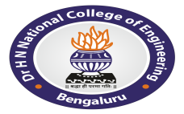
BSCK307 – Social Connect & Responsibility
Name USN
Manogna Shree K J 1HC24IS022
Department of Information Science and Engineering

Slide 2
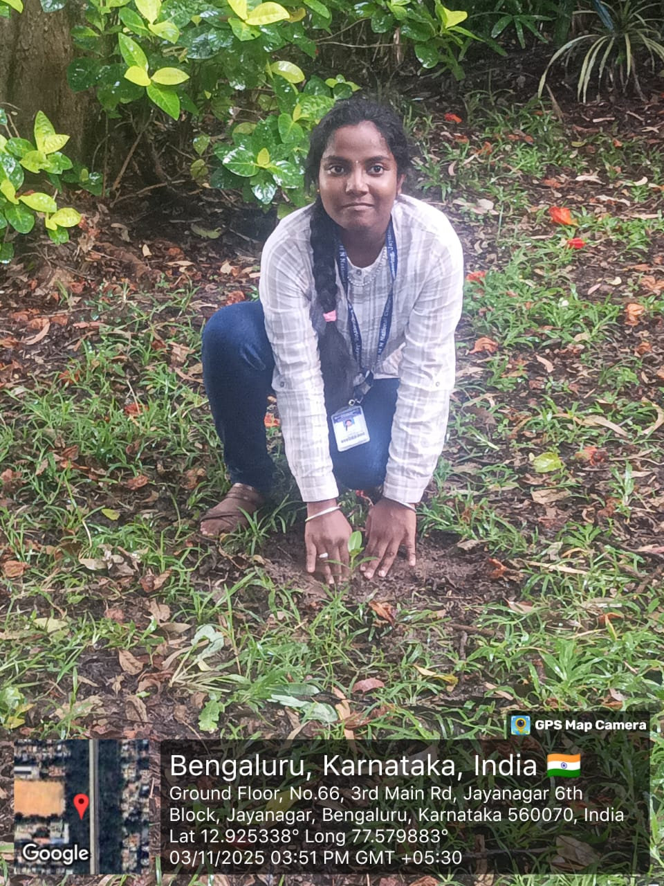
Activity-1:Plantation and adoption of a tree
I planted a Chikoo (Sapodilla) plant, scientifically known as Manilkara zapota, in Jayanagar Park. It’s an evergreen tree that grows well in warm areas like Bengaluru and produces sweet, nutritious fruits rich in vitamins and fiber. The plant helps purify the air by absorbing carbon dioxide and releasing oxygen, making the surroundings fresher. Its thick green leaves provide shade and attract birds, adding more life to the park. Planting the Chikoo tree supports a greener and healthier environment for everyone.

Slide 3
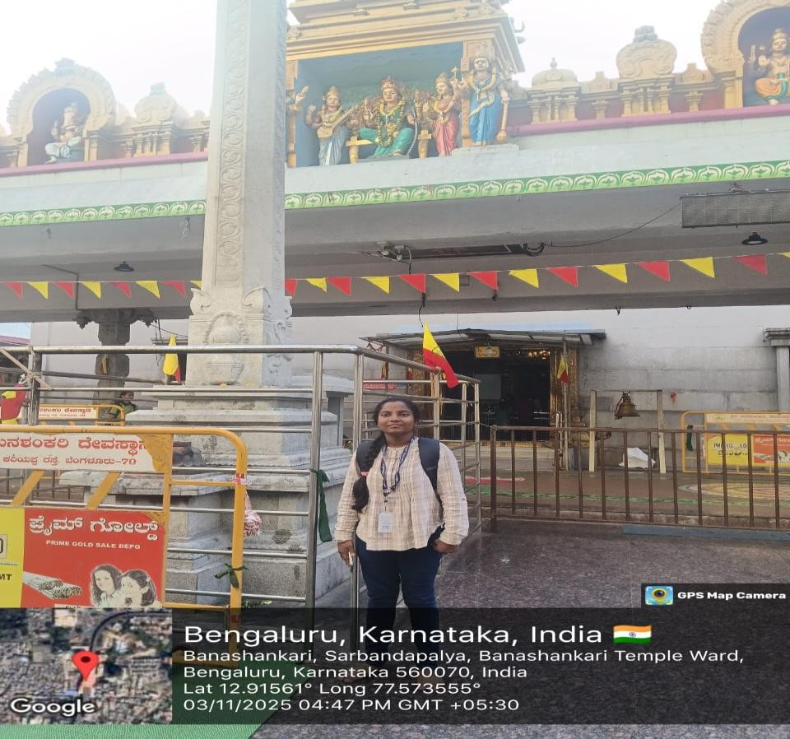
Activity-2:Heritage walk and Crafts corner
During our heritage walk, we visited the Banashankari Temple in Banashankari, one of Bengaluru’s most revered spiritual landmarks. This temple, with its centuries-old roots, has been a place of devotion and community gathering for generations. Known for its traditional Dravidian-style architecture and serene atmosphere, it continues to be a favorite stop for locals and pilgrims alike.
I experienced the temple’s unique blend of spirituality and heritage — the sanctum dedicated to Goddess Banashankari radiates peace, while the surrounding courtyards echo with the chants of devotees. The temple is not just a religious site but also a cultural hub, hosting vibrant festivals like Banashankari Jatre, where the streets come alive with colors, music, and traditional rituals.
Banashankari Temple was originally established in the 1910s by devotees who brought the idol of the goddess from Badami, and over time it has grown into one of South Bengaluru’s most iconic heritage sites. Despite urban growth around it, the temple has preserved its old-world charm and continues to be a living testimony to Bengaluru’s traditions and faith.

Slide 4
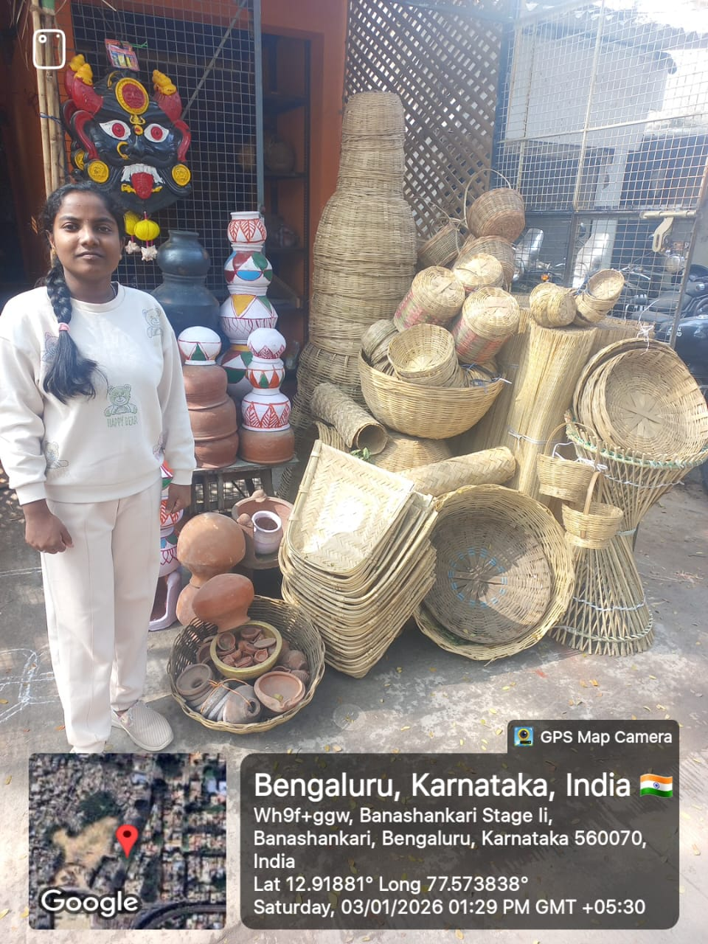
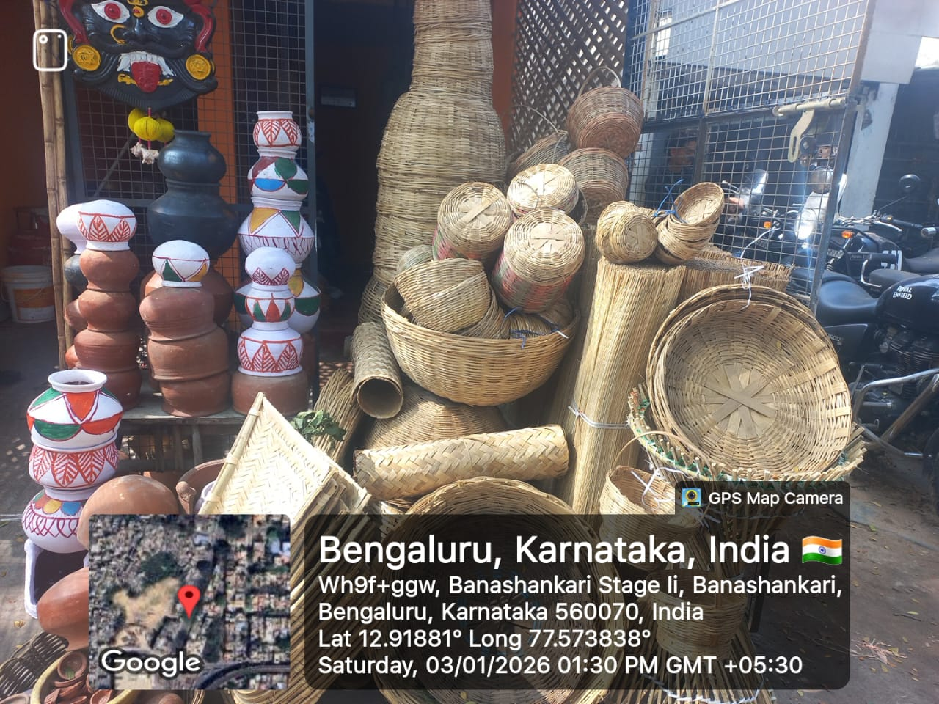
Activity-2:Heritage walk and Crafts corner
During a heritage walk in Banashankari, Bengaluru, I came across a vibrant street-side display of traditional handcrafted items that beautifully showcased Karnataka’s cultural richness. The arrangement included woven baskets of various shapes and sizes, handmade mats crafted from natural fibers, and intricately painted earthen pots with white designs. These items reflected the skill and sustainability of local artisans, offering insight into eco-friendly alternatives to modern materials. Observing this display deepened my appreciation for indigenous crafts and highlighted the importance of preserving traditional livelihoods and promoting cultural awareness in urban spaces.

Slide 5
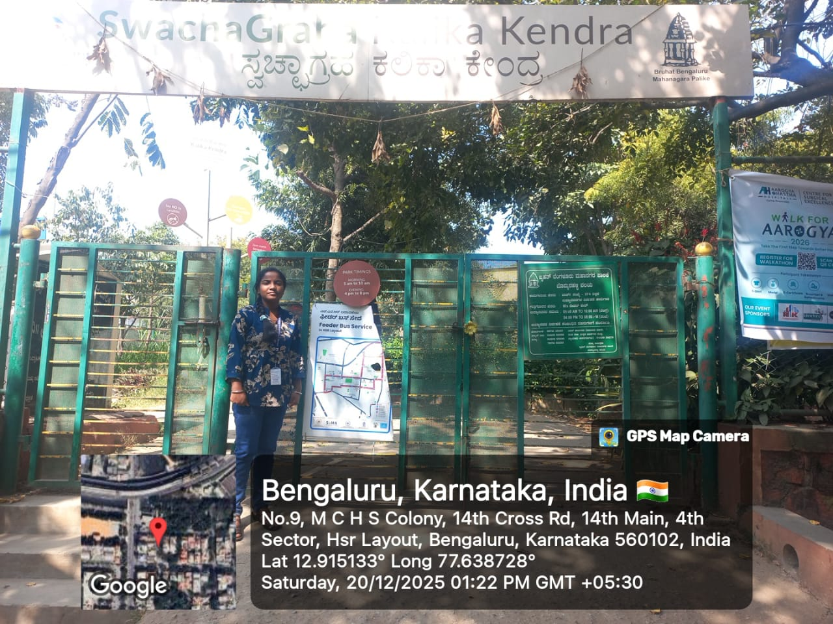
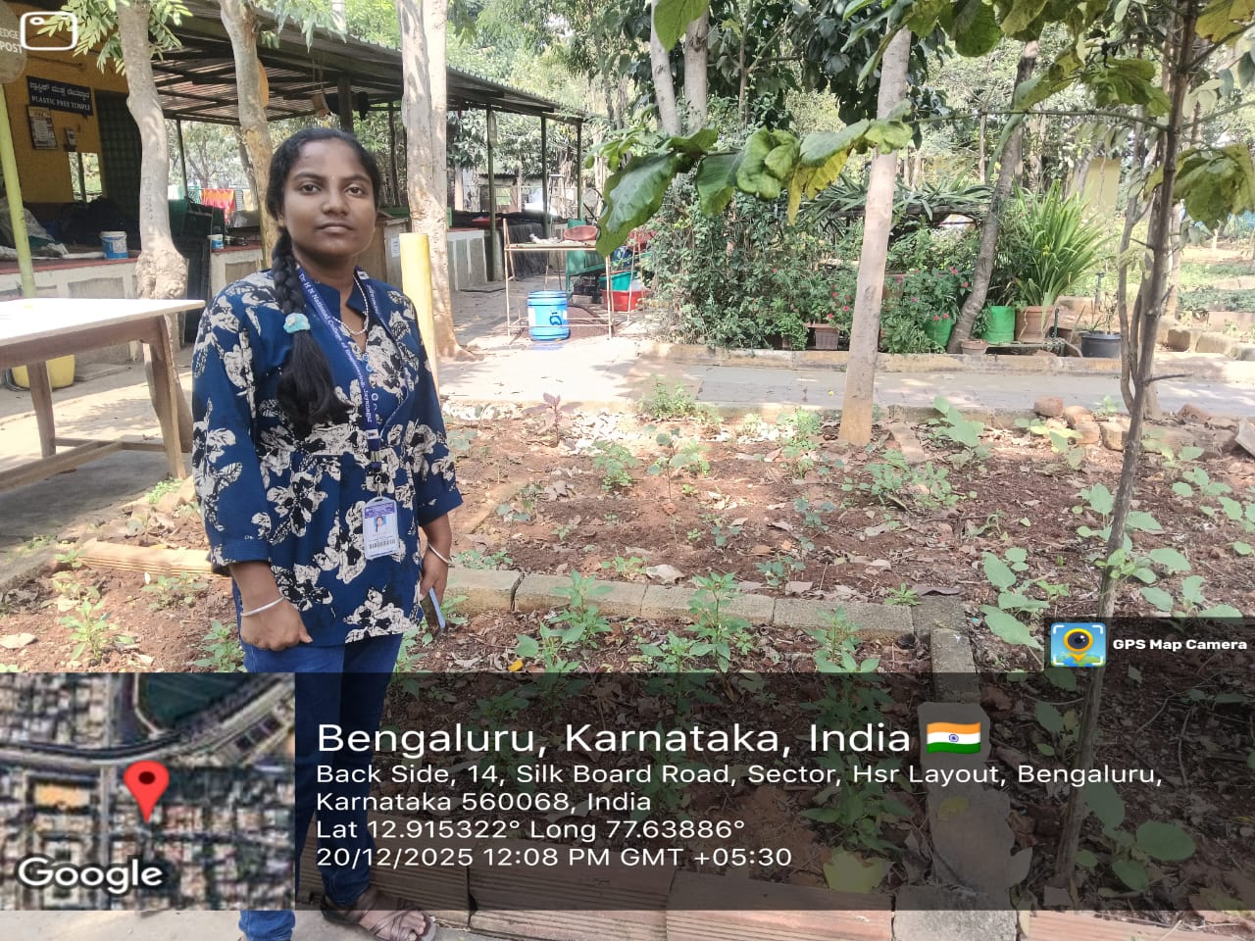
Activity-3 Organic farming and waste management
Swachagraha Kalika Kendra is a unique learning center in Bengaluru that promotes through hands-on activities in waste management. It showcases more than twenty models of home and community composting, helping citizens understand how to manage kitchen and garden waste at source and reduce landfill dependency. The center conducts awareness programs, workshops for schools, colleges, and resident welfare associations, making sustainability accessible and engaging. Creative installations made from scrap materials demonstrate recycling and reuse, while the theme-park style setup ensures that learning is interactive and fun. By encouraging households to segregate waste, compost locally, and adopt eco-friendly practices,this fosters a culture of responsibility where citizens actively contribute to cleaner neighborhoods and a healthier environment.

Slide 6
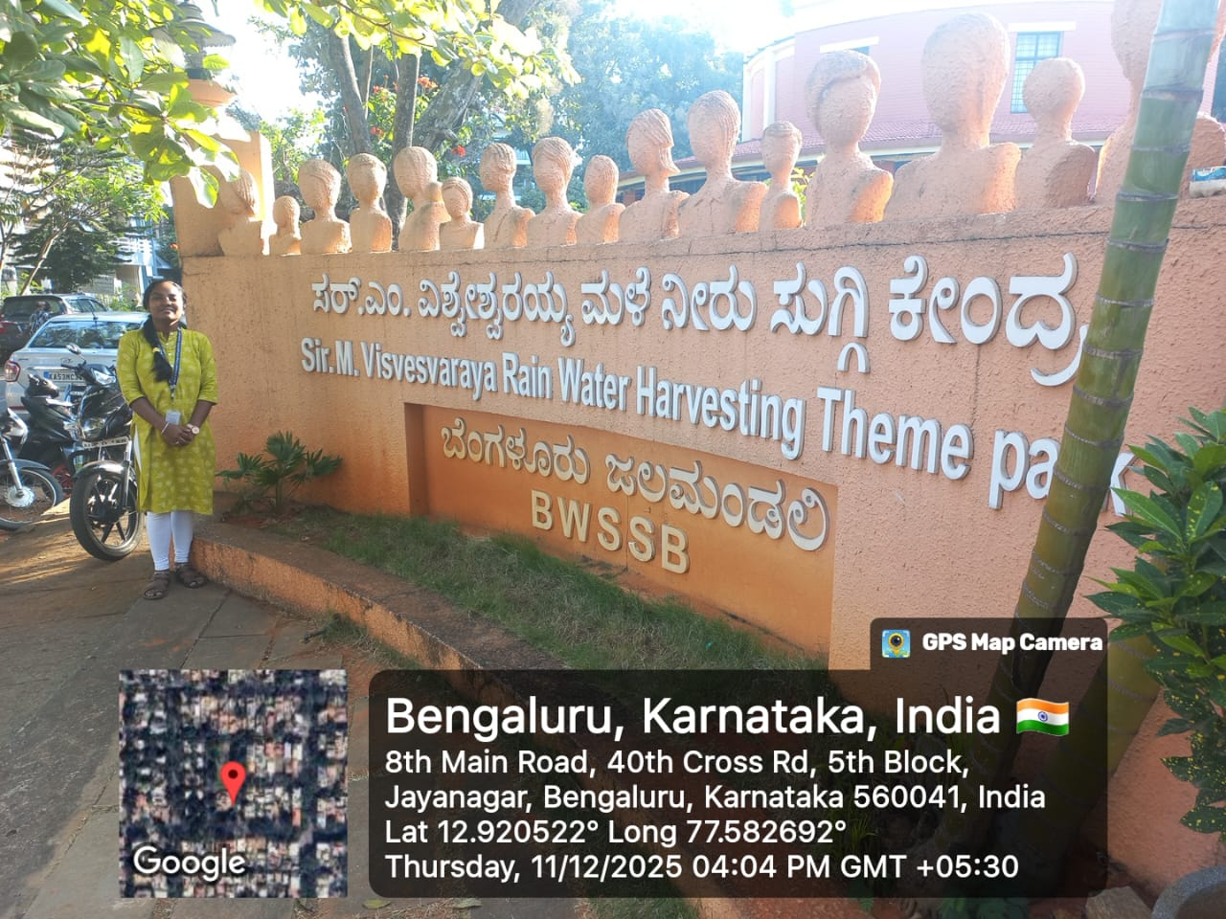
Activity-4 Water conservation
During our Water conservation we walk into the world of engineering marvels, we paused to honor the legacy of Sir M. Visvesvaraya, whose vision for water conservation transformed the way communities in India managed their resources. Known as the “Father of Modern Engineering,” his foresight in harnessing and preserving water continues to resonate across generations.
I experienced the unique blend of science and sustainability in his approach — for Visvesvaraya, water was not just a resource but a lifeline for development. His pioneering ideas in building reservoirs, check dams, and irrigation systems created a culture of conservation, ensuring that every drop of rain was valued.
Despite rapid urbanization, Visvesvaraya’s principles continue to guide Bengaluru and beyond, preserving the balance between growth and nature. His legacy in water conservation is not just technical brilliance but a living testimony to India’s traditions of foresight, resilience, and collective well-being.

Slide 7
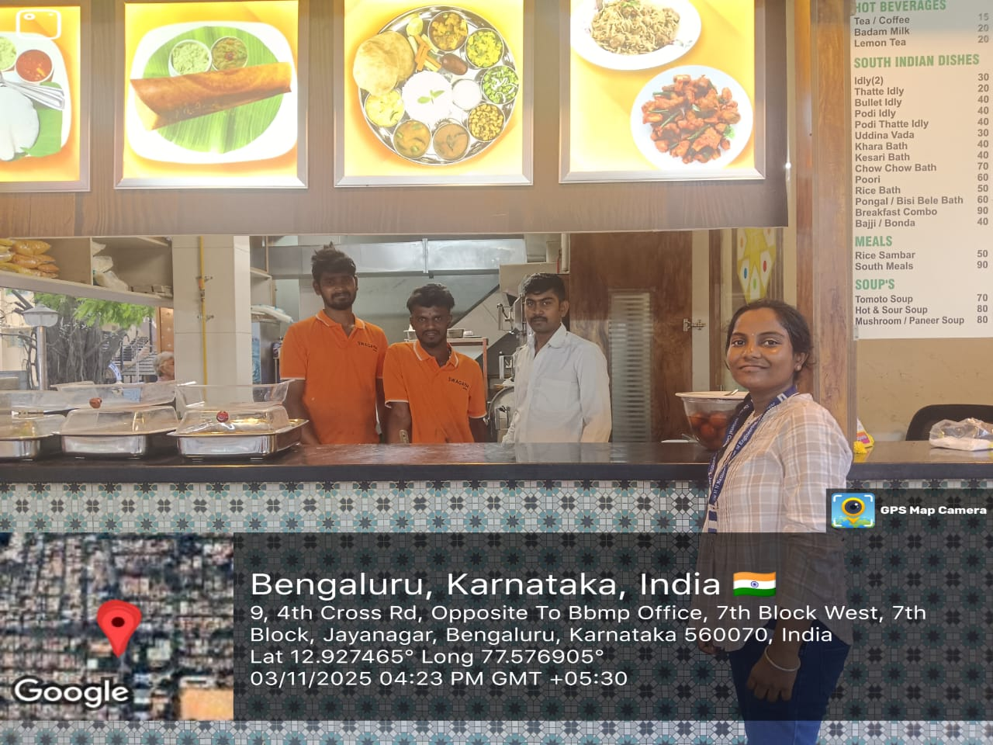
Activity-5 Food walk
During our food walk, we visited Swagath Hotel near Yediyur in Jayanagar, a cozy old-style eatery that has been serving locals for many years. Known for its simple South Indian meals, this place has become a favorite breakfast stop for people in the area. I tried their famous onion dosa along with a cup of strong filter coffee — honestly, the perfect combo! The dosa was crispy on the outside and soft inside, made from rice and lentil batter topped with caramelized onions. It’s not just delicious but also healthy, packed with carbohydrates for energy, protein for strength, and fiber that aids digestion. The traditional filter coffee was rich and aromatic, helping refresh us after a long walk. The warm hospitality and nostalgic vibe made it feel like a true taste of old Bengaluru. Swagath Hotel was started in the early 1980s as a small family-run tiffin center and has slowly grown into one of Jayanagar’s most loved local landmarks, still maintaining its old charm and authentic flavors.

Slide 8
Thank You

