Slide 1
MessagING App
First team member: Supraja Abburi
Second team member: Manogna Arla
Third team member: Tarak Nadh Naidu

Slide 2
DETAILS
Team Number: 04
Team Name: The Aggregators
Full name of assigned Use Case: Messaging App
Client Company: Easier Life
Brand name in mind for the product or service: MyPosts
Full name of first team member: Supraja Abburi
Full name of second team member: Manogna Arla
Full name of third team member: Tarak Nadh Naidu

Slide 3
INTRODUCTION
"Easier Life" is embarking on the creation of a new Messaging App, "MyPosts," and has obtained datasets from a Data Collection team. They are seeking assistance to unravel the story within this data. The company aims to understand whether the datasets can offer insights that align with their specific requirements and objectives.
These insights are crucial for making well-informed decisions about the direction and strategies for "MyPosts." By analyzing the datasets comprehensively, Easier Life intends to gain clarity on key aspects such as customer demographics, preferences, and behaviors related to messaging apps. This understanding will not only guide their decision-making process but also pave the way for potential collaborations and strategic recommendations to ensure the success of "MyPosts" in the competitive messaging app landscape.

Slide 4
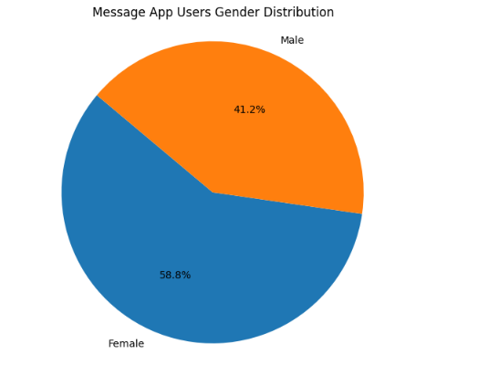
PREDOMINANT GENDER OF TARGET CUSTOMERS
Based on the pie chart analysis, it appears that the predominant gender of target customers for the messaging app is female, with a higher percentage of female users (58.8%) compared to male users (41.2%).
Notes:
Objectives & Requirements 1 (OR1)
DVP TCP Objectives & Requirements 1 (OR1):
Objectives (O1): What is the predominant gender of your client's target customers? What is the predominant income level of your client's target customers?
Requirements (R1): Use the "Gender" variable. Use the "Income" variable. (Note: some Use Cases contain monthly income, while others contain annual income.) Use the describe() function in Python. Use the summary() function in R.

Slide 5
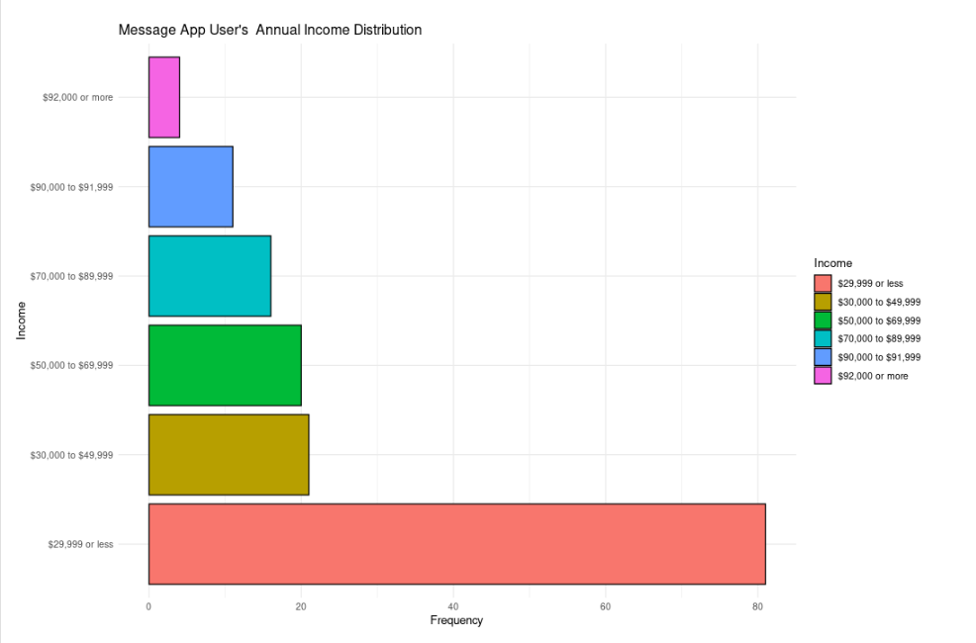
PREDOMINANT INCOME LEVEL OF MESSAGE APP CUSTOMERS
Notes:
Objectives & Requirements 1 (OR1)
Objectives & Requirements 1 (OR1)
DVP TCP Objectives & Requirements 1 (OR1):
Objectives (O1): What is the predominant gender of your client's target customers? What is the predominant income level of your client's target customers?
Requirements (R1): Use the "Gender" variable. Use the "Income" variable. (Note: some Use Cases contain monthly income, while others contain annual income.) Use the describe() function in Python. Use the summary() function in R.

Slide 6
PREDOMINANT INCOME LEVEL OF MESSAGE APP CUSTOMERS
The analysis of income brackets within the dataset revealed interesting insights regarding the user base of 'MyPosts,' Easier Life's new messaging app. The predominant income level of target customers is $29,999 or less, indicating a significant portion of the user demographic falls within this income range, making it the most prevalent income bracket among 'MyPosts' users.
There is a concentration of users in the mid-range income bracket of $70,000 to $89,999, while there are fewer users in the higher income brackets ($90,000 or more). This distribution across income levels suggests a varied user base in terms of income, with a focus on lower to mid-range income segments
Notes:
Objectives & Requirements 1 (OR1)
Objectives & Requirements 1 (OR1)
DVP TCP Objectives & Requirements 1 (OR1):
Objectives (O1): What is the predominant gender of your client's target customers? What is the predominant income level of your client's target customers?
Requirements (R1): Use the "Gender" variable. Use the "Income" variable. (Note: some Use Cases contain monthly income, while others contain annual income.) Use the describe() function in Python. Use the summary() function in R.

Slide 7
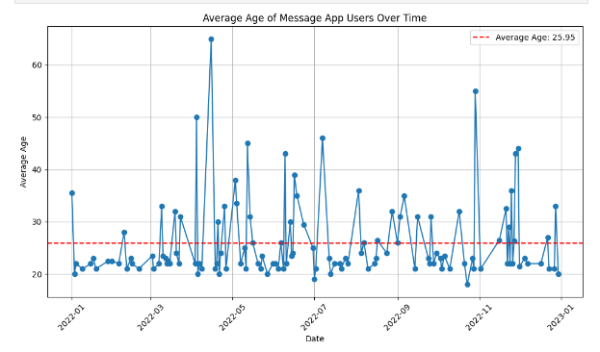
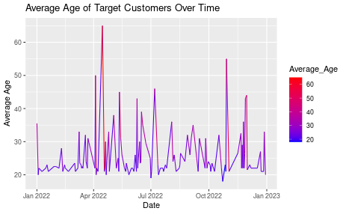
AVERAGE AGE OF MESSAGE APP USERS OVER TIME
Notes:
Objectives & Requirements 2 (OR2)
DVP TCP Objectives & Requirements 2 (OR2):
Objectives (O2): What is the average age of your client's target customers based on the Age variable in your client's D2 (Dataset 2)? Did the average age of your client's target customers vary over time? For example, were those target customers who responded to the survey during the summer months different in age than those customers who responded to the survey during the winter months?
Requirements (R2): Use the "Age" variable. Use the "Date" variable. Use the describe() function in Python. Use the summary() function in R. Group data by Date and calculate the average Age by Date.
Note: All teams are required to meet these OR2 in the final submission of their DVP TCP.

Slide 8
AVERAGE AGE OF MESSAGE APP USERS OVER TIME
The average age appears to be slowly increasing over time. The average age is 25.95 this suggest that:
Messenger apps might be becoming more popular with older age groups.
This could be due to a number of factors, such as increasing comfort with technology among older adults, or the growing popularity of features like video chat which can help family members stay connected.
It is also possible that younger people are using messenger apps less frequently
Notes:
Objectives & Requirements 2 (OR2)
DVP TCP Objectives & Requirements 2 (OR2):
Objectives (O2): What is the average age of your client's target customers based on the Age variable in your client's D2 (Dataset 2)? Did the average age of your client's target customers vary over time? For example, were those target customers who responded to the survey during the summer months different in age than those customers who responded to the survey during the winter months?
Requirements (R2): Use the "Age" variable. Use the "Date" variable. Use the describe() function in Python. Use the summary() function in R. Group data by Date and calculate the average Age by Date.
Note: All teams are required to meet these OR2 in the final submission of their DVP TCP.

Slide 9
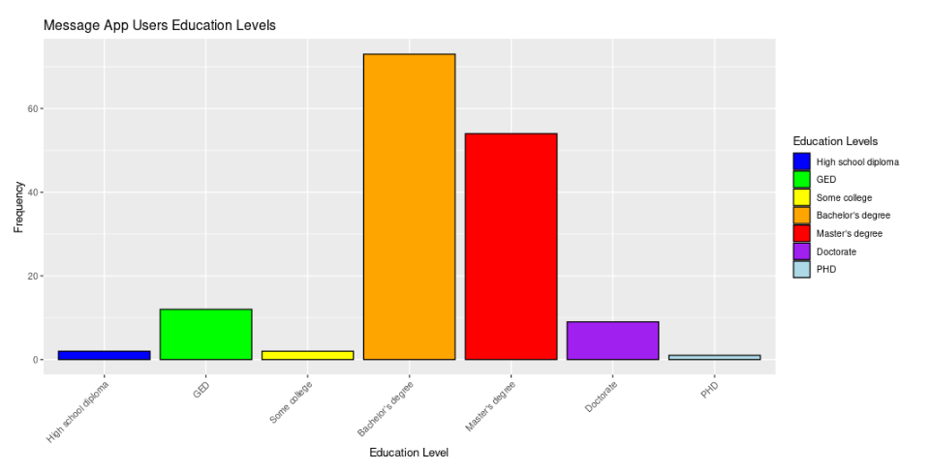
PREDOMINANT EDUCATION LEVEL
The predominant education level among users is a Bachelor's degree, with a frequency of 73 individuals.
The next most common education level is a Master's degree with a frequency of 54 individuals. Doctorate holders represent a smaller but notable group with a frequency of 9 individuals, indicating a presence of highly educated individuals among the user base.
PHD with least 1, and High school diplomas and Some college with frequencies of 2 and 2 respectively. GED holders account for a higher frequency compared to high school diploma and some college, with 12 individuals.
Notes:
Objectives & Requirements 3 (OR3)
DVP TCP Objectives & Requirements 3 (OR3):
Objectives (O3): What is the predominant education level of your client's target customers (based on education classification; e.g., freshman? What is the predominant educational interest area of your client's target customers (based on college major)?
Requirements (R3): Use the "Classification" variable (in some datasets it has a long title such as "What is your student classification?"). Use the "Major" variable (in some datasets it has a long title such as "What college does your major fall under?"). Create frequency tables in Python. Create frequency tables in R. Create DVs based on frequency tables in Python. Create DVs based on frequency tables in R.

Slide 10
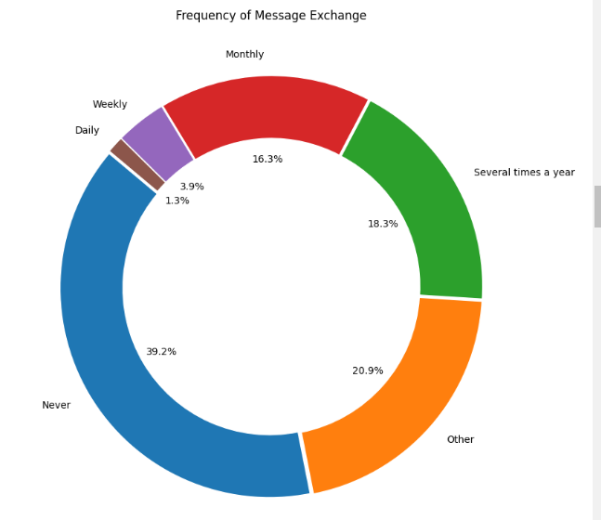
PREDOMINANT MESSAGE EXCHANGE FREQUENCY
The predominant message exchange frequency among users is several times a year, with 60 individuals falling into this category
.This suggests that the majority of users engage in messaging activities periodically throughout the year rather than on a daily, weekly, or monthly basis.
Notes:
Objectives & Requirements 3 (OR3)
DVP TCP Objectives & Requirements 3 (OR3):
Objectives (O3): What is the predominant education level of your client's target customers (based on education classification; e.g., freshman? What is the predominant educational interest area of your client's target customers (based on college major)?
Requirements (R3): Use the "Classification" variable (in some datasets it has a long title such as "What is your student classification?"). Use the "Major" variable (in some datasets it has a long title such as "What college does your major fall under?"). Create frequency tables in Python. Create frequency tables in R. Create DVs based on frequency tables in Python. Create DVs based on frequency tables in R.

Slide 11
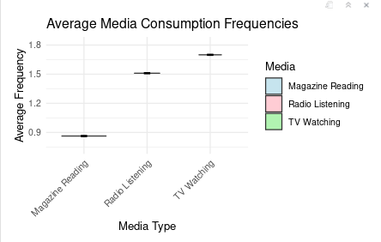
AVERAGE USAGE BEHAVIOR OF MEDIA TYPES
Notes:
Objectives & Requirements 4 (OR4)
DVP TCP Objectives & Requirements 4 (OR4):
Objectives (O4): What is the average usage behavior of print media types among your client's target customers? What is the average usage behavior of video media types among your client's target customers? What is the average usage behavior of audio media types among your client's target customers? What are the predominant attributes that your client's target customers want in the product or service that your use case is based on? (Hint: Use your D4-2 dataset).
Requirements (R4): Create DVs to analyze usage behavior variables in Python. Create DVs to analyze usage behavior variables in R. Create DVs to analyze text data in Python. Create DVs to analyze text data in R.

Slide 12
AVERAGE USAGE BEHAVIOR OF MEDIA TYPES
Average Magazine Reading Frequency: 0.8627451
Average TV Watching Frequency: 1.699346
Average Radio Listening Frequency: 1.509804
Average Magazine Reading Frequency (0.8627451): This indicates a moderate level of engagement with magazine reading among users. While not as high as some other media consumption activities, it still suggests that a segment of users is interested in reading magazines
Average TV Watching Frequency (1.699346): The higher frequency of TV watching suggests that a significant portion of users also spends time watching television.
Average Radio Listening Frequency (1.509804): Similar to TV watching, radio listening shows a substantial engagement level among users.
Notes:
Objectives & Requirements 4 (OR4)
DVP TCP Objectives & Requirements 4 (OR4):
Objectives (O4): What is the average usage behavior of print media types among your client's target customers? What is the average usage behavior of video media types among your client's target customers? What is the average usage behavior of audio media types among your client's target customers? What are the predominant attributes that your client's target customers want in the product or service that your use case is based on? (Hint: Use your D4-2 dataset).
Requirements (R4): Create DVs to analyze usage behavior variables in Python. Create DVs to analyze usage behavior variables in R. Create DVs to analyze text data in Python. Create DVs to analyze text data in R.

Slide 13
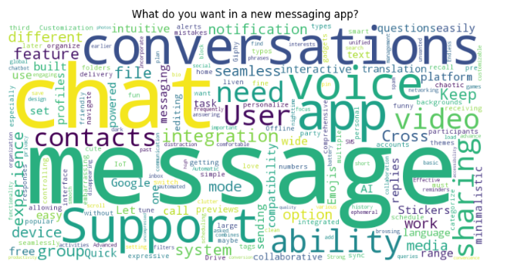
CUSTOMERS PREDOMINANT ATTRIBUTES
Notes:
Objectives & Requirements 4 (OR4)
DVP TCP Objectives & Requirements 4 (OR4):
Objectives (O4): What are the predominant attributes that your client's target customers want in the product or service that your use case is based on? (Hint: Use your D4-2 dataset).
Requirements (R4): Create DVs to analyze usage behavior variables in Python. Create DVs to analyze usage behavior variables in R. Create DVs to analyze text data in Python. Create DVs to analyze text data in R.

Slide 14
CUSTOMERS PREDOMINANT ATTRIBUTES
The predominant attributes that "Easier Life's" target customers seek in a new messaging app include robust privacy and security features ensuring their conversations remain secure, intuitive design for ease of use across multiple devices, seamless integration with Google services for enhanced productivity, responsive customer support channels, customizable notifications, and a rich set of features encompassing voice and video calling, file sharing, and expressive emojis.
User experience is paramount, emphasizing a visually appealing interface, smooth navigation, and optimal performance.
By prioritizing these attributes, "MyPosts" can meet user expectations, foster trust, and deliver a compelling messaging app experience, driving user adoption and satisfaction in a competitive market landscape.
Notes:
Objectives & Requirements 4 (OR4)
DVP TCP Objectives & Requirements 4 (OR4):
Objectives (O4): What are the predominant attributes that your client's target customers want in the product or service that your use case is based on? (Hint: Use your D4-2 dataset).
Requirements (R4): Create DVs to analyze usage behavior variables in Python. Create DVs to analyze usage behavior variables in R. Create DVs to analyze text data in Python. Create DVs to analyze text data in R.

Slide 15
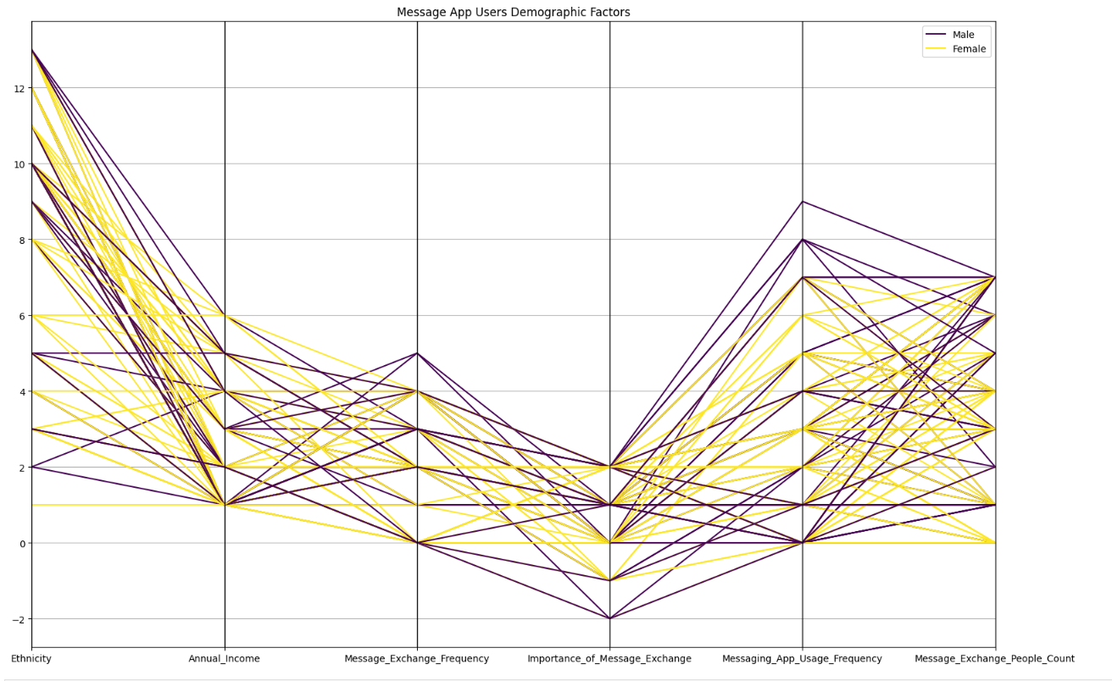
KEY DIFFERENCES ON GENDER REGARDING INTEREST AND OTHER FACTORS
Notes:
DVP TCP Objectives & Requirements 5 (OR5):
Objectives (O5): Provide actionable decision-making-value-oriented written data insights based on target customer demographics. What are some key differences based on gender regarding the interest in, likelihood of using, intended frequency of use, and amount will to pay for your client's proposed product or service? What are some key differences based on ethnicity regarding the interest in, likelihood of using, intended frequency of use, and amount will to pay for your client's proposed product or service? What are some key differences based on target customer income level categories regarding the interest in, likelihood of using, intended frequency of use, and amount will to pay for your client's proposed product or service?
Requirements (R5): Use a variety of Data Visualization (DV) types to summarize D3, D5, and D6 variables based on D1 variables.

Slide 16
KEY DIFFERENCES ON GENDER REGARDING INTEREST AND OTHER FACTORS
Key differences between males and females in terms of their usage and engagement with the message app.
Message Exchange Frequency: The data points for males and females show distinct patterns, with females generally exhibiting a higher message exchange frequency compared to males.
Importance of Permanent Storage: The importance placed on permanent storage seems to vary more significantly between genders, with females placing a higher emphasis on this feature compared to males.
Ethnicity: The differences in data points between males and females appear to be influenced by ethnicity, with some ethnic groups showing more pronounced gender-based disparities in various metrics.
TV Watching Frequency: The graph suggests that males and females have different patterns in terms of TV watching frequency, with females potentially spending more time watching TV compared to males.
Notes:
DVP TCP Objectives & Requirements 5 (OR5):
Objectives (O5): Provide actionable decision-making-value-oriented written data insights based on target customer demographics. What are some key differences based on gender regarding the interest in, likelihood of using, intended frequency of use, and amount will to pay for your client's proposed product or service? What are some key differences based on ethnicity regarding the interest in, likelihood of using, intended frequency of use, and amount will to pay for your client's proposed product or service? What are some key differences based on target customer income level categories regarding the interest in, likelihood of using, intended frequency of use, and amount will to pay for your client's proposed product or service?
Requirements (R5): Use a variety of Data Visualization (DV) types to summarize D3, D5, and D6 variables based on D1 variables.

Slide 17
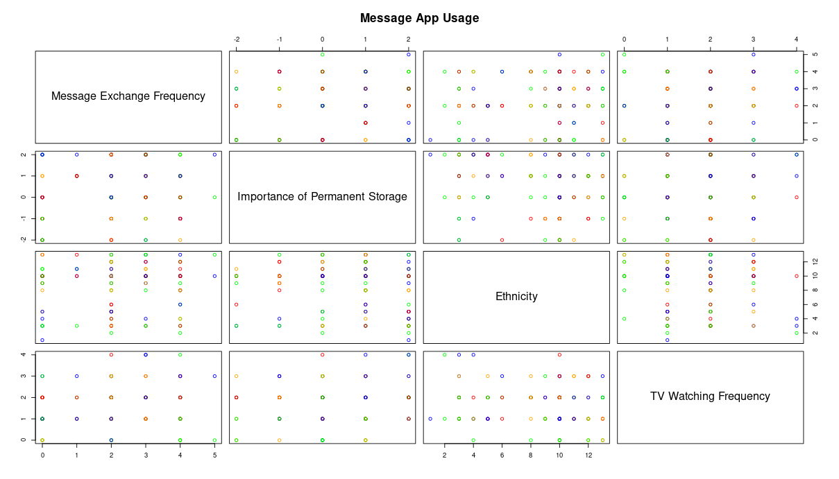
KEY DIFFERENCES ON ETHNICITY REGARDING INTEREST AND OTHER FACTORS
Notes:
DVP TCP Objectives & Requirements 5 (OR5):
Objectives (O5): Provide actionable decision-making-value-oriented written data insights based on target customer demographics. What are some key differences based on gender regarding the interest in, likelihood of using, intended frequency of use, and amount will to pay for your client's proposed product or service? What are some key differences based on ethnicity regarding the interest in, likelihood of using, intended frequency of use, and amount will to pay for your client's proposed product or service? What are some key differences based on target customer income level categories regarding the interest in, likelihood of using, intended frequency of use, and amount will to pay for your client's proposed product or service?
Requirements (R5): Use a variety of Data Visualization (DV) types to summarize D3, D5, and D6 variables based on D1 variables.

Slide 18
KEY DIFFERENCESON ETHNICITY REGARDING INTEREST AND OTHER FACTORS
Key differences in interest and usage factors across different ethnic groups:
Message Exchange Frequency: The data points show distinct patterns for different ethnic groups, indicating varying levels of message exchange frequency.
Importance of Permanent Storage: The importance placed on permanent storage feature seems to differ significantly across ethnic groups, with some groups placing higher emphasis on this aspect than others.
Ethnicity: The graph directly compares the data points for different ethnic groups, highlighting the distinct differences in their preferences and behaviors related to the message app.
TV Watching Frequency: The graph suggests that different ethnic groups have varying patterns in terms of TV watching frequency, potentially pointing to cultural or lifestyle differences

Slide 19
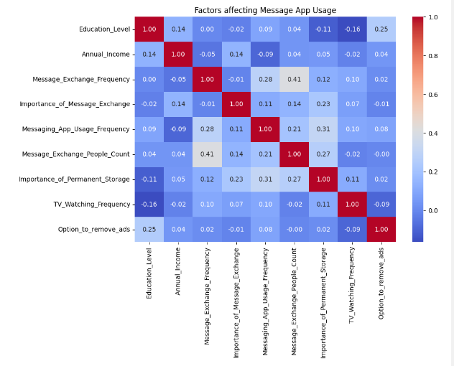
KEY DIFFERENCES ON INCOME LEVEL REGARDING INTEREST AND OTHER FACTORS
Notes:
DVP TCP Objectives & Requirements 5 (OR5):
Objectives (O5): Provide actionable decision-making-value-oriented written data insights based on target customer demographics. What are some key differences based on gender regarding the interest in, likelihood of using, intended frequency of use, and amount will to pay for your client's proposed product or service? What are some key differences based on ethnicity regarding the interest in, likelihood of using, intended frequency of use, and amount will to pay for your client's proposed product or service? What are some key differences based on target customer income level categories regarding the interest in, likelihood of using, intended frequency of use, and amount will to pay for your client's proposed product or service?
Requirements (R5): Use a variety of Data Visualization (DV) types to summarize D3, D5, and D6 variables based on D1 variables.

Slide 20
KEY DIFFERENCES ON INCOME LEVEL REGARDING INTEREST AND OTHER FACTORS
The chart indicates a positive correlation between annual income and messaging app usage frequency. In other words, people with higher incomes tend to use messaging apps more often than those with lower incomes.
There are a few reasons why this might be the case:
People with higher incomes are more likely to own smartphones which are necessary to use most messaging apps.
People with higher incomes may have more disposable income, which means they can afford to pay for data plans that allow them to use messaging apps more frequently.
People with higher incomes may also be more likely to work in jobs that require them to communicate with colleagues or clients outside of regular business hours. Messaging apps can be a convenient way to do this.
Notes:
DVP TCP Objectives & Requirements 5 (OR5):
Objectives (O5): Provide actionable decision-making-value-oriented written data insights based on target customer demographics. What are some key differences based on gender regarding the interest in, likelihood of using, intended frequency of use, and amount will to pay for your client's proposed product or service? What are some key differences based on ethnicity regarding the interest in, likelihood of using, intended frequency of use, and amount will to pay for your client's proposed product or service? What are some key differences based on target customer income level categories regarding the interest in, likelihood of using, intended frequency of use, and amount will to pay for your client's proposed product or service?
Requirements (R5): Use a variety of Data Visualization (DV) types to summarize D3, D5, and D6 variables based on D1 variables.

Slide 21
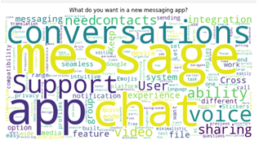
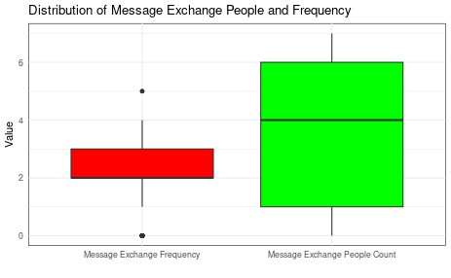
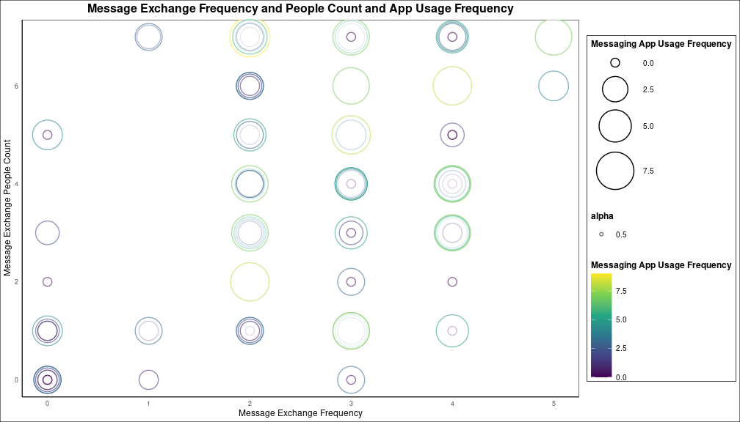
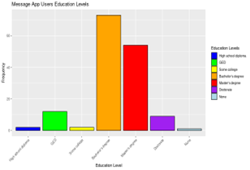
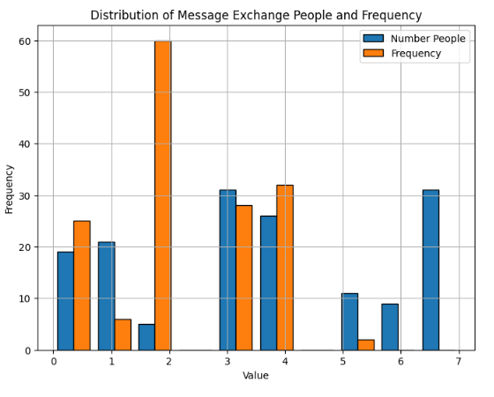
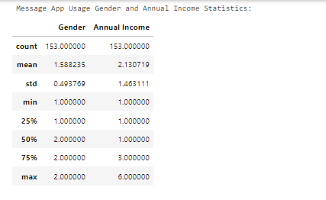
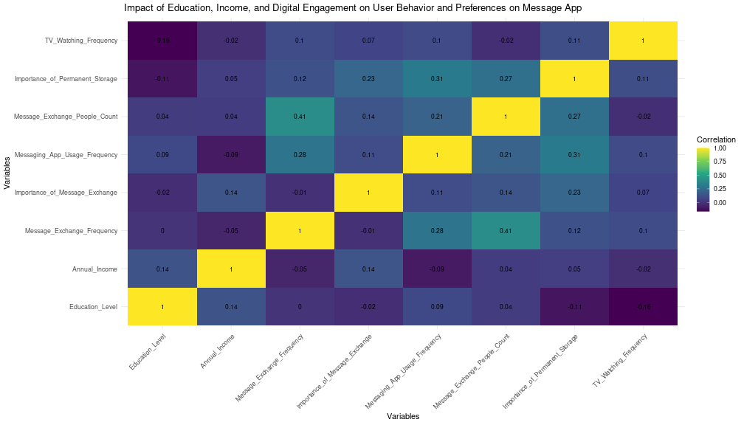
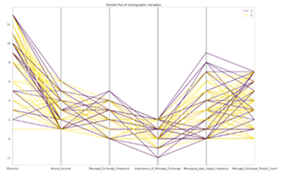
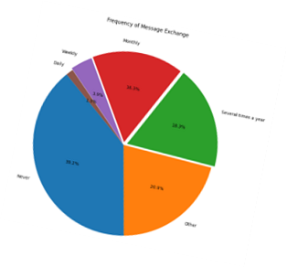
Messaging app users prioritize core messaging functionalities, emphasizing reliability, ease of use, and timely notifications for new messages. They also value cross-platform compatibility, seeking seamless access across various devices such as phones, tablets, and computers. Additionally, users highly appreciate features like emojis and file sharing, enhancing their communication experience with expressive elements and efficient data exchange.
The box plot illustrates significant variability in the number of people users exchange messages with. The majority of users fall within a range of small to moderate message exchanges, as indicated by the median line positioned in the lower half. Notably, outliers exist in message exchange frequency, visible as data points beyond the top whisker, signifying a subset of users with exceptionally high message exchange rates compared to the broader user base.
12
14
Message App
13
1
The company is aiming to identify the most promising customers for its messaging app and has shared several datasets for analysis. The Message App team needs help in interpreting the data to guide decisions that match their defined goals and objectives. The DVP team will analyze seven datasets systematically, focusing on deriving meaningful insights. The goal is to conduct a comprehensive DVP analysis and articulate the resulting insights clearly, with the potential for future collaborations and recommendations
11
2
10
The predominant education level among users is a Bachelor's degree, with a frequency of 73 individuals. Following Bachelor's degree, the next most common education level is a Master's degree with a frequency of 54 individuals. Doctorate holders represent a smaller but notable group with a frequency of 9 individuals, indicating a presence of highly educated individuals among the user base. High school diploma and Some college are less represented with frequencies of 2 and 2 respectively. GED holders account for a higher frequency compared to high school diploma and some college, with 12 individuals.
9
15
19
The histogram provides insight into message distribution among various user groups, revealing the frequency and patterns of message exchange. Despite high overall usage of the messaging app, it highlights a segment of users who do not engage with it.
16
20
The graph provides insights into the daily active users (DAU) of the app over a specific timeframe, reflecting its popularity and user engagement levels. Analysis of the data can reveal several key aspects. Firstly, observing trends in DAU can highlight periods of user growth or decline, indicating the app's overall health and potential areas for improvement in user retention strategies.
3
4
The predominant gender among the client's target customers for the messaging app appears to be slightly skewed towards males, with a mean gender value of approximately 1.59 out of 2. This suggests that there may be a slightly higher representation of males compared to females among the users. Regarding income levels, the predominant income bracket among the client's target customers falls within the lower to middle range, as indicated by the quartile breakdown. Therefore, the client's target customers for the messaging app predominantly consist of males with income levels concentrated in the lower to middle ranges
The parallel plot depicts Message App users across several factors, including ethnicity, annual income, message app exchange frequency, importance of the app, and usage frequency. It reveals a strong correlation between users and ethnicity, suggesting a notable association between the two variables.
The predominant message exchange frequency among users is several times a year, with 60 individuals falling into this category. This suggests that the majority of users engage in messaging activities periodically throughout the year rather than on a daily, weekly, or monthly basis.
18
8
21
7
17
Analyzing the heatmap for the messaging app reveals valuable insights. It uncover correlations between user demographics like age and ethnicity with features such as Message_Exchange_People_Count, Likelihood_to_Try_for_Superior_Security, and Likelihood_to_Try_for_Superior_Privacy_Controls. These correlations can indicate if certain age groups or ethnicities are more inclined towards trying advanced security or privacy features, as well as their engagement level in terms of message exchanges.
Message APP user; Looking at the graph itself, it seems like the average age of Target customers has been increasing over time. In 2022, the average customer appeared to be around 40 years old. Average Age of Message App Users: 25.95
22
6
5

Slide 22
THANK YOU

