Slide 1
PROJECT TITLE:SPORTS IN BHARATH
Team Members:
D.Manogna
G.Rishitha
P.Usha Rani
Guide:
S. Sandeep babu
Designation : Asst. Professor
Department : AIML

Slide 2
CONTENTS
• Abstract
• Introduction
• Literature Survey
• Existing System and its Drawbacks
• Problem Statement
• System Requirements
• Proposed System
• Architecture
• Use case diagram
• Class diagram
• Activity diagram
• Sequential diagram
• Deployment diagram
• Methodology
• Results
• Test case
• Conclusion
References

Slide 3
ABSTRACT
Develop an interactive web application displaying a state sport of a specific state in India map . The main purpose of this project is to include sport of each state in India as a Digital content. The technologies were used are HTML,CSS. The result of this project is ,while clicking a state reveals its official state sport . The analysis and findings conclude that a better understading to a person about a sport in a specific state of India and the person can interact through a web application which is in smart way.

Slide 4
INTRODUCTION
Sports in Bharath
India is a country where many people love playing and watching sports. There are many different types of sports played in India, including:- Cricket: a very popular game played with a ball and bat
Hockey : a fast-paced game played on ice or grass
Football : a game played with a round ball and feet
Kabaddi : a traditional Indian game that involves tagging and wrestling Many Indians enjoy playing sports and some even become famous athletes. The government of India also supports sports and helps athletes train and compete . Sports bring people together and help build strong bodies and minds.

Slide 5
LITERATURE SUVEY
S. NO | NAME | AUTHOR | DESCRIPTION | LIMITATIONS
1 | SCENARIO OF SPORTS IN INDIA- FROM ANCIENT PERIOD TO MODERN PERIOD | Monika Singh MBA student, Dr.Dhirendra Tiwari Asst director Physical Edu, BHU,Varanasi | The history of sports in India dates back to the Vedic era, where they were important for physical and defense development. Ancient India was a developed sporting nation with a rich heritage evidenced by archaeological finds and literature. | Limited availability of primary sources: Historical research often relies on fragmented or incomplete records, which can make a comprehensive analysis challenging.
2 | An overview of sport in modern India | Packianathan Chelladurai and Swarali Patil | India is a significant and diverse nation with a young population, a growing economy, and a substantial middle class, indicating a considerable potential market and demographic for sports development. | The paper primarily focuses on India's demographic and economic characteristics, providing a broad overview but lacking specific details or data directly related to the current state and challenges within the modern Indian sports landscape itself.

Slide 6
LITERATURE SUVEY
S. NO | NAME | AUTHOR | DESCRIPTION | LIMITATIONS
3 | Sports infrastructure, discipline and allocation of resources for sports in India | Master Thesis, Geneva Business School, Major in Sports Management and Marketing, Harihar Sridhar | The development and success of sports in India heavily depend on nurturing talent, providing adequate opportunities and training to athletes, and effectively allocating resources within the sports industry. | Many of the problematic situations in Indian sports are either ignored by the media or treated as isolated incidents, hindering a broader understanding of the systemic issues and the development of comprehensive solutions.
4 | Issues Related to Sports in India | Shakti Sharma (Ph.D. Researcher Scholar, Department of Political Science, University of North Bengal) | Indian sports have undergone significant transformations in recent years, moving beyond just a pastime or entertainment due to positive changes like commercialization, the rise of sporting leagues, and the influence of media and the internet. | The paper primarily relies on secondary sources, mainly articles and chapters from edited books and some online articles, which might limit the depth and originality of the analysis compared to research utilizing primary data.

Slide 7
EXISTING SYSTEM
BharathMaps
Support for E-Governance - Bharat Maps primarily aims to support various government applications, planning, and monitoring activities by providing a foundational and standardized geospatial data service.
Government-Developed Platform - Bharat Maps is a multi-layered GIS platform developed by the National Informatics Centre (NIC), a part of the Indian government's Ministry of Electronics and Information Technology.
Web-Based Access - Users can access and visualize the geospatial data through a web portal (https://bharatmaps.gov.in/) with interactive mapping tools and search functionalities.
Integrated Data Source - It integrates geospatial data from various authoritative Indian government agencies, including the Survey of India (SoI), ISRO, and other relevant departments.

Slide 8
DRAWBACKS
Potentially Complex User Interface for Specific Information - Bharat Maps, being a comprehensive GIS platform for government use, might have a more complex interface with numerous layers and tools. For a user seeking a simple display of state capitals, navigating this complexity could be a drawback.
Data Accessibility and Public Facing Simplicity- While a valuable resource for government entities, public access and ease of use for a simple query like state specific info might not be a primary design focus of Bharat Maps.

Slide 9
PROBLEM STATEMENT
Develop an interactive India map displaying the location of each state's official sport with a single click.

Slide 10
SYSTEM REQUIREMENTS
Hardware
Ram : 4GB
Hard Disk : 100GB
Processor : i3
Software
Operating system : Windows 10/11
Programming languages : HTML, Javascript, css
Platform used :VS code

Slide 11
PROPOSED SYSTEM
Map Rendering and Interactivity- The system loads an interactive map of India in the user's browser. Each state is a clickable element
Click Trigger-When a user clicks on a specific state on the map, a JavaScript event listener detects this action.
State-Specific Information- The system's core function is to provide immediate, state-specific information about the officially recognized sport with a single user interaction.
Data Lookup- The JavaScript code identifies the clicked state (based on its unique ID) and uses this ID to look up the corresponding official sport from a pre-defined data structure (likely a JavaScript object).
Information Display- The retrieved official sport for the clicked state is then dynamically displayed to the user in a designated area on the webpage (e.g., a text box or a pop-up).

Slide 12
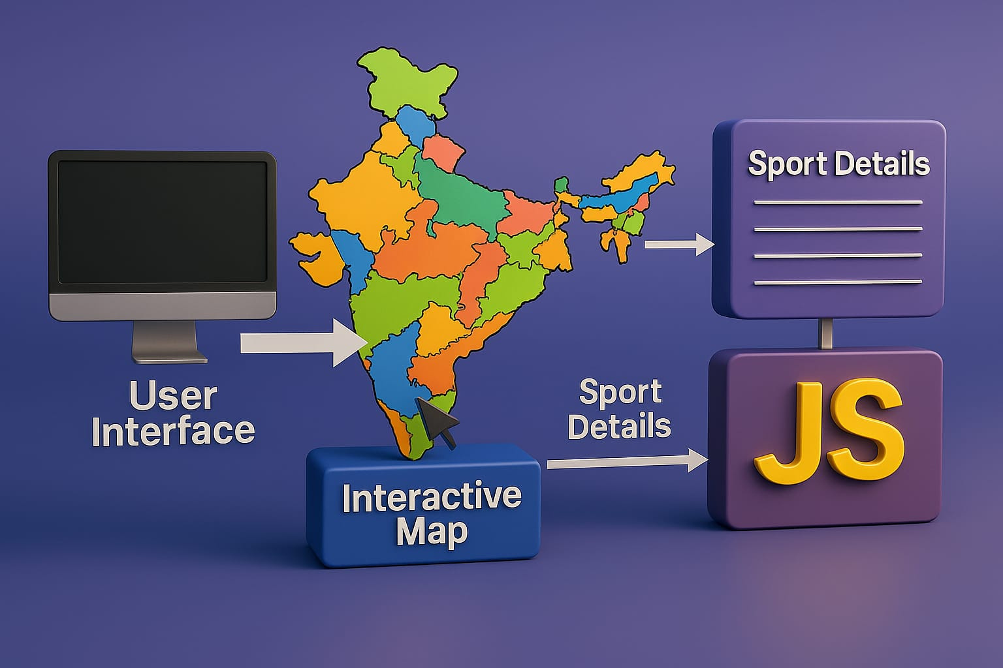
ARCHITECTURE
DIAGRAM

Slide 13
DESIGN
Usecase Diagram
Class Diagram
Sequence Diagram
Activity Diagram
Deployment Diagram

Slide 14
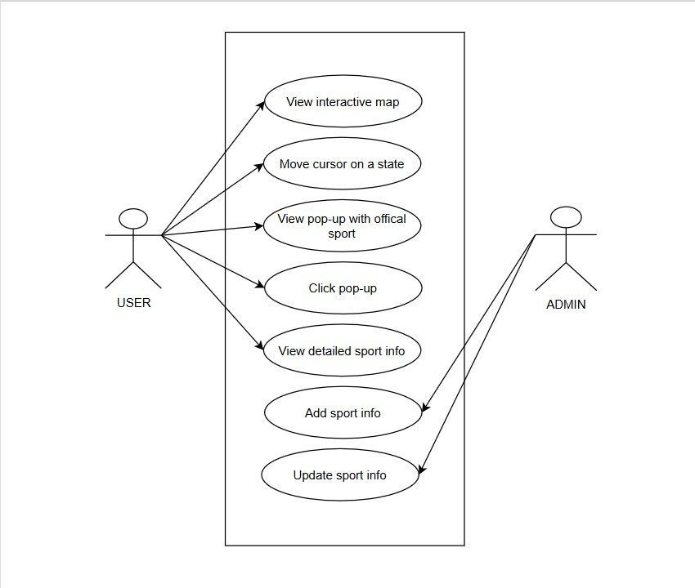
USECASE
DIAGRAM

Slide 15
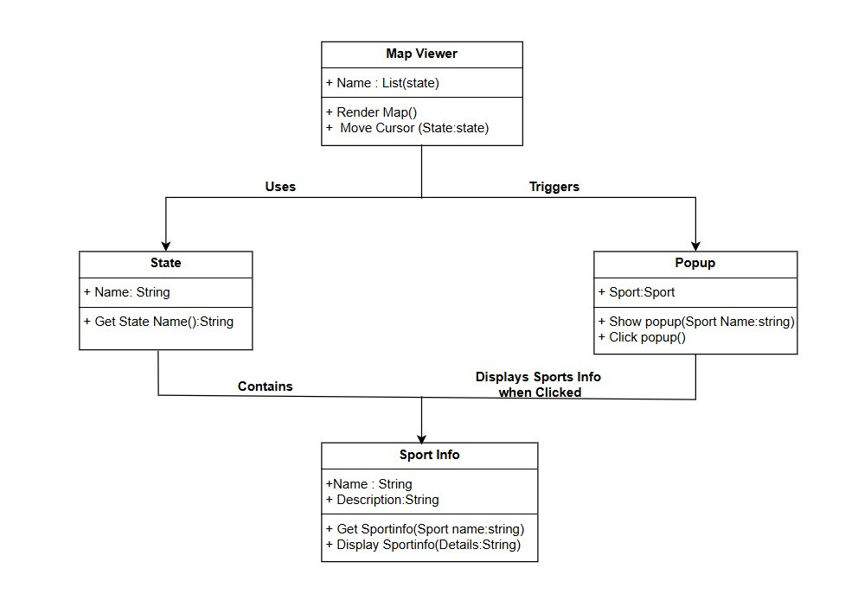
CLASS
DIAGRAM

Slide 16
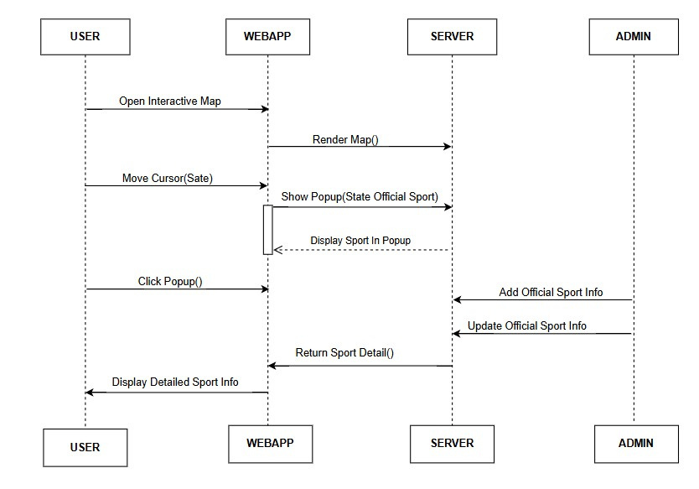
SEQUENCE
DIAGRAM

Slide 17
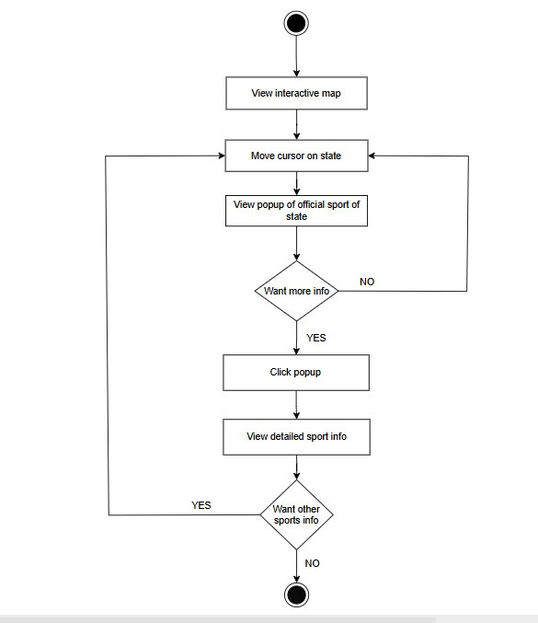
ACTIVITY
DIAGRAM

Slide 18
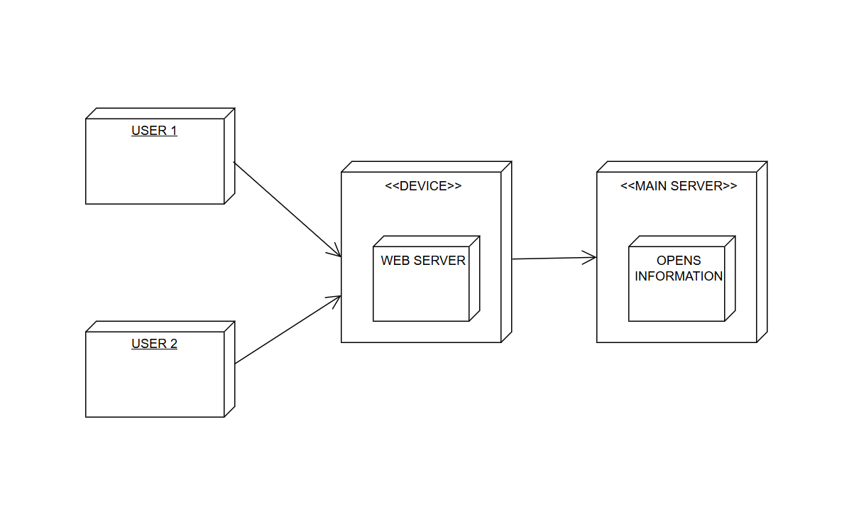
DEPLOYMENT
DIAGRAM

Slide 19
METHODOLOGY
•USER :Select A State And Move Curser Onto That State To Popup. Click State Or Popup To Get More Information Of Popular Regional Dish Of That State And Famous Restaurant.
•ADMIN : Admin Use To Store Data Of Website. Admin Can Update The Data.
•SERVER : Perform User Operations Like Open Web Pages.

Slide 20
METHODOLOGY
ALGORITHM
Create an interactive India map with state boundaries using HTML and CSS.
Utilize <map> and <area> tags to define clickable regions for each state.
Define a data structure (e.g., JSON object) to store state-specific sports information.
Store relevant sports data, including state name, sport name, history, rules, popularity, and benefits.
Create a popup/div element to display state sport information on mouseover/mouseenter events.

Slide 21
METHODOLOGY
ALGORITHM
Use JavaScript to populate the popup with relevant state sport data.
Add a click event listener to states and/or popup to display detailed sport information.
On click, display detailed sport information, including history, rules, popularity, and benefits.
Ensure responsive design and smooth popup interactions using CSS transitions/animations.
Test and refine the interactive map and popup functionality for optimal user experience.

Slide 22
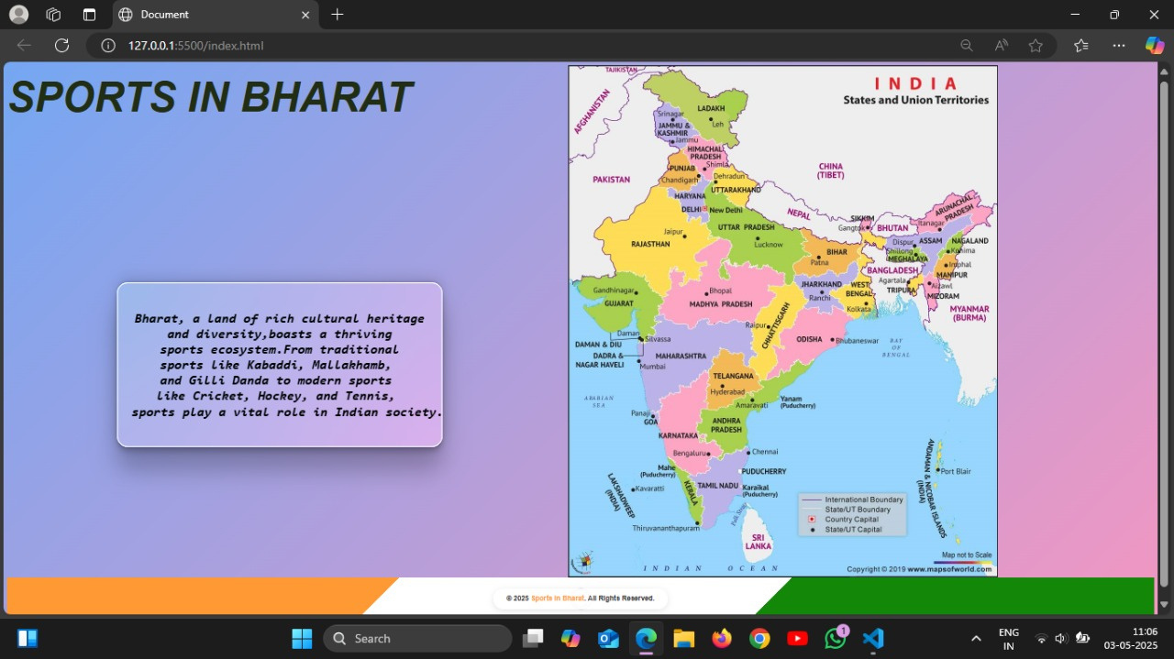
RESULT

Slide 23
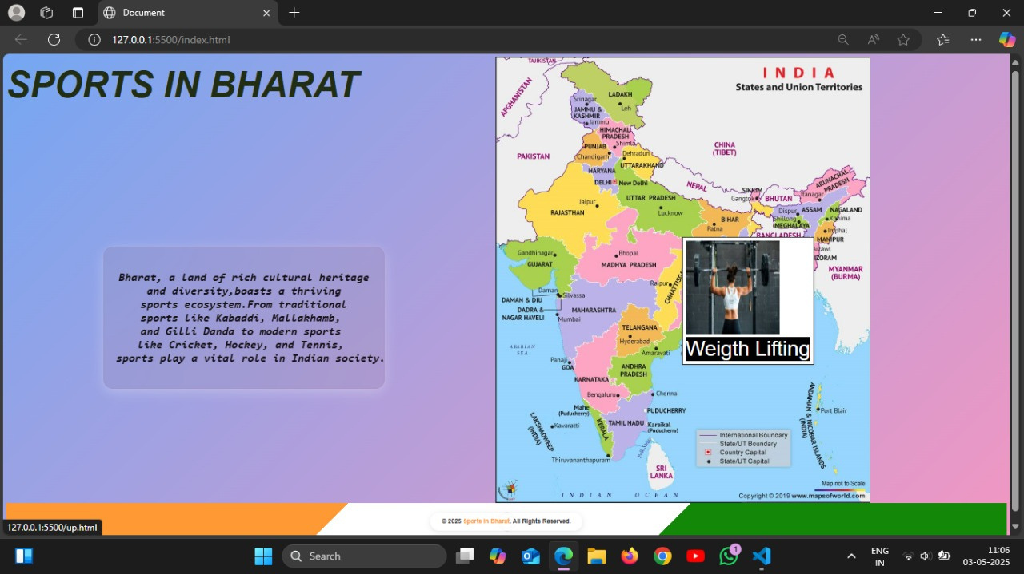
RESULT

Slide 24
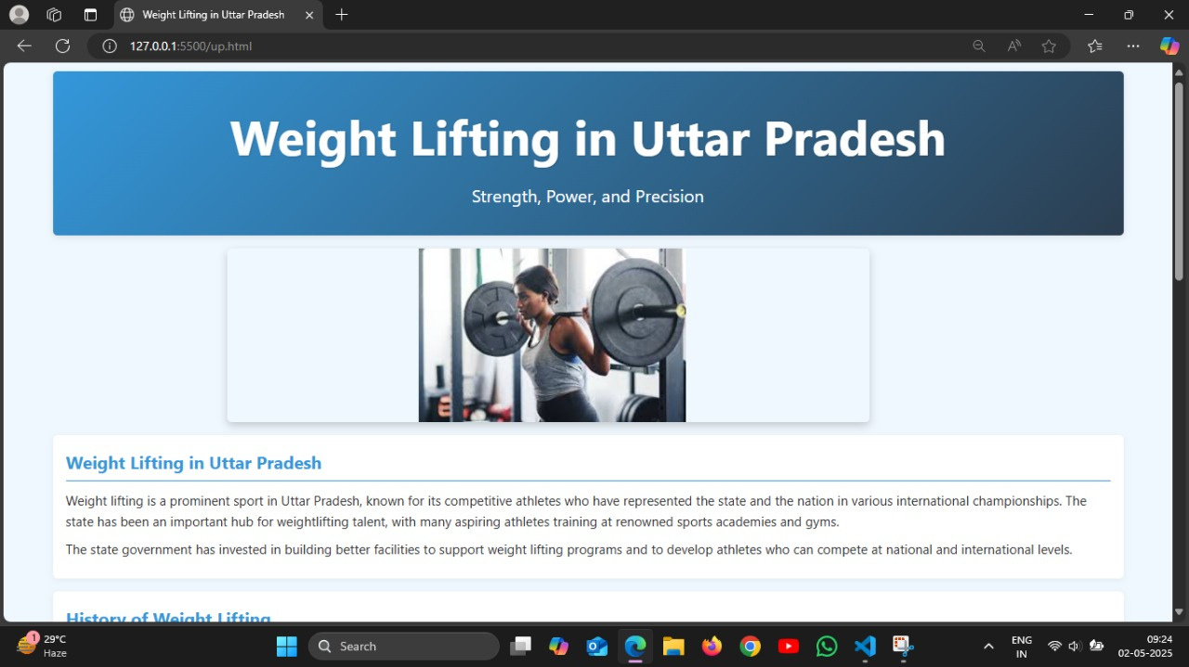
RESULT

Slide 25
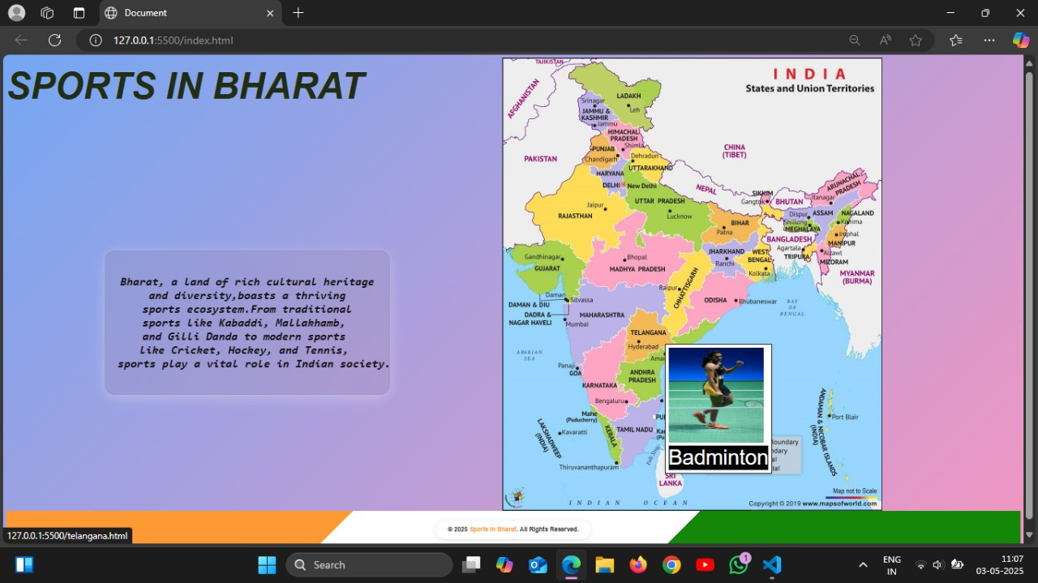
RESULT

Slide 26
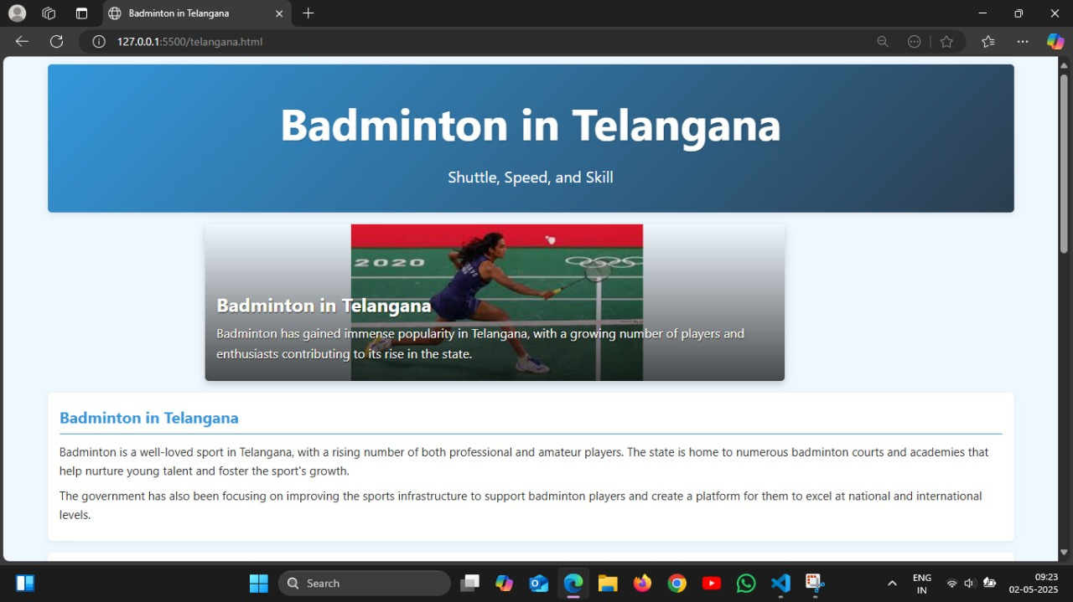
RESULT

Slide 27
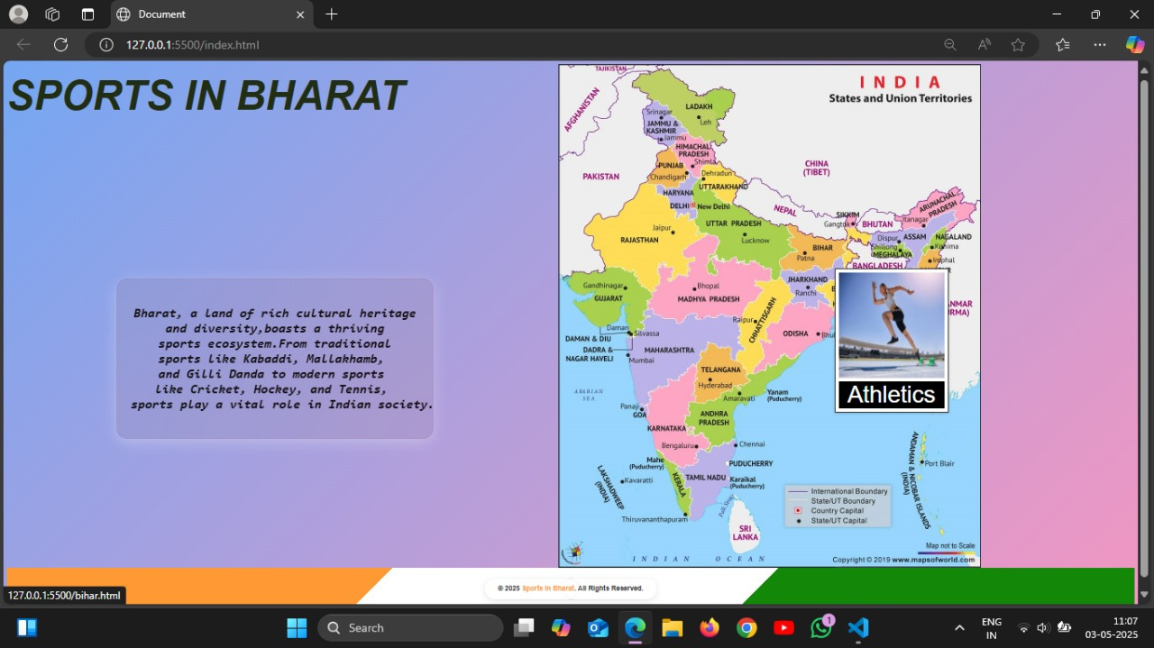
TEST CASE
Popup is not clickable.

Slide 28
CONCLUSION
"This project will demonstrate the power of interactive maps to convey information in an accessible and engaging manner." "By visualizing state-specific sports, this application will contribute to the preservation and promotion of India's sporting heritage." "The completed application will offer a dynamic and intuitive way to explore the official sports landscape of India." "This interactive map will simplify the process of discovering state sports, making the information readily available to a wide audience." "Ultimately, this project will create a fun and educational experience for users seeking to learn more about Indian sports."

Slide 29
FUTURE SCOPE
Add real-time updates on sports events, scores, and news.
Incorporate user-generated content, such as sports reviews or ratings.
Expand to other countries or regions, showcasing global sports diversity.
Develop a mobile app version for on-the-go access.
Utilize machine learning for personalized sports recommendations.

Slide 30
REFERENCES
[1].SCENARIO OF SPORTS IN INDIA- FROM ANCIENT PERIOD TO MODERN PERIOD
[2].An overview of sport in modern India
[4].Sports infrastructure, discipline and allocation of resources for sports in India
[5].Issues Related to Sports in India
[6].MapmyIndia: (https://www.mapmyindia.com/india-map/)
[7].Bharatmaps :https://bharatmaps.gov.in/BharatMaps/Home/Map

Slide 31
Thank you

