Slide 1
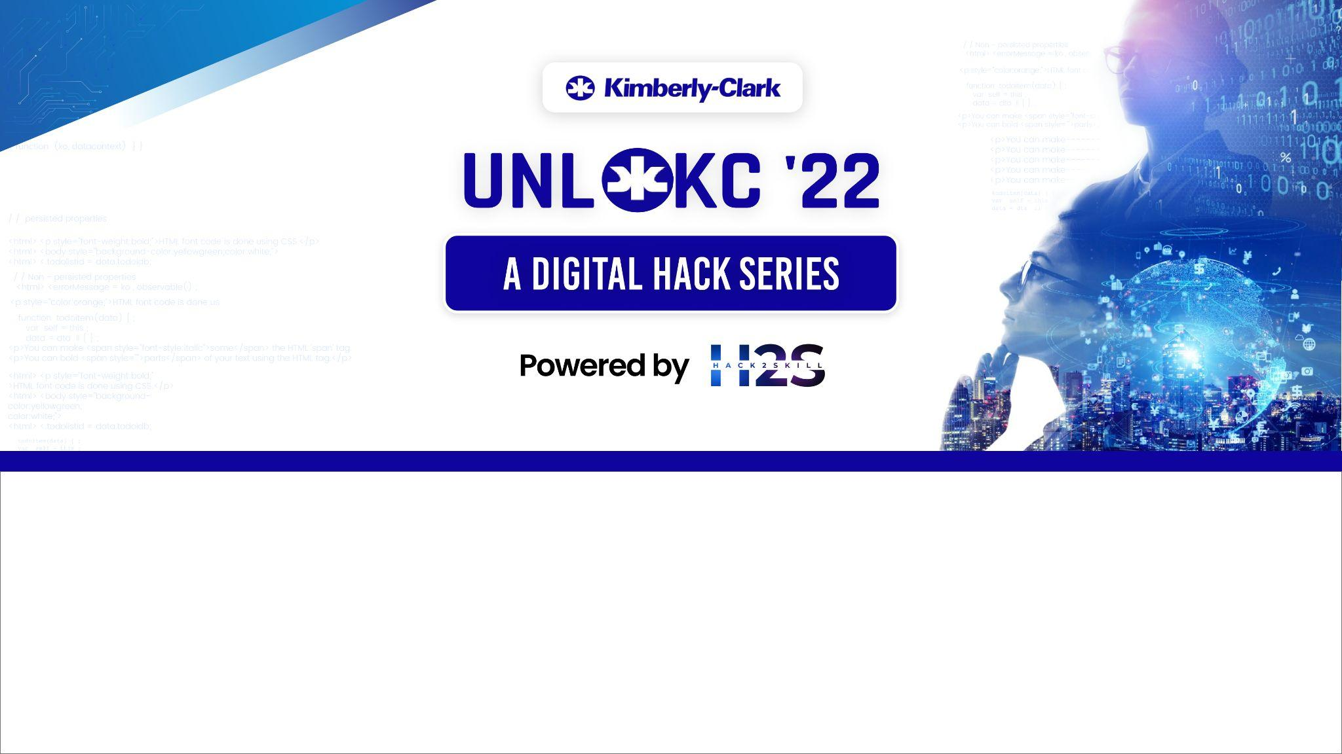
Team Name : UNPLUGGED
Problem Statement : Baby Skin Health Edutainment Through Gamification

Slide 2
About our problem statement:
Skin health is a major concern for all the parents with a new born baby as it is more common among the babies. If not treated properly, the condition may get worse than before. The problem statement asks about a way to find a more engaging gamified application that provides education through entertainment. It’s basic agenda is to educate parents about the different kinds of skin problems that a new born baby may face. The problem statement demands a series of levels or modules in a game where we work not only on a single issue but address as much conditions as possible.

Slide 3
Introduction to the game :
We let the user get a choice on how they choose to proceed as soon as they enter the homepage rather than us taking them forward in the application.
We provide the user the choice of level they are willing to play and based on their selection we move forward to the next stages.
After the game is being played we redirect the user to a quiz where we can have a user interaction.
At the home page we also provide icons like login, tips, how to play, superparents which lead to their respective modules.
After playing the interested levels the user can exit from the game.

Slide 4
Techstack :
Mind map - Build box provides an easy developer and user interface by using the principle of drag and drop, buttons and flowcharts. This provides an of how the user interfaces(UI) and worlds are interconnected and interact within each other.
Xampp App and Php myadmin - We make use of these two platforms to create a login page where we record the data like username and the required password which helps in keeping the record on who is visiting our application.

Slide 5
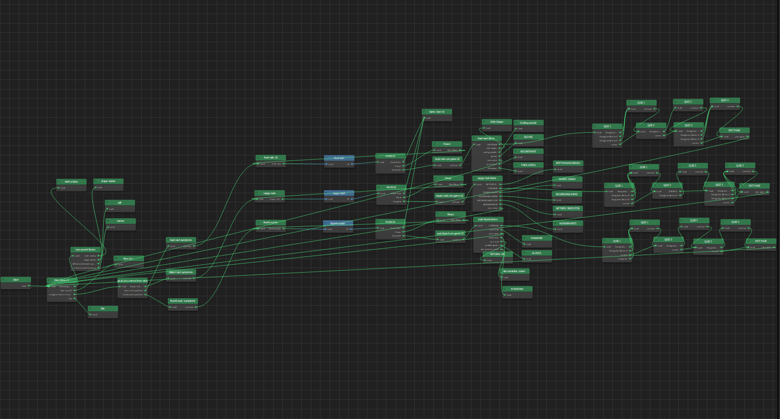
Mind map:

Slide 6
The unique features we provide:
The main criteria that our problem statement demands is how vastly we can help our users get briefed about baby skin health.
So we provide a number of ways to showcase the knowledge from resourceful platforms, to reach the parents.
This helps clear many doubts that a new parent can have and prevent them from consulting a doctor for even a minute things that can be solved through home remedies.
We also provide particular information about the different products that is used or can be used to help the baby in healing or even prevent from possible skin conditions.

Slide 7
Future prospects:
As we were constrained to a time limit we have not been able to address all the available skin care health hazards and topics. But we may be able to build a game by providing information on the overall available skin conditions.
Also due to some lack/constraints of necessary resource, we were not able to fulfil certain criteria of connecting or personalising the game based on the users inputs. Maybe in future we may get the access to them and fulfil the requirements.
We have also developed the game based on android and it cannot be exported to an app due to the high conditions required by the platform for the paid subscription for the plans of this platform.

Slide 8
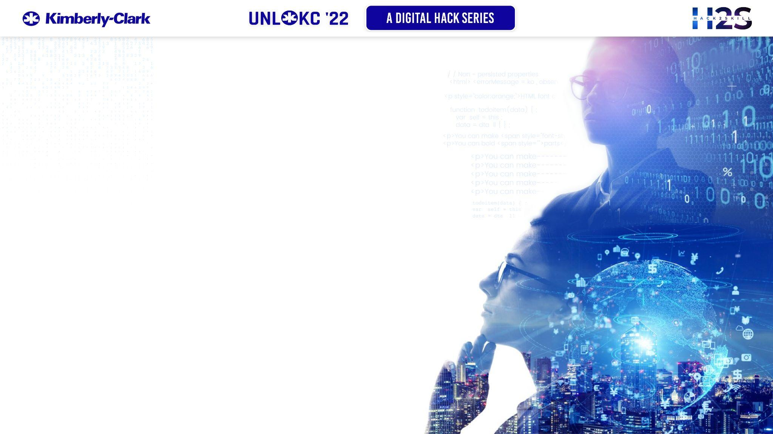
THANK YOU

