Slide 1

ABC Call Volume Trend Analysis

Slide 2
1
PLAN
2
PREPARE
STEPS FOR
DATA ANALYSIS
PROCESS
3
PROCESS
4
ANALYZE
5
SHARE
6
ACT

Slide 3
ABC Call Volume Trend Analysis
This project is all about the ABC Call Volume Trend Analysis.
In this we will find about all the details that will let us know about the ABC Call Volume Trend Analysis.
Download the csv data to excel for all the data analytics.
Things we are going to find
Calculate the average call time duration for all incoming calls received by agents
Show the total volume/ number of calls coming in via charts/ graphs [Number of calls v/s Time]. You can select time in a bucket form
As you can see current abandon rate is approximately 30%. Propose a manpower plan required during each time bucket [between 9am to 9pm] to reduce the abandon rate to 10%.
Now propose a manpower plan required during each time bucket in a day. Maximum Abandon rate assumption would be same 10%.

Slide 4



Ask: Effective questions, stating the required output by the leadership team.
DATA ANALYSIS
PROCESS
Prepare: Identify and taking the input data set to get the analytical result
The analysis makes things more simpler
Process: using the provided data by the team and excel sheet sorting.

Slide 5

Analyze: using tools ,sorting filtering data identify patterns and draw conclusions
DATA ANALYSIS
PROCESS
Share :understanding the conclusions in the form of ppt
Act: Team can work according to the results to take further action.

Slide 6
Steps to follow for Exploratory data analysis
Understanding data columns and data
Checking for missing data
Clubbing columns with multiple categories
Checking for outliers
Removing outliers
Drawing Data Summary

Slide 7
Approach
The data was downloaded from google sheets to excel .
All the data was filtered and categorised.
All steps from exploratory data analysis are performed.
For all the queries research the topics to get the optimized results for the analytics.
All the steps are done in the excel to get to know the results.
All the information regarding pivot tables and lookup and various different functions that were used to get the output for the desired results.
The solutions for the quires are there in the next slides.

Slide 8

ScreenShots and Solutions

Slide 9
Calculate the average call time duration for all incoming calls received by agents
.
Row Labels | Average of Averageif
10_11 | 97.42402163
11_12 | 116.7837413
12_13 | 144.7250237
13_14 | 149.5409567
14_15 | 146.9693211
15_16 | 169.8968228
16_17 | 181.4393491
17_18 | 179.7245137
18_19 | 174.3246753
19_20 | 144.5825468
20_21 | 105.9491371
9_10 | 92.01032541
Grand Total | 139.5321473

Slide 10
Show the total volume/ number of calls coming in via charts/ graphs [Number of calls v/s Time]. You can select time in a bucket form
Row Labels | Count of Customer_Phone_No | Count of Time
10_11 | 13313 | 11.28%
11_12 | 14626 | 12.40%
12_13 | 12652 | 10.72%
13_14 | 11561 | 9.80%
14_15 | 10561 | 8.95%
15_16 | 9159 | 7.76%
16_17 | 8788 | 7.45%
17_18 | 8534 | 7.23%
18_19 | 7238 | 6.13%
19_20 | 6463 | 5.48%
20_21 | 5505 | 4.67%
9_10 | 9588 | 8.13%
Grand Total | 117988 | 100.00%
Row Labels | Count of Time
20_21 | 4.7%
19_20 | 5.5%
18_19 | 6.1%
17_18 | 7.2%
16_17 | 7.4%
15_16 | 7.8%
9_10 | 8.1%
14_15 | 9.0%
13_14 | 9.8%
12_13 | 10.7%
10_11 | 11.3%
11_12 | 12.4%

Slide 11
As you can see current abandon rate is approximately 30%. Propose a manpower plan required during each time bucket [between 9am to 9pm] to reduce the abandon rate to 10%.
Time_bucket | Count of calls | Call volume | No of people per day
9_10 | 9588 | 8% | 5
10_11 | 13313 | 11% | 6
11_12 | 14626 | 12% | 7
12_13 | 12652 | 11% | 6
13_14 | 11561 | 10% | 6
14_15 | 10561 | 9% | 5
15_16 | 9159 | 8% | 4
16_17 | 8788 | 7% | 4
17_18 | 8534 | 7% | 4
18_19 | 7238 | 6% | 3
19_20 | 6463 | 5% | 3
20_21 | 5505 | 5% | 3
 | 117988 |  | 57

Slide 12
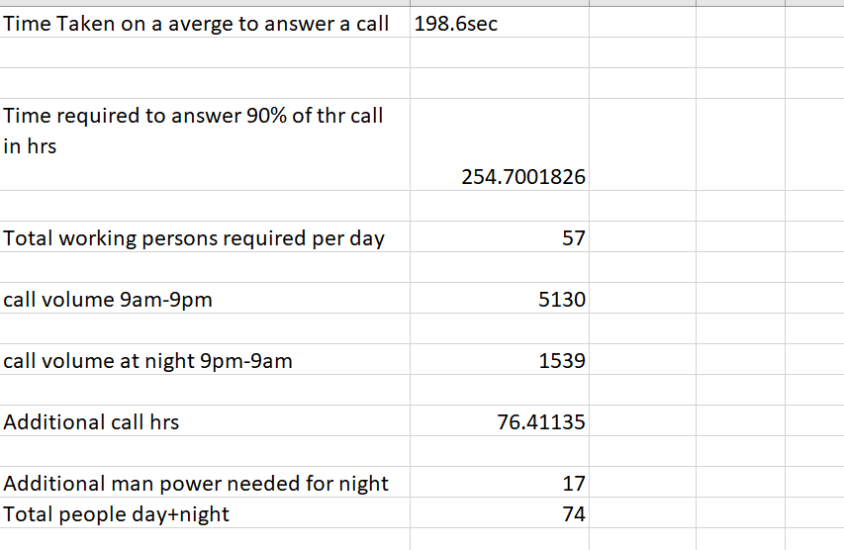
Now propose a manpower plan required during each time bucket in a day. Maximum Abandon rate assumption would be same 10%.
9am-9pm:54 people
9pm-9am:17 people
Totally 71 people are needed for 24/7 support in the company

Slide 13
Now propose a manpower plan required during each time bucket in a day. Maximum Abandon rate assumption would be same 10%.
 | Sum of Calls Received | Min of No of people
23_24 | 2 | 8
22_23 | 3 | 13
22_21 | 3 | 13
08_09 | 5 | 21
07_08 | 4 | 17
06_07 | 4 | 17
05_06 | 3 | 13
04_05 | 1 | 4
03_04 | 1 | 4
02_03 | 1 | 4
01_02 | 1 | 4
00_01 | 2 | 8
Grand Total | 30 | 4

Slide 14

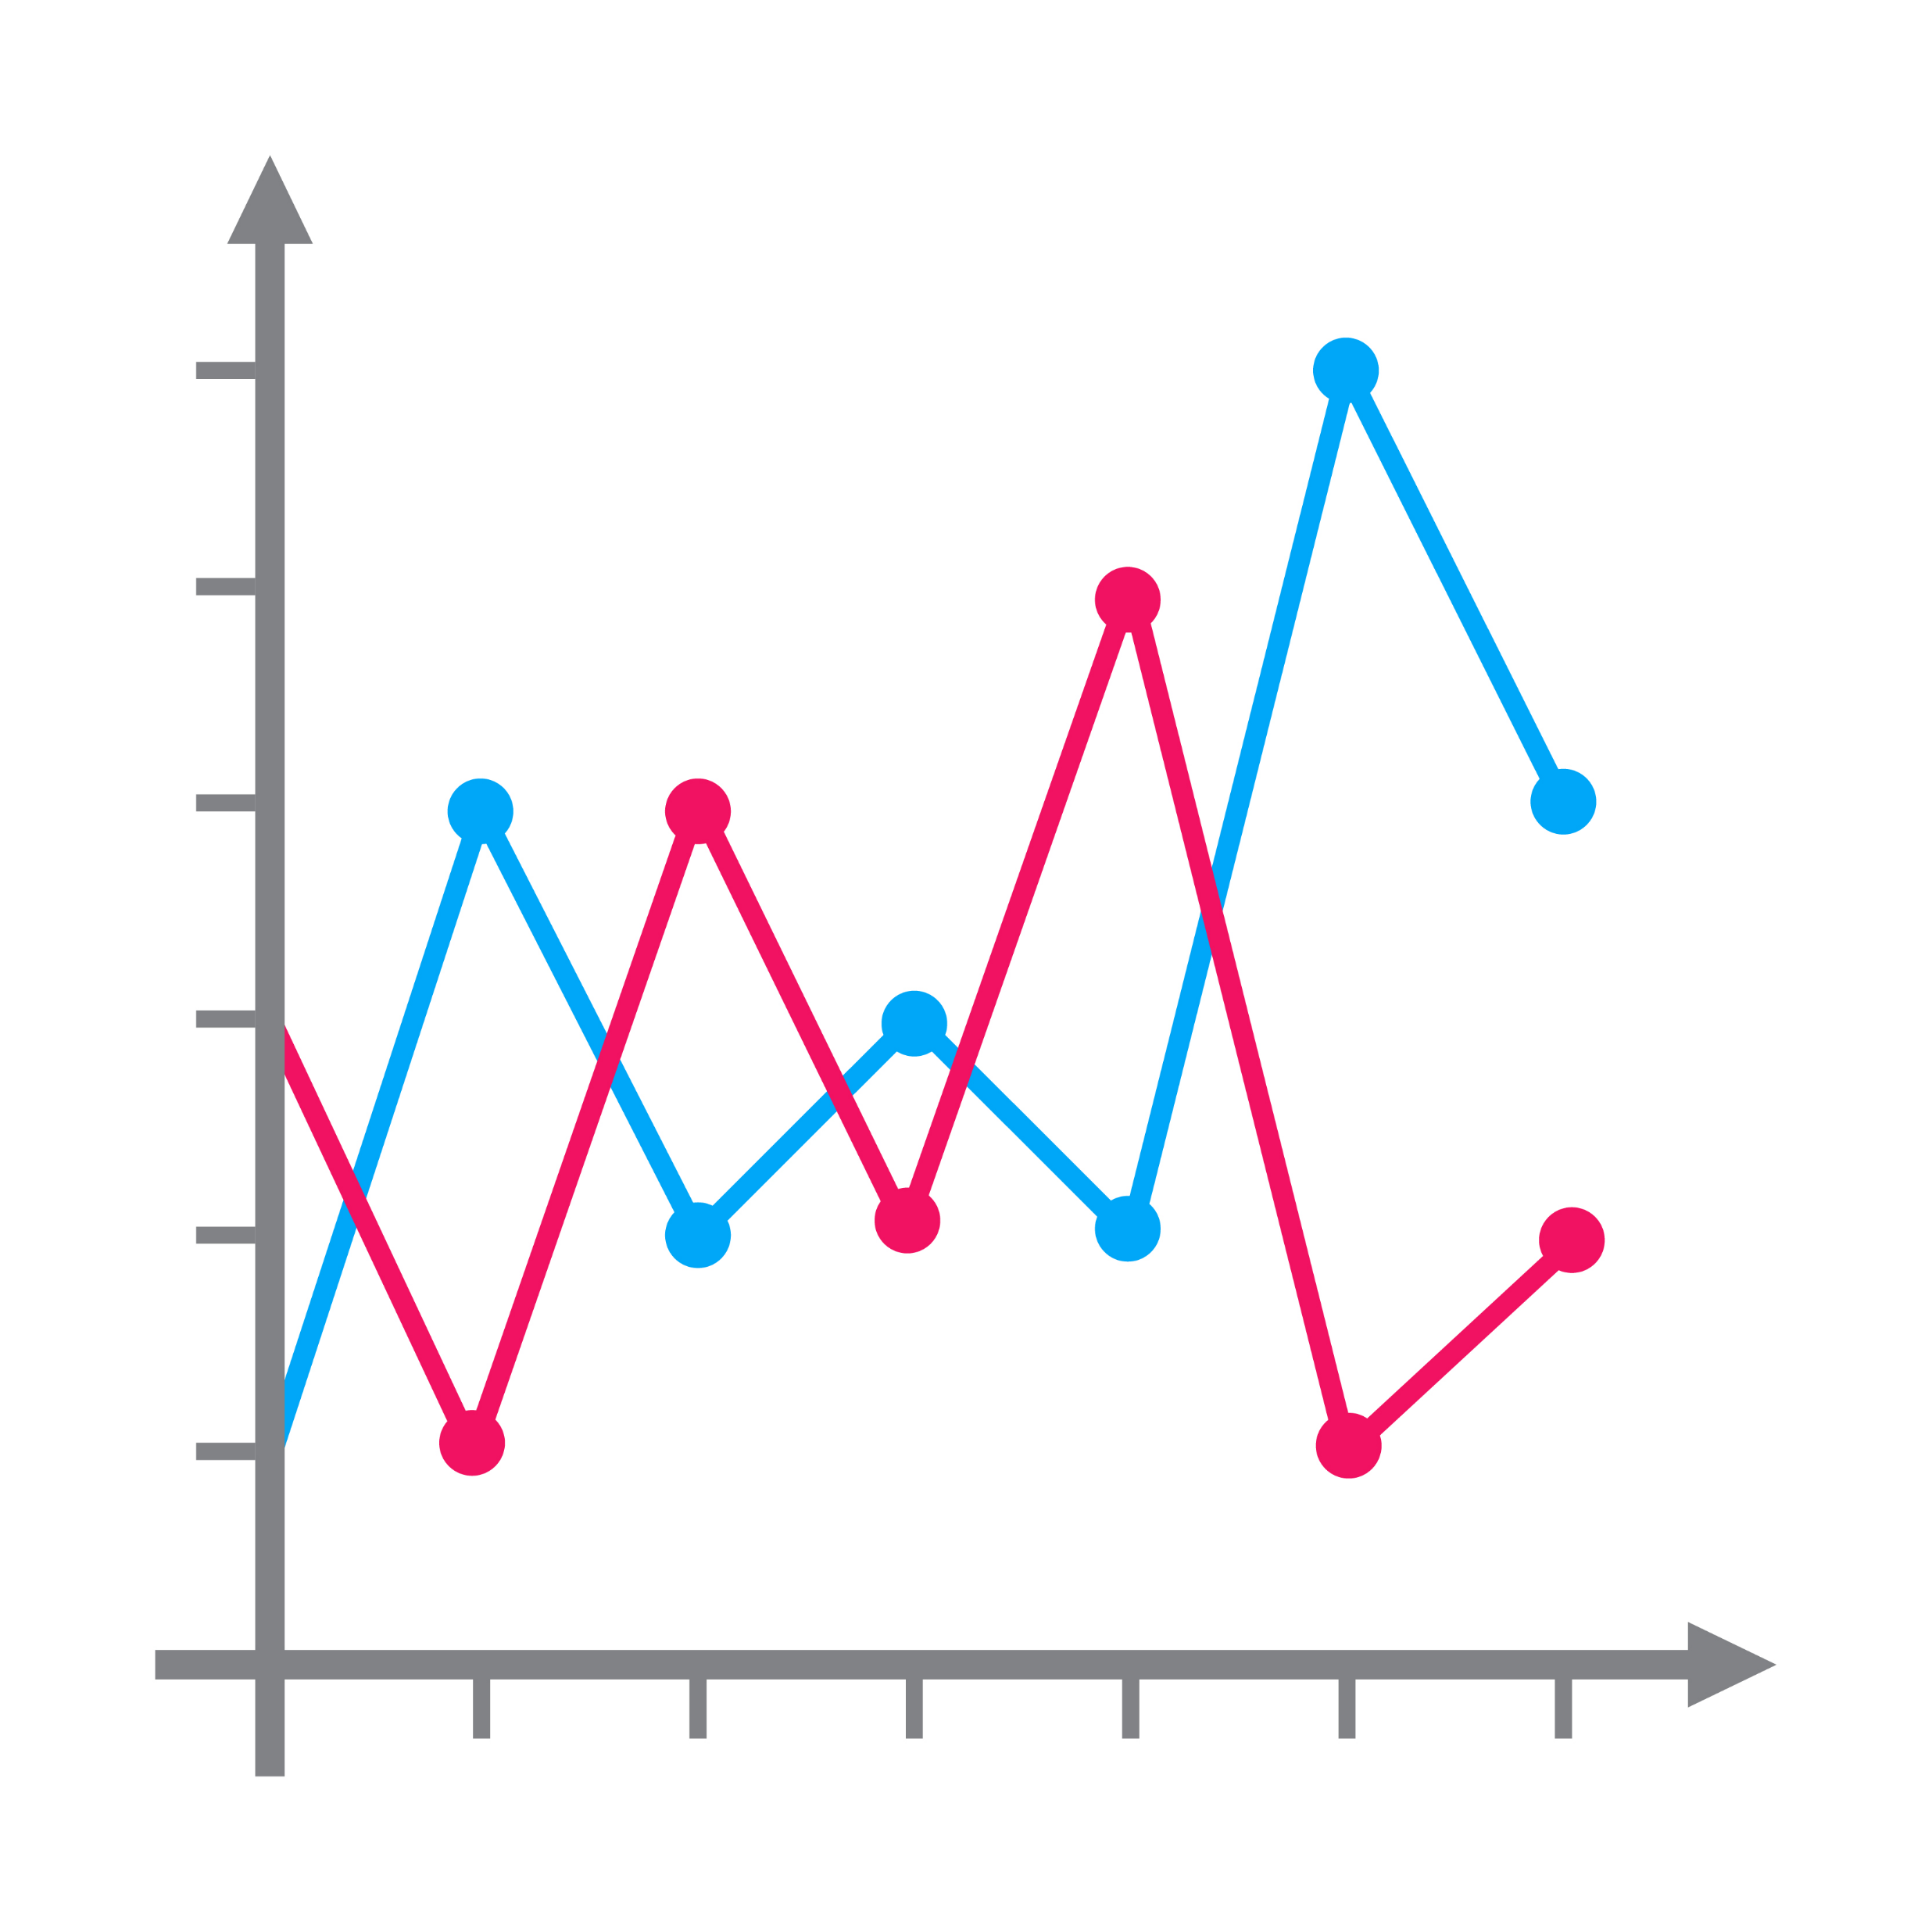
Technology Stack used

Slide 15
Insights
Creating new sheets in excel.
How to use advance excel.
All about aggregate function, VLOOKUP and look up functions. How to use them in excel.
How to draw conclusions from a given data according to stack holders .
Result
Got the desired output according to the leadership team.
How to take a informed decision in the data centric application to upgrade it.
How to use excel in an efficient way to do analysis.

Slide 16


