Slide 1
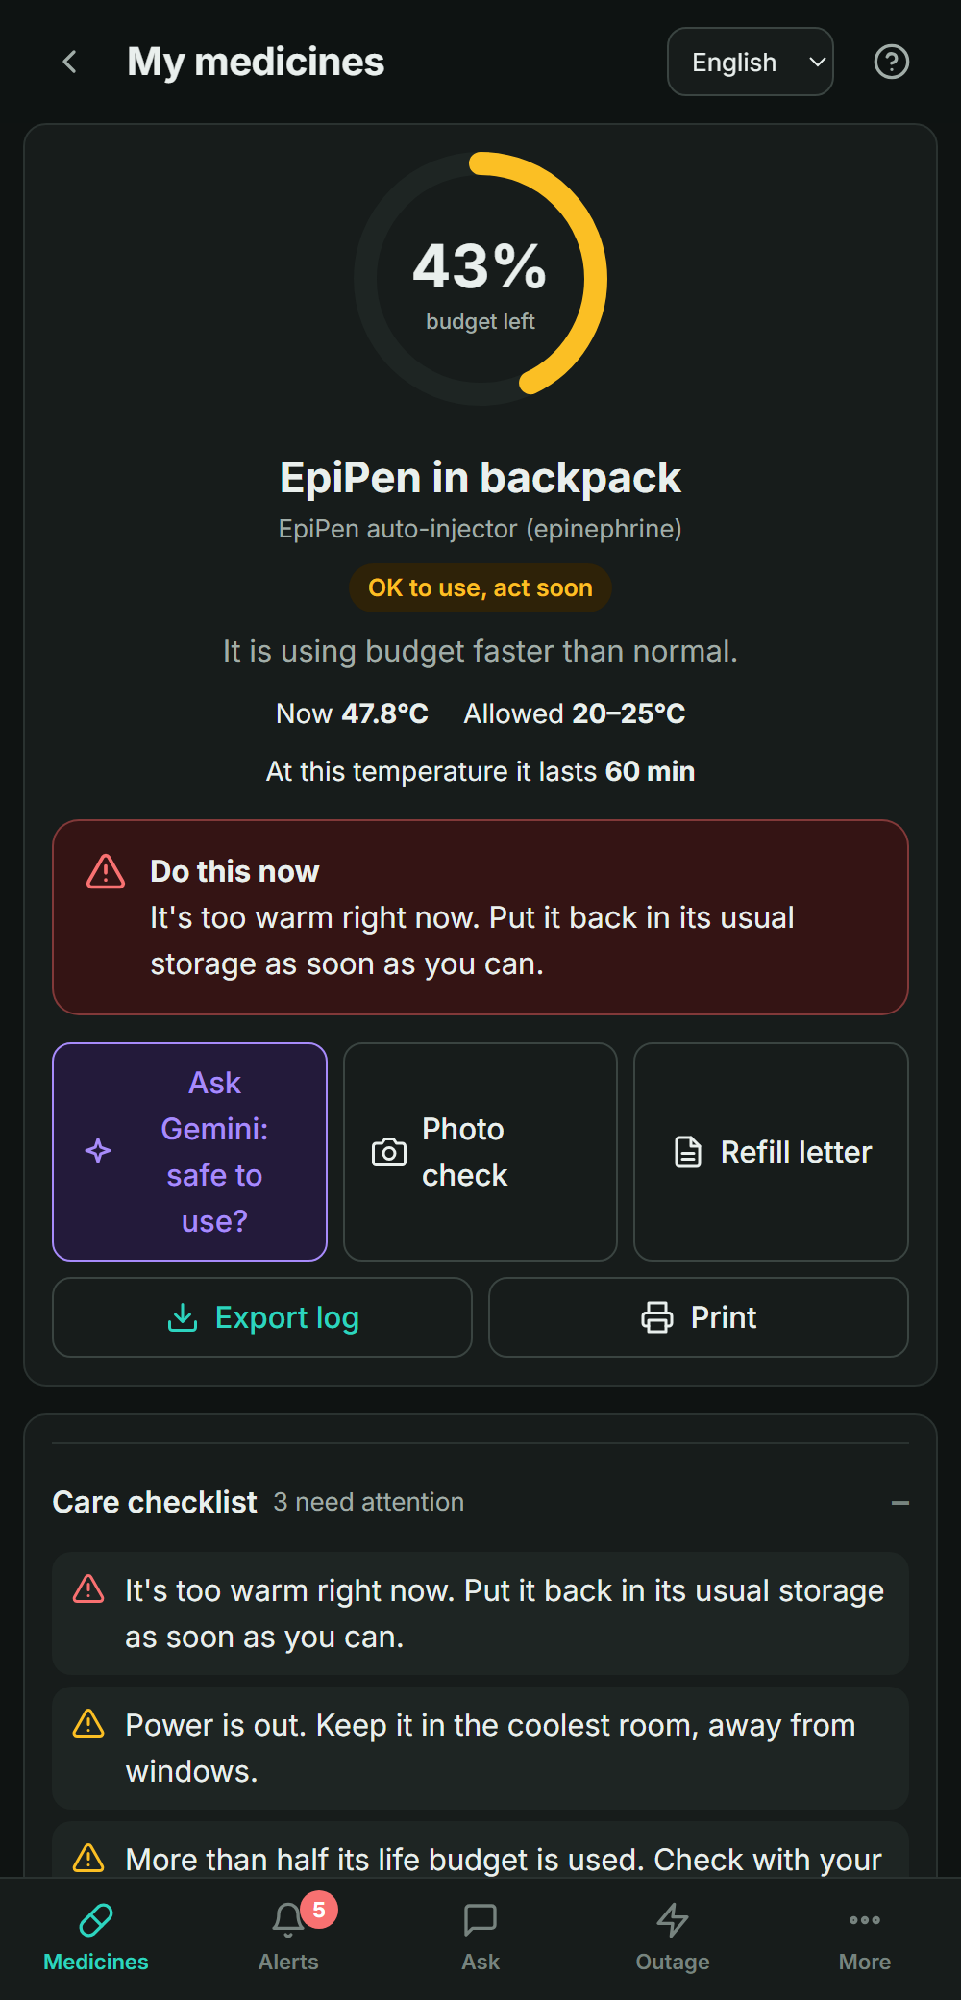

HACK DEARBORN 5 · CONJURE REALITY
LIFELOG
Conjure the hidden life of your medicine
We don't tell you if your medicine is cold right now. We tell you how much safe life it has left, and what to do about it.
Shaping Society track
Best Use of Tiger Data
Best Use of Gemini API
Notes:
[0:00–0:10] Hi, I'm Manu. This is LIFELOG. Our theme is Conjure Reality, and what we conjure is something invisible: how much safe life is left in a temperature-sensitive medicine. We're entering Shaping Society, plus Best Use of Tiger Data and Best Use of Gemini API.

Slide 2



The cold chain ends at the pharmacy door
Warehouses and pharmacies log temperature to the minute. Once a medicine goes home, nobody is watching.
The hot car
The power outage
The sunny mailbox
A parked car on a summer day can climb past 50°C. Many labels cap insulin, GLP-1 pens and EpiPens around 25–30°C.
A fridge without power warms slowly. After a storm, is the insulin still good? Nobody can say.
Mail-order medicine can sit in a hot mailbox for hours before anyone gets home.
Today's answer is a guess: throw away medicine that may be fine ($30 to $1,000 each), or use medicine that may not work.
Notes:
[0:10–0:45] Pharma tracks temperature obsessively, until the pharmacy door. After that it's a hot car, a power outage, a mailbox in August. People either throw away good medicine or use medicine that may have lost potency. Nobody can answer the simple question: is mine still OK?

Slide 3



The insight: exposure adds up
Two EpiPens. Same temperature right now. Very different lives.
Right now: 22°C
Right now: 22°C
100%
43%
Every medicine starts with a 100% life budget.
Time outside its label's range spends it, at the speed the label allows. It never refills.
A thermometer shows the present. LIFELOG remembers the past.
Stored as labeled for 3 days
Two hours in a hot car this afternoon
Safe to use
OK to use, act soon
Notes:
[0:45–1:10] Here's the key insight. A thermometer only tells you now. These two EpiPens both read 22 degrees, but one spent two hours in a hot car. Damage accumulates. So we give every medicine a life budget that starts at 100% and gets spent by exposure, at the rate its own label allows.

Slide 4
A big, growing group of people carry this risk
8M+
1 in 8
11 h
48 of 48
Americans rely on insulin to survive
U.S. adults currently take a GLP-1 drug
average power interruption per U.S. customer in 2024, nearly 2× the decade before
mail-order test packages left the labeled range in transit (27–54% of the time in summer)
American Diabetes Association, Mar 2026
KFF Health Tracking Poll, Nov 2025
U.S. EIA, Dec 2025
ASHP Midyear 2020, Univ. of Utah
Add biologics, migraine and bone injectables, EpiPens and glucagon: every one leaves the cold chain at the pharmacy door, and nobody tracks it after that.
Notes:
[1:10–1:45] This isn't a niche. Over 8 million Americans rely on insulin, 1 in 8 adults now take a GLP-1 drug, and power outages doubled last year to 11 hours per customer. When researchers mailed 48 test packages, every single one left its labeled temperature range. Add biologics, EpiPens and glucagon, and that's tens of millions of people whose medicine leaves the cold chain at the pharmacy door.

Slide 5
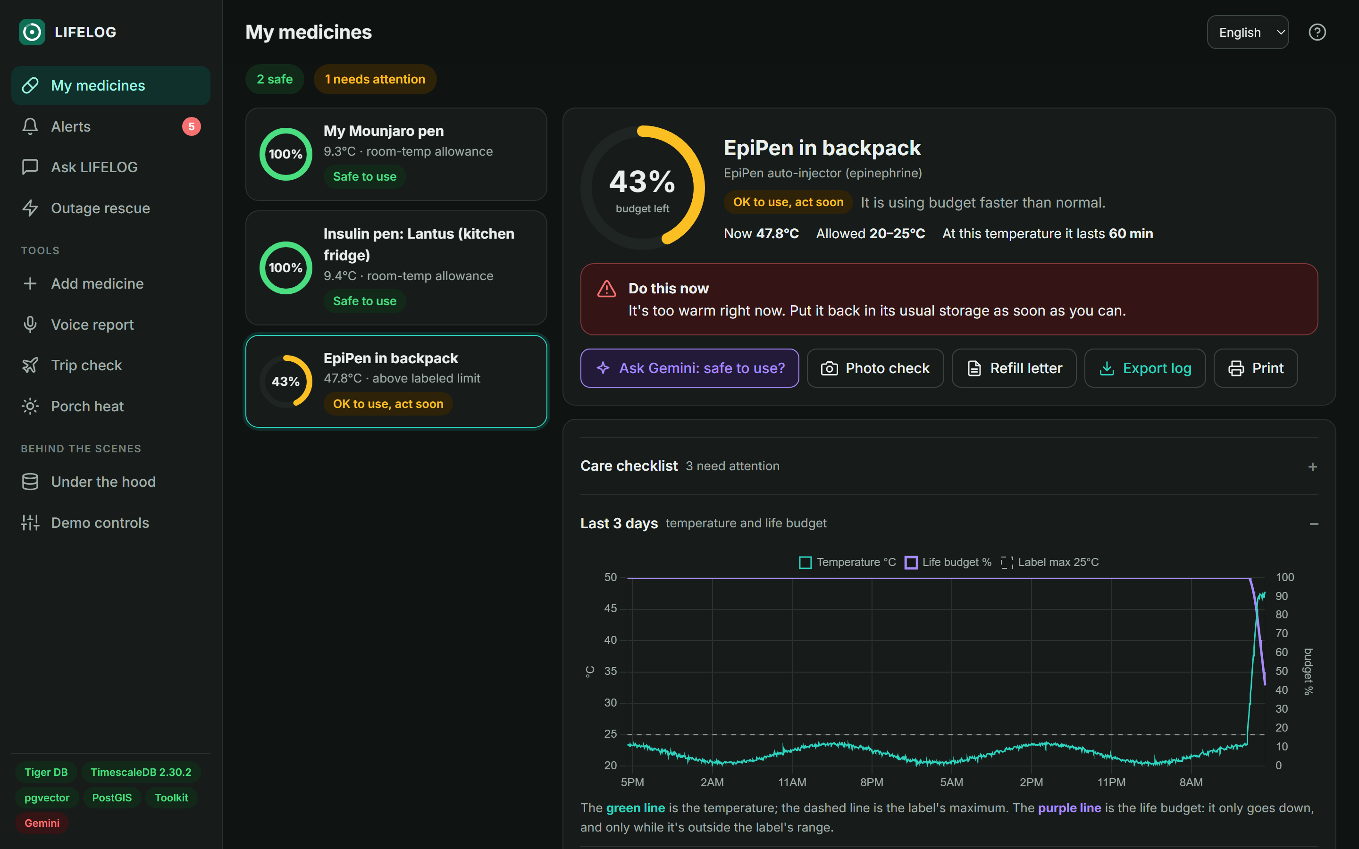



Meet LIFELOG
Plain-word status
Safe to use · Act soon · Check on it · Do not use
Do this now
The single best action, from the label and the situation
Why, and what if
What used the budget, and what each choice would save
Notes:
[1:45–2:15] Here's the app, on desktop and phone. Every medicine leads with a traffic light in plain words, a single 'do this now' action, and then the why: what used the budget and what each choice would save. Technical detail is folded away, so anyone can read it.

Slide 6



24 real medicines, checked against their FDA labels
Group | Medicines | Allowed outside the fridge
Insulins | Lantus, NovoLog, Tresiba, Humalog, Toujeo | ≤30°C · 28 days (Tresiba, Toujeo 56)
GLP-1 / GIP | Mounjaro, Zepbound, Ozempic, Wegovy, Trulicity, Victoza | ≤30°C · 14–56 days
Biologics | Enbrel, Humira, Dupixent, Stelara | ≤25–30°C · 14–30 days
Heart, migraine, bone | Repatha, Praluent, Aimovig, Emgality, Prolia, Forteo | ≤25–30°C · 7–30 days; Forteo: none
Emergency | EpiPen, Gvoke glucagon | room temp; 15–30°C excursions
Eye drops | Xalatan, opened | ≤25°C · 6 weeks
Any other medicine, by name
Official FDA label first
openFDA: exact storage text, no guessing
Gemini searches if needed
Google Search + URL Context grounding
Checked, then you confirm
Quotes not found in the label are flagged before tracking
Every quote is tested word-for-word against the saved label text, and every allowance's °C and days against its own quote. A script re-checks all 24 labels live (openFDA, DailyMed).
Notes:
[2:15–2:35] Accuracy starts with the rules. 24 real medicines: insulins, GLP-1 pens, biologics, heart, migraine and bone medicines, an EpiPen and glucagon, each from its manufacturer's FDA label. Every quote is tested word for word against the label text, and every number against its quote, and a script re-checks them live. For anything else, type the name: we fetch the official FDA label first, check what was extracted the same way, and flag anything we couldn't find.

Slide 7
How it works
Inputs
Gemini + ingest
Tiger Data
The engine
You see
Label photo or medicine name
Voice report
Temperature sensor
Weather forecast
Outage map
FDA label (openFDA) or Gemini search
Gemini reads it into rules
Gemini turns speech into readings
Ingest rejects bad data, spots late uploads
Hypertable of every reading
Continuous aggregate scores each reading
Jobs: alerts, compression, retention
Triggers push live updates
pgvector · PostGIS · Toolkit
Budget left
What used it
What if you act
Outage projection
Status + action
Gemini advice that cites the label
Rescue plan
Refill letter
Notes:
[2:35–3:10] Inputs come from a label photo, voice, a sensor, the forecast and the outage map. Gemini turns the unstructured ones into data. Tiger Data stores every reading and does the heavy lifting: continuous aggregates, scheduled jobs and live triggers. The engine computes the budget, and Gemini explains it back in plain language, citing the label.

Slide 8
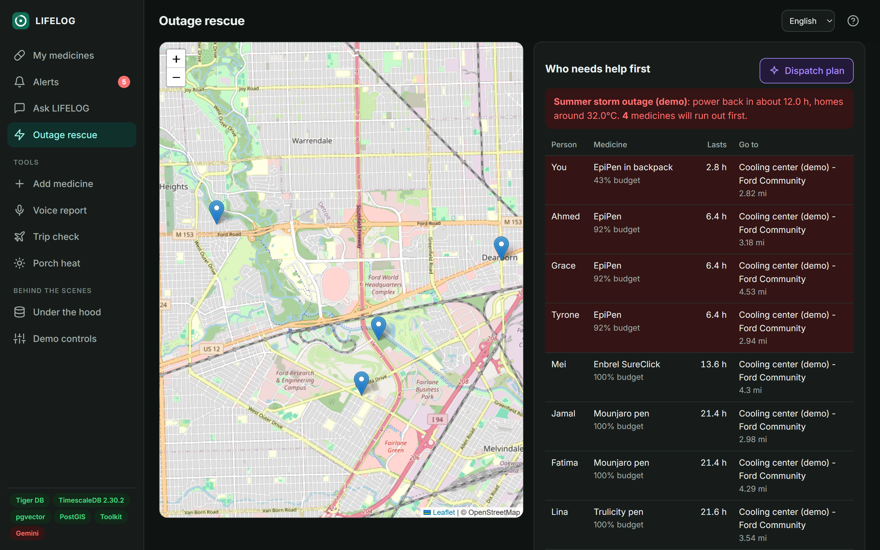



When the power goes out, who runs out first?
Finds everyone in the outage
PostGIS checks each home against the outage polygon
Ranks by hours left
Hours of medicine left vs. hours until power returns
Sends them to power
Nearest pharmacy, cooling center or neighbor who can host it
Demo: your hot-car EpiPen lasts 2.8 h; power is back in 12 h
Demo storm shown here; the next slide is the live DTE feed.
Notes:
Here's where one person's tracker becomes a community tool. During a storm outage, the database finds every home inside the outage, ranks medicines by hours left versus hours until power returns, and sends each person to the nearest place with power. In our demo, your hot-car EpiPen runs out in about 3 hours, and power is back in 12.

Slide 9
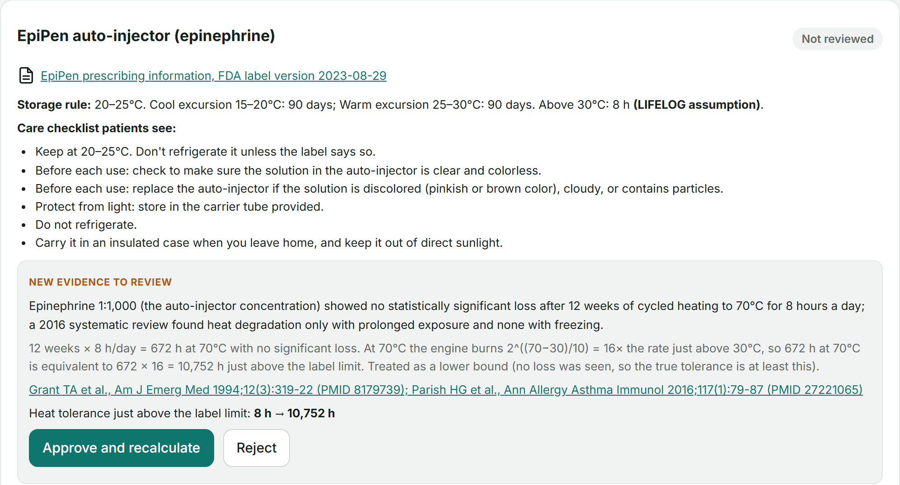




Private by design, checked by a pharmacist
Your data, enforced by Postgres
Row-level security: each signed-in person's queries only ever return their own medicines, doses and receipts
Pharmacist sign-off
Rules and the exact care-checklist wording are approved before patients see "reviewed"
Evidence replaces assumptions
Cited studies for EpiPen, Lantus, NovoLog and Humalog, e.g. EpiPen 8 h → 10,752 h (Grant 1994)
No number changes until a pharmacist approves it, and every derivation is shown, including our doubling-per-10°C rule.
Approve → history recalculated
Tiger Data refreshes every rollup; every decision is logged and shown on receipts
Notes:
[3:35–4:00] Medicine data has to be private and trustworthy. Privacy is enforced by the database itself: row-level security means a signed-in person's queries can only return their own rows. A pharmacist signs off on each medicine's rules and wording. And where the label is silent, published evidence can replace our 8-hour assumption, for example EpiPen's 1994 heat study, but only after a pharmacist approves it; then Tiger recalculates every patient's history.

Slide 10
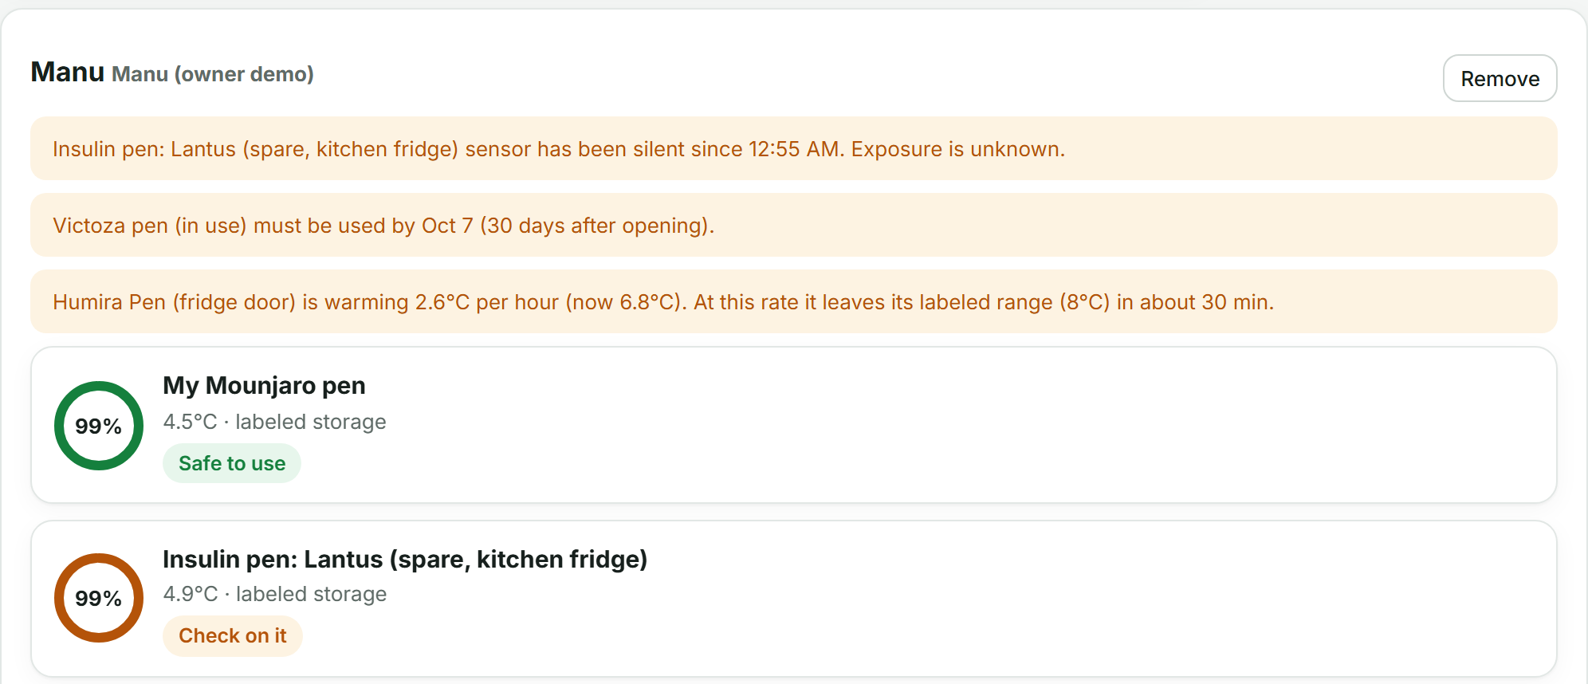


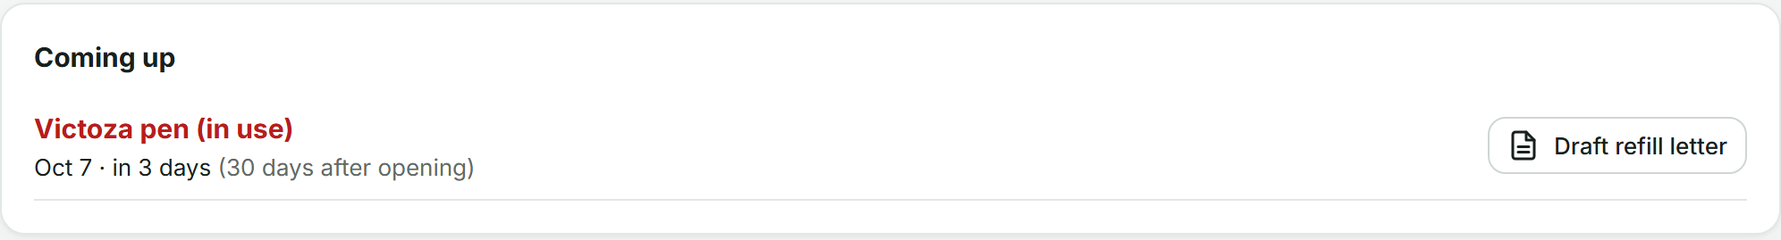


Care that reaches the whole family
People I care for
A caregiver sees each person's medicines and open alerts next to their own
Refill reminders
A "Coming up" list of use-by dates, with a refill letter drafted in one click
Alerts on every screen
Live in the app and as phone or desktop notifications, the moment the database raises them
Share links and receipt QR codes open on any phone, on any network.
"My power is out"
One tap turns a ZIP-level utility report into a plan for your own fridge
Notes:
[4:00–4:25] Medicine safety is a family affair: an older patient, or a son looking after his mother. A caregiver sees everyone they look after in one place. A Coming up list shows every use-by date with a refill letter drafted in one click. Alerts appear live in the app and as phone or desktop notifications. And one tap on My power is out turns the utility's ZIP-level report into a plan for your own fridge.

Slide 11



Who pays, and why
Patients and caregivers
Pharmacies and mail-order
Health plans and PBMs
Utilities and cities
Free
Subscription per patient tracked
Fee per verified receipt
License per service area
The app, reminders and the caregiver view. They bring the data and the network.
Proof of storage for replacements, fewer heat-damaged shipments, refill reminders that bring patients back.
Pay for replacements with evidence instead of guesswork, and see where waste happens.
Know which medical-needs homes to restore or check first in a storm.
Low cost to run: every AI feature has a no-AI fallback, and Tiger Data compresses history 11.2×. Prices are hypotheses we test in the pilot.
Notes:
[4:25–5:10] Patients never pay: they bring the data and the network. The people who lose money today pay. Pharmacies and mail-order services subscribe per patient: storage proof for replacements and fewer ruined shipments. Health plans pay per verified exposure receipt instead of approving replacements on guesswork. Utilities license the outage view to know which medical-needs homes come first. It's cheap to run: no feature depends on paid AI, and Tiger compresses the data 11 times. The exact prices are what our pilot will test.

Slide 12
Go-to-market: start in Dearborn
0–3 months
3–9 months
9–18 months
Pilot
Expand
Scale
One independent Dearborn pharmacy, about 100 insulin and GLP-1 patients, in English and Arabic.
A mail-order or specialty pharmacy using receipts for replacements, and a utility partner for storm season.
A health-plan pilot, and the open API for sensor, cooler and smart-fridge makers.
What we measure
Medicines saved from being thrown out, replacements backed by a receipt, and alerts acted on within the hour.
Why it's hard to copy
24 label-verified medicine rules, pharmacist review, and per-medicine history that a thermometer never builds.
Notes:
[5:10–5:45] We start where we are. First, one Dearborn pharmacy and about a hundred insulin and GLP-1 patients, in English and Arabic. Then a mail-order pharmacy and a utility partner before storm season. Then a health plan and our open API for device makers. We'll measure medicines saved from the trash, replacements backed by receipts, and alerts acted on within the hour. And it's hard to copy: verified label rules, pharmacist review and a history no thermometer builds.

Slide 13
We don't tell you if your medicine is cold right now.
We tell you how much safe life it has left.
WHAT WE ARE LOOKING FOR
Dearborn pharmacy pilot
Utility storm-season partner
Health-plan receipts pilot
Clinical validation study
Notes:
[5:45–6:05] So: we don't tell you if your medicine is cold right now. We tell you how much safe life it has left. We're looking for a Dearborn pharmacy for our pilot, a utility partner before storm season, a health plan to try exposure receipts, and clinicians to validate it. (Next click goes straight to the thank-you slide: the appendix is hidden.)

Slide 14
Appendix: backup slides for questions
Hidden in the slideshow. To open one while presenting, type its number and press Enter.
15
Everyone watches medicine until it reaches you
23
Was the dose I took last Tuesday still good?
16
What's new here
24
In your language, with your data in your hands
17
Tiger Data does the heavy lifting
25
Works with or without AI
18
Gemini: from messy reality to clear advice
26
Build on LIFELOG (developers)
19
A forecast trained for each medicine
27
Try it three ways (demo accounts)
20
Real outages, live from DTE
28
What you'll see in the live demo
21
Numbers you can trust, and limits we show
29
Who it helps
22
Records a pharmacist can verify
30
Tested end to end, and what's still open
Notes:
Appendix index. These slides are hidden during the slideshow; type a number and press Enter to jump to one.

Slide 15




Everyone watches medicine until it reaches you
Warehouse trackers
Fridge thermometers
The label and pharmacist
LIFELOG
e.g. Controlant, Zest Labs
Alarms and loggers
The rules exist
Patient-side, live
Track pallets and shelf life
Stop at delivery
Beep at one threshold
No memory, no label rules
Know what's allowed
Can't see what happened
Reads the label for you
Remembers every reading
Tells you what to do
Notes:
What exists today? Warehouse trackers like Controlant and Zest Labs predict shelf life for pallets, but they stop at delivery. Fridge thermometers beep at one threshold and forget. The label has the rules but nobody applies them to what actually happened. LIFELOG is the first piece that lives with the patient.

Slide 16
What's new here
1
Any label becomes a model
2
Built for patients, not pallets
Snap the box, or just type the name: LIFELOG fetches the official FDA label and Gemini turns it into rules, quoting it word for word.
Cumulative and scored on every single reading, with an honest range when the sensor goes quiet.
3
From one fridge to a neighborhood
4
The database does the thinking
In an outage, everyone's budgets become a ranked rescue list, each person sent to the nearest place that still has power.
Alerts, live updates and late-data repair run inside Tiger Data as jobs, triggers and continuous aggregates.
Notes:
Four things are new. One: Gemini turns any label into a model, so we never hand-configure a product. Two: a cumulative life budget for patients, scored per reading, honest about uncertainty. Three: one person's tracker becomes a neighborhood rescue network in an outage. Four: the intelligence lives in the database.

Slide 17







Tiger Data does the heavy lifting
11.2×
Hypertables
Continuous aggregate
Every reading, time-partitioned, compressed
Scores each reading, live
smaller history (columnstore compression)
Targeted refresh
Scheduled jobs
3 of 3
Repairs late sensor data
Alerts every minute, compression
independent calculations agree on every budget
LISTEN / NOTIFY
pgvector
Pushes live updates to phones
Finds similar exposure histories
~2 s
PostGIS
Toolkit
from a new reading to an alert on screen
Who is inside the outage
Time-weighted temperatures
Notes:
Tiger Data isn't just storage here. A continuous aggregate scores every reading in real time. When a sensor reconnects with hours of old data, we refresh exactly the affected window. Alerts run as a scheduled job inside the database, triggers push live updates, compression shrinks history 11 times, and we use pgvector, PostGIS and Toolkit.

Slide 18






Gemini: from messy reality to clear advice
Label → model
Add by name
Your language
Voice reports
A photo or PDF becomes structured rules with verbatim quotes
Google Search + URL Context grounding, with sources shown
Answers in Arabic, Spanish or Bengali; label quotes stay exact
"Left it in the car for two hours" becomes readings
Photo check
Safe to use?
Ask LIFELOG
Rescue and letters
Compares the vial with the label's visual warnings
A verdict grounded in your data that cites the label
Function calling over five live data tools
Outage dispatch texts and insurance refill letters
Notes:
Gemini works at both ends. It reads labels, voice and photos into structured data, finds official labels by name with grounded search, and turns our numbers back into advice that quotes the label, in Arabic, Spanish or Bengali if you prefer. Ask LIFELOG uses function calling: Gemini decides which of five data tools to call, and we show which ones it used.

Slide 19
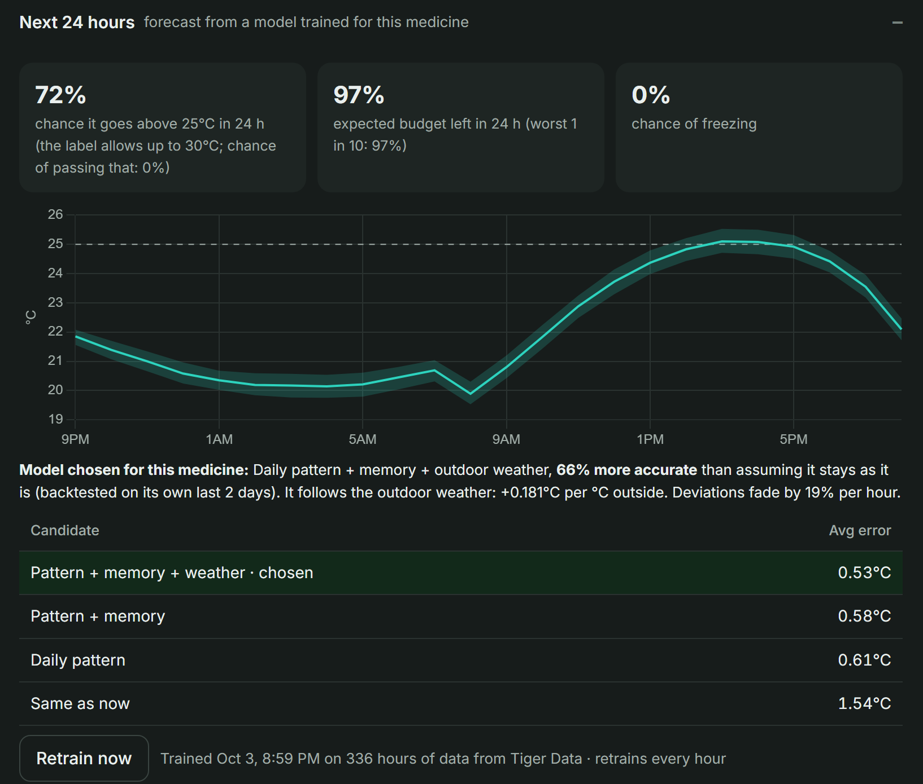

A forecast trained for each medicine
Trained on its own history
14 days of hourly temperatures from the Tiger rollup, plus outdoor weather
Four models compete
Same as now · daily pattern · + short-term memory · + outdoor weather
The best one wins, per medicine
Backtested on its own last 2 days. EpiPen in a backpack: weather model, 66% more accurate. Fridge pens: simpler models
Risk, not just a line
300 simulated futures through the life budget: chance of leaving range, freezing, budget left
Retrains every hour · models stored in Tiger Data · drives predicted-excursion alerts
Notes:
Every medicine gets its own forecasting model. Four candidates compete on that medicine's own history from Tiger Data, and the winner is chosen by backtesting. The EpiPen in a backpack follows the outdoor weather, so it gets the weather model, 66 percent more accurate than assuming nothing changes; fridge pens get simpler models. Then we simulate 300 possible futures through the life budget to get real risks, not just a line.

Slide 20
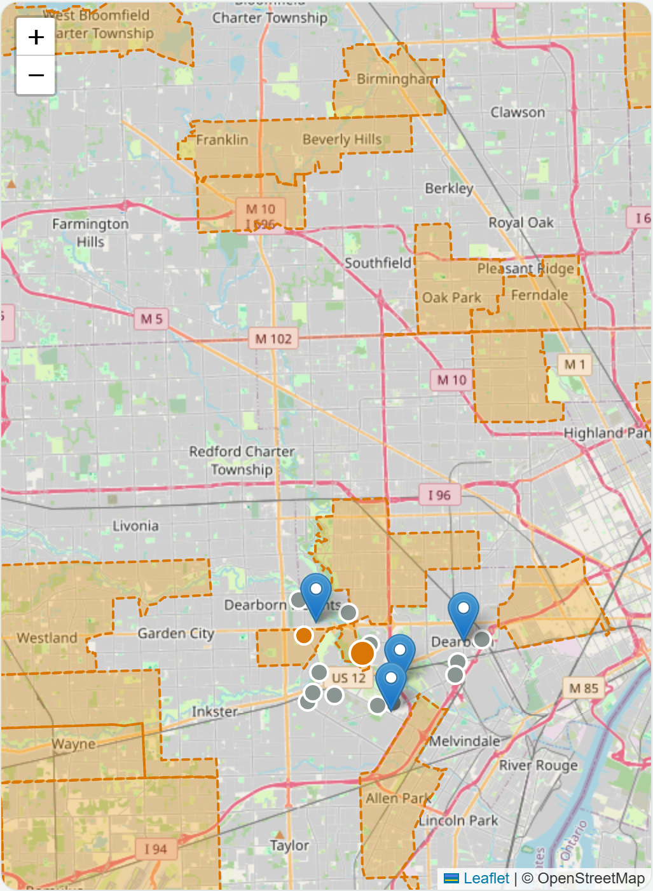




Real outages, live from DTE
Imported every 10 minutes
DTE's public outage map: areas by ZIP, customers out, restoration time when known
Stored as PostGIS polygons
Updated in place; areas close automatically when power is restored
Honest about precision
A ZIP-wide area means power may be out; one tap on "My power is out" confirms your home
Any Kubra utility
Consumers Energy and others plug in with one setting
Captured Oct 3, 2026: 174 DTE customers without power across 30 ZIP areas
Notes:
The rescue map isn't only a demo storm. Every 10 minutes LIFELOG imports DTE Energy's public outage map, stores each outage area as a PostGIS polygon with customers out and the restoration estimate, and closes areas when power is back. Utilities report by ZIP code, so we say power may be out instead of pretending we know. When we captured this, 174 customers were out across 30 ZIP areas.

Slide 21
Numbers you can trust, and limits we show
Three independent calculations, one answer
Live rollup in Tiger (what you see) | 42.83%
Recomputed from 4,320 raw readings | 42.83%
Separate Python implementation | 42.83%
Old method: averaging first | 43.10%
We score every reading, because heat damage jumps at the label's limits and grows exponentially above them.
Silent sensor → "Check on it", never "Safe"
Impossible readings rejected
Decision support, not medical advice
Notes:
Trust matters with medicine. Every budget is calculated three independent ways and they agree exactly. We also show our biggest assumption instead of hiding it: when a label doesn't say how long it tolerates heat, we assume 8 hours, and this chart shows how the answer would change. A silent sensor never shows 'safe'.

Slide 22
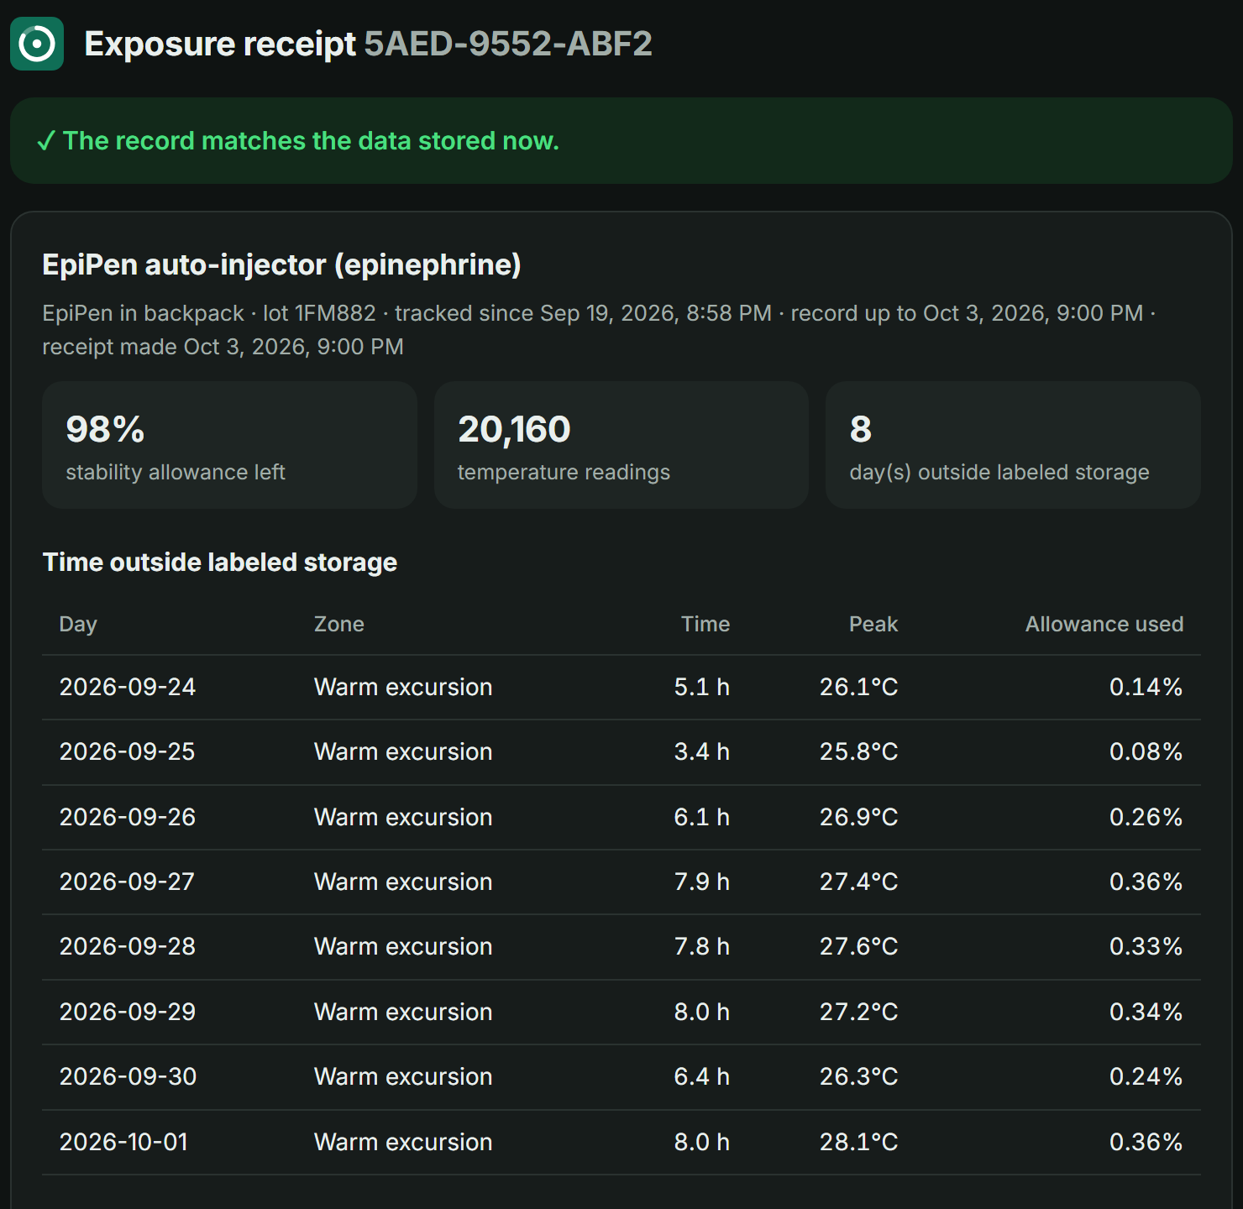




Records a pharmacist can verify
One tap freezes the record
LIFELOG stores a SHA-256 fingerprint of the exposure history in Tiger Data
The pharmacist scans the QR code
They see days outside storage, peaks, budget used and the label's own words
Changed since? It says so
Late sensor data or edits to that period are detected when the page recomputes the fingerprint
Built into refill letters
Every replacement request carries its receipt code
Notes:
Insurers and pharmacists need to trust the numbers. One tap creates an exposure receipt: a fingerprint of the medicine's temperature record stored in Tiger Data. The pharmacist scans the QR code and sees the record. If anything in that period changed later, the page says so.

Slide 23
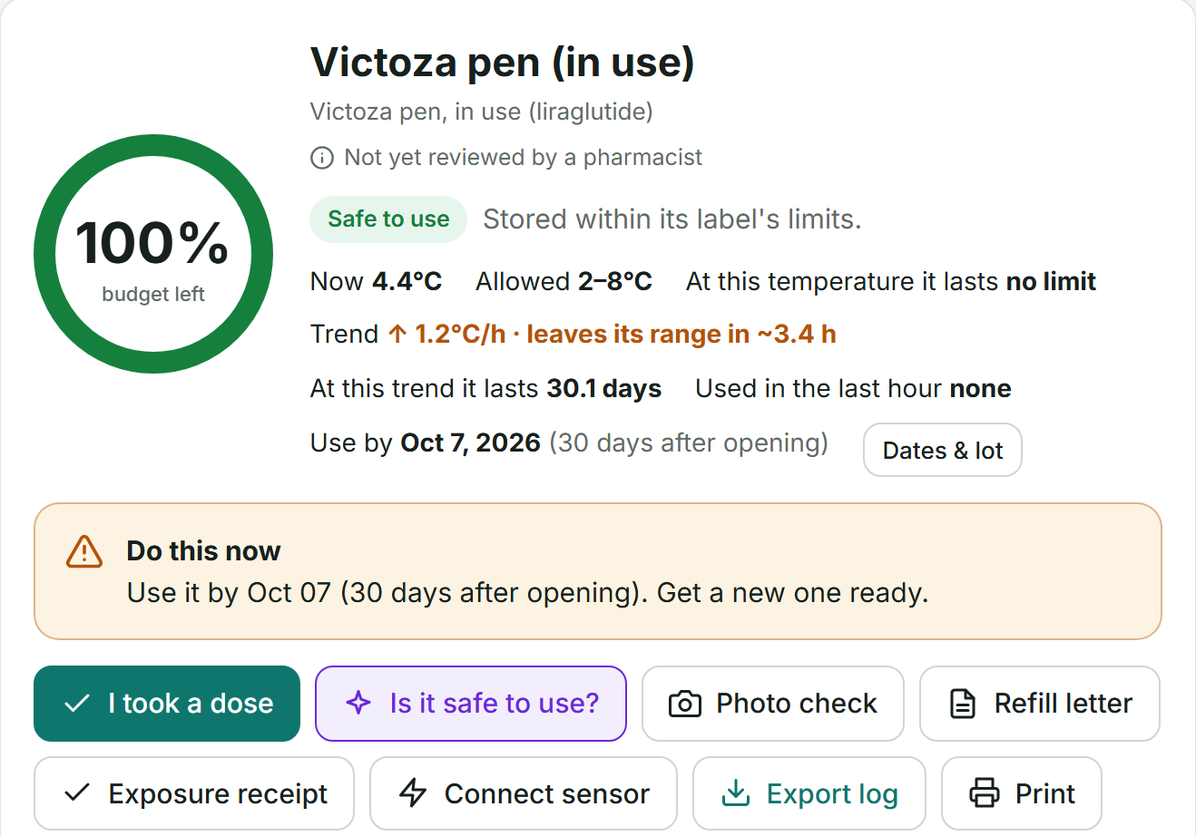
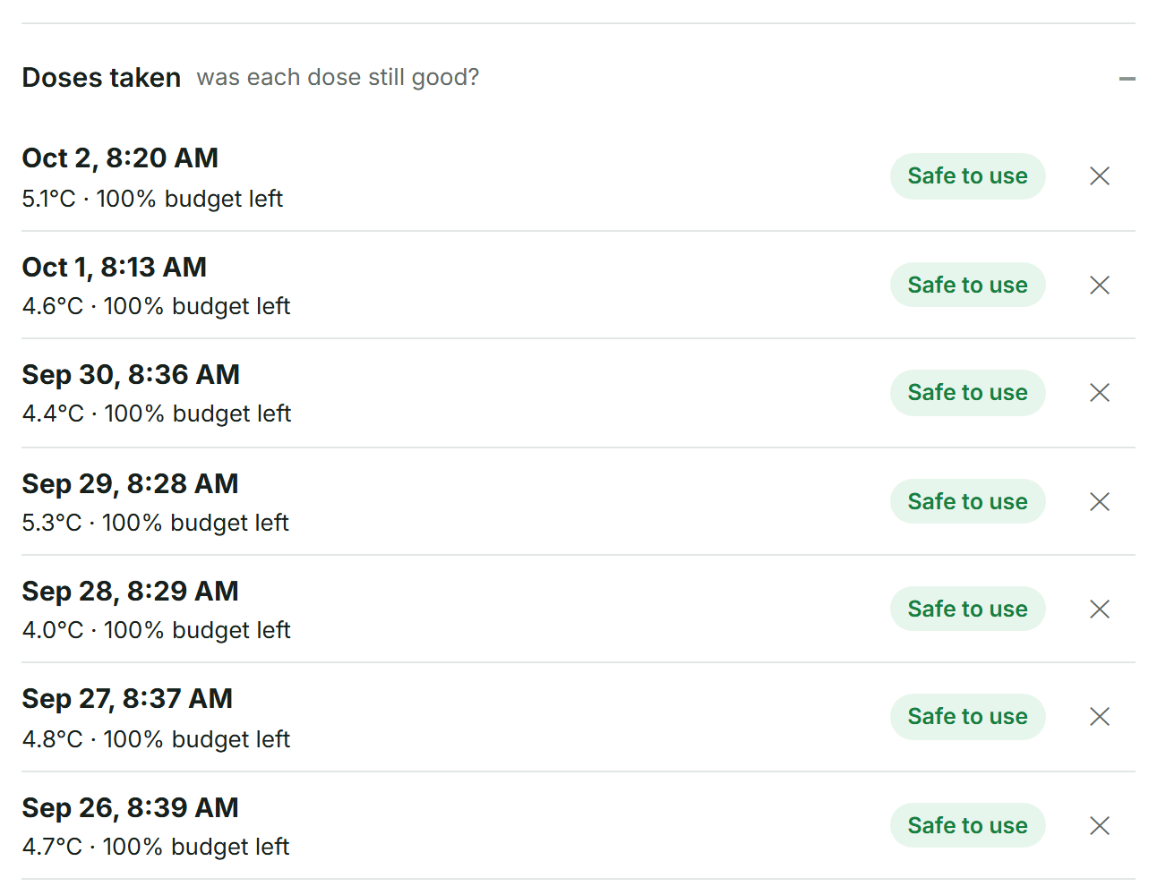



Was the dose I took last Tuesday still good?
14 days
of demo doses, each saved with the status it had at that moment, from Tiger Data
One tap: "I took a dose"
Saves the status, budget left and temperature at that moment
Rechecked when late data arrives
If a sensor uploads hours later and the answer changes, the dose is flagged
Patients stop guessing; pharmacists get a verifiable dose-by-dose record.
Ask in plain words
Ask LIFELOG calls get_doses and answers from the record; doses are in every receipt
Notes:
The question patients actually ask is: was the dose I already took still good? One tap logs a dose with the medicine's status at that moment from Tiger Data. If late sensor data later changes the answer, the dose is flagged. Doses go into the verifiable receipt, and Ask LIFELOG can answer from them.

Slide 24
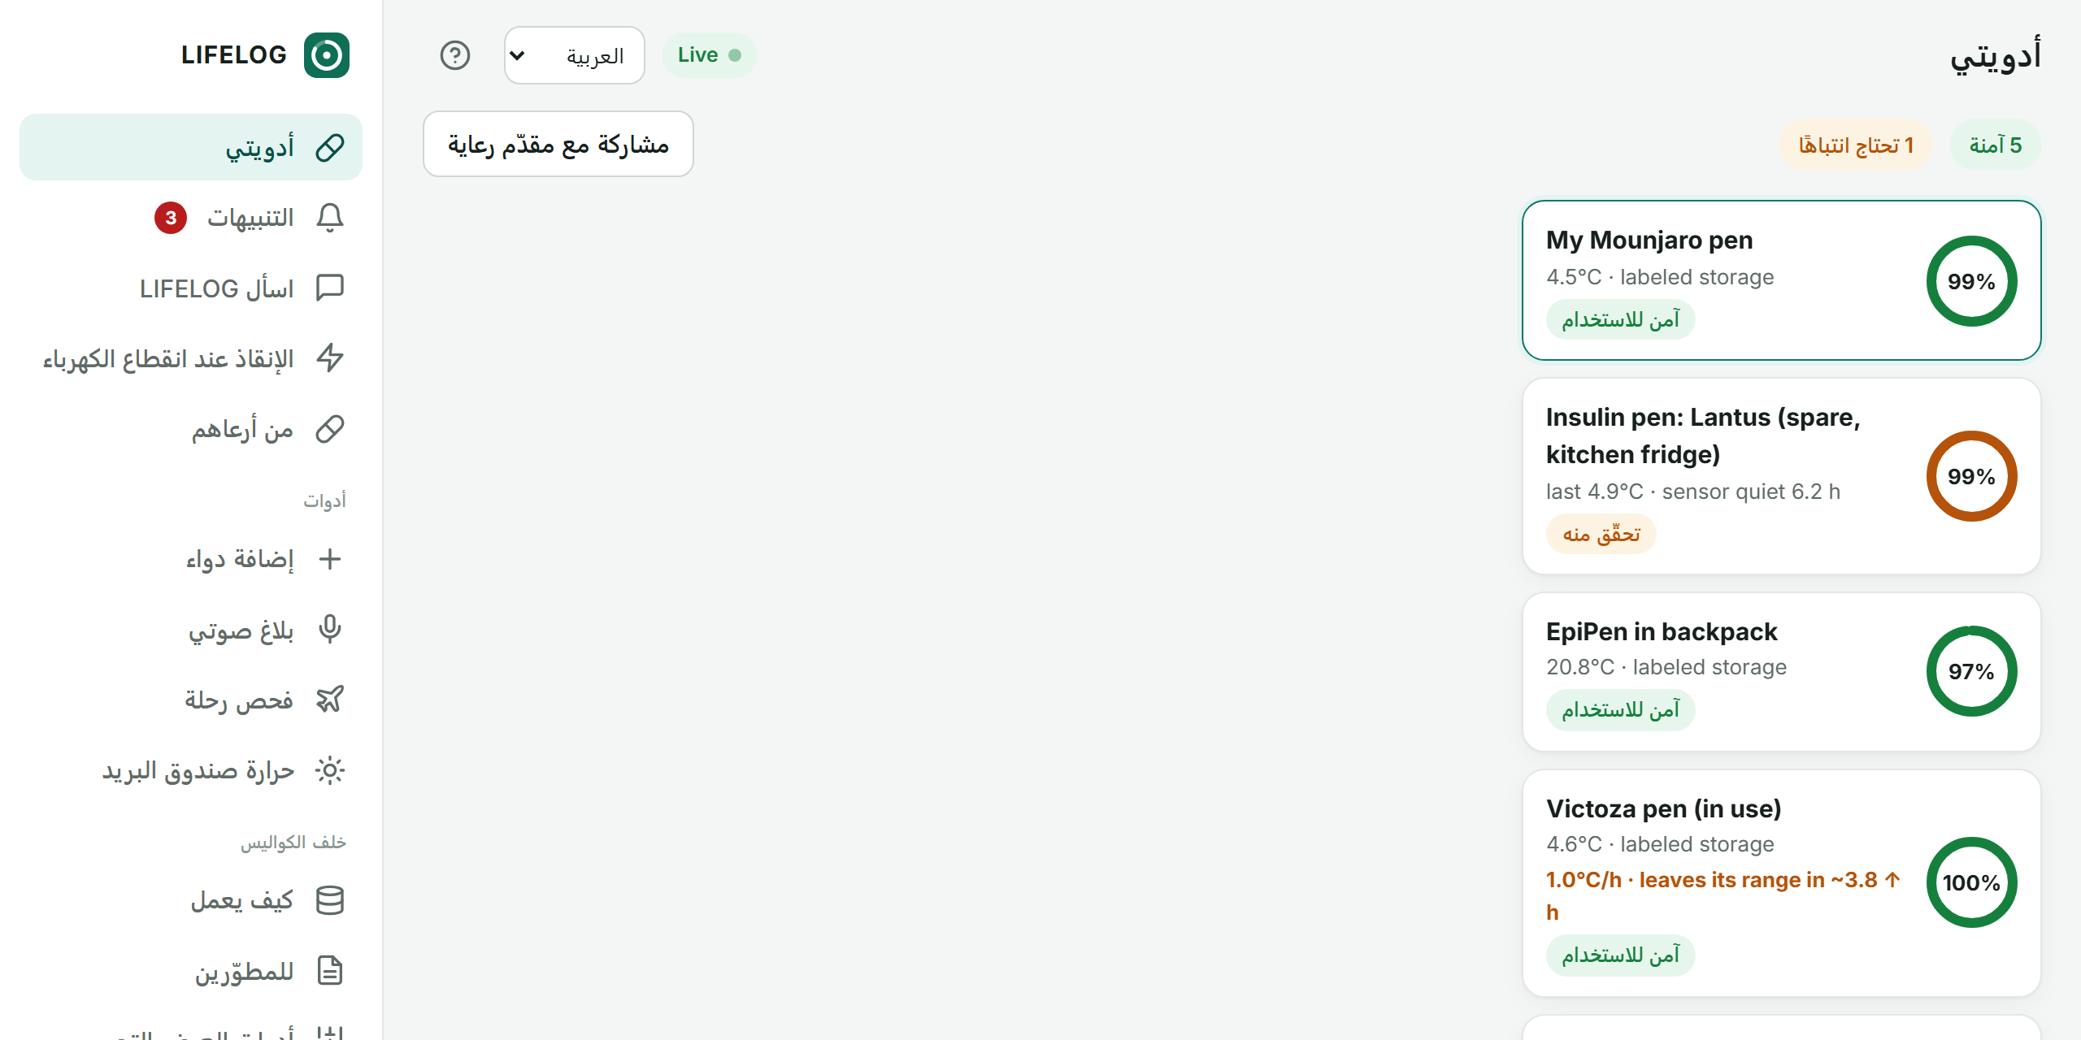



In your language, with your data in your hands
English, Arabic, Spanish, Bengali
The whole interface, right-to-left for Arabic, saved to your account. Label quotes stay exactly as the FDA wrote them
Download everything
One ZIP: every medicine, every temperature reading, doses, alerts, receipts and messages
Delete for real
Your account and every reading are removed, including the rollups built from them
Dearborn has one of the largest Arabic-speaking communities in the U.S. A safety tool has to speak its language.
Private by the database
Row-level security, as before: no one else's queries can return your rows
Notes:
In Dearborn, a safety tool has to speak Arabic, so the whole interface works in English, Arabic, Spanish and Bengali, with Arabic right to left. Label quotes stay exactly as the FDA wrote them. And people stay in control: download everything LIFELOG holds about you in one file, or delete your account and every reading.

Slide 25
Works with or without AI
Feature | With Gemini | When Gemini is unavailable
Is it safe to use? | Grounded verdict quoting the label | Rule-based verdict from your data + label
Refill letter | Written by Gemini | Template with your exposure log + receipt
Add a medicine by name | Gemini reads the FDA label | Rules read the FDA label (flagged to check)
Outage dispatch plan | Gemini, with Maps grounding | Ranked list + ready-to-send texts
Typed report ("in the car 2 h") | Gemini extracts events | Keyword + duration parser
Ask LIFELOG | Function calling over live data | Summary straight from Tiger
Free-tier Gemini quotas run out. Every LIFELOG button still answers, and says honestly when no AI was used.
Notes:
Gemini makes LIFELOG friendlier, but it's never a single point of failure. When the free quota runs out, every button falls back to rules built from your own data and the label's exact words, and the answer says so.

Slide 26
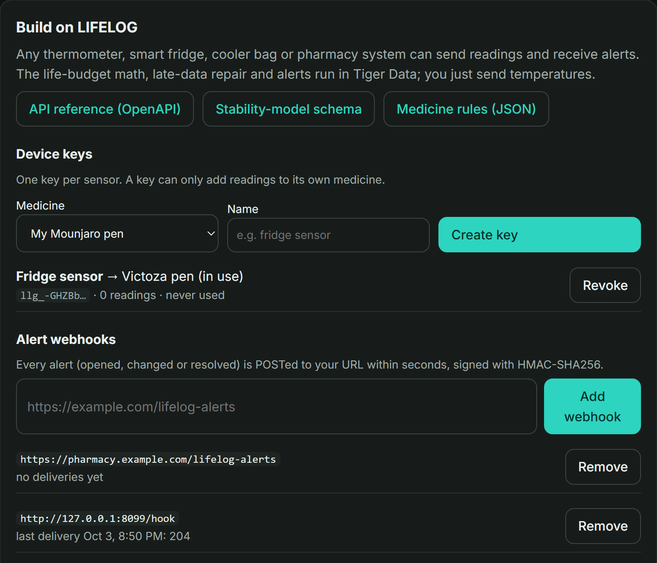



Build on LIFELOG
Any sensor, one call
POST /v1/readings with a device key; late batches repaired automatically
Signed alert webhooks
Every alert pushed within seconds, signed with HMAC-SHA256
An open format for storage rules
JSON Schema for a medicine's life-budget model, plus the full OpenAPI
Bluetooth, no app
Pair a standard thermometer from the browser (Web Bluetooth)
Smart fridges, cooler bags, mail-order pharmacies and clinics plug in; Tiger Data does the math.
Notes:
LIFELOG is also a platform. Any thermometer, smart fridge or cooler bag can send readings with a device key, receive signed alert webhooks, and use our open format for medicine storage rules. A standard Bluetooth thermometer pairs straight from the browser.

Slide 27
Try it three ways
Owner
Customer
Pharmacist
Manu · 6 medicines
Alex · 3 medicines
Demo Pharmacist
Full history, dose log, receipts, and the demo controls: hot car, late upload, storm.
Dupixent, Humalog in use, Repatha. Sees only their own data; the owner's is hidden by the database.
Reviews every medicine's rules and wording; approves or rejects heat-tolerance evidence.
One click on the sign-in page, or email + password. Receipt QR codes open on any phone through a secure tunnel.
Notes:
Judges can try it three ways. The owner account has six medicines and the demo controls. A customer account has three medicines of its own and cannot see the owner's, because row-level security in Postgres hides them. A pharmacist account reviews the rules and approves evidence.

Slide 28





What you'll see in the live demo
1. Snap a label
2. Hot car
3. Late sensor data
4. Summer storm
5. Ask LIFELOG
Gemini builds the medicine's rules
The EpiPen drops to 43%, with the reason
Dashboard 100% vs truth 91%, repaired
Live rescue list for the neighborhood
Gemini answers from your data
Live sensors stream every 5 seconds the whole time.
Notes:
Now the live demo. Snap a label. Leave the EpiPen in a hot car. Watch a sensor reconnect with hours of late data, which Tiger repairs. Trigger a summer storm and see the rescue list. Then ask LIFELOG a question.

Slide 29


Who it helps
Patients and caregivers
Pharmacies and mail-order
Utilities and emergency managers
Insurers
Know if a dose is still good, before taking it or throwing it away
See which ZIP codes and carriers cook deliveries in August
Know who runs out of medicine first during an outage
Documented exposure for replacement and early-refill approvals
Shaping Society: healthcare access, equity and crisis response, for anyone with a temperature-sensitive medicine, sensor or not, in English, Arabic, Spanish or Bengali.
Notes:
This helps patients and caregivers first, but the same data helps pharmacies fix hot deliveries, utilities and emergency managers prioritize outages, and insurers approve replacements. That's Shaping Society: healthcare access, equity and crisis response.

Slide 30
Tested end to end, and what's still open
186
54 / 54
12 / 12
24 / 24
40
automated tests pass
API checks, 0 failures
Gemini features on the live key
FDA labels re-verified live
screens and buttons clicked in a browser
Bugs the tests caught, all fixed
• QR links pointed to localhost, so phones couldn't open them
• The storm demo and live sensors assumed every pen sat in a fridge
• Outage areas were invisible on the map (an icon style shrank it)
• The Docker image was missing the saved FDA label text
• Seven label quotes were paraphrased instead of word-for-word
Still open
• The cited heat-tolerance evidence still needs a pharmacist's approval and clinical validation
• The automatic "possible outage" alert hasn't fired in a live storm yet
• Bluetooth sensors are built to spec but untested on hardware
Notes:
If asked how we know it works: 186 automated tests, an end-to-end API check with zero failures, every Gemini feature tested on the live key, all 24 FDA labels re-checked live, and a browser that clicks every screen as all three accounts. The tests caught real bugs, listed here, and we fixed them. What's still open is listed honestly on the right.

Slide 31
Thank you
Questions?
LIFELOG · Hack Dearborn 5 · github.com/Manognya86/HackDearborn5
Try it: sign in as Owner, Customer or Pharmacist with one click
Notes:
Thank you. We're happy to take questions; the backup slides are numbered 15 to 29.

