Slide 1


Kubernetes Cluster Monitoring and Custom Alert Management with Prometheus, Grafana, and Alert manager

Slide 2
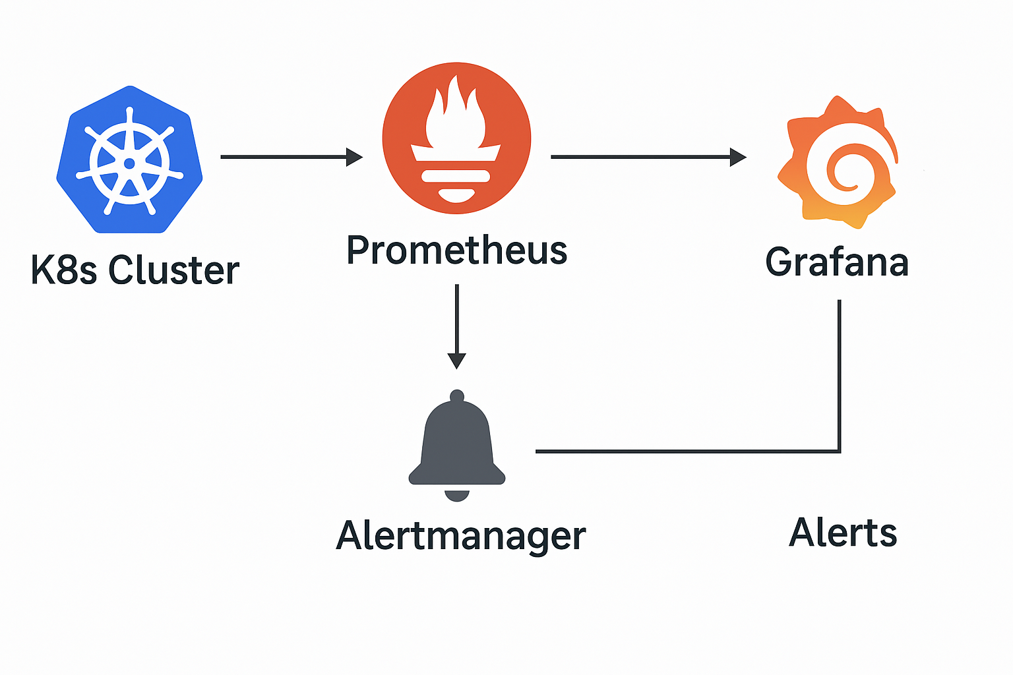
Cluster Monitoring using Prometheus Stack
Prometheus Stack is already installed in the cluster.
Create a Prometheus Rule containing the desired alert rules.
Create & Apply the rules to the cluster.
Monitor the alerts in Alert manager when incidents occur (e.g., Pending Pods, CrashLoopBackOff).
Configure alertmanager.yaml to route alerts to email, or other notification channels according to requirements.

Slide 3
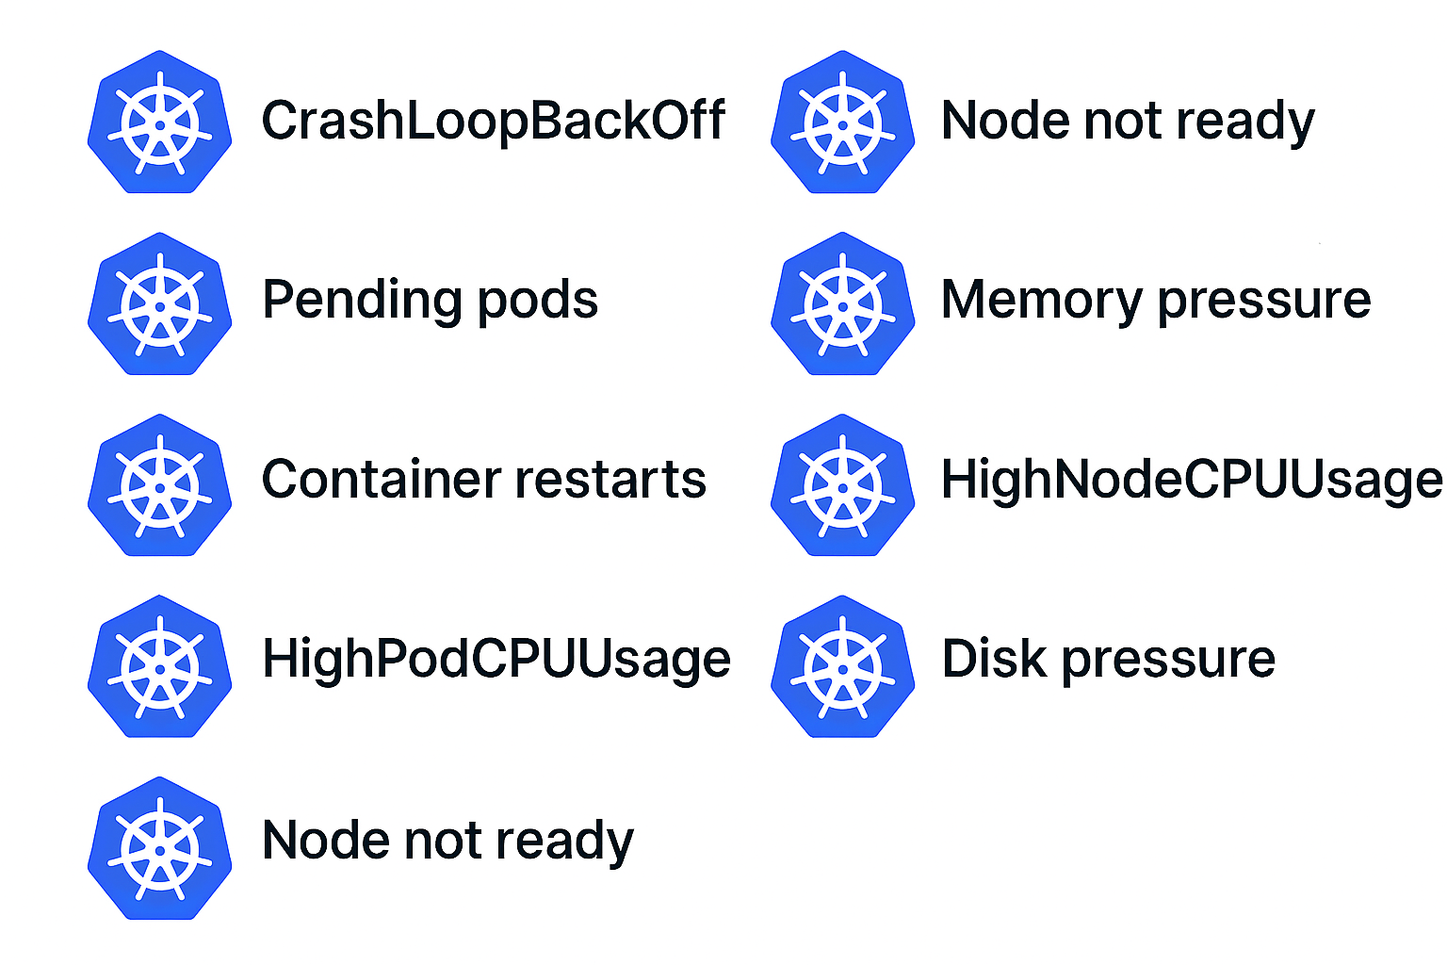
Some of the default alerts via Helm Chart
1. Node Alerts
KubeNodeDiskPressure → Node disk pressure detected.
KubeNodeMemoryPressure → Node memory pressure detected.
KubeNodeNetworkUnavailable → Node network is unavailable.
2. Pod & Container Alerts
KubePodCrashLooping → Pod in CrashLoopBackOff.
KubePodNotReady → Pod not ready for a certain time.
KubePodContainerWaiting → Container waiting for too long.
KubePodImagePullBackOff → Pod stuck pulling image.
3. Deployment / ReplicaSet Alerts
KubeDeploymentReplicasMismatch → Desired vs available replicas mismatch.
KubeStatefulSetReplicasMismatch → StatefulSet replicas mismatch.
4. Cluster / API Server Alerts
KubeAPIDown → API server unreachable
KubeSchedulerDown → Scheduler not running.
KubeControllerManagerDown → Controller manager not running.

Slide 4
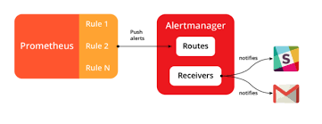
Sample Prometheus Rule for Alerts
apiVersion: monitoring.coreos.com/v1
kind: PrometheusRule
metadata:
name: k8s-alerts
spec:
groups:
- name: pod-alerts
rules:
- alert: CrashLoopBackOff
expr: kube_pod_container_status_waiting_reason{reason="CrashLoopBackOff"} > 0
for: 2m
labels:
severity: warning
annotations:
summary: "Pod {{ $labels.pod }} is crashing"

Slide 5
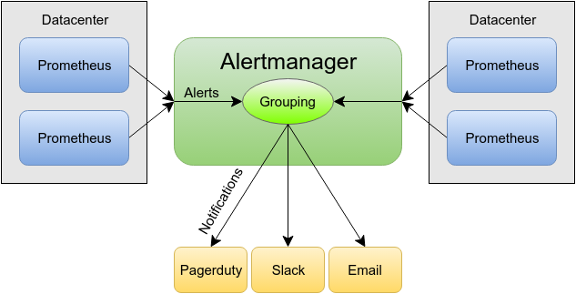
Alert Routing via Alertmanager.yaml
global:
smtp_smarthost: "smtp.gmail.com:587"
smtp_from: "tradingcontentdrive@gmail.com"
smtp_auth_username: "tradingcontentdrive@gmail.com"
smtp_auth_password: "nzigqiwkcwyctkul"
route:
group_by: ["alertname"]
group_wait: 30s
group_interval: 5m
repeat_interval: 1h
receiver: "email-alert"
receivers:
- name: "email-alert"
email_configs:
- to: "tradingcontentdrive@gmail.com"
send_resolved: true
inhibit_rules: []
'

Slide 6
Prometheus & Alert manager Custom Alerts Implementation
Retrieve all Prometheus rules currently configured in the cluster.
Review existing alerts in the cluster and on the Prometheus dashboard.
Examine the Prometheus queries associated with these alerts.
Create Prometheus rules for the custom alerts you need.
Export the Alert manager secret, update it with SMTP configuration, and reapply it.
Patch the Prometheus deployment with the necessary labels.
Add labels to ensure only your custom alerts are selected.
Restart the Prometheus and Alert manager pods to apply changes.
Configure SMTP settings to receive alert notifications via email.

