Slide 1
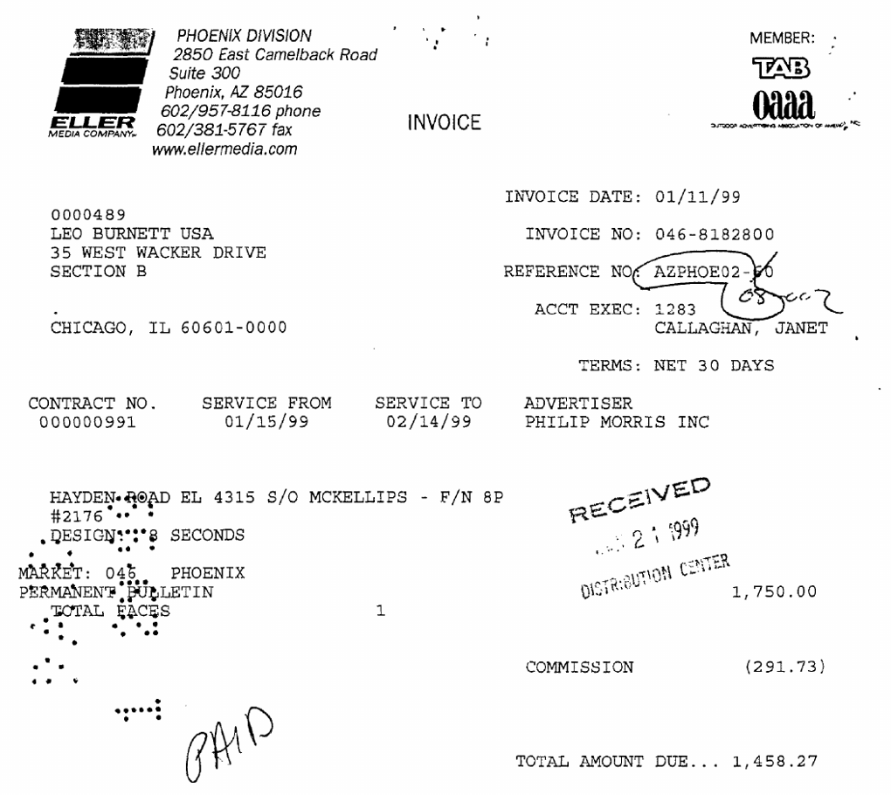
THE PROBLEM
AP teams key 10 fields off every invoice. Off-the-shelf models rarely get them all right.
$10.4B
intelligent document processing market, 2025 · ~27%/yr growth
1.53M
US bookkeeping & AP clerks · $24.36/h median (BLS)
12.8%
of real invoices fully right with base GLM 5.3 Flash
10 fields
an invoice skips review only if every one is right
The hard part is the house rules, not the reading: which number is the order number, the total after commission, blank when not printed.
Base: total 1,750.00 ✗ · currency "USD" ✗ (none printed) Fine-tune: 10 / 10 ✓
Notes:
[~25 seconds] THE HOOK: A REAL USER, A REAL COST.
- Every accounts-payable team keys the same 10 fields off every invoice: invoice number, dates, vendor, customer,
order number, payment terms, totals, currency. There are about 1.5 million bookkeeping and AP clerks in the US doing
this kind of work (BLS, 2025, median $24.36/hour).
- It's a big, fast-growing market: intelligent document processing is about $10B in 2025, forecast near $89B by 2034,
and finance & accounting is its biggest function (Fortune Business Insights; analyst sizes vary, direction doesn't).
- Why it isn't solved: the hard part isn't reading, it's the house rules. Which number is the order number? Is the total
before or after commission? Leave currency blank if it isn't printed.
- The number that matters: an invoice skips human review only if EVERY field is right. Off-the-shelf GLM 5.3 Flash
gets all ten right on just 12.8% of real invoices.
- Point at the invoice: a 1999 scan with a stamp and handwriting. The base model reports $1,750.00 (before commission)
as the total and invents "USD" though no currency is printed. The fine-tune gets all ten fields.

Slide 2
WHAT WE BUILT
Same model, same 5,000 held-out fields: prompting vs fine-tuning
1 · Lock the eval
2 · Try three ideas
3 · All on Fireworks
• DocILE (ICDAR 2023), real labelled invoices
• 500 held-out docs = 5,000 field cases
• 204 vendor layouts; 124 docs on unseen layouts
• Exact match after normalising; absent → must be null
• A: labelling rules in the prompt
• B: rules + OCR text of the page
• C: vision LoRA fine-tune on 1,400 train invoices
• Same prompt, images, temperature 0
• Serverless inference: baseline $0.24 / 500 docs
• Serverless LoRA SFT on GLM 5.3 Flash
• rank 16 · lr 1e-4 · 1 epoch · 88 steps
• ≈ $40 total, hard budget guard
Only the open model changes between rows; the test set, prompt and scoring never do.
Notes:
[~25 seconds] WHAT WE BUILT, AND WHY THE COMPARISON IS FAIR.
- Data: DocILE, a published ICDAR 2023 benchmark of real business documents labelled by Rossum, an AP-automation
company. So the labels and the task are credible.
- Eval locked first: the official validation split, 500 documents = 5,000 field cases, from 204 vendor layouts.
124 documents use layouts never seen in training: our honest generalisation test.
- Same model, same prompt, same images, temperature 0 for every system. One saved row per document.
- Three ideas, each a guess about the failure:
A) put the labelling rules in the prompt; B) rules plus OCR text; C) vision LoRA fine-tune on 1,400 training invoices.
- All on Fireworks: serverless inference for baselines, serverless LoRA training (rank 16, lr 1e-4, 1 epoch, 88 steps),
scored on the exact trained weights. Total spend about $40, with a hard budget guard in the training script.
- Rubric: this is the 'reliable improvement over the baseline' setup the judges asked for.

Slide 3
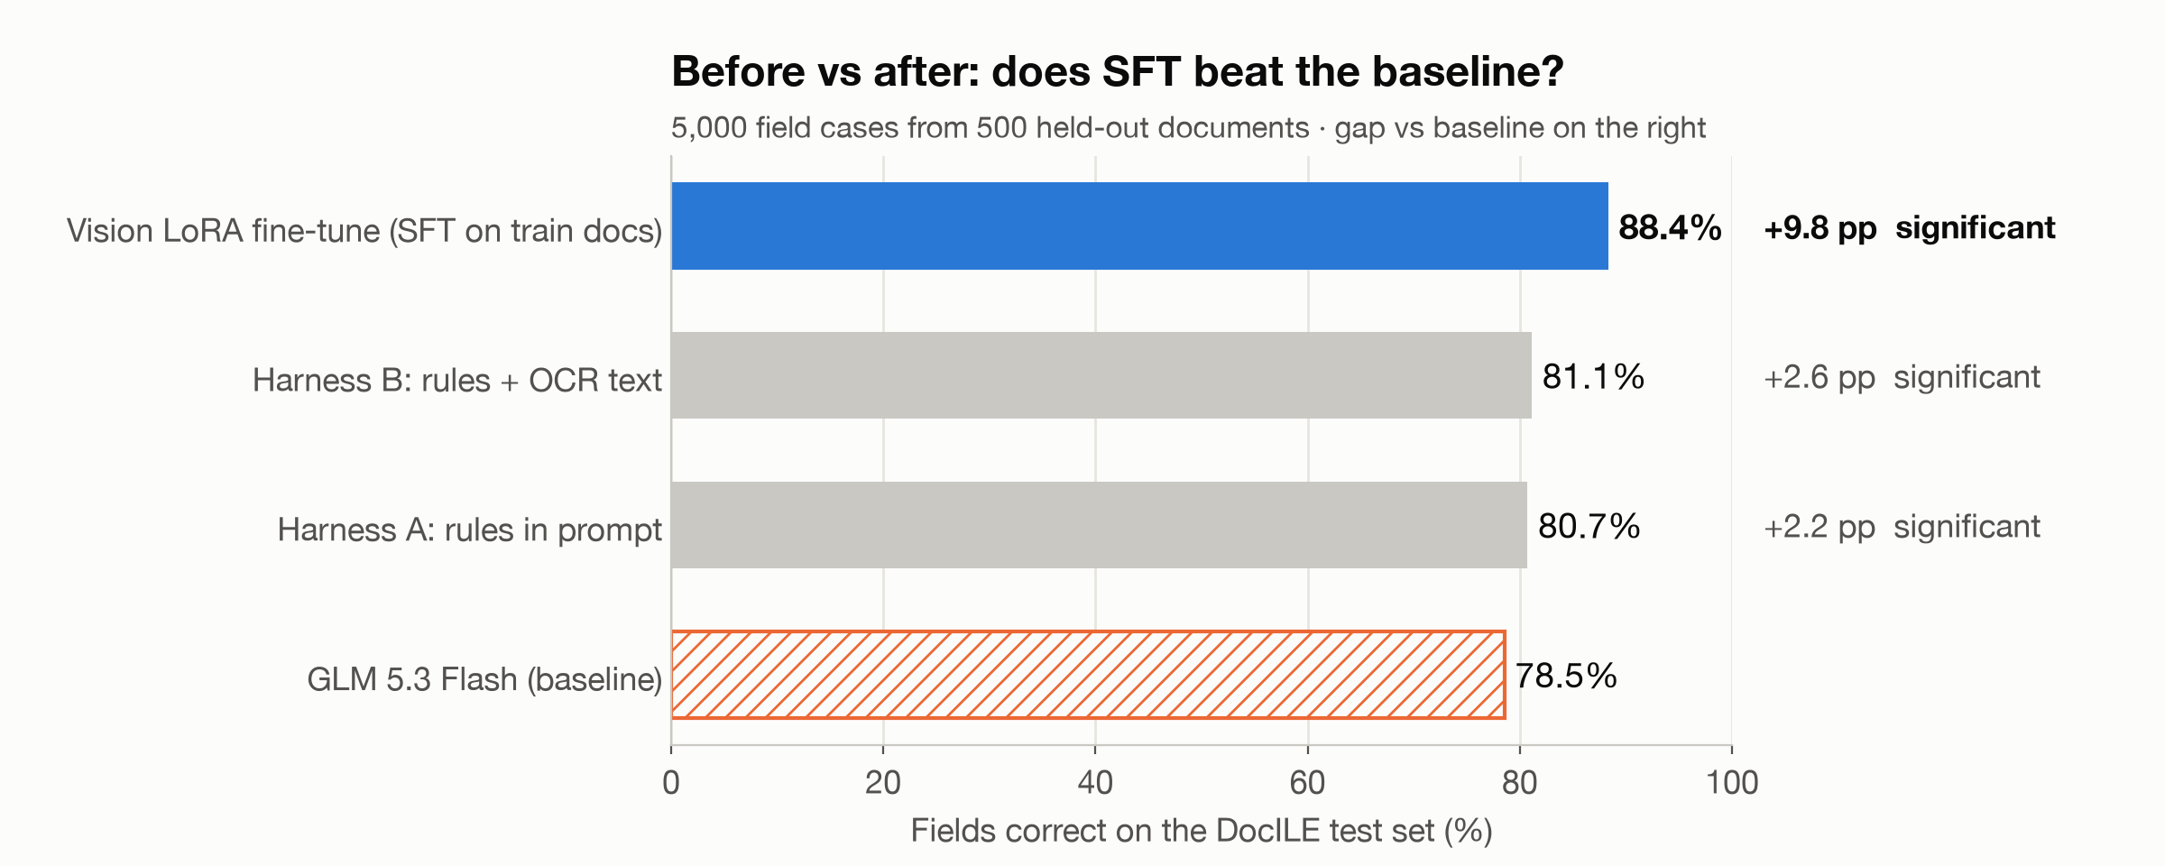
RESULTS
78.5% → 88.4% of fields, and 3× more invoices that need no human touch
13% → 39%
invoices with all 10 fields right (3×)
74% → 84%
both money fields right
65% → 87%
absent fields left blank, not invented
Every field improves: order number 58% → 79%, currency 66% → 90%, vendor 73% → 85%.
Value: ≈ 65 h/month ≈ $19k/year saved per 5,000 invoices/month (3 min per fix, BLS wage; illustrative).
Notes:
[~30 seconds] THE RESULT. Say the two numbers slowly.
- Field accuracy: 78.5% -> 88.4%, plus 9.8 points. Prompting bought only about 2 points.
- The business number: fully correct invoices go from 12.8% to 38.8%: three times as many invoices need no
human touch. Field accuracy compounds at the document level; that's why the last ten points matter most.
- Every one of the ten fields improved; the biggest jumps are the house-rule fields: order number 58% -> 79%,
currency 66% -> 90%.
- Errors are asymmetric: both money fields right 74% -> 84%; absent fields left blank instead of invented 65% -> 87%.
A blank goes to a human; a confident wrong value goes into the ledger.
- Value, with assumptions: 5,000 invoices a month, 3 minutes per fix, BLS wage -> about 65 hours a month, roughly
$19,000 a year saved per team, before overhead and before the cost of wrong payments.

Slide 4
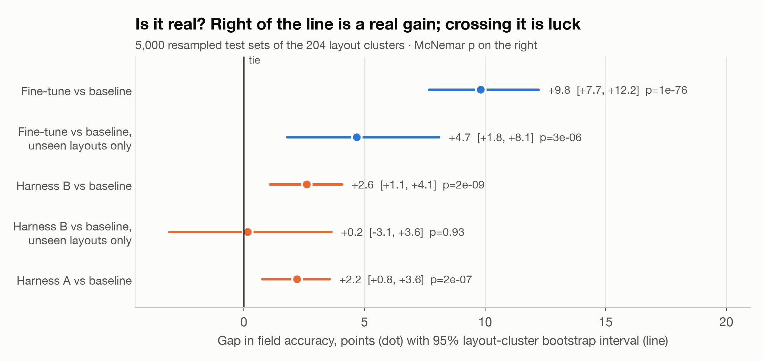
IS IT REAL?
Both tests agree — including on vendor layouts it has never seen
625 vs 134
disagreements won · McNemar p = 1e-76
[+7.7, +12.2]
95% interval, 5,000 layout resamples
+4.7
on 124 docs with unseen layouts (real)
What didn't work: the rules prompt traded errors (amount due 85% → 75%); first scoring hit a 2,048-token image limit — diagnosed, re-scored at 1,344 px, baseline unchanged.
Notes:
[~25 seconds] IS IT REAL? Two tests; we only call a gain real when both agree.
- McNemar: ignore fields both systems get right or both get wrong. Of the 759
disagreements, the fine-tune wins 625 and the baseline 134. A fair coin essentially never
does that: p = 1e-76.
- Bootstrap over vendor layouts: redraw the 204 layout clusters 5,000 times. The gain stays between +7.7 and +12.2
points. We resample layouts, not rows, because invoices from one template share their mistakes.
- Generalisation: on the 124 documents whose layouts never appear in training, the gain is smaller, +4.7,
but still real. The best prompt's gain there is indistinguishable from luck.
- Report the losses: the rules prompt fixed currency but made the model too eager to say null; amount due fell
85% -> 75%. And our first scoring pass failed on a hidden limit (the serverless sampler caps images at 2,048 tokens);
we diagnosed it, re-scored the saved checkpoint at 1,344 px, re-ran the baseline at the same size (no change), and
added a pre-flight check.

Slide 5
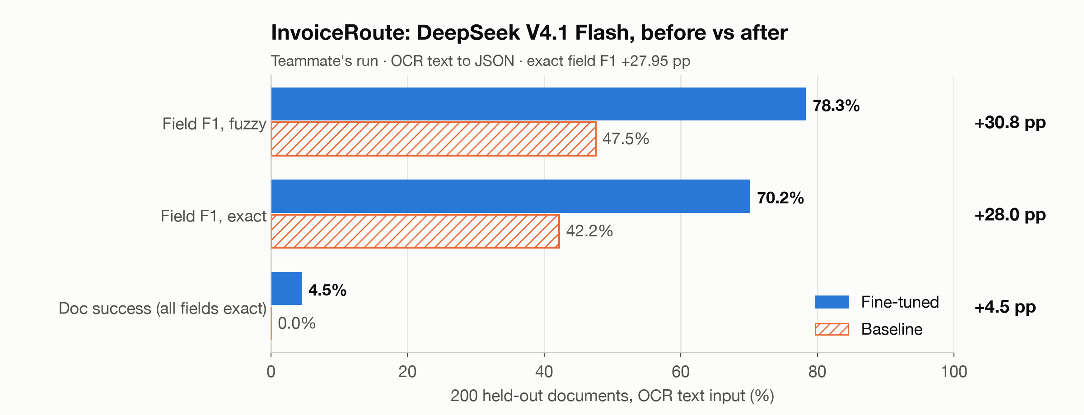
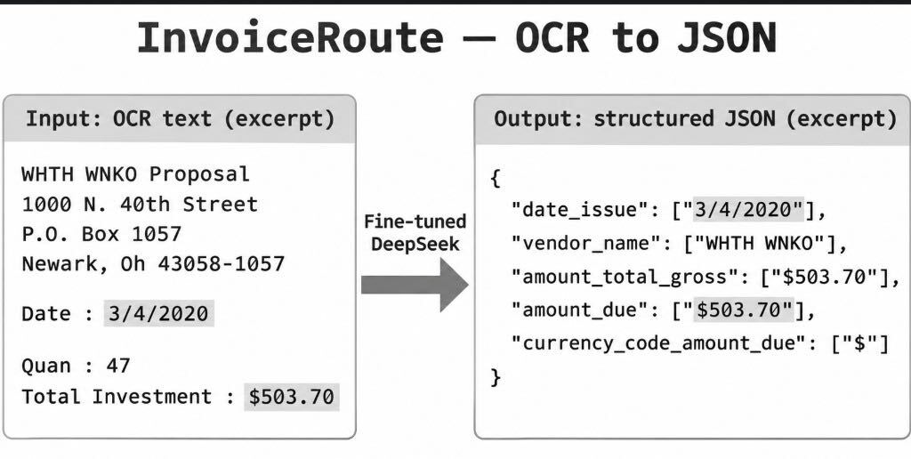
SECOND ROUTE · INVOICEROUTE (TEAMMATE)
OCR text → JSON: fine-tuning DeepSeek V4.1 Flash adds +28 points of exact F1
Same lesson, different input
Exact field F1 42.2% → 70.2% on 200 held-out invoices
Best fine-tuned model on this route: GLM 5.3 Flash, 78.7% fuzzy F1
Different test set and metric from the image run; no significance test yet
Notes:
[~20 seconds] A SECOND ROUTE FROM THE TEAM: INVOICEROUTE, OCR TEXT TO JSON.
- Same problem, different input: instead of the page image, feed the OCR text and return the fields as JSON.
This opens up text-only open models.
- DeepSeek V4.1 Flash, before vs after fine-tuning, on the same 200 held-out documents:
exact field F1 42.2% -> 70.2%, +27.95 points; fuzzy F1 47.5% -> 78.3%; documents with every field exact 0% -> 4.5%.
- Across the fine-tuned models on this route, GLM 5.3 Flash scored best (78.7% fuzzy F1), Qwen 3.8 27B close behind.
- Two lessons that match the image run: fine-tuning beats the off-the-shelf model by a wide margin, and document-level
success is the hard part — field gains compound, but every field has to be right.
- Be precise: this route uses a different test set (200 invoices) and metric (field F1), so it's not on the same scale
as the image run. No significance test has been run on it yet. Latency routes differ (baseline serverless,
fine-tuned on a dedicated deployment).

Slide 6
THE TAKEAWAY
78.5% → 88.4% fields · 13% → 39% touch-free invoices · ≈ $40 on Fireworks
Honest caveats
Second route (teammate)
Next: hill-climb with GEDD
• No closed frontier baseline (no budget; script in repo)
• Text match, not DocILE's official box metric
• One run, one seed; trained 1,600 px, scored 1,344 px
• InvoiceRoute: OCR text → JSON
• DeepSeek V4.1 Flash: +28 pp exact F1 after fine-tuning
• GLM 5.3 Flash best fine-tuned (78.7% fuzzy F1)
• AP expert labels the remaining errors
• Failure codebook → calibrated LLM-as-Judge
• Gate: post / block / human review → new training data
Repo: github.com/aws-samples/sample-GEDD/tree/docile-forge/docile-forge Data: DocILE, Šimsa et al., ICDAR 2023 Disclosure: built at the hackathon; AI coding assistant used (Claude Code).
Notes:
[~15 seconds] CLOSE: the number, honest caveats, what's next.
- One line: a $36 fine-tune of a small open model on Fireworks made it 10 points more accurate and tripled touch-free
invoices, and the gain is real by two tests.
- Second route from the team (InvoiceRoute, OCR text to JSON): fine-tuning DeepSeek V4.1 Flash added +28 points of
exact field F1; fine-tuned GLM 5.3 Flash scored best on that route too. Different test set and metric.
- Caveats, said plainly: no closed frontier baseline (no budget; the script is in the repo); our task scores extracted
text, not DocILE's official bounding-box metric; one run, one seed; trained at 1,600 px, scored at 1,344 px.
- Next step, hill-climbing with GEDD: an AP expert labels the remaining errors (real error, acceptable, label gap);
GEDD turns that into a failure codebook, a calibration set and an LLM-as-Judge gate — post, block or human review —
and the confirmed failures become new training data. Same locked test set, same two-test bar.
- Repo: code, per-document results and run order; anyone with a DocILE token can reproduce every number.
- Disclosure: built during the hackathon, following the Forge sample's playbook; code written with an AI coding
assistant (Claude Code).

