Slide 1

Development of an NLP-Powered Chatbot
Enhancing User Interactions and Information Retrieval
Presenters:
BT20CSE100 - PRIYATHAM
BT20CSE102 - ABHIRAM
BT20ECE051 - MANOHAR
BT20ECE103 – Uday Kiran
BT21ECE103 - NIGAMANVESH

Slide 2
Contents:
Introduction
Objectives
Methodology
Data Collection and Pre-processing
Model Selection and Justification
Challenges Faced and Solutions
Discussion
Future Work and Recommendations
Conclusion
References
Appendices

Slide 3
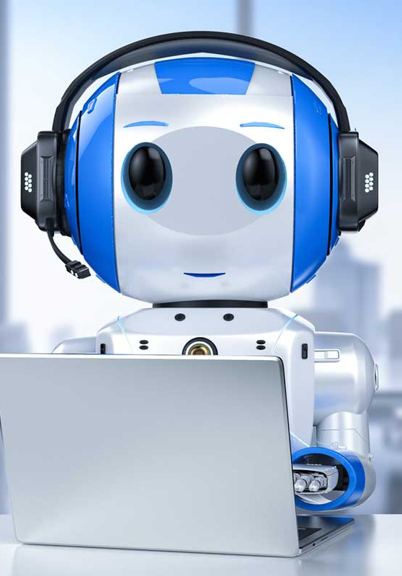
Introduction :
We present the development of an NLP-powered chatbot, a project aimed at improving user interactions and information retrieval.
This project focuses on the development of an NLP-powered chatbot, an AI-driven conversational agent. Chatbots find applications in customer service, e-commerce, healthcare, and more, enhancing user interactions through natural language understanding.
The increasing demand for automated customer support, advancements in NLP and AI technology, and the potential real-world impact of effective chatbots in enhancing user experiences and business efficiency have motivated this project.

Slide 4
Objectives :
Develop a chatbot capable of understanding user intent and generating contextually relevant responses.
Enhance user engagement and streamline information dissemination across various domains.
Improve the quality of user interactions, including personalized and context-aware responses.
Handle a wide range of user intents and maintain data security and privacy.
Establish a feedback mechanism for continuous improvement.
Create an efficient and user-friendly chatbot offering tangible benefits to both users and implementing organizations.
Example : Customer Support: Companies like Amazon and Apple use chatbots to provide efficient customer support, resolving user queries and issues in real-time.

Slide 5
Methodology :
Programming Language: Python serves as the primary programming language for the development of the NLP and AI components of the chatbot.
Natural Language Toolkit (NLTK): The project leverages NLTK, a comprehensive library for natural language processing. NLTK is employed for various NLP tasks, including text tokenization, stemming, and part-of-speech tagging.
TensorFlow: TensorFlow is utilized for building and training deep learning models that contribute to natural language understanding and dialogue generation.
Chatbot Framework (e.g., Rasa, Dialogflow): Depending on project requirements, a chatbot development framework may be integrated to facilitate dialogue management and response generation. The selection of a specific framework is based on the project's needs and the desired level of customization.
Notes:
NLP : These capabilities enhance the chatbot's ability to process and understand user queries.

Slide 6
Data Collection and Pre-processing :
Data Sources: The project primarily collects data from Wikipedia using the Wikipedia API. This API allows the chatbot to fetch text data related to user queries, making it a valuable source of information.
Data Collection: The data collection process is primarily performed using the wikipedia.summary(user query, sentences=10) function. This function retrieves a summary of the user's query from Wikipedia, providing the chatbot with relevant information to generate responses.
Data Preprocessing: To prepare the collected data for analysis, several preprocessing steps are applied, including tokenization, lemmatization, and punctuation removal. These steps ensure that the text data is structured and ready for further analysis.

Slide 7
Model Selection and Justification :
TF-IDF Vectorization: The project selects the TfidfVectorizer from scikit-learn for TF-IDF vectorization. This technique encodes text data into numerical vectors, making it suitable for finding relevant information and calculating similarities.
Justification: TF-IDF is a widely used technique for text analysis that transforms text data into numerical vectors. TfidfVectorizer provides flexibility in terms of tokenization and stop word removal, making it an effective choice for finding relevant information.

Slide 8
Model Selection and Justification (contd..) :
Cosine Similarity: The project employs cosine similarity to calculate the similarity between the user's query and sentences from the dataset. Cosine similarity is a well-established metric for comparing text documents, regardless of their size, making it a suitable choice for the chatbot's task of finding the most relevant sentence from Wikipedia.
Justification: Cosine similarity is particularly suitable for comparing documents, regardless of their size, and is a common choice for text document similarity. It allows the chatbot to identify the most relevant information based on user queries.

Slide 9
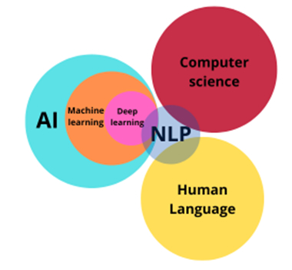
Challenges Faced and Solutions :
Natural Language Understanding:
Challenge: The chatbot's understanding of user queries is limited to TF-IDF and cosine similarity, which may struggle with complex or context-dependent questions.
Solution: Consider incorporating more advanced natural language processing (NLP) techniques, such as deep learning models, for better understanding and context-aware responses.

Slide 10
Challenges Faced and Solutions (contd..) :
User Expectations:
Challenge: Users may have high expectations for chatbots, assuming they can answer any question with high accuracy.
Solution: Set clear expectations in the chatbot's responses and communicate its limitations, especially for complex or specialized queries.
Evaluation and Improvement:
Challenge: Evaluating the chatbot's performance and iteratively improving its accuracy and user satisfaction can be a continuous challenge.
Solution: Implement feedback mechanisms and monitor user interactions to identify areas for improvement.

Slide 11
Discussion :
Project Implementation: This project implements a basic chatbot using TF-IDF for response generation and Wikipedia as a knowledge source. It collects, tokenizes, and encodes data, allowing the chatbot to generate responses based on text similarity.
Key Strengths: The chatbot's simplicity and effectiveness in responding to greetings and general user queries are key strengths. It showcases the importance of NLTK data downloads for text processing tasks.

Slide 12
Discussion (contd..) :
Key Findings:
Chatbot Capabilities and Limitations: The project implements a basic chatbot using TF-IDF for response generation. It can handle general user queries by using cosine similarity to find similar sentences from a predefined corpus. However, it may face challenges in handling diverse queries, verifying data quality, and keeping information up-to-date.
Implications and Areas for Improvement: To enhance the chatbot's capabilities, incorporating advanced NLP techniques, scalability, and better handling of user context is recommended. Evaluating and improving its performance are also crucial for providing quality interactions.

Slide 13
Discussion (contd..) :
Significance in the Broader Context:
The Role of Chatbots in Customer Service and User Engagement: Chatbots have gained immense significance in customer service, virtual assistance, and user engagement across various industries. They streamline operations, reduce costs, and enhance user experiences.
The Potential of NLP in Building Conversational Agents: The project highlights the potential of NLP in building conversational agents, which are increasingly used for automating customer interactions, answering frequently asked questions, and offering support.

Slide 14
Future Work and Recommendations :
Future Work:
Improve Natural Language Understanding and Generation Capabilities:
Enhance the chatbot's ability to handle more complex and diverse user queries by incorporating advanced models and techniques like transformers, attention mechanisms, and neural networks. This will result in more fluent and coherent dialogues.
Incorporate More Domain Knowledge and External Sources:
Enrich the chatbot's knowledge base by integrating external sources such as Wikipedia, news articles, or databases. This will enable the chatbot to provide more accurate and relevant information to users.

Slide 15
Future Work and Recommendations (contd..):
Recommendations:
Evaluate Chatbot Performance and User Satisfaction:
Assess the chatbot's performance using various metrics and methods, including BLEU, ROUGE, perplexity, sentiment analysis, and user feedback surveys. This evaluation will identify strengths, weaknesses, and areas for improvement.
Expand Chatbot Functionality and Scope:
Consider adding more features and topics to the chatbot, such as voice input and output, image recognition and generation, personalization, recommendation, and entertainment. This expansion will increase user engagement and explore new areas of research and application for chatbots.

Slide 16
Conclusion :
This project has demonstrated the development of a chatbot that efficiently handles general user queries through the utilization of TF-IDF and cosine similarity. While the chatbot showcases its capabilities in generating responses, it also reveals limitations in dealing with diverse queries, ensuring data quality, and keeping information up-to-date. Looking ahead, there is significant room for improvement, including enhancing natural language understanding and incorporating more domain knowledge. This project reiterates the significance of chatbots in customer service and user engagement, shedding light on the evolving role of chatbots in streamlining operations and enhancing user experiences across various industries.
Notes:
Summary of Key Takeaways:
The project's chatbot is proficient in handling general user queries using TF-IDF and cosine similarity for response generation. However, it has limitations in handling diverse queries, ensuring data quality, and keeping information up-to-date.
Reiteration of the Project's Significance:
The project highlights the potential of NLP in chatbot development. It underscores the role of chatbots in customer service, user engagement, and streamlining operations across various industries.

Slide 17
References :
Tarun Lalwani, Shashank Bhalotia, Ashish Pal, Shreya Bisen, Vasundhara Rathod. "Implementation of a Chatbot System using AI and NLP."
Dr. R. Regin, Dr. S. Suman Rajest, Shynu T, Jerusha Angelene Christabel G. "An Automated Conversation System Using Natural Language Processing (NLP) Chatbot in Python."
Images(in PPt) reference : uxstudioteam , Quora .

Slide 18
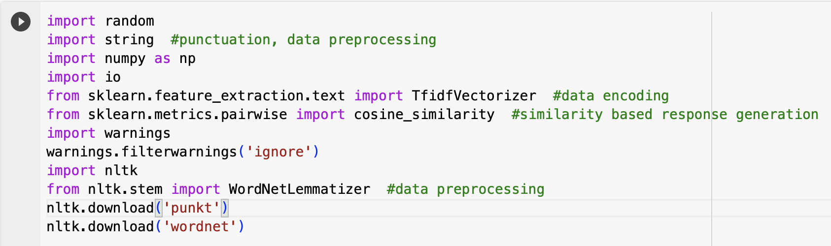
Appendices :
Code in python:

Slide 19
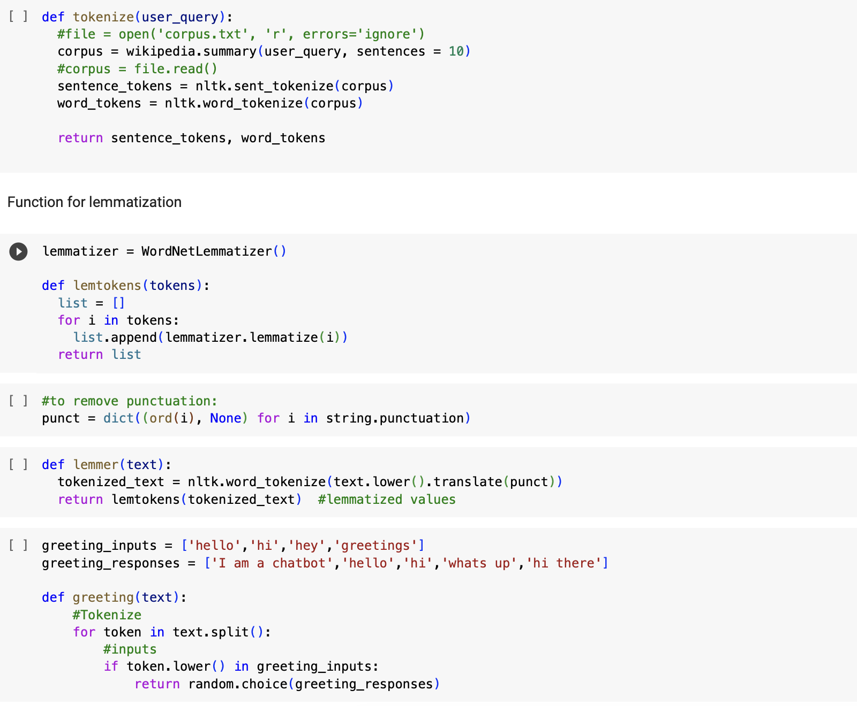
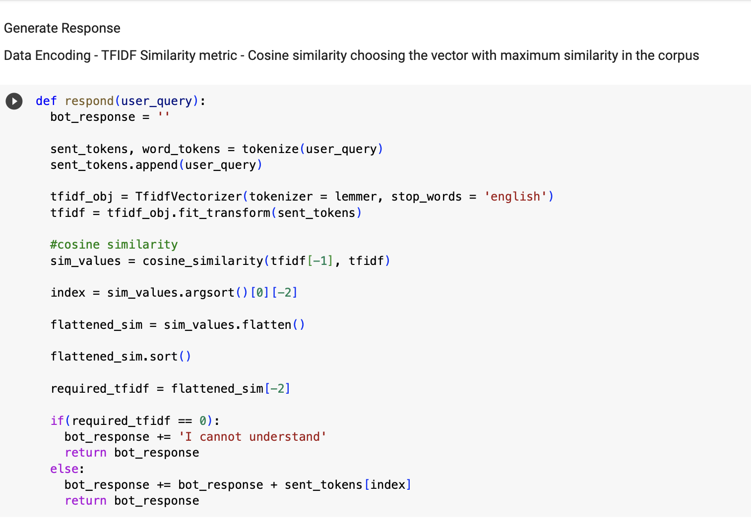
Appendices (contd..):

Slide 20
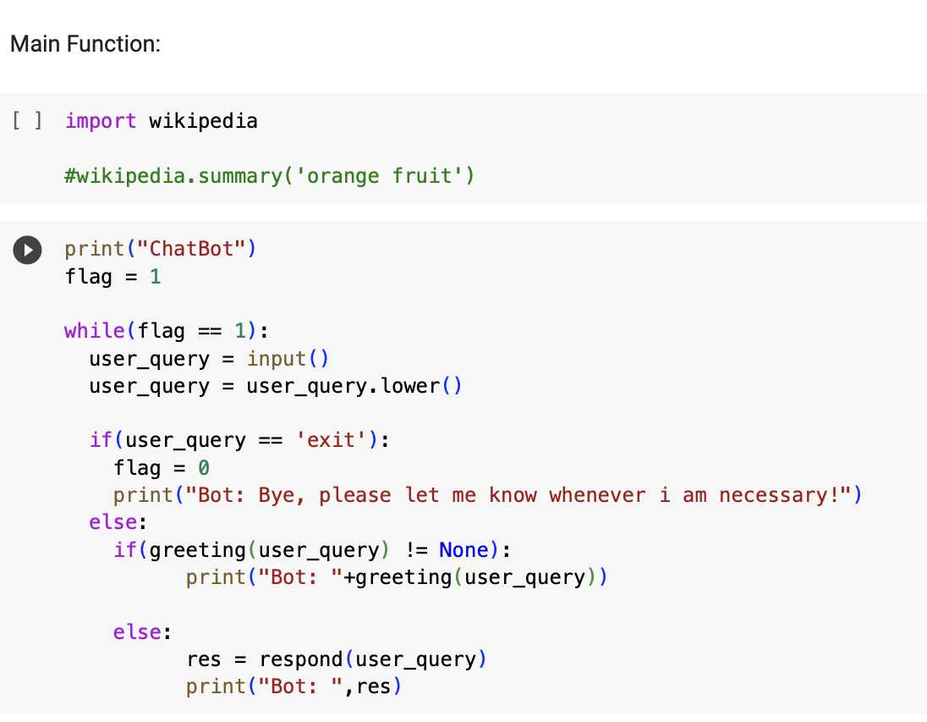
Appendices (contd..):

Slide 21
Output :

Slide 22
Thank you

