Slide 1
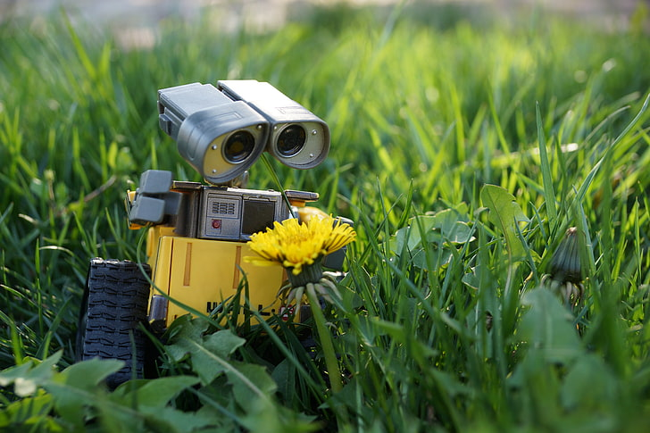
Title: PlantoBot - Your Emotions From the Plant
Done by
M MANOHAR
SIVASISH DAS

Slide 2

* INTRODUCTION
*Project Name: PlantoBot
*Tagline: "Giving your plant a voice!"

Slide 3

Problem Statement
Plants can't talk, but they still communicate through conditions.
Many people neglect plants due to lack of real-time feedback.
Need for an interactive, emotion-based display system.
It feels like we in the place of the plant it was a crazy idea

Slide 4

Solution - PlantoBot
Displays plant emotions based on:
Temperature
Humidity
Soil Moisture
Air Quality
Real-time feedback with expressive animated faces.
Promotes better plant care.

Slide 5

Components Used:
Microcontroller: ESP32
SENSORS USED:
DHT22 Sensor (Temperature & Humidity)
Soil Moisture Sensor
MQ135 (Air Quality Sensor)
OTHER:
OLED Display (128x64)
Jumper wires, Breadboard

Slide 6

System Architecture
Sensors collect environmental data.
ESP32 processes the values.
Conditions evaluated via logic.
Displays suitable emotion on OLED.
Example logic:
Happy: Optimal temp, humidity, moisture
Dead: Extreme heat + dry + poor air

Slide 7

Features:::
Interactive animations: bouncing, blinking, face shift
Real-time sensor readings
Emotion logic includes combined conditions
Eye blink and bounce synced with time

Slide 8
Emotions Displayed😎
Mood | Conditions
Happy | Temp 22-28°C, Humidity 50-70%, AQI > 60
Cold | Temp <14°C, Moisture <30%, Hum <40%
Sweaty | Temp >36°C, Hum <25%
Thirsty | Moisture <25%, Temp >33°C
Too Wet | Moisture >90%, Humidity >85%
Dead | Moisture <20%, Temp >35°C, AQI <30
Neutral | Any other in-between cases

Slide 9
Benefits:
Easy plant care understanding.
Real-time condition awareness.
Aesthetic & techie decoration.
Can be extended to alerting system.

Slide 10

Conclusion
PlantoBot bridges communication between plants and humans.
Makes plant care fun, informative, and interactive.
Ideal for homes, schools, and smart gardens.

Slide 11


